Slide 1

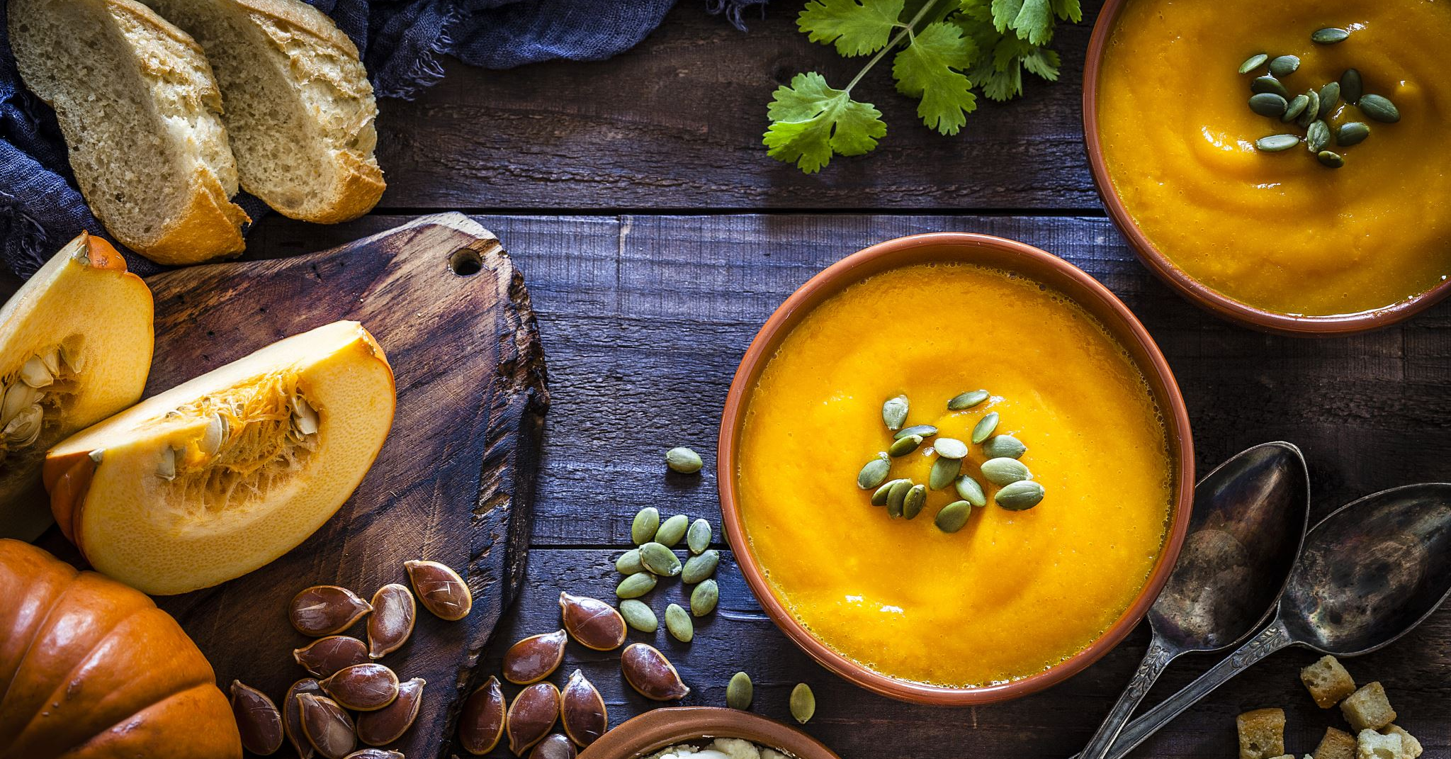

Holiday Cooking
Ilynn Berdoza-Hickey
Skylynn Mind Body Health

Slide 2
Recipes
All recipes come from my personal favorite cookbook:
“The All-Day Energy Diet: Community Cookbook”
By Yuri Elkaim
I can not take credit for any of these recipes, other than sharing their tasty deliciousness with others.

Slide 3
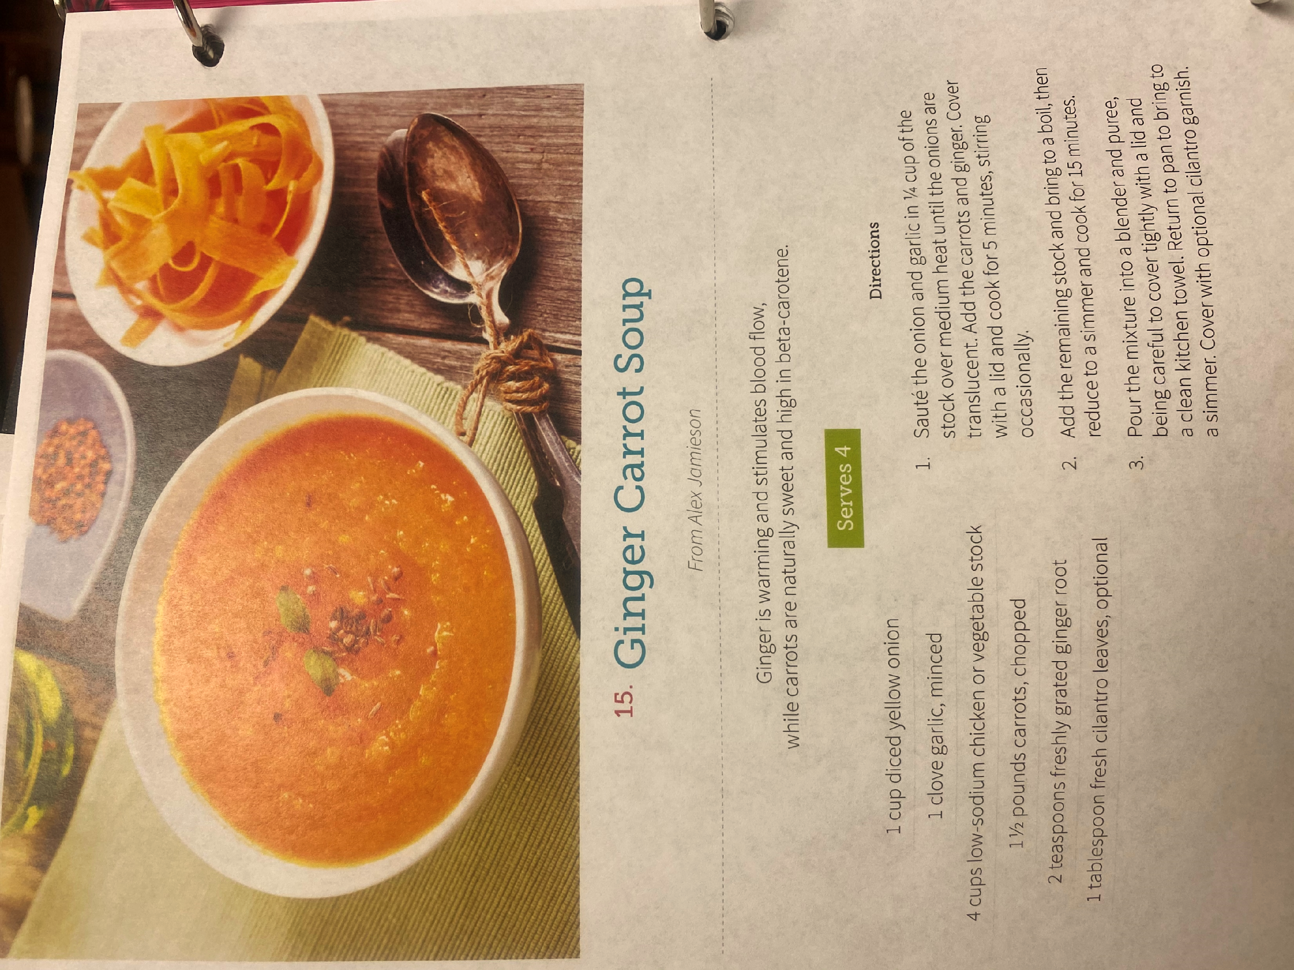
Side Dish
Warm and soothing.
Extremely high in antioxidants.
Great for boosting your immune system and lowering inflammation.

Slide 4

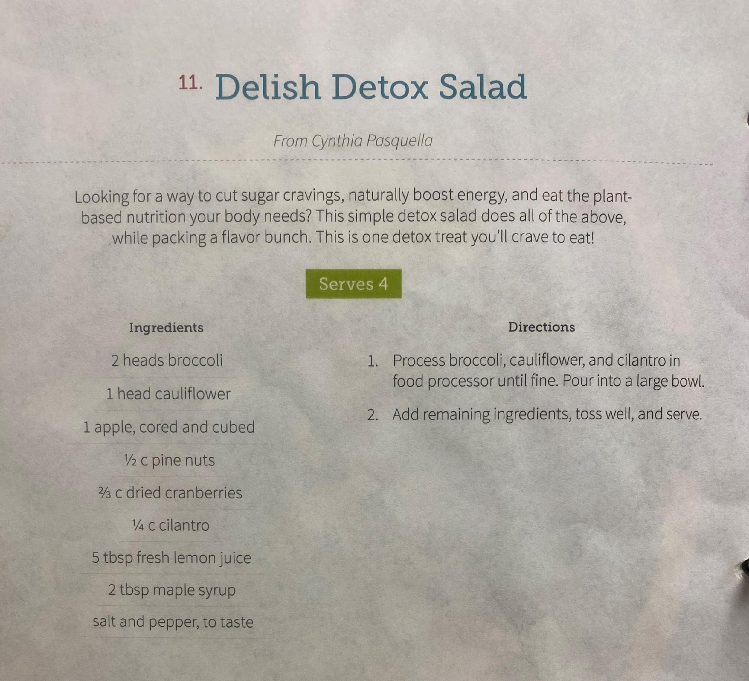
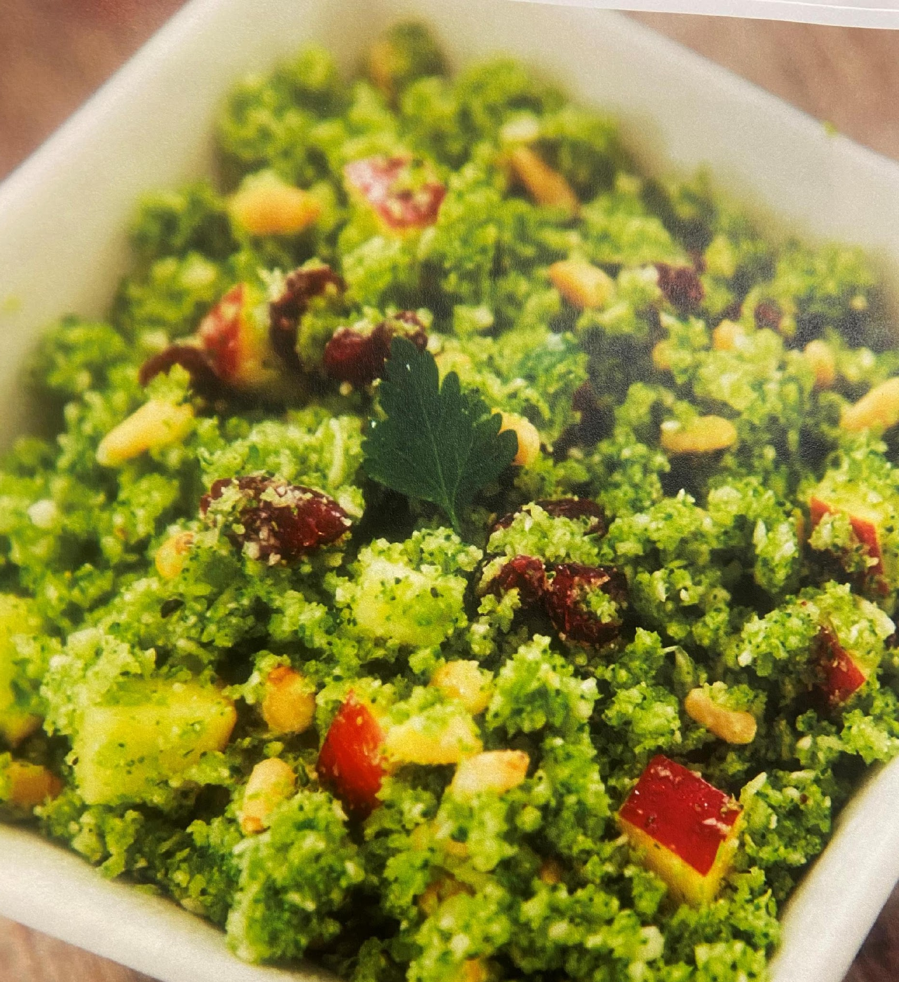
Light and Tasty
Side Dish with a hint of Sweet

Slide 5
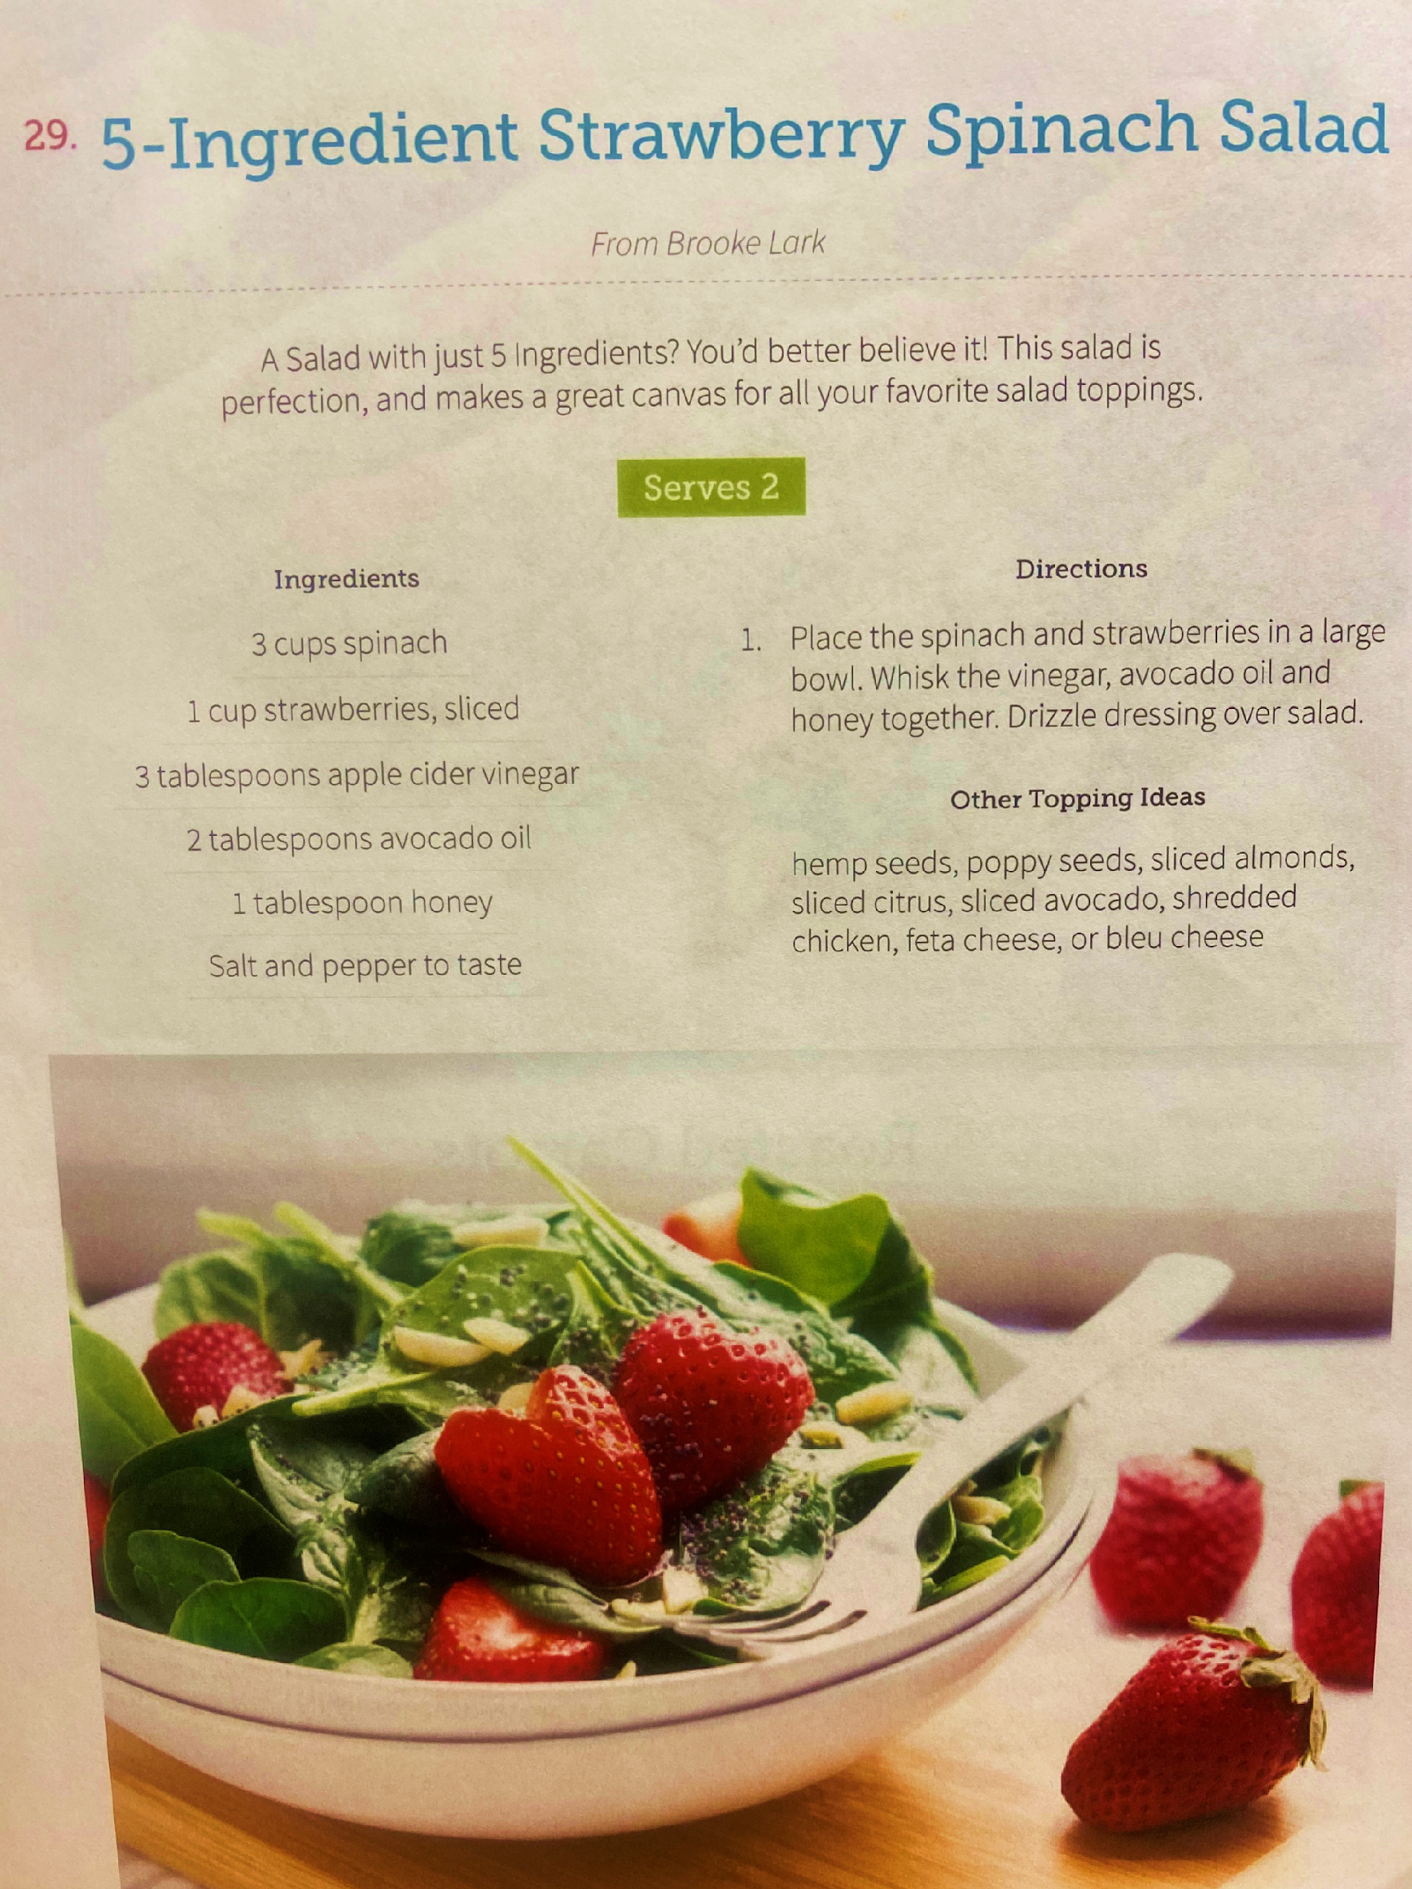
Get your Fill on Fresh Greens and Strawberries
Add the Sweet Vinaigrette Dressing when you are ready to eat!
Toss and enjoy!
- Search for local honey.
- Swap the avocado oil for olive oil if you wish.
- Vinegar dressings help stabilize blood sugar levels.

Slide 6
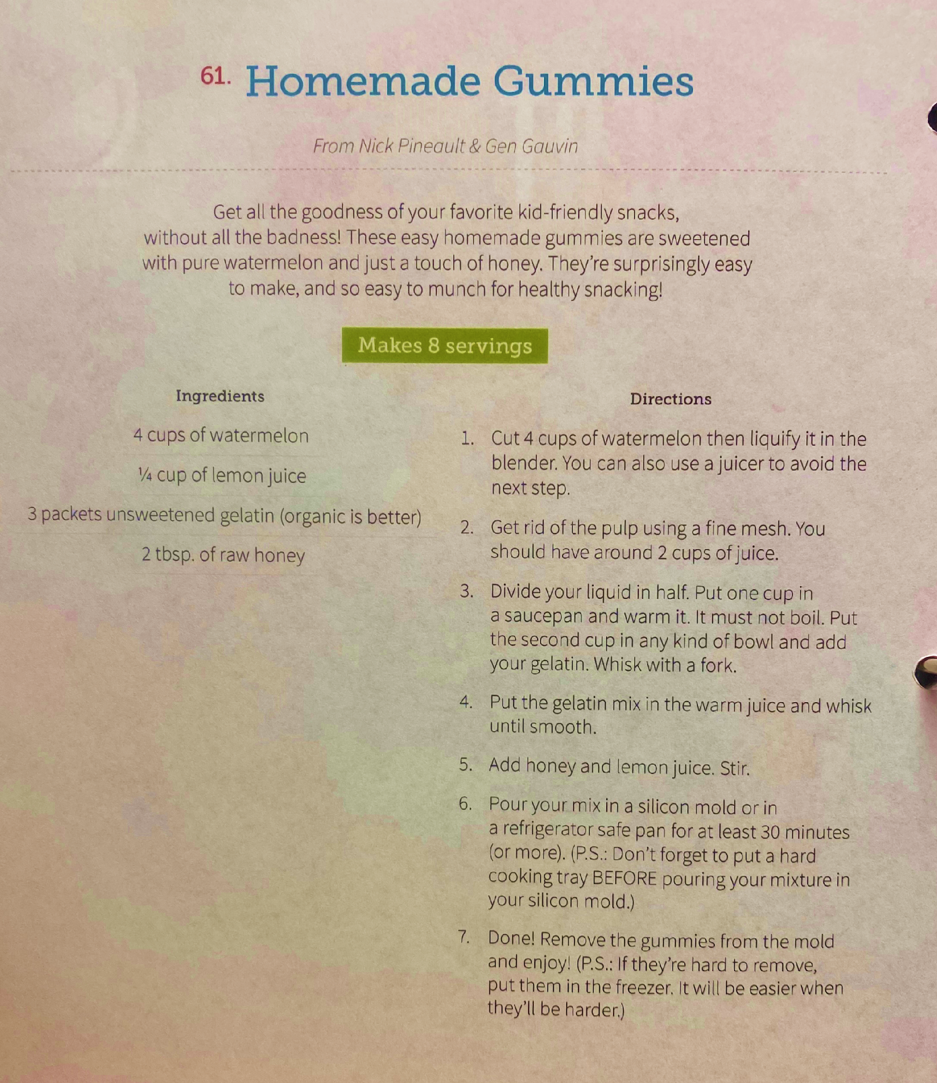
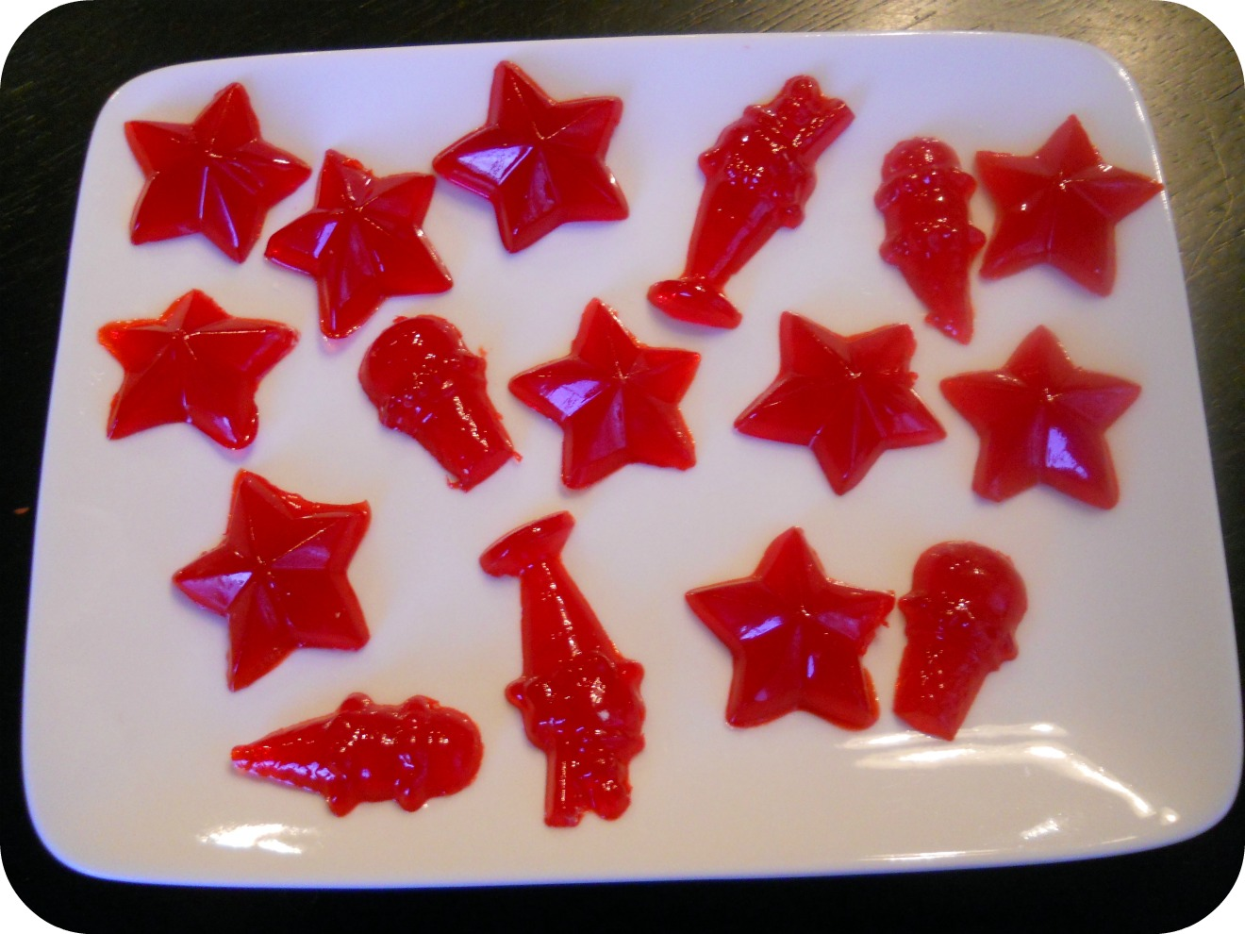
Kid Friendly
Homemade Gummies
Watermelon Flavor without all the extra sugars and chemicals!

Slide 7


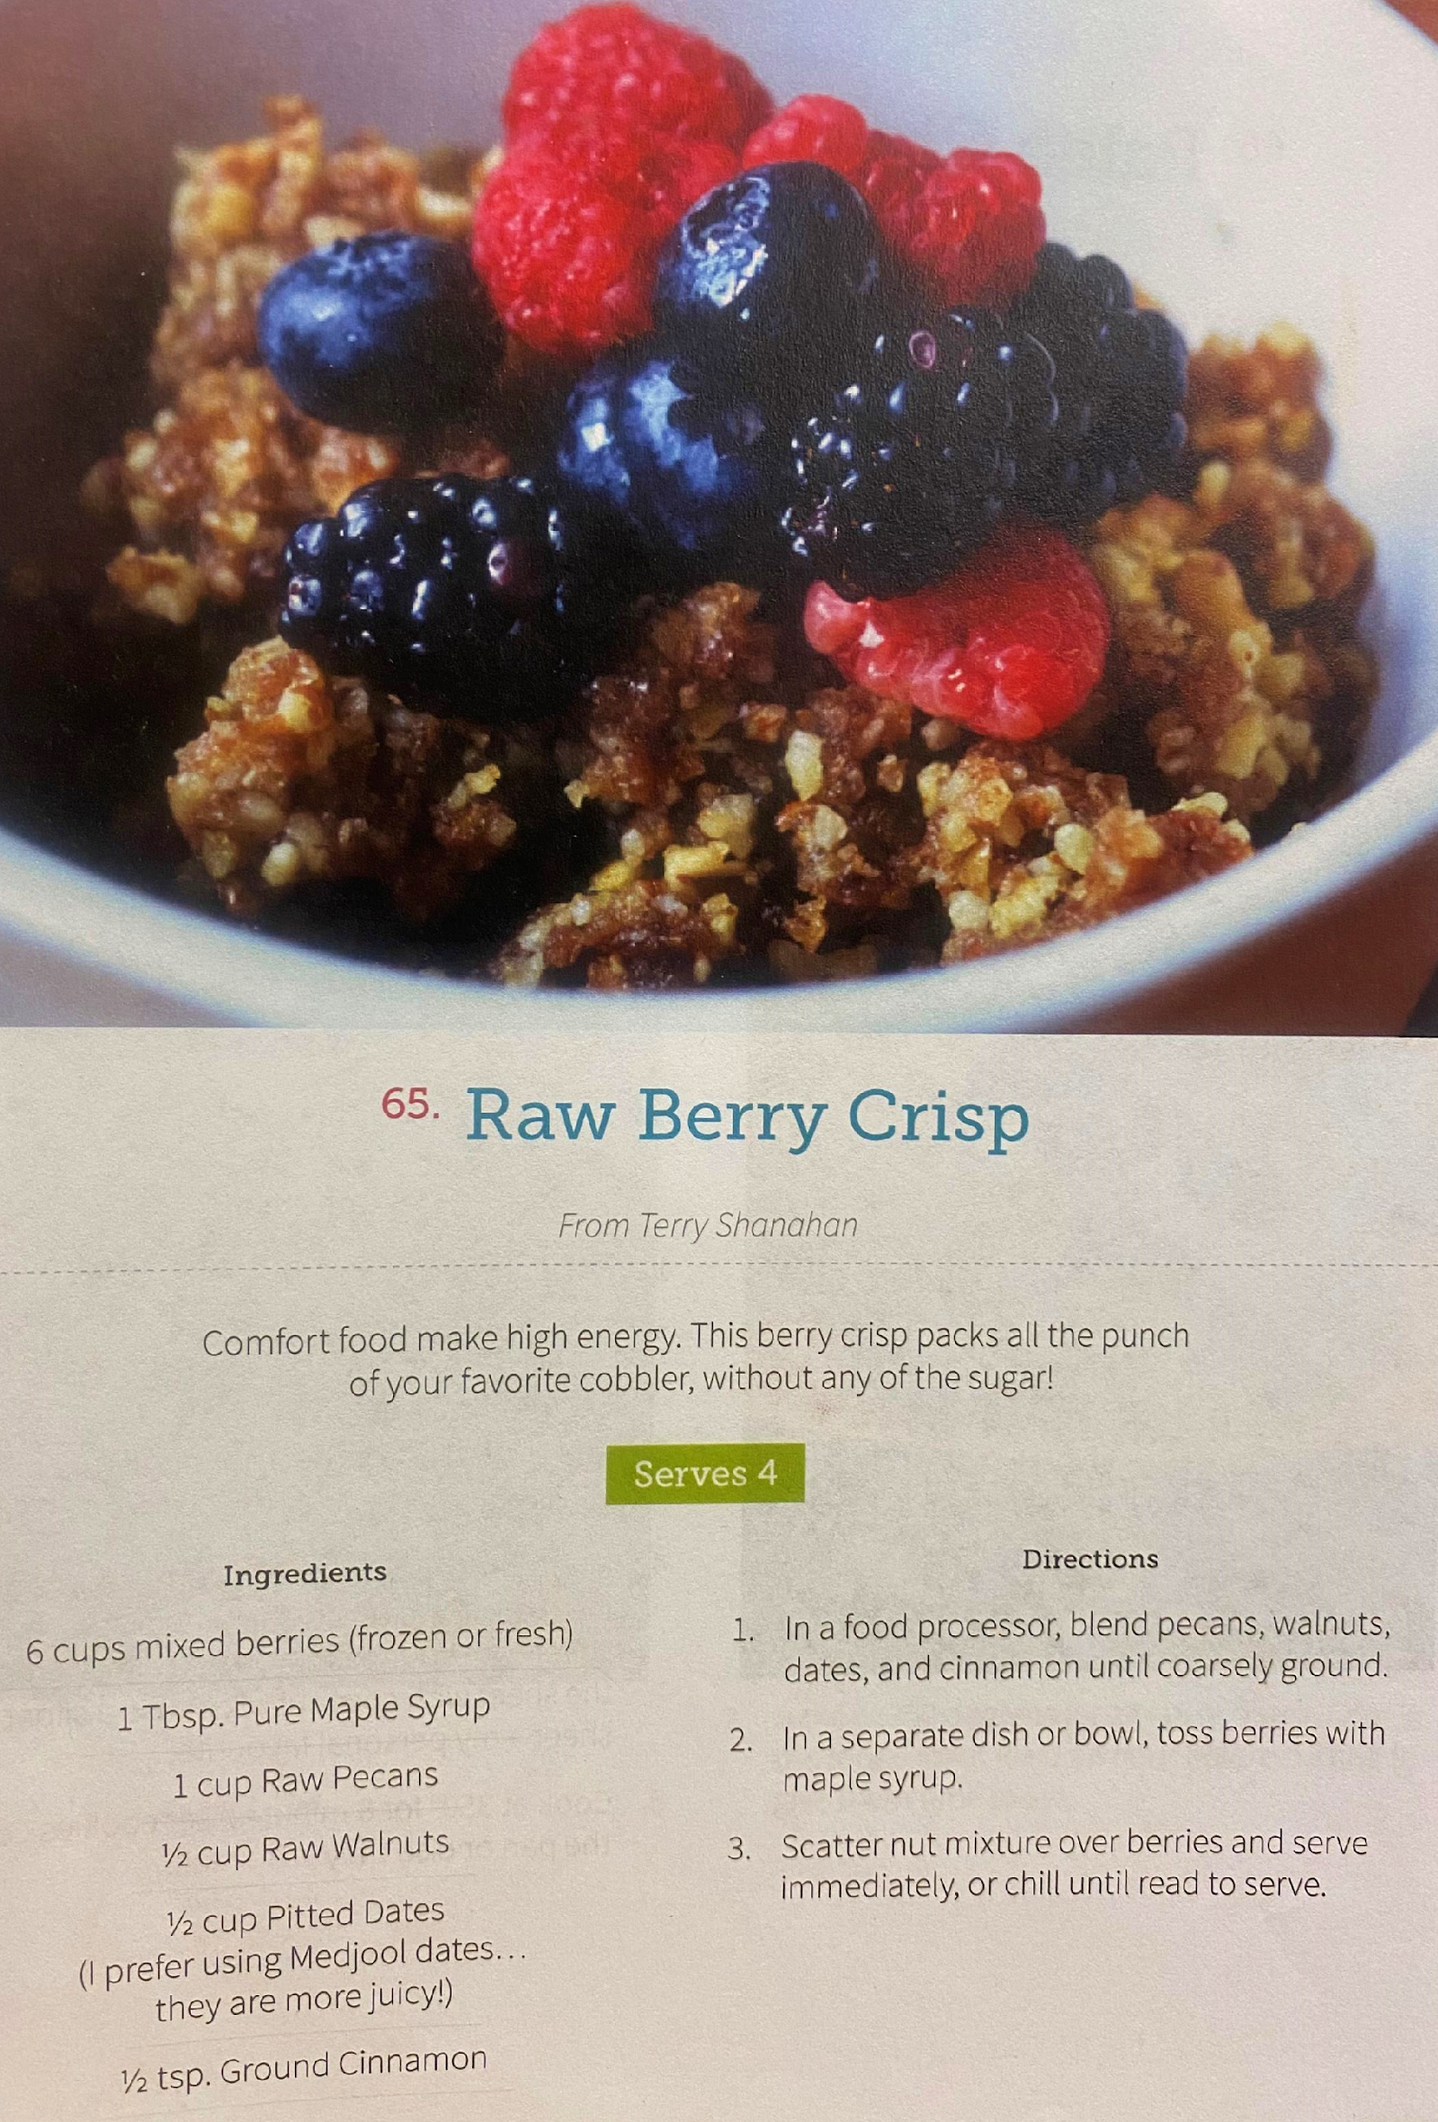

Dessert without all the guilt.

Slide 8
How to stay safe over the Holidays
The holidays are a time to be with family and friends.
How to safe and healthy:
1. Take care of your immune system
- Illness and disease strike hardest when your body’s immune system is compromised
2. Wear your mask in crowds and wash your hands with Soap and Water often.
3. Before visiting family and friends: ask them if they have been sick recently or are currently sick. Make your decision to visit or not visit.
4. Spend time outdoors if the weather permits. Sunshine and fresh air does the body good.

