Slide 1
Diabetes and Covid-19

Slide 2
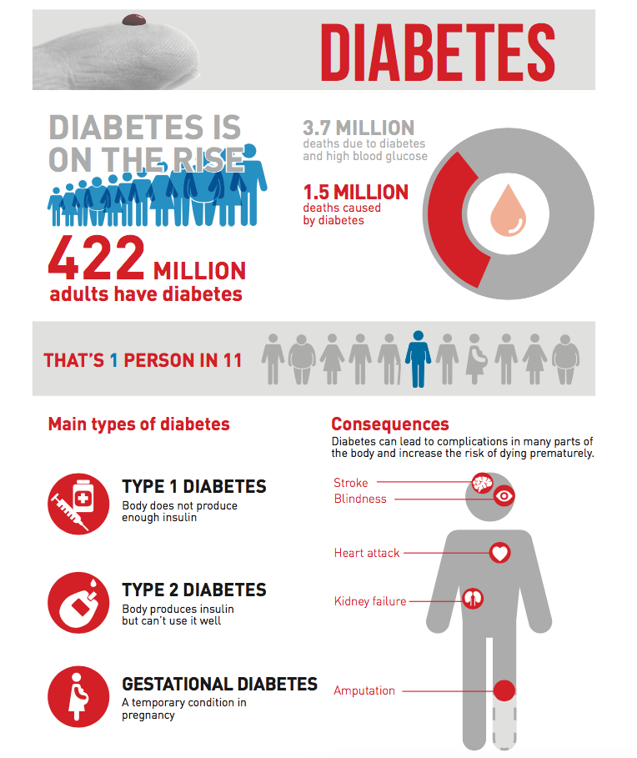

Slide 3
COVID-19 and Diabetes
Q: Are people with diabetes more likely to get COVID-19?
A: There is not enough data to show whether people with diabetes are more likely to get COVID-19 than the general population. The problem people with diabetes face is they’re more likely to have worse complications if they get it, not greater chance of getting the virus. Also, the more health conditions someone has (for example, diabetes plus heart disease), adds to their risk of getting those serious complications from COVID-19. Older people are also at higher risk of complications if they get the virus.
While the death toll is rising as the virus spreads, we expect the death rate—the number of people who die from the virus—to go down as we get better at detecting and treating it.

Slide 4
Q: Do people with diabetes have a higher chance of serious complications from COVID-19?
A: People with diabetes are more likely to have serious complications from COVID-19. In general, people with diabetes are more likely to have more severe symptoms and complications when infected with any virus.
Your risk of getting very sick from COVID-19 is likely to be lower if your diabetes is well-managed. Having heart disease or other complications in addition to diabetes could worsen the chance of getting seriously ill from COVID-19, like other viral infections, because more than one condition makes it harder for your body to fight the infection.
Viral infections can also increase inflammation, or internal swelling, in people with diabetes. This can also be caused by above-target blood sugars, and that inflammation could contribute to more severe complications.

Slide 5
Q: Are the risks different for people with type 1 and type 2 diabetes?
A: The CDC is continuing to update their website as new information about COVID-19 becomes available. Currently, they are reporting that people of any age with certain underlying medical conditions, including type 2 diabetes, are at increased risk of severe illness from COVID-19.
Based on what the CDC is reporting at this time, people with type 1 or gestational diabetes might be at an increased risk for severe illness from COVID-19. Because COVID-19 is a new disease, we don’t know as much as we’d like to about how underlying medical conditions increase the risk for severe illness from COVID-19.
It’s important to remember that people with either type of diabetes can vary in their age, complications they’ve developed and how well they have been able to manage their diabetes. People who already have diabetes-related health problems are likely to have worse outcomes if they contract COVID-19 than people with diabetes who are otherwise healthy, whichever type of diabetes they have.
Q: Does COVID-19 cause diabetes?
A: We don’t yet have evidence as to whether COVID-19 would contribute to the onset of diabetes.

Slide 6
Risks and Warning Signs
Q: Is COVID-19 different from the seasonal flu?
A: COVID-19 is proving to be a more serious illness than seasonal flu in everyone, including people with diabetes. All of the standard precautions to avoid infection that have been widely reported are even more important when dealing with this virus.
We encourage people with diabetes to follow the guidance of the CDC to be sure you’re doing everything you can to protect yourself and others. As always, people with diabetes should get a flu shot this year, although it’s important to understand the flu vaccine will not protect against COVID-19.

Slide 7
Q: What are the symptoms and warning signs I should be watching out for?
A: People with COVID-19 have reported a wide range of symptoms, ranging from mild symptoms to severe illness. Symptoms may appear 2-14 days after exposure to the virus. Pay attention for potential COVID-19 symptoms including:
Fever or chills
Cough
Shortness of breath or difficulty breathing
Fatigue
Muscle or body aches
Headache
New loss of taste or smell
Sore throat
Congestion or runny nose
Nausea or vomiting
Diarrhea

Slide 8
Q: What should I do if I think I'm developing symptoms of COVID-19?
A: If you fell like you are developing symptoms, call your doctor.
When you call:
Have your glucose reading available
Have your ketone reading available
Keep track of your fluid consumption (you can use a 1-liter water bottle) and report
Be clear on your symptoms (for example: are you nauseated? Just a stuffy nose?)
Ask your questions on how to manage your diabetes

Slide 9
Q: What are the emergency warning signs—and what should I do if I’m experiencing them?
A: If you develop emergency warning signs for COVID-19 get medical attention immediately. In adults, emergency warning signs include:
Difficulty breathing or shortness of breath
Persistent pain or pressure in the chest
New confusion
Inability to wake or stay awake
Bluish lips or face

Slide 10
