Slide 1

School Health Advisory Council
November 16, 2020

Slide 2
Respect, Value & Affirm
the Sacred Dignity of
Each Person by Caring for
Mind, Body, Spirit & Community

Slide 3
Mental Disorder or Mental Illness is a diagnosable illness that:
Affects a person's thinking, emotional state, & behavior
Disrupts the person's ability to work, carry out daily activities, & engage in satisfying relationships
Notes:
18.5% of adults experienced a mental illness in any one year
Mental disorders often occur in combination

Slide 4
Depression
Affects a person's:
Emotions, thinking, behavior, & physical well-being
Ability to work & have satisfying relationship
Ability to carry out usual daily activities

Slide 5
Depression: Signs & Symptoms
Physical
Behavioral
Psychological
Fatigue
Sleeping too much or too little
Overeating or loss of appetite
Constipation
Weight loss or gain
Headaches
Unexplained aches & pains
Crying spells
Withdrawal from others
Neglect of responsibilities
Loss of interest in personal appearance
Loss of motivation
Slow movement
Use of drugs & alcohol
Sadness
Anxiety
Guilt
Anger
Mood swings
Lack of emotional responsiveness
Feelings of helplessness
Hopelessness
Notes:
SOME signs & symptoms of depression – there are more
People with depression don't necessarily have ALL of these signs and symptoms

Slide 6
Anxiety
Generalized Anxiety Disorder: overwhelming, unfounded anxiety and worry (about things that may go wrong or one's inability to cope)
Notes:
What causes Anxiety Disorders?
Anxiety is mostly caused by perceived threats in the environment
Those most at risk:
More sensitive emotional nature
History of anxiety
Female
Abuse alcohol
Traumatic experience

Slide 7
Anxiety: Signs & Symptoms
Physical
Behavioral
Cardiovascular: pounding heart, chest pain, rapid heartbeat, blushing
Respiratory: fast breathing, shortness of breath
Neurological: dizziness, headache, sweating, tingling, numbness
Gastrointestinal: choking, dry mouth, stomach pains, nausea, vomiting
Musculoskeletal: muscle aches & pains (especially neck, shoulders & back), restlessness, tremors & shaking, inability to relax
Avoidance of situations, obsessive or compulsive behavior, distress in social situations, phobic behavior
Psychological
Unrealistic or excessive fear & worry, mind racing or going blank, decreased concentration & memory, indecisiveness, irritability, impatience, anger, confusion, restlessness or feeling "on edge" or nervous, fatigue, sleep disturbance, vivid dreams

Slide 8
Risk Factors for Depression & Anxiety
Distressing & uncontrollable event
Stressful or traumatic events
Difficult childhood
Ongoing stress & anxiety
Another mental illness
Previous episode of depression or anxiety
Family history
More sensitive emotional nature
Notes:
Illness that is life threatening, chronic or associated with pain
Medical conditions
Side effects of medication
Recent childbirth
Premenstrual changes in hormone levels
Lack of exposure to bright light in winter
Chemical (neurotransmitter) imbalance
Substance misuse; intoxication, withdrawal

Slide 9
Listen Nonjudgmentally
Reflect or restate what the person said
Ask clarifying questions
Be patient
Notes:
Ask the person how he or she is feeling and for how long
Can help the person feel hear, understood, and not judged
"I am here to listen"
"I want to support you"

Slide 10
Encourage Professional & Self-Help
People who can help (mental health professionals, primary care physicians, psychiatrists)
Self-Help Strategies
  Relaxation training
  Exercise
  Meditation
Notes:
57% of those with Depression and 42% of those with Anxiety received professional health care or other services
Finger Holds:
Thumb: Fear
Pointer: Fear
Middle: Anger
Ring: Anxiety
Pinky: Low Self-Esteem
Lightly pinch the finger you want to focus on – deep breaths – exhale negative feelings out
Emotional Check-In 1-5
Name it-Fear, Worry, Anger, Disappointed
Heart to Tummy
Place one hand on your heart and one on your tummy
Take 3 deep breaths
Think of 1 thing you are grateful for

Slide 11
Programs & Services
Clinical Mental/Behavioral Health
School Based Services
Community Outreach
Professional Development
Crisis Assistance
Congregational Care

Slide 12
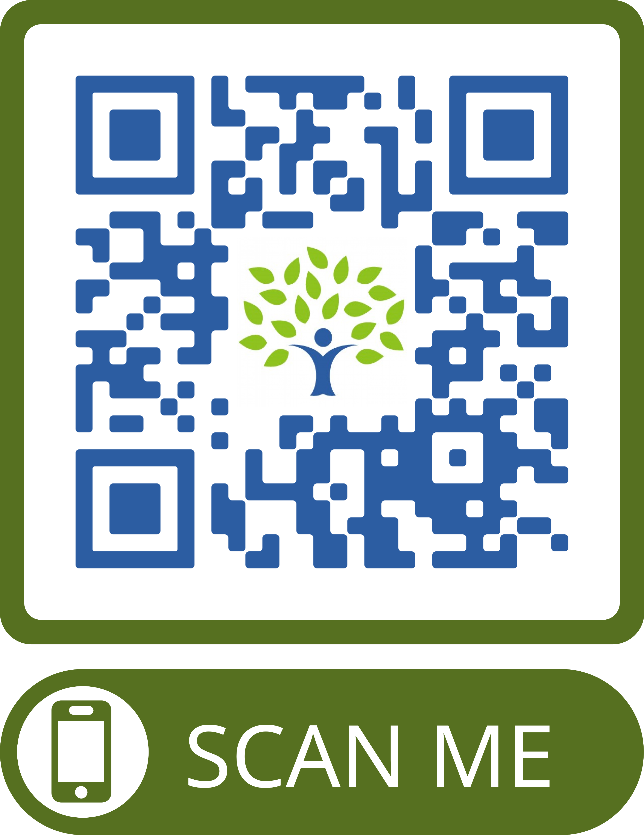
FREE
Mental Wellness Screening www.sccset.org

