Slide 1


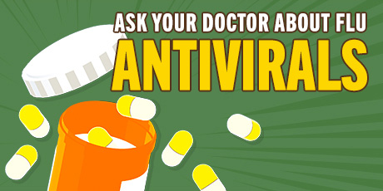
Influenza (flu) is a contagious respiratory illness caused by influenza viruses. It can cause mild to severe illness. Serious outcomes of flu infection can result in hospitalization or death.

Slide 2
Common Flu Signs and Symptoms:
Flu signs and symptoms usually come on suddenly. People who are sick with flu often feel some or all of these symptoms:
Fever* or feeling feverish/chills
Cough
Sore throat
Runny or stuffy nose
Muscle or body aches
Headaches
Fatigue (tiredness)
Some people may have vomiting and diarrhea, though this is more common in children than adults.
*It’s important to note that not everyone with flu will have a fever.

Slide 3
CDC says “TAKE 3” actions to fight Flu:
1) The best way to prevent seasonal flu is to get vaccinated every year.
CDC recommends getting a flu vaccination in September or October but getting vaccinated anytime during the flu season can help protect you.

Slide 4
How effective is the flu vaccine?
CDC conducts studies each year to determine how well the influenza (flu) vaccine protects against flu illness. Recent studies show that flu vaccination reduces the risk of flu illness by between 40% and 60% among the overall population during seasons when most circulating flu viruses are well-matched to the flu vaccine. In general, current flu vaccines tend to work better against influenza B and influenza A(H1N1) viruses and offer lower protection against influenza A(H3N2) viruses.

Slide 5
It’s likely that flu viruses and the virus that causes COVID-19 will both spread this fall and winter. Healthcare systems could be overwhelmed treating both patients with flu and patients with COVID-19. This means getting a flu vaccine during 2020-2021 is more important than ever.
While getting a flu vaccine will not protect against COVID-19, there are many important benefits, such as:
1) Flu vaccines have been shown to reduce the risk of flu illness, hospitalization, and death.
2) Getting a flu vaccine can also save healthcare resources for the care of patients with COVID-19.

Slide 6
2) Take everyday preventive actions that are always recommended to reduce the spread of flu.
Avoid close contact with people who are sick.
If you are sick, limit contact with others as much as possible to keep from infecting them.
Cover coughs and sneezes.
Cover your nose and mouth with a tissue when you cough or sneeze. Throw the tissue in the trash after you use it.
Wash your hands often with soap and water. If soap and water are not available, use an alcohol-based hand rub.
Avoid touching your eyes, nose and mouth. Germs spread this way.
Clean and disinfect surfaces and objects that may be contaminated with viruses that cause flu.

Slide 7
3) Antiviral Drugs:
If you are sick with flu, antiviral drugs can be used to treat your illness.
Antiviral drugs are different from antibiotics. They are prescription medicines (pills, liquid or an inhaled powder) and are not available over-the-counter.
Antiviral treatment works best when started soon after flu illness begins. When treatment is started within two days of becoming sick with flu symptoms, antiviral drugs can lessen fever and flu symptoms and shorten the time you are sick by about one day. They also may reduce the risk of complications such as ear infections in children, respiratory complications requiring antibiotics, and hospitalization in adults. For people at high risk of serious flu complications, early treatment with an antiviral drug can mean having milder illness instead of more severe illness that might require a hospital stay.

Slide 8
