Slide 1
Welcome
Bienvenidos
Place your name, student name and school in the chat. Thank you
Ponga su nombre, nombre del estudiante, y escuela en el chat. Gracias
Notes:
Gio

Slide 2
Our Why ~ Nuestro Porque
“To give our best so that those we serve are inspired and empowered to become their best.”
“Dar lo mejor todos los días para que aquellos quienes servimos estén inspirados y empoderados para convertirse en su mejor versión”
Notes:
Gio

Slide 3
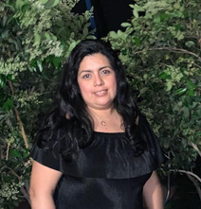
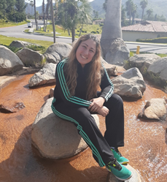
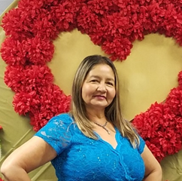
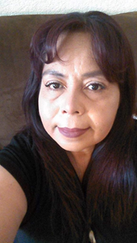
Facilitators ~ Facilitators
Giozai Varagnolo
HIGHLAND HIGH SCHOOL
Adriana Chacon
KNIGHT HIGH SCHOOL
Sandra Mota
PALMDALE HIGH SCHOOL
Blanca Morelos
KNIGHT HIGH SCHOOL
Notes:
GIo

Slide 4
Expectations ~ Expectativas
Introduce yourself when speaking.
Verify that your mute feature is on when logging in.
Chats are recorded and note that private chat is also captured.
Enter all questions in the chat box during the session. We will be monitoring during the meeting.
This zoom presentation will be recorded.
Remember to stay muted when you are not speaking.
Questions specific to your child can be address after the meeting for confidentiality purposes.
Presentence antes de hablar.
Verifique que su función de silencio esté activada al ingresar
Los chats se graban y tenga en cuenta que también se captura el chat privado
Ingrese todas las preguntas en el chat durante la sesión. Estaremos monitoreando durante la reunión.
Esta presentación de zoom se grabará.
Recuerde permanecer en mute cuando no esté hablando.
Las preguntas específicas de su hijo (a) pueden hacerlas después de la reunión con fines de confidencialidad.
Notes:
Dora

Slide 5
Approve Minutes ~ Aprobar Minutas
First Motion/ Primera Mocion:
Second Motion/ Segunda Mocion:
Notes:
https://docs.google.com/document/d/1lF_YHNAoLyts3FU6xIgiz8mssYFPNFRU/edit?usp=sharing&ouid=109322047054228582600&rtpof=true&sd=true
Dora

Slide 6
Agenda
Quarter 1 Grades Information
Disciplina Positiva (Tony & Flyers)
Director of Equity Presentation
Financial Aid/Dreamer Information
PSAT Information
Community Resources
Voting
Rifa
Información de Grados Q1
Disciplina Positiva (Tony & Flyers)
Directora de Equidad
Ayuda Financiera y Soñadores
PSAT Informacion
Recursos de la Comunidad
Votaciones
Rifa
Notes:
Dora

Slide 7
Dr. Kathryn Taylor
DIRECTOR OF EQUITY
ktaylor@avhsd.org

Slide 8




Educational Equity
Equidad educativa
Dr. Kathryn Taylor
Director of Equity
Title IX Coordinator
Dra. Kathryn Taylor
Director de Equidad
Coordinador del Título IX

Slide 9

What is Educational Equity?
¿Qué es la equidad educativa?

Slide 10

Educational equity means that each student receives what they uniquely need to develop into their full academic and social-emotional potential regardless of their race, gender, sexual orientation, disability, ethnicity, language, religion, family background, or family income.
La equidad educativa significa que cada estudiante recibe lo que necesita para desarrollar su potencial académico y socioemocional completo, independientemente de su raza, género, orientación sexual, discapacidad, origen étnico, idioma, religión, antecedentes familiares o ingresos familiares.

Slide 11








Barriers can be any circumstance, experience, status, belief, or difference from the majority-based system/culture.
Las barreras pueden ser cualquier circunstancia, experiencia, estatus, creencia o diferencia del sistema / cultura basado en la mayoría.
Social Emotional Needs
Necesidades socioemocionales
English Language Development Needs
Necesidades de desarrollo del idioma inglés
Special Needs
Necesidades especiales

Slide 12

EDUCATIONAL EQUITY | EQUIDAD EDUCATIVA

Slide 13
Educational Equity
Equidad educativa
QUESTIONS? ¿PREGUNTAS?

Slide 14
Tony Orozco
Disciplina Positiva
Notes:
Tony

Slide 15
Counseling/Consejeria
Quarter 1 grades
PowerSchool App
Quarter 1 & Quarter 2 average to Semester 1 Grade
Grados Q1
PowerSchool App
El grado del semestre es un promedio de Q1 y Q2
Notes:
Yazmin

Slide 16
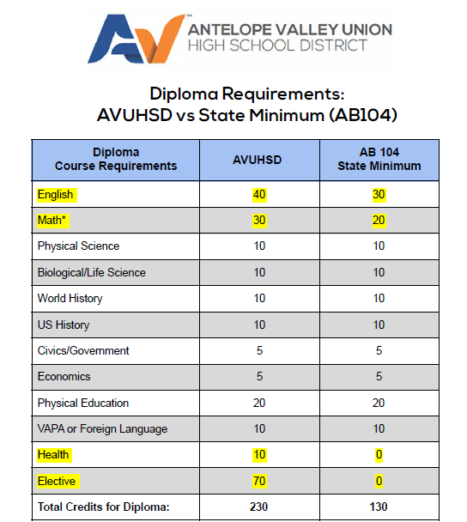
AB 104
Elegibilidad: Estudiantes en grado 12 o que regresaron por un 5to año
Proceso: Hable con su consejero y llene la aplicación
Tenga en cuenta: Los requisitos mínimos estatales de graduación, como se enumeran anteriormente, no cumple con los requisitos del curso A-G para CSU, UC y la mayoría de los demás estudios . Su estudiante puede aplicar a una universidad comunitario como AVC
Recuerde que esto no significa que su hijo o hija se puedan graduar temprano
Notes:
Yazmin
This is an opportunity that is awarded to our students due to all of the social emotional needs that were present during COVID that caused them not to earn the credits needed to graduate.
Reach out to your counselor and even if you are not sure just reach out your counselor
Who is eligible?
Students who in the 2020–21 school year were in their 3rd or 4th year of high school and are not on track to graduate in 4 years. In other words, current 4th-year seniors and current 5th-year students only. Students in their 6th, 7th, 8th, etc., year are not eligible for the state minimum graduation requirements under AB104.
What is the process?
In coordination with their respective teams, School Counselors will meet with eligible students (as defined above) to discuss their options and the most appropriate path for earning a high school diploma. The outcome of these conversations may include but are not limited to class changes, adjustment of supplemental opportunities, changes to instructional setting (i.e., comp. site to IS or vice-versa). Please review the considerations listed below regarding Special Education students, “early graduation,” 5th-year students, and diploma distribution.

Slide 17
Dream Act Application
The CA Dream Act has opened as of Oct. 1st. (2022-2023)
This application will be filled out by Seniors that are planning to attend college next Fall 2022.
It is highly recommended to be filled out as soon as possible, since funds are limited and disbursement of funds is on a first come first serve basis.
The student can enter up to 10 colleges they'd like for the application to be forward to for review.
Deadline - March 2nd
https://dream.csac.ca.gov
El CA Dream Act se inauguró el 1 de octubre. (2022-2023)
Esta solicitud será completada por estudiantes de último año que planean asistir a la universidad el próximo otoño de 2022.
Es muy recomendable completarlo lo antes posible, ya que los fondos son limitados y el desembolso de los fondos se realiza por orden de llegada.
El estudiante puede ingresar hasta 10 universidades a las que le gustaría que se reenvíe la solicitud para su revisión.
Fecha límite - 2 de marzo
https://dream.csac.ca.gov
Notes:
Yazmin

Slide 18
PSAT Information
March 13th
Preparación para el SAT
Elegibilidad competitiva
Notes:
GIo

Slide 19


Community Resources/Recursos de la Comunidad
.
Notes:
Blanca

Slide 20

Community Resources
.
Notes:
Blanca

Slide 21

Notes:
https://bit.ly/2WRd95L

Slide 22

AVC - Dreamer Center/Centro de Sonadores
Notes:
Blanca

Slide 23
Supplemental Education Services/Servicios de Educacion Supplemental
Tutorial - aplicacion
  Será mandada por correo
  Por favor complete y regrese al distrito
Notes:
Dora

Slide 24
Recommendations to the Board
Recomendaciones a la Mesa Directiva
Notes:
Dora

Slide 25
Fechas Importantes/Upcoming Dates
Next DELAC - 12/15 - Celebracion!!
Veteran’s Day - 11/11
Student Free Day - 11/12
Thanksgiving Break - 11/22-11/26
Semester Ends - 12/17 FINAL GRADES
Winter Break - 12/20 - 1/07
Notes:
Gio

Slide 26
Voting
Votaciones
Notes:
Crotty

Slide 27

Raffle ~ Rifa
Notes:
Team
https://wheelofnames.com/

Slide 28
THANK YOU! ~ GRACIAS!!

