Slide 1
School Site council 101

Slide 2
The School Site Council is…
  …A unique school-level group that is charged with improving academic achievement through the compliant and efficient use of selected funds.
  Philosophical Foundations
  Education should be a joint effort between students, parents, teachers, administrators, and other school staff whose common goal is the success of every student.

Slide 3
Legislative Intent
The Education Code for many Schoolwide Programs includes specific language regarding School Site Councils (SSC) and the Single Plan for Student Achievement (SPSA).
Ed Code requires the SSC to develop, monitor, and annually revise the SPSA for programs funded by the Consolidated Application and other funding sources.
Sources: Education Code 52852; U.S.C. 6314

Slide 4
SSC Governance
Legislative role
  SSC writes or makes revisions to the SPSA/budget based on data and monitoring
Executive role
  Principal/school staff implement SPSA
Judicial role
  Local governing board makes and interprets policy and approves SPSA

Slide 5
SSC Functions

Slide 6
Functions of an SSC
Develop and monitor a comprehensive SPSA
  Continuous planning, monitoring, revision, and review of effectiveness
  Including budgets and expenditures for strategies and actions in the SPSA
  Ensure that SPSA is in compliance with all consolidated application funding requirements, and those of other funds requiring involvement of the School Site Council
Ensure that the school is continually engaged in identifying and implementing evidence-based activities, strategies, and interventions with a focus on improving student achievement.

Slide 7
Additional Expectations
Recommend the SPSA to the Board of Trustees for approval, with signed Assurances
Participate in all reviews of the SPSA and school programs for compliance and quality (such as FPM and WASC)
Ensure that the SPSA supports the LEAP/LCAP
Participate in the district LCAP Process

Slide 8

Activities Outside the Scope of the SSC
School Management
Policy-making
Political Organization
Acting as an extension of a PTSA, Foundation, or social organization/group
Fund Raising
Acting as a grievance committee
Site personnel decisions
Policy-making

Slide 9
Possible Funding Sources

Slide 10

Local Control Funding Formula (LCFF) and SSCs
LCFF is the new state funding mechanism for districts
The LCAP is the district planning document for LCFF.
The LCFF requires district transparency and input from all stakeholders, and it is informed by school goals, which are part of the SPSA.
Control of LCFF funds is at the district level
Notes:
SSCs exist all over the US, not just CA.

Slide 11
Funding Process for Federal Programs
Consolidated Application – (District level)
- Request funding from state of California
District [Local Education Agency Plan (LEAP) – soon to be LCAP Federal Addendum] and Site Plans – Explain how the money will be spent to improve student achievement and meet other funding requirements
Monitoring –
SSC monitors and evaluates funded site programs
District reports on expenditures to state in Consolidated Application
Federal Program Monitoring – ensures compliance with state and federal laws
Notes:
Formulas guide funding amounts
District and Site Plan can’t contradict each other – should support

Slide 12
SSC MEMBERSHIP

Slide 13
SSC Composition
The SSC shall ensure parity between:
  (a) the principal, classroom teachers, and other school personnel; and
  (b) parents or other community members elected by other parents (and students elected by other students, at the secondary level)
Parent or community members, representing that group, may not be employed at the school site
“Other school personnel” refers to classified and/or non-classroom certificated staff (i.e. custodian, resource teacher, counselor, assistant/vice principal, instructional aide, secretary, etc.)
Selection will be according to by-laws if those exist (recommended)

Slide 14
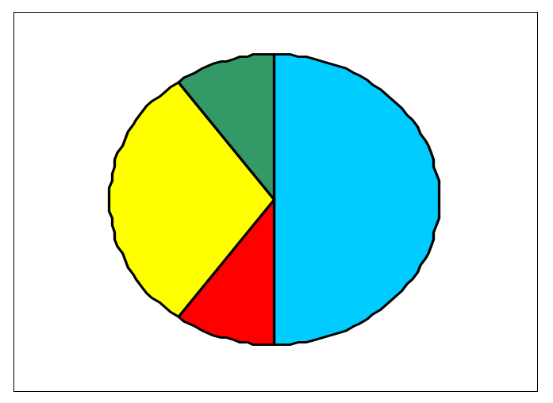
Elementary Composition
…a school with two or more grades in the K-6 grade span (e.g., K-6, 4-6, K-8)
Principal (1)
Classroom Teachers
Parents/Community
Other school personnel
Possible Configurations
Principal | 1 | 1 | 1
Classroom Teachers | 3 | 4 | 4
Other staff | 1 | 1 | 2
Parents/Community members | 5 | 6 | 7
Total Members | 10 | 12 | 14

Slide 15
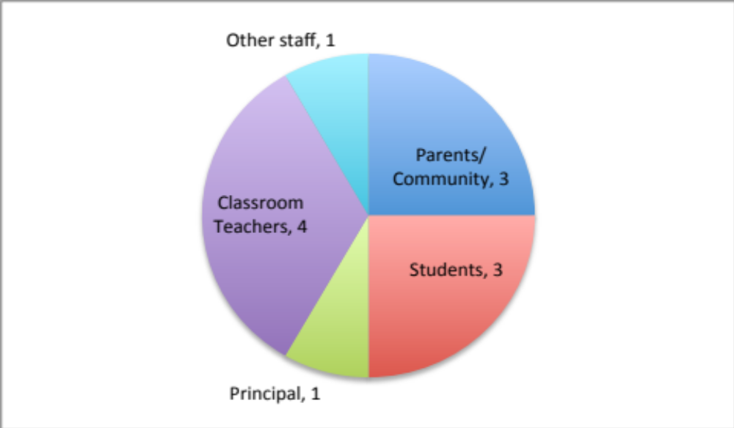
Secondary Composition
…a school with fewer than two grades in K-6 grade span (e.g., 6-8, 9-12)
Possible Configurations
Principal | 1 | 1 | 1
Classroom Teachers | 4 | 5 | 6
Other staff | 1 | 2 | 3
Parents/Community members | 3 | 4 | 5
Students | 3 | 4 | 5
Total Members | 12 | 16 | 20

Slide 16
SSC Officers
Typically, annual election of officers includes:
Chairperson – Presides at all meetings of the council – works with principal to organize, convene, and lead meetings of the council
Vice Chairperson – Substitutes for the Chairperson in his or her absence
Secretary – Maintains records of regular and special meetings of the council, records events and actions taken at council meetings

Slide 17
Responsibilities of SSC and SSC Members
Attend meetings regularly; share information with others you represent
Analyze the academic achievement of students at the school, including sub-groups, to determine priorities and areas of focus
Work with school advisory groups (ELAC, GATE, Title I, SpEd) regarding development/revision of the SPSA.
Also obtain input from school stakeholders (PLCs, Leadership Team, Classified Staff, Counselors, etc.)
Notes:
d

Slide 18
SSC Nuts & bolts

Slide 19
Rules of Order
Notice of the meeting must be posted at the school site or other accessible place at least 72 hours before the meeting.
Include:
  Date, Time, and Place of the meeting
  An Agenda that describes each item of business, with action (vote) items noted.
  Translation into all applicable languages for the school site

Slide 20
Rules of Order
Meetings must be open to the public. (Greene Act)
The public may address the council on any item within jurisdiction of the council. Meeting materials should be available to the public upon request.
The council cannot act on any item not on the posted agenda unless, by unanimous vote, it first finds a need for an action that was unknown when the agenda was posted. (RARE)
Questions and brief statements of no impact on pupils or employees that can be resolved by providing information need not be described on the posted agenda.
If procedures are violated, upon demand of any person, the council must reconsider the item at its next meeting, after allowing for public input on the item.
Notes:
A sign in sheet is a good idea

Slide 21
Records
Federal law requires that all records pertinent to federally-funded programs be retained for three years
SSC records must be available for public review upon request
Records to be maintained:
  Elections
  Official correspondence
  Meeting agendas
  Evidence of input from advisory committees
  Minutes of meetings, recording attendance, discussions, recommendations, and actions
  Copies of SPSA

Slide 22
Resources
CDE website
http://www.cde.ca.gov/fg/aa/co/ssc.asp
Patricia Karlin
Coordinator, State & Federal Programs
(858) 292-3811
patricia.karlin@sdcoe.net

