Slide 1

2021-22
VOLUNTEER OPPORTUNITIES
In Pierce County

Slide 2
VOLUNTEER FRIDAYS @ GATES
As a Check & Connect, you can sign up to do one of the following on a Friday during CC (1/2 hr per Friday):
  Pick up trash around the campus
  Take out the recycle for each portable
  Weed an area of the campus
  Do something to beautify the campus or your portable
  Find a meaningful way to say “Thank You” to our community partners (such as Our Savior Lutheran Church who keeps our Food Pantry stocked in Room 8)
  Have another idea to better GATES or our community?? Submit it on the form!
  Volunteer Friday Sign-Up Form: https://forms.gle/82iYAHBKJBCJxbtP6

Slide 3

Humane Society for Tacoma & Pierce County
2608 Center Street
Tacoma, WA 98409
(253) 383-2733
We welcome you to apply to Volunteer if you are:
  16 years of age or older.
  Able to make a minimum commitment of 6 hours per month for at least 6 months.
  Able to squat, bend, twist, lift, or stand for long periods of time when working directly with the animals.
  A people person, as well as an animal person.
  Committed to creating a compassionate community for not only animals but also for the people that love them.
Availability:
  7 days a week, 7am to 6:30pm. Limited availability on weekends.
  https://www.thehumanesociety.org/get-involved/volunteer/
Below are some of our most in-need positions.
  Administrative Assistant
  Animal Transport
  Bath Brigade
  Cat Care Specialist
  Customer Service Aid
  Dog Enrichment
  Dog Walker
  Events and Outreach
  Laundry Folding Crew
  Pet Food Pantry
  Pet Store Liaison
  Purrtime Specialist (cat enrichment)
  Rabbit Enrichment Specialist
  …and many more!

Slide 4

CHURCH OF ALL NATIONS FOOD PANTRY
111 112th St E
Tacoma, WA 98445
Join us volunteering at the Pantry! Whether you have one day off a week, or Saturdays to serve, we have a place for you!
To receive more information about this wonderful serving opportunity, email our Pantry Director at jenni.thompson@cfan.church
https://cfan.church/the-pantry

Slide 5

NW FURNITURE BANK
117 Puyallup Ave
Tacoma, WA 98421
253-302-3868 x 102 volunteer@nwfurniturebank.org
Qualifications to volunteer include the following:
17 years or older
Good health
Be able to stand for 3 or more hours
Be able to bend, lift, and carry 25 lbs.
Pass a criminal background check
For more information, visit our Volunteer FAQ page.
Individual Opportunities
Shoppers (Shifts available Tuesday-Saturday AM)
Retail Assistants in Hope Furnishings Retail Store (Shifts available Monday-Sunday - AM & PM shifts offered)
Stock Assistants at Hope Furnishings Retail Store (Any day(s) Monday-Sunday AM/PM shifts offered) Role Detail here
Donation Sorter (Shifts available Monday-Saturday - AM & PM shifts offered)
Furniture Assemblers - no experience needed (Tacoma location only; Shifts available Monday-Friday AM)
Special Events
Cleaning and General Housekeeping (Schedule Flexible)
https://www.nwfurniturebank.org/volunteer

Slide 6
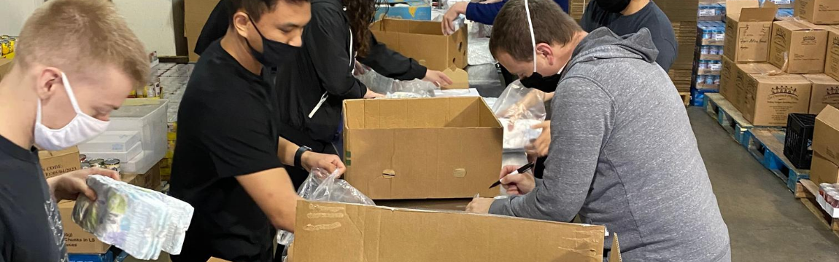
NOURISH PIERCE COUNTY FOOD BANK
We are serving record numbers of people since spring of 2020 and need your help!
Nourish depends on the services of 1,000 volunteers to help maintain the operations of our 25 distribution sites and warehouse facility.
253-383-3164 https://nourishpc.org/volunteer/
Qualifications to volunteer include the following:
17 years or older
Good health
Be able to stand for 3 or more hours
Be able to bend, lift, and carry 25 lbs.
Pass a criminal background check
For more information, visit our Volunteer FAQ page or e-mail Volunteer@nourishpc.org

Slide 7

TACOMA RESCUE MISSION
425 South Tacoma Way
Tacoma, WA 98402
253.383.4493
By volunteering, you are able to walk alongside those in need throughout our community and be a symbol of hope to the hurting individuals that are experiencing homelessness. Whether you are an individual, family or group, we would love to find a volunteer opportunity for you!
What volunteer opportunities are available?
  Kitchen Shifts every day of the year (approx. 6am – 9am; 11am – 2pm & 3pm – 6pm)
  Litter Pick up (Mon, Wed, Fri 11:30am – noon) Lunch included
  Coffee Team (Mon, Wed and Sat 6:30am – 8:30am)
  Women’s Shelter Organizing (Mon & Sat 10:00am – noon)
  Landscaping (times vary)
https://www.trm.org/volunteer/

Slide 8
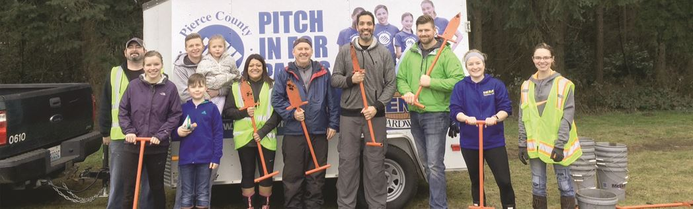
PITCH IN FOR PARKS PIERCE COUNTY
Pitch in for Parks is a volunteer based program offered through the partnership of Pierce County Parks and McLendon Hardware. Pitch in for Parks a great opportunity for all ages and abilities (ages 15 and under with guardian) to pitch in and help your community. Join us rain or shine!
Pre-Registration: Pitch in for Parks will have limited registration and is not open to drop-in volunteers at this time. Volunteers are welcome to Pitch In for an hour or two or the entire time and must pre-register to reserve your spot, spaces are limited:
  Pre-register by selecting the Saturday Date or time
  frame of interest
  Registration closes by 12:00 p.m. (noon) the Friday
  before the listed Saturdays
Saturday Date | Location & Activity | Pre-Register by
November 20 10 am - 12 noon | Chambers Creek Regional Park - 6320 Grandview Dr. W. University Place, 98467 (map) Enjoy the crisp autumn air and help us remove invasive species like Scotch broom and Himalayan blackberry. | Nov. 19

Slide 9

UNITED WAY VOLUNTEER OPPORTUNITIES
https://uwpc.galaxydigital.com/need/
Our website is constantly updating with various volunteer opportunities in Pierce County!
From helping a child learn to read to community garden projects and corporate philanthropy, we have all kinds of gratifying volunteer opportunities.
Virtual Volunteer Opportunities: https://uwpc.galaxydigital.com/need/index?s=1&need_init_id=4037

Slide 10

PIERCE COUNTY VOLUNTEER HUB
https://uwpc.galaxydigital.com/need/index?s=1&need_init_id=4037

