Slide 1
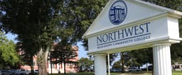
Northwest community college
Beverly brewer stark Career center

Slide 2



Marketing tool reflecting your employment history, skills, talents, & accomplishments
NWCC
Purpose of a resume

Slide 3

RESUME format
Concise & Easy to Read
Consistent Font
10-12 Font Size
Consistent Verb Tense
Past = Previous Employment
Present = Current Employment
Optimal Length
1 Page
NWCC
15-30 seconds to catch employer’s attention!

Slide 4
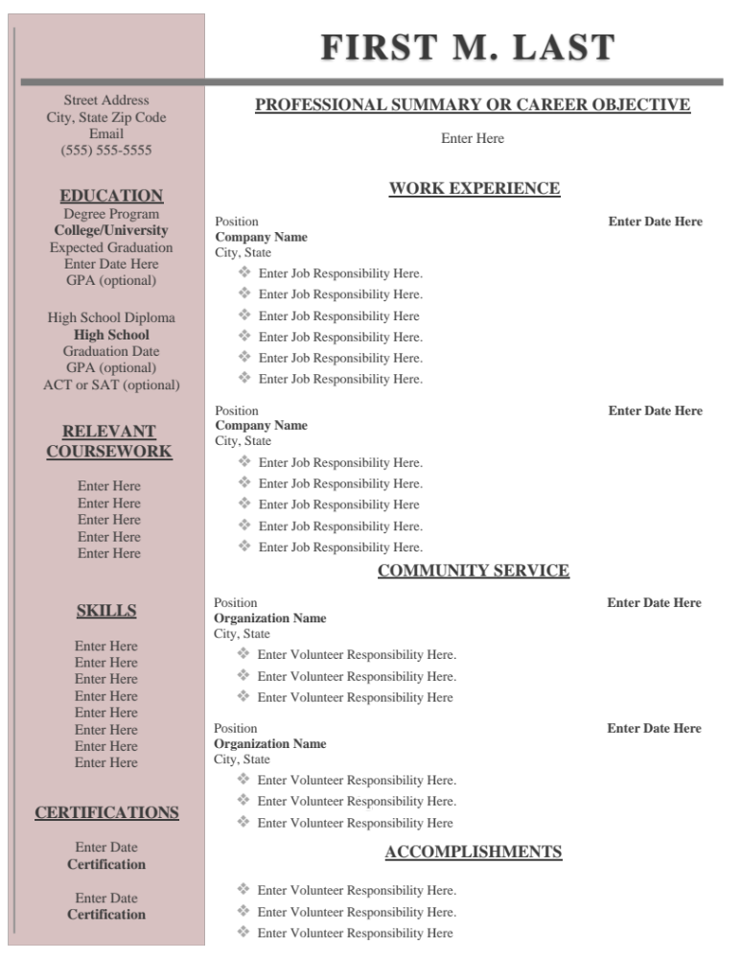
Personal Contact Information
Career Objective or Summary
Statement that clearly demonstrates goals/objectives in applying for employment. Objective should focus on company and answer the question, “What can I do for you?”
Education, Certifications, &/or Relevant Coursework
Skills
Include ‘hard skills’ such as job-specific abilities or knowledge learned through education, hands-on experience as well as
‘soft skills’ like communication, teamwork, and leadership.
COMMUNITY SERVICE AND/OR ACCOMPLISHMENTS
TIP:
ASK SOMEONE TO PROOF-READ FOR MISTAKES!
NWCC
PARTS OF A RESUME

Slide 5
Versus
CHRONOLOGICAL
FUNCTIONAL
NWCC
MOST COMMON RESUME FORMAT
FOCUS IS ON SKILLS RATHER THAN WORK HISTORY
ARRANGED IN DATE ORDER WITH CURRENT JOB LISTED FIRST
GOAL IS TO PROVE THAT JOB REQUIREMENTS CAN BE CARRIED OUT
SHOWS CAREER PROGRESSION
IN-DEPTH OVERVIEW OF PROFESSIONAL SKILLS & QUALIFICATIONS
HIGHLIGHTS EXPERIENCE
WHAT IS THE DIFFERENCE?

Slide 6
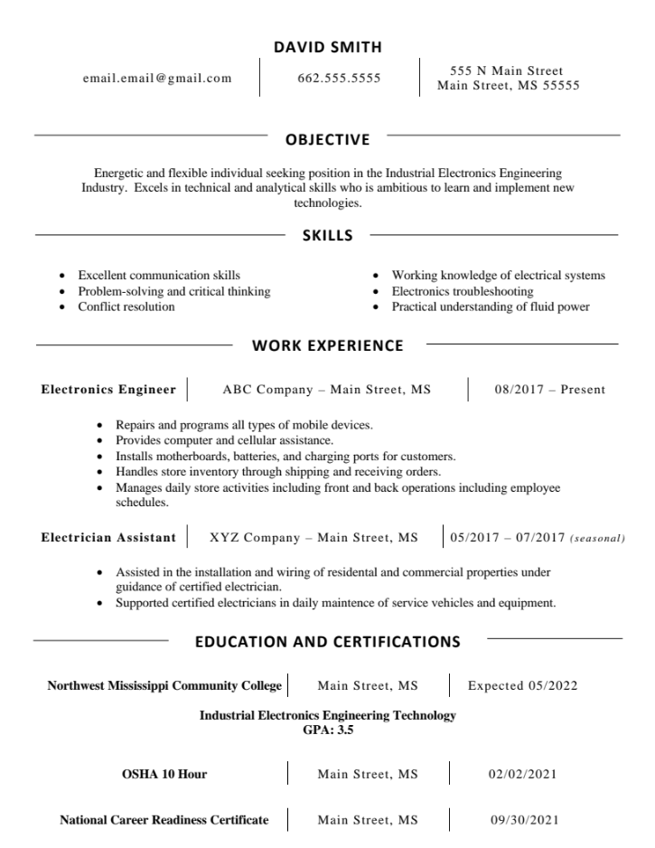
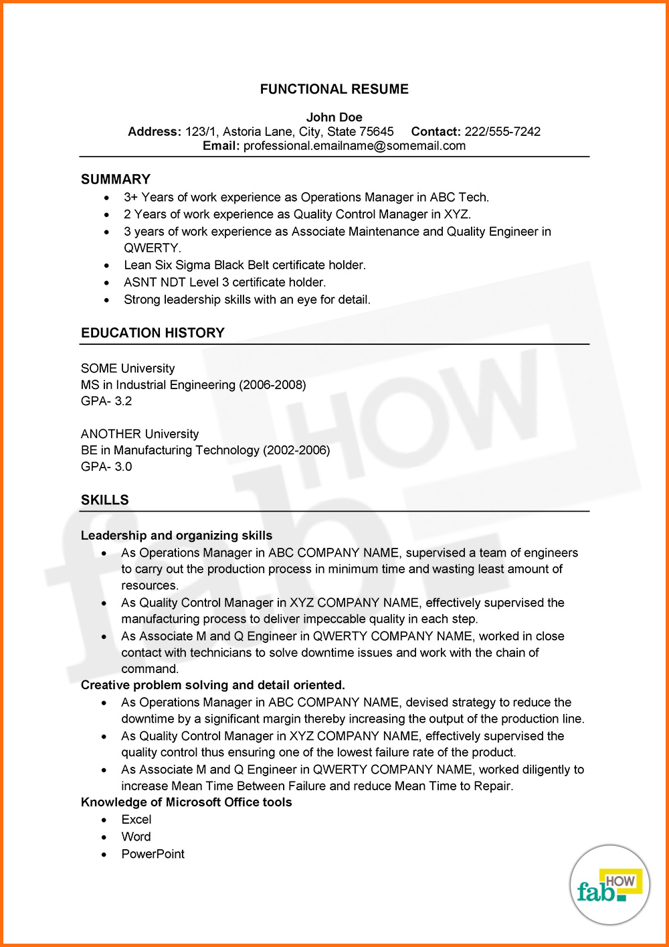
CHRONOLOGICAL
FUNCTIONAL
Versus
NWCC
SAMPLE RESUMES

Slide 7
Consistent Font
10-12 Font Size
Optimal Length
1 Page
COVER LETTER
A THANK- LETTER EXPRESSES KINDNESS & ALLOWS YOU TO REITERATE QUALIFICATIONS
TIPS:
SEND WITHIN 24 HOURS OF INTERVIEW
TYPE LETTER TO LOOK MORE PROFESSIONAL
BE BRIEF & TO THE POINT, BUT INCLUDE SOMETHING YOU FOUND APPEALING OR INTERESTING
INTRODUCES YOU & YOUR QUALIFICATIONS AND GENERATES INTEREST FOR AN INTERVIEW
RESEARCH: USE JOB POSTING TO WRITE EFFECTIVE LETTER
UNDERSTAND EMPLOYER NEEDS & ADDRESS THOSE NEEDS
QUESTIONS TO CONSIDER
WHAT EXPERIENCE/SKILLS IS REQUIRED?
WHAT IS THE ORGANIZATION’S MISSION?
HOW WILL YOU CONTRIBUTE TO ORGANIZATION MEETING ITS GOALS?
THANK-YOU
LETTER
NWCC
THE ESSENTIALS

Slide 8
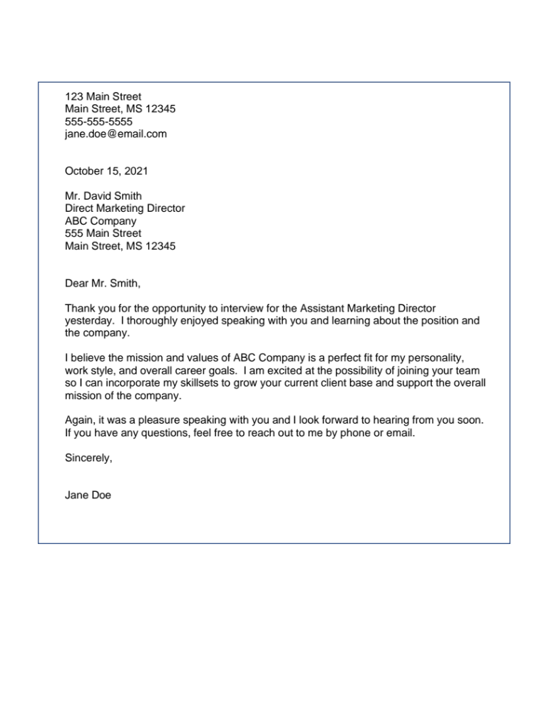
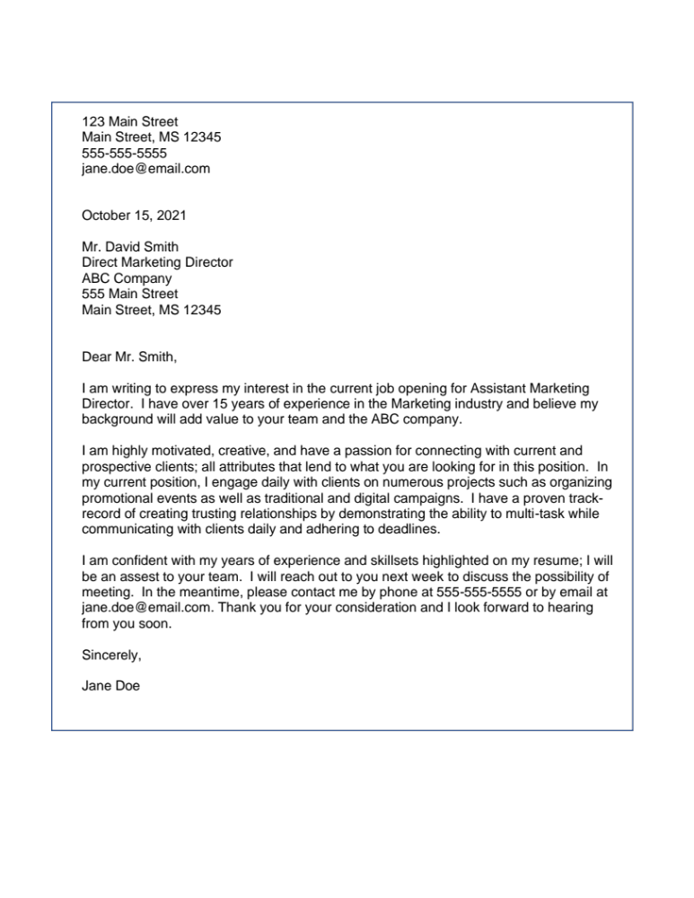
COVER LETTER
NWCC
THANK-YOU LETTER
samples

