Slide 1

Operating and Capital Projects Levies
FIRST NAME LAST NAME
MONTH, DAY, YEAR
Notes:
Our Fall referendum informational campaign is focused on operational Stability and Technology.

Slide 2


What’s on the Ballot Nov. 2
Question 1 - Stability: Combine and replace 2015 and 2017 operating levies with one operating levy to provide funds for classrooms, instruction and other school operating costs.
Question 2 - Technology: Combine the 2017 capital projects levy into a new levy for improved instructional technology, tech support staffing, maintenance and support for student and staff devices and enhanced technology infrastructure.

Slide 3
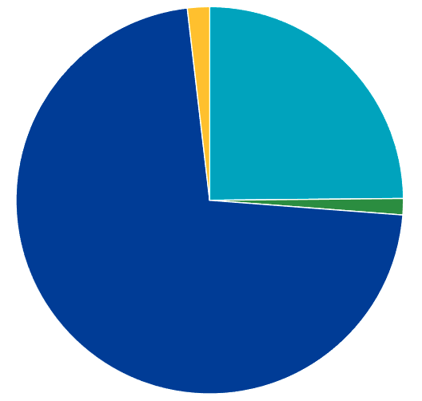
School Funding
Federal Aid
2%
2021-22 school year budget is $260 million (state, federal and local funds)
The state added 2.45% to the basic education formula (2021-22) and 2% (2022-23)
Local Taxes
25%
Other Local Aid
1%
State Aid
72%
Notes:
Let’s take a look at how we receive our funding.
The State of Minnesota recently added 2.45% to the basic education formula for the 2021-22 school year and a 2% increase to the basic funding formula the following school year...These percentage only get added to the state aid portion of our budget.
The dollars generated by local taxes are not increased at that rate.
There were three main pieces of legislation that included one-time funding:
Coronavirus Aid, Relief and Economic Security Act (CARES)
Coronavirus Response and Relief Supplemental Appropriations Act (CCRSA)
American Rescue Plan (ARP)
Each funding source was restricted and had a list of allowable uses, such as operational costs for cleaning supplies and equipment, technology devices, internet access for students and summer programming. The funding for these COVID-19 related costs do not continue once the money is used. Dollars are considered to be one time funding.
CARES funding based on poverty rate of the school district.
Anoka – largest MN School District = $1,543.71
Minneapolis - $7,455.65
St. Paul - $9,068.69
Osseo - $2,080.68
RAVE - $1,308.98
SoWashCo - $557.88

Slide 4

Spending of Every Dollar
Facilities
12¢
District Support
6¢
Administration
3¢
Classroom Instruction
42¢
Student Support
11¢
Instructional Support
6¢
Special Education
20¢
Notes:
91 cents of every dollar goes directly toward student learning and keeping our schools safe and comfortable?
How do we spend every dollar received?
Classroom instruction = All costs that go into regular instruction and activities
Special education = All costs which relate to Special Education
Facility and maintenance costs = The cost to clean, heat, cool, and provide water to buildings and grounds. Also garbage removal and daily maintenance and repairs
Student Support = transportation, counseling, health services, psychological and mental health services, social work
District Support = HR, Payroll, school elections, census, student information, technology, finance, legal
Instructional Support = curriculum, media centers, instructional related technology, staff development, teaching and learning
Administration = Superintendent and School principals, and the Board

Slide 5
Three-year Budget Adjustment Process
Year 1 2021-22 | $9.4 Million
Year 2 2022-23 | $7.5 Million
Year 3 2023-24 | $100,000

Slide 6
Ballot Question 1 Stability

Slide 7

Question 1 - Stability
WHAT IS AN OPERATING LEVY?
Operating levies are voter-approved and provide funding for classrooms, instruction and other school operating costs.
STABILITY

Slide 8
Current Challenge
QUESTION 1 - STABILITY
Our savings account (unassigned fund balance) is below board policy at 4.7%
Cuts of $9.4 million for the 2021-22 school year
Federal, state and local funding is not keeping pace with inflation or the educational needs of our students

Slide 9
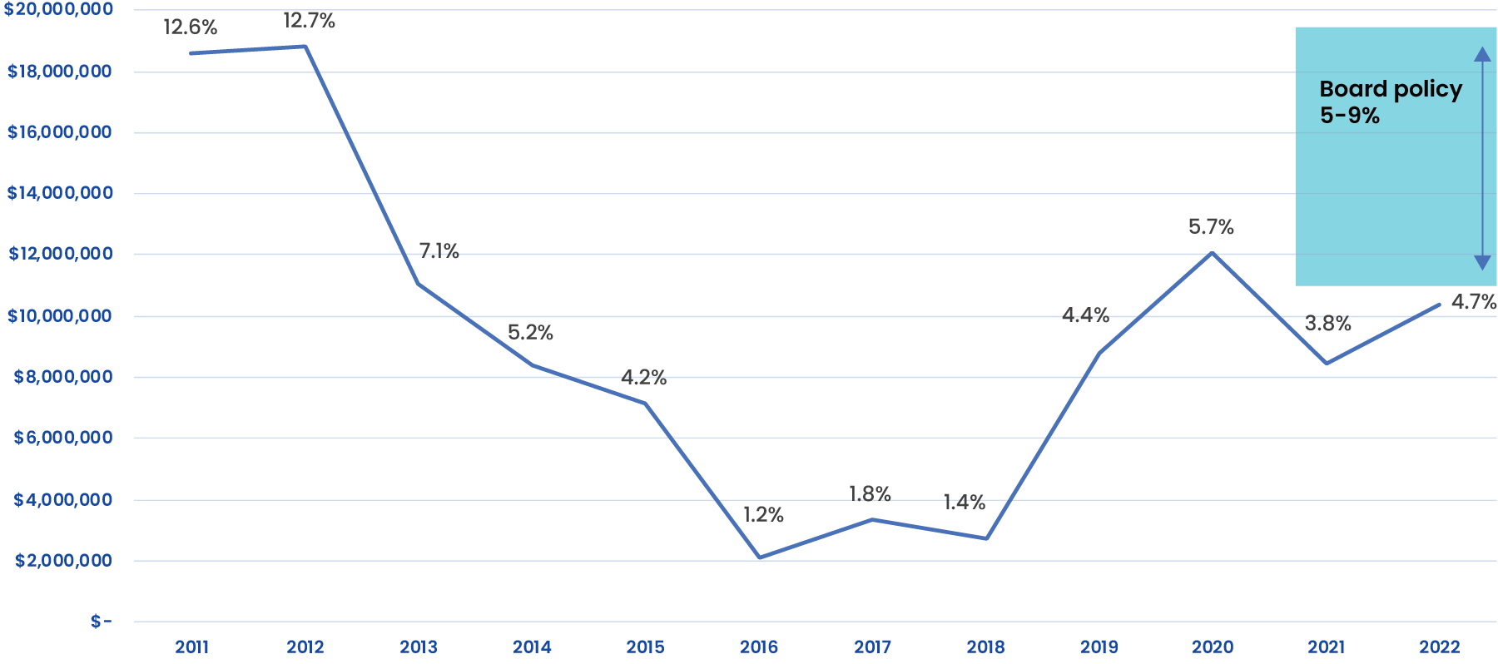
Unassigned Fund Balance

Slide 10
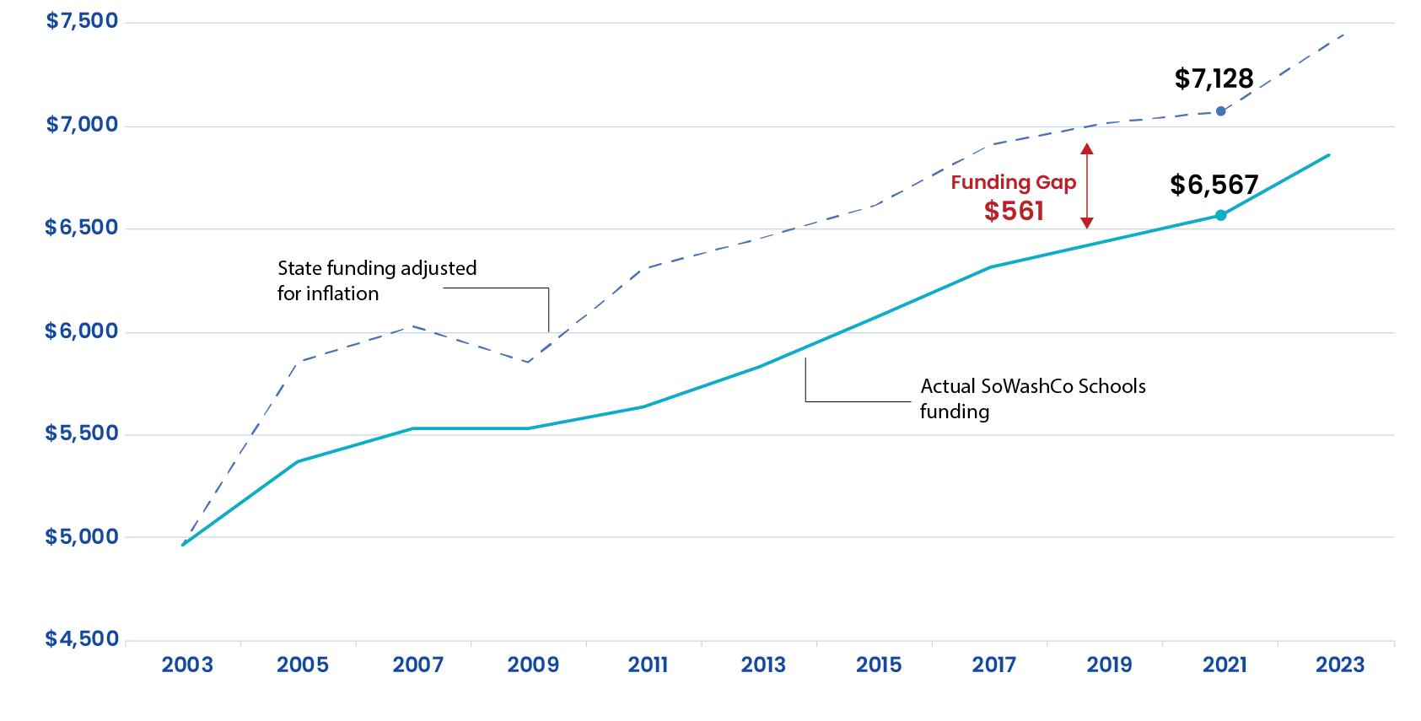
State Basic General Education Funding per Student
If state funding had kept pace with inflation over the past 18 years, we would have received nearly $561 more per student last school year – or a total of $10.4 million.
Notes:
Source: Minnesota Department of Education Inflation Estimates, July 2021

Slide 11
Question 1 - Stability
WHAT’S ON THE BALLOT NOV. 2?
Revoke and Replace: Combine and replace 2015 and 2017 operating levies with one operating levy
Stability: No renewal until 2031 with annual increase at rate of inflation
Increases Funds: From $1,536 per student to $1,886
Financial Impact: The estimated tax impact on the average homeowner ($300,000 value home) would be about $13.16 more per month or $158 a year
WHAT’S ON THE BALLOT NOV. 2?
STABILITY

Slide 12
If Voters Approve Question 1
Provide stability in operations so the district can address challenges with growth in the community, facility needs and uneven enrollment increases
Limit additional budget cuts to programs and staffing
Offset required and unfunded costs for special education, English learner and related services
On track to meet the school board policy that requires 5-9% of savings
STABILITY

Slide 13
If Voters Do Not Approve Question 1
Potential cuts to
  Staff and academic programs
  Athletics and activities programming
  Administration and support staff
Reexamination of attendance boundaries to reduce transportation costs
Examining inefficiencies with low-enrollment schools and addressing the challenges
STABILITY

Slide 14
Ballot Question 2 Technology

Slide 15

Question 2 - Technology
WHAT IS A CAPITAL PROJECTS LEVY?
A capital projects levy provides funds for improved instructional technology, support staffing, maintenance and support for student and staff devices and enhanced technology infrastructure.
TECHNOLOGY

Slide 16
Current Challenge
QUESTION 2 - TECHNOLOGY
Maintenance and upgrades for 20,000 devices distributed during the pandemic
Expanded dependence on educational technology for personalized learning in and outside the classroom
Devices for every student require modern and reliable technology infrastructure

Slide 17
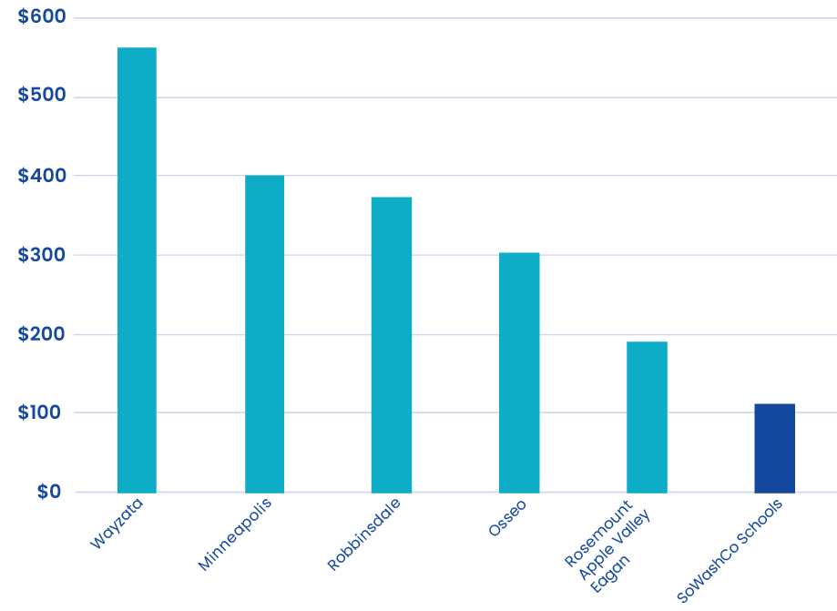
How We Compare
Lowest Capital Projects Levy in the State per Student
$564
$400
$375
$304
$191
*
Shown: School districts with a capital projects levy among the top 10 districts by student population.
$112
Notes:
When compared to every school district in the state of Minnesota with a capital projects levy, South Washington County Schools has the lowest levy at only $112 per student.
$112 does not cover costs of device, accessories and licenses for iPads at $350 each (K-2) and Chromebooks at $310 each (3-12)
*Shown: School districts with a capital projects levy among the top 10 districts by student population.

Slide 18
Question 2 - Technology
Question 2 - Technology
WHAT’S ON THE BALLOT NOV. 2?
REVOKE AND REPLACE: Combine the 2017 capital projects levy into a new levy for technology
STABILITY: No renewal until 2031
INCREASE FUNDS: From $112 to $270 per student; or from $2 million to $5 million per year for technology
FINANCIAL IMPACT: The estimated tax impact on the average homeowner ($300,000 value home) would be about $4.16 per month or $49.92 a year
TECHNOLOGY

Slide 19
If Voters Approve Question 2
IF VOTERS APPROVE THE REQUEST, THE FUNDING WOULD HELP:
Expand digital access to curriculum and learning tools
Update educational and business software licensing
Maintain the devices distributed to students and staff during the pandemic with a refresh cycle to keep devices updated
Strengthen personalized learning through technology
Enhance technology infrastructure (wifi, network equipment, etc.)
TECHNOLOGY

Slide 20
If Voters Do Not Approve Question 2
Device and technology costs would come from the general fund
Technology support and device maintenance for families and staff would be limited
Device upgrade cycles would be delayed
TECHNOLOGY

Slide 21
Please Vote Nov. 2
Question 1 - Stability
  Combine and replace 2015 and 2017 operating levies with one operating levy to provide funds for classrooms, instruction and other school operating costs.
Question 2 - Technology
  Combine the 2017 capital projects levy into a new levy for improved instructional technology, tech support staffing, maintenance and support for student and staff devices and enhanced technology infrastructure.

Slide 22
Tax Impact
Ballot Question | Annual Increase | Tax Impact
Question 1 Operating Levy | Additional $350 per student $6.9 million per year Inflation increases | $13.16 more per month
Question 2 Capital Projects Levy | Additional $158 per student $3 million per year | $4.16 more per month
Total Net Tax Impact | $9.9 million per year | $17.32 more per month
Estimated tax impact on the average value home of $300,000.
Notes:
View the tax impact calculator at sowashco.org/vote2021.

Slide 23
Vote 2021
ELECTION DAY IS TUESDAY, NOV. 2, 2021
Early in-person voting began Friday, Sept. 17 and ends Monday, Nov. 1 and is also available from 8 a.m. to 3 p.m. on Saturday, Oct. 30 at four sites
Early voting by mail-in ballot is available via www.mnvotes.org or by calling 651-430-6175. Must be received before Nov. 2
Regular polling locations are open 7 a.m. to 8 p.m. on Tuesday, Nov. 2
Find your polling location and early voting sites at www.mnvotes.org
Visit sowashco.org/vote2021 • Call 651-425-2888 • Email vote2021@sowashco.org

Slide 24
Visit sowashco.org/vote2021
Call 651-425-2888
Email vote2021@sowashco.org
Notes:
Visit sowashco.org/vote2021 for:
Detailed Questions and Answers | Tax Impact for your property | A resource toolkit of materials that includes sample ballots | Voting information | News and Updates
And contact us by phone or email with any questions.

