Slide 1

Grand Rapids Christian High School
FAFSA Seminar
An overview of financial aid and the FAFSA Process
Calvin University – Fall 2021
finaid@calvin.edu 616-526-6134

Slide 2

Agenda
Timeline
Types of Aid
Eligibility
FAFSA Online

Slide 3
Financial Aid Timeline
August
October
February
May
Receive award packages
Submit
the
FAFSA
Apply for admission
Select a college

Slide 4

Types of Aid
Scholarships
Merit-based
+
Grants
Need-based
+
Student Loans
Aid you pay back
=
typical financial aid package

Slide 5
Scholarships
Academics
Major or program
Music
Athletics
Diversity
“Named”

Slide 6

Outside
Scholarships
1. Community resources
  School counselors
  Foundations
  Libraries
  Parent employers
2. Search Online

Slide 7

Grants
 | Grant | Amount
 | College Grants | Varies, based on need
 | State of Michigan Grant | Up to $2,800
 | Pell Grant | Up to $6,495
 | Supplemental Educational Grant | varies
 | TEACH Grant (not based on need) | Up to $4,000
File the FAFSA and other financial aid forms by December 31
for maximum consideration of grants.

Slide 8
Federal Student Loans
First Year | $3,500 Subsidized | $2,000 Unsubsidized | $5,500 Total | 3.73% fixed
Second Year | $4,500 Subsidized | $2,000 Unsubsidized | $6,500 Total
Other Years | $5,500 Subsidized | $2,000 Unsubsidized | $7,500 Total
(2021-2022)
Subsidized loans: The government pays the interest while you’re in college at least half-time
Unsubsidized loans: Interest begins accruing right
away

Slide 9
Other Loans
Federal PLUS Loan (Parent Loan for Undergraduate Students)
Parent is borrower Modest credit check Fixed interest rate: 6.28% Origination fee: 4.228% FAFSA required Can borrow remaining unmet costs Deferrable but not interest free
Private Loans
Student and co-signer apply Full credit evaluation Choice of fixed or variable rate Can borrow remaining unmet costs Deferrable but not interest free

Slide 10

Student
Jobs
On-campus
Off-campus
Work study
Summer
Internships

Slide 11
Financial Aid Applications - CSS Profile
Used by some colleges, including Hillsdale, University of Michigan, University of Chicago, Notre Dame, Northwestern, Olivet, Stanford, ivy league
Collects data beyond what’s required on FAFSA
  Non-custodial parent income and assets
  Business assets
  Equity in primary home
Costs $25, plus $16 for each additional school
Don’t submit unless required by your colleges

Slide 12
Financial Aid Applications
The FAFSA
For the 2022-2023 academic year:
  File starting October 1, 2021
  Use 2020 tax information
  Can apply online (studentaid.gov) or on mobile
  app (myStudentAid)

Slide 13
Features of the FAFSA
FSA ID
Save Key
Skip Logic
IRS Data Retrieval Tool
Help
Contact
30 – 60 minutes

Slide 14
Preparing for the FAFSA
FSA IDs and passwords (create at studentaid.gov)
Social Security or Alien Registration numbers
2020 Federal tax return (1040) and wage statements (W2) for parents and students
Records of untaxed income (child support received, interest income, clergy housing allowance, pension contributions, untaxed IRA distributions, etc.)
Information on cash, savings, checking account balances, investments, 529 plans & UGMAs, and real estate (time of filing)

Slide 15
Filing the FAFSA
Major factors considered when determining financial aid eligibility:
Parents’ income
Parents’ assets (exclude primary home & retirement accounts)
Business/farm value (exclude family business/farm)
Size of family
Siblings in college
Student’s income and assets
Age of older parent

Slide 16
2022-23 FAFSA
  Federal Student Aid ID (FSA ID)
      www.fsaid.ed.gov
      Student and one parent
      Get SSNs correct!
      Permanent email address (not high school)
      Challenge questions

Slide 17
Special Circumstances
Job loss or income reduction
Private school tuition
High cost of living
Parental college costs or student loan payments
Exceptional medical
or dental expenses
Other extenuating circumstances

Slide 18
Avoid Common FAFSA Errors
Make sure social security numbers are accurate
Pay attention to whether you need to enter PARENT info or STUDENT info (especially on income & asset questions)
Don’t include equity in retirement accounts or primary home
FAFSA must be submitted each year to be considered for need-based aid
File by college/state deadlines
Both student and parent must electronically sign the FAFSA for your colleges to receive the FAFSAs
Don’t forget to submit!

Slide 19
Expected Family Contribution (EFC)
The EFC is an indicator of a family’s financial strength and ability to pay for college
Determines eligibility for need-based aid from Federal, State and college sources
Colleges will meet as much “need” as
possible with their limited resources

Slide 20


Eligibility
Cost
EFC
Need

Slide 21
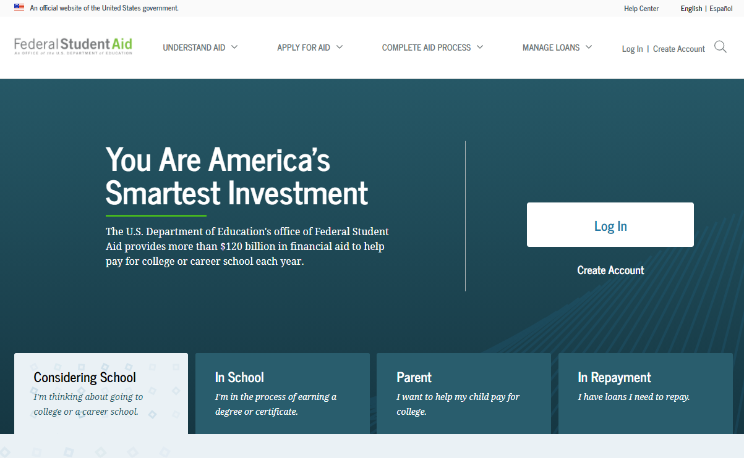
FAFSA Home (studentaid.gov)

Slide 22
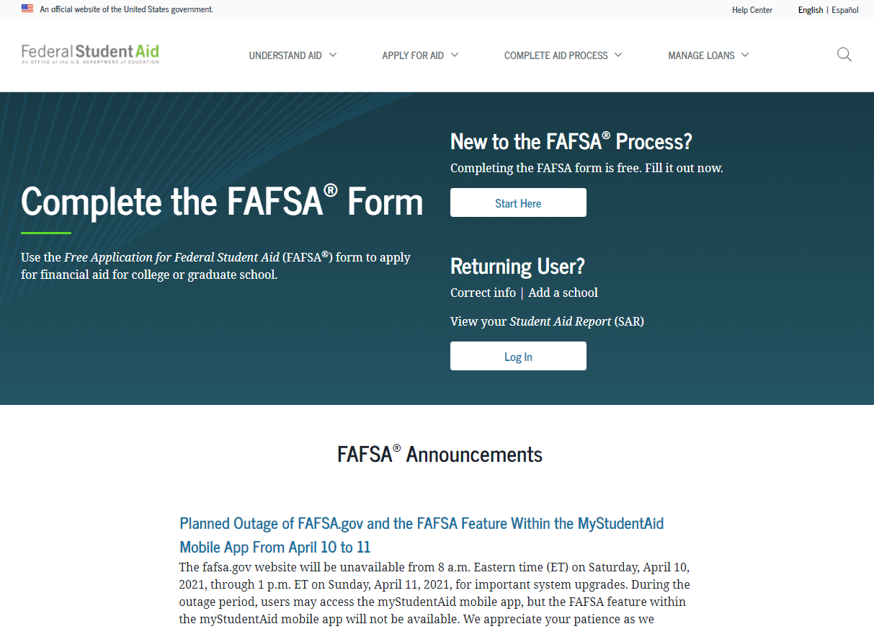
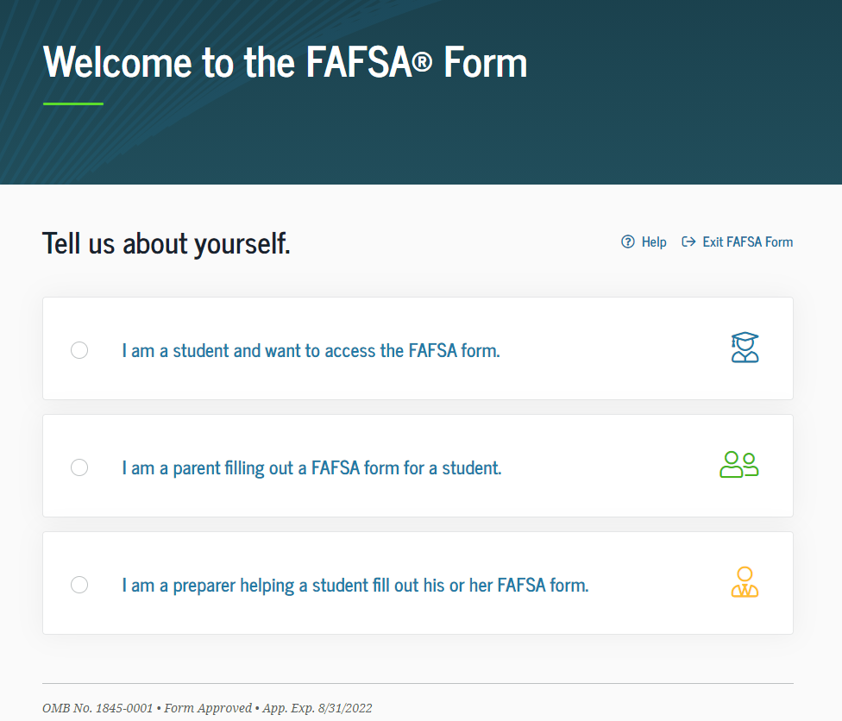

Slide 23
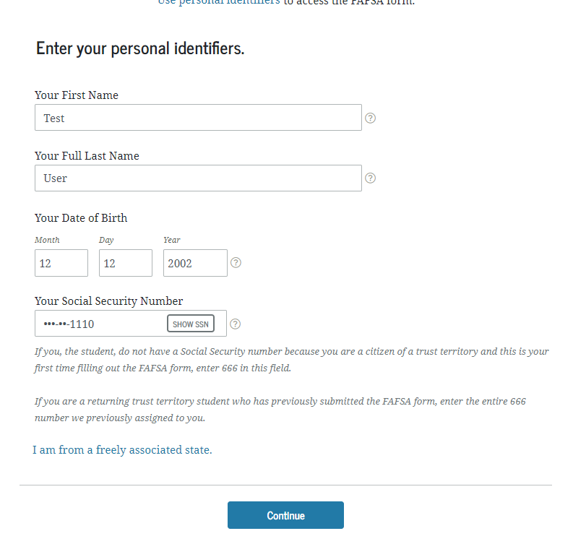

Slide 24
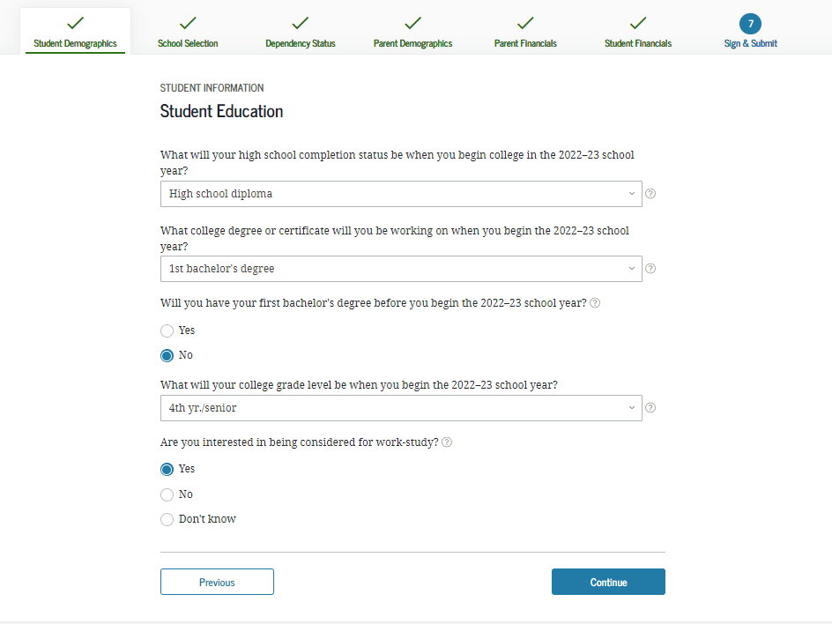
Student Education/Work Study

Slide 25
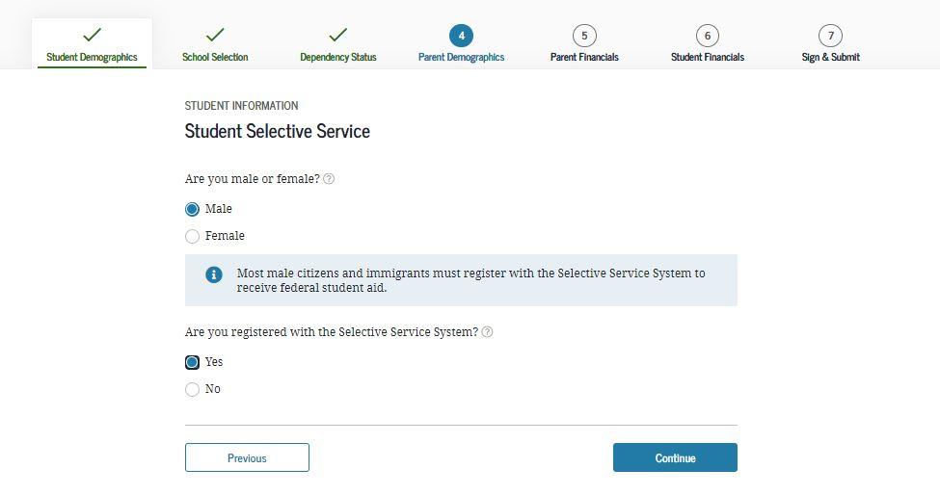
Selective Service

Slide 26
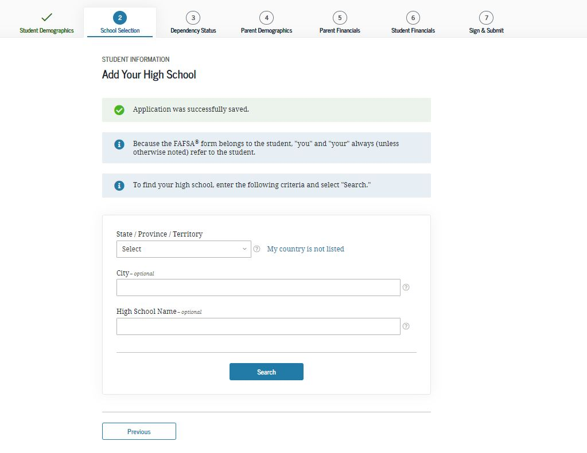
Add your high school

Slide 27
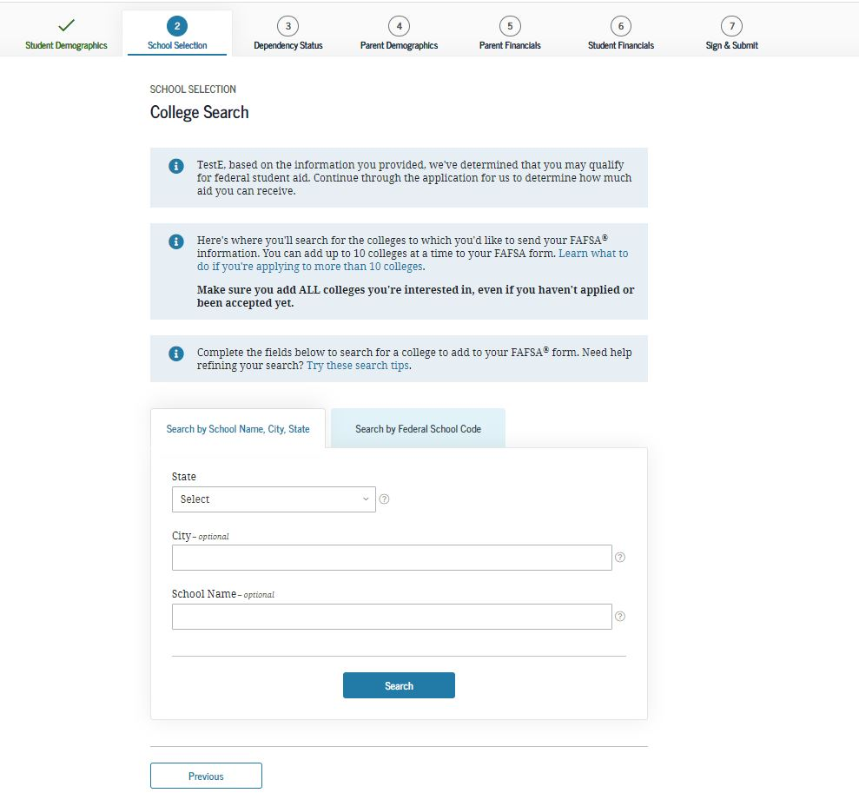
Search for College – up to 10 colleges

Slide 28
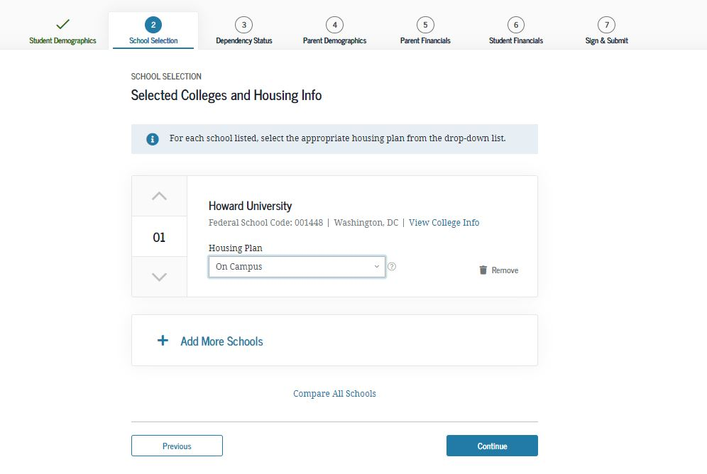

Slide 29
Independent Student on the FAFSA
Age 24+
Already have a bachelor’s degree
Married
Has dependent children or other dependents that receive more than 50% of their financial support from the student
Currently serving in US Armed Forces
Since age 13, both parents have died, or in foster care, or ward of the court
Emancipated minor or in a legal guardianship
Homeless unaccompanied youth (or self-supporting & at risk of being homeless)

Slide 30
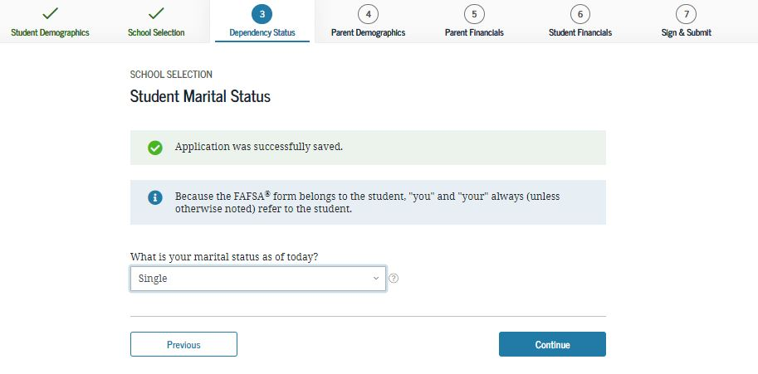
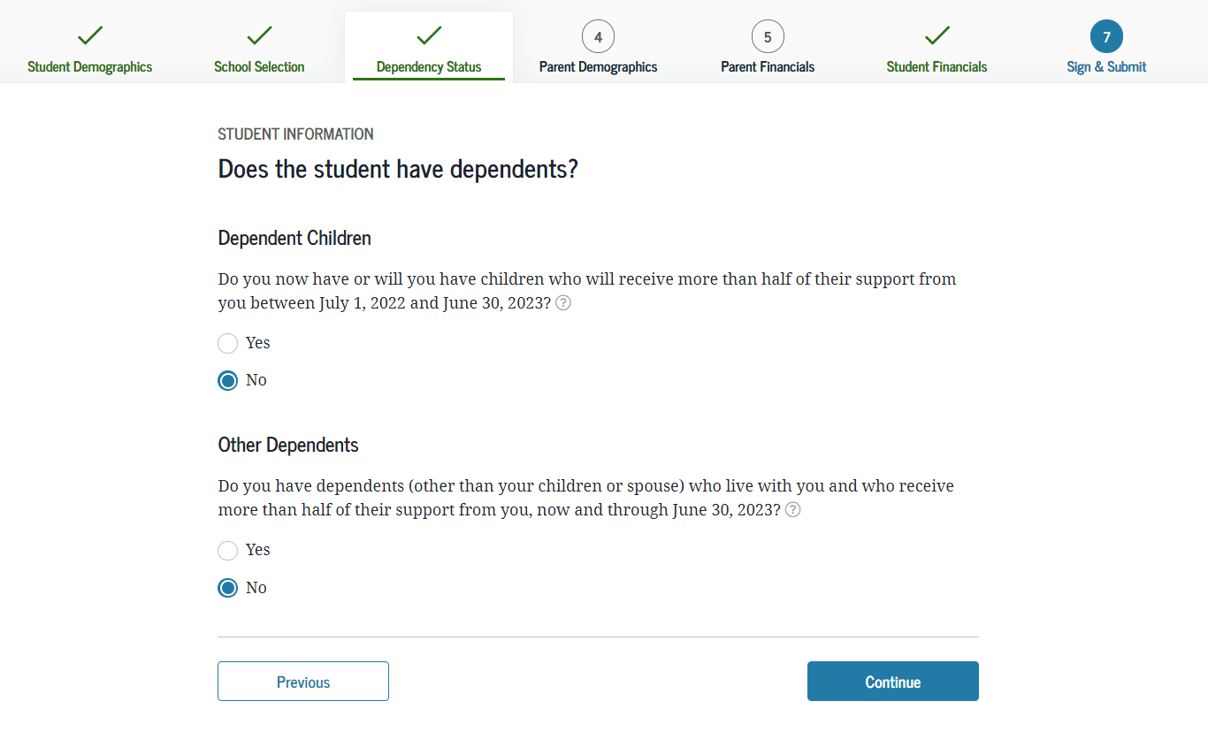
Student Dependency Questions

Slide 31
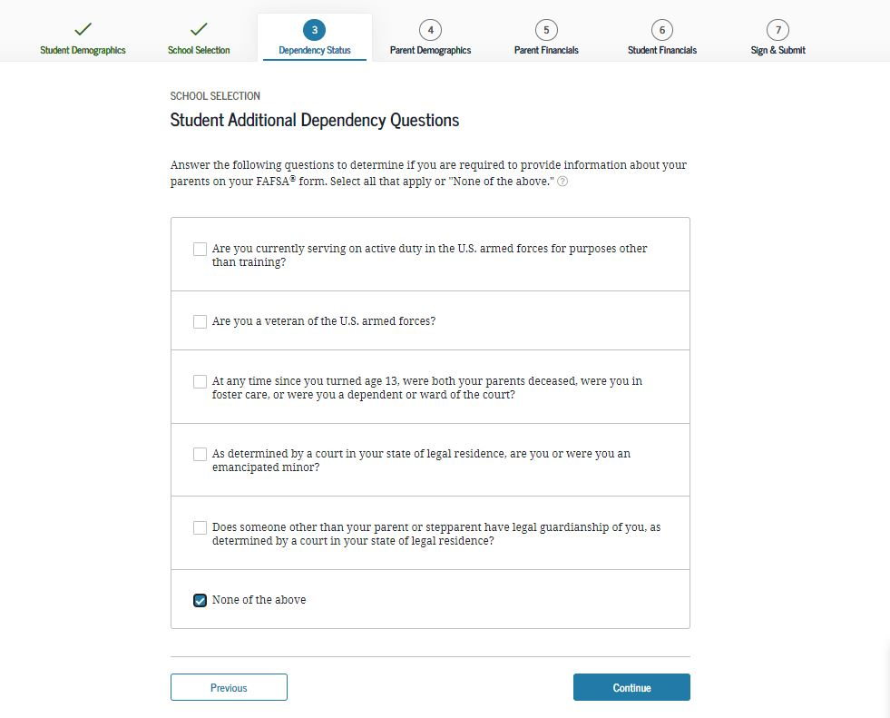
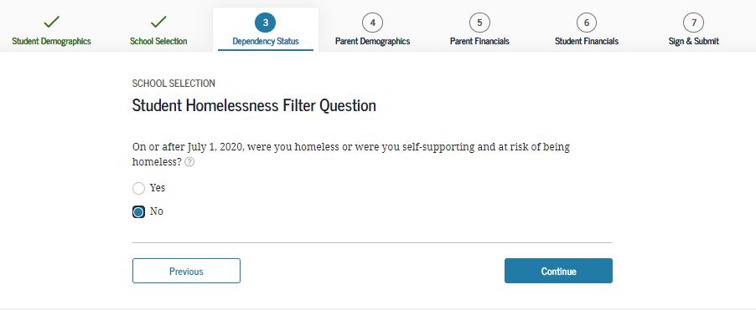
Student Dependency - continued

Slide 32
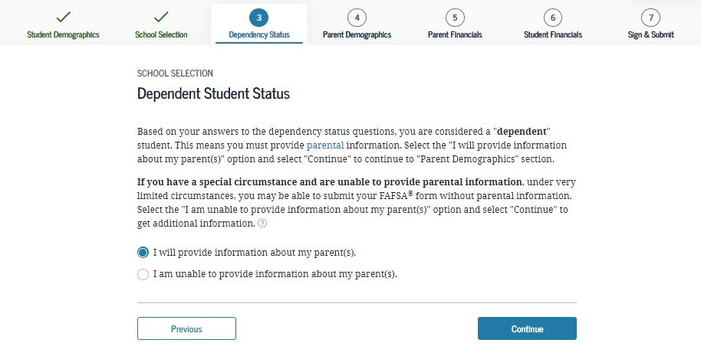
Dependent or Independent?

Slide 33
Which parent is on the FAFSA?
Question 1: which parent does the student live with the most? If you can answer this question, you don’t have to go to second question.
Question 2: (if student lives with parents 50/50), which parent provides the majority of the student’s financial support?

Slide 34
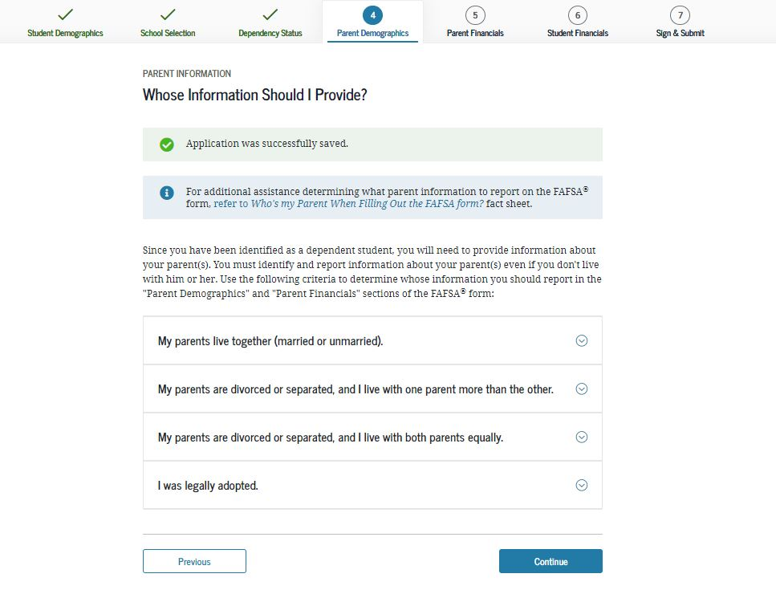
Which parent is included on the FAFSA?

Slide 35
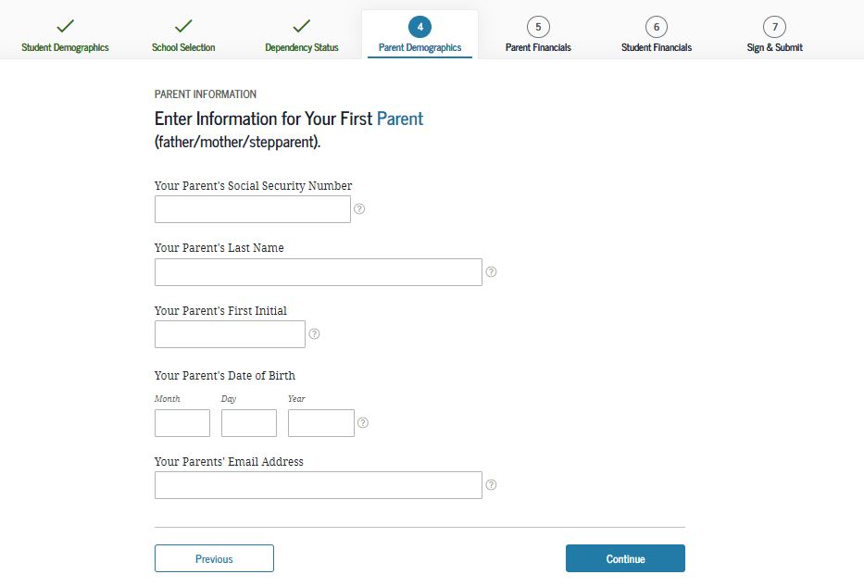

Slide 36
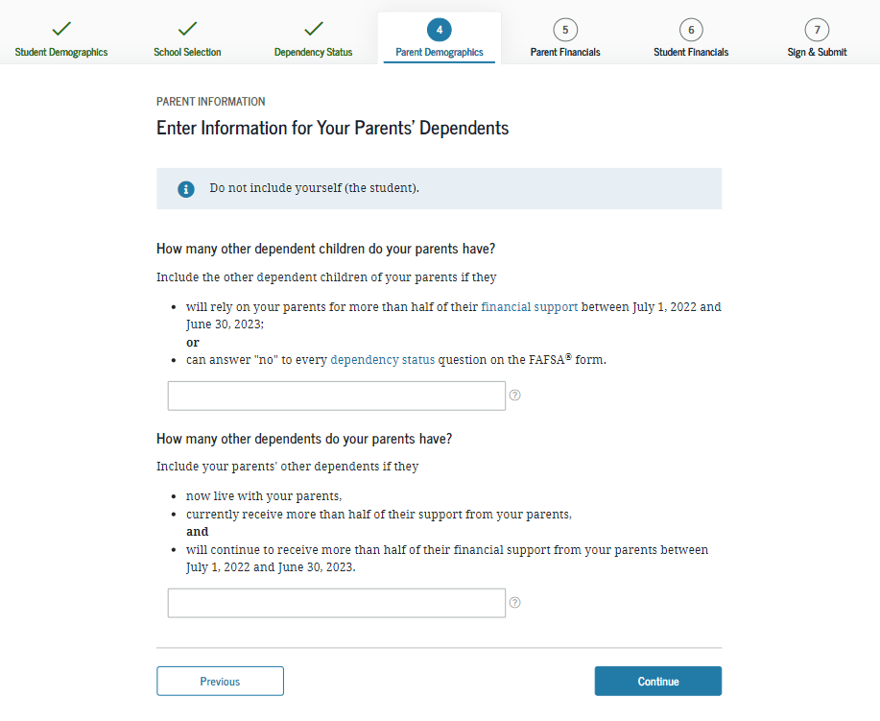
(2)

Slide 37
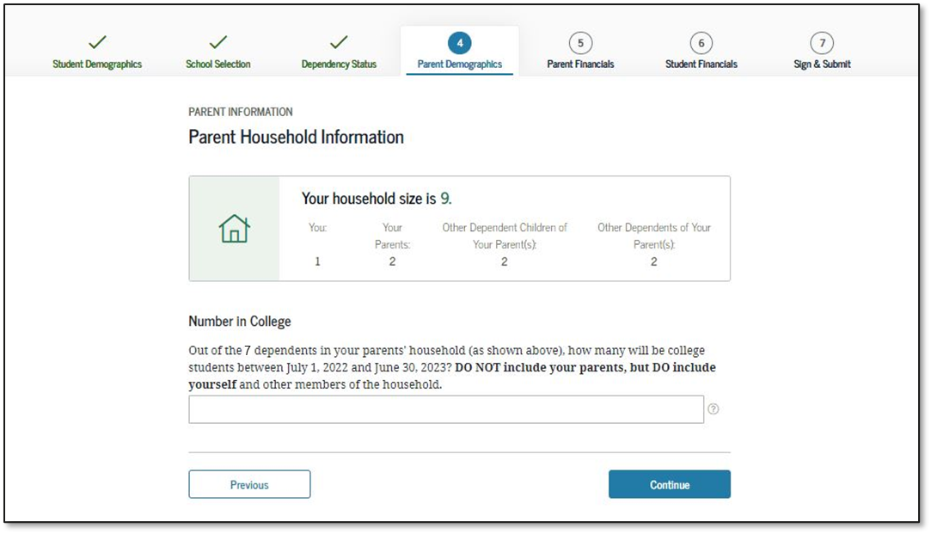
Parent Household Information

Slide 38
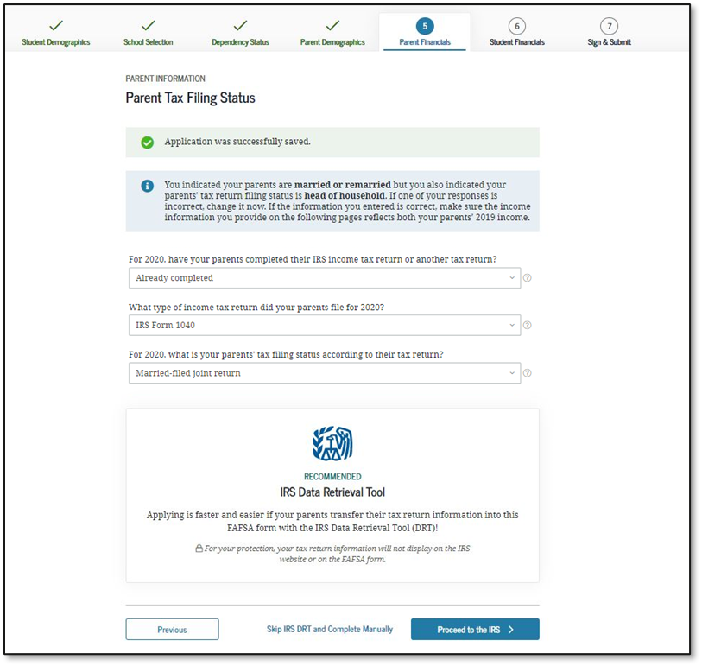
Parent Tax Filing Status

Slide 39
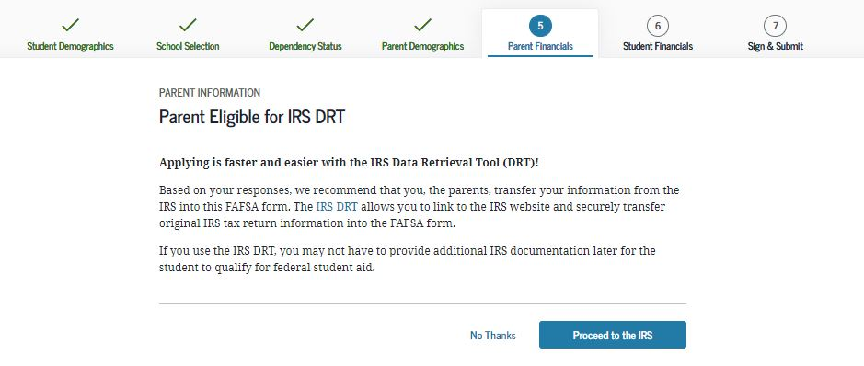

Slide 40
Parent Income -
Use IRS Data Retrieval Tool!
Pulls IRS data directly from your tax return into the FAFSA
Faster
More accurate
Less likely to be required to provide additional documentation
When data is populated with the DRT, your income info is “masked” (hidden), meaning your student will not see the numbers

Slide 41
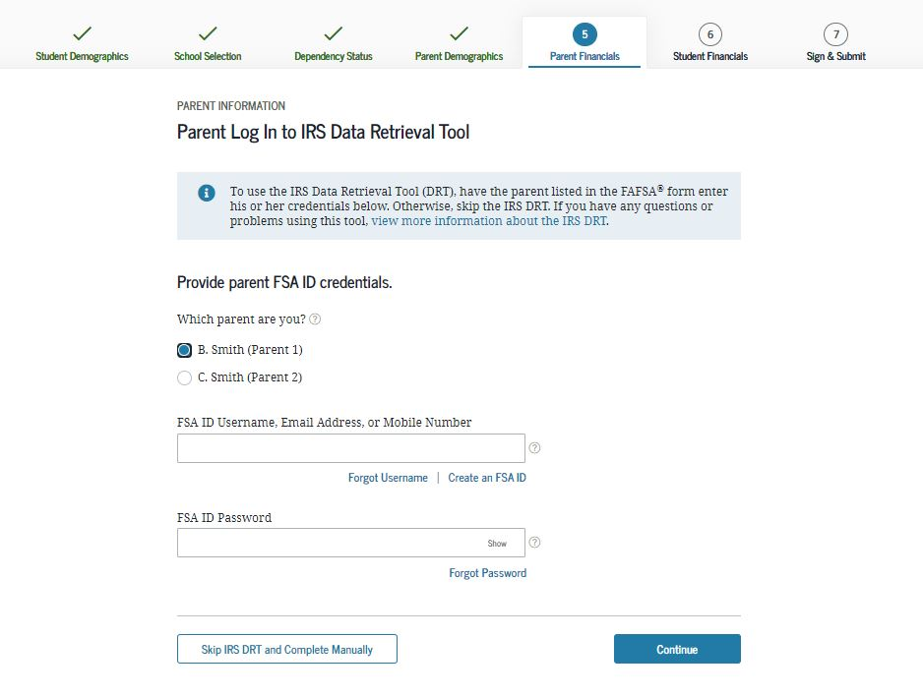

Slide 42
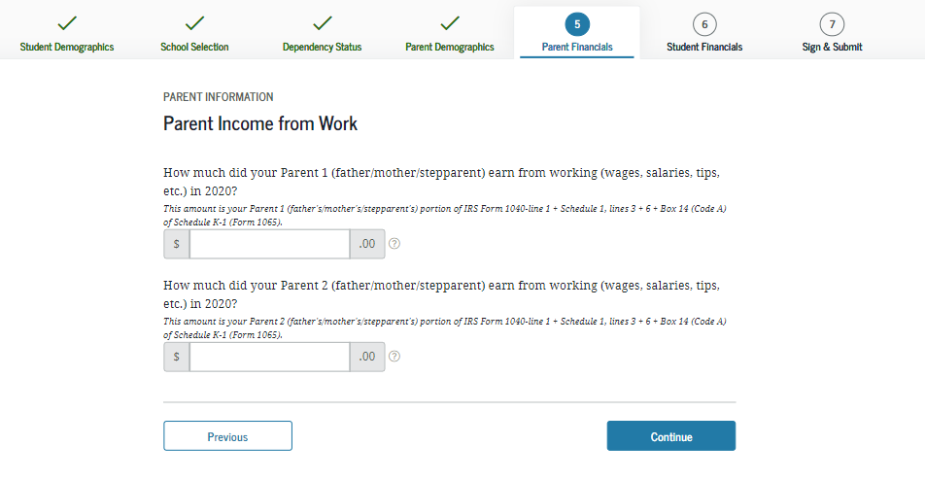
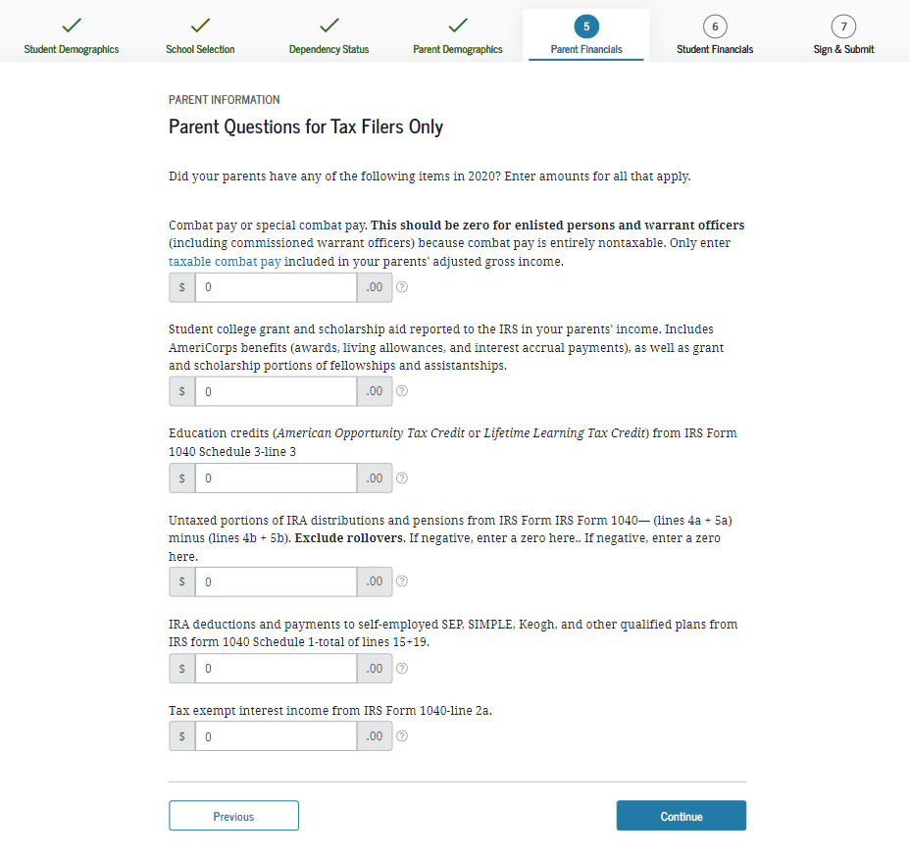

Slide 43
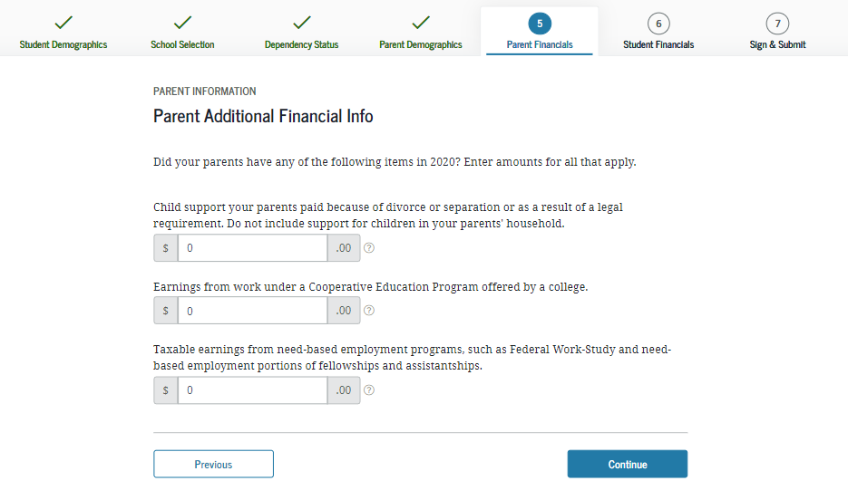
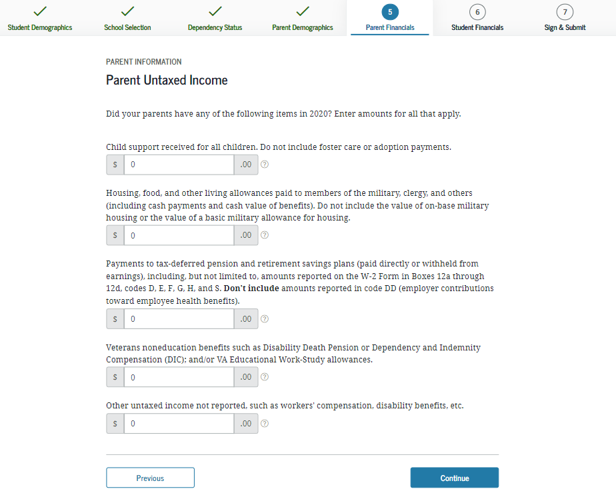

Slide 44
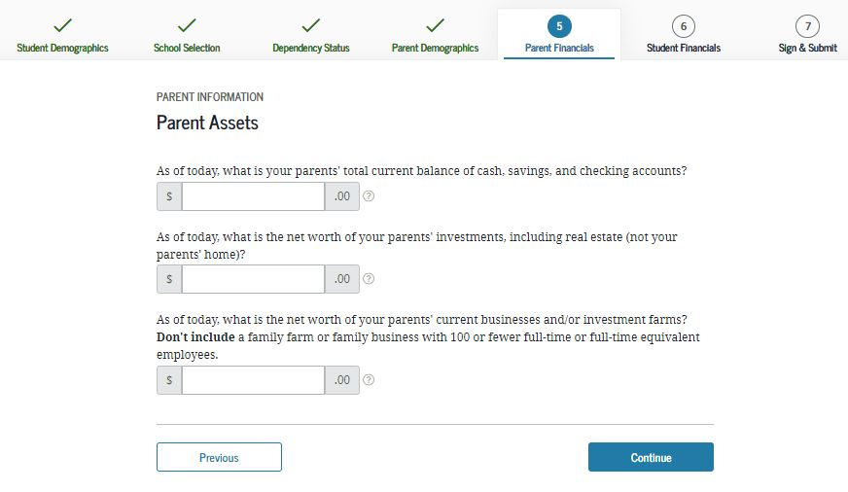

Slide 45
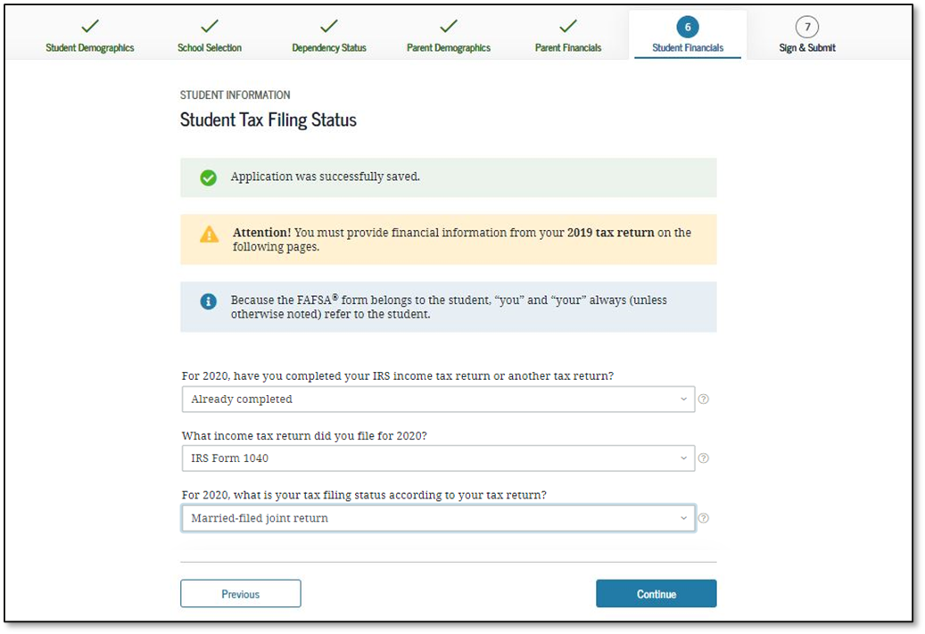
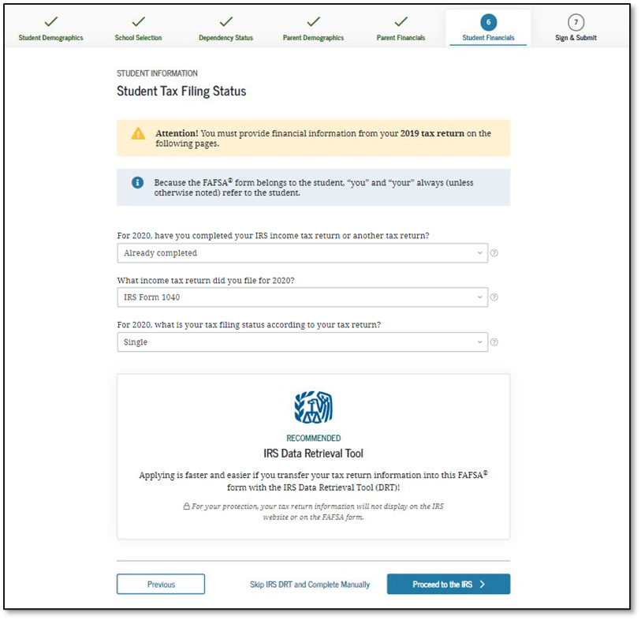
Student Tax Filing Status

Slide 46
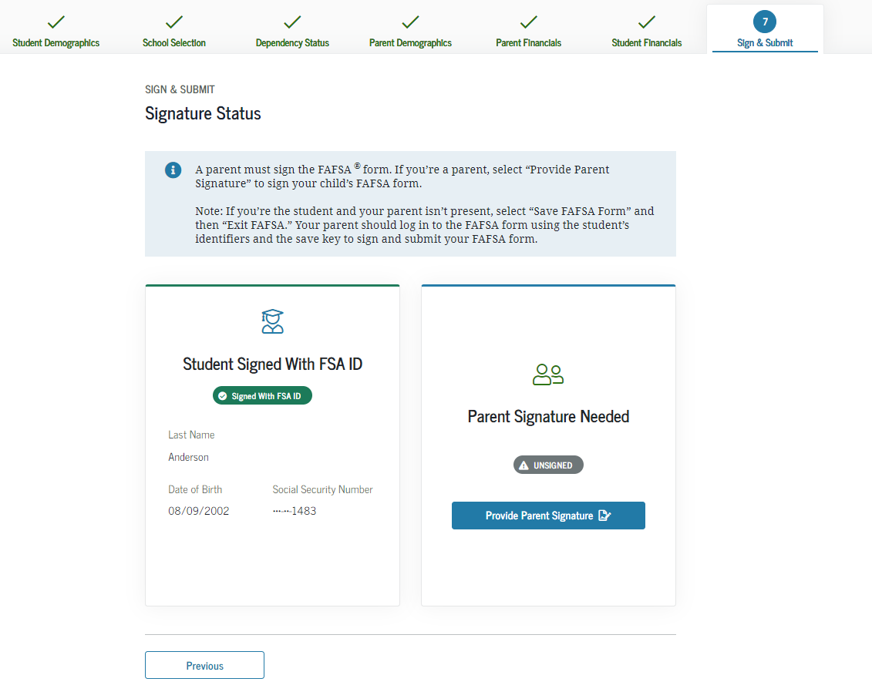
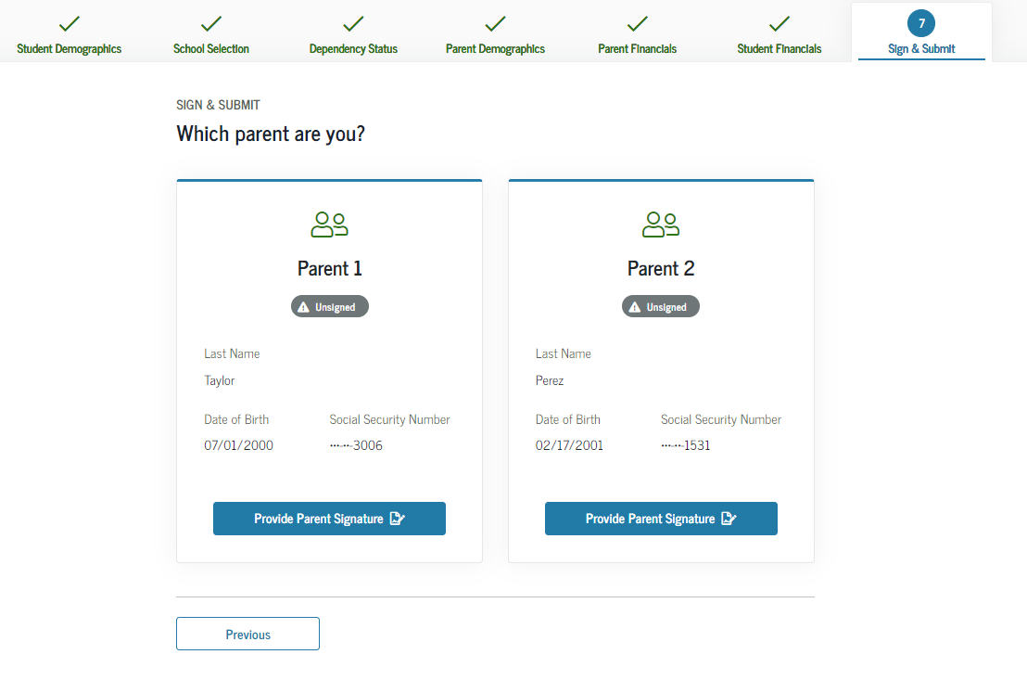
Signing the FAFSA

Slide 47
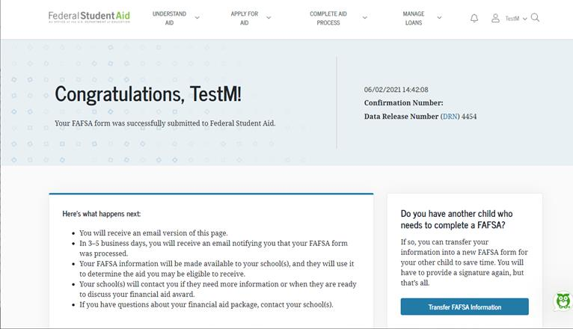
Confirmation Page

Slide 48

Contact Us
(616) 526-6134
finaid@calvin.edu
Paula Elenbaas
paula@calvin.edu

