Slide 1

Getting to Know Your New Polycom VVX 411 Phone

Slide 2
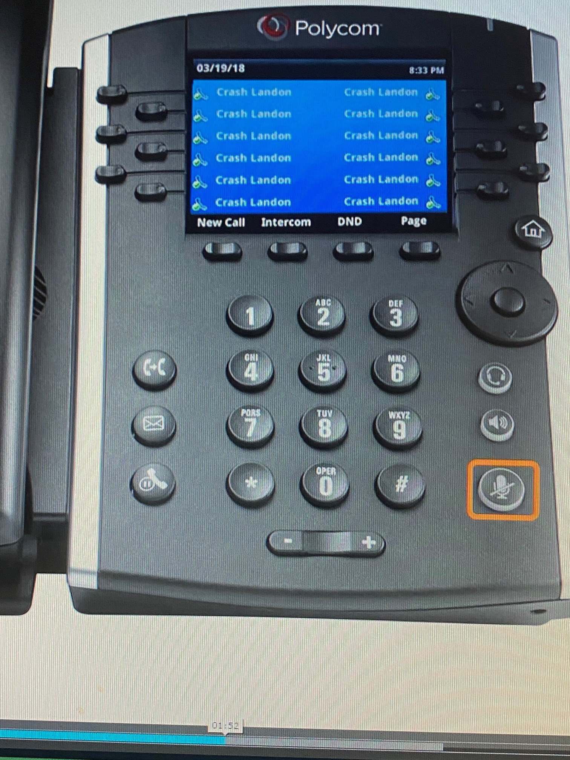
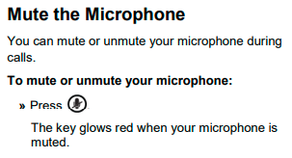
Putting Your Phone On Mute
Notes:
No Video – Just a highlighted button.

