Slide 1

Getting to Know Your New Polycom VVX 411 Phone

Slide 2
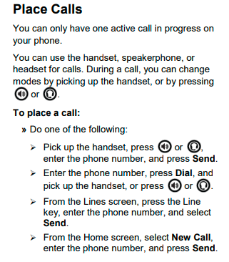

Making & Ending A Call

