Slide 1

Getting to Know Your New Polycom VVX 411 Phone

Slide 2


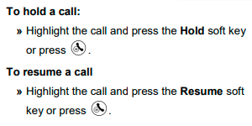
Hold & Resume A Call

