Slide 1

Local Control Accountability Plan 21-22/23 & Learning Continuity Plan 20-21
Nea Governing Board
May 19, 2021

Slide 2
Need to Knows:
LCAP
Definition
Data
Goals
Action
LCP
Definition
Reminder

Slide 3
Local Control Accountability Plan
What is it?
Hold schools accountable to local stakeholders: learners, families, staff, and the district
Outlines how the school aligns funding to data based needs
Approved by the board and submitted to the county

Slide 4
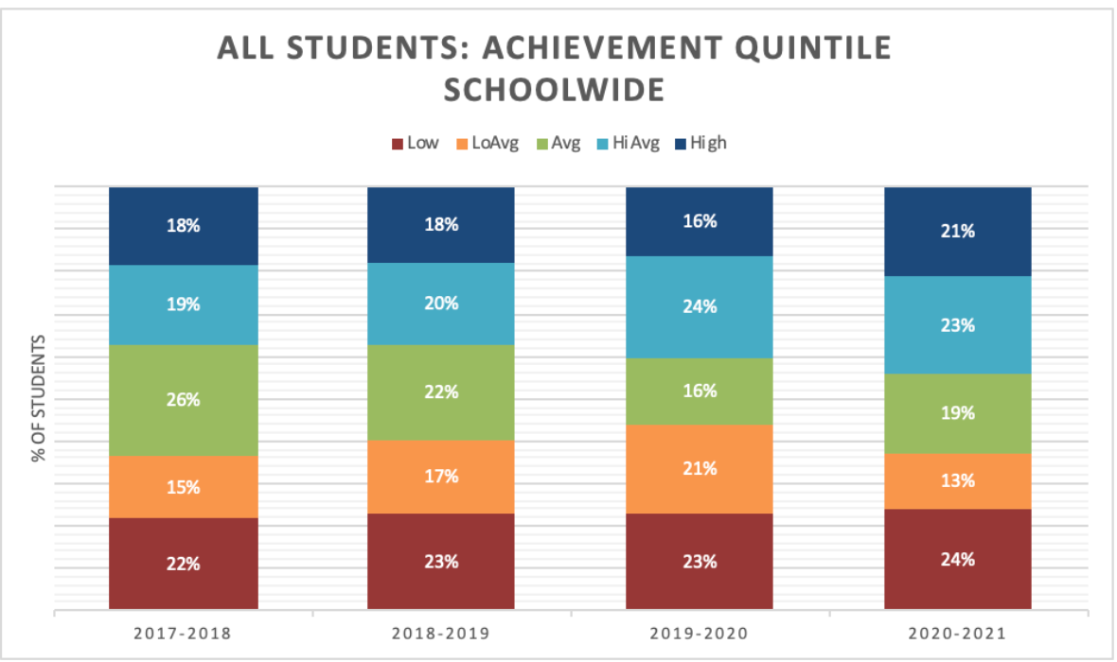
Data
Schoolwide Snapshot: Reading

Slide 5
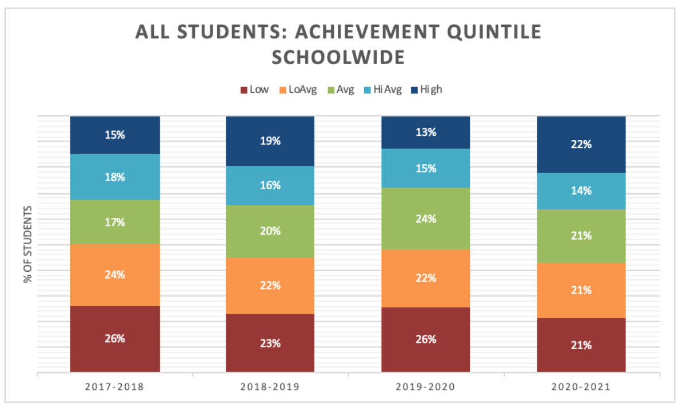
Data
Schoolwide Snapshot: Math

Slide 6
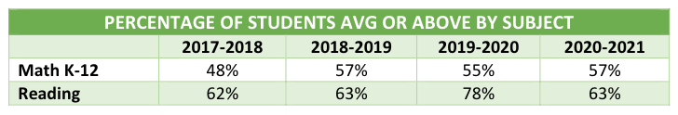
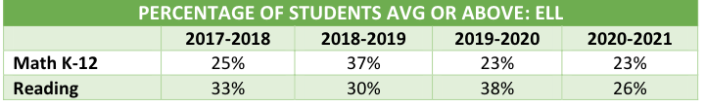
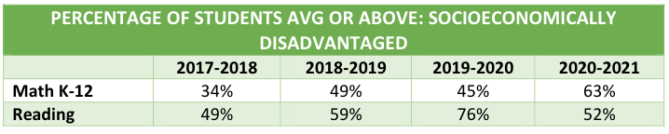
COMPARISONS
Key data for local plan:
Whole School
English Language Learners
Socioeconomically disadvantaged

Slide 7
Aligned Local Goals
We have aligned our LCAP and WASC goals. We have four goals for our upcoming 21/22-23 LCAP cycle and our charter renewal visit is in September.

Slide 8
Goal 1
Access to Broad and Challenging Curriculum focusing on closing the achievement gap in the areas on the California School Dashboard includes targeted action for improved standards-based instruction and a focus on meeting UC a-g requirements.

Slide 9
Goal 2
Positive School Environment, Climate, and Culture with Equity at the Core and support for the whole child to provide safe and well-maintained facilities and positive learning climates and instructional practices that are culturally responsive, challenge bias, and support the academic, social, emotional, and physical needs of students.

Slide 10
Goal 3
Focus on Family, Community, and Staff Engagement with actions to support meaningful parent/guardian participation and engagement and the school as a place of family and community support.

Slide 11
Goal 4
Quality Leadership, Teaching, and Learning with an evident system-wide, unifying vision that equips and empowers all stakeholders to provide optimal student learning opportunities and outcomes with actions to retain quality teachers, support new teacher training, and quality professional development in ELA, Mathematics, ELD using Project Based Learning.

Slide 12
Snapshot of Actions
Family Learner Liaison role added
UV ELD Coordinator and Teacher role added
Middle School Reading Intervention Coordinator and Teacher role added
Middle School Elective Teacher role added
Lead of Curriculum and Instruction role added
Part time College and Career Counselor from 8 to 20 hours
Learner Support Coaches in Lower Village
Reading, Science, Math, and SEL curriculum buys or additions
Professional Development

Slide 13
Learning Continuity Plan
In review of 2020-21 adjustments to support learners reflected in the LCP:
Camp Connect
Learner Support Coaches
Local MAP Testing
Local Star Renaissance Testing
Learner, Family & Staff Surveys
Staff PD Committee Work

Slide 14
Questions??

