Slide 1

LCAP
Definition, Data, Goals, & Actions
LCP Reminder

Slide 2
LCAP: What is it?
Local Control Accountability Plan
Holds schools accountable to “local” stakeholders (learners, families, staff, and local district)
Outlines how school aligns funding to data-based needs
Approved by boards, submitted to County

Slide 3
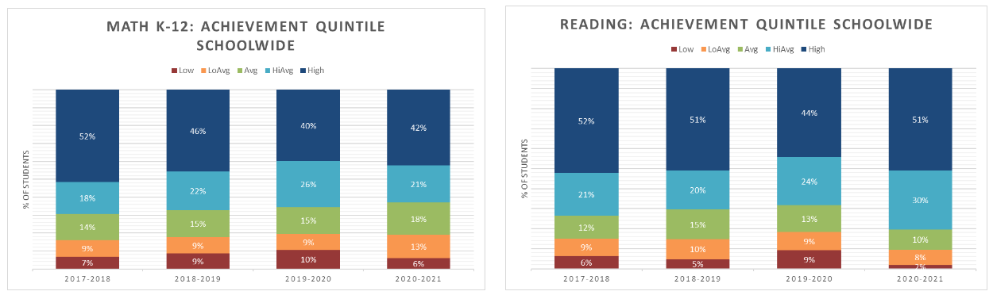
Data: Schoolwide Snapshot*
*In general, our school is a high performing school, as you can see from the data. Simple goal is more learners in the green and blue and less in the orange and red...

Slide 4
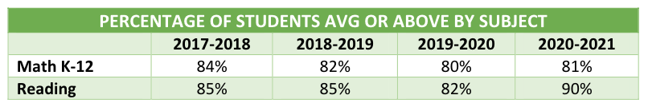
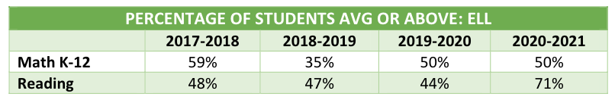
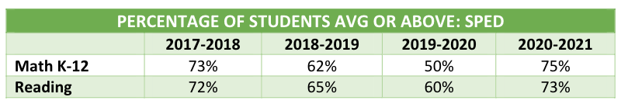
Data: Some Representative ACLC Data*
Whole School
English Language Learners
Special Education Learners
*This gap in performance for our ELLs and Special Education learners spans gradebooks, SBAC testing, etc., but I’m including MAP since it’s all we have that includes this year...

Slide 5
Aligned Goals
Goal 1: Collect and analyze data to drive instruction and curriculum access for learners
Goal 2: Support learners in becoming college and career ready
Goal 3: Ensure that learners have access to basic services, supports, and intervention
During our WASC / charter renewal process, we worked to align goals across all major reporting and accountability platforms! Yay!

Slide 6
Aligned Actions
Family & Learner Liaison role (NEW full time)
Instructional Coaching (DOUBLE from 20 to 40 hours/week)
English Language Development Coordinator (NEW full time)
Intervention Aide (DOUBLE from 20 to 40 hours/week)
College Counseling (DOUBLE+ from 8 to 20 hours/week)
Curriculum shifts in math and ELA
Equity Task Force
Professional Development
Self Study via Schools To Watch
During our WASC / charter renewal process, we worked to align goals across all major reporting and accountability platforms! Yay!

Slide 7
The LCP
We discussed this at the April meeting. Reminder of key focus areas…
  Distance Learning Engagement Coordinator (full time)
  Temporary increase of Intervention Aide from 20 to 40 hours/week
  Camp Success for in-person learning
  MAP Testing 3x/year
  Learner, Family, & Staff Surveys
  PD focused on DL, Hybrid
  Curriculum Review
I’ll bring back finalized LCAP and LCP with accurate budgets next month!
Learning
Continuity
Plan

Slide 8
Questions?

