Slide 1


Slide 2
To be courteous to others, we ask that you silence or shut off your phones.
Your consideration is appreciated.

Slide 3

FAFSA 101
Free Application for Federal Student Aid

Slide 4
Your Presenter
Carol Handlan
Higher Education Access Partner Cumberland Valley Region
chandlan@pheaa.org

Slide 5

We’ll talk about…..
What is the FAFSA?
How do I apply? When do I apply?
What other applications might I need to file?
What happens after I apply?
Where can I get help?
Notes:
Where to find help:
Guidance office
Financial Aid office
PHEAA HEAP
Websites
literature

Slide 6
FAFSA
What is it?
The FAFSA is the primary means of applying for financial assistance to attend postsecondary school

Slide 7
Financial Aid Available
The FAFSA is used to determine eligibility for the following:
  Federal programs, such as Pell Grants, work-study, and loans
  State programs, such as Pennsylvania State Grant, state work-study, and other special programs
  School programs, such as need-based grants and scholarships.
Notes:
A standard form that collects demographic and financial information about the student and family
Information used to calculate the Expected Family Contribution or EFC -
The amount of money a student and his or her family may reasonably be expected to contribute towards the cost of the student’s education for an academic year

Slide 8
Financial Aid Available
Know what form(s) your school(s) require!
  FAFSA
  CSS Profile
  Institutional Form
  Other?
Notes:
A standard form that collects demographic and financial information about the student and family
Information used to calculate the Expected Family Contribution or EFC -
The amount of money a student and his or her family may reasonably be expected to contribute towards the cost of the student’s education for an academic year

Slide 9

When to Apply
The FAFSA may be filed beginning on January 1 of the upcoming award year. For the 2012-13 award year this would be January 1, 2012.
Note that if a paper FAFSA is submitted prior to January 1 for an award year it will not be accepted.
Notes:
Know your deadlines - Since the FAFSA is used to apply for federal, state, and school funds, it must be submitted by earliest of all applicable deadlines. Many schools set application deadline dates which are earlier than federal or state deadlines
Students may list up to ten schools on their online FAFSA, and need not be accepted for admission at the time of FAFSA submission. Applicants may delete and add schools by making a correction to the FAFSA.
Often, a school deadline for receipt of the FAFSA occurs prior to an applicant completing their tax returns. Applicants and their families may choose to use estimated information on their FAFSA if the appropriate tax return data is not yet available. However, if an applicant chooses to use estimated data, they should correct the FAFSA, using the FAFSA-IRS Data Retrieval process, after completing their actual tax return

Slide 10
FAFSA
Most Important:
Know Your School’s FAFSA Application Deadline

Slide 11

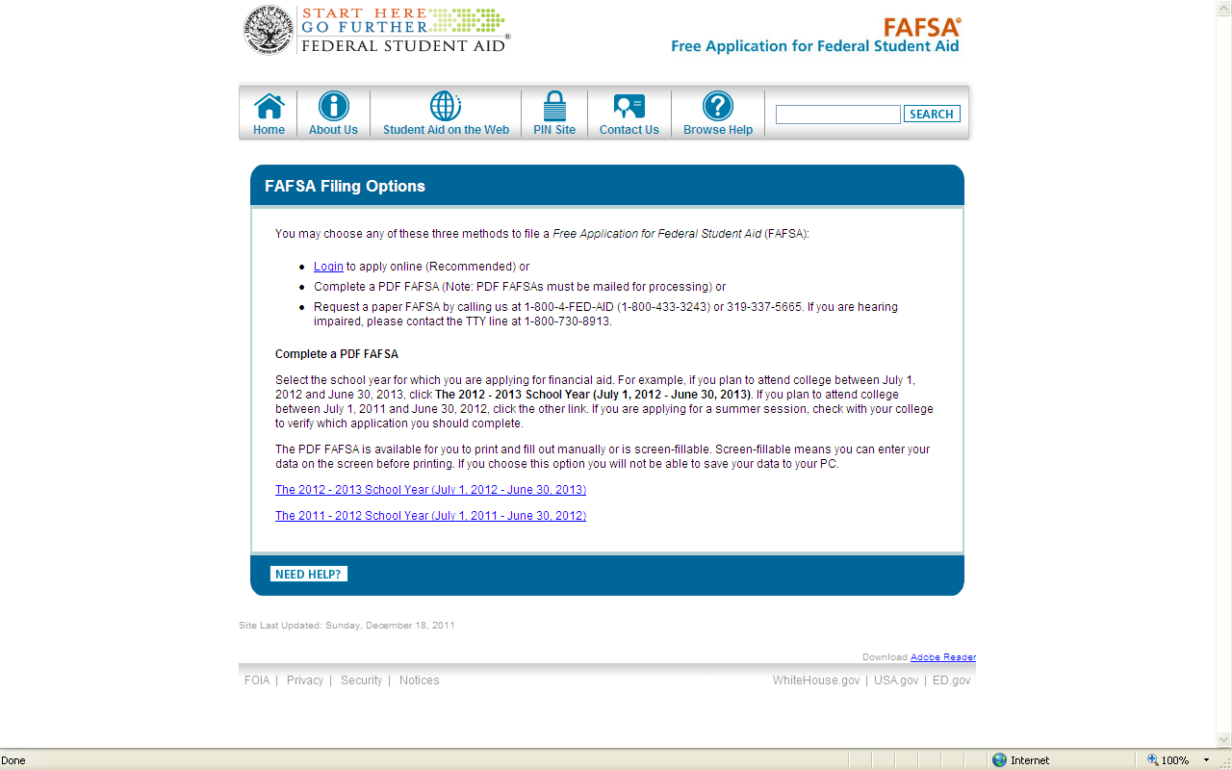
Ways to apply
Notes:
The FAFSA is used to determine student eligibility for many need based programs. Federal programs such as Pell Grants, work study and student loans. State Programs such as the Pennsylvania State Grant , state work study and other special programs. School Programs such as need based grants and scholarships.
The FAFSA must be filed beginning on January 1 of the upcoming award year. For the 2012-2013 school year, this would be January 1, 2012. Students may list up to ten schools on their online FAFSA and need not be accepted for admission at the time of FAFSA submission. You should check with each school that you apply to and see what is their deadline date that they need you to complete the FAFSA.
FAFSA on the web is the preferred and most popular method for submitting the FAFSA. Online applications are processed faster, are more accurate and are easier to correct. Only incudes basic questions due to “Skip Logic” The application is available in English and Spanish.
A paper FAFSA is available in both English and Spanish. The paper process takes longer and is used by very few applicants.
The FAFSA on the web worksheet can be used to gather certain pieces of information before going online to complete the actual form. This worksheet is optional and you are not required to complete it.
The Free Application for Federal Student Aid on the Web (FOTW) is now completed by 99% of students applying for financial aid. Paper FAFSAs are virtually obsolete.

Slide 12
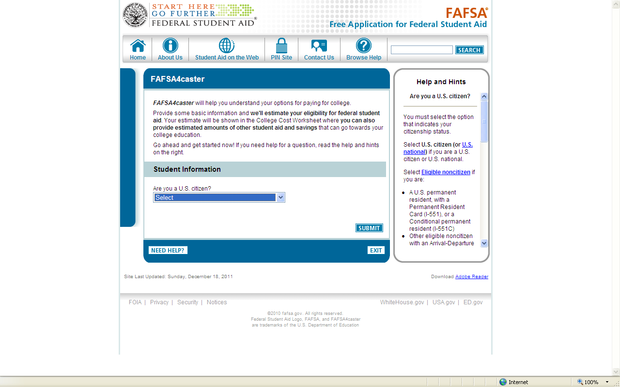
FAFSA4caster
For those not beginning postsecondary school in 2012
Notes:
The FAFSA is used to determine student eligibility for many need based programs. Federal programs such as Pell Grants, work study and student loans. State Programs such as the Pennsylvania State Grant , state work study and other special programs. School Programs such as need based grants and scholarships.
The FAFSA must be filed beginning on January 1 of the upcoming award year. For the 2012-2013 school year, this would be January 1, 2012. Students may list up to ten schools on their online FAFSA and need not be accepted for admission at the time of FAFSA submission. You should check with each school that you apply to and see what is their deadline date that they need you to complete the FAFSA.
FAFSA on the web is the preferred and most popular method for submitting the FAFSA. Online applications are processed faster, are more accurate and are easier to correct. Only incudes basic questions due to “Skip Logic” The application is available in English and Spanish.
A paper FAFSA is available in both English and Spanish. The paper process takes longer and is used by very few applicants.
The FAFSA on the web worksheet can be used to gather certain pieces of information before going online to complete the actual form. This worksheet is optional and you are not required to complete it.
The Free Application for Federal Student Aid on the Web (FOTW) is now completed by 99% of students applying for financial aid. Paper FAFSAs are virtually obsolete.

Slide 13
FOTW
FAFSA On The Web

Slide 14
FOTW (FAFSA On The Web)
Web Address:
fafsa.gov
(be sure of the extension)

Slide 15
FOTW (FAFSA On The Web)
Why Apply Online?
Faster
Easier
Detailed Help and Hints
Skip Logic
Data Integrity Checks

Slide 16
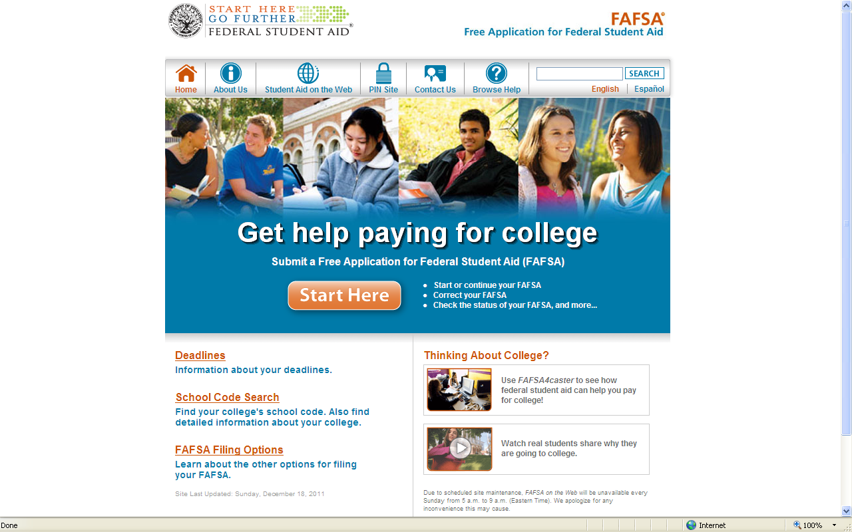
www.fafsa.gov
Notes:
The web site to apply on line is www.fafsa.gov. This will default to fafsa.ed.gov. Applicants begin by click on Start Here.
Be cautious, there are websites that charge students to complete the Free Application for Federal Student Aid. Fore example, www.fafsa.com. DO NOT pay any fees to file the FAFSA.
Two items on the site are helpful to applicants as they prepare to file the FAFSA. The FAFSA on the web worksheet can be used to gather certain pieces of information before going online to complete the actual form. This worksheet is optional and you are not required to complete it.
Applicants can also view a listing of documents needed to complete the FAFSA to ensure that you have everything that you need before starting the on-line process. Keep in mind, that on average, it takes about an hour and 15 min. to complete the on-line FAFSA.

Slide 17

Personal Identification Number (PIN)
Website: www.pin.ed.gov
Sign FAFSA electronically
  Not required, but speeds processing
Student and parent sign with PIN
Do NOT lose it. Write it down and store in a safe place.
Do NOT share it with anyone
Notes:
A pin is used to electronically sign the FAFSA when filing on-line.
The PIN enables an applicant to sign their application on FOTW, provides access to check on their FAFSA status, and is used to sign corrections made on FOTW. Also, the PIN is used to sign the master promissory note (MPN) for student loans and is used by students to review their federal student aid history within the National Student Loan Data System at www.nslds.ed.gov. A pin is used to electronically sign the FAFSA when filing on-line.
The student needs his/her own PIN and uses the same PIN as long as they are attending school.
One parent of a dependent student needs a PIN and uses the same PIN for all children attending any post secondary institution.
The student and parent should go to www.pin.ed.gov to choose a pin or they may have one assigned to them. Students and parents may apply for a pin any time during the student’s senior year of high school. They may also apply for a PIN at the time of completing the FAFSA.
The parent PIN allows a parent of a dependent student to sign the FAFSA electronically. It also is used by parent borrowers to sign the Direct PLUS Loan MPN.
Without a pin, an applicant must print off a signature page, sign it, and mail it to the federal processor, which delays the processing by several weeks.

Slide 18
FAFSA
TIPS
Don’t mix answers for student and parent information.
Ensure SSN accuracy.
Gender question is optional – answer it!
Have federal income tax and other related information
as references.
If you have yet to file your federal income taxes, you
can estimate income information and update/correct
later with IRS Data Retrieval.
Don’t delay

Slide 19
Documents Needed to Complete the FAFSA:
Applicants may need the following items:
  Social security numbers
  Drivers license (student only; this information is optional)
  Federal income tax returns (1040, 1040A or 1040EZ)
  W-2 forms from all employers
  Current bank statements (checking and savings)
  Current business and farm records
  Records of any stocks, bonds and other investments, including 529 accounts
  Additional untaxed income tax records may be needed such as: Veteran’s non educational benefits, child support paid/received and workers compensation.
  Alien registration or permanent resident card (if not a US citizen)
Notes:
Information concerning income and assets is needed in order to complete a FAFSA. Please note if an applicant uses the FAFSA-IRS Data Retrieval Process, they may not need to have an actual copy of a tax return with them to complete the FAFSA.

Slide 20
Who is independent?
24 or older on Jan 1st of award year (1/1/89)
Veteran (includes active duty personnel)
Working on graduate level degree
Emancipated minor in legal guardianship
Orphan, in foster care, or ward of the court at
anytime when student was age 13 or older
Have legal dependents other than spouse
Student deemed homeless by proper authority
Notes:
Note that there are questions on the FAFSA that dictate if a student can file as a dependent or independent student.
Many students each year attempt to file as independent students simply because they are living on their own and are self-sufficient or their parents refuse to contribute to their education. However, under federal regulations, they are still classified as dependent students. You must file your FAFSA based on the dependency requirements listed above or you risk losing out on receiving federal financial aid.
If you have questions about your family situation and if you should be considered independent or dependent, talk to the financial aid staff at ths schools at which your are applying for financial aid.

Slide 21
FAFSA On The Web
Highlights

Slide 22
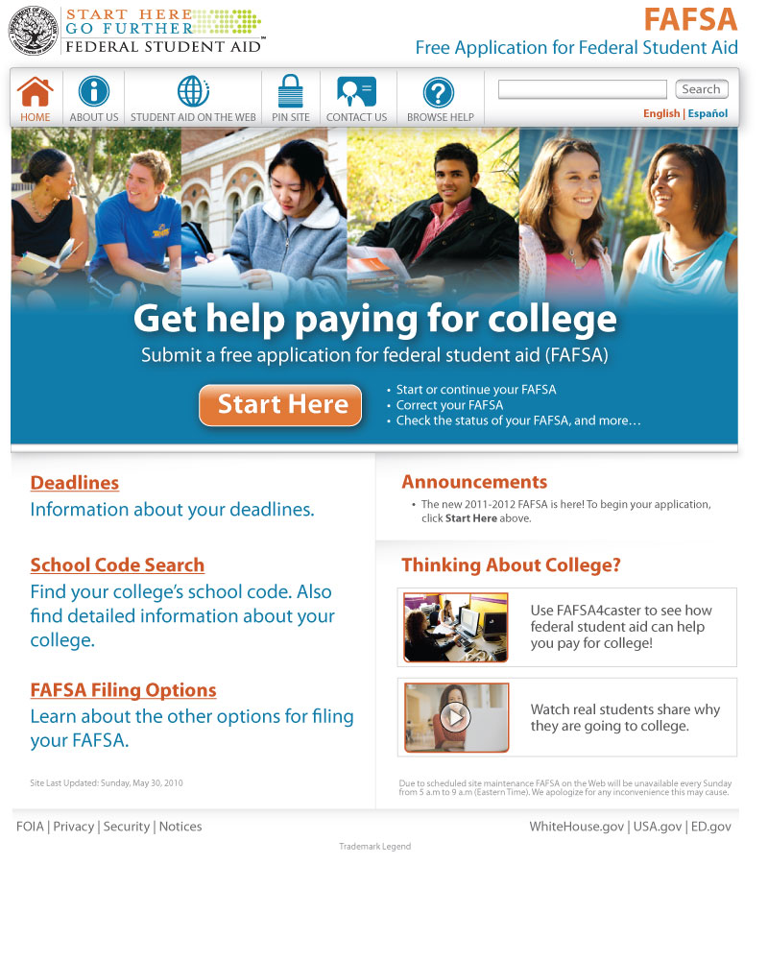
Customized “My FAFSA”
Start Here for all options –
  Initial FAFSA Entry
  Renewal Application Entry
  FAFSA Corrections
  Providing Signatures
  Continuing a Saved FAFSA
  Viewing Transaction History

Slide 23
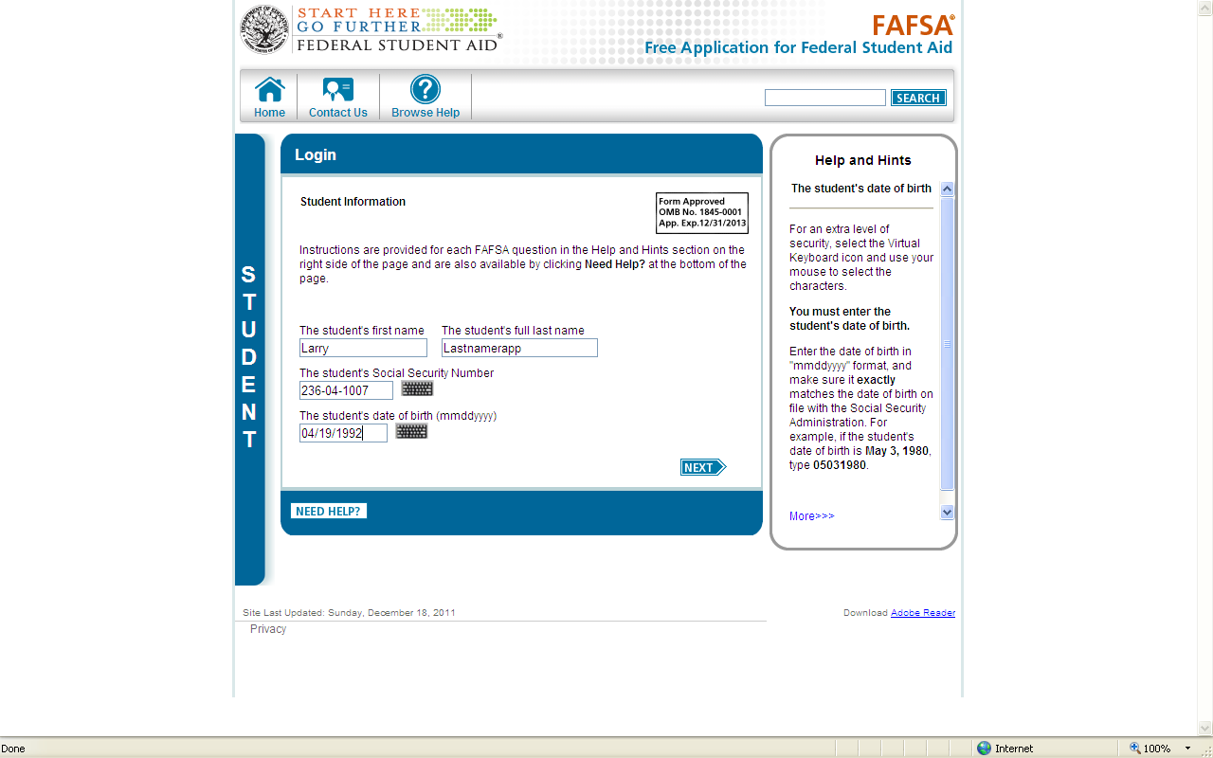
FOTW - Login

Slide 24
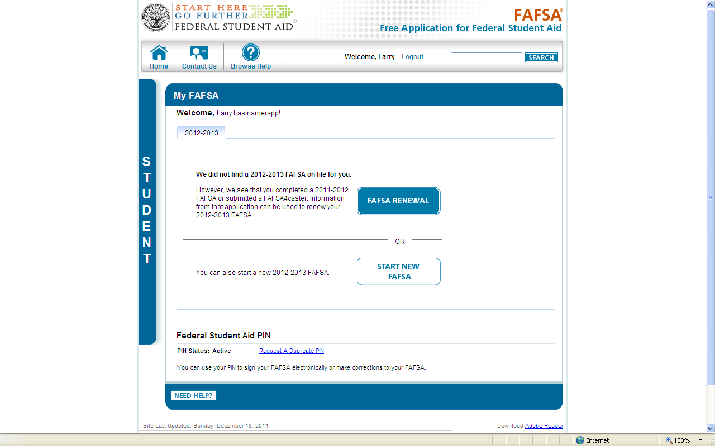
FOTW – App Selection/PIN Status

Slide 25
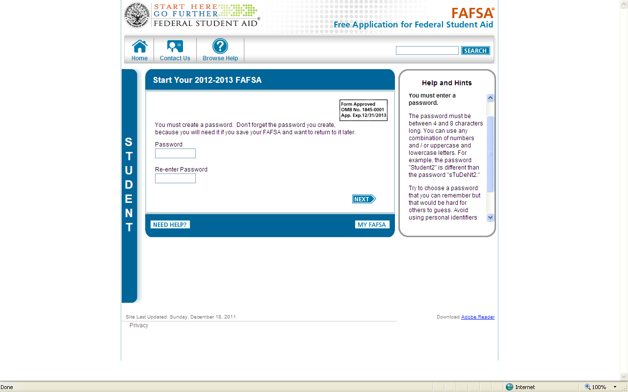
FOTW – Start New FAFSA

Slide 26
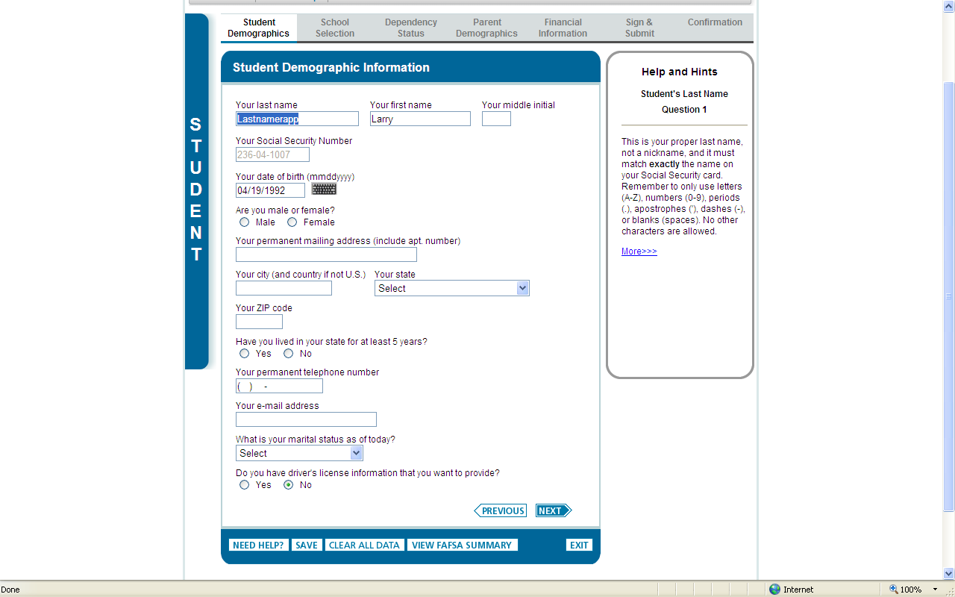
FOTW – Student Demographics

Slide 27
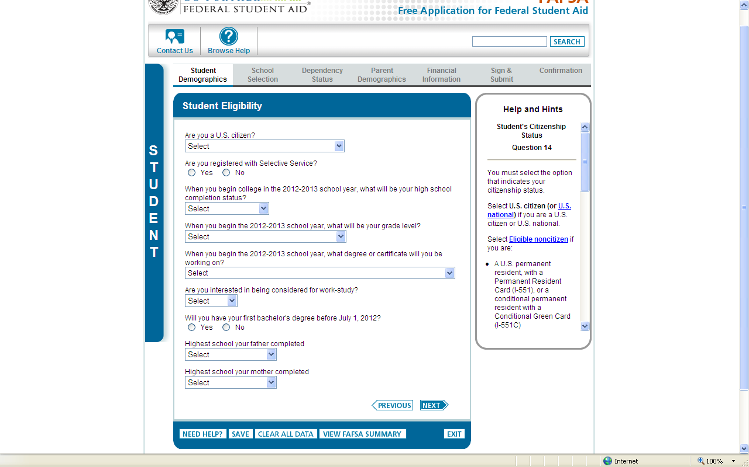
FOTW – Student Eligibility

Slide 28
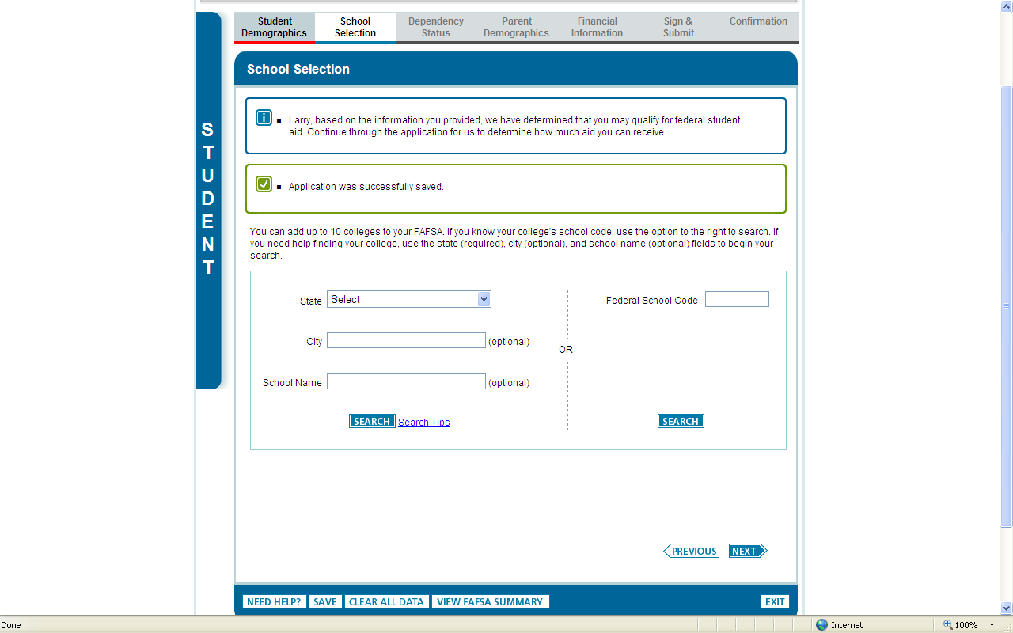
FOTW – School Selection

Slide 29
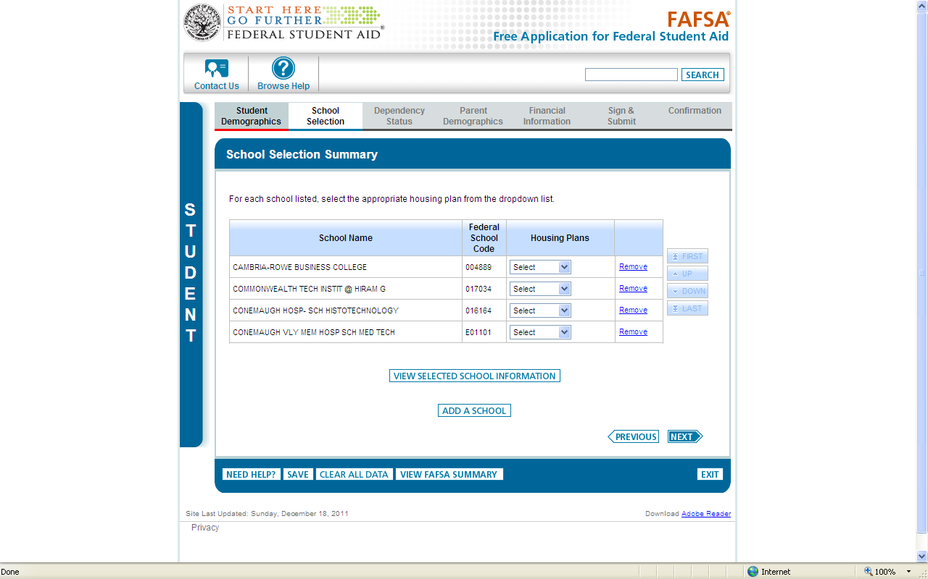
FOTW – School Re-ordering

Slide 30
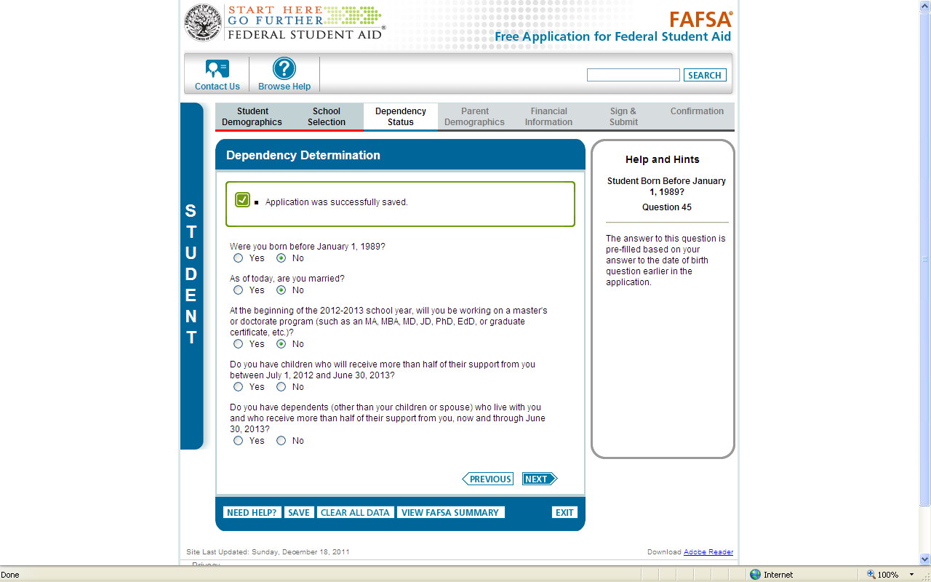
FOTW – Dependency Determination

Slide 31
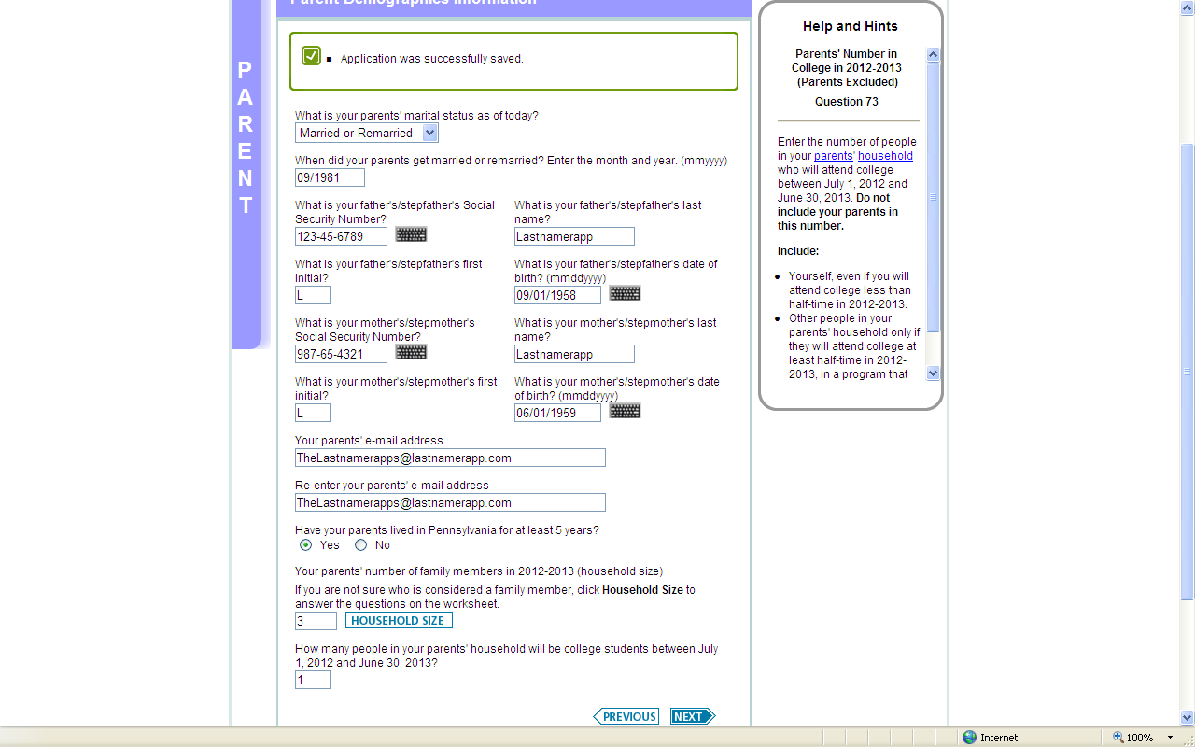
FOTW – Parent Demographics

Slide 32
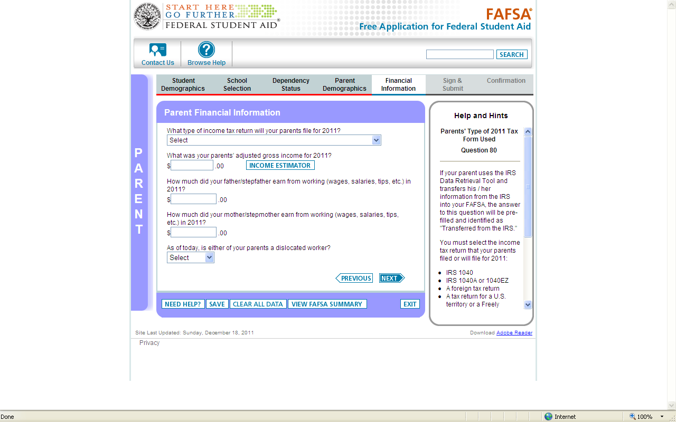
FOTW – Parent Financial Info

Slide 33
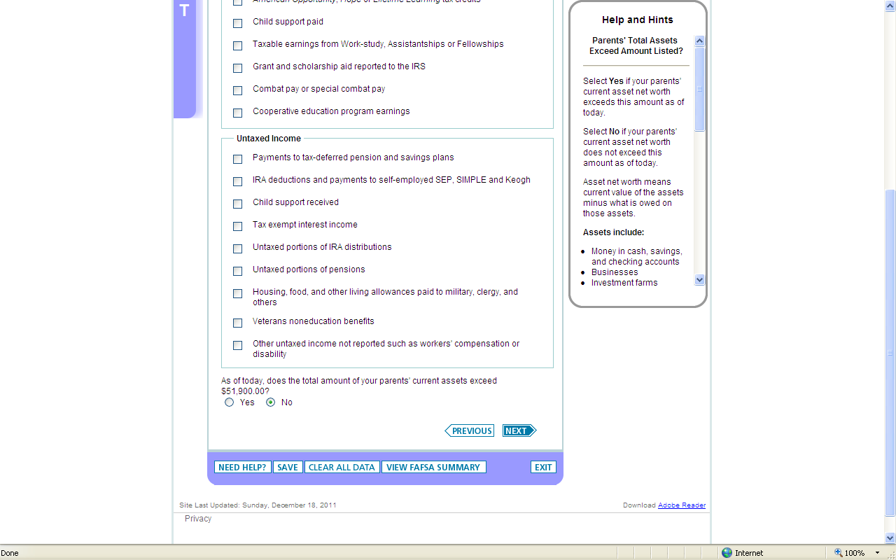
FOTW – Parent Asset Question

Slide 34
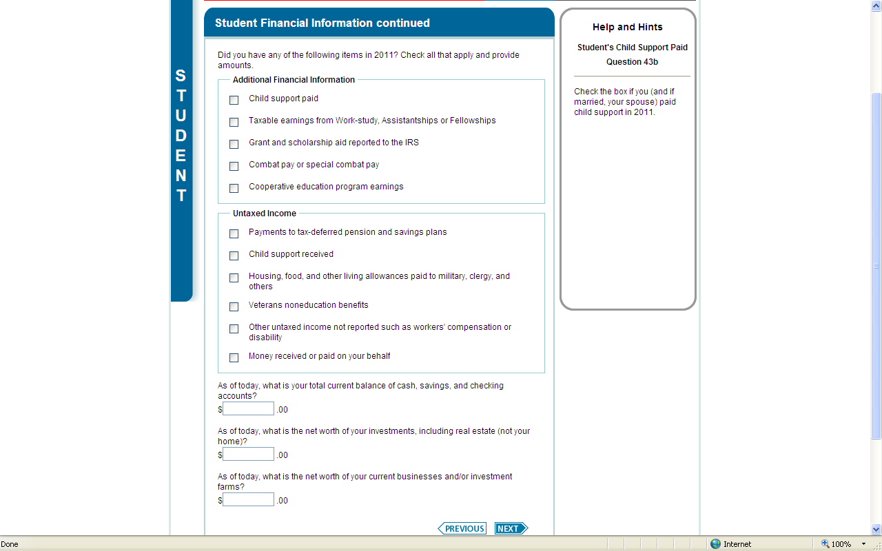
FOTW – Student Financial Info (Cont’d)

Slide 35
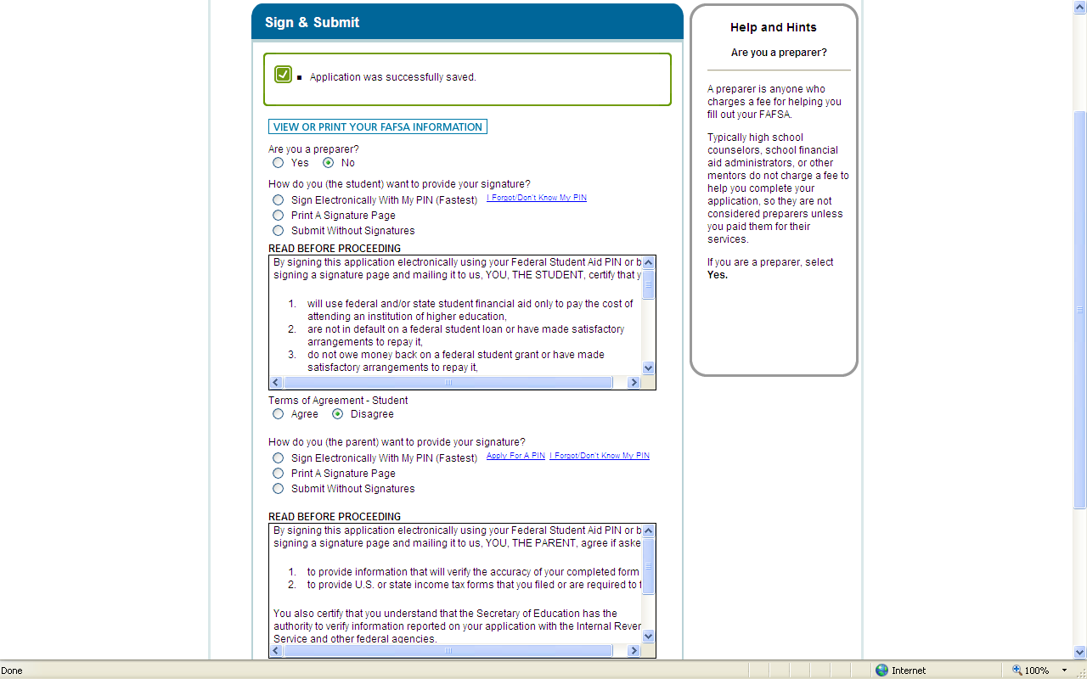
FOTW – Sign & Submit

Slide 36
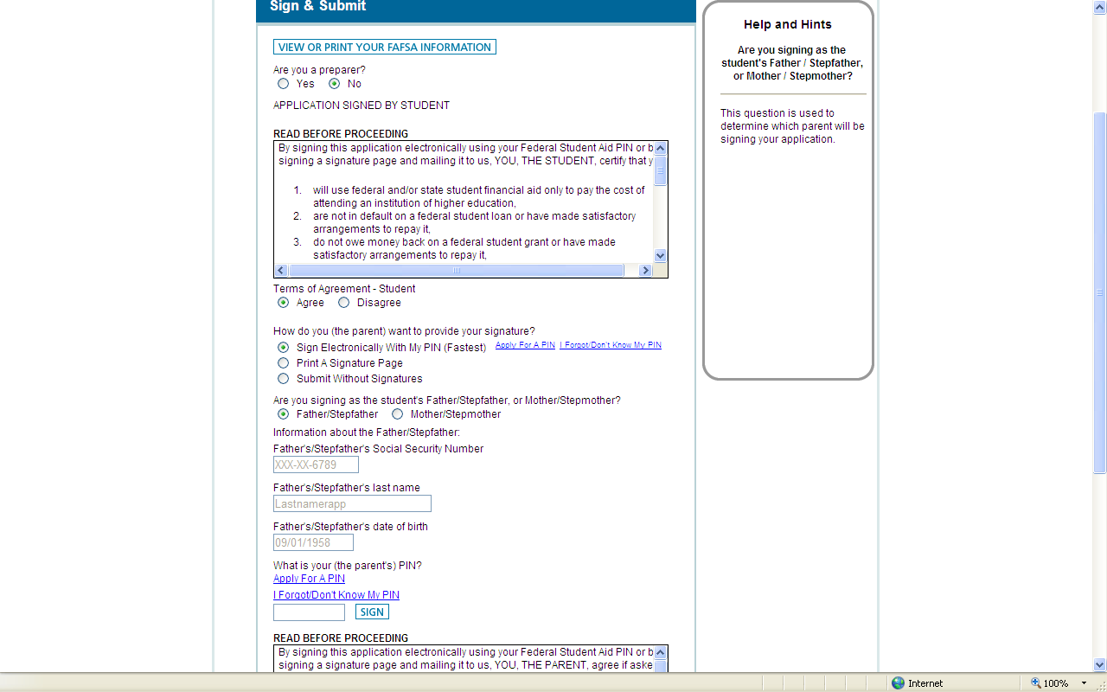
FOTW – eSignature Process

Slide 37
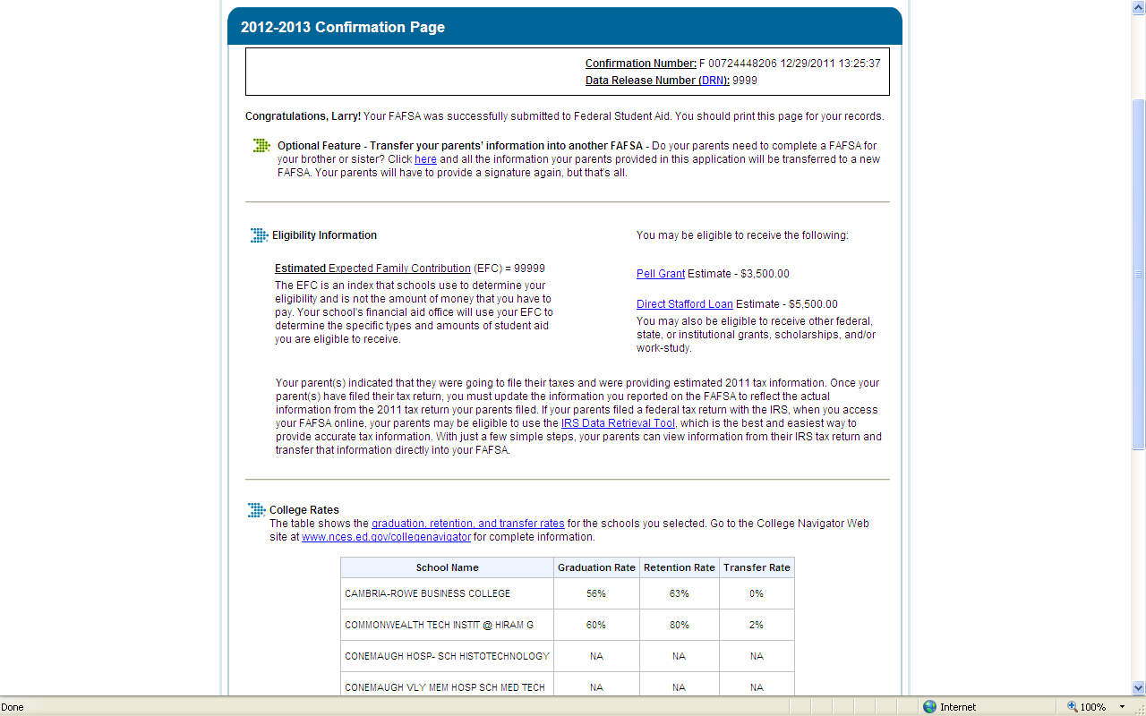
FOTW – Confirmation Page

Slide 38
FAFSA On The Web
IRS Data Retrieval

Slide 39
IRS Data Retrieval Tool
While completing FOTW, applicant may submit real-time request to IRS for tax data
IRS will authenticate taxpayer’s identity
If match found, IRS sends real-time results to applicant in new window
Applicant chooses whether or not to transfer data to FOTW
Notes:
Applicant will have to authenticate by using FSA Pin and SS#

Slide 40
IRS Data Retrieval Tool
2012-2013 FAFSA on the Web will include logic to determine if the student and/or parent(s) is eligible to use the IRS Data Retrieval Tool
Students and parents who were eligible to use the IRS Data Retrieval Tool but didn’t, will receive an e-mail notification encouraging them to return to FAFSA on the Web and use the tool
If estimated income used, can go back once taxes are filed and use IRS Data Retrieval Tool
Notes:
If any of the following statements apply to the student or to the parent, The IDRT will not provide the information needed to complete the FAFSA. The applicant will have to use their own tax records to complete the FAFSA
My tax filing status is “married filing separately”
My tax filing status is “head of household”
I filed an amended tax return
I filed a foreign tax return
I filed my taxes within the last 8 weeks
If FAFSA filed prior to February 1st, and used estimated income information - After the April 15th IRS tax filing deadline, students and/or parents will receive e-mail reminders to update the student’s FAFSA with filed tax information.

Slide 41
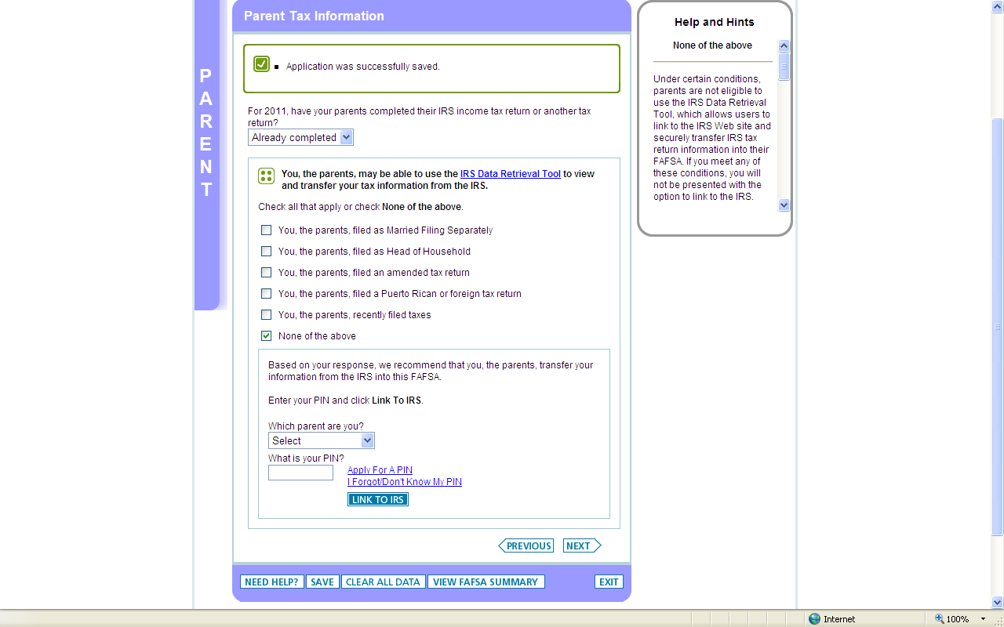
IRS Data Retrieval

Slide 42
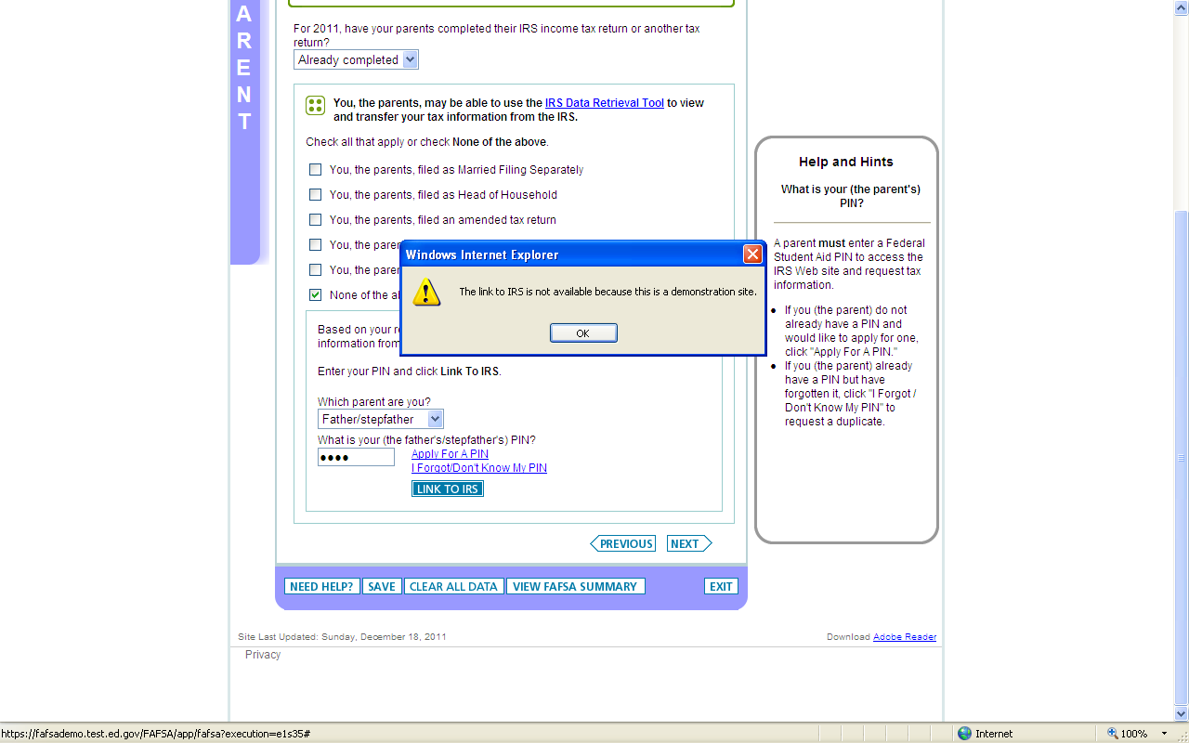
IRS Data Retrieval (Cont’d)

Slide 43
FAFSA On The Web
PHEAA State Grant Interface

Slide 44
Two Apps in One Process
  Take advantage of the opportunity to file your FAFSA and your State Grant application in one online session!

Slide 45
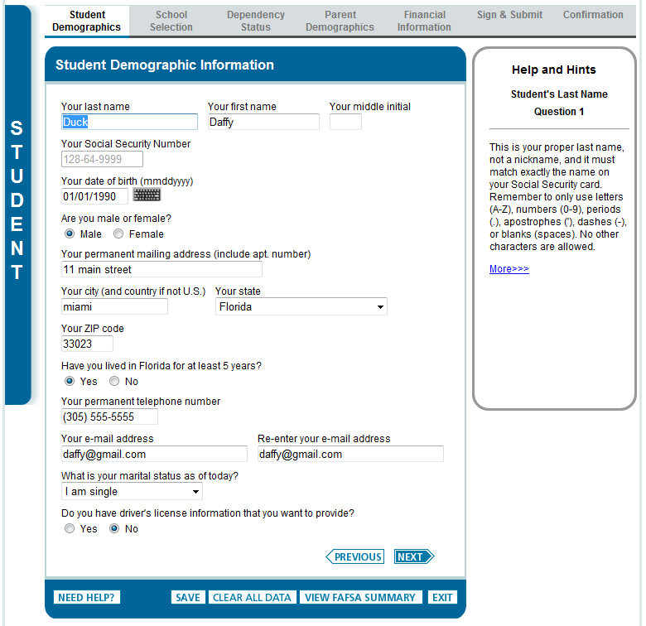
Student Demographics
First page of the FAFSA. This is the page where the student identifies their state of legal residence
Anywhere
Pennsylvania
16600
PA
814-555-5555

Slide 46
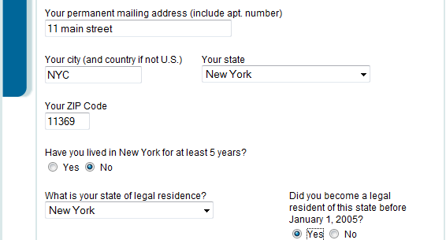
Student Demographics
State residency information is established.
FOTW now knows what state application to present to the student .
Anywhere
Pennsylvania
16600
PA
Pennsylvania

Slide 47
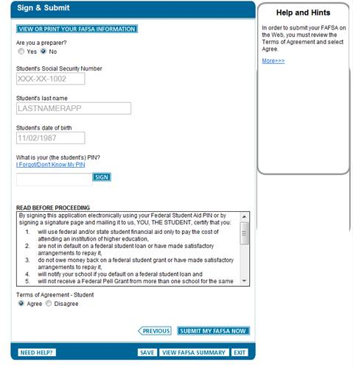
Application Submission
Once the applicant completes the remainder of the FAFSA, they can sign and submit their FAFSA for processing

Slide 48
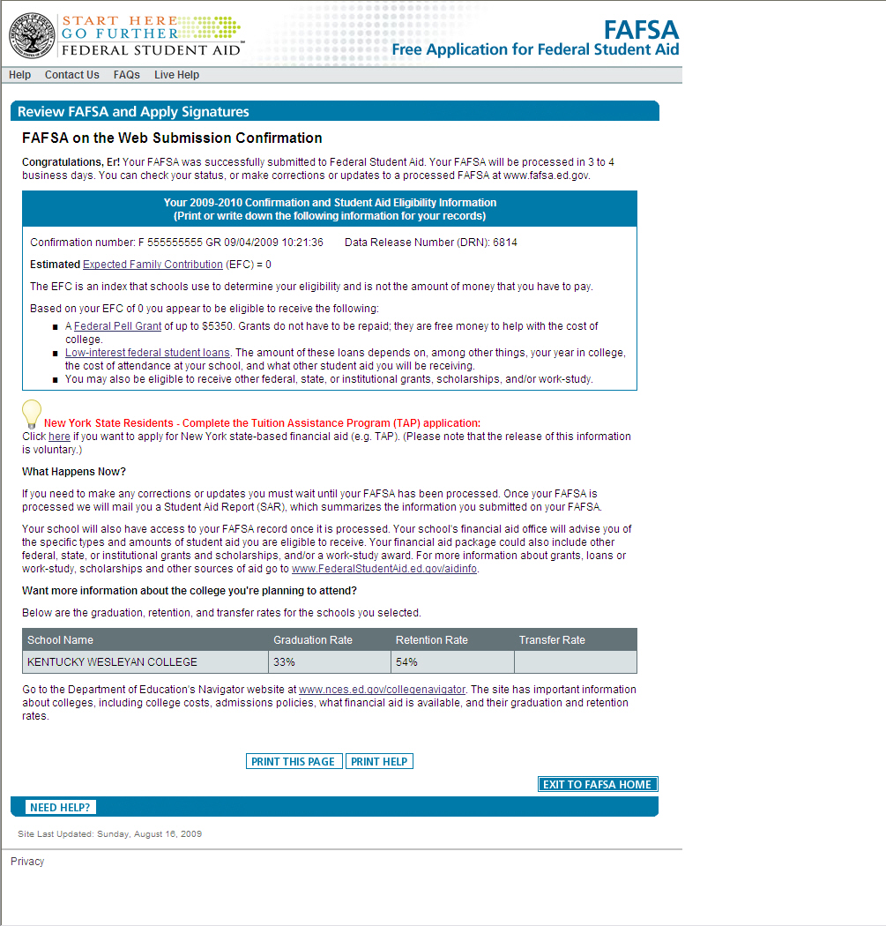
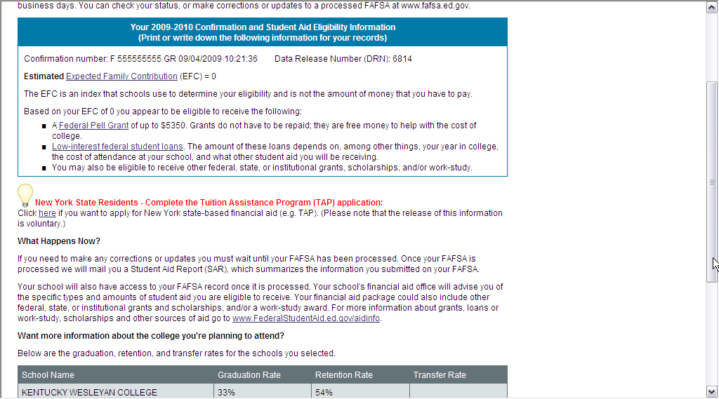
Confirmation Page
After submitting, the students are provided with a confirmation page from which they will be given the option to transfer their FOTW data to their state grant application.
Pennsylvania residents – Complete the State Grant application
Click here if you want to apply for the Pennsylvania State Grant.
Pennsylvania residents – Complete the State Grant application
Click here if you want to apply for the Pennsylvania State Grant.

Slide 49
On-Line State Grant Application
At this point, students who click on the link will be automatically moved to the PA State Grant Form for the completion of the additional data information items that are needed.

Slide 50
On-Line State Grant Application
The opportunity to use the on-line State Grant application will only occur at the point of completing the first FOTW. It cannot be accessed at any other point in time.
Renewal students may not need to complete the State Grant Form and a message will indicate that to them.

Slide 51
On-Line State Grant Application
Students who do not take advantage of this opportunity will still be able to complete the on-line State Grant Form (SGF) through Account Access as they have in the past. They will be directed via email to Account Access at pheaa.org.

Slide 52
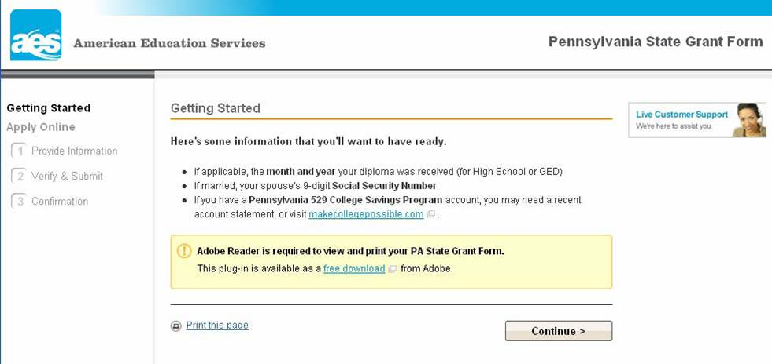
On-Line State Grant Application

Slide 53
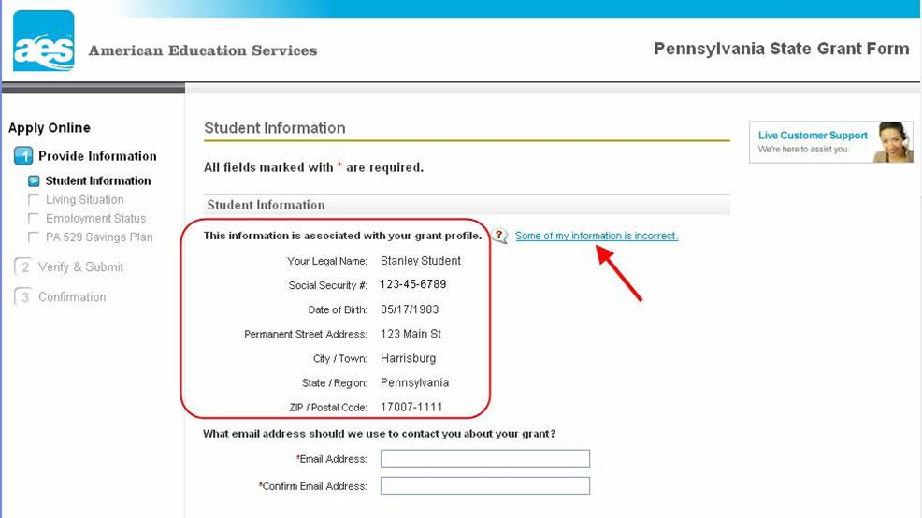
On-Line State Grant Application

Slide 54
On-Line State Grant Application
  Students will now be presented with the additional questions needed to determine State Grant eligibility which includes such items as enrollment status, value of PA 529 College Savings Program, program of study for students in vocational programs, and employment status.
  Help screens are available for all questions.

Slide 55
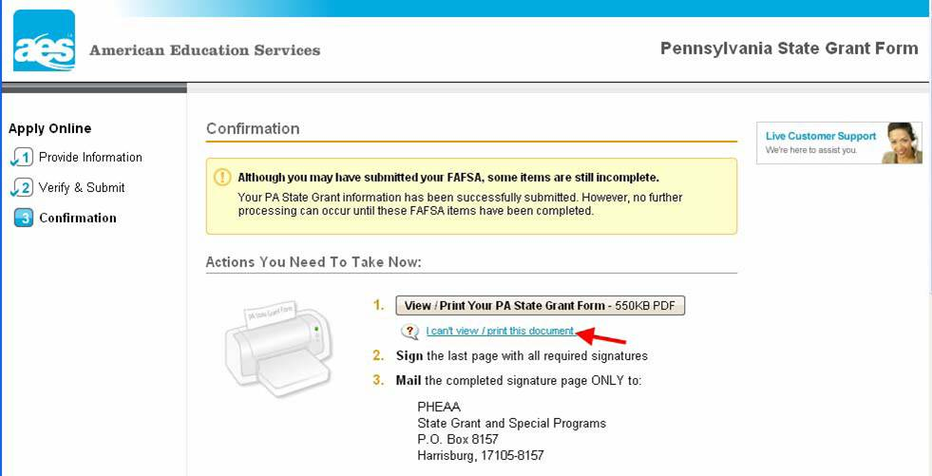
All Done!

Slide 56
All Done!
  Printing , signing, and mailing in the State Grant confirmation page is the last step in the process. PHEAA is working on an electronic signature capability but that is not available at this time.
  Students will be able to view their status on Account Access available at pheaa.org about three days after completing the FOTW.
  Establish a personal account at pheaa.org.

Slide 57
FAFSA 101
OK, I filed ---
What’s next?

Slide 58
After the FAFSA
EFC Calculated
SAR/e-SAR
State Grant eligibility calculated
Schools receive results
Schools produce award letters
Compare award letters
Determine true cost of school

Slide 59
Expected Family Contribution (EFC)
The EFC is a number derived from a federal formula which considers a family’s income, assets, and other factors
In theory, the EFC is the amount a family can reasonably be expected to pay toward college expenses each year
In reality, it is not the amount a student is required to pay and it rarely is the amount a family actually pays.
Notes:
The EFC is a number derived from the federal formula which considers a family’s income, assets, and other factors. Because this is a federally calculated number, the EFC is the same no matter which school the student attends. The EFC formula is very much income driven. While assets must be reported in many cases, they often have little impact on the EFC.

Slide 60
How is the EFC calculated?
Parent contribution + student contribution = EFC
Bulk of EFC comes from income
Home, personal property, qualified retirement funds, and value of life insurance excluded from assets
Asset protection allowance (based on age of older parent, or the parent if single parent household)
Parent asset contribution usually = roughly 6%
Student income contribution = 50% of amount over $6,000
Student asset contribution = 20% of assets
Parent contribution divided by number of children in college at the same time
Notes:
The major factors in determining the EFC for dependent students are:
Parental income and assets
Student income and assets
Family size and number of family members in college
Age of the older parent
Income is treated as follows:
For parental income, the formula includes allowances for federal, state, and local taxes, Social Security taxes, and working parent households, and also includes a standard living allowance based on the size of family.
For student income, the formula includes allowances for federal, state, and local taxes and Social Security taxes. Then an income protection allowance ($6,000 for 2012-13) is applied. Any remaining amount is assessed at 50%. Prior year Federal Work Study earnings are not treated as income in determining the EFC
Assets are treated as follows:
Parents do NOT report the value of the primary residence, personal property, retirement accounts, or life insurance. Most other assets (cash, savings, CD’s, mutual funds, 529 plans, stocks, rental properties, etc.) must be reported.
An Asset Protection Allowance (based on the age of the older parent) is then applied against the net worth of reported parental assets. Often this allowance exceeds reported assets, meaning no assets count in the EFC calculation.
Dependent students must report any assets in their name. They do not receive an Asset Protection Allowance. Their reported assets are assessed at 20% and factor into the calculation of the EFC.
Two special processing formulas (noted below) eliminate all assets from the EFC formula.
The EFC formula does not include provisions for home mortgages, consumer debt, auto expenses, unusual medical or dental expenses, private elementary or secondary school tuition, or parents enrolled in college.

Slide 61
What is Need Analysis?
A student’s financial need is determined through a process called “need analysis”. Need analysis has two components – the student’s cost of attendance at the institution attended and the student’s Expected Family Contribution (EFC).

Slide 62
Special Circumstances
Divorced or separated parents
Stepparents
Adoptive parents
Foster parents
Legal guardians
Living with others
Recent death or disability
Reduced income
Notes:
Since the FAFSA is a federal form used by millions of students nationwide, it is not feasible for the FAFSA process to take unusual circumstances into account. Therefore, schools have “Professional Judgment” which enables them, on a case by case basis, to make changes to the student’s FAFSA record and financial aid eligibility.
This authority rests with each school; decisions made by one school do not apply to another. In addition, the Financial Aid Officer’s professional judgment applies to federal aid only. For consideration of special circumstances for PA State Grant, students must contact PHEAA directly and complete the appropriate review process
At the time of filing the FAFSA, if the parents are divorced or separated, the parent is considered to be the one which the student lived with more (51% of the time or more) in the past 12 months. If parent’s divorce after the FAFSA is filed, the student needs to contact their financial aid office at their college to see how this will impact their financial aid.
Reduced Income: Many families experience a change in their income, either before or after the FAFSA has been filed. It is important that they file the FAFSA based on actual data and then contact their Financial Aid Office to discuss what has changed.
Likewise, anything that occurs after the FAFSA is actually filed, such as a loss of a parent’s job, death of family member, or other circumstance that impacts the family financially, should be reported to the financial aid office at the college that the student will attend. The financial aid staff may advise the student to report this change in circumstances to PHEAA’s state grant division as well.

Slide 63
FAFSA 101
Final Thoughts

Slide 64
FOTW
Important Notes:
Get your PIN: pin.ed.gov
File FAFSA for 2012-13
Do your FAFSA and State Grant app at the same time
Meet your school’s deadline.

Slide 65
Resources
pheaa.org
EducationPlanner.org
Youcandealwithit.com
Myfedloan.org
Toll Free: 1-800-692-7392
Federal Student Aid Info Center – 1-800-433-3243
www.fafsa.gov
www.federalstudentaid.ed.gov – general financial aid info
www.direct.ed.gov – information on federal loans

Slide 66
Contact Information
Carol Handlan
Higher Education Access Partner Cumberland Valley Region
chandlan@pheaa.org

Slide 67
QUESTIONS?

