Slide 1
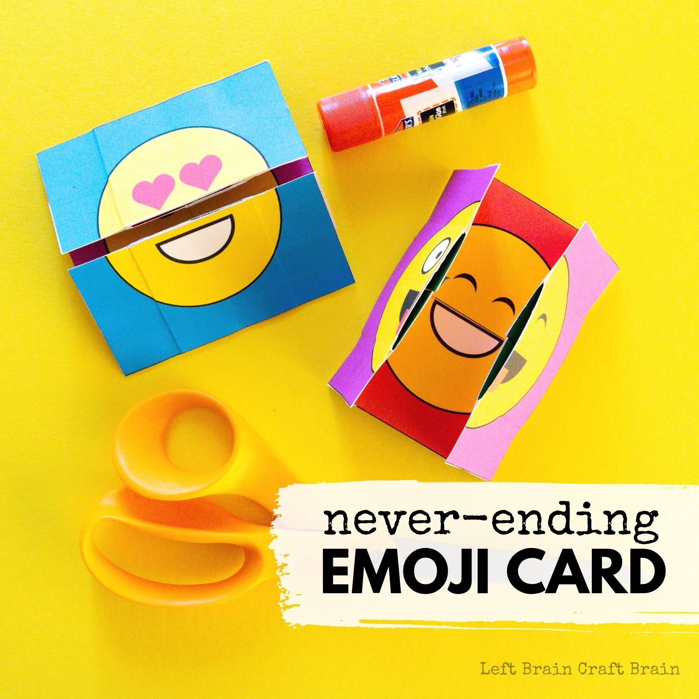
How to Make a Never-ending Emoji Card
By: leftbraincraftbrain.com

Slide 2
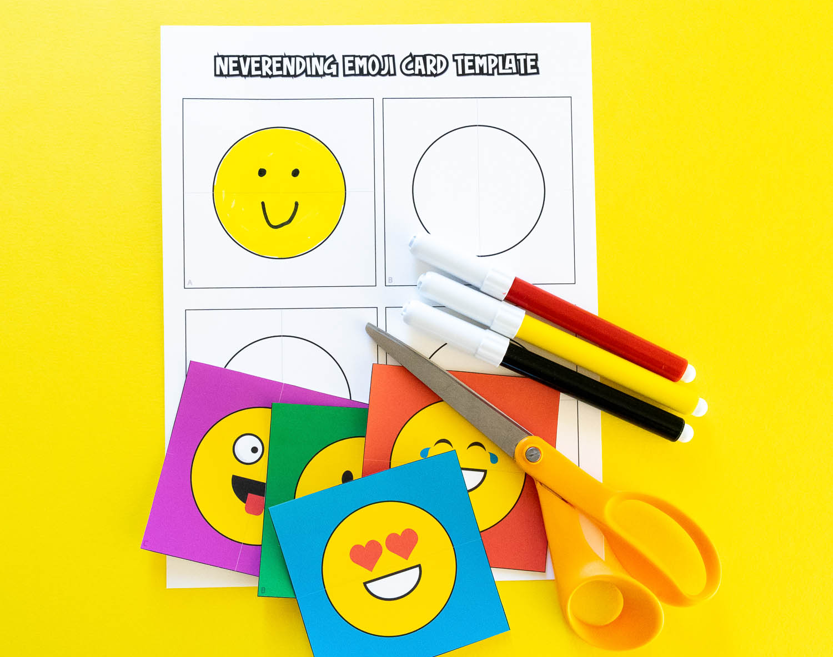
Emoji Never-ending Card Supplies Needed
Cardstock or paper
Scissors
Markers, crayons, or colored pencils (optional)
Glue stick
Never-ending Emoji Card free printable template(sign up for the free template) @leftbraincraftbrain.com

Slide 3
How to Make an Emoji Never-ending Card
1. Cut out the never-ending emoji card template. If using the blank version, draw and color your own emoji designs inside the circles and color the background if desired.
2. Pick up Emoji Design A (as noted in the corner) and fold the left and right edges to the center hash mark (not the line that runs across the entire square). Open and cut down the line that runs across the entire square. Repeat with Emoji Design D. Then repeat with Emoji Designs B and C, except fold the top and bottom edges to the center hash mark. Then open and cut down the line that runs across the entire square. Set B, C, and D aside.

Slide 4
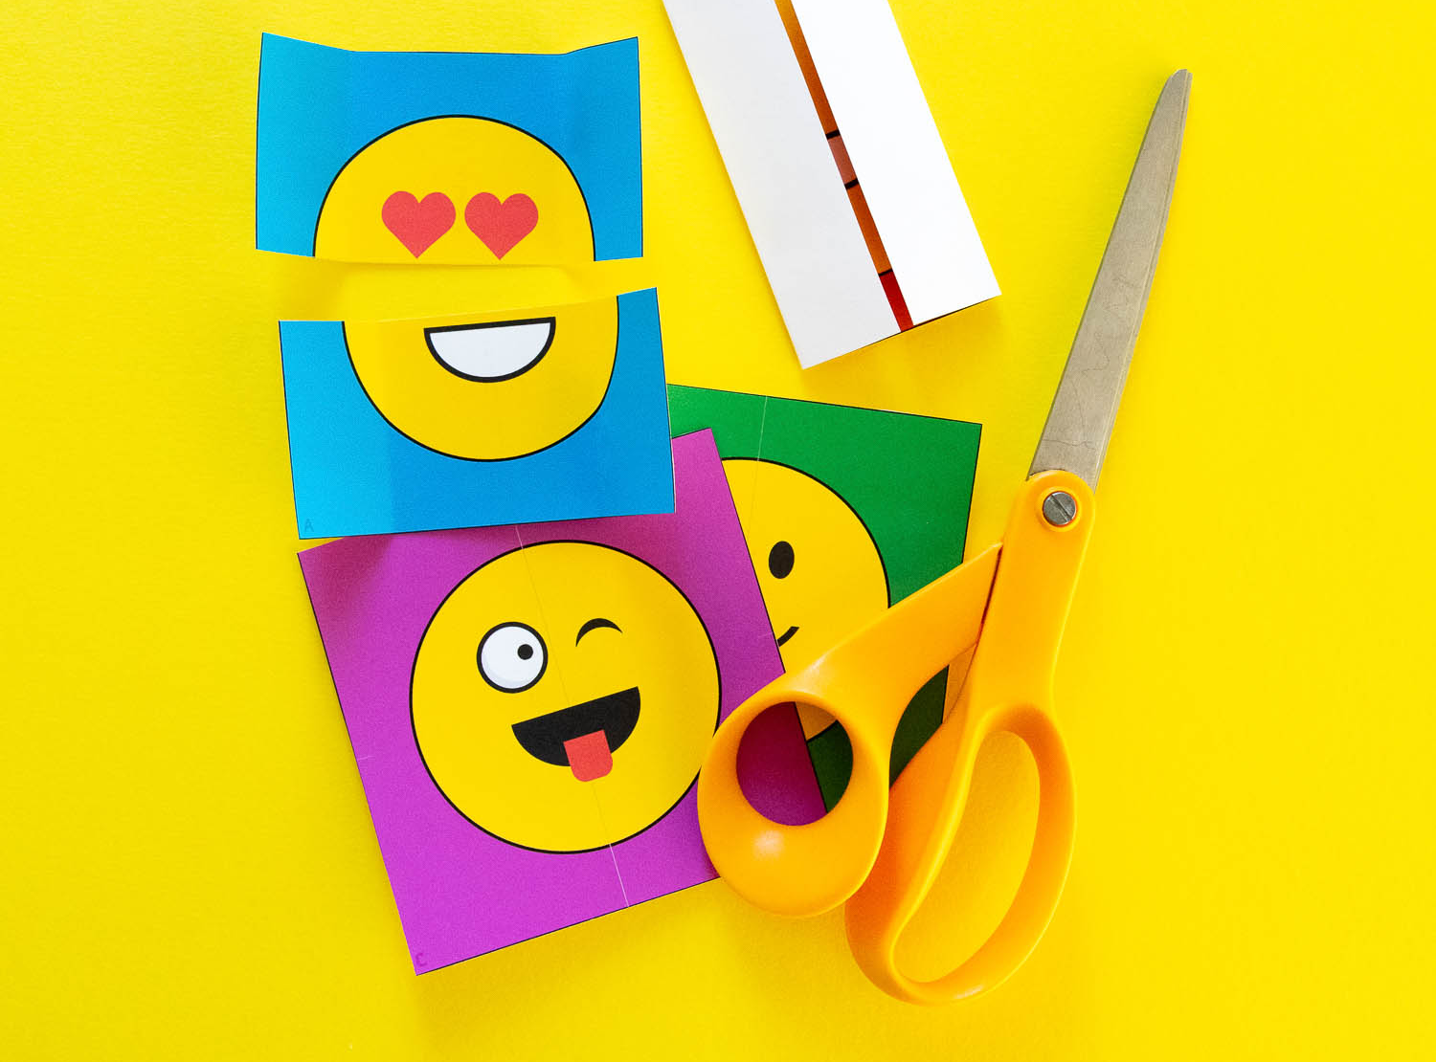

Slide 5
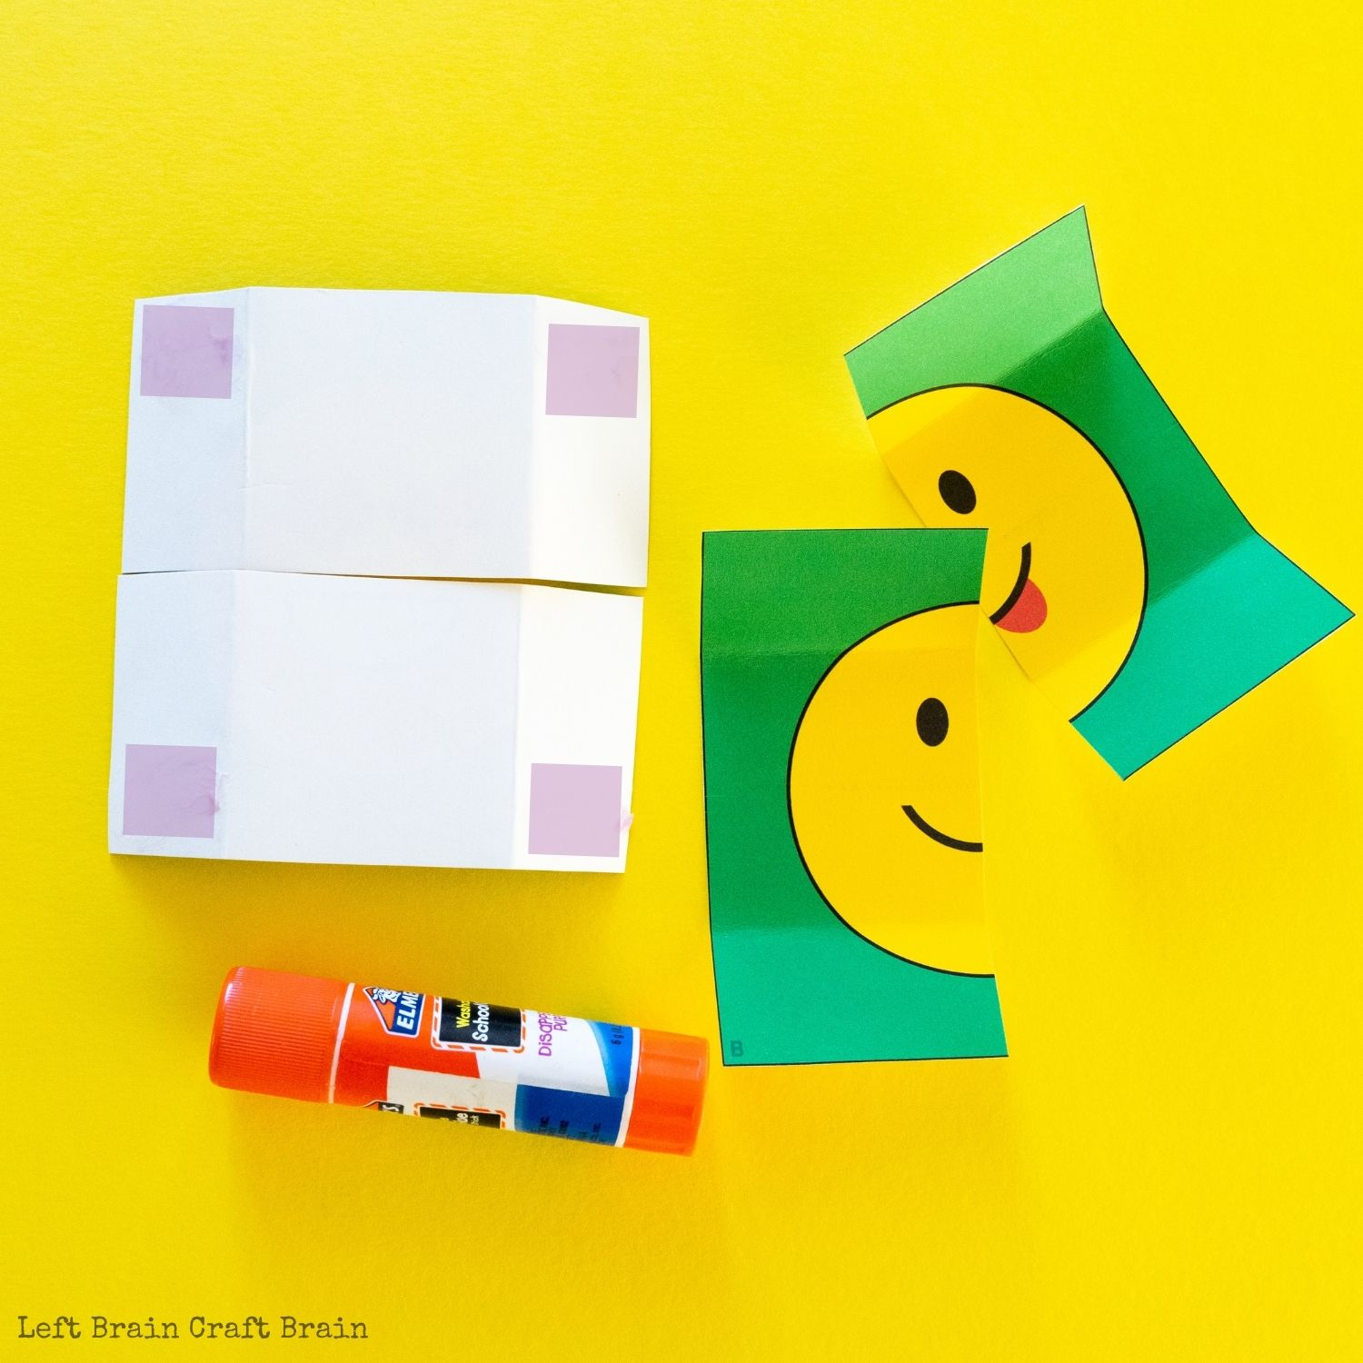
3. Lay the two pieces of Emoji Design A down on the table. Flip them over so the blank side faces up. Place glue in corners as shown in the purple squares in the picture below.
4. Place the RIGHT side of Emoji Design B on the LEFT side of both pieces of Emoji Design A. Place the LEFT side of Emoji Design B on the RIGHT side of both pieces of Emoji Design A. Press tightly to seal the glue.

Slide 6
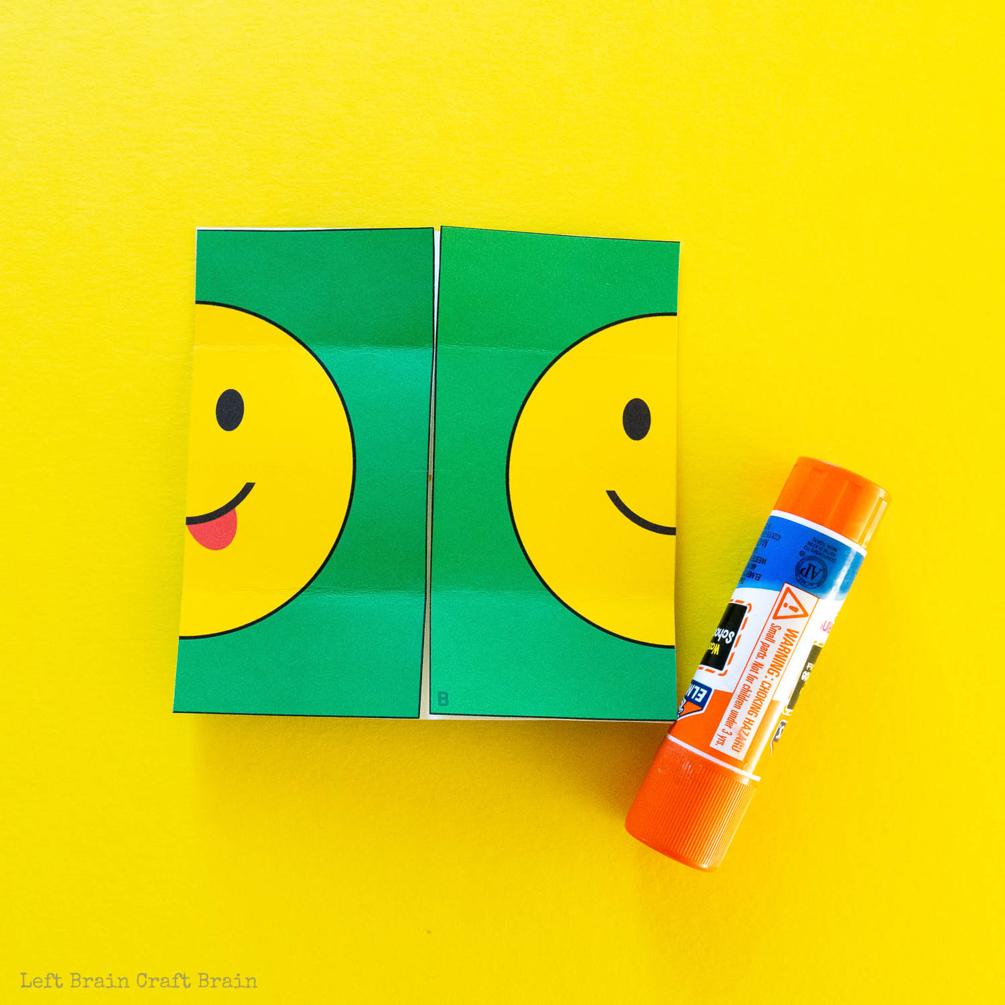
5. Flip open the card so that Emoji Design A is on the bottom. Apply glue on the sides as highlighted in purple in the picture. Attach the left side of Emoji Design C on the left and the right side of Emoji Design C on the right. Press tightly to seal the glue.

Slide 7
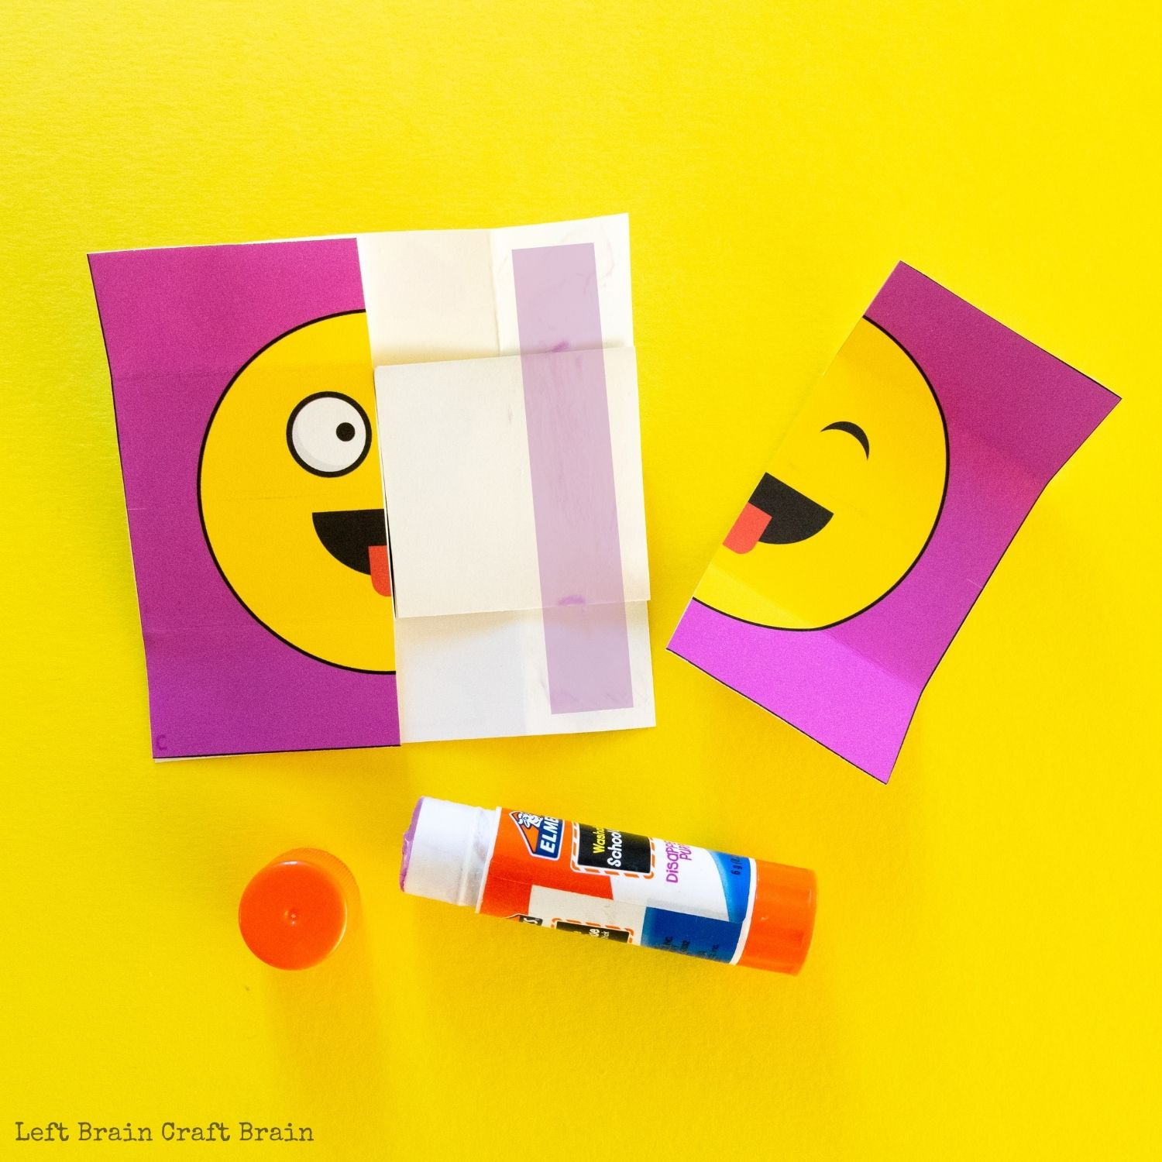
6. Flip open the card so that Emoji Design C is on the bottom. Apply glue to the entire blank surface. Attach the top of Emoji Design D on the top and the bottom of Emoji Design D on the bottom. Press tightly to seal the glue.

Slide 8
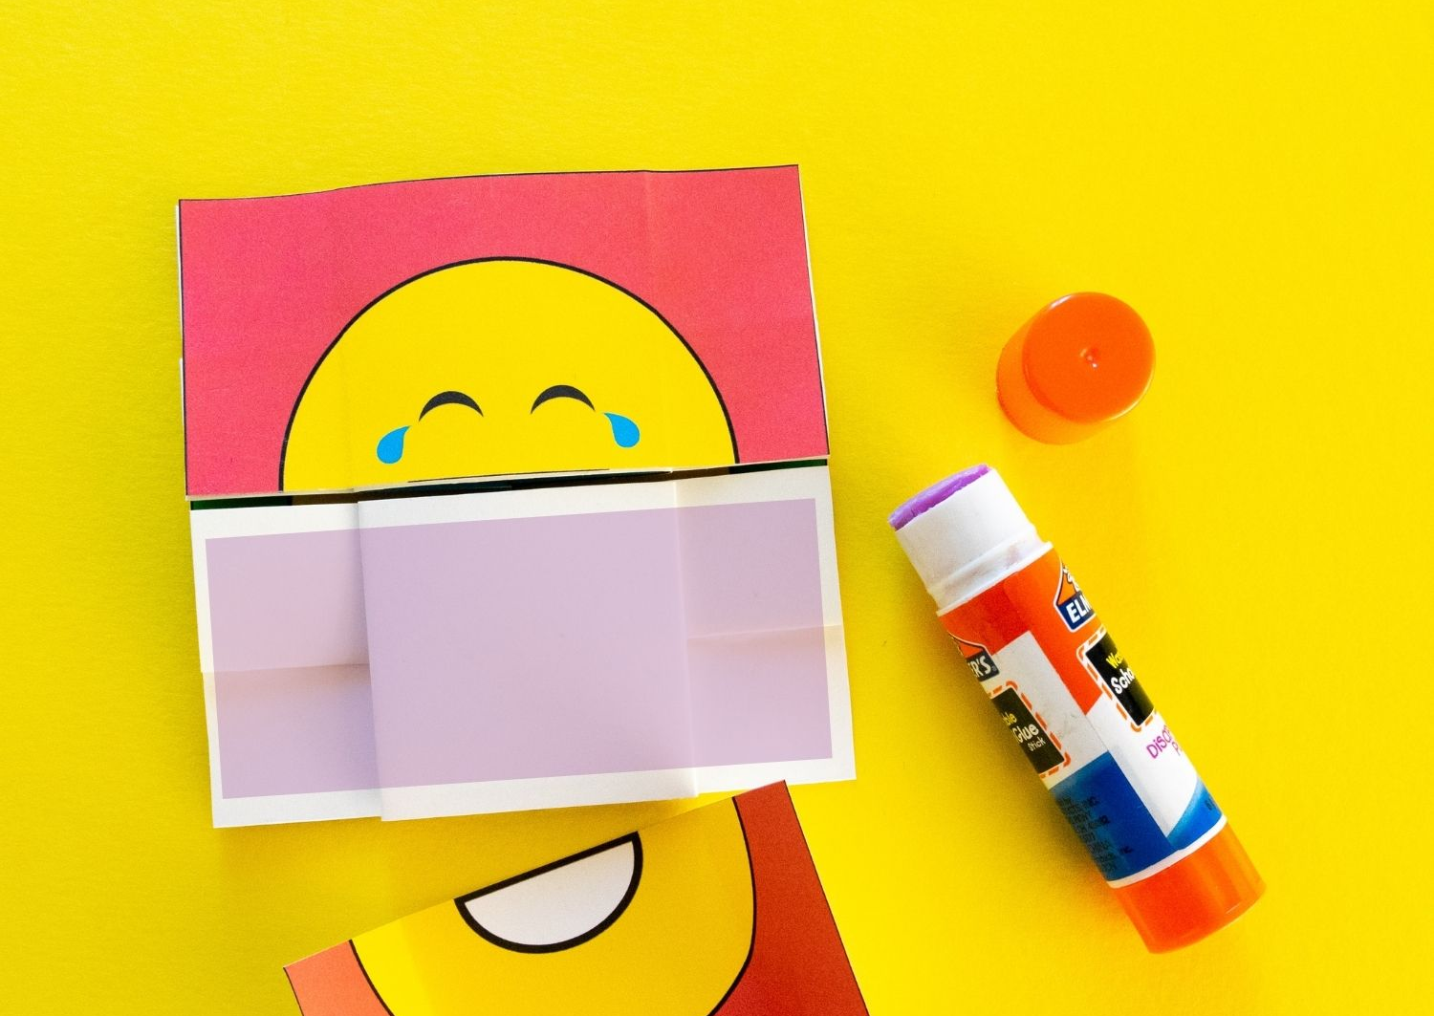
7. Let card dry completely (at least 30 minutes) before playing with the card

Slide 9
