Slide 2

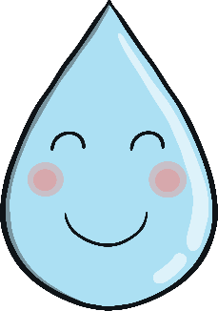
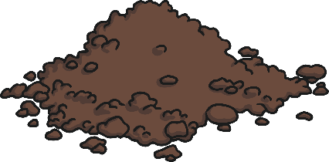

Growing Things Using Hydroponics
Everyone knows that to grow plants you need four things.
Can you remember what they
are?
soil
water
food
light
Do you think plants could grow without soil?
Yes! Growing plants using hydroponics
means plants can be grown without soil.

Slide 3
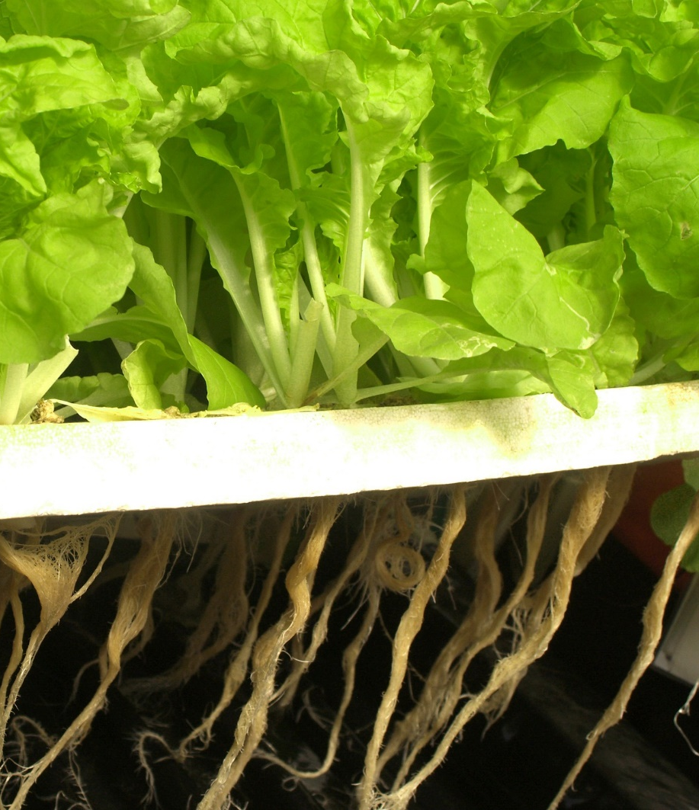
Growing Things Using Hydroponics
In the 1600, a scientist from
Belgium, Jan Van Helmont, wrote
about a test he carried out on a
willow tree. He discovered that
the tree could be grown in water
with no soil.
In fact, growing things hydroponically dates back to ancient times and one of the Seven Wonders of the Ancient World, the Hanging Gardens of Babylon, may well have been using hydroponics.
Did You Know?
Because they don’t use herbicides
or pesticides, hydroponically
grown crops are far better for
the environment.

Slide 4
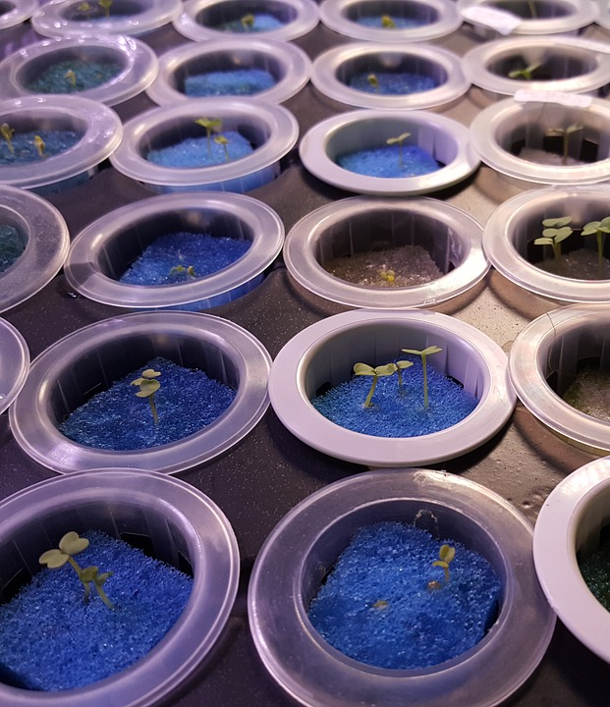
How Do You Grow Plants Without Soil?
Growing things hydroponically
involves placing a seed in water
and putting the nutrients, or
food, the plants needs to grow in
the water.
Did You Know?
The word hydroponics
comes from Greek: ‘hydro’
means water and ‘ponos’ means
work.
Materials, such as sand, gravel
or sawdust are used to help
control how much water the
plant gets. This makes sure the
plant is never over-watered.

Slide 5
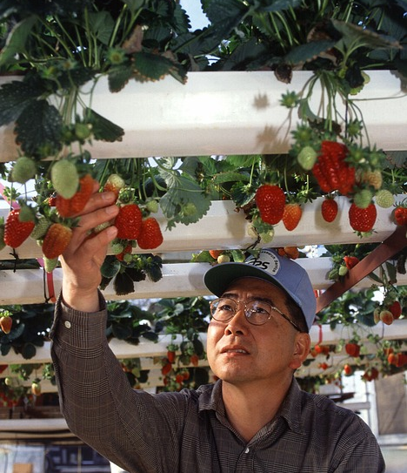
Which Plants Can Be Grown Using Hydroponics?
Some of the foods you eat every day
can be grown using hydroponics.
Tomatoes, lettuce, blueberries,
spinach, cucumbers and
strawberries are just a few.
Lots of herbs, flowers and indoor
plants have been grown with great
results too. Using hydroponics even
allows you to grow an orange tree
indoors!
Did You Know?
In 2015, rice was grown
hydroponically for the first time
with excellent results.

Slide 6
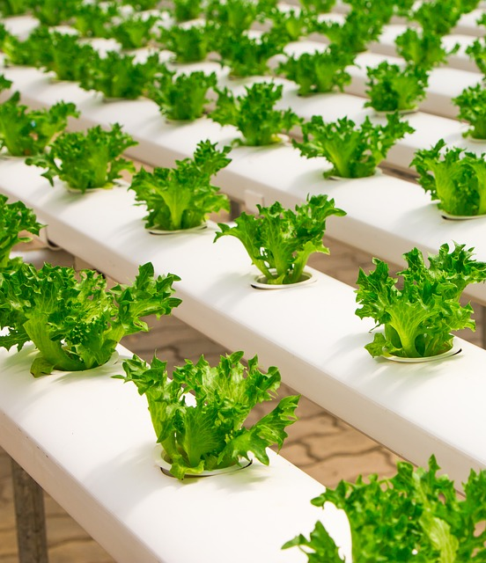
What Are the Benefits of Using Hydroponics?
Using hydroponics not only means
that crops can be grown
anywhere, it cuts down the work
involved as well. Some of the other
benefits are:
control of pests
there are no weeds
crops are less likely to be subject to diseases
resources are recycled
Did You Know?
Less water is used growing things using hydroponics than the
traditional method of growing crops.

Slide 7

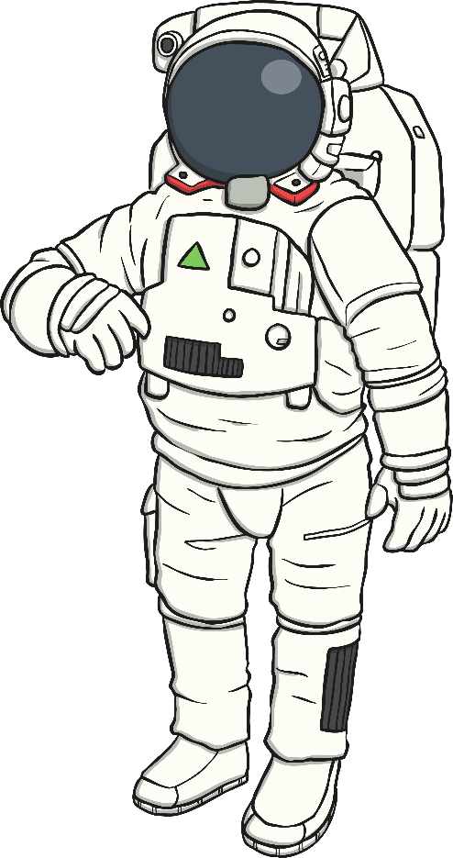
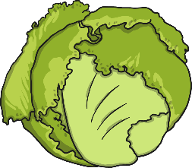
Do Hydroponics Work in Space?
In 2015, astronauts on board
the International Space Station
ate the first lettuce grown
hydroponically in space.
Since then, lots of crops have
been grown in space. These have
fed the crews and been kept for
research by scientists.

Slide 8
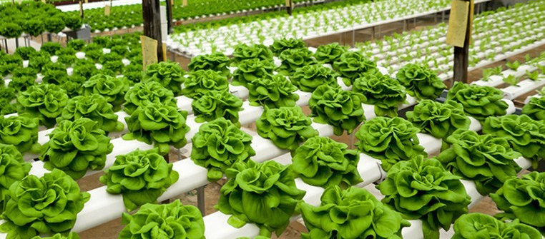
What Is the Future of
Growing Things Using Hydroponics
Now, we know that growing things using hydroponics gives us the
ability to grow more in a shorter space of time. It also helps us to grow
plants in areas where there is poor soil or there is no soil at all.
Talk About It
How could growing things hydroponically help us in the future?
Where would it be useful to be able to grow plants using hydroponics?

