Slide 1




&
Welcome Wiseburn Parents!
Check-in at rightatschool.com/districts/wiseburn-ca/
to be entered to win FREE REGISTRATION!

Slide 2


Tonight’s Topics
Who is Right At School?
What Makes Right At School Different?
2020-21 Tuition/Fees
Safety is #1
Curriculum / Daily Schedule
Our Staff
Questions / Discussion

Slide 3


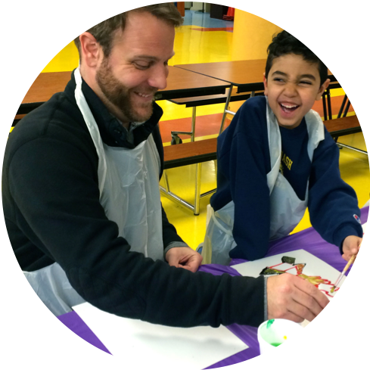
Who is Right At School?
Our Mission
  To inspire a love of learning, support schools, and give parents peace of mind.

Slide 4
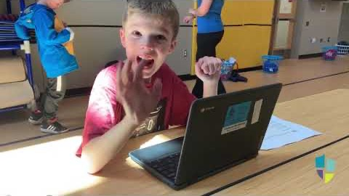
A Day in the Life with Right At School

Slide 5
What makes Right At School different?
Dedicated local Area Managers & Regional Director
Highly qualified staff
Health and Safety Practices
Curriculum aligned to academic standards that offer a continuum of services
Open for late start, early release, non-school days, break weeks, and summer
Flexible 1-5 day options for families
Discounts for siblings and free or reduced lunch families
Convenient online Parent Portal for payment & schedule changes
Full Customer Service Department in addition to on-site staff

Slide 6

Schedules & Pricing
Hybrid Before & After School Care
Before School
7:00am–8:30am
4 Days / Week
$40/week
3 Days / Week
$30/week
2 Days / Week
$20/week
1 Day / Week
$10/week
School Day
8:30am–12:30pm or 11:00am–3:00pm
4 Days / Week
$120/week
3 Days / Week
$90/week
2 Days / Week
$60/week
1 Day / Week
$30/week
After School
3:00pm–6:00pm
4 Days / Week
$80/week
3 Days / Week
$60/week
2 Days / Week
$40/week
1 Day / Week
$20/week
Discounts:
  Sibling: 10% off • Free/Reduced Lunch: 20% off

Slide 7

Schedules & Pricing
Asynchronous Learning Days
Morning
7:00am–11:00am
1 Day / Week
$30/week
Afternoon
11:00am-3:00pm
1 Day / Week
$30/week
All Day
7:00am–3:00pm
1 Day / Week
$55/week
After Hours
3:00pm–6:00pm
1 Day / Week
$20/week
Discounts:
  Sibling: 10% off • Free/Reduced Lunch: 20% off

Slide 8
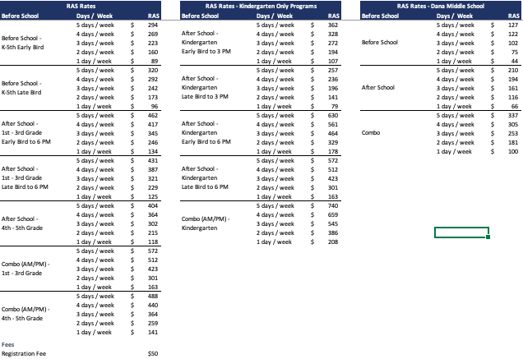
Schedules & Pricing 2021-22 SY
Before & After School Care
Discounts:
  Sibling: 10% off • Free/Reduced Lunch: 20% off

Slide 9
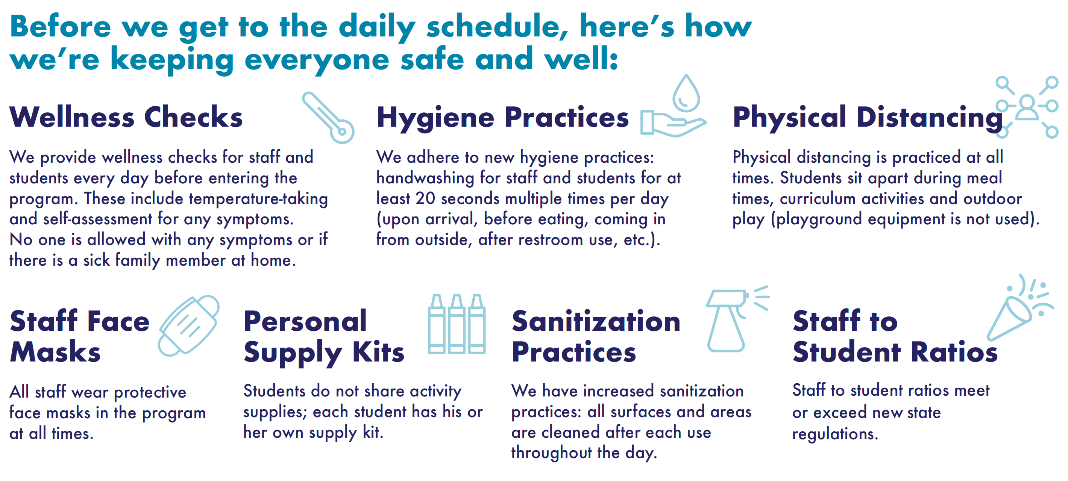
Health & Safety Practices

Slide 10
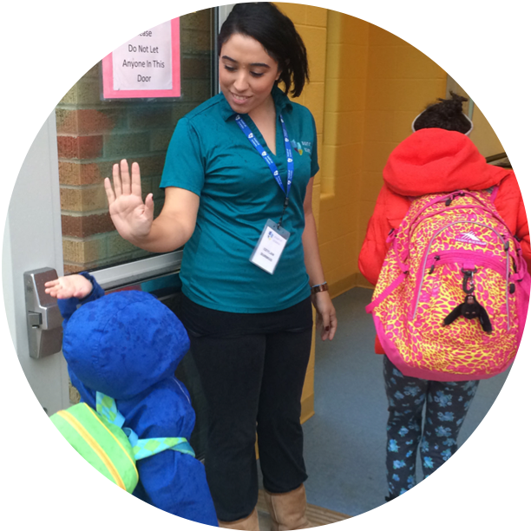
Safety is our #1 priority
BEFORE HIRE: Exhaustive pre-hire vetting (FBI & BCI background checks, sex offender & abuse/neglect registry checks, past employment verification, reference checks)
PROCEDURES: Every procedure (check-in/out, attendance, transitions) is focused on ensuring student safety
PARTNERSHIP: We partner closely with District on school safety procedures (emergency plans, lock-down drills, etc.) and communicate proactively
PRACTICE: Our Managers focus continuously on safety (live training, drills, quality checks)

Slide 11
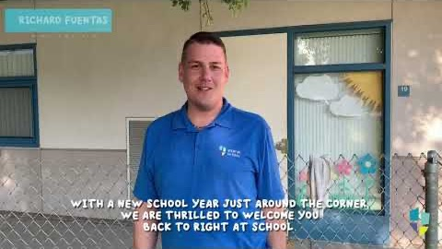
Back To School 2020

Slide 12
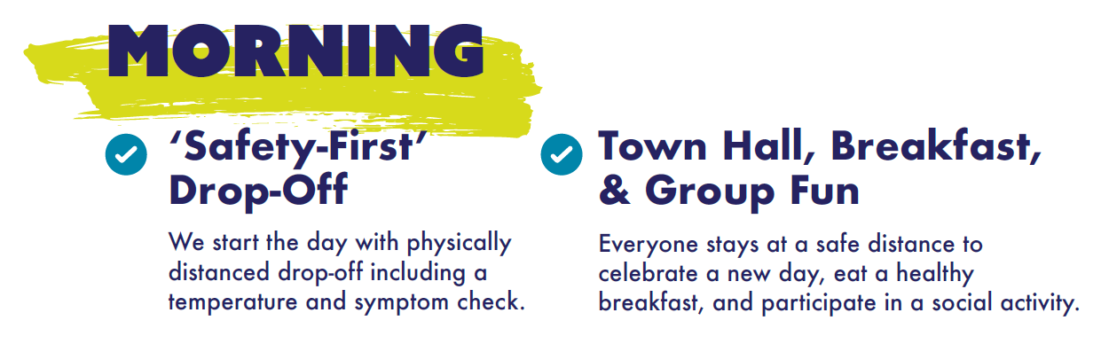
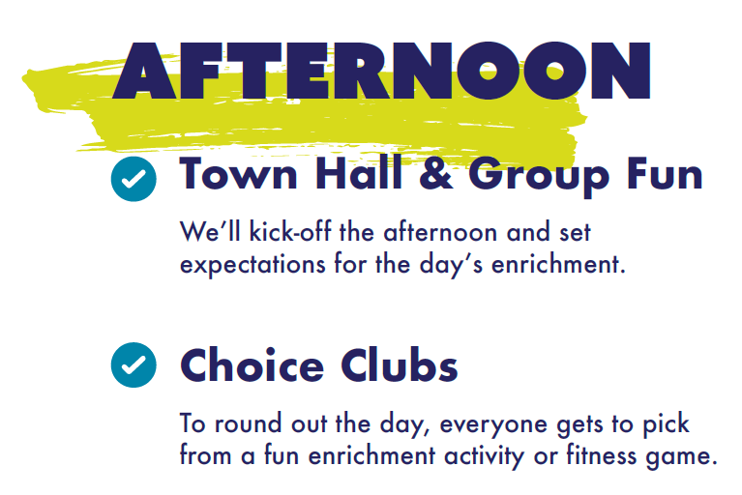
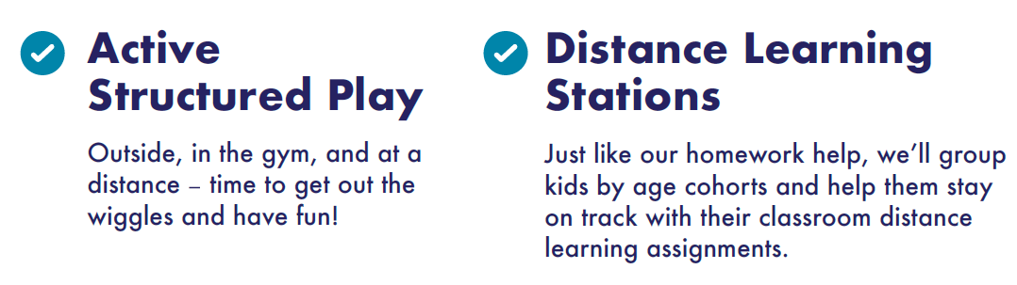
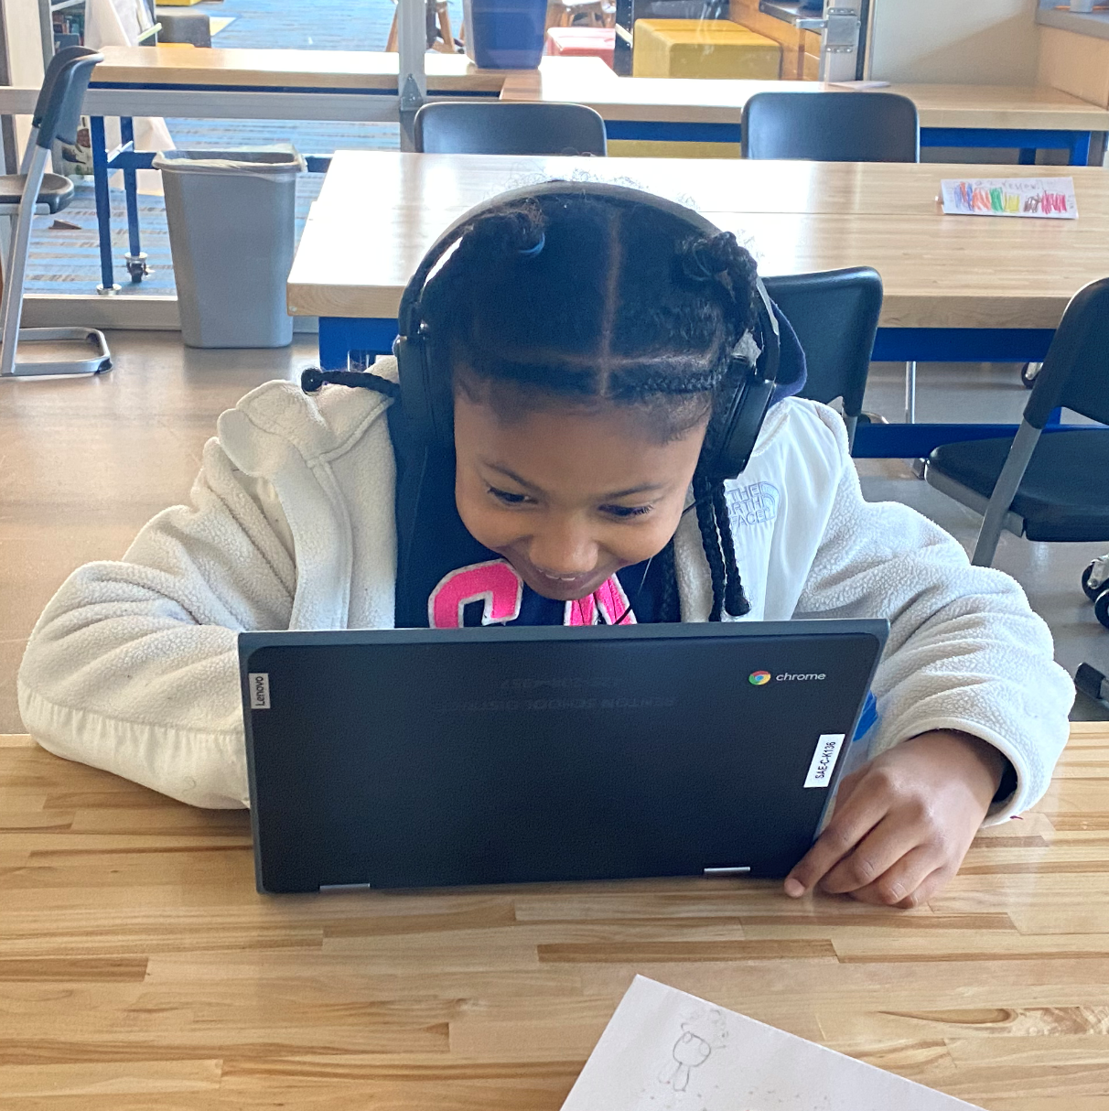

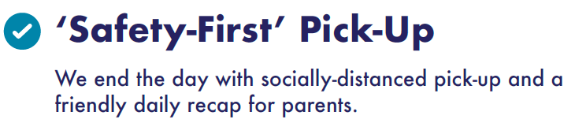

Full-Day Schedule

Slide 13
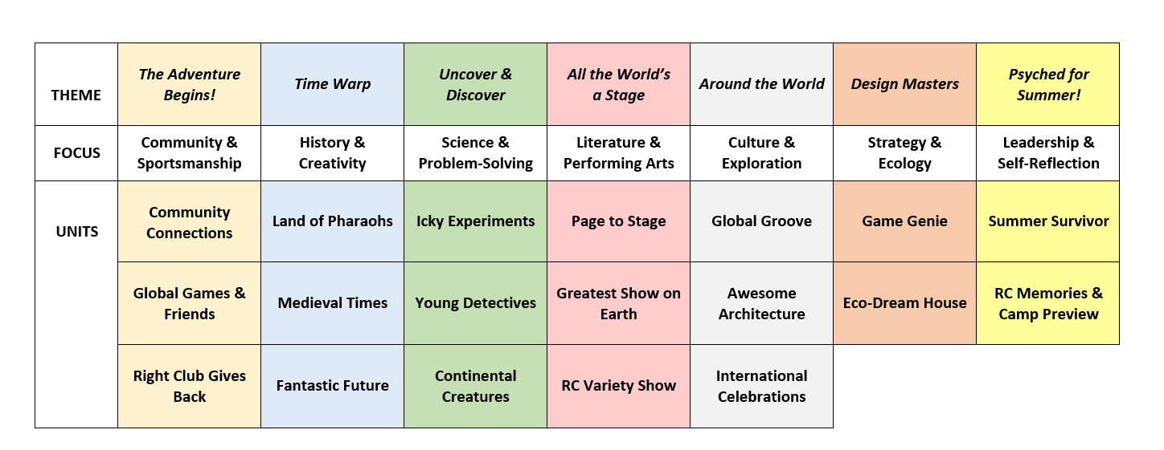
We keep hands-on learning diverse, new, and exciting
Sample Activity Theme Calendar

Slide 14
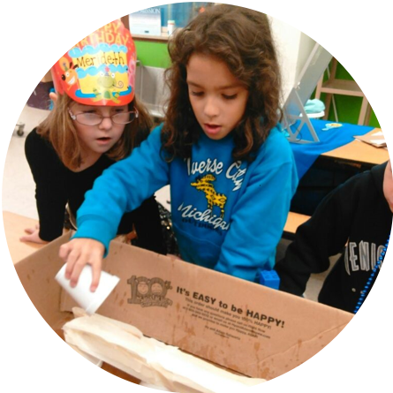

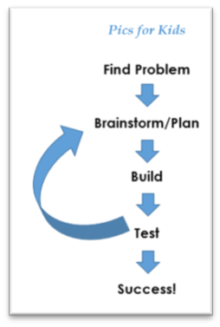
Students love our hands-on Disguised Learning
Just another day in
Right Club…
Critical Thinking
Social-Emotional Learning
Collaboration
Problem-Solving
Engineering & Physics
History & Geography
And much more…

Slide 15
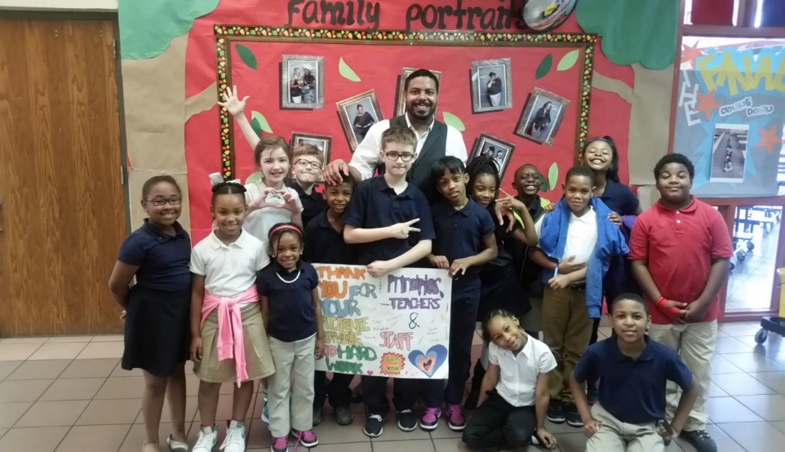
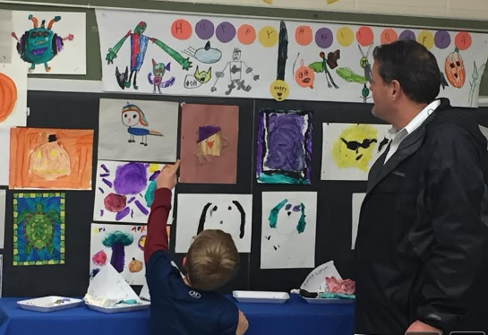
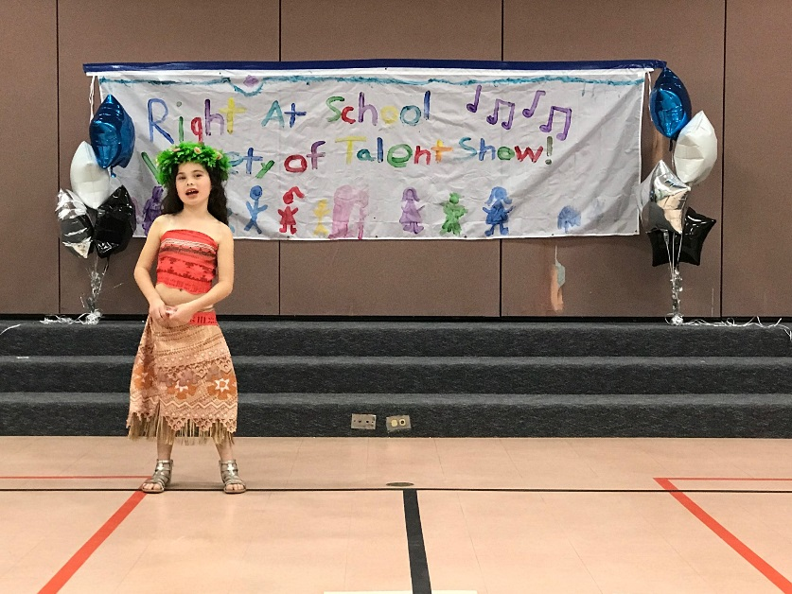
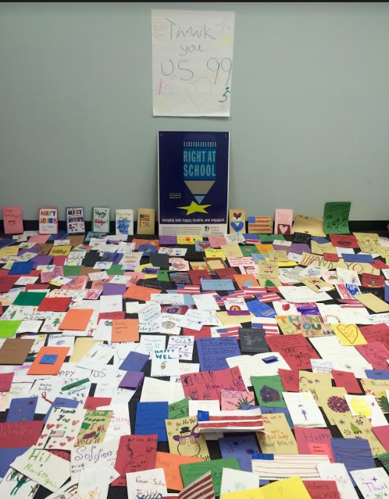

School & Community Connection

Slide 16

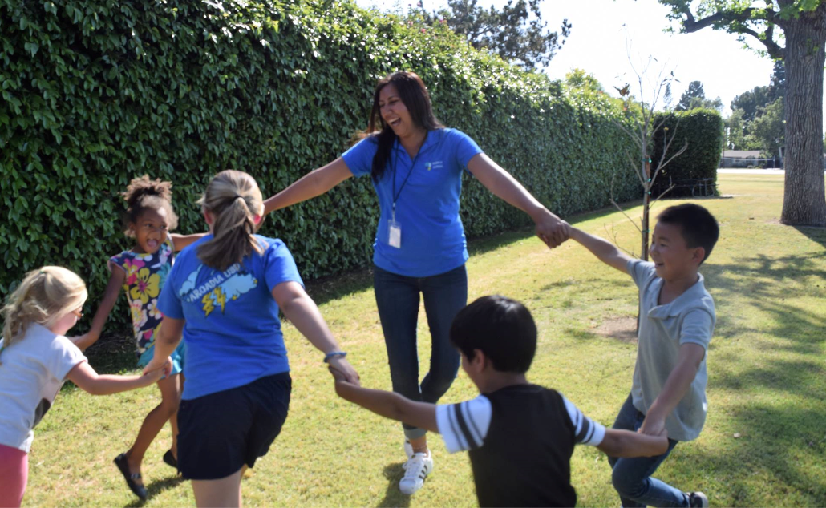
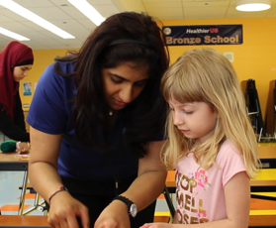

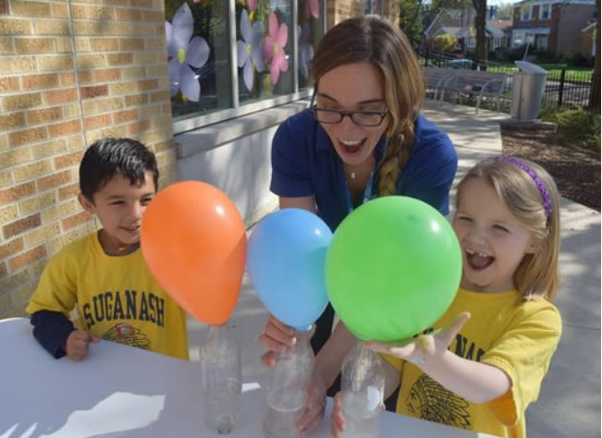
We hire highly qualified local educators who LOVE kids!

Slide 17
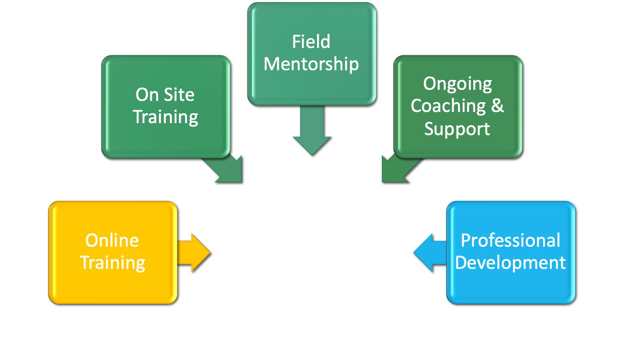

Employee Training & Development
Staff who are: PREPARED, ENGAGED & CONFIDENT

Slide 18
Registration is easy, convenient, and online
Registration is open online at:
www.rightatschool.com/districts/wiseburn-ca/
Need registration help or have payment questions?
Our customer service team is available for you:
Call 855-287-2466 or use our contact form on our website.

Slide 19

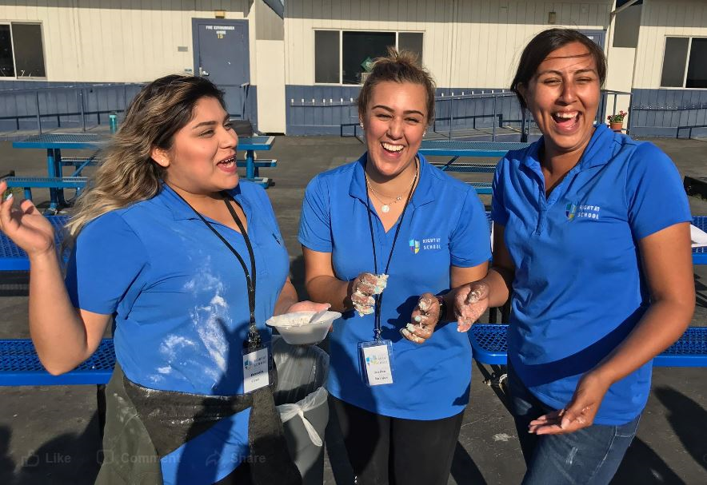
Questions / Discussion
Questions after tonight?
RAS Customer Service
855-287-2466
Wendy Vanderpoort, Area Manager
Wendy.vanderpoort@rightatschool.com

