Slide 1






Language Paper 1 Texts
How to revise …
For revision, you will need:
Preferably:
You can work with:

Slide 2
Reading!
Start with …
Do you read enough? What kind of texts are you reading?
JANE EYRE – Charlotte Brontë
REBECCA – Daphne Du Maurier
GREAT EXPECTATIONS – Charles Darwin
FRANKENSTEIN – Mary Shelley
DRACULA – Bram Stoker
PRIDE AND PREJUDICE – Jane Austen
WAR OF THE WORLDS – HG Wells
THE CHRYSALIDS – John Wyndham
Read 19th century texts, as this style has come up several times in the exam before, and it will broaden your vocabulary.
Keep a reading journal. Did you like the book you read? Why or why not? Were there parts that you didn’t understand?
Keep a glossary of unusual vocabulary. Make sure you look up the meanings and write them down, so you recognise them when you see them again.

Slide 3
Analysing Language
Move on to…
Are you thinking about how the writer uses language? Are you picking out key language techniques? Are you considering how the writer wanted to impact the reader?
Take the opening of any of the books you’ve read and start to think about them critically.
First, make a note on the MOOD or TONE of the story. What kind of atmosphere is the writer trying to evoke?
Second, start to identify language techniques. If you’re able/allowed to, highlight these techniques on a printout of the text. You’ll only need the first two pages.
Now annotate this with what you think the writer’s intentions were. How did they want the reader to feel and why?
Do this with as many different texts as you can.

Slide 4
Unpicking Structure
Consider…
Are you aware of how a writer uses structure to develop their texts? Do you know how a writer has shifted your focus from one idea to the next?
Now take the same text extracts you used to understand language and do exactly the same thing for structure!
Where does the writer focus your attention at the start? How does this shift as the narrative goes on?
Does the writer make use of setting to help develop a mood?
What person and tense is being used and how does this affect the narrative?
Do this for as many texts as you can.

Slide 5
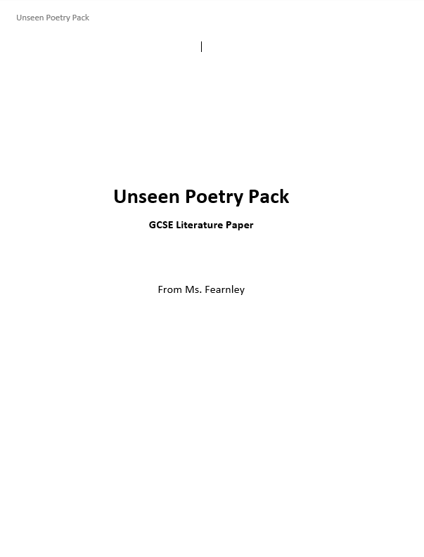
Exam Answers!
Finally…
Have you practised answering exam questions?
This is the most important thing you can do! Make sure you do this as often as you can.
Use past papers, or questions set by your teacher.
Time yourself for 1 hour to practice answering questions 1 - 4. Ask you teacher to supply you with past papers if you need.
ALWAYS read back through your answers and annotate them with what you could do better. You could (virtually) swap answers with a classmate, too, and read each other’s.

Slide 6
Key Advice
Make sure you’re getting enough sleep: If you’re staying up late playing video games or on your phone, try to limit this! A good eight hours’ sleep on average is really important to ensuring your brain functions well. Try to turn off screens half an hour before you go to sleep.
(Safely) Get some exercise and sunlight every day: We’re all spending lots of time indoors right now, which means our bodies aren’t being as active as they should be. This will also make your mind sluggish. Make sure you’re staying within government guidelines, but try and get outside and go for a walk for ten minutes every day.
Try to work on paper where you can: the blue light from computer screens can affect your brain and stop you from sleeping. It can also cause headaches and fatigue. Try to take breaks from your computer screen by revising with a paper and pen if you’re able to. This will help you manage headaches and enable you to get sleep. And drink plenty of water!

