Slide 1
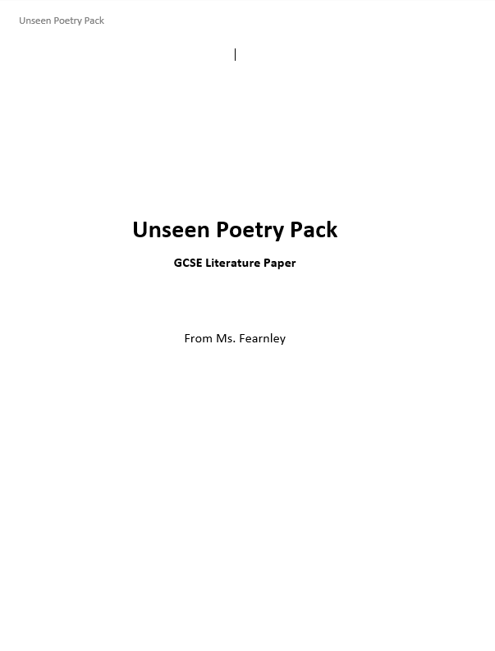




Unseen Poems
How to revise …
For revision, you will need:
Preferably:
You can work with:

Slide 2
Getting to know Poetry
Start with …
Do you read poetry often? If you don’t, you’re going to find it much harder to get to grips with unseen poetry.
Read at least a poem a day.
When you read new poems, jot down or highlight the words and phrases you enjoy, even if you’re not quite sure what they mean.
Think about what the poet might be trying to communicate to you. What is the LESSON in each of the poems you read?
See if you can identify one key language feature in each poem. Does the poet like rhythm and rhyme? Do they use lots of metaphor? Do they use direct address?

Slide 3
Poetry reviews
Move on to…
Reflect on the poetry you’ve read, think about what you liked about it and what you didn’t like. How do the poems make you feel?
Start writing short reviews for each of the poems you read. You could do this on flash cards. Try to include things you liked, things you weren’t sure about and what you thought the poet was trying to teach you.
Start thinking about how you would compare this poem to other poems. Is this your favourite? Where would you rate it alongside other poems and why?
Write down the emotional impact of the poems you read. How do they make you feel?

Slide 4
Unpicking language
Consider…
Can you identify key language in the unseen poems? Can you begin to understand how this language could be compared to other poems?
Now spend some time really unpicking and analysing a poem. Take a copy of it and practice annotating it exactly as you did with your anthology poems. What techniques does the poet use? What are they trying to teach us? What do they want us to feel?
When you’ve got two or three poems annotated like this, put them beside each other. How do the poems compare? Do they have similar or conflicting messages? Do the writers use different techniques? Make notes on this. You could add it directly to the poems or to the flash cards.

Slide 5
Exam Answers!
Finally…
Have you practised answering exam questions?
This is the most important thing you can do! Make sure you do this as often as you can.
Use past papers, or questions set by your teacher.
Time yourself for 45 minutes to practice answering the question. Ask you teacher to supply you with poems if you need. Remember to only look at them during the time you practice your unseen poetry questions.
ALWAYS read back through your answers and annotate them with what you could do better. You could (virtually) swap answers with a classmate, too, and read each other’s.

Slide 6
Key Advice
Read lots of different poems by different poets: You will need to get used to a range of different poetic styles. To do this, make sure you’re reading lots of different poets! I recommend: Vanessa Kisuule, George the Poet and Theresa Lola to start off with.
Have a bottle of water with you while you revise: Make sure you stay hydrated! This is really important, especially if you are straining your eyes by staring at a screen all day. Take regular, short breaks where you get up and move around. Keep your water in a bottle with the lid on so you don’t spill it over your work or your device.
Minimise Distractions: I know this isn’t always possible, but try to find somewhere quiet to work, or put headphones in and listen to some classical music. (Beethoven or Bach are good choices!) Put your phone away, unless you’re using it to sign on to lessons. Try to minimise the amount of things around you that can distract you from your work.

