Slide 1

How is My SAE Graded?
What Is Required?
How Do I Get An ‘A’?

Slide 2
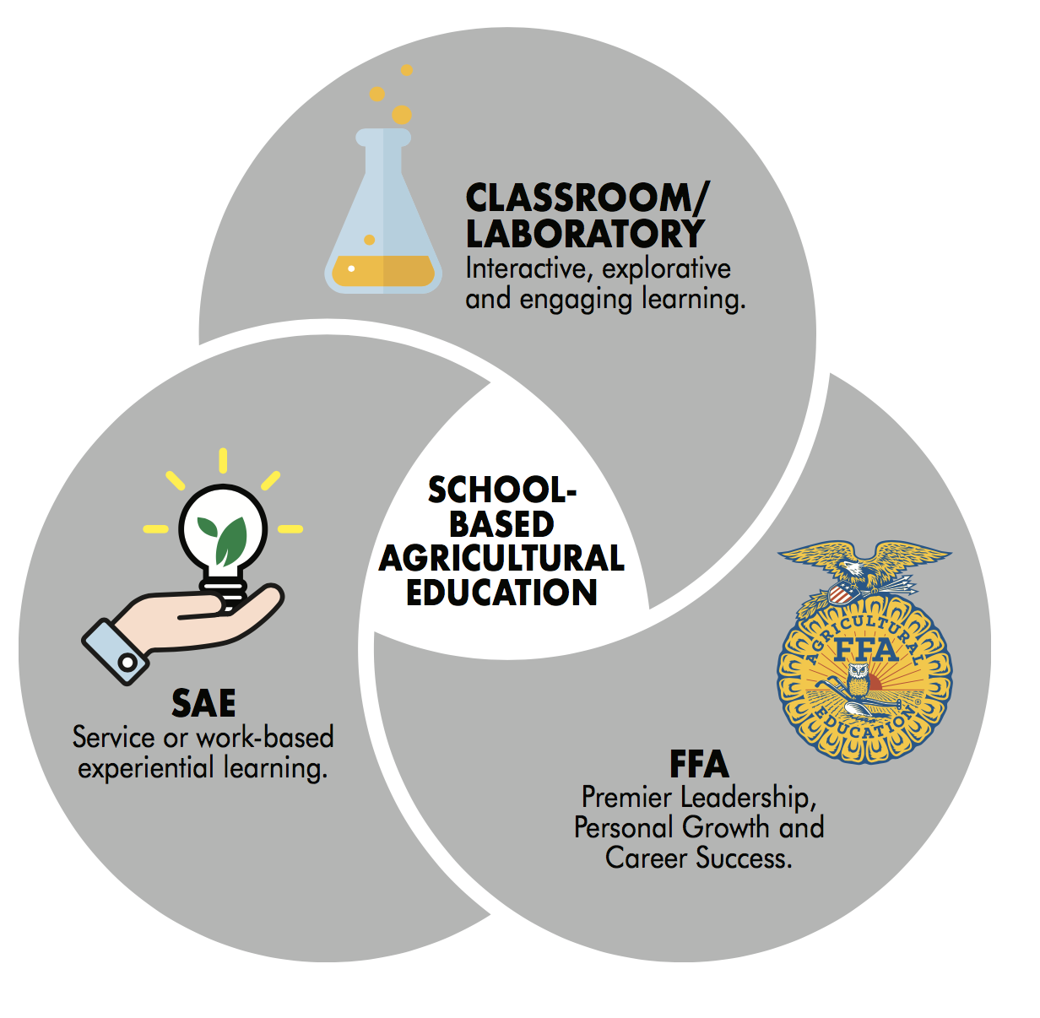
Supervised Agricultural Experience
SAE is one of the three essential components of all agriculture education programs.

Slide 3
Killingly SAE Requirements
The SAE project counts for 25% of the agriculture class grade beginning in the second quarter of your freshman year.
Your first SAE grade will be at the end of quarter 2 in January!
Each student should document a minimum of 25 hours per academic quarter.
All SAE’s require students to…
  Set SMART goals
  Keep Accurate Records
  Learn new skills
  Reflect on your learning
Depending on the SAE project, other records and state paperwork may be required; an Agriculture Teacher will help determine what is required.

Slide 4
Your SAE Project is Graded.
A Quality SAE Project focuses on the student as a LEARNER. The student…
  Sets challenging and realistic learning objectives
  Continually develops and practices new skills
  Takes advantage of opportunities to learn and grow
  Communicates with teachers and workplace mentors
  Maintains accurate and detailed records
  Meets the hourly requirements
  Keeps all required paperwork and goals current
  Documents the project (photographs, portfolios, etc.)
  Demonstrates the ability to reflect on their learning

Slide 5
Your Online SAE Record Book
When a teacher grades your SAE; they will use your online SAE Recordbook, Ag Experience Tracker website www.theaet.com
When information is missing from your online Record Book, it is very difficult to grade your SAE and you may get a lower grade than you deserve!
Your SAE Record Book should include…
  Completed SAE Plan and Annual Review
  Time (Hours and Minutes) recorded in your journal
  Income and Expenses related to your project
  Pictures or other evidence uploaded to your portfolio

Slide 6

Keep Accurate Records!
IT’s all About Showing what you Learned!!
You will be given time in class to update your online records; but it is your responsibility to make sure your records are current.
Be sure to include enough detail so that what you are learning and accomplishing is documented in your journal.

Slide 7
Quality SAE projects are built through setting Learning Objectives and working towards those Goals.
Goals are a way to keep us focused and give all our actions purpose and direction.
People who set goals and continue to work toward them set higher standards and are more likely to achieve them!
You should always have 3 current learning objectives recorded in AET.

Slide 8
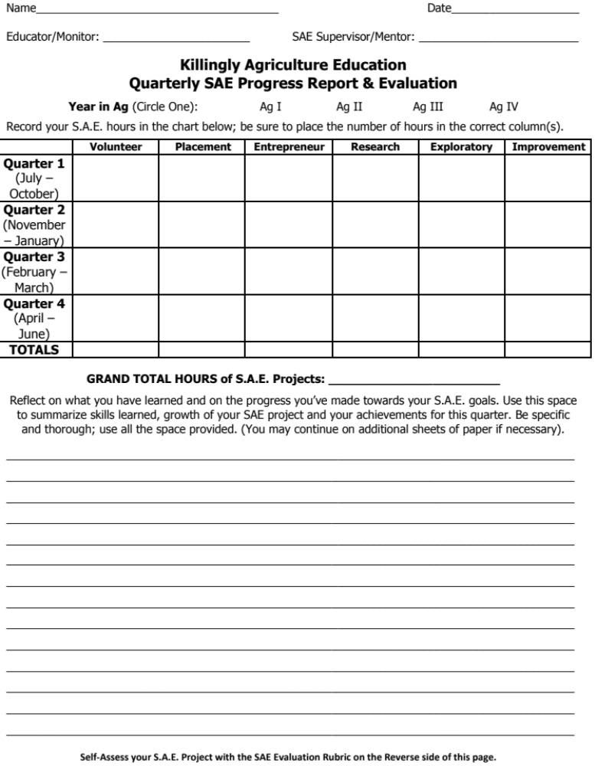
SAE Progress Report and Evaluation
You will fill it out at the end of each quarter
  Record the number of hours worked.
  Reflect and Summarize what you have learned and accomplished.
  Complete the Evaluation Rubric
Your teacher will review your record book and the use rubric to determine your grade.

Slide 9
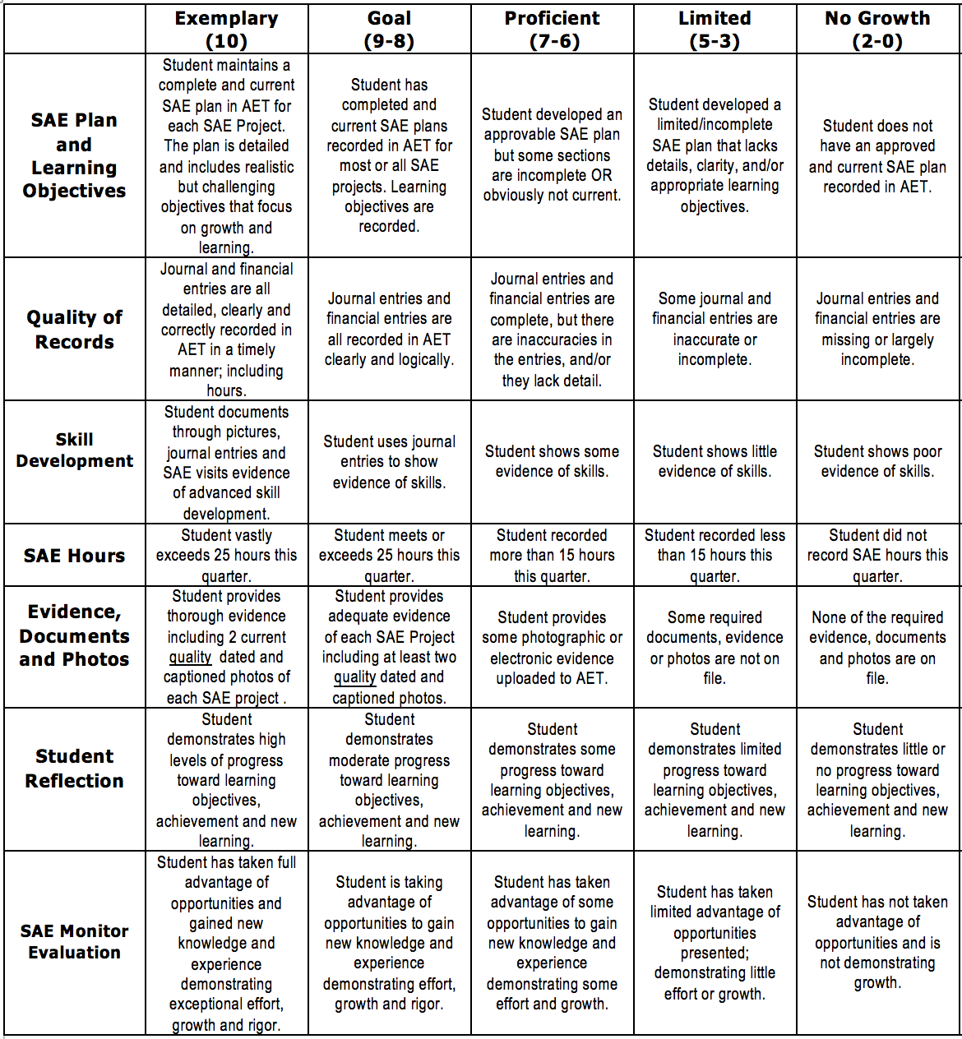
Evaluation of Your Project
No matter what kind of SAE Project you have, your SAE will be evaluated using the same Rubric.

Slide 10
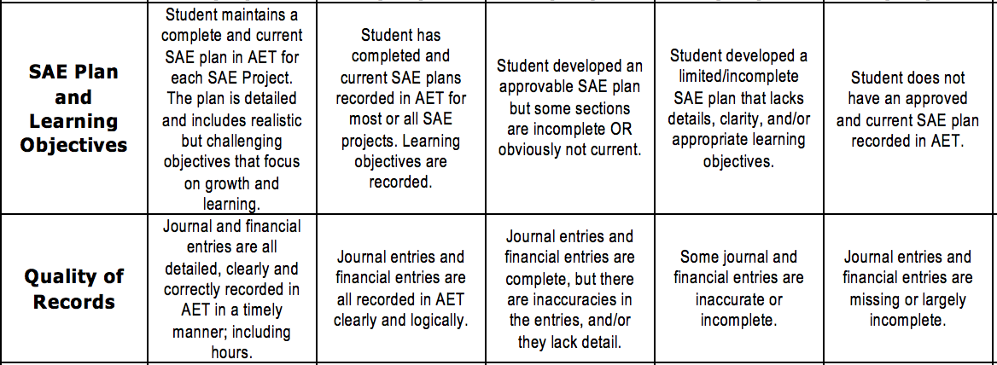
How do I get an ‘A’?
Complete an SAE Plan for each SAE and update it at least once a year!
Your plan should include 3 challenging learning objectives properly recorded in AET.
Update your financial and journal entries weekly!
Make sure that you include enough detail so that your ag teacher knows what you are learning!

Slide 11
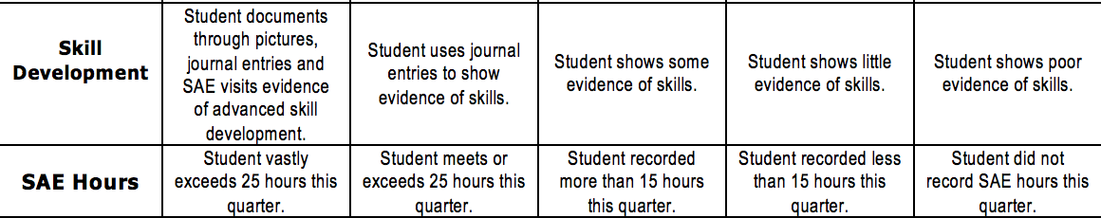
Make sure to include what you are learning! We look for statements such as…
“I learned how to…”, “_____ taught me how to…”, “I did some research to try to figure out…” .
Plan ahead so that you can devote more than 25 hours to your SAE each quarter.

Slide 12

Take at least two high quality photos of each SAE project!
High quality photos are well lit, in focus, include the students face and show the student practicing a skill.
In some cases a photo is not appropriate; other evidence could work as well, it depends on what works for your project.
We do not recommend selfies!

Slide 13
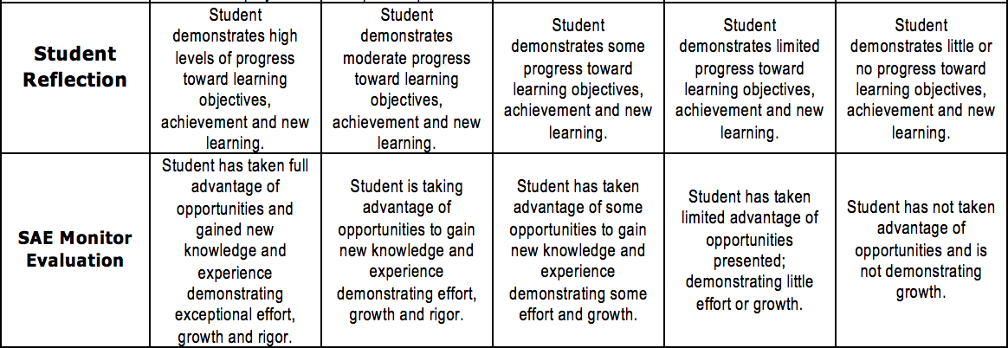
Use your reflection as an opportunity to tell your ag teacher what you have learned or accomplished this quarter.
Quality SAE projects are always growing and changing.
We want you to take advantage of opportunities to learn. As you learn more you accomplish more and build a higher quality project.

Slide 14

An SAE project is required for each Ag Student!
An SAE is the most individualized project that could be. We understand that each individual student has different interests, abilities and opportunities. We do consider these when grading your project!
Our goal is to support you so that you can graduate ready for college and/or the workforce.
A quality SAE project helps you get there!

