Slide 1




United States
Air and Space Force

Slide 2
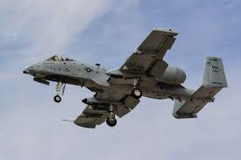
Top 25 In Demand Careers
Security Force
Tactical Aircraft Maintenance
Refuel/Bomber Aircraft Maintenance
Airlift Special Mission Aircraft Maintenance
All Sources Intel analyst
Cyber Systems Operations
Aerospace Propulsion
Munition Systems
Aircraft Armament Systems
Material Management
Cyber Transport Systems
Fire Protection
Air Transportation
Intelligence Analyst
Sensor Operator
Client Systems
Aerospace Ground Equipment
Fuels
Electrical and Environmental Systems
Air Traffic Control
Weather
Geospatial Intelligence
Services
Transmission Systems
Personnel
You can learn about all of the careers and 100+ more by checking out our IG @AirForce_TriCities or at airforce.com

Slide 3
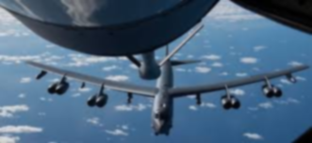
Benefits
Education Benefits
  Tuition assistance
    $4,500 each year!
  Post 9/11 G.I. Bill.
    Use during or after your service. Tuition paid and housing allowance for the location of your school. (average $1,833 per month)
  Community College of the Air Force.
    BMT, Tech school and much more is college accredited with your every day job in the Air Force!
Travel
  Permanent Change of Station(PCS)
  Temporary Duty (TDY) – business trips
  HOPS (Free Military Flights)
Outdoor Rec/Organized Trips
  Cheap outdoor rental gear
    Tents, Boats, Kayaks, trips to nearby adventures like London, Disney, Etc.
Paid Vacation
  2.5 Days/Month/30 days year
  Keep 60 days total
  Holidays off and paid
  “Family days” linked with holidays. Ex: Thanksgiving on Thursday, family day on Friday. Both off and paid

Slide 4

Starting pay and allowances
Will be about $3,609 if you lived off base/in the city of Kennewick
Base Pay: $2,043 + Housing: $1,197 + Food Allowance: $369
Base Pay
  E-1 : $1,733 Per Month
  E-2 : $1,943
  E-3 : $2,043
Basic Housing Allowance (BAH)
  $1,197 per month for Kennewick
  Non-taxed
  Varies by base/city
Food Allowance
  $369 Per Month
  Non Taxed
 | Air Force (E-3, 2 years in the AF, in the dorms) | Civilian (above min wage)
Total Pay/Monthly | $2,043 (salary-monthly pay) | $2,080 ($13/hr)
Rent/Mortgage | Included | Average $950
House Bills | Included | Average $200
Food expenses | Included | Average $300
Medical | Included | Average $500
Cell Phone | $75 | $75
Car note/Insurance | $50 | $50
$TAKE HOME MONEY$ | $1,918 | $5

Slide 5



Contact Info
        Are you qualified to join?
        Open your camera and scan the icon!
      Technical Sergeant Adam Wriglesworth
      910 S. Columbia Blvd Ste F. Kennewick, WA 99336
      Cell: 509-412-2289
      AirForce_Tri-Cities

