Slide 1

Monarch
College Credit Opportunities

Slide 2

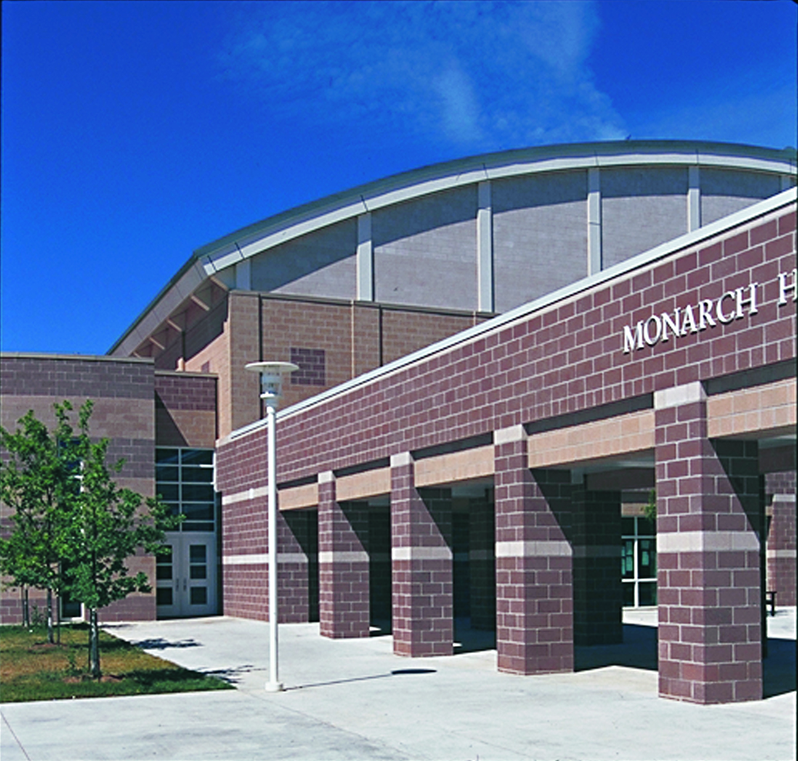
College Credit Program
VISION
Monarch provides students with the opportunity to earn substantial college credit, through college level courses in a variety of content areas. Our vision is to make college credit something all students can obtain.

Slide 3
College Credit Program
MISSION
In an effort to make our vision a reality, Monarch High School will…
purposefully build opportunities that provide all students with access to college credit bearing courses, and
promote student success by providing targeted and specific support for staff and students, and
inform and provide opportunities for staff to earn the required credentials to be able to support a growing concurrent enrollment program.

Slide 4
College Credit Program…
Goals
Increase levels of student engagement and motivation
Increase resiliency and decrease at-risk behavior
Academic articulation and coherence between grade levels and college
Continue high graduation rates
Prepare for postsecondary education and careers
Increase post secondary options
Increase college acceptance, retention, success, and completion rates

Slide 5

Who We Are...
Neil Anderson - Principal
Mark Sibley -
Assistant Principal and CTE Coordinator
Jody Bennett - CTE Teacher
Michael Blakely - CTE Teacher
Jo Harpring - Counselor
Madeline Brockish - BVSD Coordinator for Concurrent/Dual Enrollment
Deborah Craven - Dean of Instruction
Marty Goldberg - Director, High School Programs
Rick DeVoss - Student Services Coordinator
Deb Craven - Instructional Coordinator
Jaime Bertrand - College Now Student Services Coordinator

Slide 6
Concurrent Enrollment …What is It
Opportunity to simultaneously earn college and high school credit from enrollment in one class at one time
MoHi Teachers are Adjunct Professors @ FRCC and/or CU
MoHi Teachers co-teach with FRCC instructors
Follow FRCC/CU curriculum/standards @ Monarch
College level course with high school supports
Ability to take approved courses on college campus

Slide 7
College Credit Program…
What & Why?
High School of Business provides a comprehensive program to support student success
Potential to earn up to 60 credits while in high school
Many courses are transferable to 4-year colleges or universities
  Determined by receiving institution
  Transferology
Will increase college/career readiness
Increased student motivation
Deep engagement and advanced coursework
Early career path development

Slide 8
Students who participate in college credit opportunities are more likely to:
Graduate from high school
Enter and persist in college by being prepared for college rigor
Earn substantial college credit in high school
Save time when pursuing a four year degree after high school
Save money by completing college classes in high school, and are less indebted as college graduates
More readily take credit bearing college classes upon admittance to college
Need up to 30% less remediation

Slide 9
+ Front Range Community College
Monarch High School and Front Range Community College are partners.
Over the past several years representatives from each school have collaborated to develop the Monarch College Credit Program.
J

Slide 10
Concurrent Enrollment w/ FRCC
…What Courses
B04a Marketing Management Entrepreneur Front Range CC Intro Entrepreneurship ENP 105 FREE 3
B04b Marketing Management Entrepreneur Front Range CC Marketing for the Entrepreneur ENP 205 FREE 3
B33a Prin of Business & Economics Front Range CC Intro to Business BUS 115 FREE 3
B33b Prin of Business & Economics Front Range CC Intro to Economics ECO 105 FREE 3
B35b Principles of Marketing Front Range CC Principles of Marketing MAR 216 FREE 3
B37S Principles of Finance Front Range CC Principles of Finance 201 FREE 3
B38S Principles of Management Front Range CC Principles of Management MAN 226 FREE 3
B44S Business Law Front Range CC Legal Environment of Business BUS 216 FREE 3
B71a Business Internship Front Range CC Internship BUS 281 FREE 1
B83S Marketing Internship Front Range CC Internship BUS 281 FREE 1
T77S AP Microeconomics Front Range CC Principles of Microeconomics ECO 202 FREE 3
T75S AP Macroeconomics Front Range CC Principles of Macroeconomics ECO 201 FREE 3
College Credit Listing

Slide 11
Concurrent Enrollment w/ FRCC
…Cost
FREE!!!
BVSD will cover tuition cost of approved FRCC concurrent enrollment courses during the school year
Student/Family responsible for course fees for courses taken on college campus
Summer course tuition & fees?

Slide 12
CU Succeed
Courses where students earn Univ of CO college credits upon successful completion of the course
Like Concurrent Enrollment, student simultaneously earns high school and college credits
Tuition required ($77/credit)
Many courses are transferable to 4-year colleges or universities
  Determined by receiving institution

Slide 13
College Credits w/ CU
…What Courses
Advanced Pre-Calculus
Calculus AB
Calculus BC
Calculus II
Calculus III
Statistics
Biology
Chemistry
Physics
Computer Science
Marketing 3
College Credit Listing

Slide 14
AP Coursework
College Board Advanced Placement (AP) approved curriculum for college credit
Nationally standardized program
Credit determined by receiving institution based on exam score
Exam fee required ($97)
Notes:
** Generally this is the case

Slide 15
College Credit w/ AP
…What Courses
Art History
Biology
Calculus AB
Calculus BC
Chemistry
Computer Science
English Lang. & Comp.
English Lit. & Comp.
European History
French
Macroeconomics
Microeconomics
Physics
Spanish
Statistics
U.S. Gov. & Politics
U.S. History
World History
German
Human Geography

Slide 16
Concurrent Enrollment…
Student Support: Academic
Students will have access to:
  Weekly Access Time @ Monarch
  Peer Tutors in Tutor Center @ Monarch
  The FRCC Online Writing Lab
  Tutoring in the FRCC Student Success Center as needed
  Accommodations for 504, Special Education, and ESL
    Provided by Monarch High School staff
  Academic Advising from FRCC and MHS

Slide 17
FRCC…
Student Support Services
  Front Range Community College staff will have a dedicated space at Monarch High School to meet with students and support their success.
  Additional support will be provided by Front Range Community College to support course selection at key times during the academic year (Spring Course Selection, Beginning of the Academic year) and for the application process and for D2L Assistance.

Slide 18
  Principles of Business & Business Economics
...Expectations
  Gives a broad introduction to the world of business and the project based learning concepts used throughout HSoB
  Classes are challenging, and follow the expectations of an introductory level college course, but assignments, projects and learning environment are geared toward busy Freshmen and Sophomore students.
  Anyone possibly interested in business will receive a useful foundation in the practical application of business principles.

Slide 19
Business Law
...Expectations
  Low stress, low pressure, and entertaining in a low pressure environment that should not be a significant drain on their time and energy.
  Role playing to learn about concepts such as forming a business (“If I’m opening a lemonade stand, do I need to form a limited liability company?”) or using your property to run a business (“If I wanted to open a skate/snowboard park in Louisville, are there any restrictions on the land that would prevent me from doing that?”) or what to do if your business fails (“Bankruptcy??? But that would never happen to me, my business selling underwater basket weaving kits is bulletproof”).
  Students also get a chance to argue legal cases related to contracts (“what happens if you contract to ship your car across the ocean and the ship sinks), property (“can the city take my property and give it to a business if that business is going to make a ton of money for the city?”) or torts (“if I ship contaminated lemonade to Florida, can I get sued there?”).
  Mock trial at the end of the semester, where students can lawyer-up and apply what they’ve learned in a trial setting.
  Almost all homework is completed in class.
  Historically, 9th graders have done well. Probably the best quote to encapsulate this comes from a 9th grader:
    “I learned a ton of stuff in this class, and it was way more fun than I ever imagined it would be going into it.”

Slide 20
FRCC Enrollment Process
Apply to Front Range
COF (College Opportunity Fund)
  Sign up for COF at www.frontrange.edu/cof
  Stipend that pays a portion of in-state tuition. Failure to apply for the COF will result in paying higher tuition. BVSD is only responsible for tuition costs minus COF.
  This step may have been completed with the online application.
Complete FRCC Agreement
  Return to Jo Harpring
Register for FRCC Course
  Beginning of semester with FRCC support

Slide 21

Concurrent Enrollment…
Q and A

