Slide 1
The Impact & Implications of Microaggressions
A Reinforcement of Trauma
By: Rachel v. Jones ‘08

Slide 2
Community Agreements for the Chat Box
AFFIRM Sentiments and experiences!
Lean into your growing edge & meet people at theirs
Try to be fully present
DON’T debate, do seek clarity…..Q&A time after session ends!
What is said here stays here, what is learned here leaves
  Please note: complete confidentiality is limited since this will be available on the visi website

Slide 3
Who are you talking with this evening??
White Team Victory! + love for NYC= DMV born, NYC raised
My why?

Slide 4
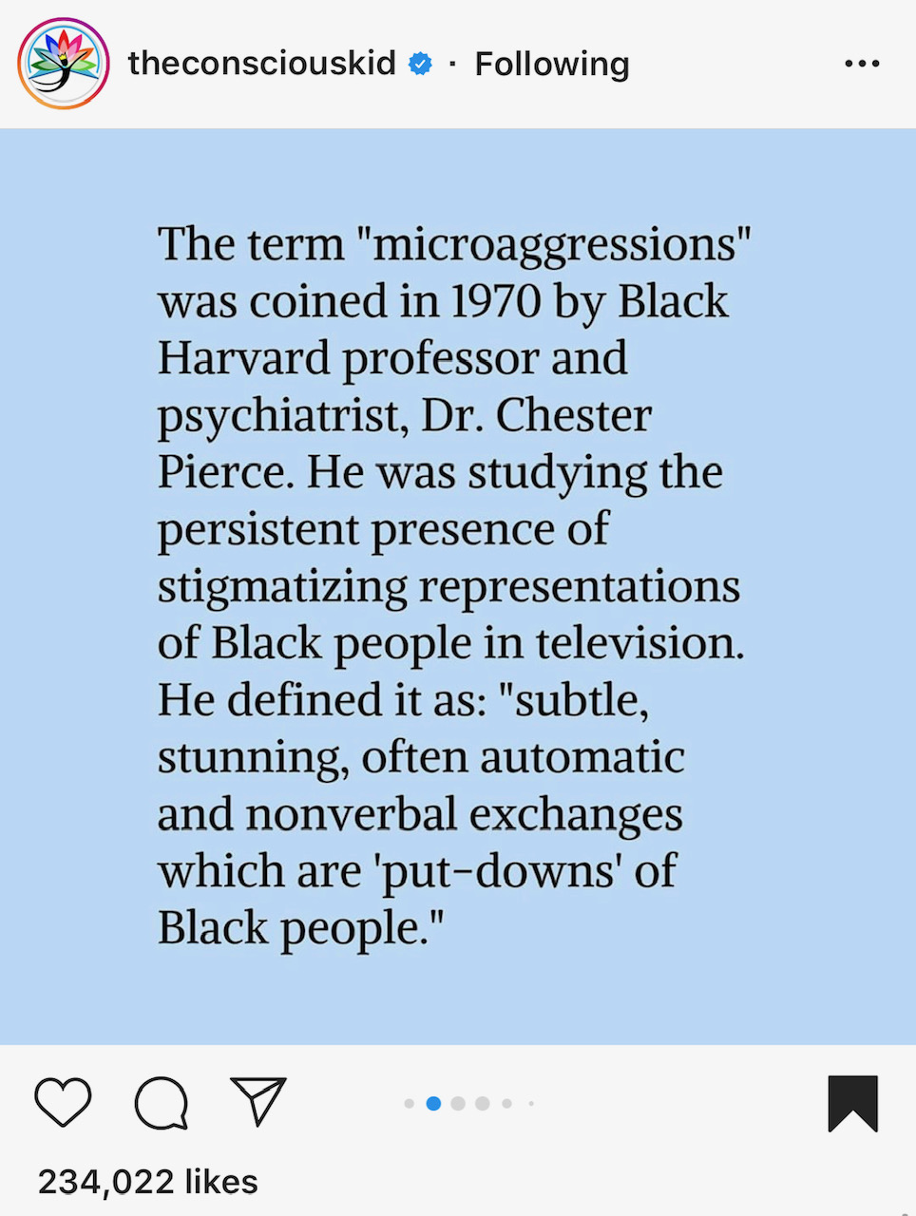
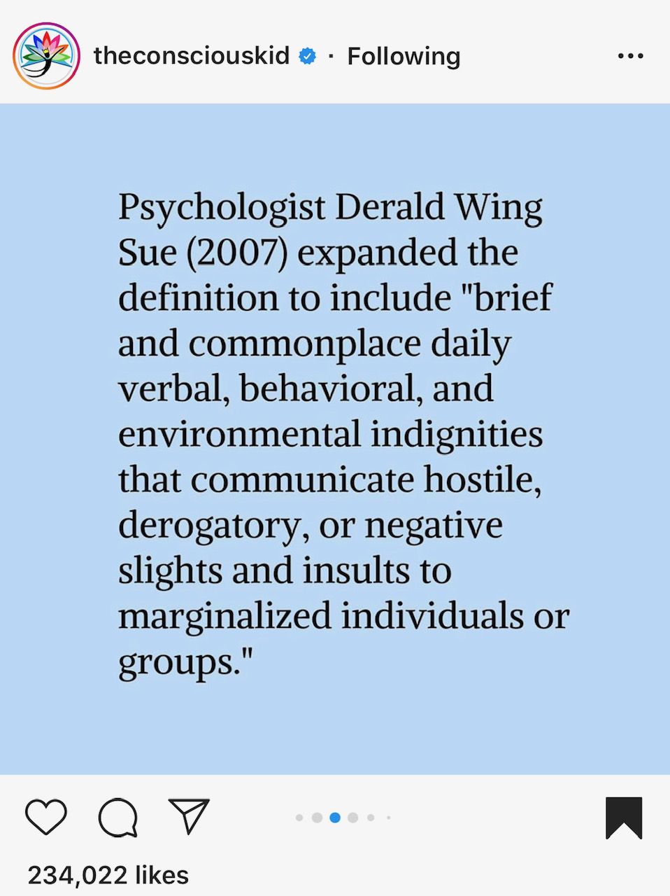
What is a Microaggression??

Slide 5
Things to remember about Microaggressions….
They are reflective of ingrained, often implicit and unconscious ideologies
They can create or reinforce oppressive narratives for POC, especially BIPOC (Black, Indigenous People of Color), which could impact how they navigate workspaces, friendships/relationships, schools, stores, and all types of environments
They can prompt either self defense OR defensiveness- the distinction is important (we’ll circle back to this)

Slide 6
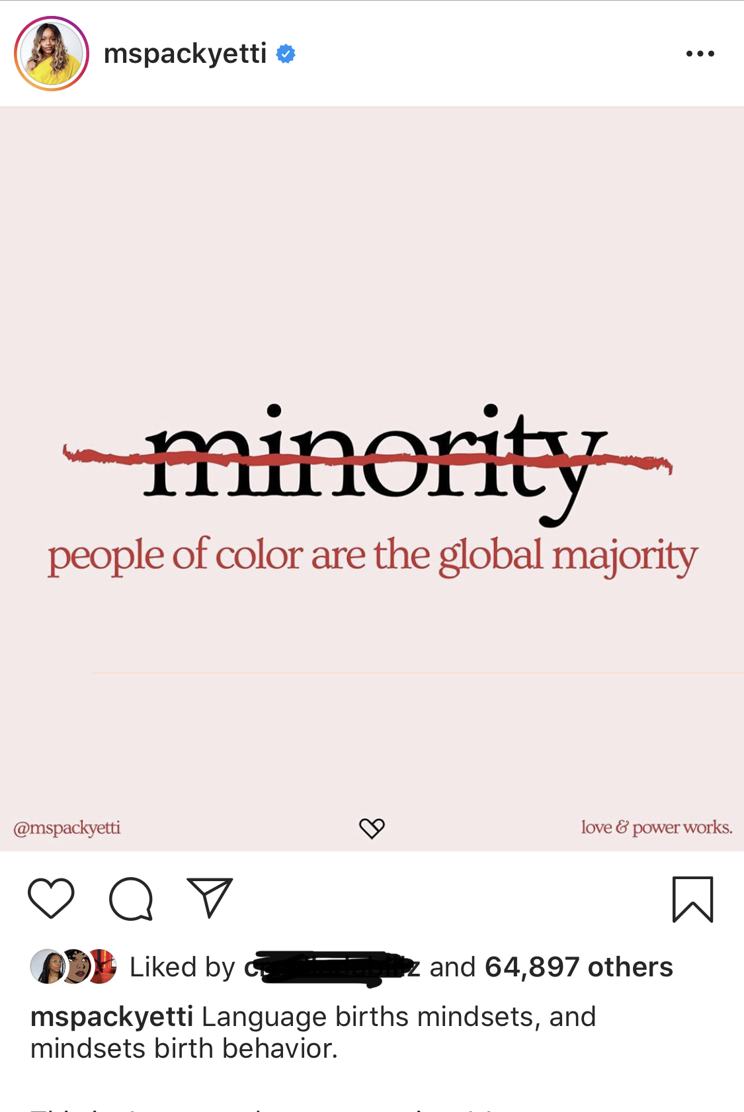
-Microaggressions function as feedback loops
-Intent vs. Impact

Slide 7
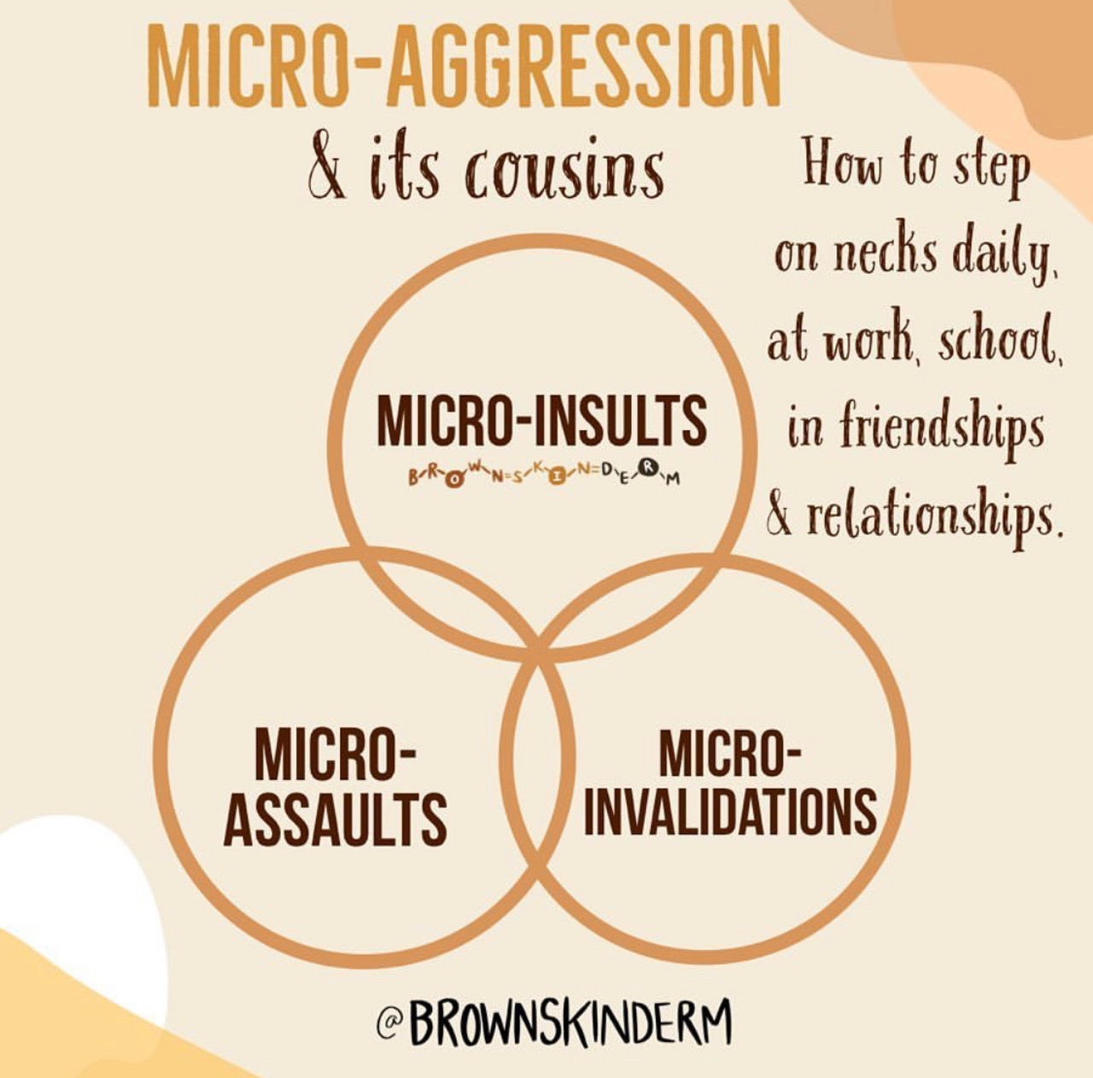
Types of Microaggressions

Slide 8
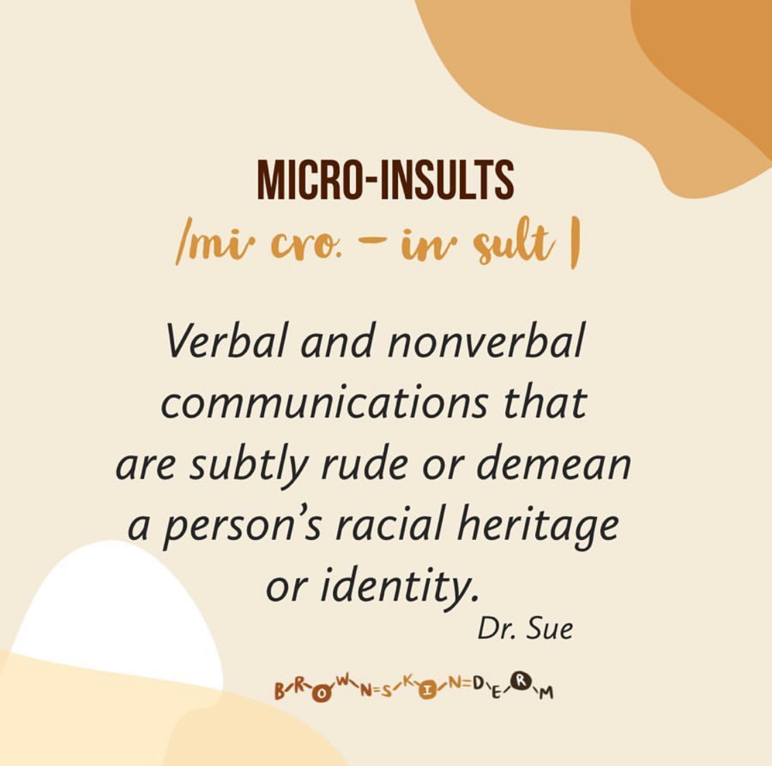
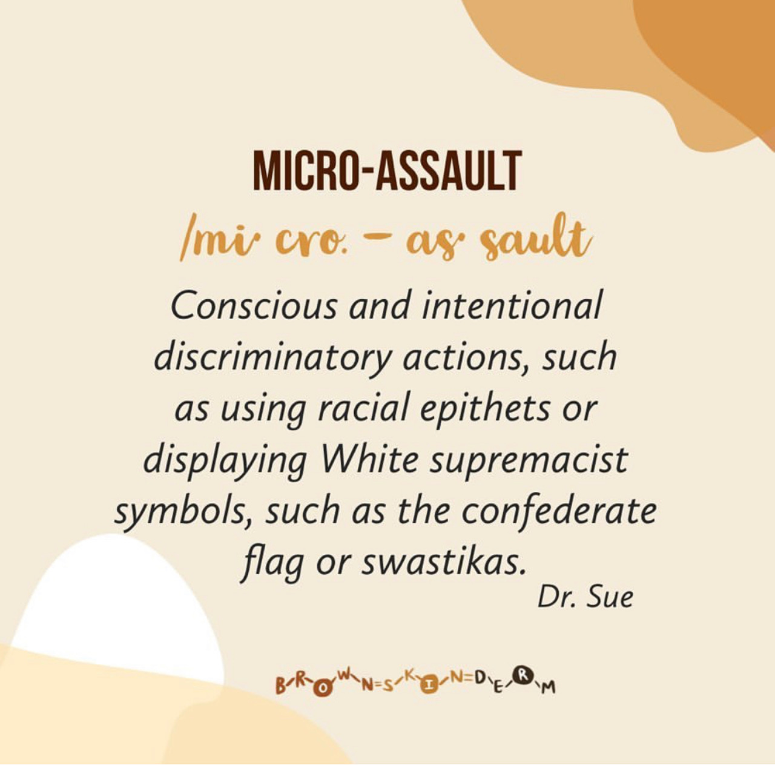
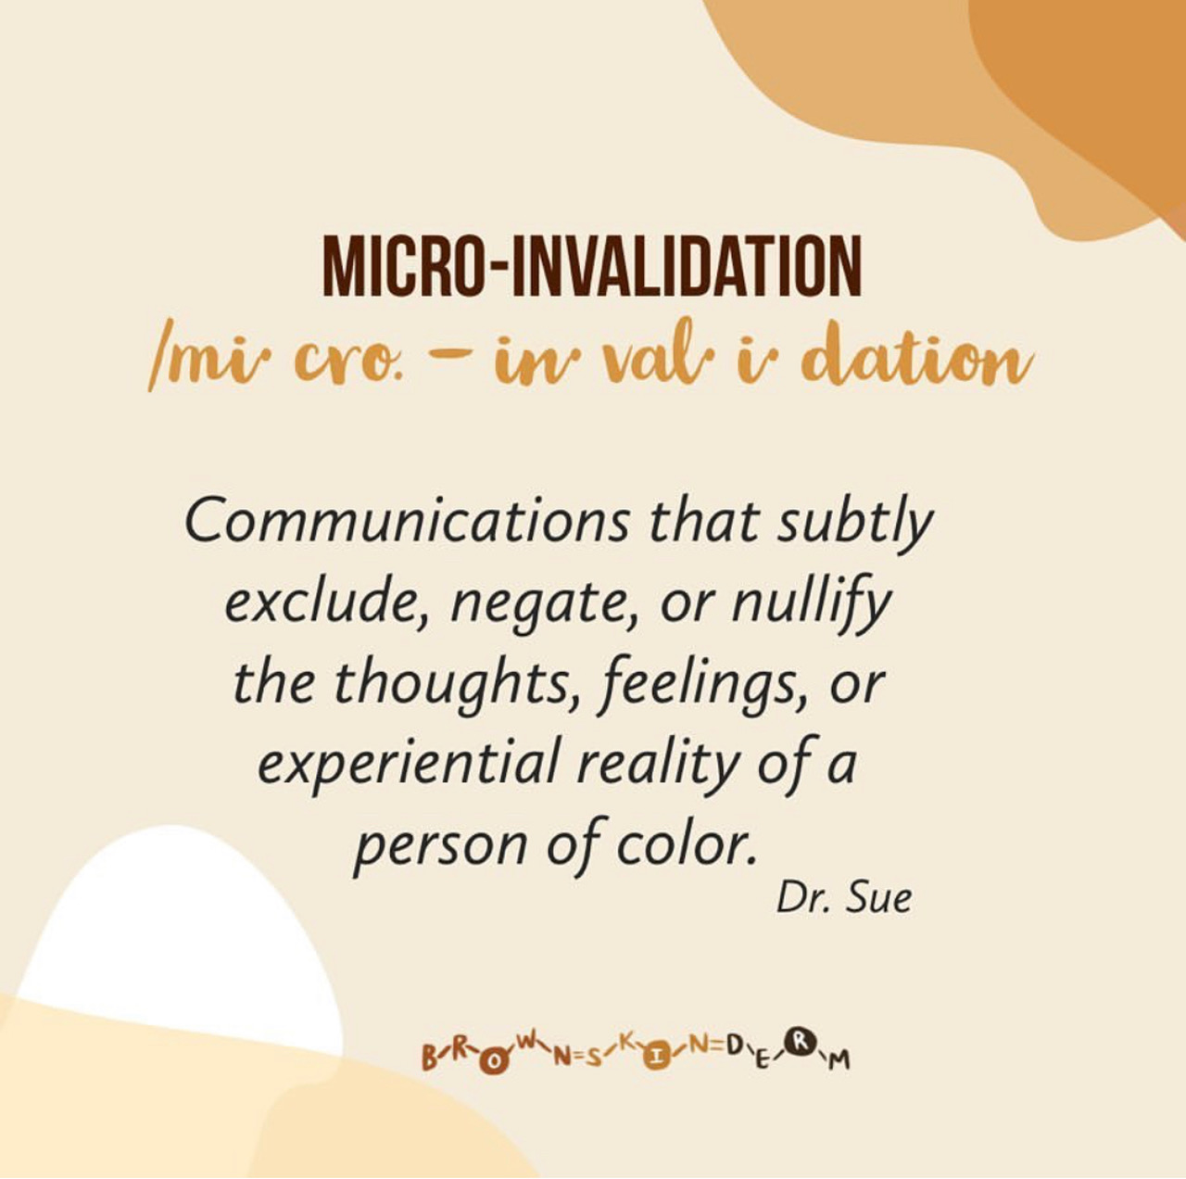
3 Types of Racial Microaggressions

Slide 9
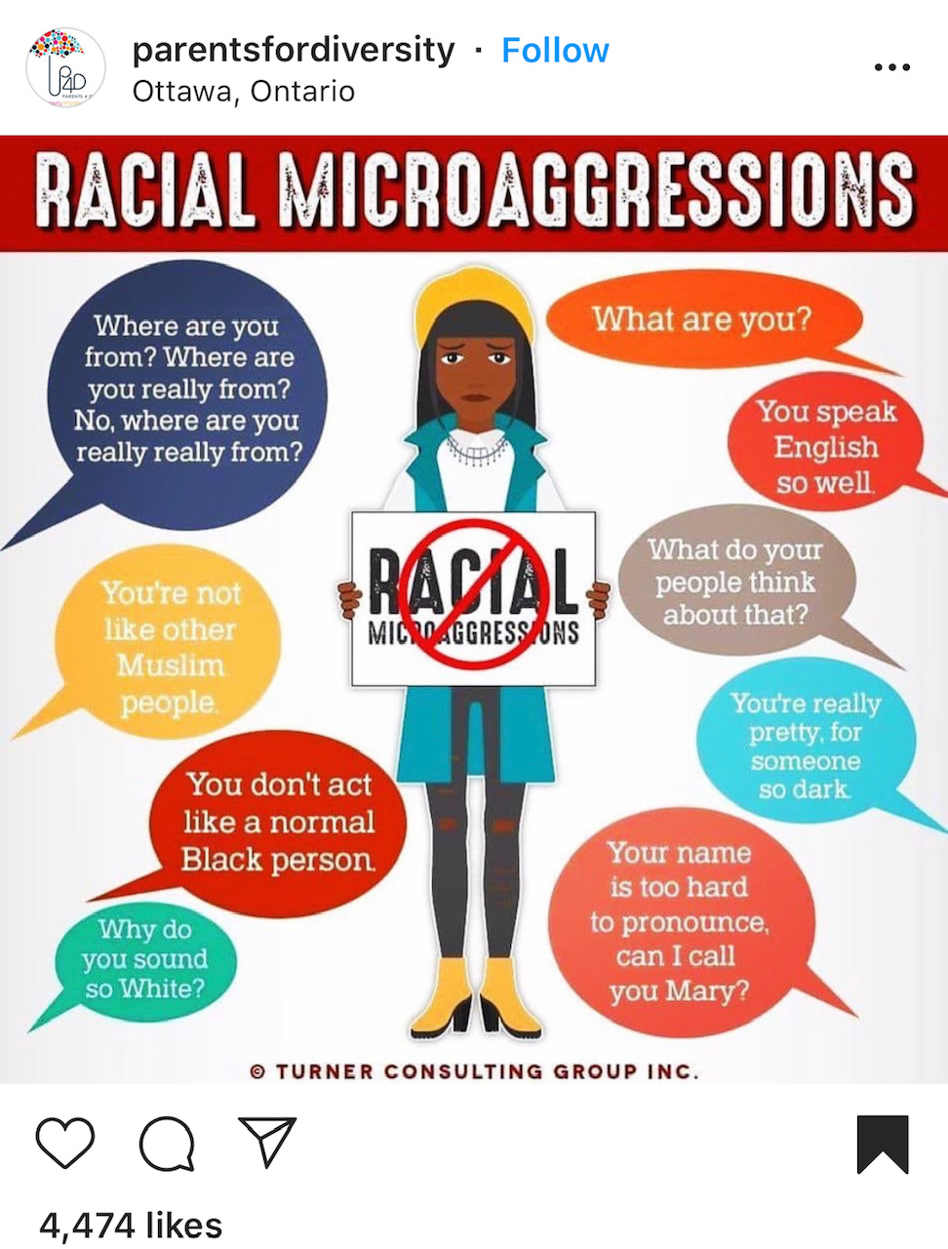
Microaggressions reflect themes & ideologies
Let’s take a breath….the examples are overwhelming.
Notes:
https://academicaffairs.ucsc.edu/events/documents/Microaggressions_Examples_Arial_2014_11_12.pdf

Slide 10
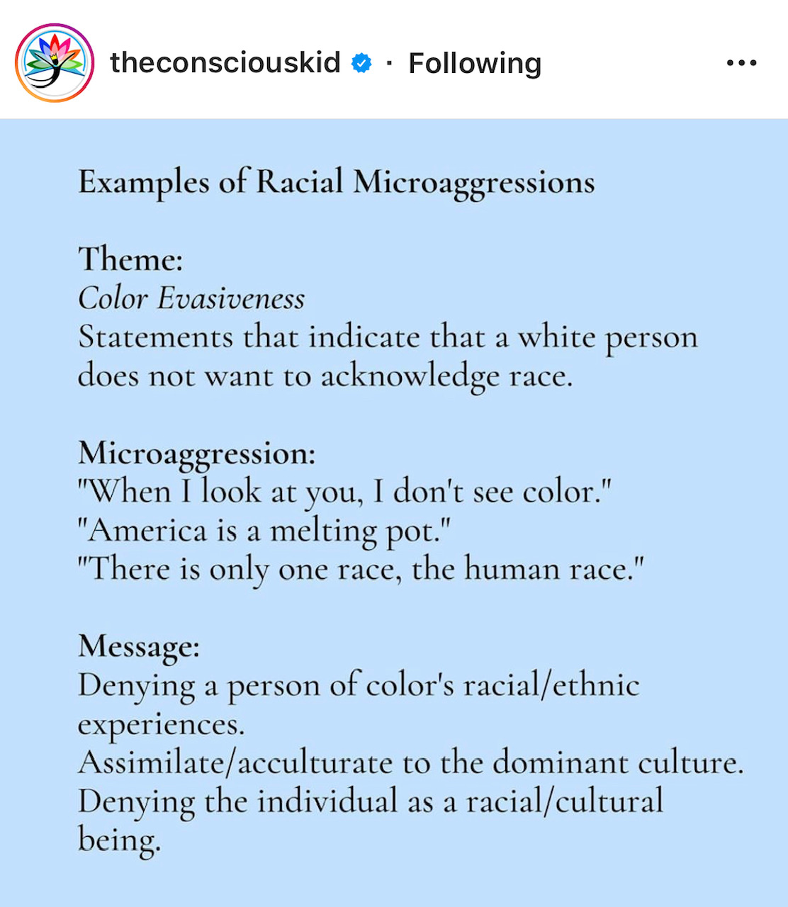
Color Evasiveness
Current Examples:
“ALL Lives Matter”
We’re All Human
There’s only one Human Race
The Impact: ERASURE OF POC’s Individual & Collective EXPERIENCES
*Remember: if you don’t acknowledge my Blackness, you aren’t acknowledging my full humanity

Slide 11
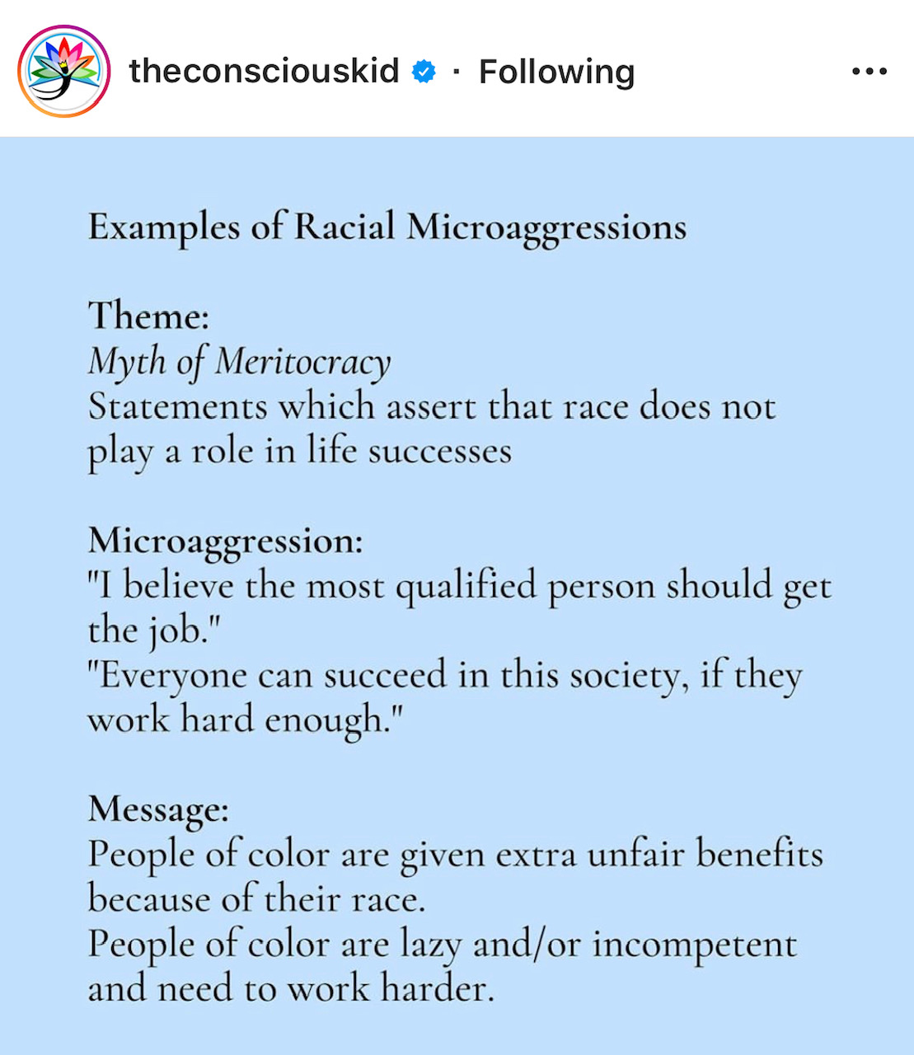
MYTH OF MERITOCRACY
Ideology:
Work Harder
Black Exceptionalism Ex: Obama, Oprah, etc.
Dismissal of Generational Wealth Gaps
The Impact: ERASURE OF POC’s Systemic Oppression, Structural Barriers and Micro Trauma
(Ex: Affirmative Action)

Slide 12
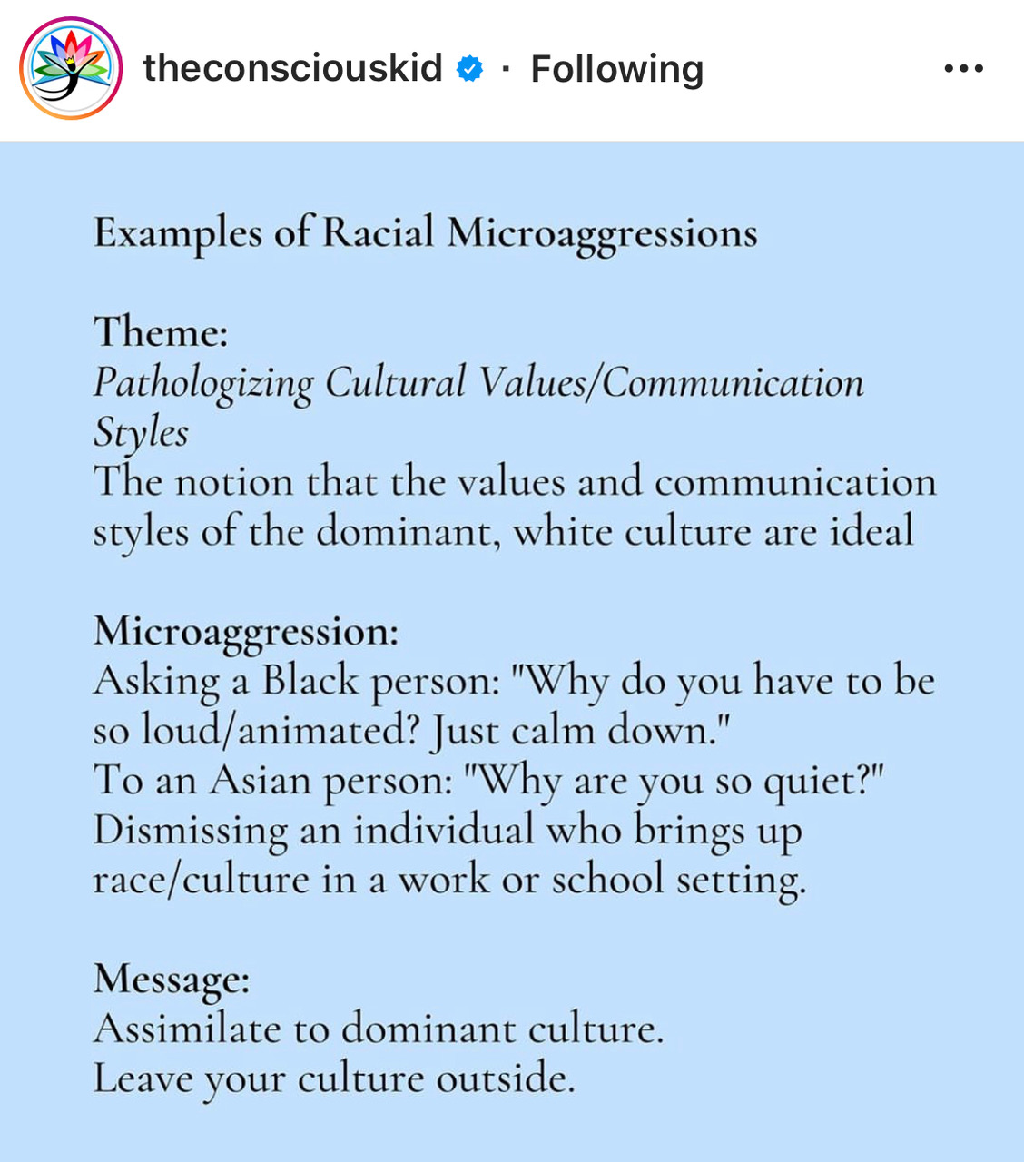
Pathologizing Cultural Values & Communication Styles
The Impact: Places White Dominant Culture as the norm
Chat Question: How did this appear in rhetoric around George Floyd and Black Lives Matter Protestors?
Underlying Message: BIPOC need to uphold respectability politics (act in a way that makes white folks comfortable)

Slide 13
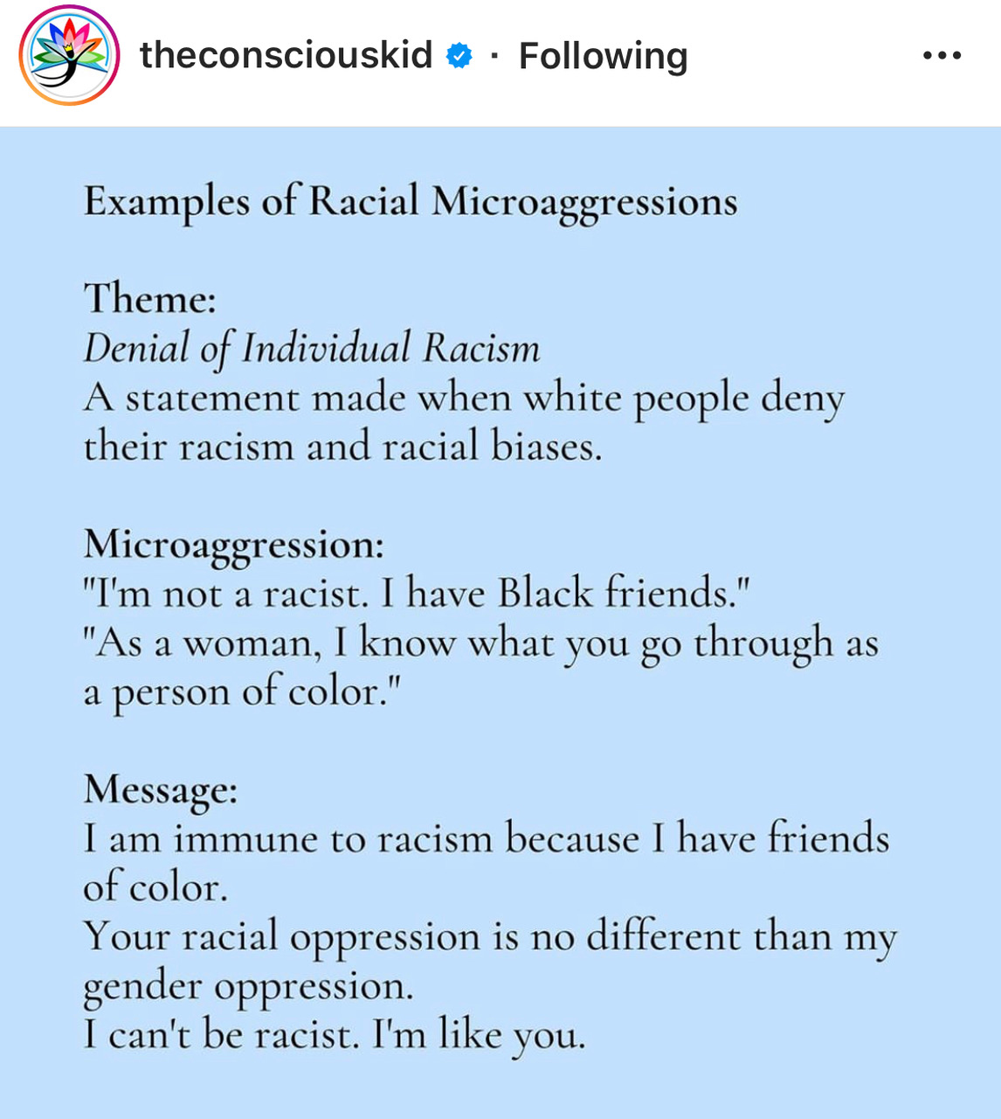
Denial of Individual Racism
Ideology: I’m exempt, distancing from oppressor
The Impact:
Dismisses unconscious notions of white supremacy and influence of biased systems that were made to benefit White people (Ex: redlining)
Notes:
*Remember: You can’t undo racism if you deny it
**White folks are victims to racism too b/c unearned privileges

Slide 14
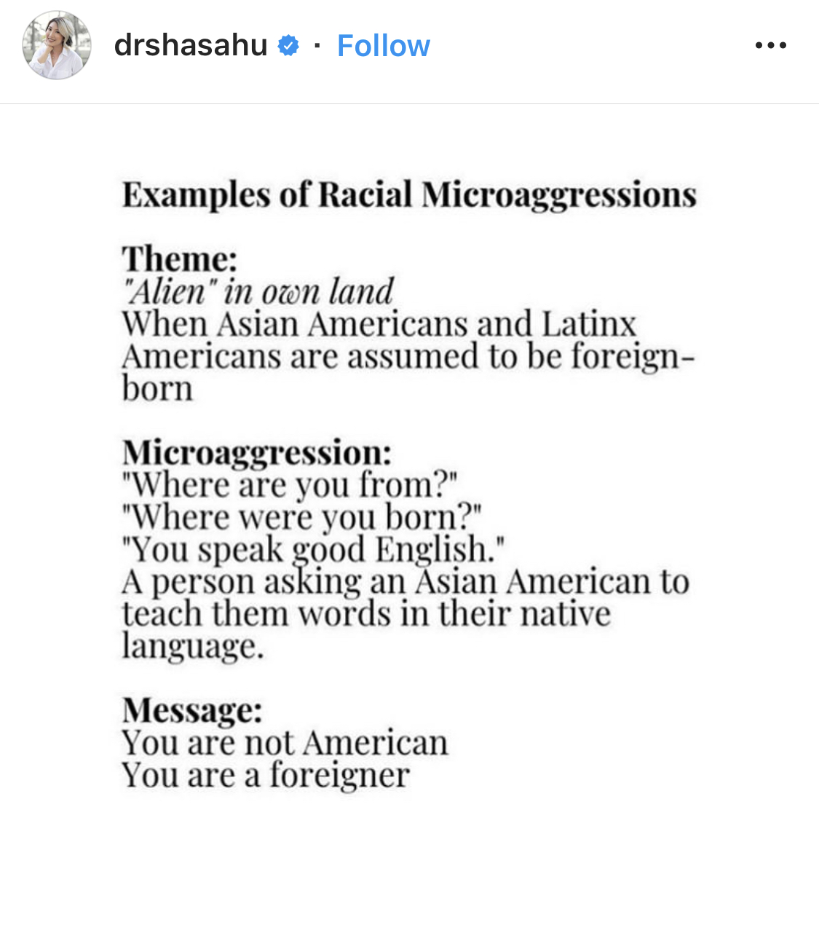
What is the message???
You are NOT an American
You are a foreigner/outsider

Slide 15
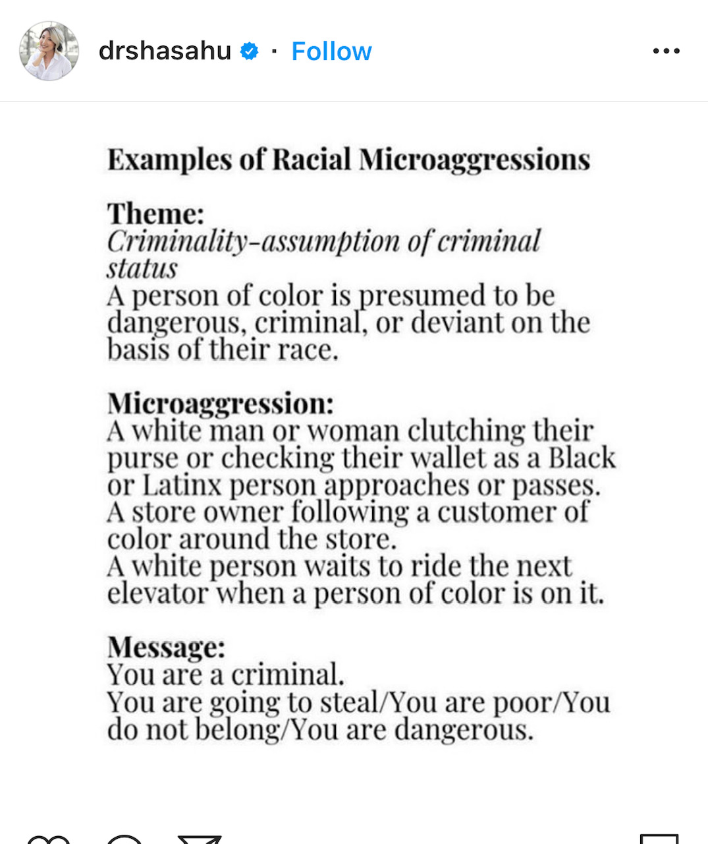
What is the message???
BIPOC are unsafe threats
POC are criminals
Othering:
  They steal
  They are poor
  They do not belong here (Ex: “Permit Patty”)

Slide 16
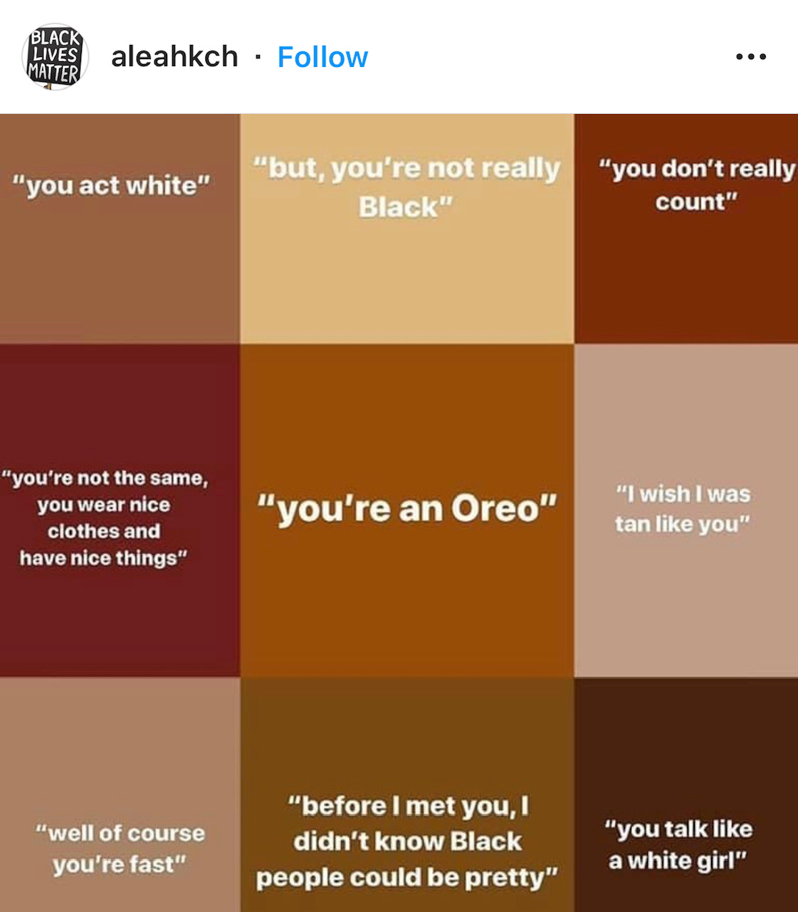
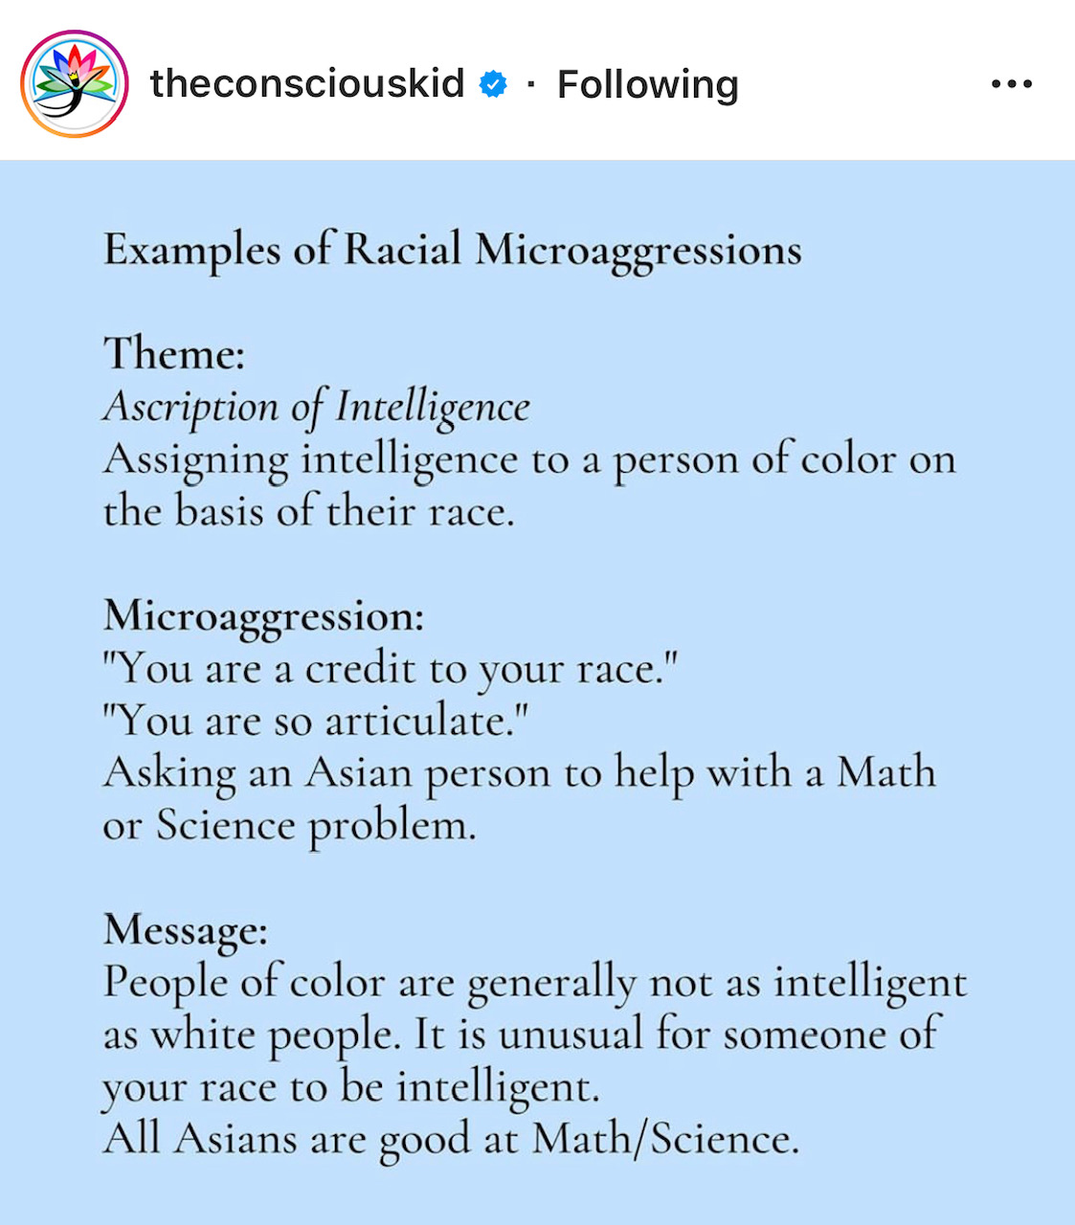
Racial Microaggressions at School… or the Workplace

Slide 17
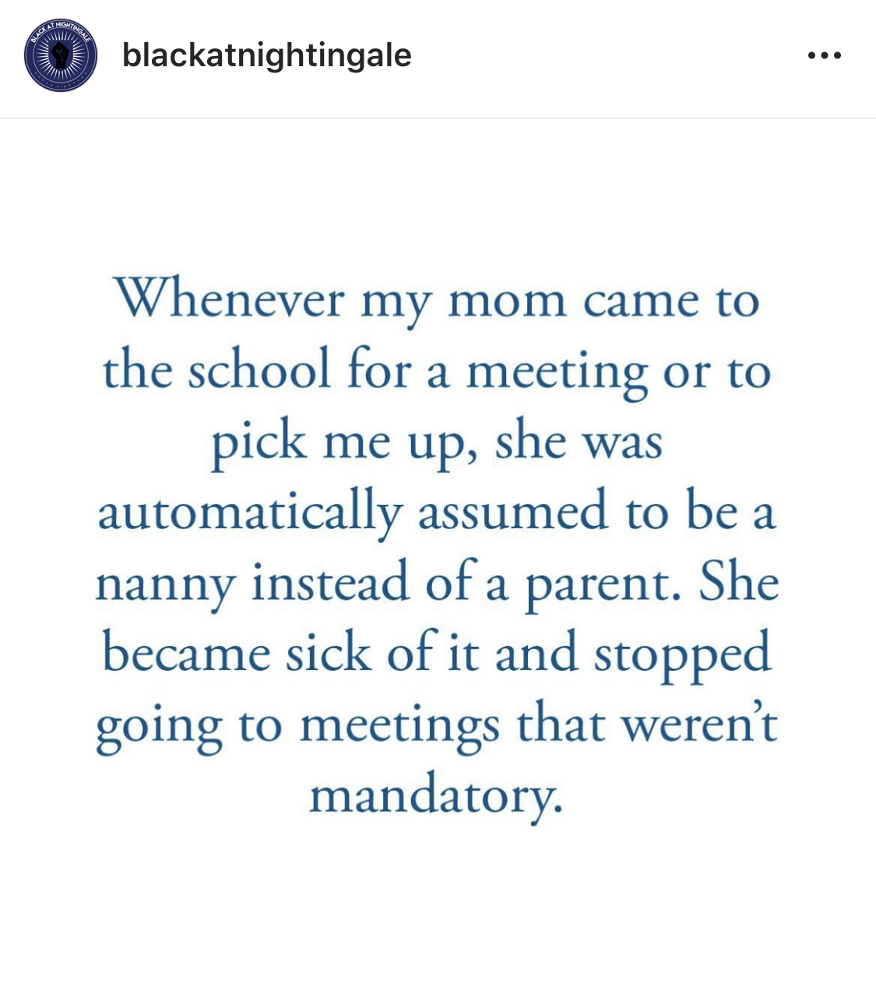

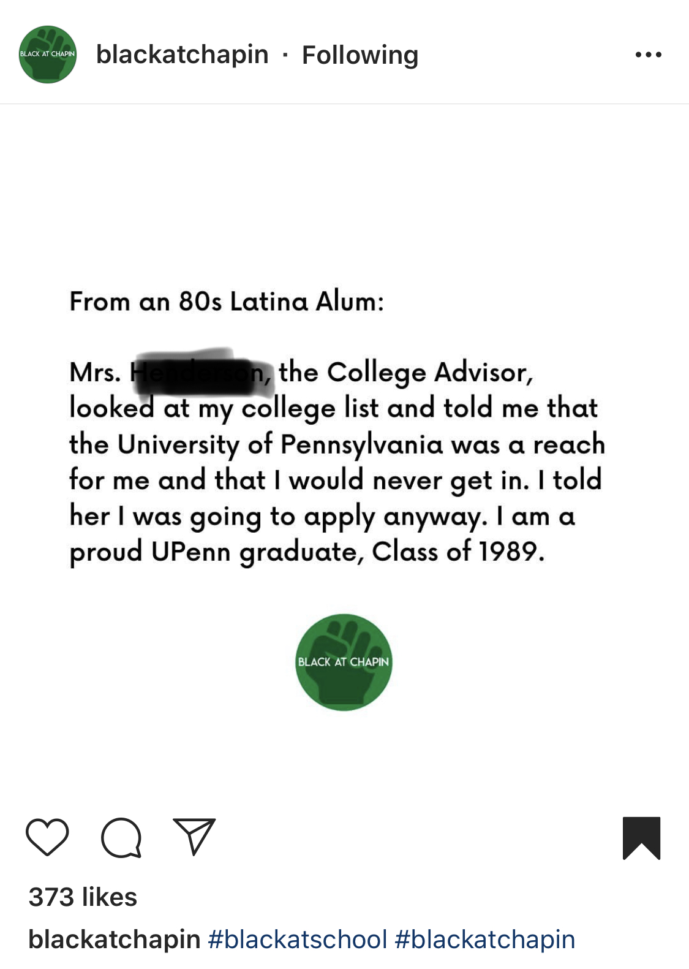
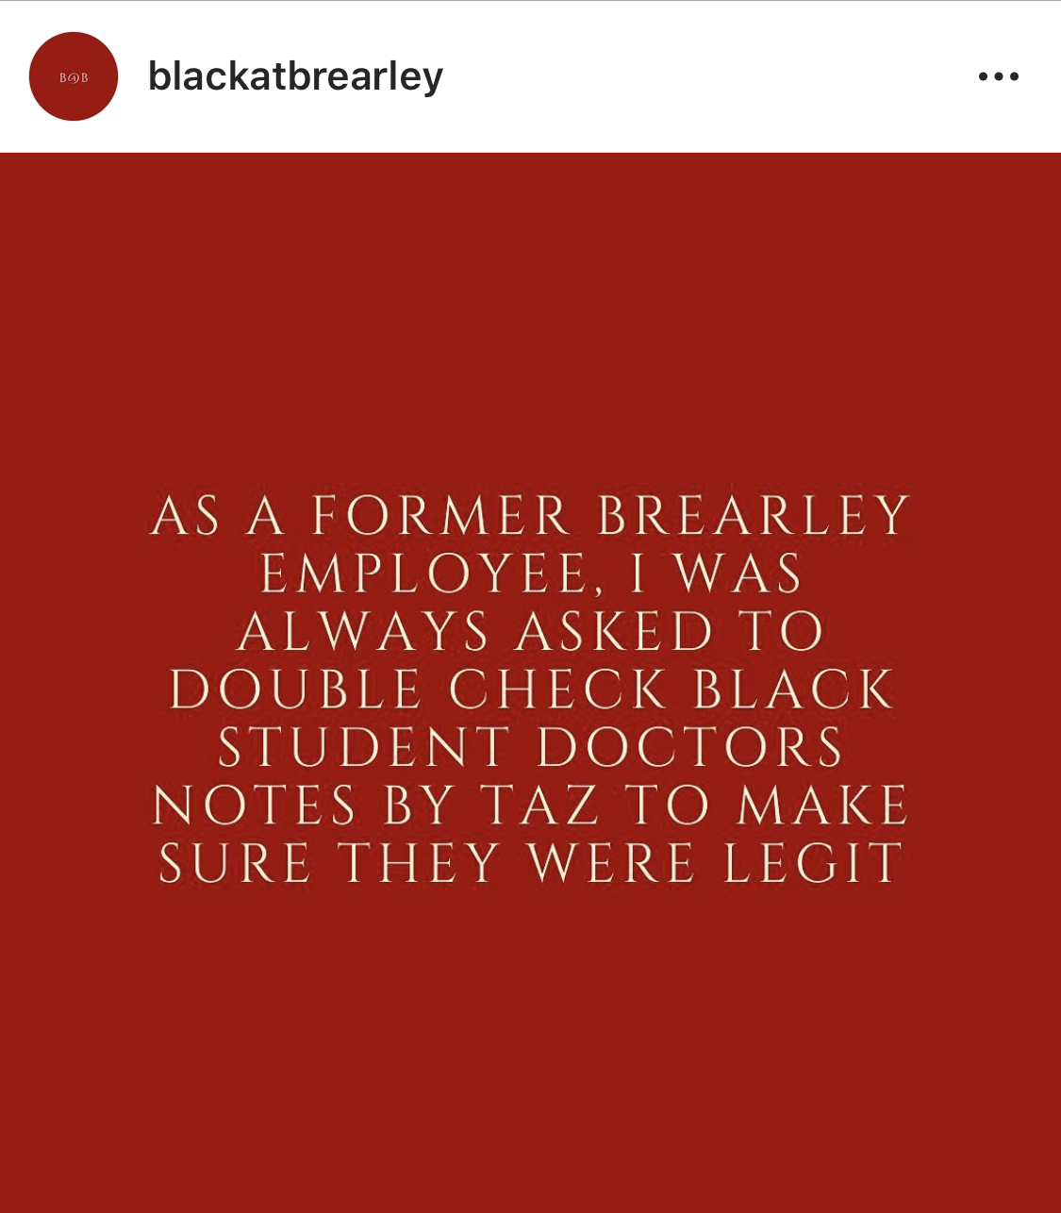
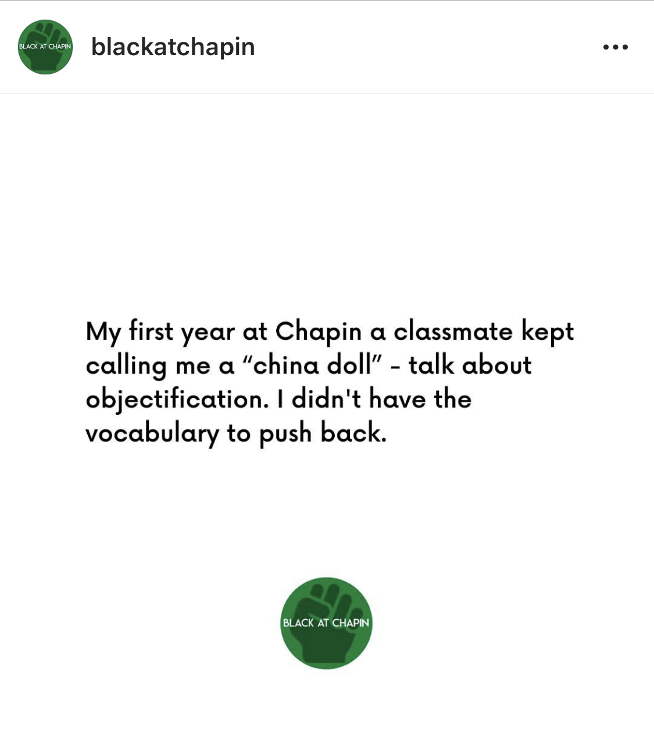
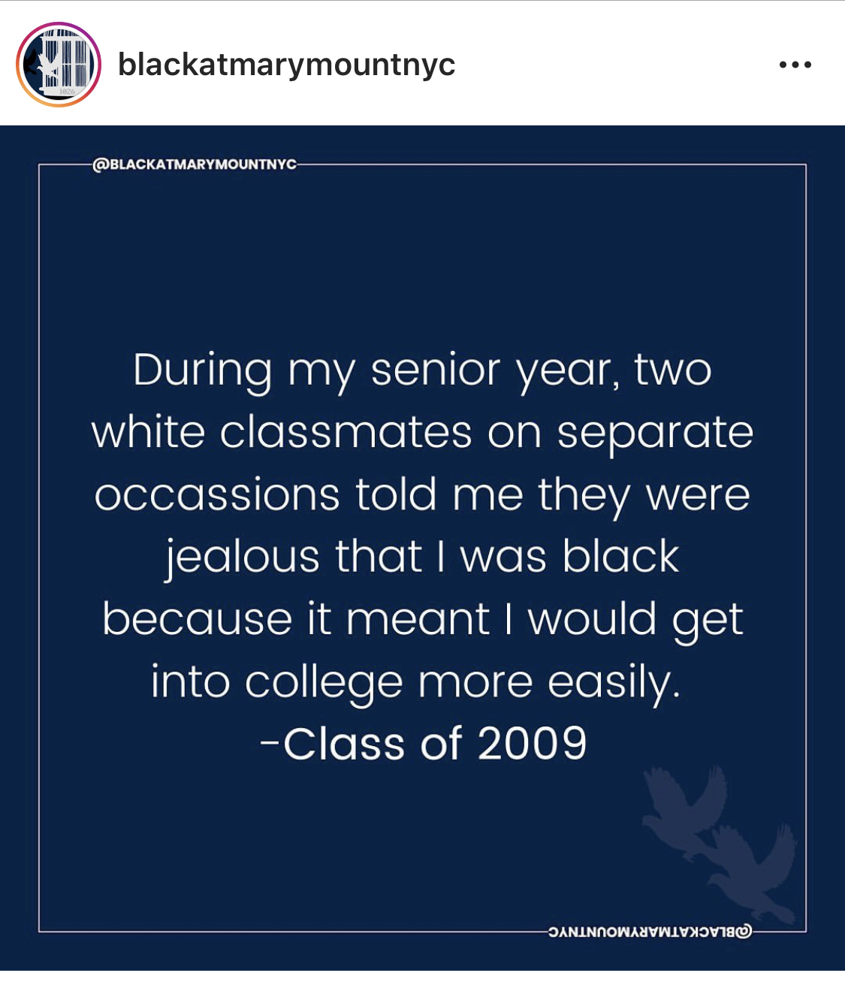

Slide 18
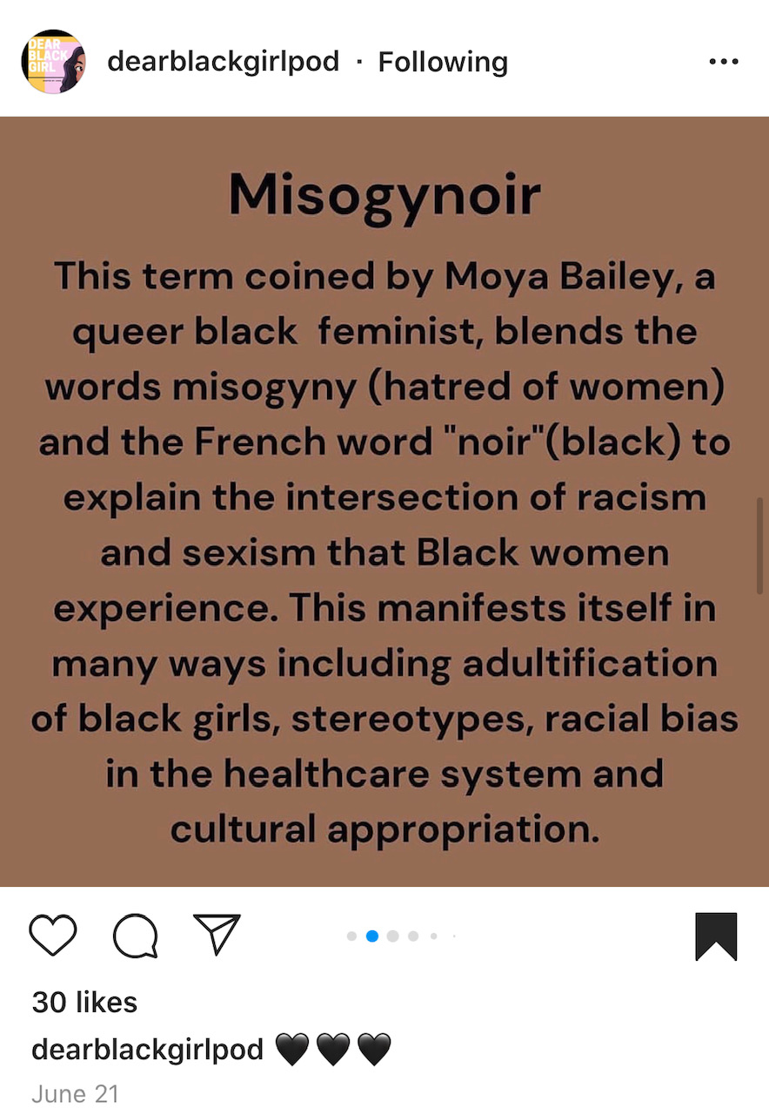
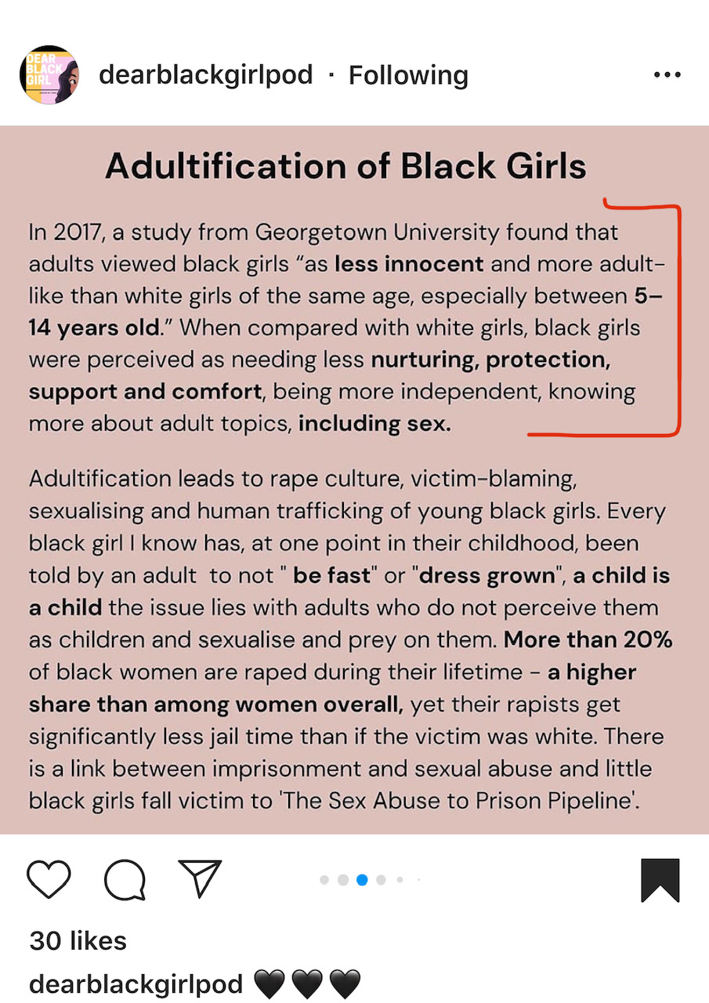

Slide 19
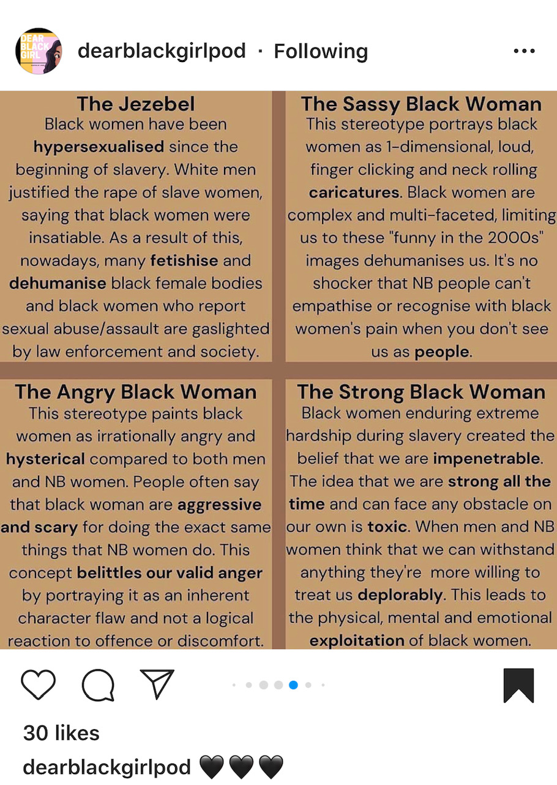
Pervasive Stereotypes of Black Women

Slide 20

John Leguizamo’s Netflix Special:
“Latin History for Morons”
Racial Wounds
Racial Trauma…
“To be a Negro in this country and to be relatively conscious is to be in a state of rage almost, almost all of the time — and in one’s work. And part of the rage is this: It isn’t only what is happening to you. But it’s what’s happening all around you and all of the time”
-James Baldwin
*apologies for the language in this video

Slide 21
Impact of Microaggressions:
A Reinforcement of Trauma
Which reinforces…..
Internalized Oppression (Inferiority for the target and superiority for aggressor)
Mental Health Problems (Anxiety, Depression, Stress, Anger)
Self Doubt, Performance Anxiety, Stereotype threat, Over-functioning to prove competence
Conforming and Repression
High Risk, Racial Inequity within systems (Criminal Justice, Housing, Healthcare, etc.)
  Examples: Birth Mortality Rate for Black Women, the dismissal of pain/symptoms of POC, Disproportionate number of people of color being killed by police, etc.
Perpetuation of the Pay Gap in workplaces and the Opportunity Gap within education
Notes:
https://www.centerforhealthjournalism.org/2017/11/08/how-racism-and-microaggressions-lead-worse-health

Slide 22
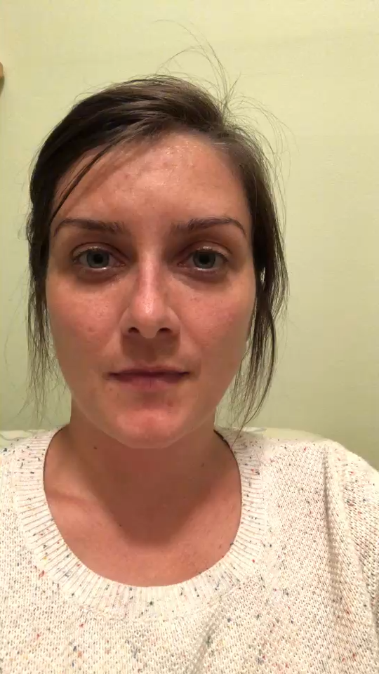
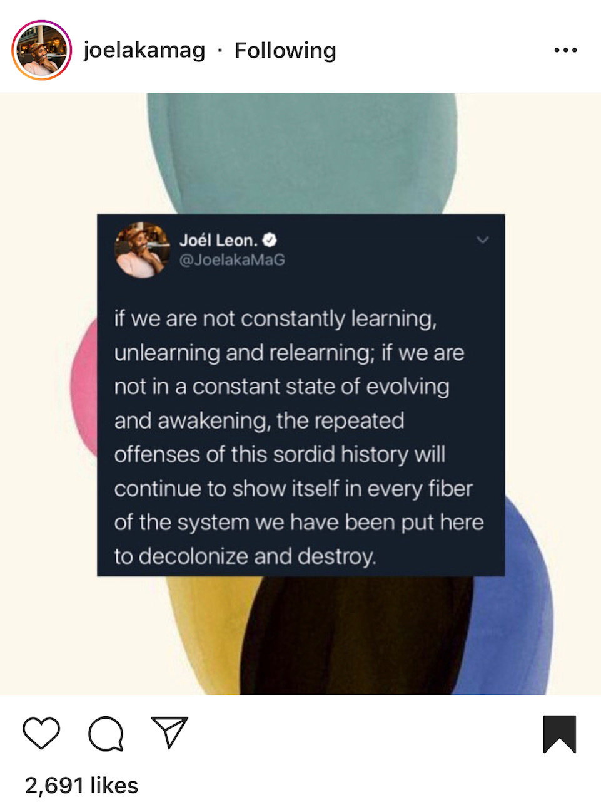
Notes:
Other Examples of Microaggressions at work
The 2 Afro-Latinas colleagues are not twins or sisters, they’d be filthy rich for every time we heard that comment from someone on staff! The message is- you two look alike b/c of your race, you’re names are easily confused as the only few Latinas in the office, etc.
Adult staff members of color constantly mistaken for students…at the schools I supported, the students wore uniforms at every event. Next guess was always “are you a parent/the parents then?”
It took my most vocal and experienced colleague who also happened to be the best manager on the team (yet the only manager of color), 7 years to get a promotion. A white colleague her same age was paid 20k more than her and a white colleague with ten years less experience was paid her same salary.
We worked with two leaders who were of Caribbean descent; their names were interchanged CONSTANTLY in meetings.

Slide 23
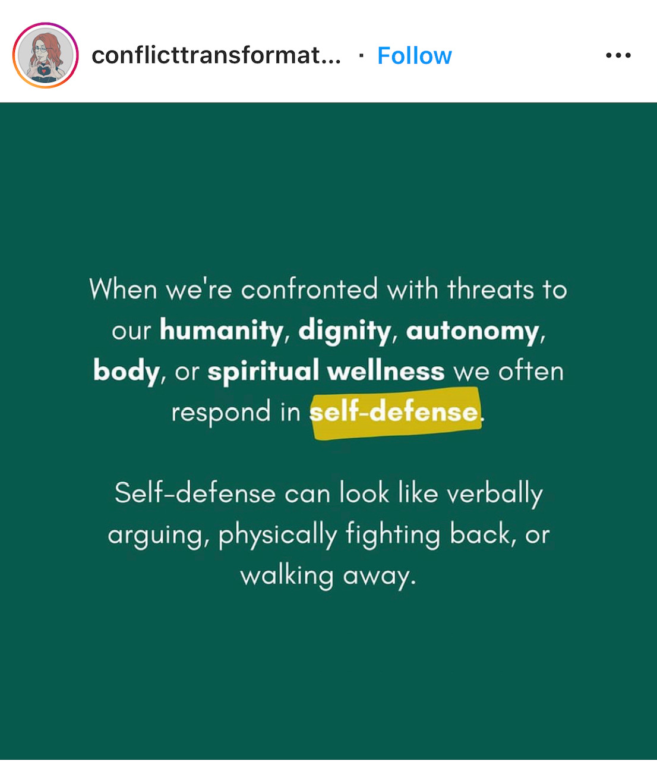
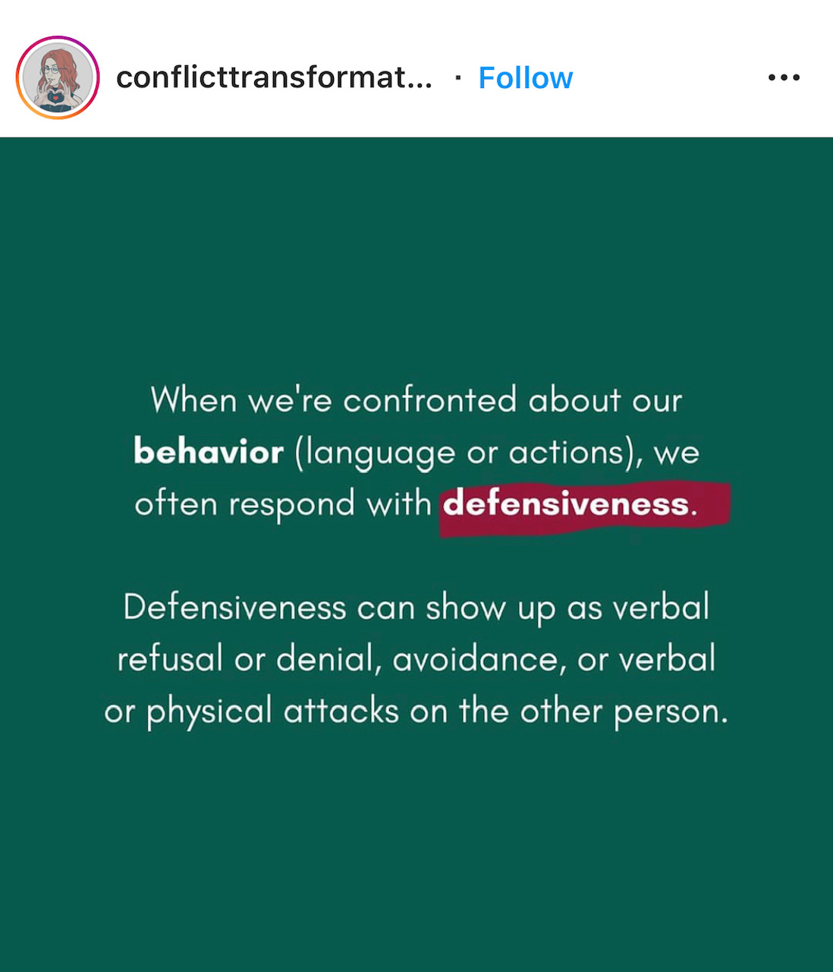
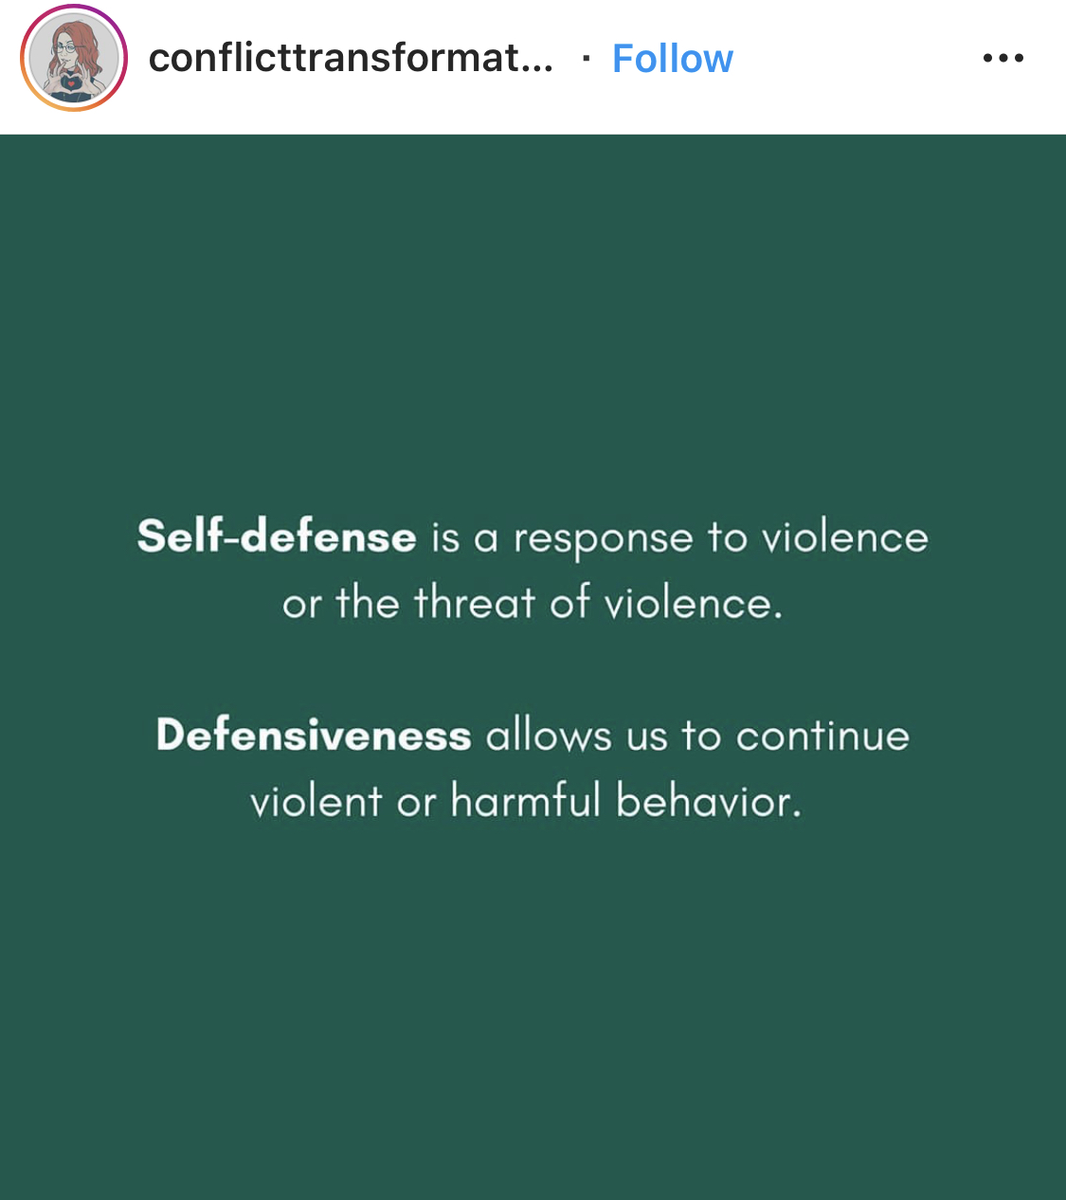
SELF DEFENSE VS DEFENSIVENESS

Slide 24
Something to consider…Are they being “difficult/sensitive” or are they actually practicing self-defense?
What narratives in schools, workplaces, or public areas are your fueling about BIPOC when they challenge your thinking?
Impact: promotions aren’t given, students are labelled/pigeonholed, shoppers are targeted, innocent are criminalized, etc.

Slide 25
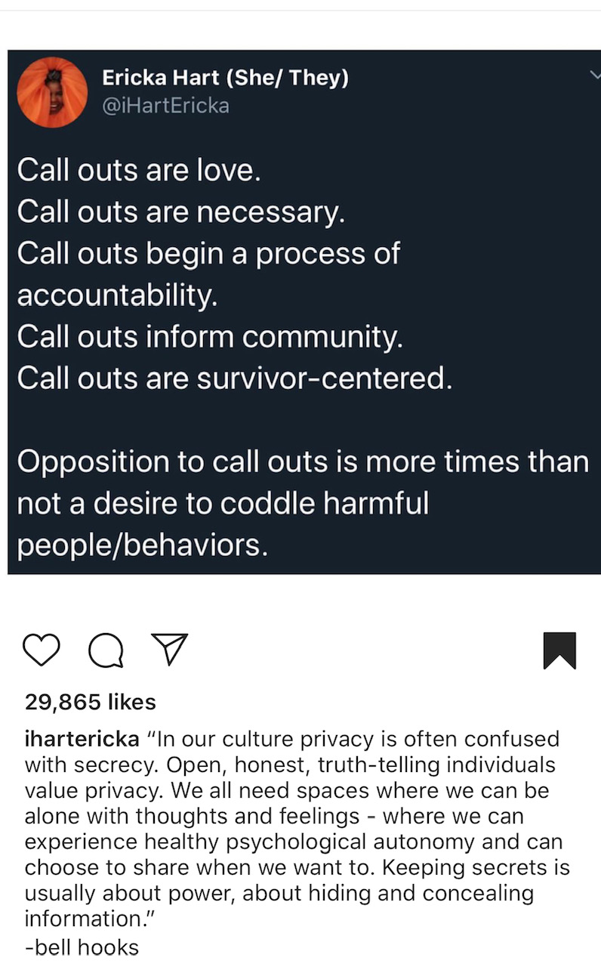
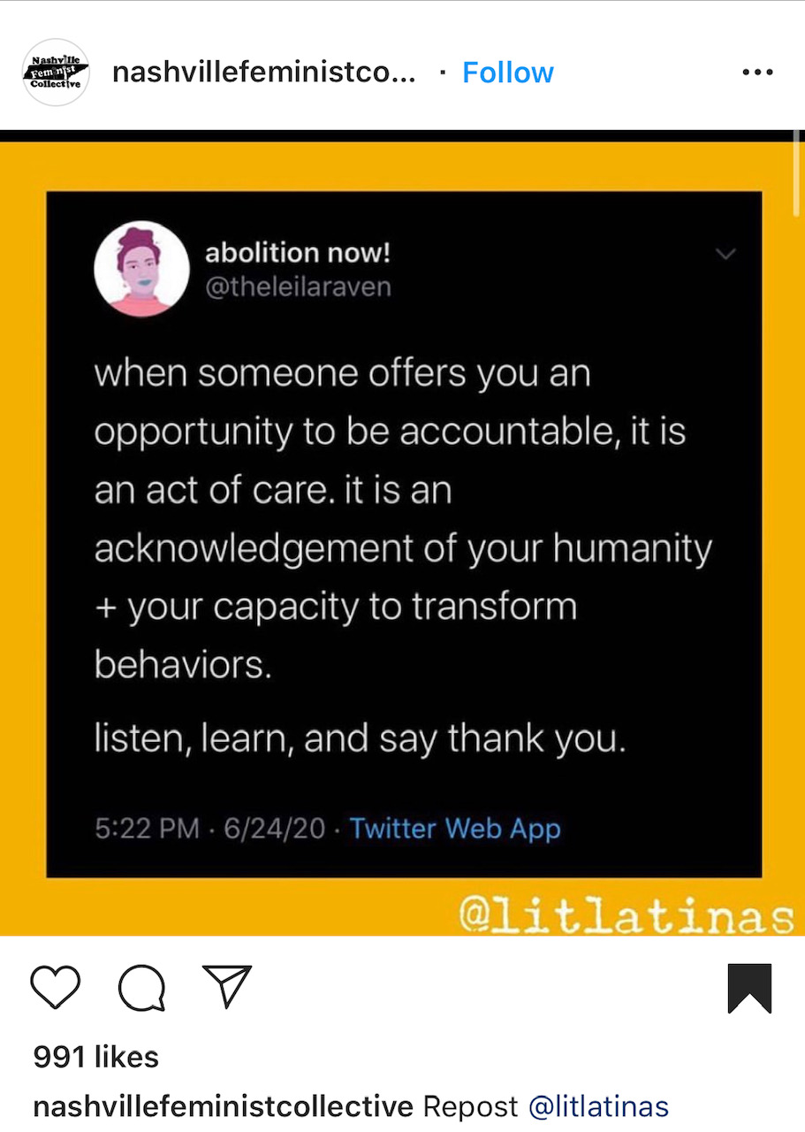
A Microaggressor’s Call Out
is
Their Opportunity To Deepen Their relationship with self and others

Slide 26
How to respond after you’ve been
“called out” or “called in”?
Pause and Breathe (Don’t get defensive!)
Apologize……”I’m sorry what I said/did had a negative impact on you”
Seek to understand
  DO research/google or get a book on the topic
  DO be accountable to the person harmed….rebuild that relationship/trust
  DO NOT go ask other POC’s about their thoughts/experience on topic- it isn’t their job to teach you by sharing their stories.. it’s emotionally taxing

Slide 27
How to respond as the target/recipient?
Various Micro-interventions
If you have the emotional capacity to engage….
If you may be met with hostility/danger if you respond….
Break it Down, share all your thoughts…try not to self-sensor
SELF CARE + SEEK COMMUNITY!
1) Document, DOCUMENT, DOCUMENT!!!!!!!!
2) Engage with a bystander/witness and shift your engagement in real time
3) Afterwards, share with HR or file a formal complaint/grievance, ask for mediation or immediate accountability
4) SELF CARE + SEEK COMMUNITY!

Slide 28
How to respond as the witness/bystander of a microaggression?
Speak from your own perspective! Do NOT speak on behalf of targeted person
Use “I” statements as an ally
EDUCATE! Highlight your own personal progress by sharing similar experience and your changed ways
Be an accomplice or disruptor by challenging
  “Help me understand…” or “What did you mean by that?”
  Mirror and restate notion
  Clarify sentiment
  Explicitly name difference between Intent and Impact
  Set a boundary that outlines acceptable language/behavior

Slide 29
What if you’re met with resistance?
Pause and Breathe (Don’t get defensive!)
Focus on impact
  How did it make someone feel? What did their words/actions signify? Why is it problematic (give context)?
Roll with the resistance
When you can no longer engage…..
1) Either completely disengage
Example: “it sounds like you are really committed to upholding XYZ sentiment since you insist on defending this statement/action
2) pause and revisit the conversation after a cool down period

Slide 30
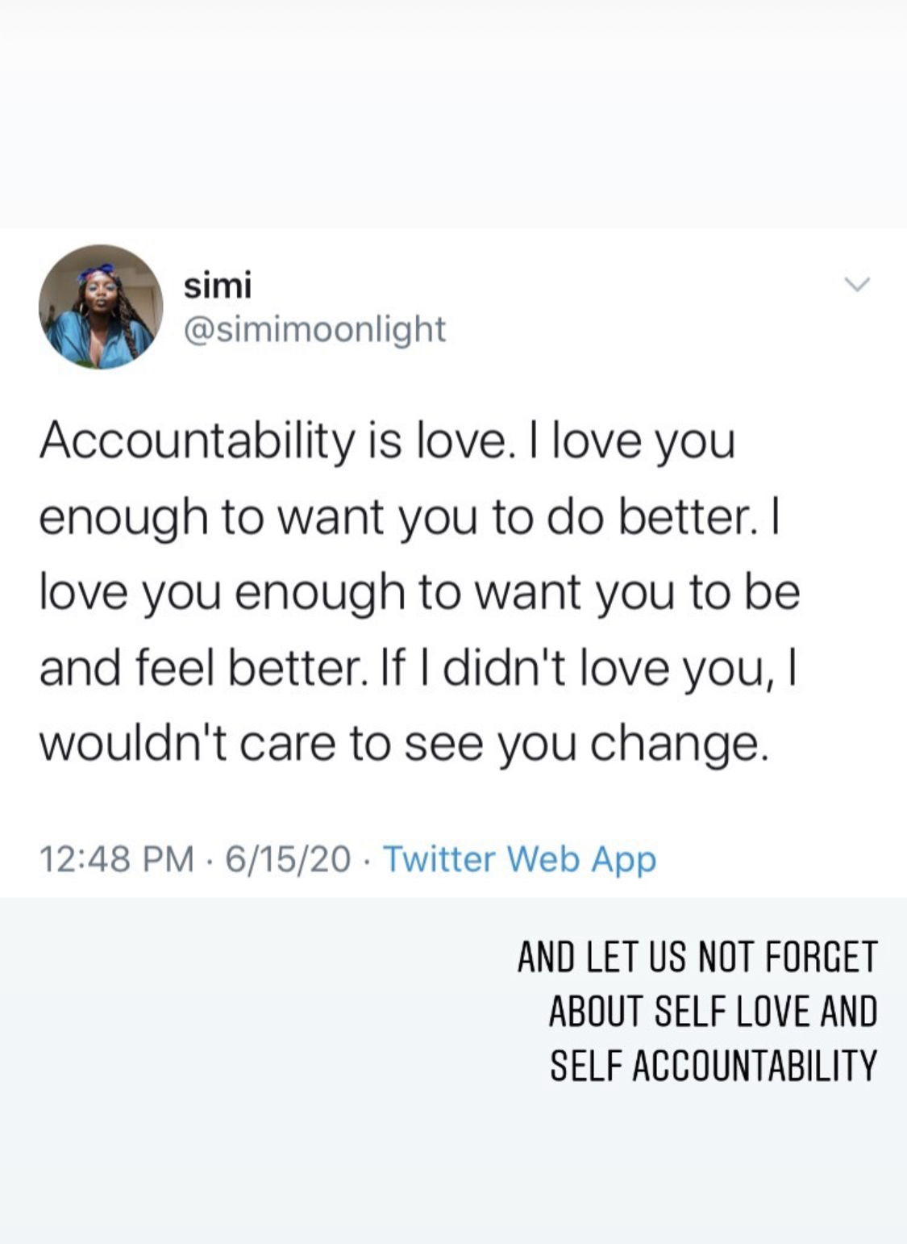
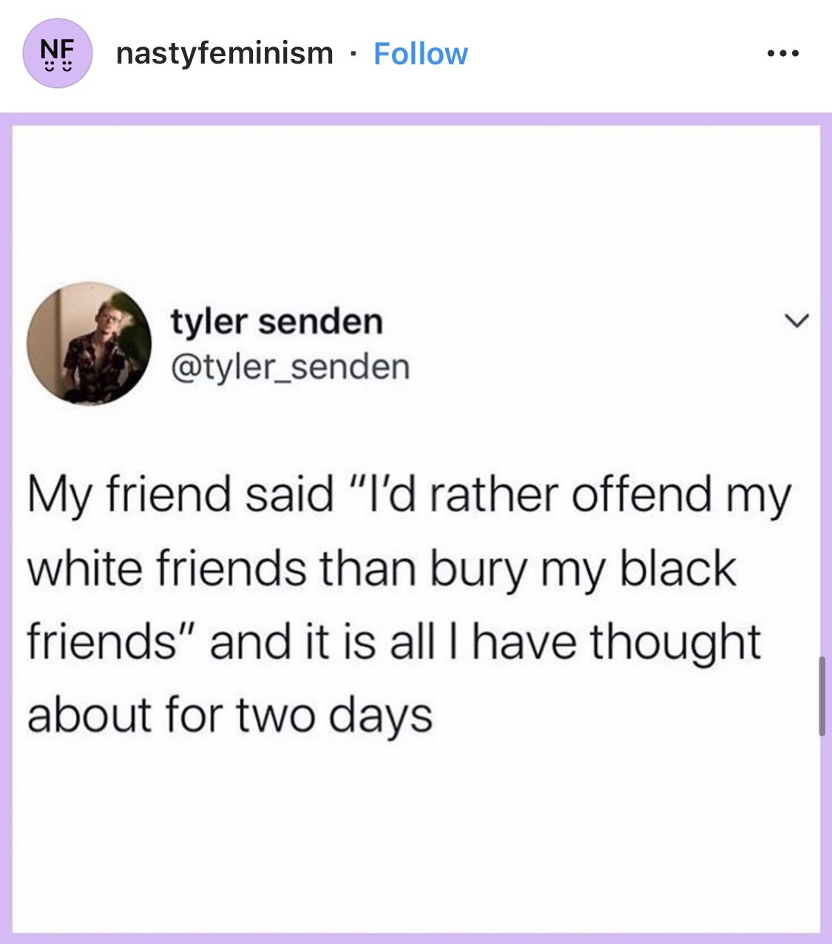
Keep Going! Don’t Stop! Do it for you! Do it for those after us!

Slide 31
Thank you!!
STAY IN TOUCH!
Rachel's Email: Racheljones2012@gmail.com

