Slide 1
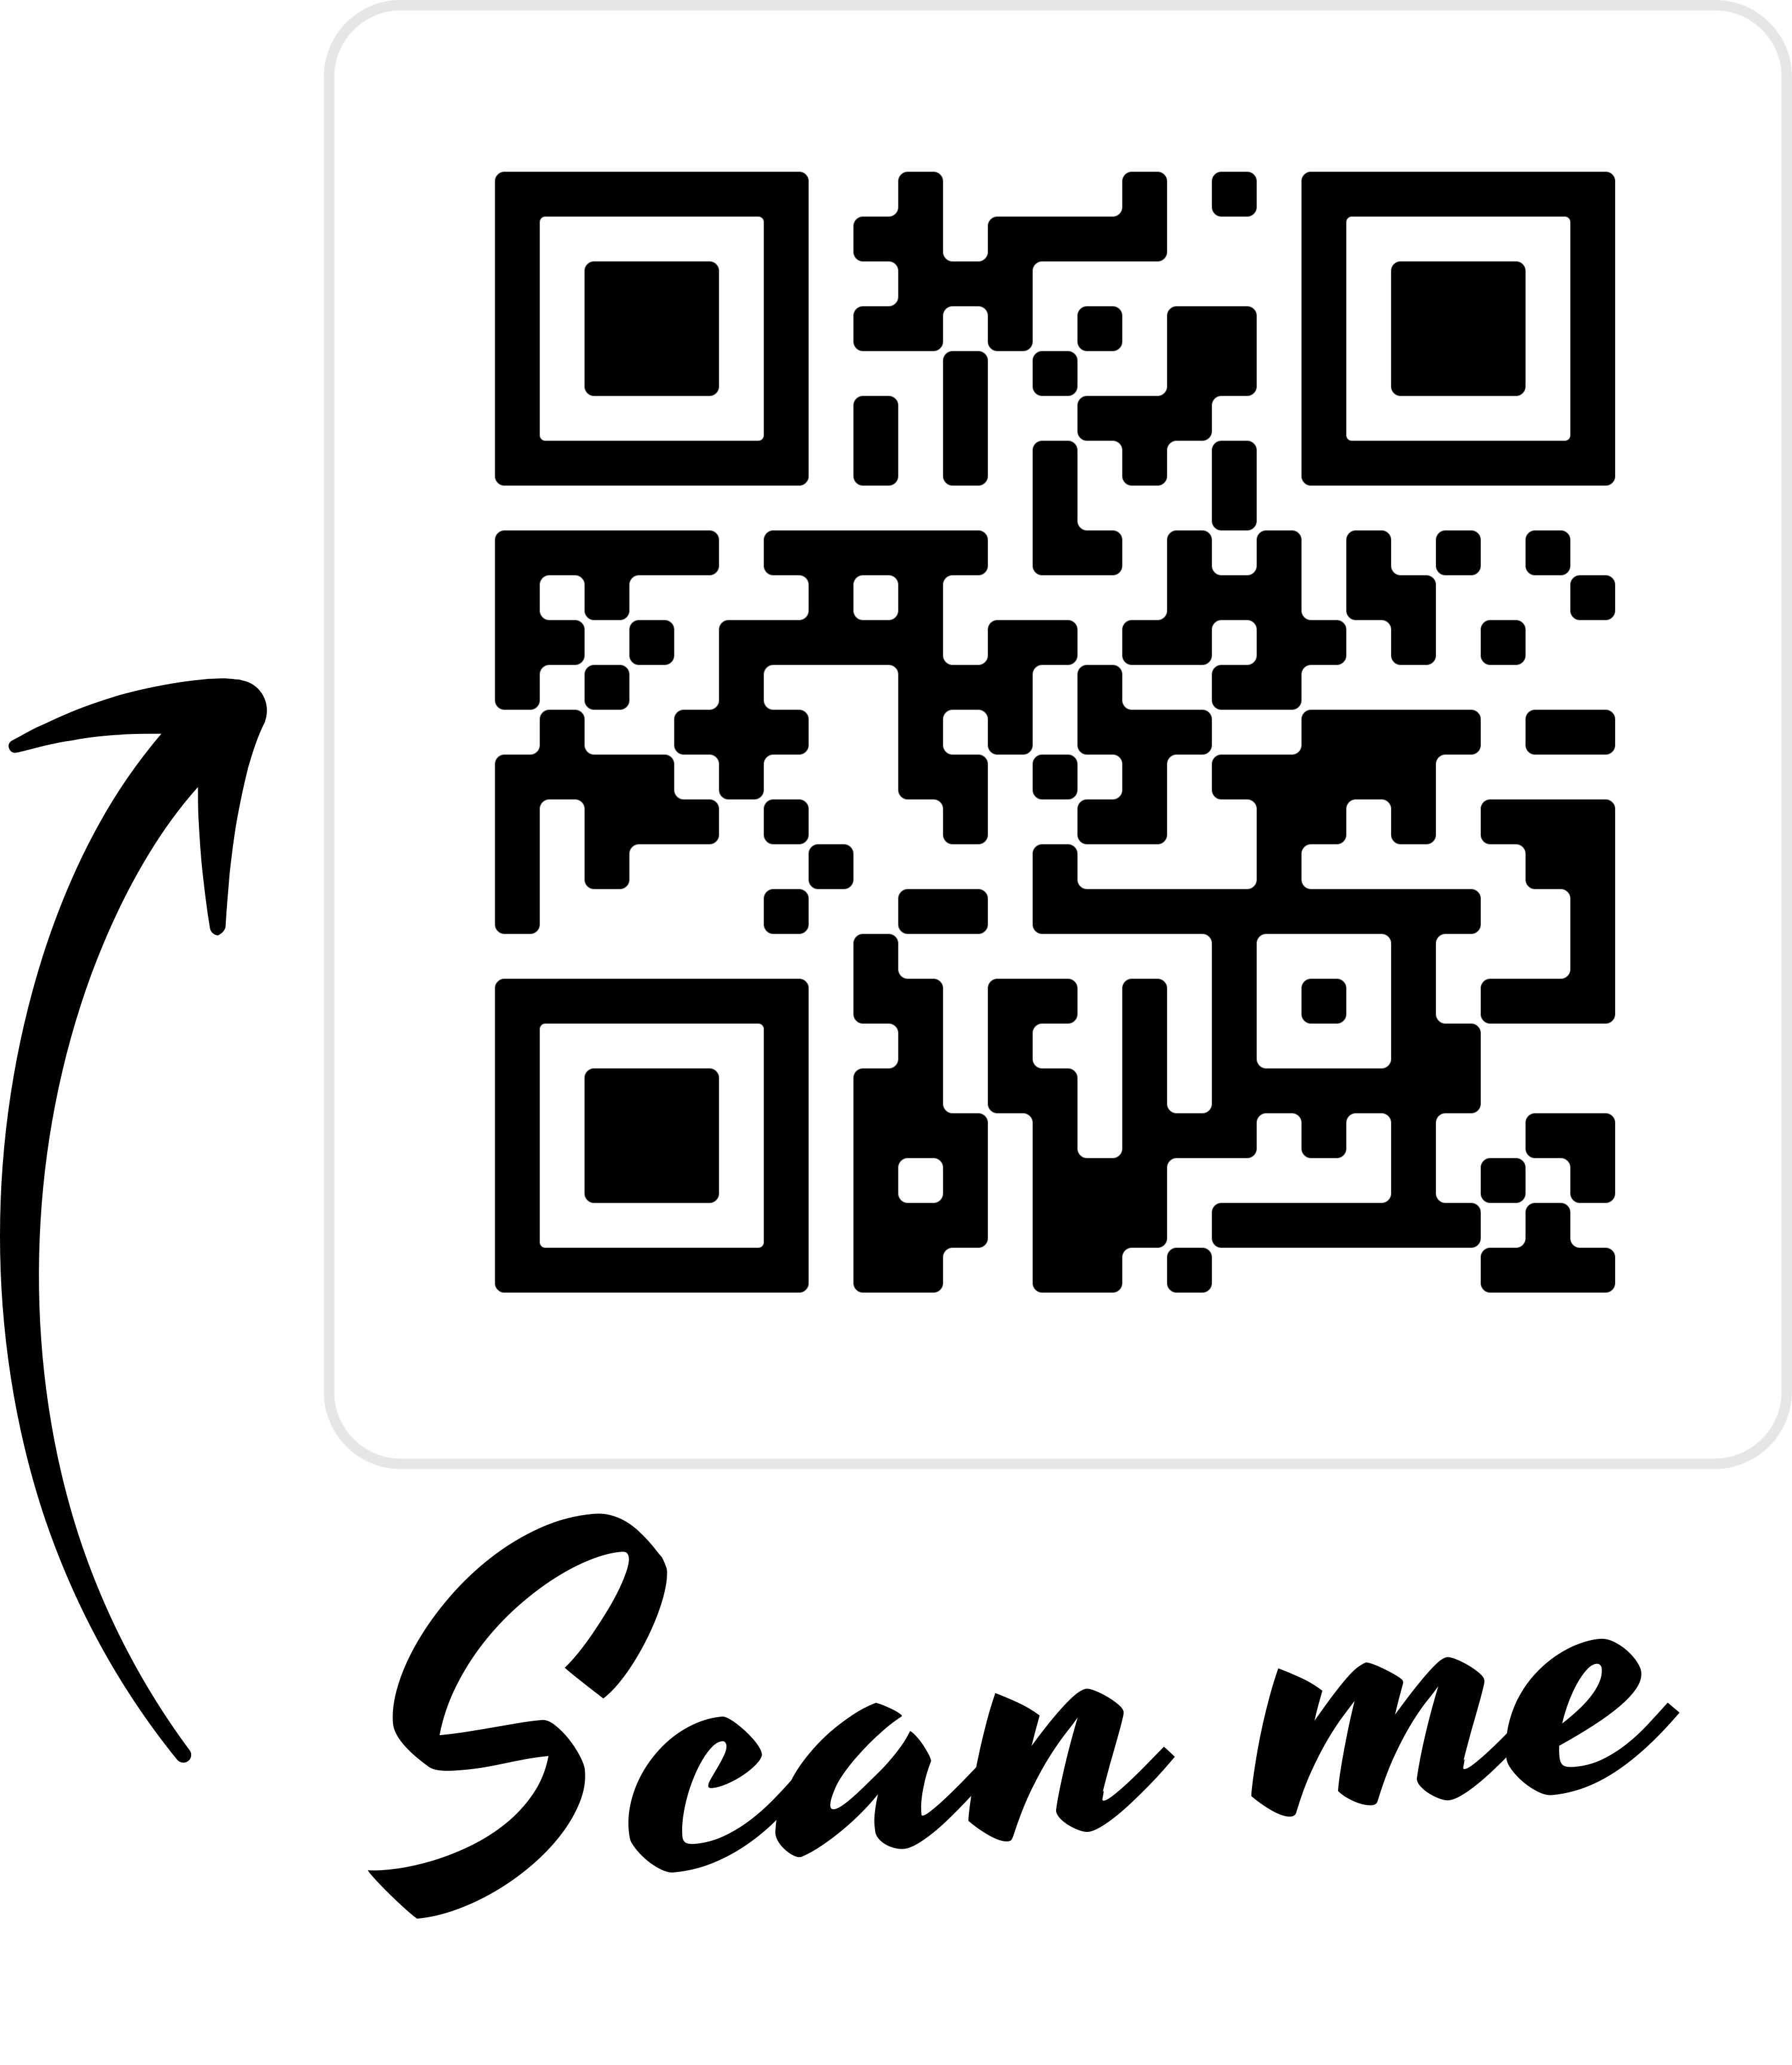
Join us for a FREE opportunity to prepare for the next ACT at DHS!
When: January 25, 2020 or February 1, 2020
We are offering two (2) sessions each day:
Morning (8:00 a.m. – 12:00 p.m.)
Afternoon (1:00 p.m. – 5:00 p.m.)
All sessions will begin in the East Seminar.
We hope to see you there!
To register for one or more
ACT Prep sessions!
Contact Dr. Bernard (nbernard@duncanvilleisd.org) for more information.

