Slide 1

For Your Information
Visitation Alumnae Board Presents:
Navigating the Virtual Job Landscape Session One
Maximizing Your
Profile
Georgetown Visitation Lifelong Learning Series

Slide 2
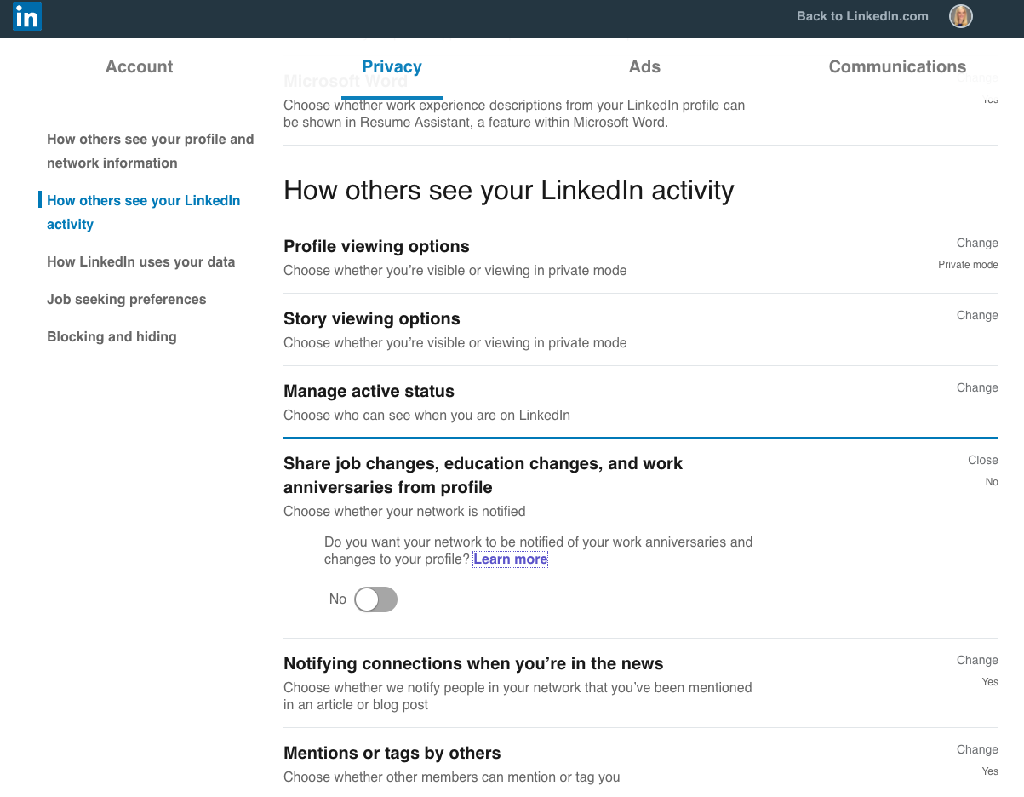
BEFORE WE START:
Turn off setting that alerts your network on updates to your profile.
Settings & Privacy section / “Sharing Profile Edits” / toggle button to “No”
Georgetown Visitation Lifelong Learning Series

Slide 3

Quick Facts:
Only 50% of users have a complete profile
90% of recruiters use LinkedIn
47% of employers say that if they can't find a job candidate online, they are less likely to call that person for an interview.
610 Million members
Photo by Andrea Piacquadio from Pexels
Georgetown Visitation Lifelong Learning Series

Slide 4
3 Keys to Maximizing LinkedIn:
1: a findable profile
2: a visually appealing profile
3: an active profile
Georgetown Visitation Lifelong Learning Series

Slide 5

Photo by Andrea Piacquadio from Pexels
PART #1:
A Findable Profile
Georgetown Visitation Lifelong Learning Series

Slide 6
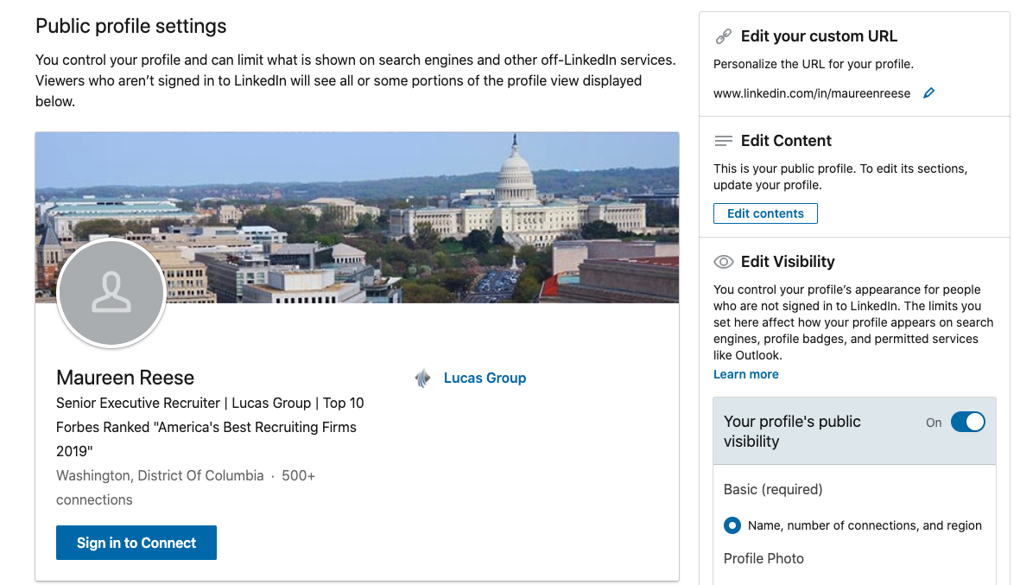
URL Customization: so you can include it on business cards, resumes and email signatures.
Go to the upper right of your profile under the toolbar, click on: “Edit public profile and URL.”
Georgetown Visitation Lifelong Learning Series

Slide 7
What does it take to be found?
KEY WORDS –
Words used in search queries that answer your potential employer’s main question: “How can you help me?”
Search job postings for your area of expertise to see what words and phrases the postings use.
Use those keywords in your profile (and your resume).
Georgetown Visitation Lifelong Learning Series
Notes:
Indeed, Glassdoor, LinkedIn jobs – search titles

Slide 8
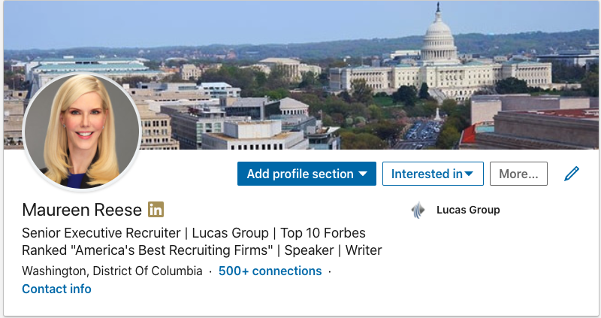
Your Headline
The most important part on your profile. 120 Characters.
Use your official job title if it explains what you do.
Speak to the audience you want to attract using key words
Georgetown Visitation Lifelong Learning Series
Notes:
”Proficient self-starter with exceptional multitasking skills and
incredible attention to detail.”

Slide 9
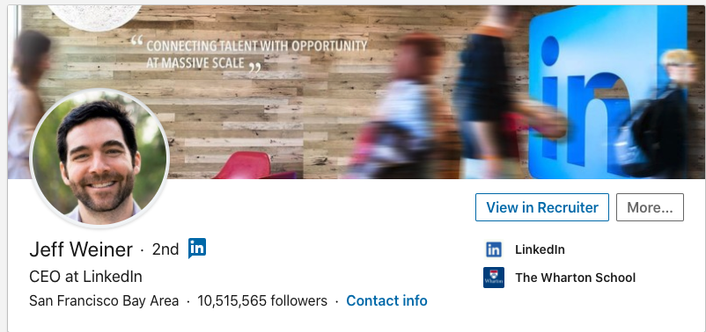
Headlines I like:
Banner
Headline
CEO at LinkedIn – enough said
Good use of a banner
Great headshot
Notes:
Free photography – Pexels

Slide 10
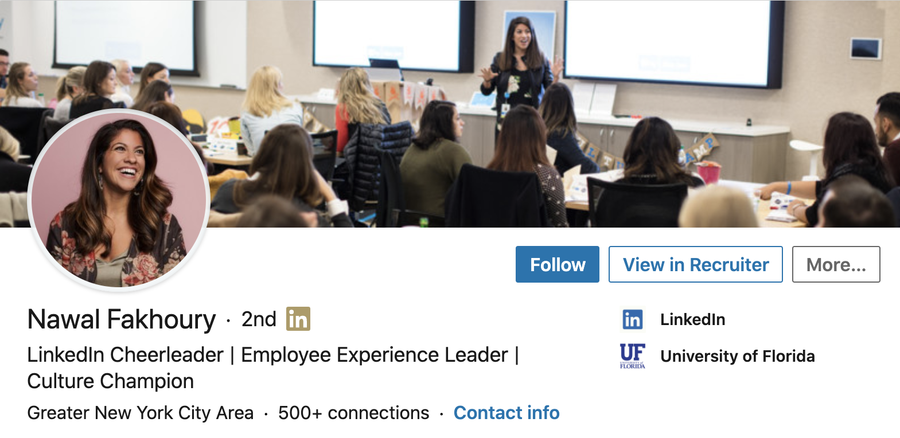
Headlines I like:
Shows us exactly what she does – Director of Employee Experience
Good use of a banner
Great headshot
Notes:
Makes me want to read her profile. I like her already. Whoa Sharp.

Slide 11
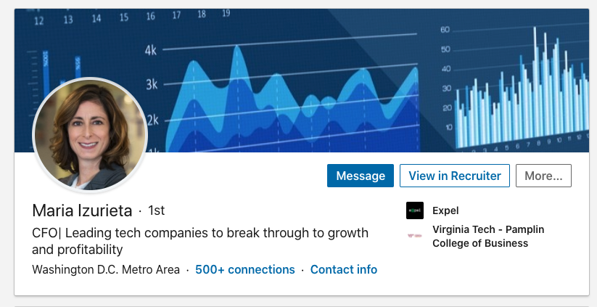
Headlines I like:
Good use of telling us what industry she is in and what she is great at
Good use of a banner
Great headshot

Slide 12
Title: Recent College Graduate
Mention the role you want using industry-specific key words
Example:
Freelance Software Developer / Experience building apps in Java, Python, C++ / Full Stack Engineer
Do not say, “Georgetown University Student” -- hiring managers are not searching for those terms.
Notes:
You want to be sure you end up in search results when they search for those terms.

Slide 13
Returning after a career break:
Use titles you want to be hired for:
  “Experienced Sales Leader” + other key words
  “Professional Copywriter” + other key words
  “Mechanical engineering professional with a passion for machine design” + key words
  “CPA with strong knowledge of SOX and GAAP.”
  “Special education teacher with state certifications in chemistry and biology” + key words

Slide 14
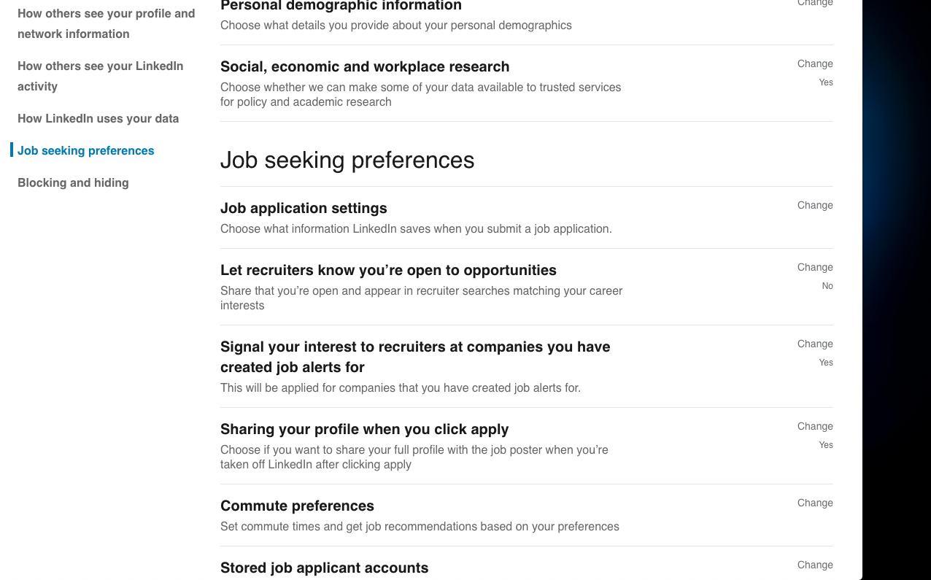
Unemployed Job Seekers:
Go to the Settings & Privacy section / under “Job Seeking Preferences”
Toggle to “Yes”
Georgetown Visitation Lifelong Learning Series
Notes:
Don’t write - unemployed or seeking new opportunities - in your headline.

Slide 15
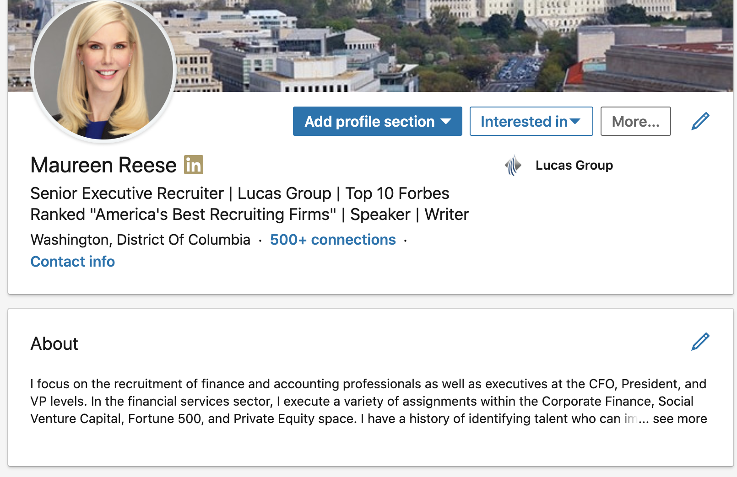
LinkedIn Summary:
Write in the first person in a conversational tone
First sentence should be your biggest strength
Why are you passionate about your job or industry?
What problems do you solve?
Add specialty list – key words
Georgetown Visitation Lifelong Learning Series

Slide 16
A LinkedIn Summary that I like:
I am a transformational leader focused on business development, customer satisfaction, and technology that supports those objectives. My success at guiding companies to reach their business goals owes as much to strong professional relationships as financial acumen.
Growth conveys part of my story--double-digit revenue and profit increases during my current tenure as CFO/CEO. To help companies achieve that growth, I rely on collaboration and clear communication with my executive peers, the staff I lead, and the clients we serve.
As a lifelong baseball player, I understand that success depends on how well each team member understands their role. In the C-suite, I present issues in a way they can be heard and absorbed, then devise responsive strategies that move a company forward.
Specialties: Mergers & Acquisitions, Company Spinoffs, ERP System implementation, Venture capital & debt financing, IPO strategy, and SEC Reporting
Georgetown Visitation Lifelong Learning Series

Slide 17

End your Summary section with a call to action.
“If you want to talk about grass roots political campaigns, non-profit fundraising or the Washington Nationals baseball send me an invitation to connect and let’s talk!”
Georgetown Visitation Lifelong Learning Series
Notes:
Many people miss this important piece in their LinkedIn profile and lose opportunities by not telling those who land on their profile what to do next.

Slide 18
Work History: Reverse Chronological Order
Include each of your jobs with a short description of your accomplishments
List the years that you held each role within each company and if you were promoted during a period of employment.
If you were only at a position for a short period of time leave it off and explain the gaps in person.
Georgetown Visitation Lifelong Learning Series

Slide 19
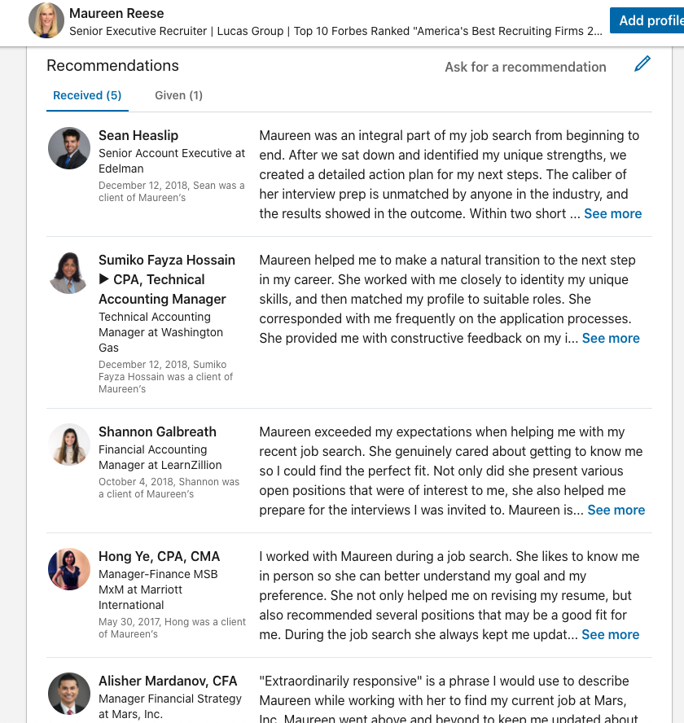
Recommendations:
A powerful way to impress potential employers
Georgetown Visitation Lifelong Learning Series
Notes:
I’m working on improving my LinkedIn profile and one of my goals is to get a couple of recommendations from colleagues that know my work well. Would you be able to write me a LinkedIn recommendation in the next couple of days to help me improve my profile? I could do the same for you if you’d like, just let me know.”

Slide 20
Photo by CoWomen from Pexels
Part #2: a Visually Appealing Profile
Georgetown Visitation Lifelong Learning Series

Slide 21
Have a professional looking headshot
People will read your profile in a much more positive light if your LinkedIn picture makes an excellent first impression.
7Xs more likely to have your profile viewed if you have one.
Georgetown Visitation Lifelong Learning Series
Notes:
Like a house that’s on sale, the assumption is that if there's no photo, something's wrong.

Slide 22

Headshots I like:
Gold? Or White?
Georgetown Visitation Lifelong Learning Series
Notes:
Like a house that’s on sale, the assumption is that if there's no photo, something's wrong.

Slide 23

Choose the Right Mood and Look for Your Audience
Georgetown Visitation Lifelong Learning Series
Notes:
Think about your audience/industry --
Are you looking for a new job in a law firm?
Are you trying to show potential employers that you are a collaborative leader?
Are you a teacher looking to move to a new school? I recommend a simple smile.

Slide 24

Fill The Frame With Face and Be Recognizable
Katie wears her glasses so that she is recognizable.
Georgetown Visitation Lifelong Learning Series

Slide 25
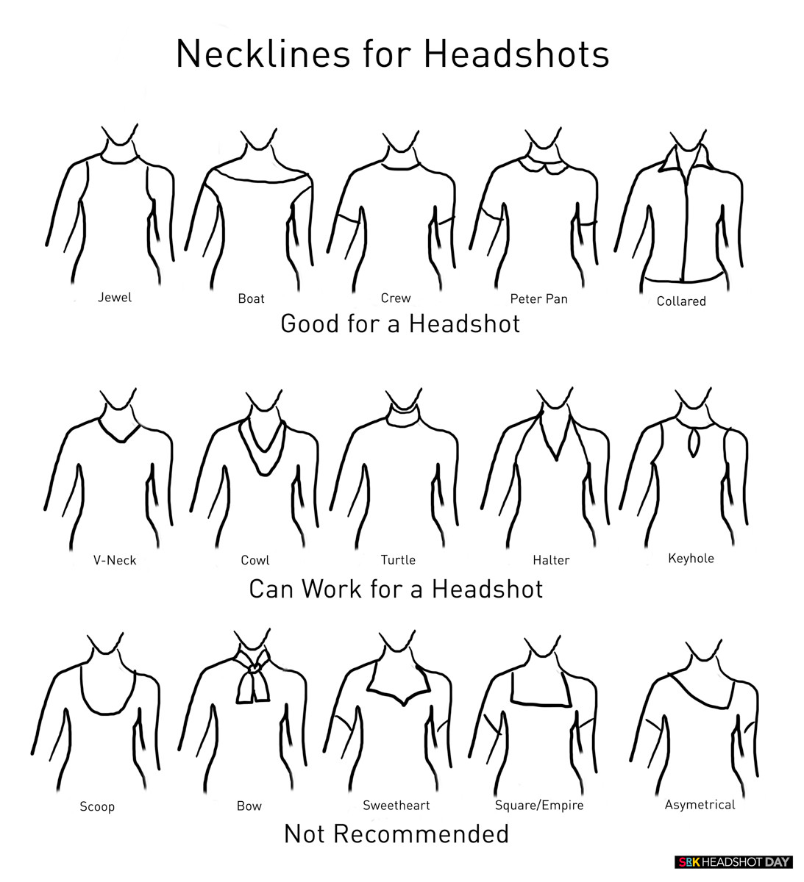
Georgetown Visitation Lifelong Learning Series

Slide 26


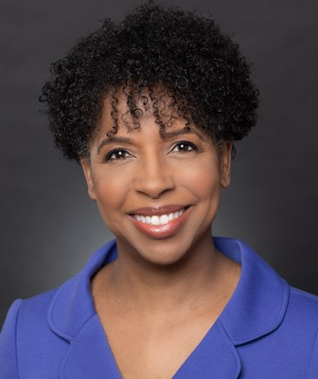
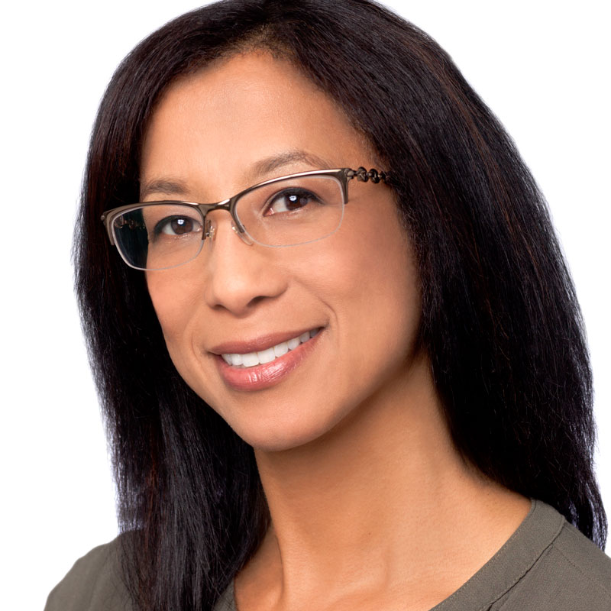
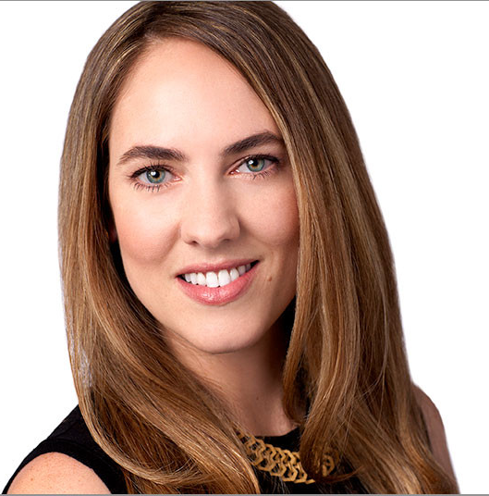
Good headshot examples
Georgetown Visitation Lifelong Learning Series
Notes:
Iphone – add a white background for you in portrait mode

Slide 27
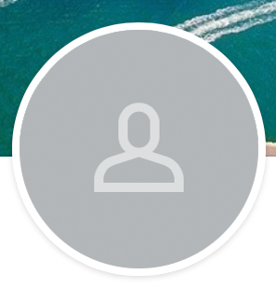
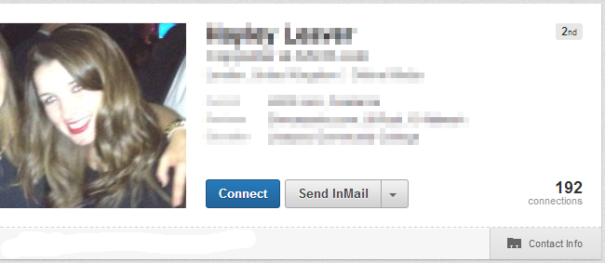
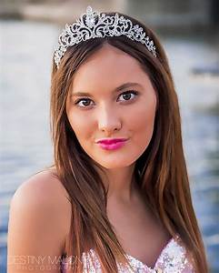
Avoid these types of photos
Georgetown Visitation Lifelong Learning Series

Slide 28

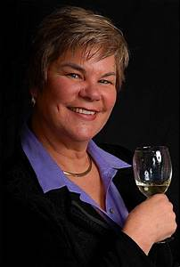
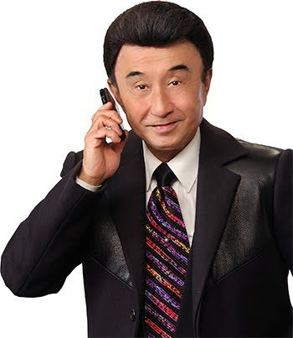
Avoid “Props”
Georgetown Visitation Lifelong Learning Series

Slide 29


Avoid “Family Photos” – This is not Facebook
Georgetown Visitation Lifelong Learning Series

Slide 30
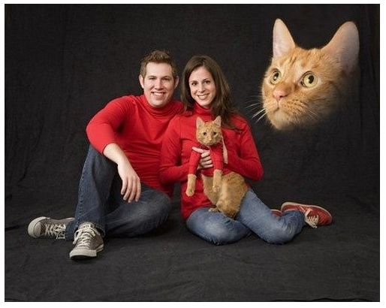
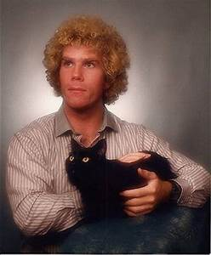
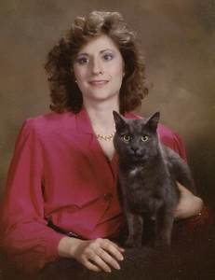
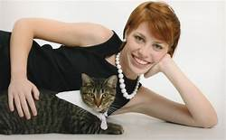
Avoid “Pets”
Georgetown Visitation Lifelong Learning Series

Slide 31
Photo by CoWomen from Pexels
Part #3: An Active Profile
Georgetown Visitation Lifelong Learning Series

Slide 32

Grow Your Network
A great place to start:
Connect with Visi Alums in your industry, related to your industry, or those you have common connections.
College Alum
Co-workers
Georgetown Visitation Lifelong Learning Series
Notes:
Goal 6-10 new connections per week

Slide 33

Be specific when reaching out to new contacts:
Personalize all your messages -- something that identifies you specifically and why you reached out to that person.
Georgetown Visitation Lifelong Learning Series
Notes:
This is the start of a longer-term relationship.

Slide 34

Post great content
Establish yourself as a thought leader.
Post relevant content—industry news, advice articles, and videos.
Posts appear on your company page and in the news feed on the homepage of each of your followers.
Georgetown Visitation Lifelong Learning Series
Notes:
Establishing yourself and your brand as an authority in your area of focus will help build authority and trust among your customers, both current and prospective. Be cautious about directly pitching your products or services.
You will also be on the front of their minds twice a week because you will appear on their feeds.

Slide 35
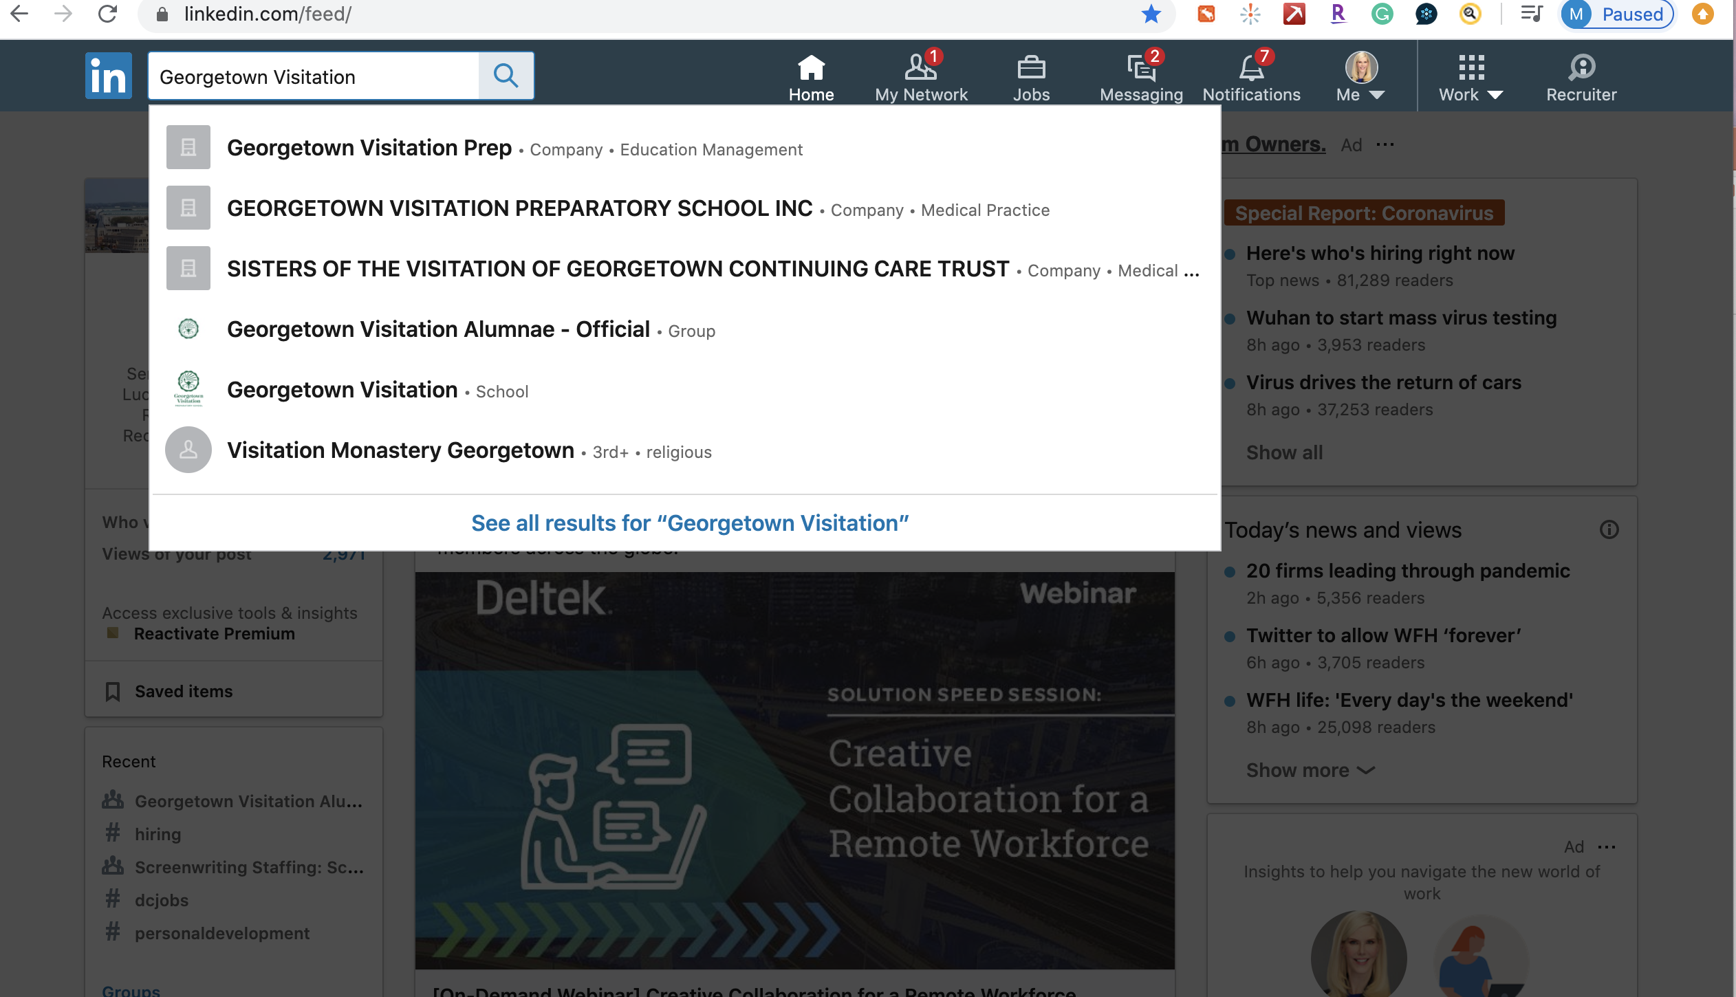
Joining a group – Two Ways
1) By Name
Enter group name in the Search bar at the top of your LinkedIn homepage.
Select (group name) Groups from the dropdown.
Georgetown Visitation Lifelong Learning Series
Notes:
This will help you strengthen connections with people who share common skills, experiences, industry affiliations and goals.

Slide 36
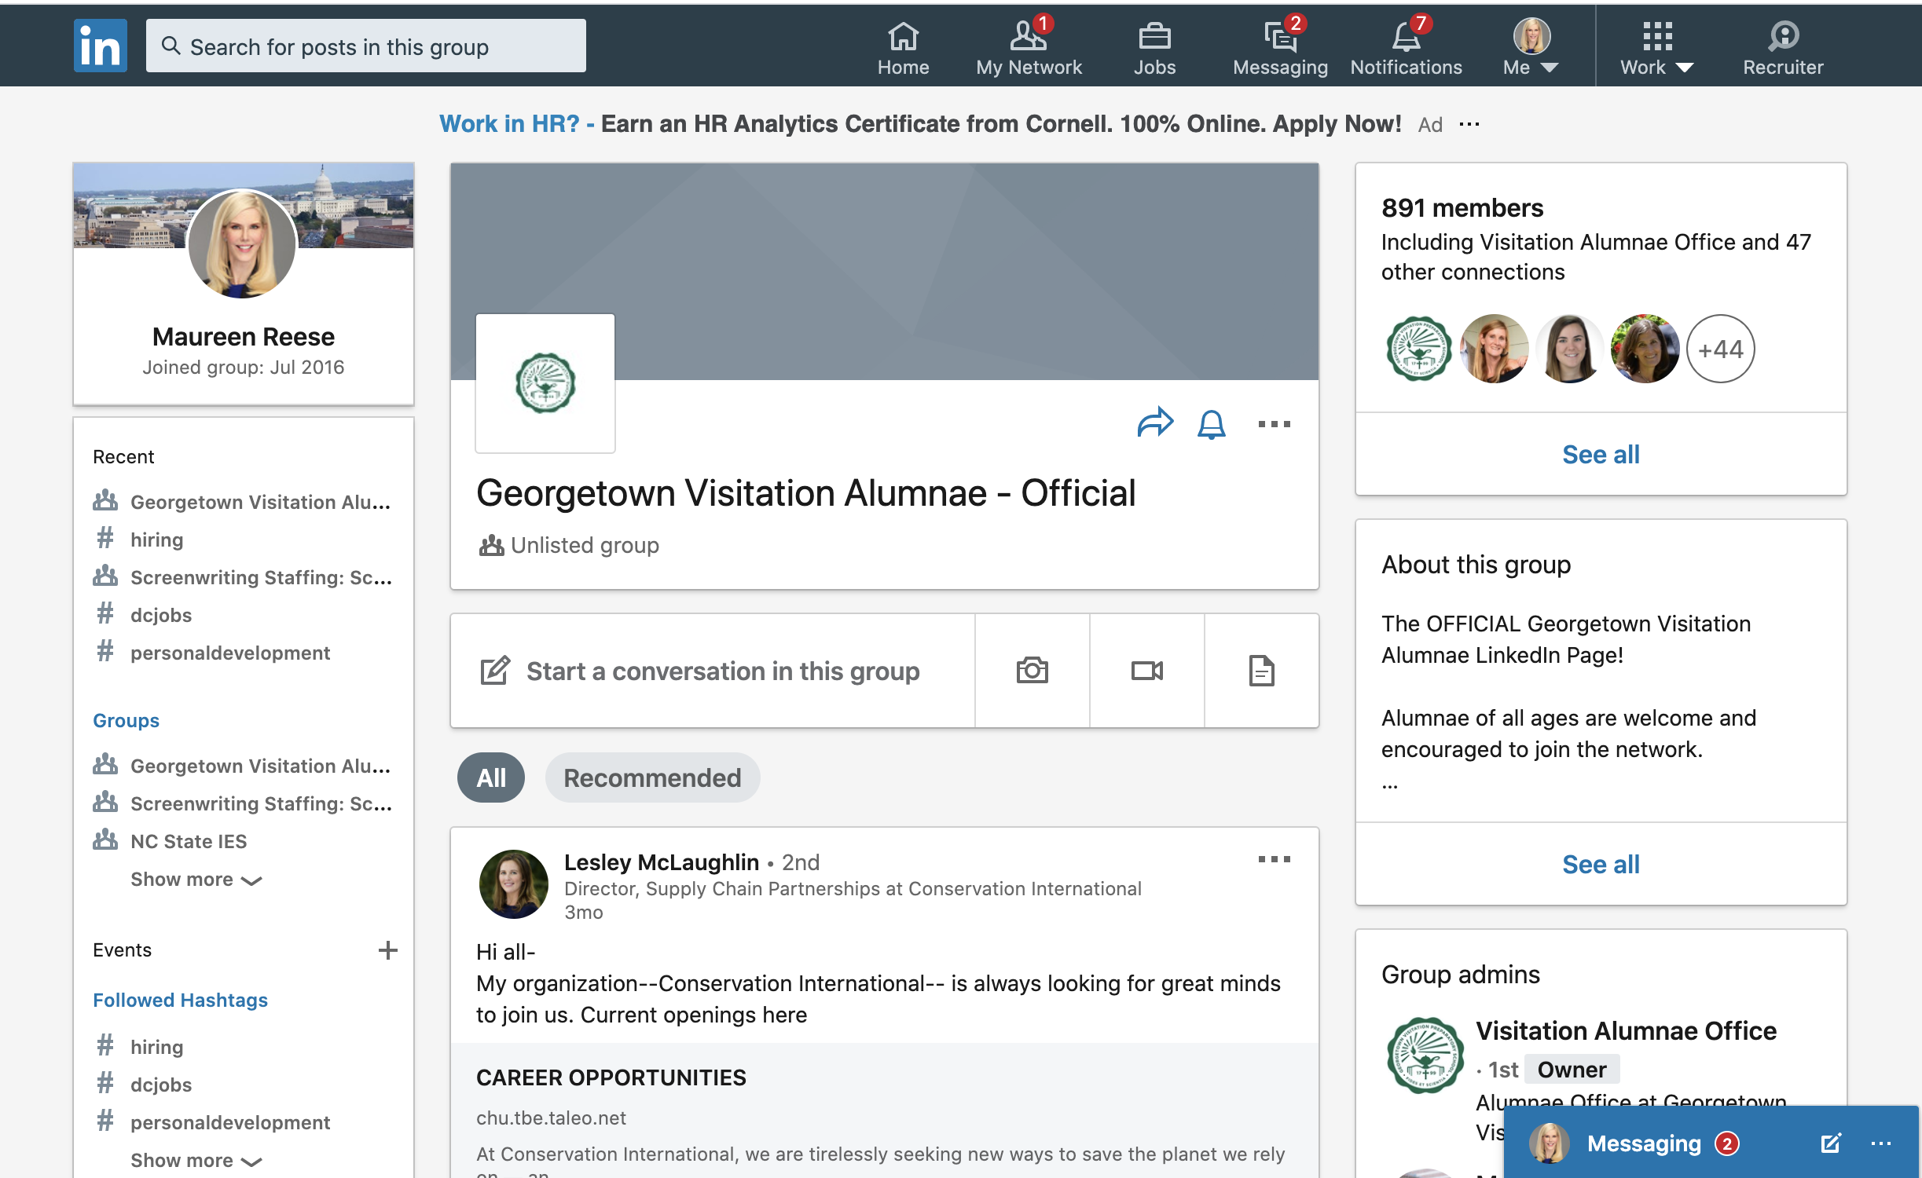
Joining a group – Two Ways
1) By Name
Georgetown Visitation Lifelong Learning Series
Notes:
Establishing yourself and your brand as an authority in your area of focus will help build authority and trust among your customers, both current and prospective. Be cautious about directly pitching your products or services.
You will also be on the front of their minds twice a week because you will appear on their feeds.

Slide 37
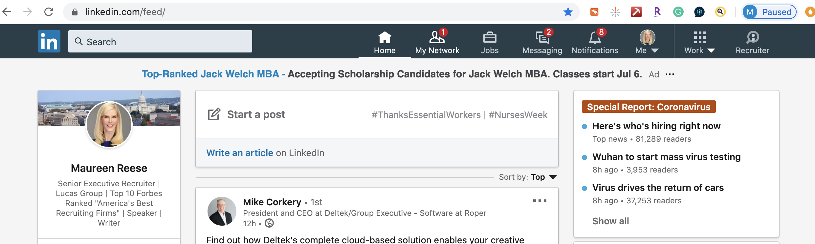
Joining a group –
2) To browse for groups recommended for you by LinkedIn:
Click Work icon in the top right of your LinkedIn homepage
Georgetown Visitation Lifelong Learning Series
Notes:
Establishing yourself and your brand as an authority in your area of focus will help build authority and trust among your customers, both current and prospective. Be cautious about directly pitching your products or services.
You will also be on the front of their minds twice a week because you will appear on their feeds.

Slide 38
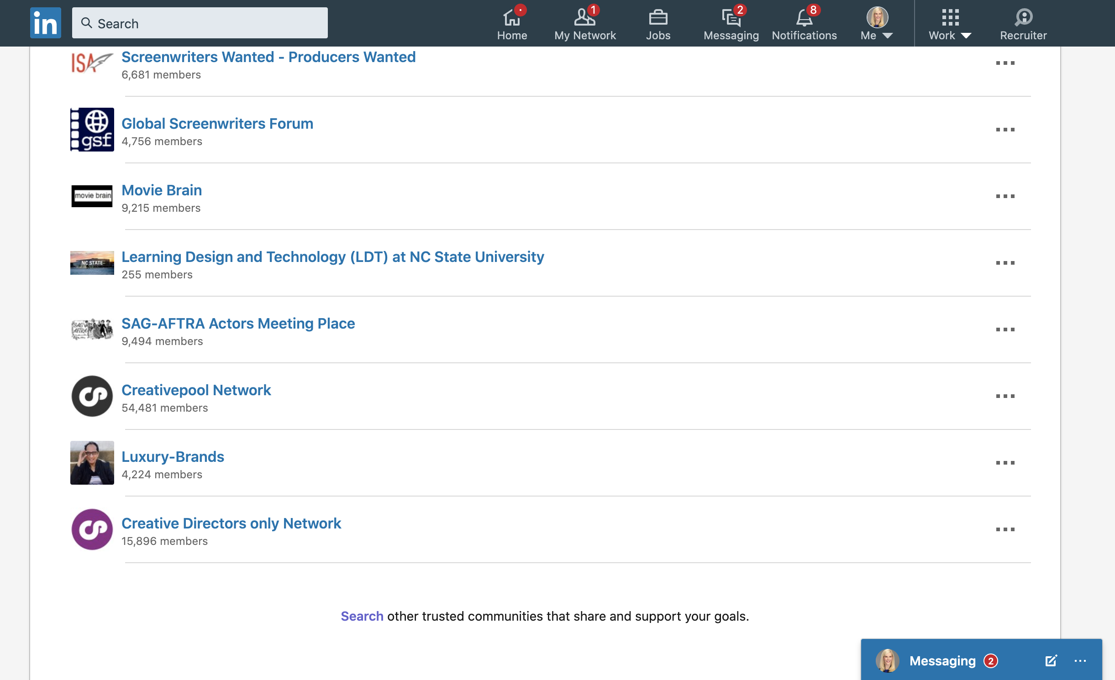
Joining a group –
Scroll down to the bottom of the page and click Search.
Georgetown Visitation Lifelong Learning Series
Notes:
Establishing yourself and your brand as an authority in your area of focus will help build authority and trust among your customers, both current and prospective. Be cautious about directly pitching your products or services.
You will also be on the front of their minds twice a week because you will appear on their feeds.

Slide 39
Other things to do to stay engaged:
Leverage @mentions: LinkedIn users can tag or @mention other users and companies in their status updates - they will get alerted that you mentioned them.
Congratulate others on successes, like, comment on or share posts.
Follow Up With New Connections: Whenever appropriate, move the relationship offline and have a telephone call or an email.
Use #Hashtags in your posts help you discover and engage in topics and interests relevant to you.
Georgetown Visitation Lifelong Learning Series
Notes:
, such as job moves and anniversaries, promotions or professional milestones (winning an award, publishing book, being named to a board or speaking at a conference – you catch my drift). It gives you a reason to be in touch with these individuals. Remember that no one dislikes a compliment ever
(reference something from when you met or a commonality) but note that LinkedIn makes it hard to do this from your mobile device.
This helps to build relationships and keeps you top of mind with individuals in your network who may need someone with your expertise down the line
Stay connected to your network, reach out to them regularly, add value for them and move the relationship forward.

Slide 40

Photo by Andrea Piacquadio from Pexels
Regularly Check and respond to messages:
Set up notifications to go directly to your email.
Don’t miss out on opportunities.
Georgetown Visitation Lifelong Learning Series

Slide 41
IN SUMMARY –
Findable: Optimize your key words and write a compelling summary with a call to action
Visually Appealing: Have a professional looking headshot and effective headlines
Active Profile: Post great content – make connections on a regular basis
Georgetown Visitation Lifelong Learning Series

Slide 42
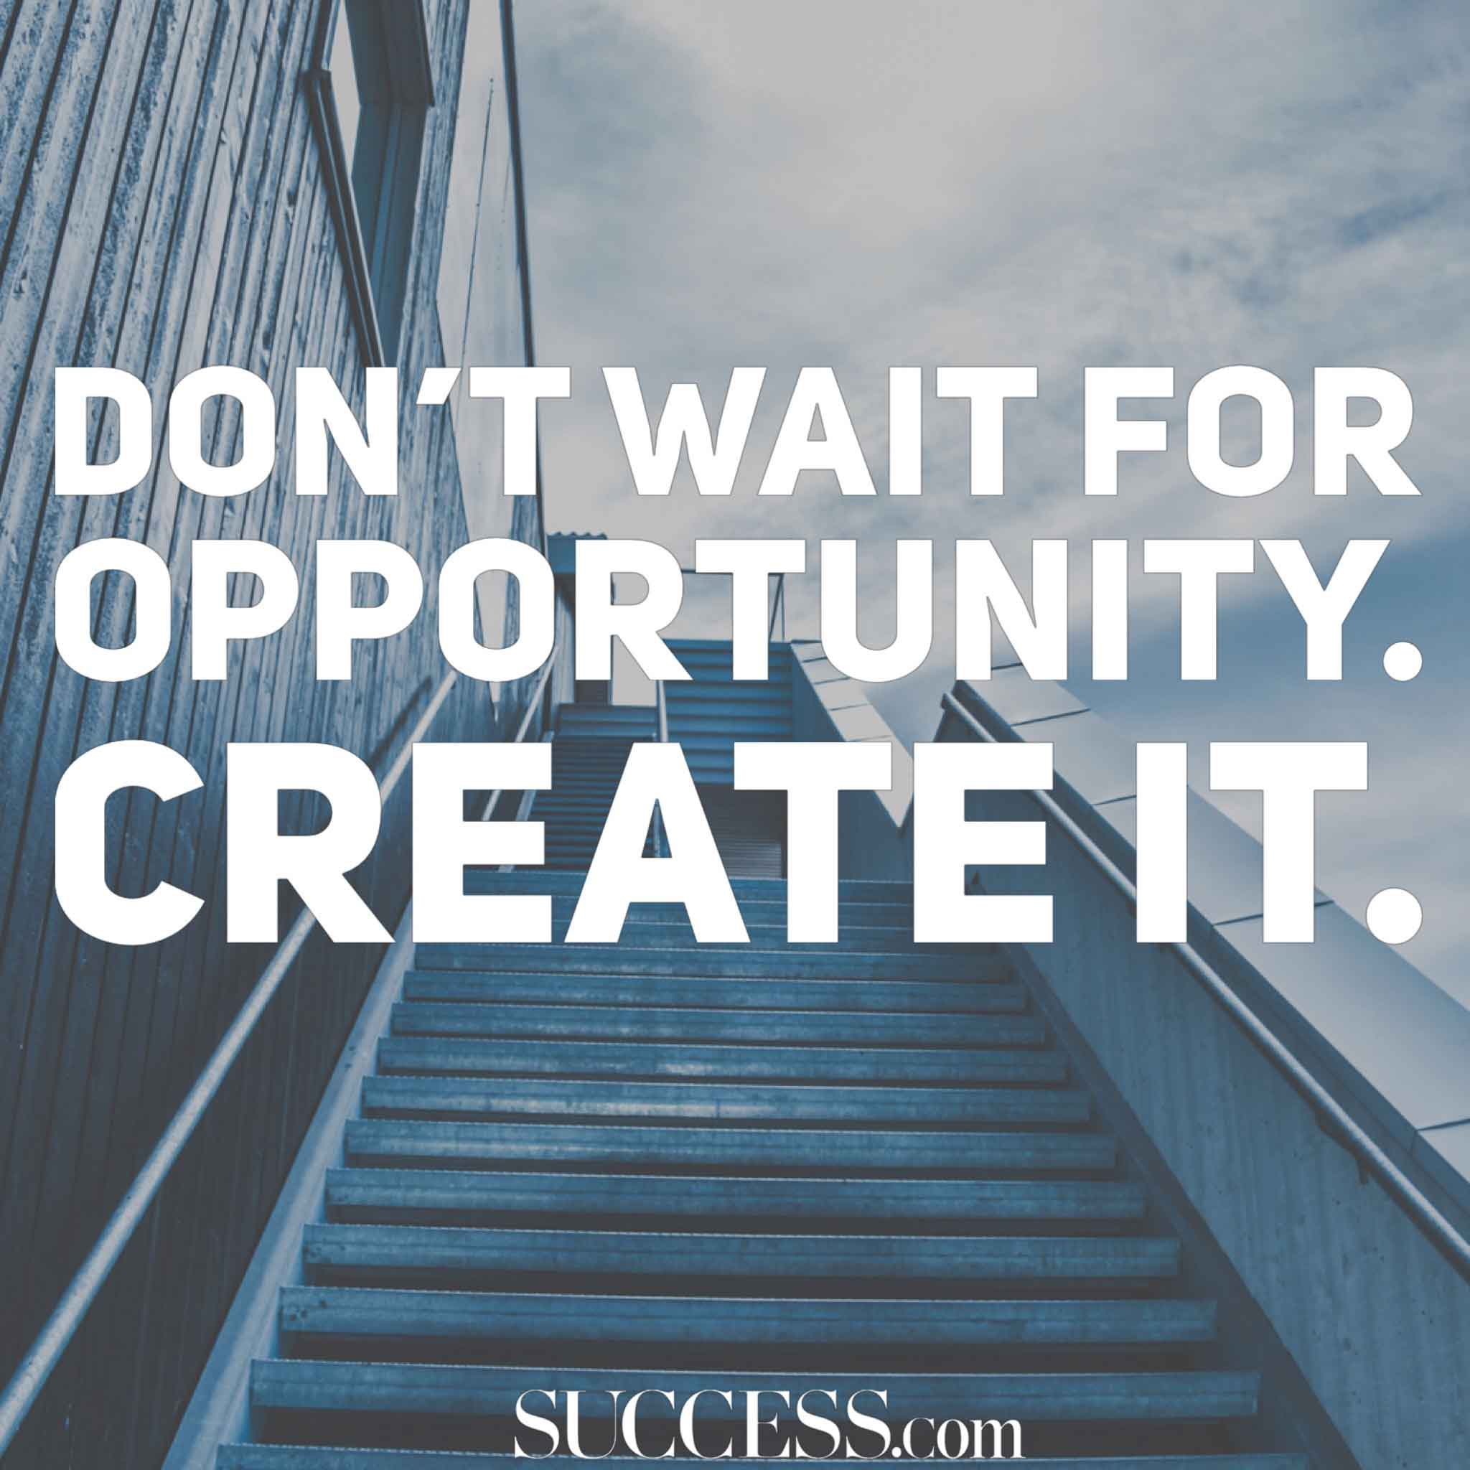
And finally---

Slide 43

NEXT SESSION:
Wednesday, May 20th – 8PM – via ZOOM
Getting a Potential Employers Attention
Developing your personal brand and creating a resume that gets read!
Georgetown Visitation Lifelong Learning Series

