Slide 1
2016-2017 Proposed Budget
Public Hearing
June 27, 2016

Slide 2
Budget Development
Budget Timeline
  December – June
Budget development:
  TEC section 44.002 – 44.006 establishes legal basis for budget development.
  The superintendent is the budget officer for the district and prepares or causes the budget to be prepared.
  Budget must be prepared by June 29th (July 1 fiscal year)
  Hold a Public Hearing

Slide 3
Collaborate with Principals and Departments
Senior Leadership Team
Board Budget Workshops/Budget Priority Survey
District Educational Improvement Council
Final Adoption by June 30th
  Public hearing for Proposed Budget and Tax rate
  Adopt Salary Schedules
  Adopt budgets for General, Child Nutrition and Debt Service Funds

Slide 4
Taxpayer Cost for Quality Schools
2011-12 2012-13 2013-14 2014-15 2015-16 2016-17
M&O $1.040 $1.040 $ 1.040 $ 1.040 $1.040 $1.040
Debt $0.378 $0.378 $ 0.390 $ 0.370 $0.489 $0.489
Total $1.418 $1.418 $ 1.430 $ 1.410 $1.529 $1.529
Avg Taxable
Value $83,690 $80,406 $94,704 $99,589 $105,526 $105,526
Avg Annual
Tax Bill $1,187 $1,150 $1,331 $1,404 $1,614 $1,610
Avg Monthly
Tax Bill $99 $96 $111 $117 $135 $134
**
** Projected tax rate
Notes:
The Debt service rate of $.4895 is estimated for 16-17 until we get certified values on July 25th.

Slide 5
Board Budget Priorities

Slide 6
2016-2017 District Budget Priorities
Meet Student Academic needs of the District
Present a Balanced Budget
Maintain Student Teacher ratios
Offer Competitive Salaries
Support the Strategic Plan

Slide 7
Health Insurance

Slide 8
Health Insurance | Total Staff | Employees Participating
TRS ActiveCare 1-HD |  | 576
TRS ActiveCare 2 |  | 304
TRS Select |  | 160
Scott & White |  | 50
Total Participants |  | 1090
Total Staff | 1720
63% of Total Employees Participate

Slide 9
 | 2016-2017 Plan Year Rates | Employer Contribution | 2016-17 Employee Portion | 2015-16 Employee Portion | Rate changes 2016-2017
TRS ActiveCare 1 - HD
Employee Only | $ 341.00 | $ 245.00 | $ 96.00 | $ 96.00 | $ 0
Employee/Spouse | $ 914.00 | $ 245.00 | $ 669.00 | $ 669.00 | $ 0
Employee/Child(ren) | $ 615.00 | $ 245.00 | $ 370.00 | $ 370.00 | $ 0
Employee/Family | $ 1,231.00 | $ 245.00 | $ 986.00 | $ 986.00 | $ 0
TRS ActiveCare 2
Employee Only | $ 645.00 | $ 245.00 | $ 400.00 | $ 369.00 | $ 31.00
Employee/Spouse | $ 1,552.00 | $ 245.00 | $ 1,307.00 | $ 1,233.00 | $ 74.00
Employee/Child(ren) | $ 1,042.00 | $ 245.00 | $ 797.00 | $ 747.00 | $ 50.00
Employee/Family | $ 1,597.00 | $ 245.00 | $ 1,352.00 | $ 1,276.00 | $ 76.00
TRS ActiveCare Select Plan
Employee Only | $ 484.00 | $ 245.00 | $ 239.00 | $ 228.00 | $ 11.00
Employee/Spouse | $ 1,147.00 | $ 245.00 | $ 902.00 | $ 877.00 | $ 25.00
Employee/Child(ren) | $ 779.00 | $ 245.00 | $ 534.00 | $ 517.00 | $ 17.00
Employee/Family | $ 1,361.00 | $ 245.00 | $ 1,116.00 | $ 1,086.00 | $ 30.00
Notes:
New rates have been included on this slide.
Active-Care 1 HD:
TRS Active-Care 1 HD did not have any premium increases. We have 576 employees, 53% who are part of this plan.
Active-Care 2:
We did see an increase in Active-Care 2 ranging from $31 - $76 per month depending on which category staff were in. There was an 5% increase in premiums for this plan.
$550 raise = $45.83/month

Slide 10
District/State Funding to Help Offset the Cost of TRS-ActiveCare Coverage
District/Entity | $170
State of Texas | $75
Total Per Month for DISD | $245
Total Participants | 1090
Monthly District Contributions | $ 267,050
Yearly District Contributions | $3,204,600

Slide 11
District Contribution for $10,000 Life Insurance Policy
2014-2015 | 1653 Participation | $.85 per Participation
Monthly |  | $1,405
Yearly |  | $16,861
2015-2016 | 1720 Participation | $.55 per Participation
Monthly |  | $ 946
Yearly |  | $11,352

Slide 12
District/Entity Monthly Contribution (2015-2016 Plan Year) | Responses | % Responding
Fixed Contribution
$225 (minimum required by State) | 343 | 36.37%
$226-$275 | 217 | 23.01%
$276-$325 | 229 | 24.28%
$326-$375 | 72 | 7.64%
$376-$425 | 35 | 3.71%
$426-$475 | 16 | 1.70%
$476-$525 | 5 | 0.53%
$526+ | 26 | 2.76%
Total | 943 | 100%

Slide 14
Proposed General, Child Nutrition & Debt Service Fund Budgets

Slide 15
2016-2017 Proposed Budget
 | General Fund | Child Nutrition Fund | Debt Service Fund | Total All Funds
Estimated Revenues
Local Sources
Ad Valorem Taxes | $ 39,718,914 | $ | $ 17,378,913 | $ 57,097,827
Other | $ 401,150 | $ 1,219,718 | $___________ | $ 1,620,868
Total Local Sources | $ 40,120,064 | $ 1,184,900 | $ 17,378,913 | $ 58,683,877
State Sources
State Aid | $ 58,293,325 | $ 42,000 | $ 2,064,062 | $ 60,399,387
TRS On-behalf Payments | $ 4,273,640 | $ _________ | $__________ | $ 4,273,640
Total State Sources | $ 62,566,965 | $ 42,000 | $ 2,064,062 | $ 64,673,027
Federal Sources | $ 2,025,000 | $ 6,276,909 | $ | $ 8,301,909
Other Revenue Sources | $ | $ | $ | $
Total Revenues | $ 104,712,029 | $ 7,538,627 | $ 19,442,975 | 131,693,631
Notes:
General Fund Revenue:
Based on 5% increase in local property values
July 25th – we will get our certified values from DCAD
Early indications from DCAD is that they are expecting another increase this year in local property values
State Aid:
Based on ADA of 11,750; Refer to ADA document in budget notebook to discuss enrollment and ADA trends in the last several years.
ADA through the 6th 6 weeks was 11,927.79

Slide 16
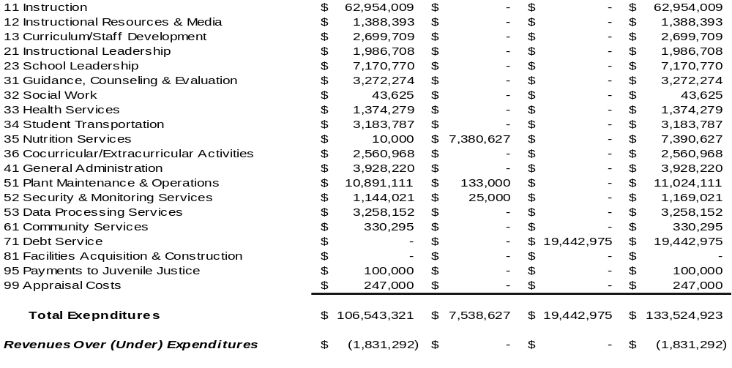
Child Debt
General Nutrition Service Total
Fund Fund Fund All Funds
Notes:
Rolled all current positions from 15-16 to the 16-17 budget.
Campus Budgets were based on the October snapshot date
Departmental budgets were cut 5 %

Slide 17
STAFF SALARY RECOMMENDATION
1% GPI & $50,000 Beginning Teacher Salary
Pay Group |  |  |  |  | General Pay Increase |  | Adjustments |  | Estimated Total Increase
Teachers |  |  |  |  | $450,358 |  | $87,955 |  | $538,313
Administrative Management |  |  |  |  | $22,563 |  | $19,520 |  | $42,083
Administrative Professional |  |  |  |  | $134,612 |  | $30,624 |  | $165,236
Administrative Support |  |  |  |  | $28,687 |  | $62,484 |  | $91,171
Instructional Support |  |  |  |  | $32,826 |  | $34,508 |  | $67,334
Auxiliary |  |  |  |  | $102,471 |  | $61,919 |  | $164,390
 |  |  |  | Total | $771,517 |  | $297,010 |  | $1,068,527
% of Current Costs |  |  |  |  | 1.00% |  | 0.40% |  | 1.40%
Notes:
See 15-16 Compensation schedule for details within each Pay Group
Each employee group will be affected by the 1% raise and certain positions will also be adjusted according to the TASB salary study.

Slide 18
Where does the money come from?
State Revenue:
State Aid projections based on 11,750 ADA.
Approximately 61% of the total revenue budget comes from State revenues.
7% of this amount represents TRS-on-Behalf. This number is dependent on payroll and represents about 5% of total payroll.
Local Revenue:
Local Property revenue based on a 5% increase from 2015 Certified Values
  A 1% percent change in total taxable values equals an approximate $350,000 change

Slide 19
Notes:
5.31% increase in 2014
5.37% increase in 2015

Slide 20
Notes:
60% of Revenue funding comes from the State, 38% comes from Local Sources and 2% comes from Federal Sources.

Slide 21
How does the District spend the money?
Expenses:
  1% salary increase of midpoint for Staff in 16-17 plus adjustments in the pay groups.
  5% decrease in departmental budgets and campus budgets are based on enrollment at Snap-shot date in October.

Slide 23
Notes:
Unassigned fund balance:
Look at graph in your notes

Slide 24
Enrollment @ Snapshot Compared to ADA

Slide 25
General Fund Staffing

Slide 26
Elementary Teachers
Maximum Class Sizes
  K-4 22
No Waivers
Net Change: 8
Intermediate Teachers:
Class Size:
  5th 25
  6th 25
Applying current Staff ratios decreases staff by 8
Net Change: -8
Middle School Teachers:
Class Size:
  7th 28
  8th 28
Net change: 0
High School Teachers:
Applying current staff ratios results in no change of staff
Net change: 0

Slide 27
Legislative Update

Slide 28
House Bill 2610
Enacted by the 84th Texas Legislature
Changed language requiring 180 days of instruction to providing at least 75,600 minutes of instruction
175 instructional days in 2015-16 and 172 instructional days for 2016-17
3 Additional non-instructional days in calendar will be used for Staff Development
Negative impact on Child Nutrition and Transportation staff – working 3 less days
Notes:
This will have an negative impact on Child Nutrition department as they will have 1 less work day in the calendar.

