Slide 1

Preparing for Postsecondary Opportunities through Advanced Academic academics in duncanville isd

Slide 2


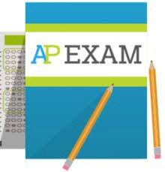
Advanced Placement (AP)
May of each school year:
Summer/Early Fall:
Teachers may attend summer professional development; teachers submit class syllabus to the College Board for AP Course Audit
Students take AP Exam (approximately $94), may earn college credit with a passing score on the exam in accordance with the individual university’s AP recognition policy or state of Texas credit policy
School Year:
Students take the AP course, providing college-level content taught at the high school
Rigorous, college-level coursework with the opportunity to earn college credit through AP exams

Slide 3
Duncanville high school ap sneakpeak
Students are expected to:
● Complete an AP exam in the spring*
● Participate in study sessions to prepare for the AP exam/s
● Complete 4 of 5 campus/district AP activities to earn test fee waivers
AP Boot camp/Study Session (required activity)
1. Enrolled in 1 course – 2 sessions
2. Enrolled in multiple courses – 1 or more sessions per course
3. Complete an AP course survey – scholar
4. Complete an AP course survey - parent
5. Parent attends an AP/College Readiness session
6. AP Lock-in
*Special considerations are given for Senior AP students enrolled in multiple AP classes

Slide 4

Partnership agreement must be established between IHE and LEA to offer dual credit courses
Student eligibility based on achieving the minimum college readiness standards under the Texas Success Initiative (TSI); exemptions and waivers are available
High school and college credit earned simultaneously through college course enrollment
Dual Credit
Taught by a credentialed instructor (college/high school instructor)
Academic core or career and technical courses offered; guaranteed to transfer to any Texas public institution
Offered on high school campus, college campus, or online

Slide 5
Statewide Policy for Dual Credit
Courses for Joint High School and Junior College Credit
Authority: Texas Education Code 130.008 – High School And College Credit Program
  Public junior colleges may establish dual credit partnerships with public and private high schools/school districts to allow a student to enroll in a course and receive both college and high school credit. Courses must be one or more of the following:
Career and Technical
Core Curriculum
Foreign Language

Slide 6

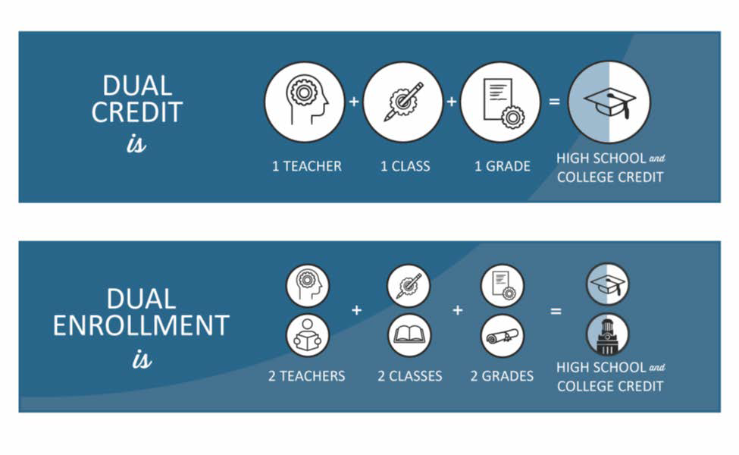
Comparison of Dual Credit and OnRamps Dual Enrollment
Source: OnRamps, The University of Texas at Austin

Slide 7


Dual Enrollment: OnRamps
Structure:
Districts partner with an OnRamps provider; course is co-taught by high school teacher and university faculty
End of each school year:
Students determine whether they want to accept college credit, which is immediately transcripted from UT Austin or Texas Tech University
School Year:
Students take the OnRamps course, providing college- level content taught at the high school
Rigorous, college-level coursework with the opportunity to earn college credit

Slide 8
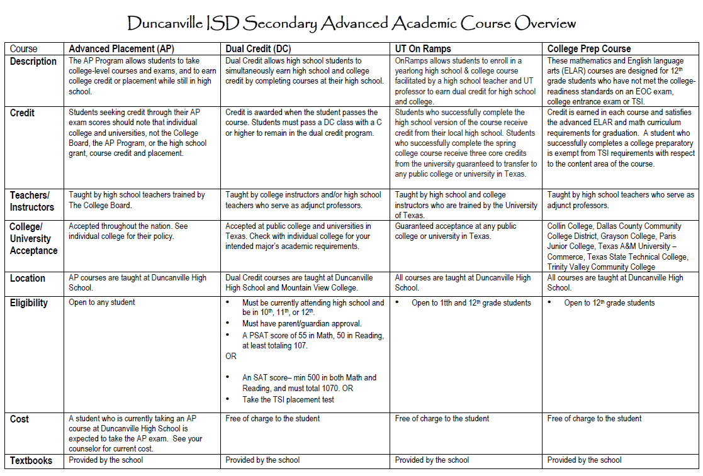

Slide 9

Considerations for Students
Dual Credit and OnRamps
AP and IB
ALL PROGRAMS
Must pass the exam to earn college credit (exam pass scores vary depending on postsecondary institution)
Credits accepted nationally for AP and internationally for IB
AP courses may be offered during the summer, but exams are only administered in May of each year
Guaranteed college credit at most in-state public universities and colleges
Impact on college transcript
Students may opt-out of college credit in OnRamps courses
Dual credit courses can be offered during the summer
Impact on GPA/class rank (varies by local education agency)
College-level courses
May enhance college application
Transferability of credits
Opportunity to earn Performance Acknowledgement

Slide 10
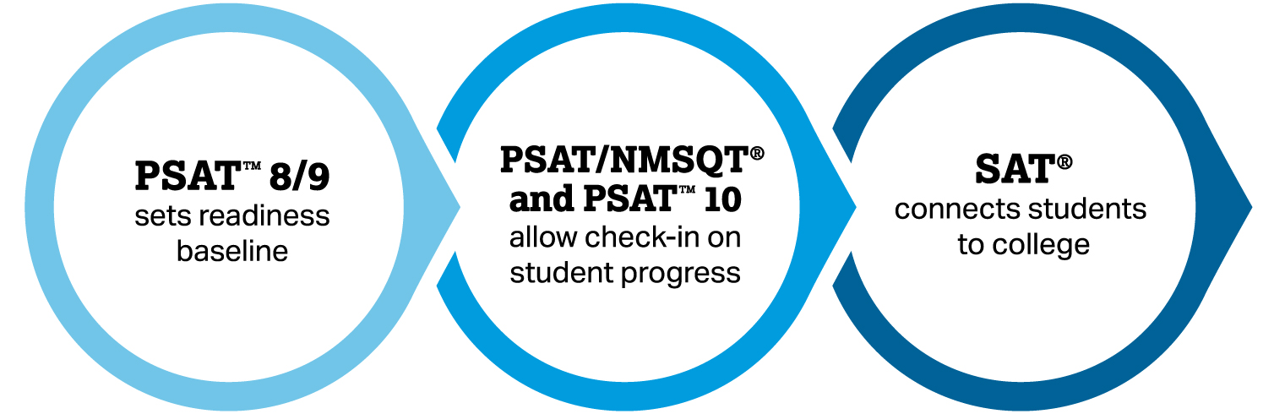
College readiness/entrance exams

Slide 11
PSAT in Duncanville ISD
In Duncanville ISD, all 8th, 9th 10th, and 11th grade students have the opportunity to take the PSAT during the school day at no cost to the student’s family
This is a great investment in your future…
More than ever before, the PSAT supports students on their path to college readiness.
The PSAT will:
Provide a report with insightful information on your individual score (strengths, areas to focus on)
A predicted SAT score (used for college admission and scholarship opportunities)
Your progress toward the college readiness benchmarks.
4

Slide 12
SAT vs. ACT: Which College Entrance Exam
According to NACAC, 58.3% of colleges place considerable importance on admission test scores. Chances are if you’re applying to college you’ll need to take either the SAT or ACT to gain admission. But which test is right for you?
 | SAT | ACT
Sections | Math, Reading, Writing, Optional Essay (Science passages embedded in all sections.) | English, Math, Reading, Science, Optional Essay
Time | 3 hours, +50 minutes with essay | 2 hours 55 min, +30 minutes with essay
Answering | 4 answer options, no point deduction | 4 answer options, no point deduction
Scoring | Out of 1600 – 800 math, 800 reading/writing | Out of 36 – 36 per section that is then averaged for composite; Essay scored separately on a 2-12 scale
Math Section | Two sections: One calculator allowed, one no calculator; 80 minutes; Less geometry, more algebra, pre-calculus & trigonometry added | One 60-question, 60-minute section. Tests pre-algebra through trigonometry. Calculator allowed entire time.
Reading Section | 5 passages, 2 with charts/diagrams, 1 historic document | 4 long passages with questions that require students to recall what they read. Questions in random order.
Science Section | No science section, however science-related passages will be peppered throughout the exam. | Science section covers reasoning, charts and graphs, and hypothesis.
Writing | 4 passages and 44 multiple-choice questions; 35 minutes | Just the essay.
Essay | 1 prompt and one full passage; 50 minutes; essay is optional | One topic and three perspectives; students evaluate and provide their own perspective with evidence; 40 minutes; essay is optional

Slide 13

How can students prepare for advanced academics assessments/exams?
Duncanville’s secondary schools have prep sessions for students to receive face to face support as well as online resources.
*Contact your school counselor for details and dates
According to the Prep Scholar, practice makes progress
10 hours = 30-50 point gain
20 hours = 60-100 point gain
The more you practice, the better chance for an increased score

