Slide 1
Texas Performance Standards Project
A Region 10 ESC GT Parent Portal
Notes:
TIME: 5 minutes
Title Slide
General welcome

Slide 2
Agenda
Unpack the state goal for gifted education in order to understand the district’s alignment of services.
Share the history of the TPSP in order to understand why the project exists
Explore various TPSP projects in order to experience the level of depth and complexity associated with each project.
Explain how the district utilizes TPSP in order to understand the individual district’s service design/model.
Share resources for TPSP in order to build capacity with parents in support of the districts.
Notes:
TIME: 3 minutes
DIRECTIONS: This agenda follows the written objectives for this presentation; please feel free to modify.
SAY: During our time together, we’ll be focusing on the following agenda items [read slide]. While we are striving to be helpful and provide information, we want you to guide the conversation. Feel free to ask questions and form connections with other parents/community members.
NOTE:

Slide 3
What is the State Goal for Gifted Education?
“Students who participate in services designed for gifted/talented students will demonstrate skills in self-directed learning, thinking, research, and communication as evidenced by the development of innovative products and performances that reflect individuality and creativity and are advanced in relation to students of similar age, experience, or environment.
High school graduates who have participated in services for gifted/talented students will have produced products and performances of professional quality as part of their program services.”
Texas Education Agency, (2009).
From Texas State Plan for the Education of Gifted/Talented Students.
Notes:
TIME: 2-5 minutes
DIRECTIONS: This is the full state goal; however, there are alternatives to reading the whole thing aloud. You can choose to either 1) let the participants read the goal and then discuss highlights; 2) go to the next slide which abbreviates the main points.
SAY: Texas has a goal for any kid who is identified as gifted in the state. It is what [your] ISD uses to guide our programming. [choose to either read aloud, have participants read and note highlights, or skip to the abbreviated slide].
NOTE:

Slide 4
The State Goal for Gifted Education
Abbreviated
Students [who receive gifted services] will demonstrate self-directed learning, thinking, research, and communication by the development of innovative products and performances.
Notes:
TIME: 1-2 minutes
DIRECTIONS: This is not intended to undermine or supplant the state goal, but instead to focus on the creation of products and performances--the purpose of this TPSP presentation.
SAY: This is the abbreviated state goal [read slide]. There are other legal requirements of a gifted program, but this is the focus--the development of innovative products and performances. When [our] ISD thinks about gifted programing, we think about how we are going to get students creating these products and performances.
NOTE:

Slide 5
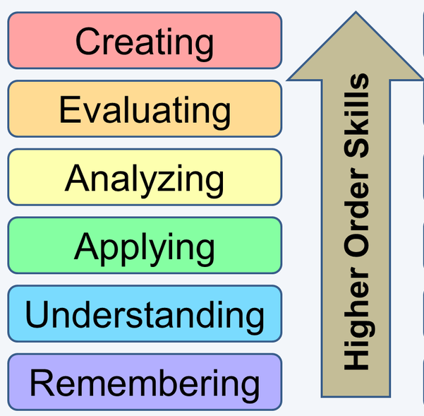


What are ways to meet the State Goal?
“...develop innovative products and performances.”
Notes:
TIME: 5-10 Minutes
DIRECTIONS: This slide allows the parents the chance to share ways that their children could meet the state goal. You’ll hear a broad range of answers, and just remember that there are many ways to reach this goal.
SAY: You have just seen the state goal, “...to develop innovative products and performances.” What are some ways that students could meet the state goal? [Allow time to respond] There are many ways to accomplish the state goal, from students working independently, to students working in groups with other gifted students, to advanced level course work, and even mentorships for older students. One way is to have projects that focus on higher order thinking skills and challenge the students with greater depth and complexity.
NOTE:

Slide 6
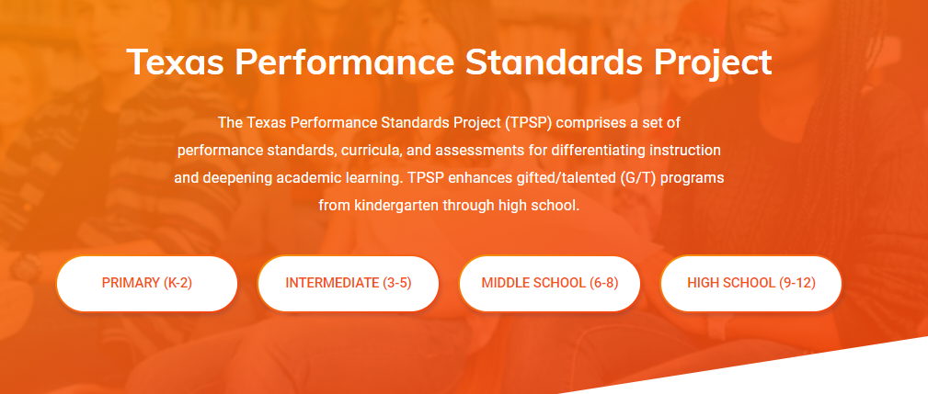
The Texas Performance Standards Project (TPSP)
TexasPSP.org
Notes:
TIME: 5 minutes
DIRECTIONS: This is the brief overview of the Texas Performance Standards Project. You can encourage participants to visit the website while you talk.
SAY: [reading small description] “The Texas Performance Standards Project comprises a set of performance standards, curricula, and assessments for differentiating instruction and deepening academic learning. TPSP enhances gifted/talented programs from kindergarten through high school.” What this means is that there are projects for every grade level specifically written with gifted kids in mind.
NOTE:

Slide 7
Two parts to every project
Phase I, Learning Experiences, is a suggested series of TEKS-based lessons and performances to be used in large groups, in small groups, and/or individually. Phase I allows students to work with advanced content and processes through a discipline-based research model. Phase I is developmental and formative.
In Phase II, Independent Research, students utilize and extend their learning from Phase I to develop a product. The product provides students with opportunities to synthesize learning, apply knowledge to a novel situation, and provide an advanced, high-quality demonstration of the student’s knowledge and skills.
Phase One
Phase Two
Before we look at any projects, how does the TPSP
help districts meet the state goal?
Notes:
TIME: 5 minutes
DIRECTIONS:
SAY: Every project, regardless of grade level, is made of two components or phases. Phase One is Learning Experiences and there is a lesson for use in larger or small groups, or individually. Phase Two is Independent Research and is meant to be completed as an independent project. Before we go any further, [click, reading the question] “How does the TPSP help districts meet the state goal?”
NOTE:

Slide 8
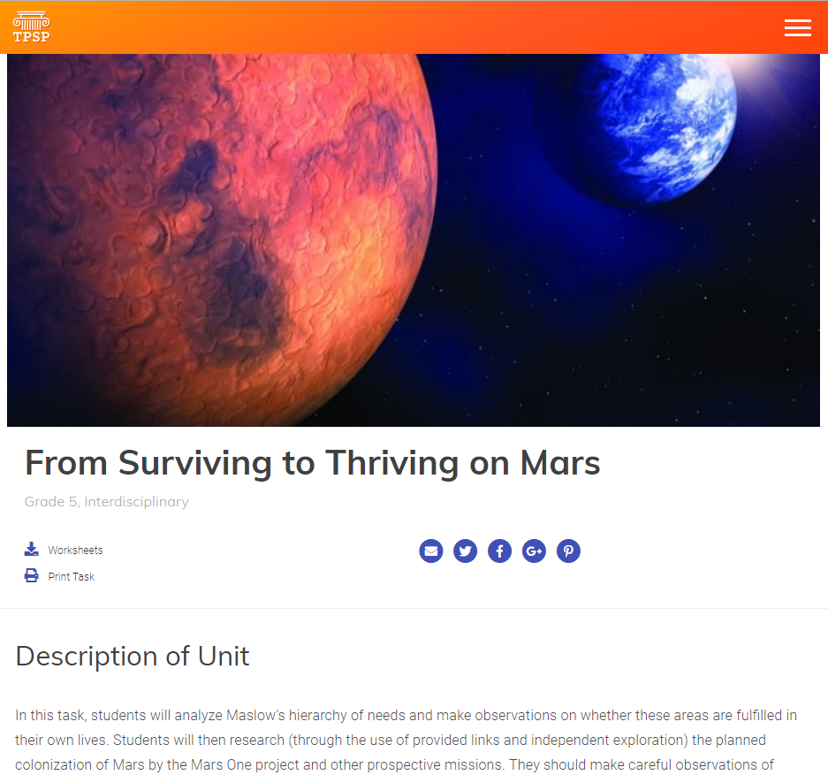
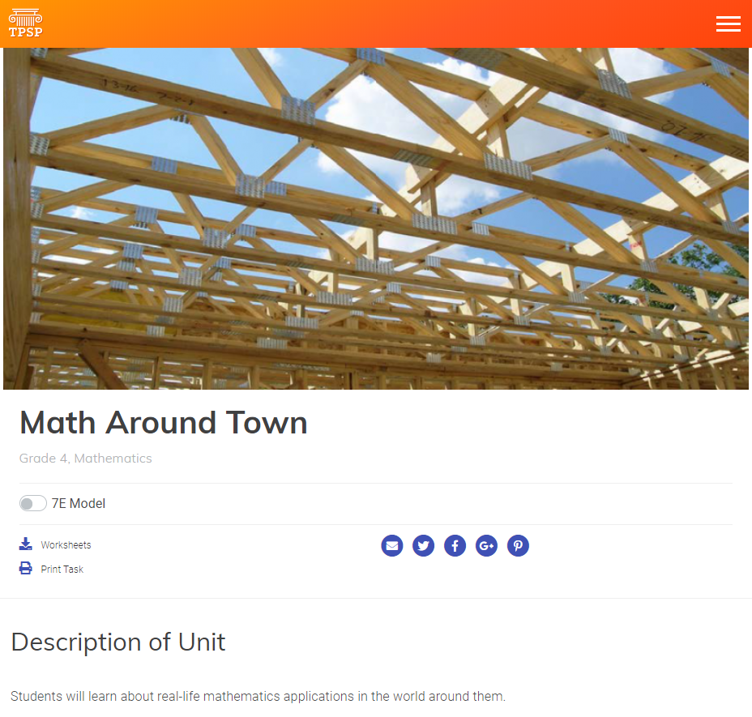
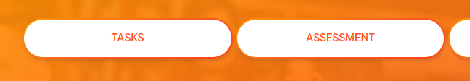
Explore a Project
At this time, we encourage you to explore a task at your child’s grade level.
Notes:
TIME: 10-20 minutes
DIRECTIONS: This is a chance to explore a project. Based on your district’s use of TPSP, you can 1) guide the parents through a live exploration; 2) allow the parents to explore at their own speed; 3) have hard copies of various projects for distribution.
SAY: [choose which option is best for your district--see DIRECTIONS above].
NOTE: Note to districts: you may need to revise this slide based on how the TPSP projects are used in your district. For example, if GT students use the Pursuit of Passion project, then you would want to guide the exploration and show parents the Pursuit of Passion Project.

Slide 9
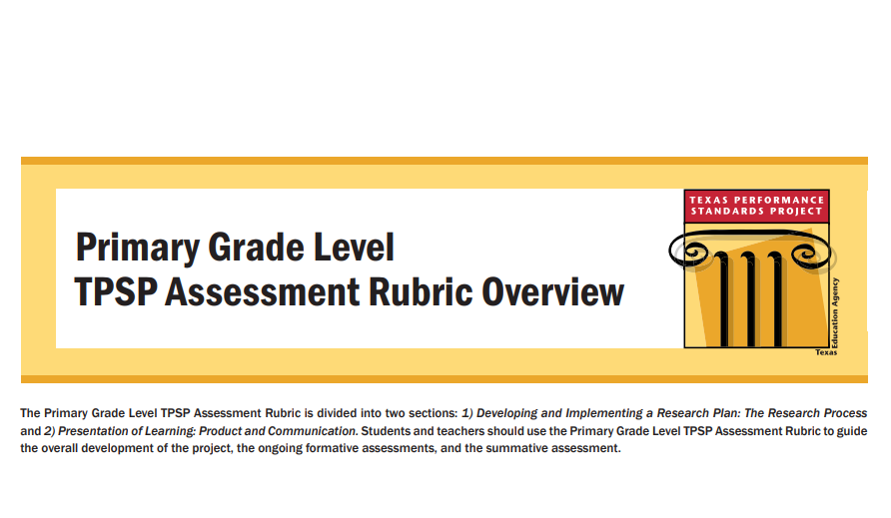
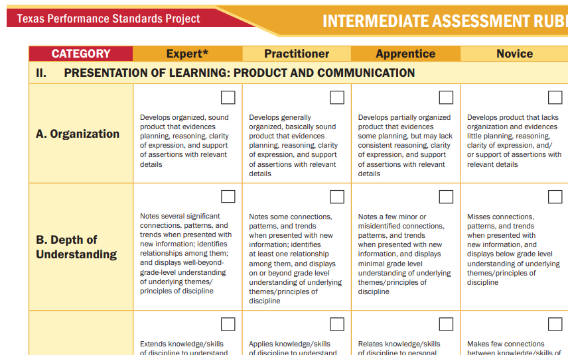
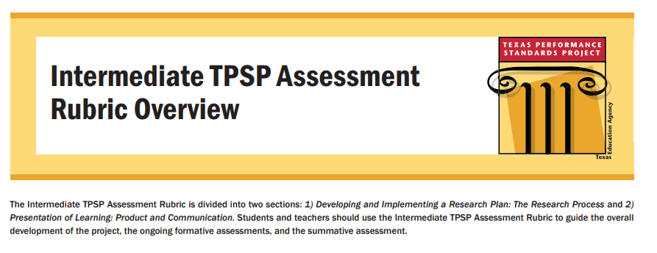
Exploring a Rubric
Take a moment to explore a rubric for your grade level.
Notes:
TIME: 5-10 minutes
DIRECTIONS: This is a chance for parents to understand the high level of depth and complexity. Based on technology and internet assessibility, you can 1) guide the parents through the exploration of a live rubric; 2) have the parents explore rubrics; or 3) have copies of rubrics provided as handouts.
SAY: Because every project has the same two phases, and because every project focuses on research and the creation of individual products--all of the assessment rubrics for a grade level are the same.
That means a classroom of gifted second graders could choose different projects, and the teacher uses the K-2 rubric. This is also great for students and parents to best understand what is expected as they complete these advanced level projects. Please take a moment to explore a rubric [choose which option is best for your district -- see DIRECTIONS above]
NOTE:

Slide 10
How Duncanville ISD uses the TPSP
Kindergarten -2nd grade: Teachers, who are GT trained on using the Texas Performance Standards Project, provide specific projects that complement the class’’s learning objectives.
3rd-5th grade: Core teachers provide opportunity during school hours for students to complete a Pursuit of Passion project.
6th-8th grade: Students complete a TPSP project of their choosing each year as part of their honors-level course work.
High School: Courses, such as Independent Studies and Mentorship, AP Capstone, CTE course work, allow students to complete independent research in a field of their choosing. Student in the GT program submit a portfolio.
Notes:
TIME: 3-5 minutes
DIRECTIONS: This is chance to explain how the TPSP is used at your district and take any questions.
SAY: [Depends on district’s program implementation of the Texas Performance Standards Project].
NOTE:

Slide 11
How does TPSP help meet the State Goal?
“Students who participate in services designed for gifted/talented students will demonstrate skills in self-directed learning, thinking, research, and communication as evidenced by the development of innovative products and performances that reflect individuality and creativity and are advanced in relation to students of similar age, experience, or environment.
High school graduates who have participated in services for gifted/talented students will have produced products and performances of professional quality as part of their program services.”
Texas Education Agency, (2009).
From Texas State Plan for the Education of Gifted/Talented Students.
Notes:
TIME: 3-5 minutes
DIRECTIONS: This is chance to recap the exploration, and take any questions.
SAY: Thank you for your time in exploring the Texas Performance Standards Project and how you child will utilize these projects as part of the gifted service. As we conclude, I would like to revisit the state goal for gifted education to show how TPSP helps [our] ISD serve gifted students.
“Self-directed learning, thinking, research” is Phase One of each TPSP.
“Communication” and “the development of innovative products and performances” is Phase Two of each TPSP
[Continue with the definition as it matches your district’s service design--for example, individual choice of the project and the high school programming options.]
NOTE:

Slide 12
Additional Resources
Searchable TPSP Projects
These charts explain how Depth & Complexity is added into each of the grade-level projects. (Continuum of Learning Experiences Framework - COLEF)
Parent Brochure (English / Spanish)
Letters to students and parents that help explain the project; optional contracts for independent research, and more. (K-2; 3-5; 6-8; 9-12)

