Slide 1

Creciendo las Mentes Dotadas
Notes:
Time: 3 minutes
Tiel Slide
General Welcome

Slide 2
Agenda
Explorar el poder del control percibido
Para comprender el impacto de la autoficacia en la resiliencia
Comprender el impacto de las relaciones positivas entre adultos y niños sobre la resiliencia
Para practicar elogios positivos
Notes:
TIME: 2-3 minutes
DIRECTIONS: This agenda follows the written objectives for this presentation; please feel free to modify.
SAY: During our time together, we’ll be focusing on the following agenda items [read slide]. While we are striving to be helpful and provide information, we want you to guide the conversation. Feel free to ask questions and form connections with other parents/community members.
NOTE:

Slide 3
Actividad: ¿Cómo definimos…?
Tómese un momento para pensar en un corredor. .
  Crea una imagen mental de este corredor.
  Piensa en sus características.
  Piensa en lo que hace él o ella.
Notes:
TIME: 5-10 minutes
DIRECTIONS: This explores the ideas of constructs and idealized states. The purpose is to show how we all have different definitions of what makes a runner, and that each of us have these definitions based on our experience and understanding.
SAY: [Reading the slide]. I want to start with a short exercise. [Read bullet point and provide ~30 seconds].
I’m going to provide you with some behaviors and you tell me if the person I’m describing fits your definition of a runner.
“Micah bought some new running shoes.” - Is Micah a runner? [allow responses]
“Micah put on the shoes and ran 20 steps down the sidewalk” - Is Micah a runner? [allow responses]
“Micah gets up early every morning and runs 20 steps down the sidewalk” - Is Micah a runner? [allow responses]
“Micah runs 2 miles every morning.” - Is Micah a runner [allow responses]
“Micah finishes a 5K race” - Is Micah a runner [allow responses]
“Micah qualifies for the Boston Marathon” - Is Micah a runner [allow responses].
We each have different definitions of what makes someone a runner based on our past experiences and our mindsets. For some of us, Micah was a runner when he or she bought the shoes and made the commitment. For others it wasn’t until Micah was consistent. For others it required showing the ability to perform that made Micah a runner.
NOTE:

Slide 4
¿Cómo definimos a los dotados y talentosos?
¿El cociente intelectual de un niño lo hace dotado y talentoso
¿Qué pasa si el niño no hace ninngún trabajo en la escuela, es él/ella dotado y talentoso?
¿Qué pasa si el niño solo hace lo que se requiere,es él/ella dotado y talentoso?
¿Tiene el niño que mostrar un talento de alguna manera para ser dotado y talentoso?
¿Tiene el niño que desempeñarse a un alto nivel para ser dotado y talentoso?
Todos tenemos diferentes definiciones de dotados y talentosos. Esto crea conversaciones saludables pero también puede generar estrés innecesario para un niño.
Notes:
TIME: 3-5 minutes
DIRECTIONS: This slide draws the comparison and points out how we all have different definitions of gifted & talented.
SAY: We won’t repeat the activity, but I want you to think about how you define gifted and talented. Each of the questions align to the analogy of the runner.
[First bullet] - similar to buying the shoes and having the ability
[Second bullet] - similar to only taking the shoes out once for 20 steps
[Third bullet] - compare to using the shoes daily, but only going 20 steps
[Fourth bullet] - compare to running a 5K
[Fifth bullet] - compare to qualifying for the Boston Marathon
The point it, we all have different definitions of what makes someone gifted and/or talented. This difference in how we define giftedness creates a lot of healthy conversations, but it can also lead to a lot of unnecessary stress in a child’s minds. In the next slide, I you to image how a child would feel.
NOTE:

Slide 5
¿Cómo estamos CRECIENDO nuestras mentes dotadas?
¿Cómo reaccionarías personalmente a las siguientes afirmaciones?
Tienes un coeficiente de inteligencia alto, eres inteligente.
Eres inteligente; ¿Por qué no haces tu trabajo?
Eres inteligente; Esperaba más de ti
Puedes hacerlo; eres inteligente.
Pudiste lograr eso porque eres inteligente.
Con base en esas declaraciones, ¿sobre qué sientes que tienes el control?
Notes:
TIME: 3-10 minutes
DIRECTIONS: This slide begins the conversation on how we praise and grow our gifted learners. It starts by having us think about how it feels to have a gift and what you feel you have control over.
SAY: Using those same patterns of defining giftedness, I want you to think about the following [reading slide] “How would you personally react to following statements?” [read bullet points - allow think and conversation]. Based on those statements what do you feel you have control over? Is your gift a good thing? Do you have control over your gift? When you mess up, are you still gifted? Often, the way we communicate a gift makes the child feel as though he or she doesn’t have control of his or her abilities.
NOTE: The last sentence “Often…” is the salient point of the opening activity. Allow questions and discussion, as this allows us to consider the power of praise.

Slide 6
¿Están ellos en control de sus dones?
Cuando sentimos que no tenemos control, somos propensos a la apatía y a la impotencia aprendida.
Sin embargo, si la persona cree en que él o ella tiene el control de las habilidades, él / ella puede desempeñarse mejor y cambiar el comportamiento.
Aronson, Akert, Wilson, Timothy (2010); Rotter, J. (1954).
Notes:
TIME: 2-3 minutes
DIRECTIONS:
SAY: [Read slide]
NOTE:

Slide 7
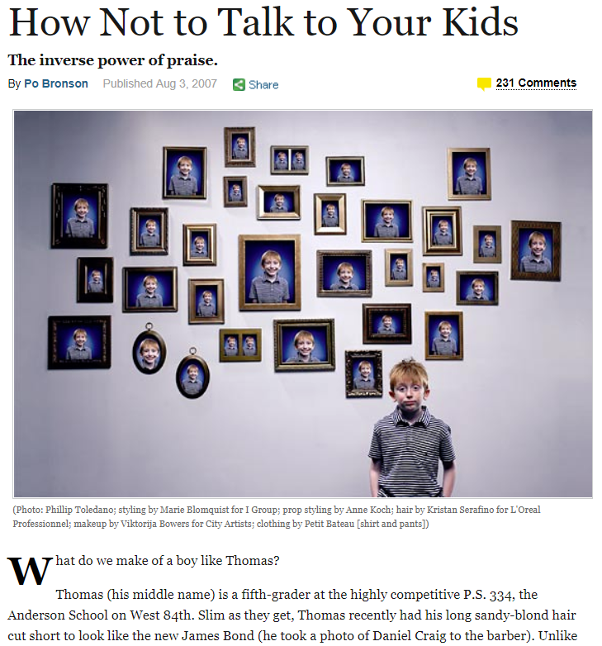
El poder (y el peligro) de alabanza
Según el artículo, qué sucede cuando decimos:
Tienes un coeficiente de inteligencia alto, eres inteligente.
Eres inteligente; ¿Por qué no haces tu trabajo?
Eres inteligente; Esperaba más de ti.
Puedes hacerlo; eres inteligente.
Pudiste lograr eso porque eres inteligente.
Notes:
TIME: 10-20 minutes
DIRECTIONS: The purpose is to read about Dweck’s work on praise and how praising “natural intelligence takes [success] out of the child’s control.” Depending on your audience and seating accomodations, you could either 1) Read the article to them; 2) Have copies for everyone to read individually; 3) have the participants partner read; 4) have a group read and discuss the article together, or other ideas.
SAY: The way that we define gifted and the way that we praise our children has an impact on their perceived level of control. I want to take just a moment to cover a little bit of Carol Dweck’s research. In this activity we’ll [choose method--see directions above]. When you are done, we’ll cover some questions. [Allow time] Read discussion questions and allow opportunity to share.
NOTE:

Slide 8
Control Percibido = Crecimiento y Resistencia
Queremos niños que sientan que controlan sus habilidades.
Queremos niños que no se den por vencidos en contratiempos negativos.
El Centro sobre el niño en desarrollo (Universidad de Harvard) encontró un conjunto común de factores que predisponen a los niños a resultados positivos frente a la adversidad. Incluido en estos factores están:
Relaciones de apoyo entre adultos y niños
Creando un sentido de control percibido.
Notes:
TIME: 2-3 minutes
DIRECTIONS: This makes the connection between supportive parenting and perceived control.
SAY: The power of positive praise is more than just achievement, it’s growing our gifted minds to be resilient. [Read slide].
NOTE:

Slide 9
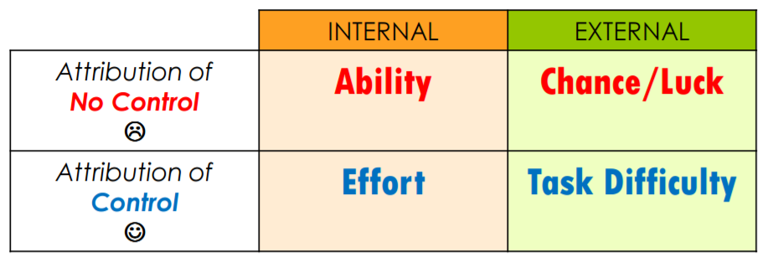
Simplemente no soy una "Persona de Matemáticas". No pienso así.
Algunas personas simplemente nacen con habilidades matemáticas naturales; ¡No es justo!
Creciente resiliencia
No puedo hacer esto todavía Si realmente me aplico y obtengo ayuda, ¡puedo hacer esto!
Esta matemática es muy difícil, y todavía no estoy en ese nivel. Necesito algo de ayuda.
Notes:
TIME:10-15 minutes
DIRECTIONS: This click through will give examples of the Locus of Control. The purpose is to see the subtle shift from No Control (apathy and learned helplessness) to Control through perception.
SAY: Let’s see some quick examples in action. This graph (known as the Locus of Control) shows us how we attribute internal and external factors. When we have NO CONTROL, we believe our skills are based on a natural, given ability (click to show “I’m just not a Math Person.”) In that same way of thinking, we believe other just have special abilities by chance or luck (click to show “some people are just born with natural math skills…”)
When we have self-efficacy, when we believe that we have CONTROL, our mindset and resilience changes. We saw this in the Carol Dweck research. The kids who were praised for their intelligence struggled and became panicky at the harder test--they thought that they just didn’t have the ability. The kids who felt in control of their effort, tried harder and enjoyed the process. (click to show “I can’t do this yet…”) In this same way of thinking, things will be tough--so tough you can’t do them yet. Someone who perceives to be in control isn’t in denial of this, they just don’t take it personally. Their failure is not a reflection of themselves; they know it’s the difficulty of the task (click to show “This math is very difficult, and I’m not on that level yet. I need some help.”)
What is the difference between the two types of responses (NO CONTROL and CONTROL)? What can we do to help our kids grow? (allow time for discussion)
NOTE:

Slide 10
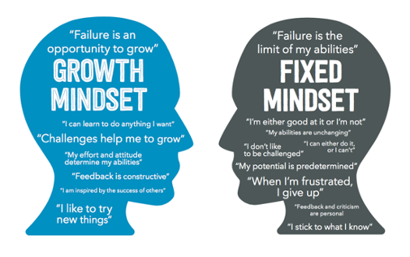
Creciente Mentes Dotadas
Notes:
TIME: 2-3 minutes
DIRECTIONS: A final summary of the control theory, known as Growth and Fixed mindsets
SAY: The theory of control and attribution has been researched for 50 years. A popular way of thinking about this concept is known as Growth Mindset, and was published by Carol Dweck in her book Mindset: The New Psychology of Success (2004).
NOTE:

Slide 11
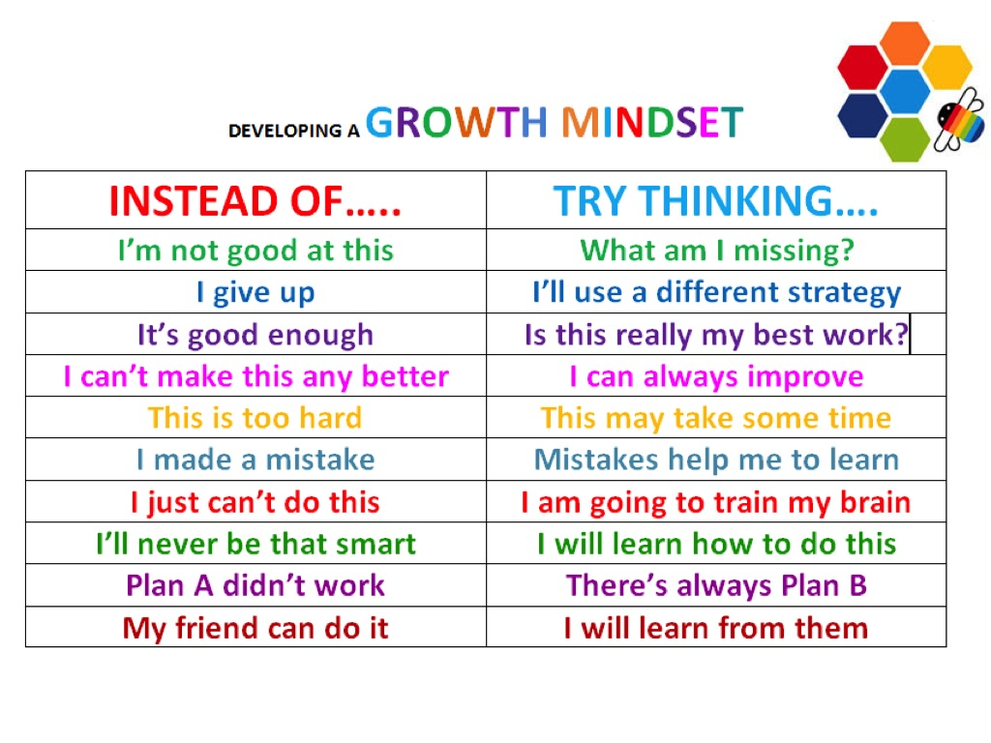
Comprométete con las mentes dotadas crecientes
Notes:
TIME: 5-10 minutes
DIRECTIONS: You can conclude with this short activity or continue to share the resources in the following slides.
SAY: We know that providing children with a supportive adult relationship and perceived self-control is the best way to grow gifted minds. As we conclude, let’s review some ways to praise and commit to helping our children become the best they can be.
NOTE:

Slide 12
Recursos
Bust your Buts: Tips for Teens who Procrastinate by Dr. Joanne Foster
Mindset: The New Psychology of Success (book)
The Power (and Peril) of Praising Your Kids (New York Times article)
“Resilience” from The Center on the Developing Child (Harvard University)

Slide 13
Fuentes
Aronson, Elliot; Akert, Robin M.; Wilson, Timothy D. (2010). Sozialpsychologie. Pearson Studium. As quoted in ‘Perceived Control’ Wikipedia.org
Dweck, Carol (2004; 2007). Mindset: The New Psychology of Success. Ballantine Book
Nolen, Jeannette. "Learned Helplessness". britannica.com. https://www.britannica.com/science/learned-helplessness
Rotter, J. (1954). Social learning and clinical psychology (Prentice-Hall psychology series). New York: Prentice-Hall.

