Slide 1

FAMILIES AS PARTNERS IN LEARNING
THE
PARENT-TEACHER
CONFERENCE
PATTI JOMO
WILLOW ROAD CONSULTING

Slide 2
HOPES
THIS IS WHERE IT STARTS …
&
DREAMS
WILLOW ROAD CONSULTING

Slide 3
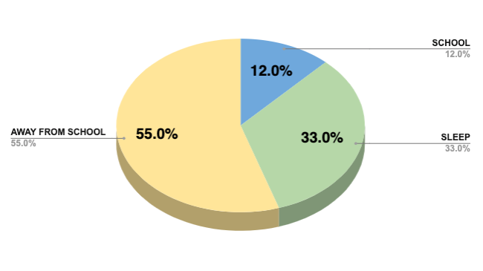
LET’S LOOK AT THE FACTS
Families as Partners in Learning
NOT a nice to have, but
a NEED to have.
WILLOW ROAD CONSULTING

Slide 4



The SUM of the
PARTS
FAMILIES
as PARTNERS
in LEARNING
WILLOW ROAD CONSULTING

Slide 5



Three Roles
Families Play to Accelerate
Student
Learning
COMMUNICATE
high expectations
SUPPORT
learning at home
MONITOR
child’s performance

Slide 6



Why are Conferences IMPORTANT?
Education is a
TEAM EFFORT!
Information on
performance
Suggestions for
support at home
WILLOW ROAD CONSULTING

Slide 7
The
Report Card
What it shows …
How often it’s
delivered …
Who provides the grades …
WILLOW ROAD CONSULTING

Slide 8




PREPARE for the Conference
Pre-Conference Questionnaire
Talk to your child.
Make a list of questions.
WILLOW ROAD CONSULTING
Translation

Slide 9




DURING the Conference
Be on time
Partnership
Take notes
WILLOW ROAD CONSULTING
Ask questions

Slide 10

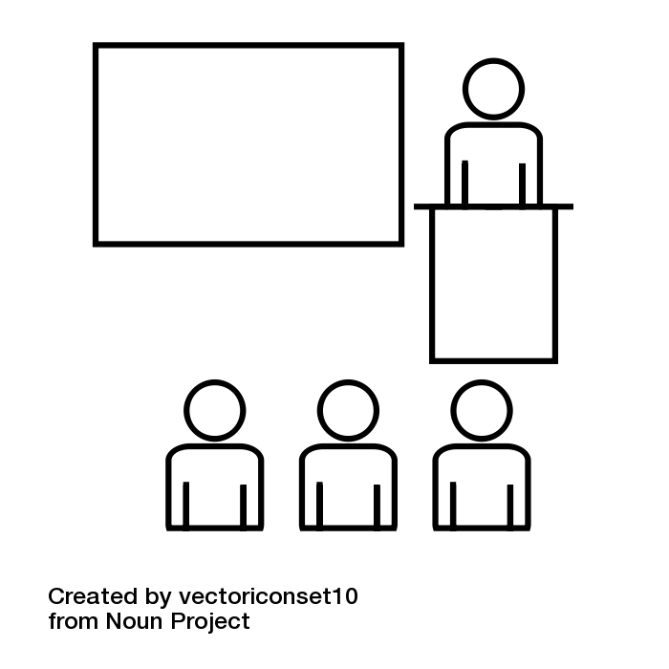

What QUESTIONS should I ask?
How can I help my child?
How will you help my child?
How can we be in contact with each other?
WILLOW ROAD CONSULTING

Slide 11
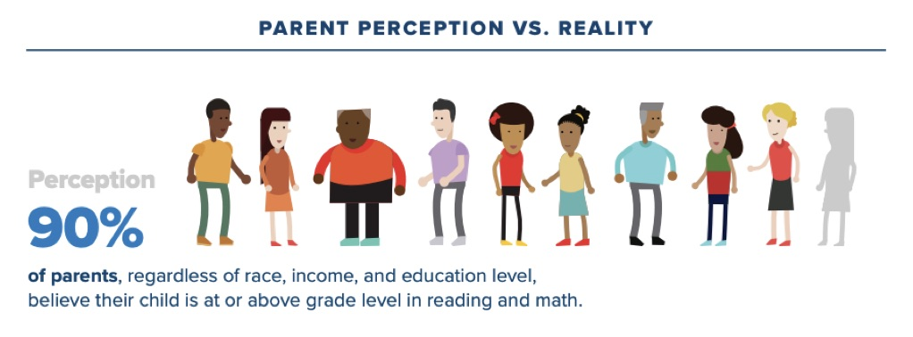
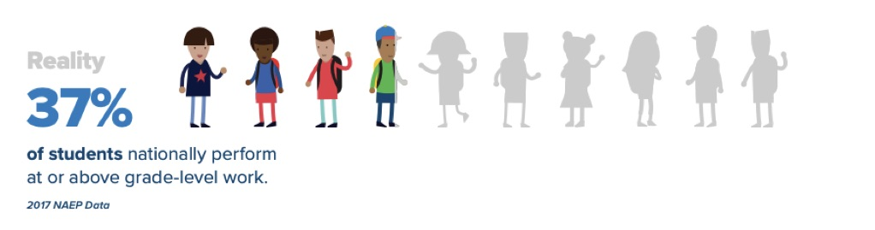
PARENT
PERCEPTION
VS.
REALITY
WILLOW ROAD CONSULTING
(* Learning Heroes 2016 study on Parent Mindsets)

Slide 12
Get
RESOURCES to reach GOALS
Understand your child’s
current strengths and
weaknesses.
Set GOALS
Make them REALISTIC and DOABLE
WILLOW ROAD CONSULTING

Slide 13
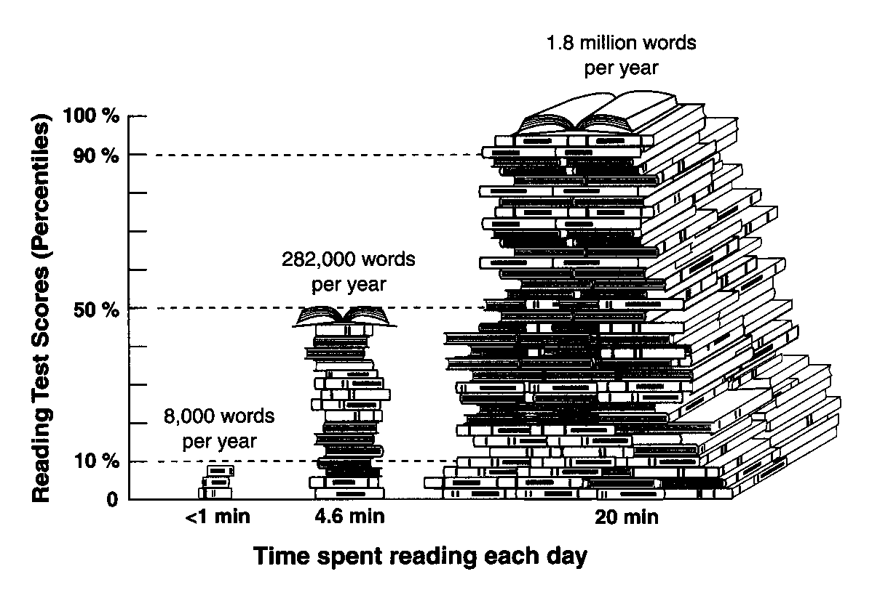
Extra doses matter!
WILLOW ROAD CONSULTING
(*Shaywitz 2004)

Slide 14


AFTER the
Conference
Report back to your child.
Goals & Commitments
Parent & Teacher Support
WILLOW ROAD CONSULTING

Slide 15


PLAN for GROWTH and COMMUNICTION
GROWTH
& COMMUNICATION
YOU
CHILD
TEACHER

Slide 16

Know that your team
is in sync!
WILLOW ROAD CONSULTING

Slide 17
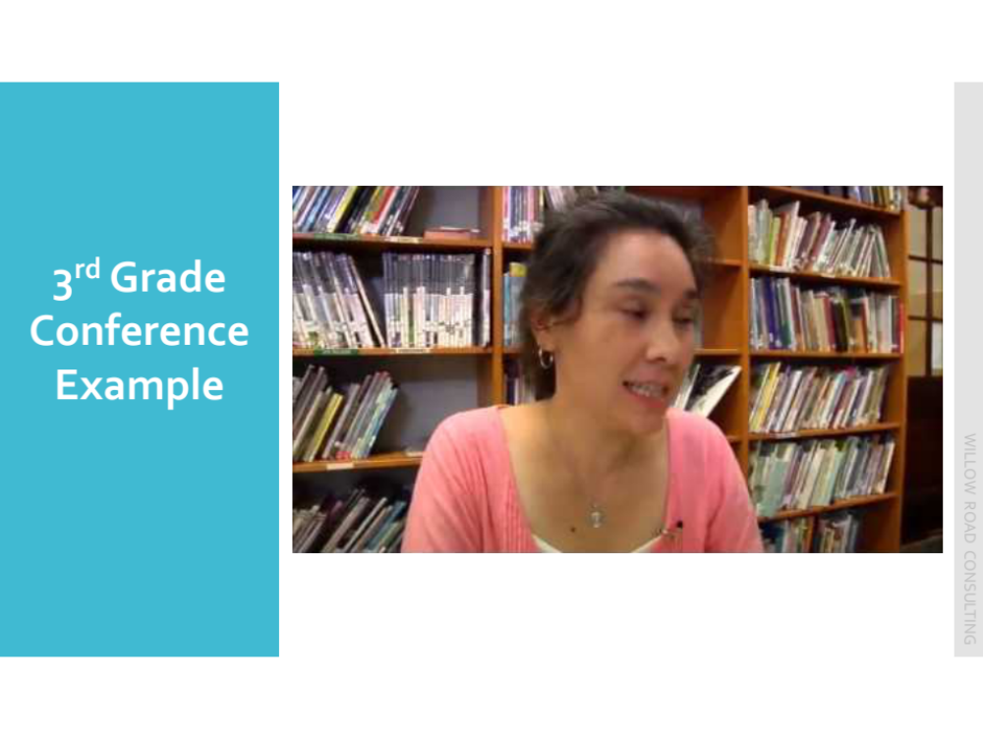
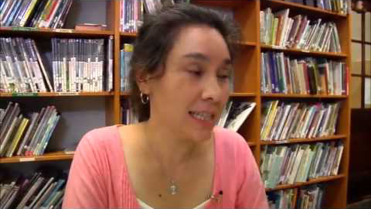
3rd Grade
Conference Example
WILLOW ROAD CONSULTING

