Slide 1

Policy and Procedures
Prohibiting
Harassment and Bullying
New Hanover County Schools
Student Support Services
Judy Stubblefield, Bullying Prevention Coordinator
Kristin Jackson, Director of Student Support Services
Updated August 2018

Slide 2

Bullying Prevention
What We Have and What We Do

Slide 3
PROHIBITION AGAINST HARASSMENT AND BULLYING BY STUDENTS
The New Hanover County Board of
Education believes that all employees,
students and their parents/families should
be free of harassment and bullying as part
of a safe, orderly, caring and inviting
working and learning environment. The
Board expressly prohibits harassment or
bullying of students, employees and their
parents/families, by students.
Policy:8307

Slide 4
PROHIBITION AGAINST HARASSMENT AND BULLYING BY STUDENTS (cont.)
Any violation of this Policy is considered a
serious violation and appropriate action
shall be taken in response to a violation in
accordance with the Student Discipline
Policy 8410.

Slide 5
This Policy will apply in the following circumstances:
While in any school building or on any school property before, during or after school hours;
While on any bus or other vehicle as part of any school activity;
While waiting at any bus stop;
During any school function, extracurricular activity or school sponsored function;
When subject to the authority of school personnel; and
During any time, at any place or using any method of communication, including but not limited to electronic communications, when the behavior has a direct and immediate effect

Slide 6
Acts reasonably perceived as being motivated by any actual or perceived differentiating characteristic.
Defining
“Bullying”
or
“Harassment “
race,
ethnicity,
ancestry,
color,
national origin,
gender,
socio-economic status,
academic status,
gender identity
age

Slide 7
Acts based on:
Defining
“Bullying”
or “Harassment “ (cont.)
physical
appearance,
sexual orientation,
pregnancy,
religion,
mental disability
physical disability
developmental or
sensory disability,
based on an
association with a
person who has or is
perceived to have one
or more of these
characteristics

Slide 8
Defining “Conflict”
When a conflict occurs:
both people involved have equal power in the relationship
both people are emotional and upset
neither one is seeking power or attention
both parties just happen to disagree.
Also, when people experience conflict :
they likely will feel remorse and take responsibility for what
they did wrong.
they just want to solve the problem so that they can start
having fun again.
Lastly, conflict happens occasionally and is usually not serious or emotionally damaging to either person.

Slide 9
HARASSMENT OR BULLYING
COMPLAINT PROCEDURES
Who can file a complaint
Students
Parents/guardians,
School employees
Volunteers
Visitors or others

Slide 10
What happens next
Teacher, staff member, student or parent can fill out ‘Bullying/Harassment Reporting Form’ found on website @
  http://www.nhcs.net/forms.htm
Form is turned over to designated investigator on campus
Investigation initiated within 72 hours
If not bullying, follow up with individuals to make sure comments, conflict or supposed bullying does not continue
If bullying, turn form into administration for further handling of matter to include follow up support for victim and offender.

Slide 11
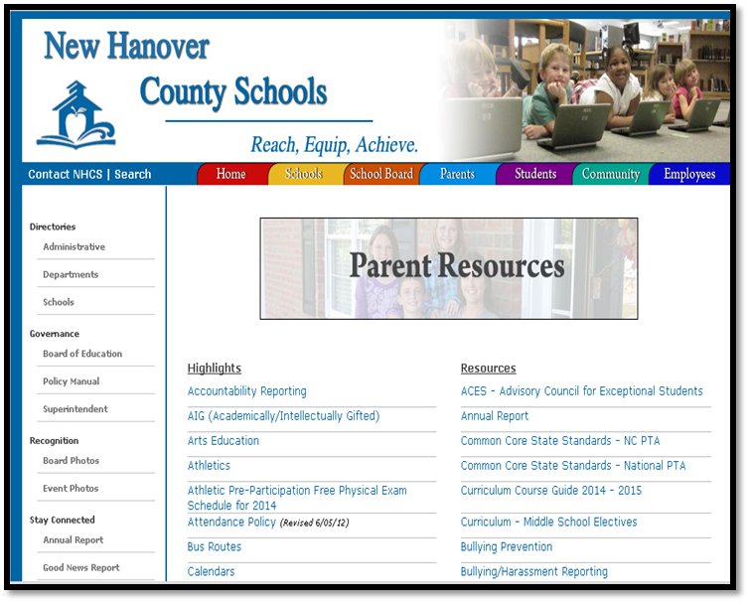
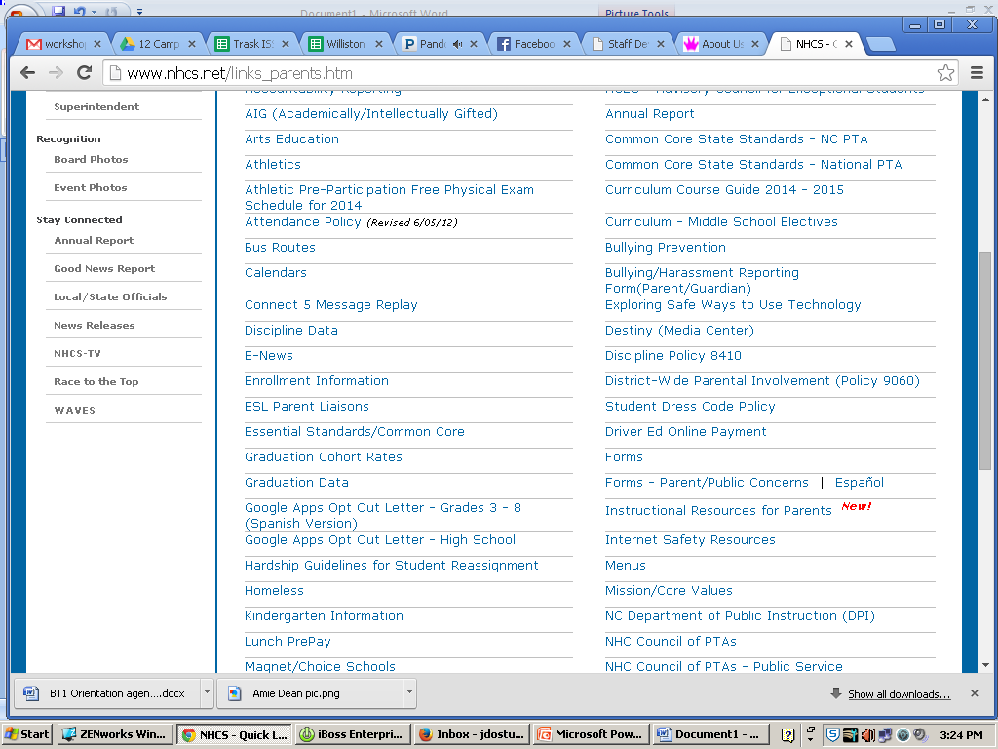
Where to Find
Parent Resources – Bullying Harassment Reporting Form (Parent/Guardian/Teacher)

Slide 12
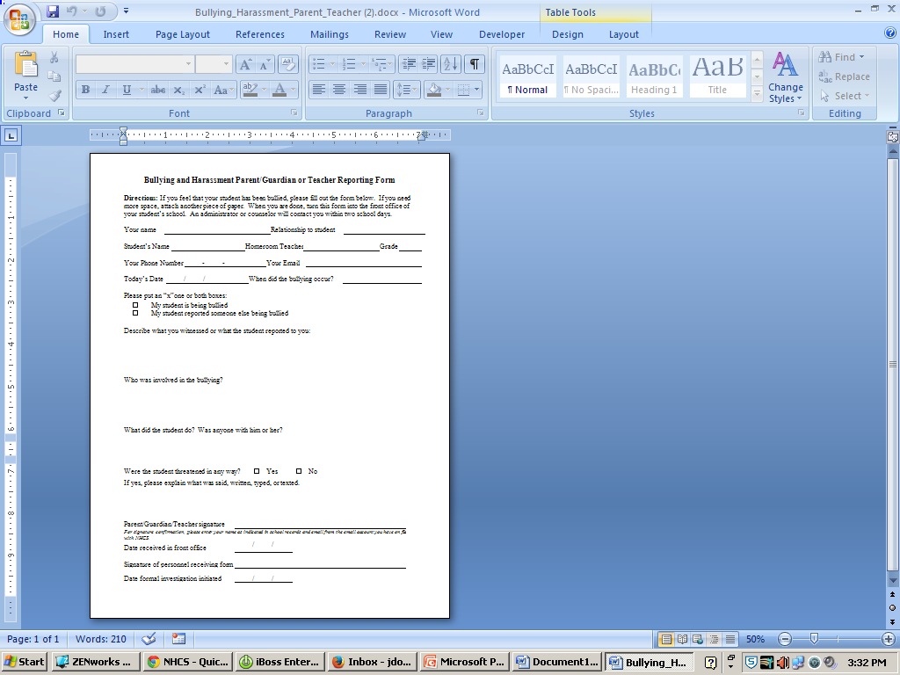
Reporting form for Parents/Guardians/Teachers
Complete and turn in to your:
Campus administrator,
School Counselor
School Social Worker
Classroom teachers
Bus Driver or
SRO

Slide 13
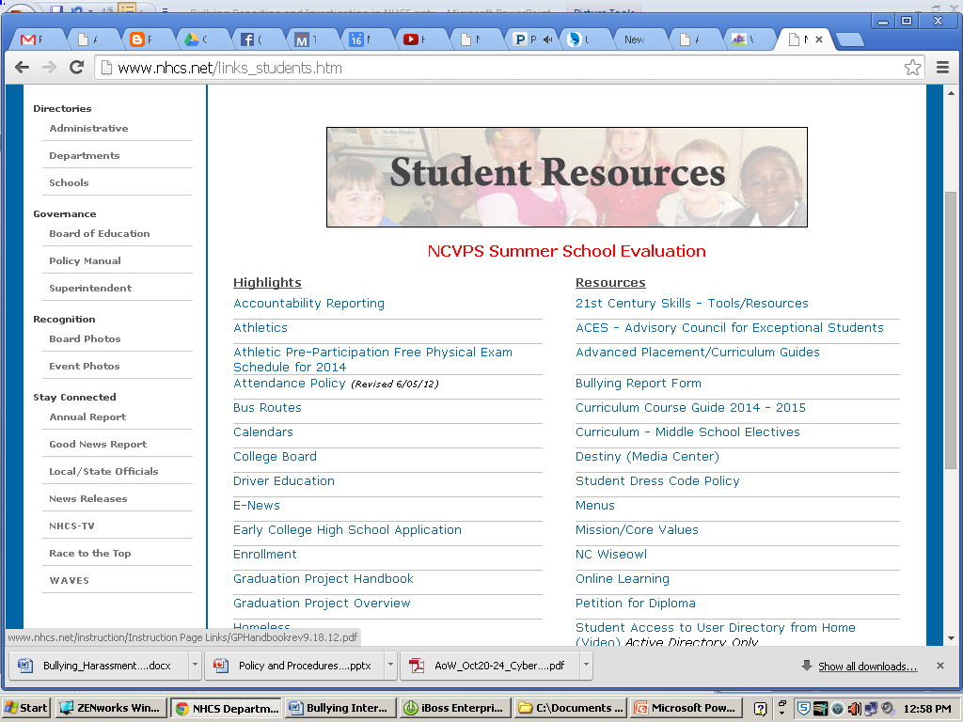

Reporting Form for Students
Complete and turn in to your:
Campus administrator,
School Counselor
School Social Worker
Classroom Teacher
Bus Driver or
SRO

Slide 14
NHCS Campuses Bullying Prevention Tools
  Character Education - N.C. Common Core Essential Standards of the Guidance Curriculum
  Sanford Harmony SEL
  EYES-Empowering Youth Engaging Students -6-8
  PBIS- Positive Behavior Interventions and Support
  Second Step
  Seven Habits of Highly Effective Kids, Teens and People
  Mindfulness
  Why Try
  Conscious Discipline
  ABE Social Skills Modules
  VictimProof –Anti-Bullying
  Connected School
  Student Mentoring
  Peer Mediation
  Salvaging Sisterhood
  G.I.R.L.S.= Girls In Real Life Situations
  Restorative Practices Circles
  Zones of Regulation

Slide 15
Ongoing
District-wide observance of Bullying Prevention Awareness Month – October
Professional Development tools for staff refresher
  Active Supervision training
  Bullying Investigations training
  Bystander Response
  Behavior Management Systems implementation to
  prevent Bullying
Bullying Prevention Orientation for new employees

Slide 16
The End

