Slide 1
Unit B
Nurse Aide Resident Care Skills
Essential Standard NA6.00
Understand nurse aide skills needed to provide for residents’ nutrition, hydration, elimination, and urination needs.
Indicator 6.02
Understand nurse aide skills needed to provide care for residents' elimination and urination needs.
Understand NAI skills needed to provide care for residents' elimination and urination needs.

Slide 2
6.02 Introduction
Elimination is the process of expelling solid wastes made up of the waste products of food that are not absorbed into the cells of the body.
Urination is the passage urine from the bladder to the outside of the body. Urine is made up of water and waste products filtered from the blood by the kidneys.

Slide 3
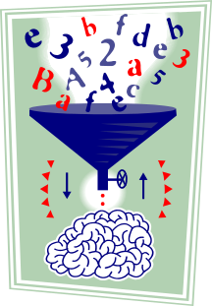
6.02 Introduction
Residents often require assistance from the nurse aide in caring for elimination and urination needs.
Reviews of the body systems involved assist the nurse aide in understand the importance of these excretory functions.

Slide 4
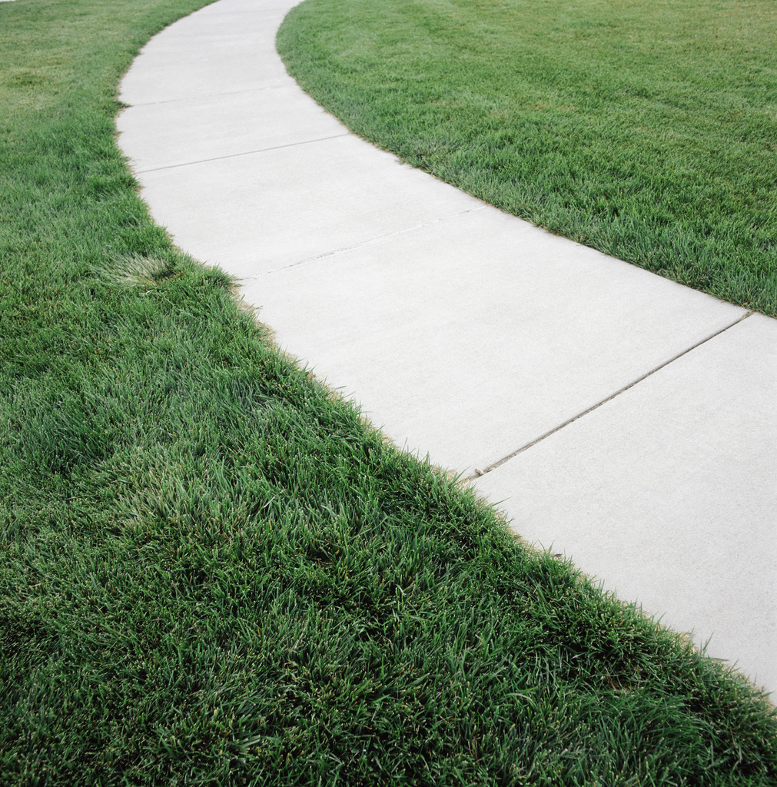

There is intentional repeat of some HSII course content in Nursing Fundamentals.
Repeating course content distributes learning over time and increases long term memory.
Academic and skill competence must be maintained at a very high level for direct resident care.
Be GREEN. Recycle knowledge and build on it!

Slide 5
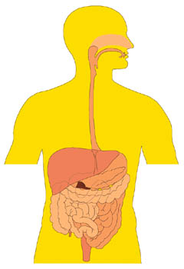
Digestive System
An excretory system

Slide 6
Digestive System
AKA gastrointestinal system
Extends from mouth to anus
Functions
  Digestion
  Absorption

Slide 7
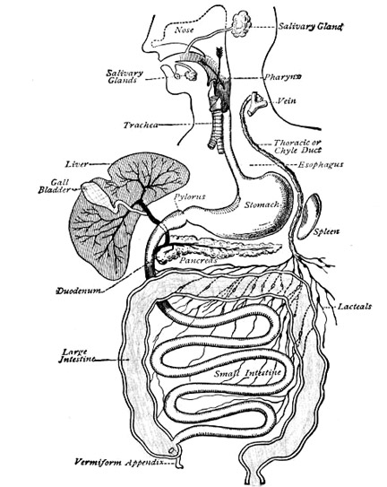
Digestive System - Structures
Mouth
Stomach – holds food until digestive juices chemically break it down into liquid chyme

Slide 8
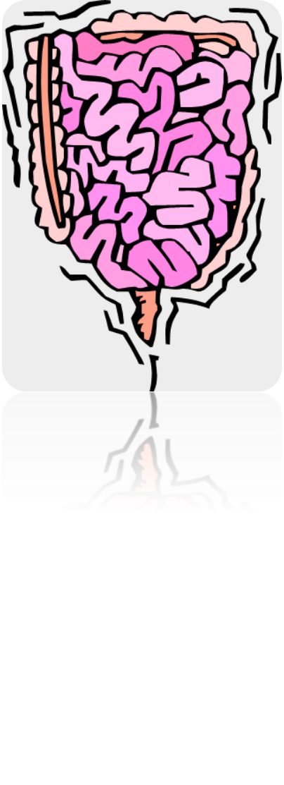
Digestive System - Structures
Intestines
  small intestine
    about 20 ft. long
    food digestion completed and nutrients absorbed into bloodstream

Slide 9
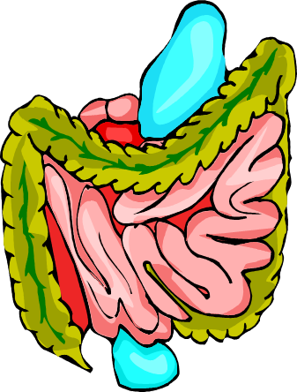
Digestive System - Structures
Intestines
  large intestine
    6 ft. long
    absorbs water, mineral salts and vitamins
    secretes mucus to aid in movement of feces
    has ability to add or remove water from feces

Slide 10
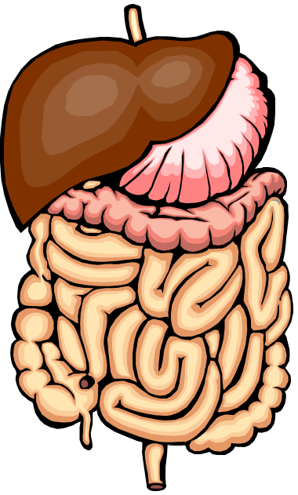
Digestive System – Accessory Organs
  Liver – produces bile for breakdown of fats
  Gallbladder – stores bile produced by liver
  Pancreas - manufactures insulin and digestive enzymes

Slide 11
Digestive System – Common Diseases
Ulcer - a lesion or erosion of the lining of the stomach or small intestine
Hepatitis – inflammation of the liver
Cirrhosis – chronic disease of liver where scar tissue replaces liver tissue
Cholelithiasis - stones in the gallbladder

Slide 12
Digestive System – Common Diseases
Pancreatitis – inflammation of the pancreas
Cholecystitis – inflammation of the gallbladder
Colitis – inflammatory disease of the colon

Slide 13
Digestive System – Common Diseases
Gastritis – inflammation of the stomach lining
Enteritis – inflammation of the intestines
Gastroenteritis - inflammation of the stomach lining and intestines

Slide 14
Digestive System – Common Diseases
Cancer - may occur anywhere along digestive tract
Hernia – protrusion of organ through wall of cavity where it is normally contained

Slide 15
Digestive System – Common Diseases
Diverticulosis - chronic disease in which many diverticula (small blind pouches) form in the lining and wall of the colon
Diverticulitis – inflammation of diverticula

Slide 16
Digestive System – Common Diseases
Diarrhea – watery bowel movements
Constipation - difficulty in expelling fecal material; incomplete or infrequent bowel movements- severe constipation leads to a FECAL IMPACTION
Hemorrhoids - enlarged veins in anal area Care Point

Slide 17
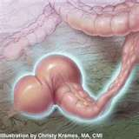
Digestive System – FECAL IMPACTION

Slide 18

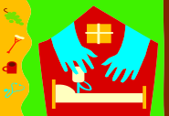
✴ Be extra careful when inserting a thermometer, enema tip, or when cleaning the rectal area of a resident with hemorrhoids!

Slide 19
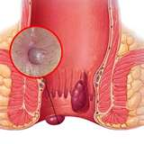
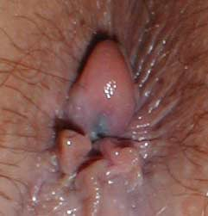
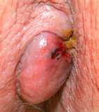
Hemorrhoids

Slide 20

Digestive System – Changes Due to Aging
Loss of teeth and decreased number of taste buds
Decrease in amount of digestive enzymes and saliva production
Difficulty chewing and swallowing
Altered taste and smell
Decreased appetite

Slide 21

Digestive System – Changes Due to Aging
Slower absorption of nutrients
Slowing of peristalsis causing constipation
Loss of bowel muscle tone

Slide 22
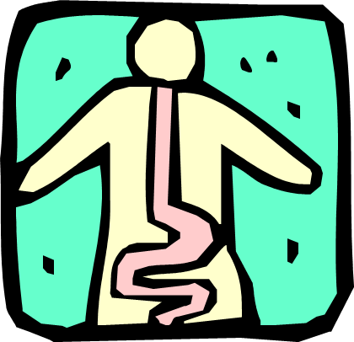
Digestive System – Observations
Stool color and consistency
Abdomen – flat or distended
Date/time of last bowel Mmovement
Nausea and/or vomiting

Slide 23

Blood in emesis or stool
Complaint of pain in stomach
Difficulty swallowing
Poor appetite
Constipation and/or diarrhea

Slide 24

digestive system …
Have we got it?
Let’s check and see
Student Name A
Student Name B
Stick diagnostics

Slide 25
NAI SKILLS
Related to the Digestive System

Slide 26

Training Lab Assignment
Engage in the Skill Acquisition Process for:
SKILL 6.02A
Assist with use of bathroom

Slide 27
Training Lab Assignment
Engage in the Skill Acquisition Process for:
SKILL 6.02B
Assist with bedside commode (BSC)

Slide 28
Training Lab Assignment
Engage in the Skill Acquisition Process for:
SKILL 6.02C
Assist with bedpan

Slide 29
Training Lab Assignment
Engage in the Skill Acquisition Process for:
SKILL 6.02D
Apply adult briefs

Slide 30
Training Lab Assignment
Engage in the Skill Acquisition Process for:
SKILL 6.02E
Administer cleansing enema

Slide 31
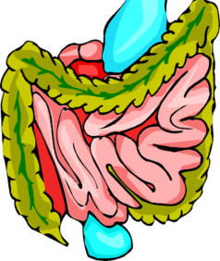
Bowel
Retraining

Slide 32
Digestive System – Bowel Retraining
Incontinence: Inability to control defecation
  Embarrassing for resident
  Uncomfortable

Slide 33

Digestive System – Bowel Retraining
Information collected:
  bowel pattern before incontinence
  present bowel pattern
  dietary practices
Plan developed to assist to return to normal elimination pattern and
Recorded on care plan

Slide 34


Digestive System – Bowel Retraining
Participants in plan
  resident
  family
  all staff members

Slide 35



Bowel Retraining - Guidelines
Enemas may be ordered by physician and given by nurse aide, as directed by supervisor
Regular, specific times to evacuate bowels established
Fluids encouraged on regular basis

Slide 36
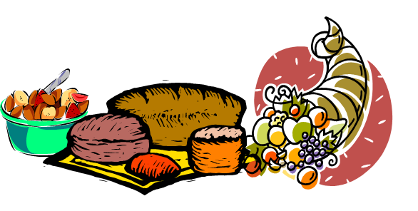
Bowel Retraining - Guidelines
High bulk foods given, (if not rrestricted)
  fruits
  vegetables
  bread
  bran cereals

Slide 37

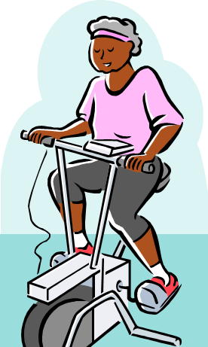
Bowel Retraining - Guidelines
Bowel aids ordered by physician and administered by licensed nurse only:
  laxatives
  suppositories
  stool softeners
Regular exercise encouraged

Slide 38

Offer bedpan on set schedule
Assist to bathroom when request is made
Provide privacy
Display unhurried attitude

Slide 39
  Offer warm drink
  Be patient
  Encourage with positive remarks
  Do not scold when accidents happen (this is verbal abuse)
  Check on resident frequently

Slide 40
Training Lab Assignment
Engage in the Skill Acquisition Process for:
Training Lab Assignment
Engage in the Skill Acquisition Process for:
SKILL 6.02F
Collecting a stool specimen

Slide 41
digestive system
Related NAI Skills
Have we got it?
Let’s check and see
Student Name A
Student Name B
Stick diagnostics

Slide 42
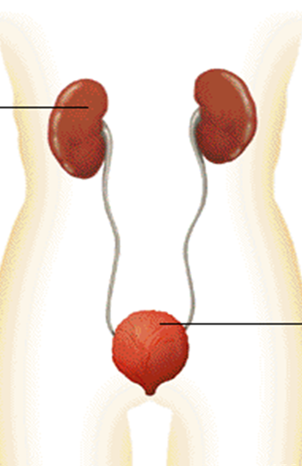
Urinary System
An excretory system

Slide 43
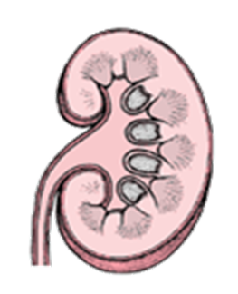
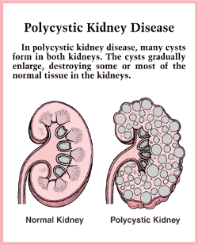
Urinary System - Structure
Kidneys:
  Purplish brown, bean-shaped organs
  Located at back of abdominal cavity
  Weighs 4-6 ounces each

Slide 44
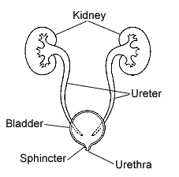

Urinary System - Structure
Ureters - tubes that carry urine from kidneys to bladder
Urinary bladder - muscular sac that expands to hold urine received from the kidney
Urethra - tube extending from bladder to outside of body

Slide 45
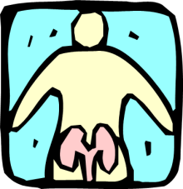
Urinary System - Functions
  Filters waste products from blood
  Produces urine
  Aids in maintenance of water balance
  Regulates acid-base balance of body
  Stores urine until passed from body

Slide 46

Urinary System
Characteristics of Normal Urine
Pale yellow to amber
Clear (not cloudy)
Acidic / pH 5.0 – 7.0
Quantity (output) 1000-1500 ml. per day

Slide 47
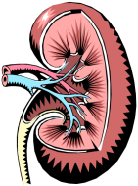
Urinary System
Common Disorders
Nephritis - inflammation of kidney due to infection
Cystitis - inflammation of urinary bladder due to infection
Calculi – kidney or bladder stones

Slide 48
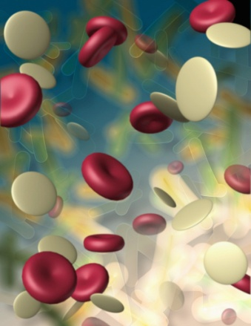
Urinary System
Common Disorders
Uremia - accumulation of urea in blood due to kidney disease
Urethritis - inflammation of the urethra

Slide 49
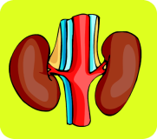
Urinary System
Common Disorders
Kidney failure – decreased ability of kidney to filter waste products from the blood
Urinary incontinence -inability to control urination

Slide 50
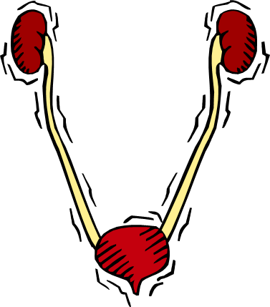
Urinary System
Common Disorders
UTI - Urinary Tract Infection
Retention - inability to completely empty the bladder
Hematuria - blood in the urine

Slide 51

Urinary System
Affects of Aging
Decreased kidney size
Decreased elasticity of ureters, bladder and urethra
Decreased muscle tone
Diminished blood flow to kidneys

Slide 52
Urinary System
Affects of Aging
Decreased ability of kidneys to concentrate urine
Difficulty emptying urinary bladder
Enlarged prostate in males which presses on urethra

Slide 53
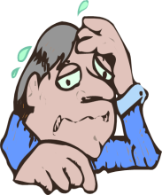
Elevated temperature
Sugar and/or acetone in urine (NAIIs may check blood sugar via finger stick)
Urine color other than clear, pale yellow

Slide 54
Complaint of burning on urination
Incontinence
Polyuria - excessive amounts of urine per voiding

Slide 55
Hematuria - blood in urine
Nocturia – excessive urination at night
Urine having strong odor or cloudy appearance
Voiding small amounts of urine frequently

Slide 56
urinary system…
Have we got it?
Let’s check and see
Student Name A
Student Name B
Stick diagnostics

Slide 57
NAI SKILLS
Related to the Urinary System

Slide 58
Training Lab Assignment
Engage in the Skill Acquisition Process for:
SKILL 6.02G
Assist resident
with urinal

Slide 59
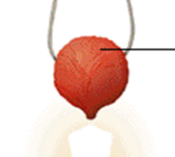
Urinary Bladder Retraining

Slide 60


Urinary System
Bladder Retraining
Plan developed to assist to return to normal voiding pattern
Recorded on care plan
Staff must be consistent and follow plan

Slide 61

Urinary System
Bladder Retraining
Individualized plan includes:
  schedule that specifies time and amount of fluids to be given
  schedule for attempting to void

Slide 62
Urinary System
Bladder Retraining Guidelines
Get resident’s cooperation
Record incontinent times
Provide with opportunities to void:
  when resident awakens
  one hour before meals
  every two hours between meals
  before going to bed
  during night, as needed

Slide 63
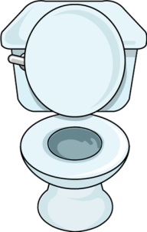
Urinary System
Bladder Retraining Guidelines
Provide for comfortable voiding position
Be supportive and sensitive
Provide encouragement
Offer fluids according to schedule

Slide 64

Urinary System
Bladder Retraining Guidelines
Provide stimuli as needed:
  run water in sink
  pour water over perineum
  offer fluids to drink
  place hands in warm water

Slide 65
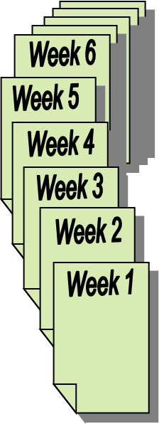
Urinary System
Bladder Retraining Guidelines
Provide good skin care to prevent skin breakdown
Retraining may take 6-10 weeks
  be patient
  be supportive
  ignore accidents
  respect resident’s feelings

Slide 66

Urinary System
Bladder Retraining Guidelines
Follow facility procedure for use of:
  incontinent pads
  adult protective pants
  incontinent briefs

Slide 67
Bladder retrianing
Have we got it?
Let’s check and see
Student Name A
Student Name B
Stick diagnostics

Slide 68
Indwelling
Urinary Catheters

Slide 69


Indwelling Catheters
Balloons filled with fluid help prevent the catheter from slipping out of the bladder. Pulling on the catheter may damage soft tissue if the inflated balloon is pulled.

Slide 70
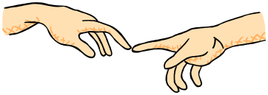
Hold the catheter securely near the meatus to prevent tugging while cleaning the indwelling catheter.

Slide 71
Indwelling Catheters
Used to continuously drain urine from bladder
Inserted by licensed nurse or NA II after being ordered by physician
Attached to tubing that connects to urinary drainage bag

Slide 72
Indwelling Catheters
When are they ordered?
  Residents with nerve injury:
    following spinal cord injury
    after stroke
  After surgery
  Some incontinent residents

Slide 73

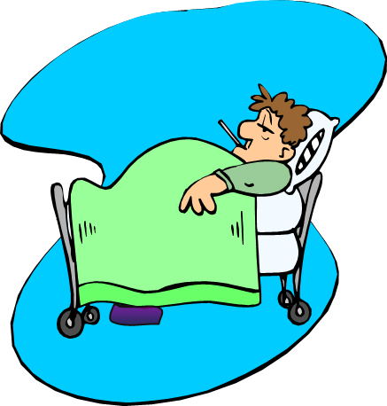
Indwelling Catheters
Increased Risk of Urinary Tract Infections
  Urinary meatus and surrounding area must be kept clean
  Catheter care given at least daily and PRN

Slide 74
Indwelling Catheters Guidelines maintain-drainage-bag-dependent-position.html nih.gov/ccc/patient_education/pepubs/bladder/foley
Never pull on catheter
Keep catheter tubing and drainage tubing free of kinks, so that urine can flow freely

Slide 75
Indwelling Catheters Guidelines
Keep collection bag below bladder
Attach collection bags to bed frame, never to side rail
Never leave on floor
Follow facility policy for securing catheter to resident’s leg without tension on catheter

Slide 76
Indwelling Catheters Guidelines
Never disconnect catheter from tubing to drainage bag
When emptying urinary drainage bag, never touch drain with measuring container or graduate

Slide 77
Leakage
Complaints of pain
Burning
Need to urinate

Slide 78
Swelling
Skin irritation
Discoloration

Slide 79

When measuring urinary output note color, odor and appearance of urine.

Slide 80
indwelling catheters
Have we got it?
Let’s check and see
Student Name A
Student Name B
Stick diagnostics

Slide 81
NAI SKILLS
Related to Catheters

Slide 82
Training Lab Assignment
Engage in the Skill Acquisition Process for:
SKILL 6.02H
Providing catheter care

Slide 83
Training Lab Assignment
Engage in the Skill Acquisition Process for:
SKILL 6.02I
Emptying a urinary drainage bag

Slide 84
Collecting a routine urine specimen

Slide 85

Routine Urine Specimens
Collected for laboratory study
  Aids physician in diagnosis
  Evaluates effectiveness of treatment
Laboratory requisition slip completed and sent to laboratory with each specimen

Slide 86
Routine Urine Specimens - Guidelines
Wash hands carefully before and after collection of urine specimens
Wear gloves
Collect specimen at appropriate time
Use proper container and do not touch inside of lid or container

Slide 87
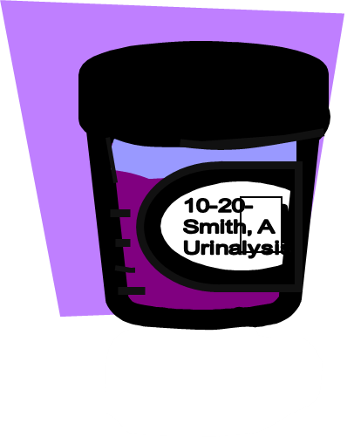
Routine Urine Specimens - Guidelines
Label container accurately and transport to laboratory as soon as possible
Tell resident not to have bowel movement or discard tissue in bedpan when collecting urine specimen

Slide 88
Related
SKILL

Slide 89
Training Lab Assignment
Engage in the Skill Acquisition Process for:
SKILL 6.02J
Collecting a routine urine specimen

Slide 90
Other Types of
Urine Collections
Clean Catch Urine Specimen
24-Hour Urine Collection
Straining Urine for Stones

Slide 91
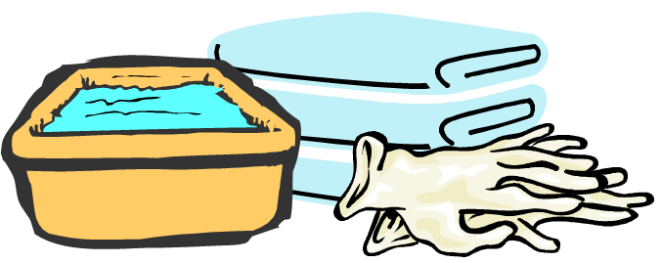
Clean Catch Urine Specimen
AKA: Mid-Stream Specimen
Cleansing of perineum prior to collection of urine reduces number of microbes that may contaminate specimen

Slide 92

Clean Catch Urine Specimen - Procedure
Follow standard precautions
Assure resident’s perineum is cleaned prior to collection
Instruct resident to begins voiding into appropriate receptacle and stop midstream
Place container in urine stream and collect specimen

Slide 93
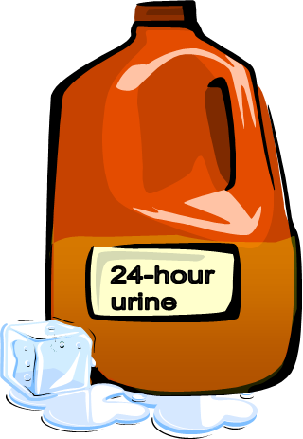
24-Hour Urine Collection
All urine voided in 24-hour period collected
  Urine chilled on ice to prevent growth of microorganisms
  Some tests may require preservative
  Urine usually collected in dark colored gallon jug

Slide 94

24-Hour Urine Collection
Imperative that resident and staff understand procedure and exact time period for urine collection

Slide 95
24-Hour Urine Collection - Procedure
  Follow Standard Precautions
  Begin test with resident’s bladder empty
  Discard first voiding
  Collect all voidings for next 24 hours
  Restarted collection with new gallon jug if test is interrupted

Slide 96

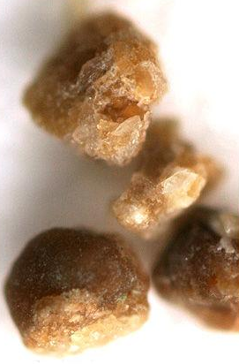
Straining for Kidney Stones

Slide 97
Urine specimens/Collections…
Have we got it?
Let’s check and see
Student Name A
Student Name B
Stick diagnostics

Slide 98
Condom Catheters

Slide 99
Condom Catheters
Description and Use
  External catheter used for incontinent men
  Made of soft rubber sheath that fits over penis with tubing connected to urinary drainage bag
  Ambulatory residents may prefer leg bags during day
  New condom catheter is applied daily

Slide 100
Observe penis for reddened or open areas and report to supervisor prior to new condom being application.

Slide 101
Related
SKILL

Slide 102
Training Lab Assignment
Engage in the Skill Acquisition Process for:
SKILL 6.02K
Apply a condom catheter

Slide 103

The Endocrine System
Endocrine glands secrete chemicals called hormones directly into the blood stream.
Why discuss it?

Slide 104
The Endocrine System
Endrocrine System
affects the function of the
Urinary System
and other body functions

Slide 105
Endocrine System - Function
  Secretes hormones that regulate:
  growth and development,
  metabolism and reproduction,
  and the immune response.

Slide 106
Diabetes Mellitus
The most common disorder of the endocrine system.

Slide 107
Diabetes Mellitus
80% of diabetics over 40 years of age
Incidence increases as people age
5% of people over age 65 require treatment

Slide 108
Diabetes Mellitus
  USA has highest morbidity and mortality rates
  Disorder of carbohydrate metabolism with decreased insulin production from pancreas

Slide 109
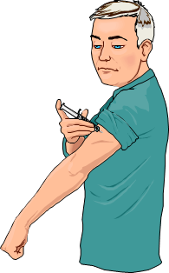
Diabetes Mellitus
Uncontrolled diabetes leads to damage to eyes, kidneys, circulation
Diabetes characterized by consistent, elevated blood glucose levels requiring oral medication to stimulate pancreas or insulin injections

Slide 110
Diabetes Mellitus
L
Hypoglycemia
W
Low blood sugar

Slide 111
Diabetes Mellitus
lavated
Hyperlycemia
High blood sugar

Slide 112
Endocrine System – Changes Due to Aging
Decrease in thyroid, parathyroid, adrenal and sex hormone secretions
Decreased glucose tolerance (Diabetes M)
Multiple physical changes due to decrease of sex hormones

Slide 113

Endocrine System – Observations
Irritability & restlessness
Nervousness
Confusion
Weight loss
Diaphoresis
Edema
Excessive thirst
Sweet, fruity odor to breath

Slide 114

Endocrine System – Observations
Complaint of headache
Drowsiness
Rapid, weak pulse
Low blood pressure
Nausea or vomiting
Flushed, dry, hot skin
Excessive urination

Slide 115
Observations previously listed must be reported to the nurse.

Slide 116
Endocrine system & diabetes
Have we got it?
Let’s check and see
Student Name A
Student Name B
Stick diagnostics

Slide 117
 END 
6.02
Understand nurse aide skills needed to care for residents' elimination and urination needs.

