Slide 1
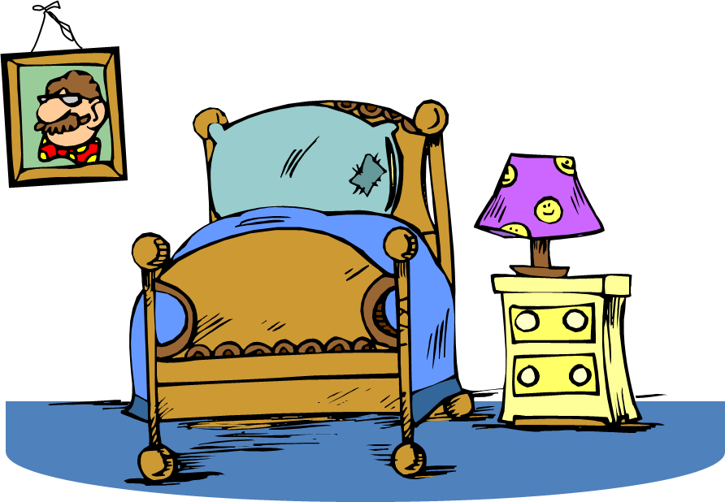
Unit B
Resident Care Skills
Essential Standard NA5.00
Understand nurse aide’s role in providing residents’ hygiene, grooming, skin care, and living environment needs.
Indicator 5.03
Understand nurse aide’s role in creating a safe and clean environment that fosters resident independence, contentment and self-esteem.
Understand nurse aide’s role in creating a safe and clean environment that fosters resident independence, contentment and self-esteem.

Slide 2
5.03 Introduction
Surroundings that are pleasant and contain personal possessions add to the residents’ comfort and sense of well-being.

Slide 3
5.03 Introduction
The nurse aide’s job is to keep the resident’s unit safe and clean and to create an environment that fosters independence, contentment and self-esteem.

Slide 4
5.03 Introduction
This indicator reviews:
environmental control,
the resident’s room,
cleaning the unit,
and bedmaking.

Slide 5



Environmental Control - Temperature
Older people often chilly
Sweaters, lap robes and shawls provide warmth
Drapes, shades and screens used to block drafts
Extra blankets used when sleeping

Slide 6
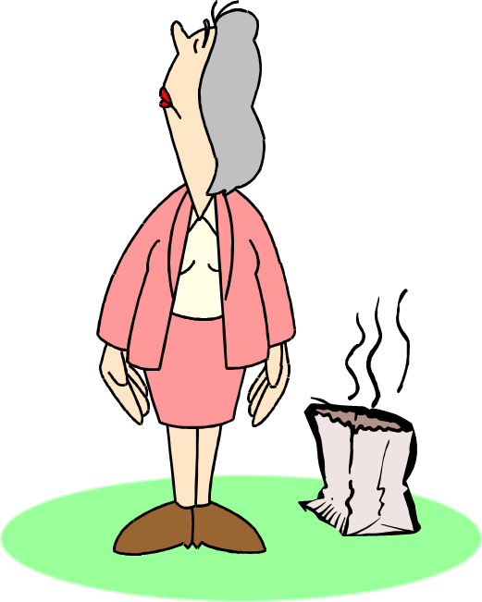
Environmental Control – Preventing Odors
Good ventilation helps to control odors
Wastes should be removed and discarded as soon as possible
Good personal hygiene practices

Slide 7

Environmental Control – Prevent Noise Pollution
Residents easily disturbed by unfamiliar noises
Staff should avoid loud laughter and loud talking.

Slide 8

Environmental Control – Safe/Comfortable Lighting
Adjust to meet needs
Use shades and drapes to control bright, natural light
Provide adequate light for reading
Control glare and shadowed areas if possible

Slide 9

Environmental Control – Keeping Floors Maintained
Clean, but not slippery from wax
Clear of clutter and spills
No throw rugs
In good repair

Slide 10



Environmental Control – Maintaining Cleanliness
Remove meal trays and dishes after use
Remove crumbs and clean eating areas after use
Removing dirt and dust controlled by housekeeping
Waste containers emptied promptly

Slide 11

Environmental Control – Controlling Pest
Remove open food left in units that will attract ants and roaches, as well as microorganisms
Family and visitors should consult with charge nurse before bringing in food for residents
Ensure proper disposal of food and waste materials

Slide 12



Environmental Control – Faulty Equipment and Unsafe Conditions
Spilled fluids - wiped up immediately
Frayed electrical cords – unplug and remove
Defective outlets – report immediately and do not use
Malfunctioning equipment – remove and do not use

Slide 13

Environmental Control – Faulty Equipment and Unsafe Conditions
Broken glass - clean up immediately
Beds or wheelchairs that won’t lock - remove and do not use
Faulty toilets - report

Slide 14
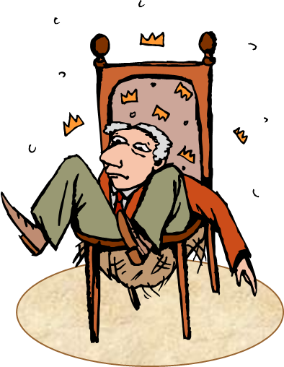
Environmental Control – Faulty Equipment and Unsafe Conditions
Leaks in bathrooms – wipe up and report
Burned out light bulbs - report
Faulty call signals – replace immediately
Defective furniture – remove if possible and report

Slide 15

Environmental Control – Faulty Equipment and Unsafe Conditions
Structure problems - alert resident to danger and report to supervisor immediately:
loose floor tiles frayed or loose carpet
loose fixtures and hand rails

Slide 16

Environmental Control – Faulty Equipment and Unsafe Conditions
Structure problems - alert resident to danger and report to supervisor immediately:
doors that stick or don’t latch properly
damaged paint or wallpaper

Slide 17

Environmental control
Have we got it?
Let’s check and see
Student Name A
Student Name B
Stick diagnostics

Slide 18
The Resident’s Room - Furniture
Note: The student needs to be aware that each facility has different equipment and room set-ups.
Safety features in the resident’s room, furniture, and equipment is of paramount importance.

Slide 19
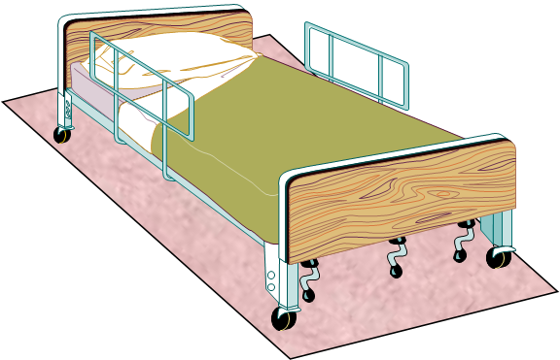
The Resident’s Room - Furniture
BED
electric or manual controls (gatch)
side rails (if used)
positions bed can be in other than flat:
  Fowlers
  Semi-Fowlers
  Trendelenburg
  Wheels that lock

Slide 20
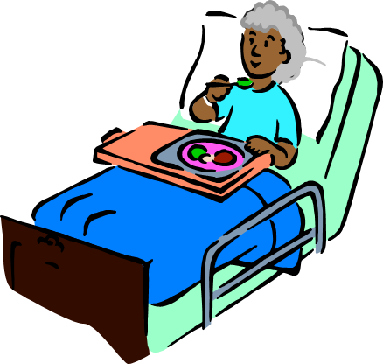
The Resident’s Room - Furniture
OVER-BED TABLE
Adjusts to various heights
used for eating, writing, and other activities
may contain storage area for personal grooming articles
may by used by nursing team as work area

Slide 21

The Resident’s Room - Furniture
BEDSIDE STAND
storage area for personal belongings and personal care items
drawer on top
cabinet with shelf below drawer

Slide 22

The Resident’s Room - Furniture
BEDSIDE STAND CONTAINS
urinal/bedpan and covers
wash basin
emesis basin
soap dish and soap
bath blanket
toilet paper
personal hygiene items

Slide 23

The Resident’s Room - Furniture
BEDSIDE STAND TOP
Top used for various items:
telephone
tissues
flowers
cards
other items as resident desires

Slide 24

The Resident’s Room - Furniture
CHAIRS
upholstered with arms
straight-backed with no arms

Slide 25

The Resident’s Room - Furniture
PRIVACY CURTAINS
provide privacy
cubicle curtain between beds in semi-private rooms
privacy always provided when care given

Slide 26
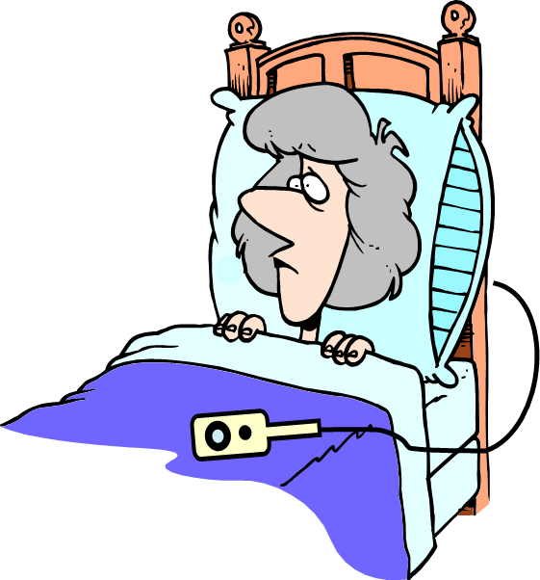
The Resident’s Room - Furniture
Personal care items
Call signal
to request assistance
bell, light, or intercom system
placed within reach at all times

Slide 27
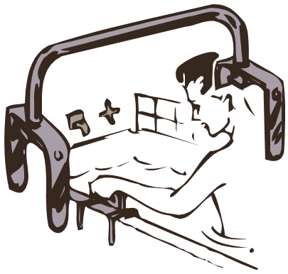
The Resident’s Room - Bathrooms
Bathrooms
  contain call signals
  contain handrails
  Contain towel racks

Slide 28

The Resident’s Room - Furniture
Towel rack:
washcloth
Towel
DO NOT LET RESIDENT PULL ON TOWEL RACK! Must use handrails

Slide 29
The Resident’s Room - Equipment
Television
Telephone
Wastebasket
Reading lamp
Storage space for clothing

Slide 30
Caring for resident’s room
Have we got it?
Let’s check and see
Student Name A
Student Name B
Stick diagnostics

Slide 31
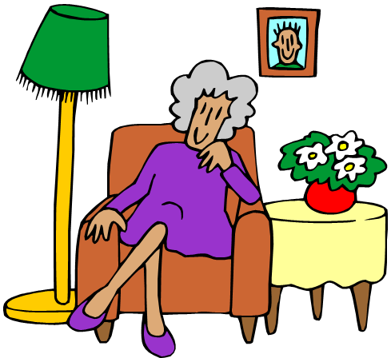
Guidelines For Arrangement Of Unit
Don’t rearrange items without permission
Respect private space
Knock on door prior to entering room
Speak prior to opening a drawn curtain

Slide 32

Guidelines For Arrangement Of Unit
Close curtains to provide privacy when doing a procedure
Assure personal items are convenient to promote independence and safety

Slide 33
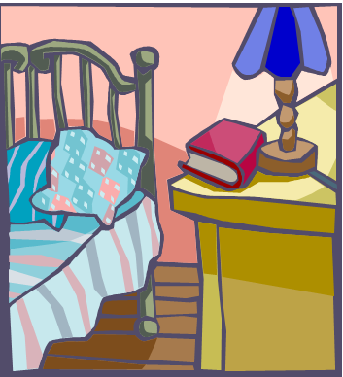
Guidelines For Arrangement Of Unit
Accommodate physical problems by locating equipment on unaffected side
Store clothing and personal belongings in closet and chest of drawers, as directed by resident

Slide 34



Cleaning the Resident’s Unit
Concurrent Cleaning
Occurs daily
Also called scheduled or routine cleaning

Slide 35

Care of Bed Linens
Changed completely on bath days, usually once or twice weekly, according to facility policy
Pillowcases may be changed more frequently
Soiled linens should be replaced immediately

Slide 36

Care of Bed Linens
Top sheet may be used to replace bottom sheet
Soiled linen folded inward
Do not shake linen.
Soiled linen held away from uniform
Soiled linen placed in covered linen hamper after removal from bed

Slide 37

Care of Bed Linens
Types vary according to facility
Plastic/rubber and cotton draw-sheets may not be required if mattress moisture-proof
Most facilities use fitted-bottom sheets
Drawsheets may be used as lifters when moving residents

Slide 38
Caring for the unit and linens
Have we got it?
Let’s check and see
Student Name A
Student Name B
Stick diagnostics

Slide 39
Bedmaking

Slide 40

Bedmaking – General Rules
Always use good body mechanics
Follow medical asepsis rules
Wash hands prior to handling clean linen and after handling soiled/dirty linen

Slide 41
Bedmaking – General Rules
Take enough linen to resident’s room
Never shake linen to prevent spread of micro-organisms
Excess linen in room considered contaminated and cannot be used for other residents

Slide 42
Bedmaking – General Rules
Take enough linen to resident’s room
Never shake linen to prevent spread of micro-organisms
Excess linen in room considered contaminated and cannot be used for other residents

Slide 43
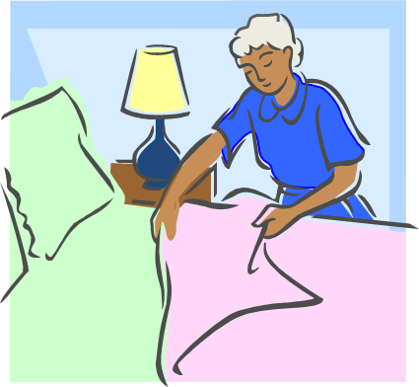
Bedmaking – General Rules
Plastic draw sheets should never touch resident’s skin
Tighten loose linens as necessary
Save time and energy by making one side of bed prior to going to other side
Leave unused clean linen in the resident’s room

Slide 44

Bedmaking – Closed Bed
Closed Bed
made after terminal cleaning of unit
remains closed until new admission, then converted to open bed

Slide 45

Bedmaking – Open Bed
unoccupied bed
linens folded back so that resident can get into bed with ease
made when resident will be out of bed for short time

Slide 46
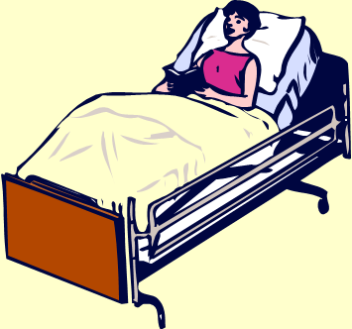
Bedmaking – Occupied Bed
Made with resident in bed
Keep in good body alignment
Be aware of any restrictions in movement due to linen or way bed made
Explain procedure
Ensure safety

Slide 47

Bedmaking – Occupied Bed
Loosen the top bedding at the foot of the bed for a dependent resident to reduce pressure on the toes.

Slide 48
Related
SKILLS

Slide 49

Training Lab Assignment
Engage in the Skill Acquisition Process for:
SKILL 5.03A
Making a Closed Bed

Slide 50
Training Lab Assignment
Engage in the Skill Acquisition Process for:
SKILL 5.03B
Opening a Closed Bed

Slide 51
Training Lab Assignment
Engage in the Skill Acquisition Process for:
SKILL 5.03C
Making an Occupied Bed

Slide 52
 END 
5.03
Understand nurse aide’s role in creating a safe and clean environment that fosters resident independence, contentment and self-esteem.

