Slide 1
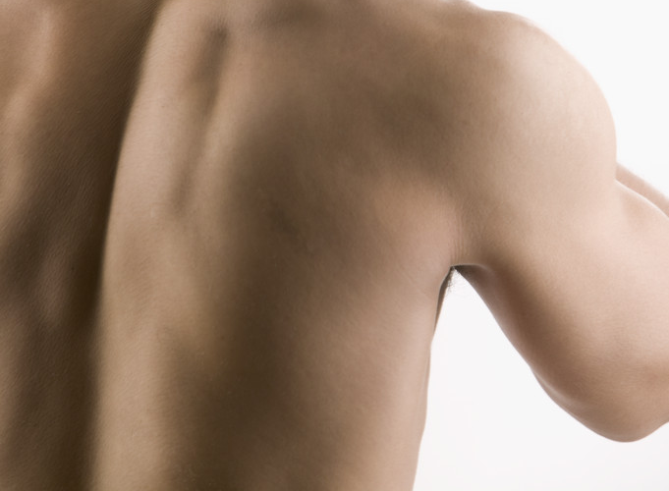
Unit B
Resident Care Skills
Essential Standard NA5.00
Understand nurse aide’s role in providing residents’ hygiene, grooming, and skin care.
Indicator 5.02
Understand nurse aide skills needed to promote skin integrity.
Understand nurse aide skills needed to promote skin integrity.

Slide 2
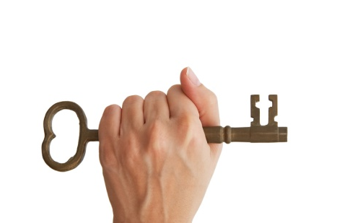
5.02 Introduction
As a direct care giver, the nurse aide will be the key team member in the prevention of pressure ulcers.

Slide 3
Pressure Ulcers
AKA:
Bedsores
Decubitus Ulcers

Slide 4
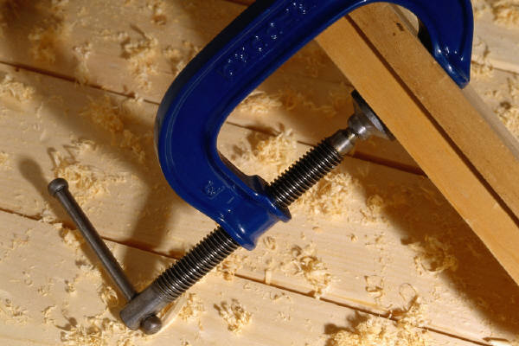
Pressure Ulcers
Caused by pressure on area of skin that interferes with circulation

Slide 5



BRAIN STORM
Think
What does circulation
provide for tissues?
Act
Raise your hand and share your thoughts! Wait to be called on.

Slide 6
Pressure Ulcers
Occur where bones come close to the skin surface or bony prominences.

Slide 7
Pressure Ulcers
  toes, heels, ankles, knees
  hips, elbows, shoulders
  spine (especially tailbone area)
  ears, cheeks, collarbone area
  back of head

Slide 8
Pressure Ulcers
Can develop where areas of body rub together and moisture collects, especially in obese residents

Slide 9
Pressure Ulcers
  Under breasts
  Between folds of abdomen
  Between crease of buttocks
  Between thighs

Slide 10

Pressure Ulcers
1 POUND CURE
1 OUNCE
PREVENTION

Slide 11
Pressure Ulcer prevention
Keep skin clean and dry!

Slide 12
Pressure Ulcer prevention
Keep linen dry and free of wrinkles and objects that cause pressure to the skin!

Slide 13
Pressure Ulcer prevention
Clean urine and feces from skin as soon as possible!

Slide 14

Pressure Ulcer prevention
Reposition residents at least every two hours!

Slide 15

Pressure Ulcer prevention
Make sure clothing and shoes do not bind or constrict!

Slide 16

Pressure Ulcer prevention
Pat skin dry when bathing; never scrub.

Slide 17
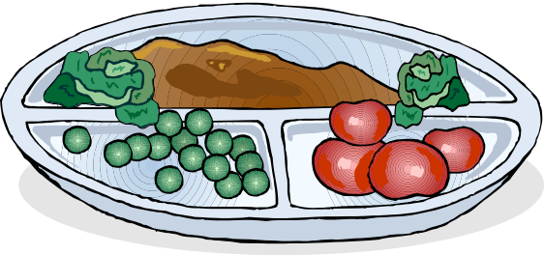

Pressure Ulcer prevention
Encourage adequate nutrition and fluids!

Slide 18
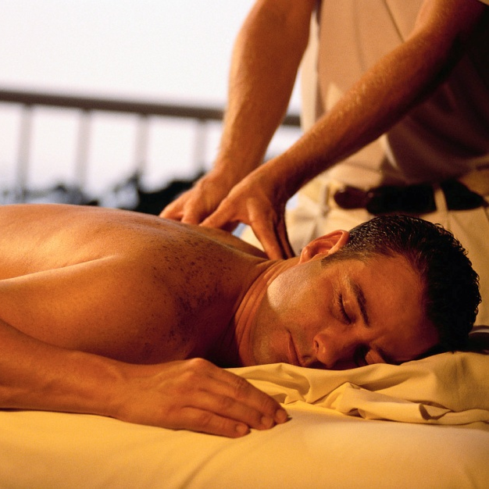
Pressure Ulcer prevention
Massage healthy skin and tissue around the area.

Slide 19


Pressure Ulcer prevention
Massage skin often.
Use light circular stroke to increase circulation.

Slide 20
Pressure Ulcer prevention
Use little or no pressure on bony areas.

Slide 21


Pressure Ulcer prevention
Do NOT message a white, red, or purple area or put any pressure on it.

Slide 22

Pressure Ulcer prevention
Be careful during transfers. Avoid pulling or tearing fragile skin.

Slide 23
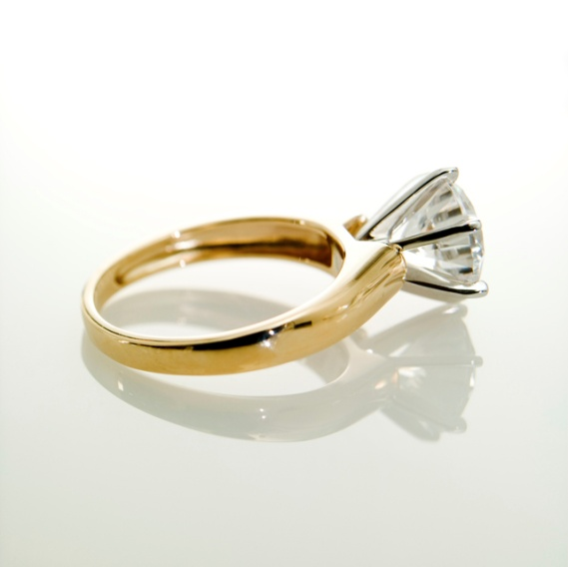
Pressure Ulcer prevention
Take YOUR jewelry off!
This is just like a knife!

Slide 24
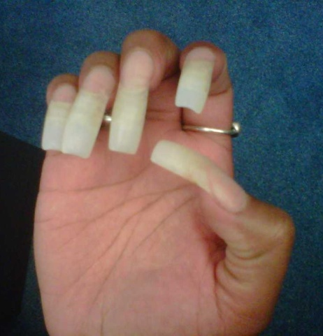
Pressure Ulcer prevention
Keep YOUR nails short!
This is just like a knife!

Slide 25
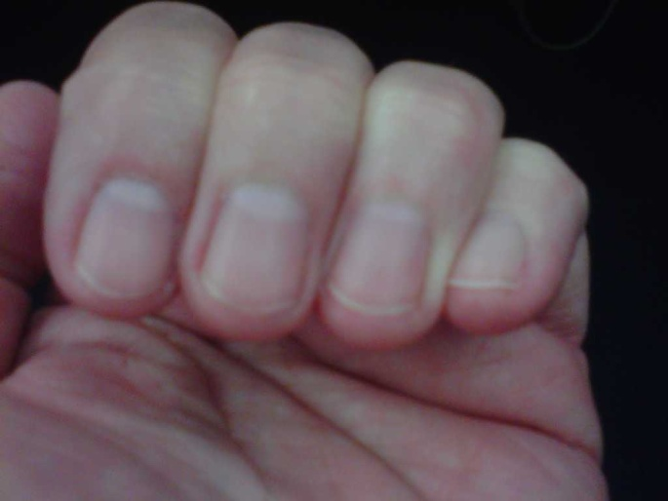
Pressure Ulcer prevention
Keep YOUR nails short!
This is safe.

Slide 26

IMMEDIATELY
ANY CHANGE IN SKIN CONDITION!

Slide 27
Pressure Ulcer preventive devices
Bed cradle
Heel and elbow protectors
Flotation pads or cushions
Pillows
Water beds
Alternating pressure mattresses
Eggcrate mattresses

Slide 28
Pressure Ulcers: Stages Of Tissue Breakdown And Treatment
  Stage One - red, darkened or non-blanchable skin, which is still present 30 minutes after pressure relieved

Slide 29
Pressure Ulcers: Stages Of Tissue Breakdown And Treatment
  Stage One position off area and report; do not massage
    observe every 2 hours and report changes to supervisor

Slide 30
Pressure Ulcers: Stages Of Tissue Breakdown And Treatment
  Stage Two - addition of blister-like lesions; skin may be broken

Slide 31

Pressure Ulcers: Stages Of Tissue Breakdown And Treatment
  Stage Two
  position off area at all times,
  report need for dressing changes
  report odor, drainage, any change in size

Slide 32
Pressure Ulcers: Stages Of Tissue Breakdown And Treatment
  Stage Three - skin tissue is destroyed and fatty tissue may be involved; infection and eschar (scab) may result

Slide 33
Pressure Ulcers: Stages Of Tissue Breakdown And Treatment
  Stage Three
  continue prevention practices
  report any changes in area

Slide 34
Pressure Ulcers: Stages Of Tissue Breakdown And Treatment
  Stage Four - skin, fatty tissue destroyed and muscle and bone involved!

Slide 35
Pressure Ulcers: Stages Of Tissue Breakdown And Treatment
  Stage Four
    report any signs of systemic infection, including but not limited to:
      wound odor
      pain
      elevated temperature with confusion

Slide 36
positioning

Slide 37

F Y I - Intentional Repeat
There is intentional repeat of some HSII course content in Nursing Fundamentals.
Repeating course content distributes learning over time and increases long term memory.
Academic and skill competence must be maintained at a very high level for direct resident care.

Slide 38
positioning
Purposes:
  Assist with examinations
  Assist with procedures
  Prevent pressure on skin for prolonged periods of time

Slide 39
positions
Dorsal recumbent position
  flat on back
  knees slightly separated and flexed
  feet flat on bed
  http://www.wisc-online.com/objects/ViewObject.aspx?ID=MEA1604

Slide 40
positions
Horizontal recumbent position – supine
  flat on back
  legs slightly separated and extended
  http://www.wisc-online.com/objects/ViewObject.aspx?ID=MEA1604

Slide 41
positions
Prone position
  flat on abdomen with head turned to side
  arms at sides or flexed on either side of head
  http://www.wisc-online.com/objects/ViewObject.aspx?ID=MEA1604

Slide 42
positions
Side lying position
  positioned on either side
  head in straight line with spine
  pillows used to support head, back, arm, and leg
  http://www.wisc-online.com/objects/ViewObject.aspx?ID=MEA1604

Slide 43
positions
Lateral position
  positioned on either side
  bottom arm extended behind back, top arm flexed in front of body
  top leg slightly flexed
  http://www.wisc-online.com/objects/ViewObject.aspx?ID=MEA1604

Slide 44
positions
30° Lateral Reclined Position
  hips rotated 30 degrees
  pillow between knees
  pillow under arm for comfort and to relieve pressure on elbow
  pressure relieved from sacrum and http://www.wisc-online.com/objects/ViewObject.aspx?ID=MEA1604
  hip

Slide 45
positions
Fowler’s position
  sitting position in bed with head elevated at 45-60 degree angle.
  knees slightly flexed
  position causes pressure on sacrum and buttocks
  http://www.wisc-online.com/objects/ViewObject.aspx?ID=MEA1604

Slide 46
positions
Sim's position
  positioned on LEFT side
  left arm extended behind body
  right arm flexed in front of body
  right leg flexed toward abdomen
  used for enema administration
  http://www.wisc-online.com/objects/ViewObject.aspx?ID=MEA1604

Slide 47


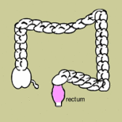
positions
Sim's position
Best position for enemas

Slide 48
TURNING
POSITIONING
LIFTING
MOVING

Slide 49
Moving, Turning, Positioning
And Lifting
Good body mechanics necessary
  Prevents injury to resident
  Protects nurse aide from injury
  Good body alignment Promotes comfort for resident

Slide 50
Moving, Turning, Positioning
And Lifting
Safety major considerations
  Get help if needed
  Receive directions from supervisor regarding any restrictions for positioning or movement

Slide 51
Moving, Turning, Positioning
And Lifting
Safety major considerations
  Protect and secure any special equipment being used by the resident prior to movement (e.g., drainage tubes).
  Elevate bed to comfortable working level

Slide 52
Moving, Turning, Positioning
And Lifting
Safety major considerations
  Protect skin from friction
    roll when possible
    lift with assistance
    prevent sliding
    use turning sheet

Slide 53
Moving, Turning, Positioning
And Lifting
Use postural supports as directed:
  Rolled blankets
  Pillows
  Rolled towels
  Footboards
  Bed cradles

Slide 54
Moving, Turning, Positioning
And Lifting
Reposition at least every two hours or as directed
  Eliminates pressure on bony areas
  Provides comfort
  Exercises muscles
  Moves joints
  Stimulates circulation

Slide 55
Moving, Turning, Positioning
And Lifting
Coordinate lifting and moving
  Move on a certain count, usually count of three
  Gain cooperation of resident
  Have residents help themselves as much as possible

Slide 56
Moving, Turning, Positioning
And Lifting
Coordinate lifting and moving (continued)
  Use transfer belt (gait belt) when appropriate
  When in doubt, always ask for assistance from co-workers

Slide 57
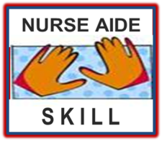
Training Lab Assignment
Engage in the Skill Acquisition Process for:
SKILL 5.02A
Moving Resident Up in Bed with/without Turn Sheet

Slide 58
Training Lab Assignment
Engage in the Skill Acquisition Process for:
SKILL 5.02B
Positioning Resident on Side

Slide 59
Repositioning Resident In Chair
Or Wheelchair

Slide 60
Repositioning Resident In Chair
Or Wheelchair
Reasons for changing position every two hours or as directed
  Promotes comfort
  Reduces pressure
  Increases circulation
  Exercises joints
  Promotes muscle tone

Slide 61
Repositioning Resident In Chair
Or Wheelchair
Body kept in good alignment with head in straight line with spine
Plastic or vinyl surface of chair covered, with use of pressure-relieving cushion preferred
Pillows or soft blankets used for support

Slide 62
Repositioning Resident In Chair
Or Wheelchair
Feet REST
on floor or footrest of wheelchair

Slide 63
Repositioning Resident In Chair
Or Wheelchair
Hips positioned well back in chair

Slide 64
Repositioning Resident In Chair
Or Wheelchair
Weight shifting utilized in between repositioning

Slide 65
BRAIN STORM
Think
Why shift weight?
Act
Raise your hand and share your thoughts! Wait to be called on.

Slide 66
Other Nurse Aide Skills that Promote Skin Integrity
http://www.webmd.com/skin-problems-and-treatments/slideshow-common-adult-skin-problems
Applying Non-Sterile Dressing
Applying Warm and Cold Therapy

Slide 67
Applying non-sterile dressings
Covering applied to wound or injured body part where slight risk of infection or re-injury
Materials come in various types and sizes:
  Gauze pads
  Band-aids
  Thick compresses

Slide 68
Related
SKILL

Slide 69
Training Lab Assignment
Engage in the Skill Acquisition Process for:
SKILL 5.02C
Apply Non-Sterile Dressing

Slide 70
Warm and cold therapy
Requires physician’s order for type of therapy and length of time for application

Slide 71
Warm and cold therapy
Purposes and Effects
  WARMTH: dilates blood vessels
    increased blood supply to area
    blood brings oxygen & nutrients for healing
    fluids are absorbed
    muscles relax
    pain relieved

Slide 72
Warm and cold therapy
Purposes and Effects
  COLD: constricts blood vessels
    decreased blood supply to area
    prevents swelling
    controls bleeding
    numbs skin, reducing pain
    reduces body temperature

Slide 73
Types of Warm and cold therapy
Dry cold - water does not touch skin
  ice bags
  ice caps
  ice collars
  disposable cold pack

Slide 74
Types of Warm and cold therapy
Moist cold - water touches skin
  compresses – localized application
  soaks - body part immersed in water
  cool sponge bath

Slide 75
Types of Warm and cold therapy
Dry warmth – pads with circulating warm water
Moist warmth
  compresses
  soaks
  sitz bath

Slide 76
Guidelines for Warm therapy
  Use bath thermometer to measure the temperature of moist heat solutions.
  Do not operate equipment you have not been trained to use.
  Temperature never over 105° F. Check skin frequently and report any signs of complications.

Slide 77
Guidelines for cold therapy
  Apply ice caps with metal or plastic lids away from skin
  Cover ice caps/bags/collars prior to application
  Check skin frequently and report any signs of complications
  Never leave in place longer than directed by supervisor

Slide 78
Related
SKILL

Slide 79
Training Lab Assignment
Engage in the Skill Acquisition Process for:
SKILL 5.02D
Apply Warm and Cold Applications

Slide 80
The
Bottom
Line
Skin is the body’s first line of defense against disease. Maintain the integrity of the skin.

Slide 81
 END 
5.02
Understand nurse aide’s role in promoting skin integrity.

