Slide 1
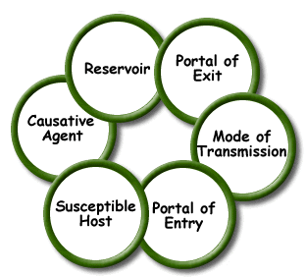
Unit A
Nurse Aide Workplace Fundamentals
Essential Standard NA3.00
Understand infection control, safety and emergency skills within the nurse aide scope of practice. (B2)
Indicator 3.01
Understand nurse aide’s role in infection control
Understand nurse aide role in infection control

Slide 2

For Your Information
There is intentional repeat of some HSII course content in Nursing Fundamentals.
Academic and skill competence must be maintained at a very high level for direct resident care.

Slide 3
Research has shown that after reaching a high level of performance during an initial training period, additional training can lead to substantial improvements in long-term retention.
This additional repetitive training is called overlearning.
J Neurophysiol. 2008 November; 100(5): 2948–2955. Published online 2008 September 10.

Slide 4
Nurse aides have a responsibility to understand and follow the facility’s infection control policies and procedures.

Slide 5

The
Bottom
Line
BAD GERMS make people sick!

Slide 6

SOOOOO…
GERM SPREAD!

Slide 7


GERMS are called MICROORGANISMS
Can only be seen by using a microscope

Slide 8


MICROORGANISMS
Can Be
GOOD
OR
Can Be
BAD

Slide 9
MICROORGANISMS
May cause
illness
infection
disease
Can Be
BAD

Slide 10
MICROORGANISMS
Germs that start infection, illness, or disease in the body and make you sick are called PATHOGENS
Can Be
BAD

Slide 11

Infection
invasion of the body by microorganisms
invading microorganisms:
  use the host’s resources to multiply
  interfere with normal function
  3rd leading cause of death in the U. S.

Slide 12
INFECTION
LOCAL
SYSTEMIC

Slide 13
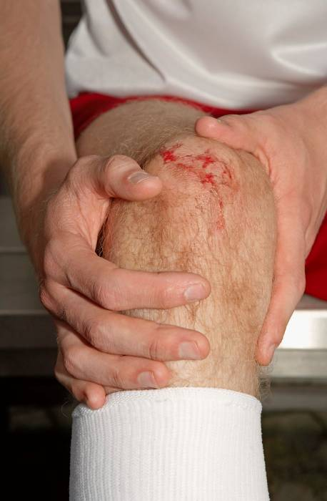
Local infection
only a specific portion of the body is infected
  pain
  redness
  heat at the site
  swelling
  pus
  foul smelling drainage

Slide 14

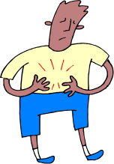

Systemic infection
affects the entire body
  fever
  aches
  chills
  nausea
  vomiting
  weakness

Slide 15

Another way to classify INFECTION…
  Endogenous (endo- inside; genous- type or kind)
    type or kind of infection or disease that originates from within the body
  Exogenous (exo- outside; genous- type or kind)
    type or kind of infection or disease that originates outside the body

Slide 16

REPORT ANY SIGNS OR SYMPTOMS OF INFECTION THAT YOUR RESIDENT MAY HAVE!

Slide 17



Residents with systemic infection may become confused or exhibit behavioral changes.

Slide 18
MICROORGANISMS
Benefit us by maintaining a balance in our environment and in our body
Can Be
GOOD

Slide 19
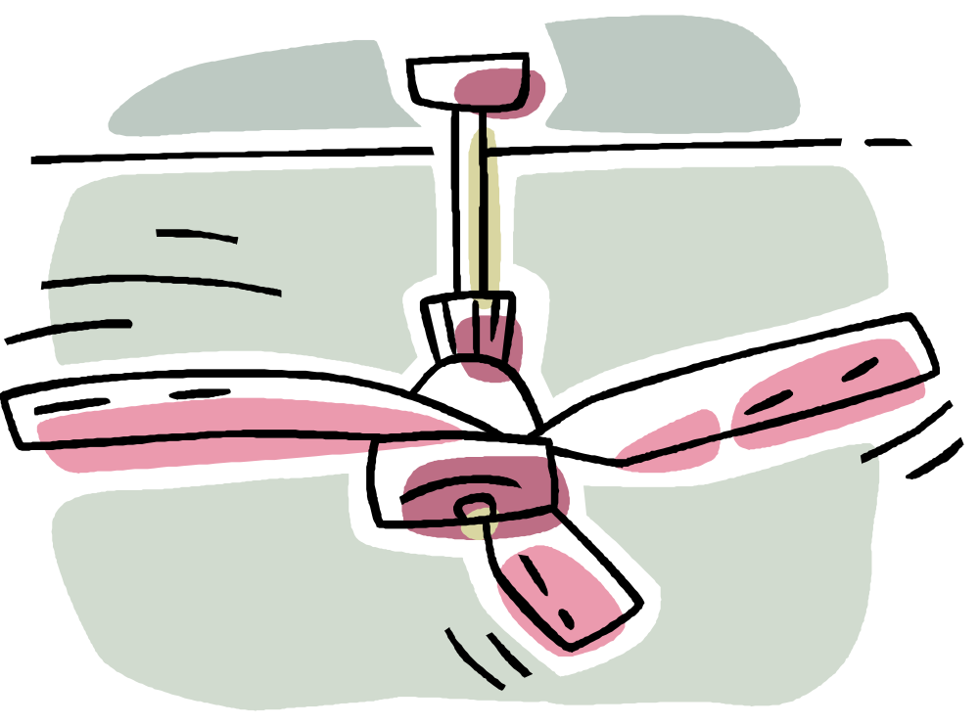
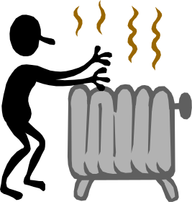

MICROORGANISMS
Require certain elements to survive:
  oxygen – aerobic
  no oxygen – anaerobic
  warm temperatures
  moisture
  dark area to grow

Slide 20
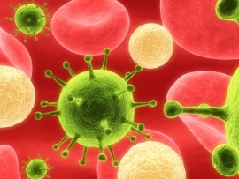

MICROORGANISMS
Require certain elements to survive: (CONT.)
  food
    dead tissue – saprophytes
    living tissue – parasites

Slide 21
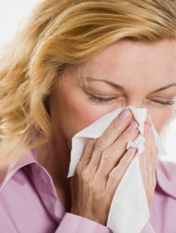

Human Body Defenses against
MICROORGANISMS
External natural defenses
  skin as mechanical barrier
  mucous membrane
  cilia – fine microscopic hairs in nose
  coughing and sneezing
  hydrochloric acid in stomach
  tears

Slide 22

Human Body Defenses against
MICROORGANISMS
Internal defenses:
  Phagocytes –
  Inflammation –
  Fever –
  Immune response -

Slide 23
Human Body Defenses can only do so much!

Slide 24
SOOOOO…
GERM SPREAD!
bre ak the CHAIN OF INFECTION

Slide 25
Chain of Infection

Slide 26
Causative Agent
Bacteria
Viruses
Fungi
Protozoa

Slide 27
Reservoir of the Causative Agent
Human with active cases of disease or those that carry disease without having symptoms
Animals/insects
Fomites
Environment

Slide 28
Causative Agent Portals of EXIT
Tears (slight risk)
Saliva/respiratory tract
secretions
Urine
Feces
Wound drainage
Reproductive tract secretions

Slide 29
Causative Agent Portals of ENTRY
Cuts/break in skin
Openings in the mucous membranes
Respiratory system
Gastrointestinal system
Urinary system
Reproductive system
Mother to fetus

Slide 30
Mode of Transmission
Contact
  direct – person to person
  indirect – fomite to person
  droplet – common cold
Common vehicle
  salmonella in food

Slide 31
Mode of Transmission
(continued)
Airborne
  tuberculosis
Vectorborne
  mosquito harbors malaria parasite

Slide 32
Host
Individual who harbors the infectious organisms

Slide 33
Host
Susceptibility may be caused by poor diet, fatigue, inadequate rest, stress, or poor health

Slide 34
Elderly are at a higher risk for infection!
The elderly have a higher risk for infection because of:
weakened immune systems
decreased circulation
slow wound healing
malnutrition
dehydration
limited mobility

Slide 35
Aseptic Control
Chain of Infection Buster!
Antisepsis - Disinfection - Sterilization

Slide 36
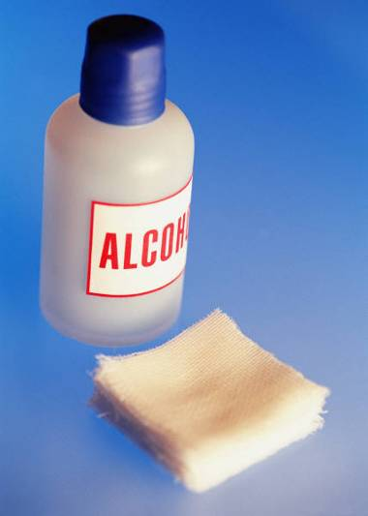
Aseptic Control
Antisepsis
  effective in preventing or inhibiting the growth of pathogenic organisms, but not spores or viruses
  safe to be used on skin

Slide 37

Aseptic Control
Disinfection
  destroys pathogenic organisms that are already present
  not effective against spores or viruses
  chemicals are used
  NOT used on skin
  Used on THINGS

Slide 38

Aseptic Control
Sterilization
  kills all microorganisms, including spores and viruses
  methods
    steam under pressure
    gas
    radiation
    chemicals
  not used on skin

Slide 39
STOPPING THE SPREAD OF INFECTION IS CALLED
MEDICAL ASEPSIS
  The practice used to remove or destroy pathogens and to prevent their spread from one person or place to another person or place; clean technique

Slide 40
Cleanest
to the
Most soiled area
ALWAYS CLEAN FROM THE LEAST SOILED TO THE MOST SOILED AREA WHEN CARING FOR RESIDENTS

Slide 41
MEDICAL ASEPSIS
Is accomplished by using ASEPTIC TECHNIQUE

Slide 42
ASEPTIC TECHNIQUE Includes:
Proper handwashing (hand hygiene)
Employee being clean and neat
Proper handling of all equipment
Using sterile procedure when necessary
Using proper cleaning solutions
Following Standard Precautions

Slide 43
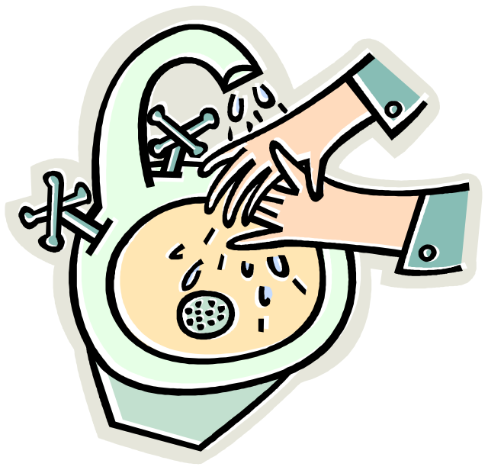
Aseptic Technique #1
Hand Hygiene

Slide 44

Hand hygiene
the sigle-most effective way
prevent the spread of infection

Slide 45
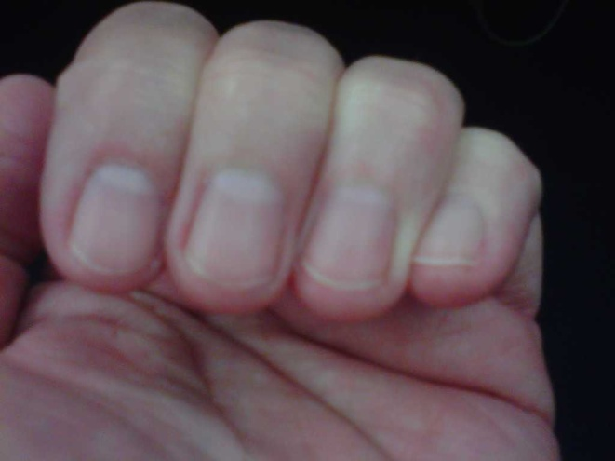
Nurse Aide Nails
Short; ¼ inch
Clean
Smooth
No artificial nails, No extenders, No overlays. These harbor bacteria

Slide 46
Hand Hygiene
HandWASH
HandRUB

Slide 47


When to Wash Hands
Anytime when the hands are visibly soiled!

Slide 48
When to Wash Hands
Before and after contact with a resident and/or resident’s belongings
Before and after eating
After using the bathroom
After handling any contaminated fluid or object
After touching body fluids, even if wearing gloves
Before and after wearing gloves
  Between tasks and procedures on the same resident to prevent cross-contamination of different body sites

Slide 49
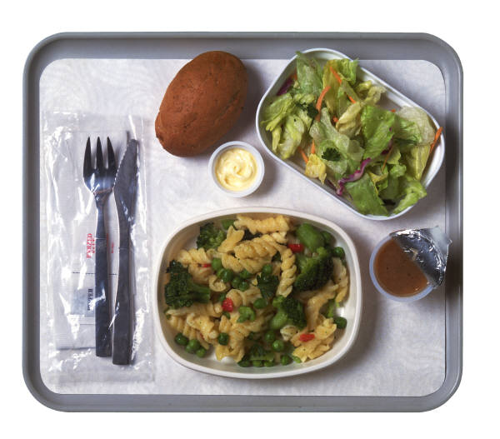
Wash the resident’s hands before meals

Slide 50
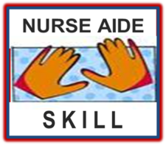
Training Lab Assignment
Engage in the Skill Acquisition Process for:
SKILL 3.01A
Wash Hands

Slide 51
HandRUB
The following slides outline the steps (learning targets) for hand hygiene using handrub products.

Slide 52


RUB HANDS FOR HAND HYGIENE!
Apply a palmful of the product in a cupped hand
Rub hands palm to palm

Slide 53


RUB HANDS FOR HAND HYGIENE!
Right palm over left dorsum (back of hand) with interlaced fingers and vice versa
Palm to palm with fingers interlaced

Slide 54
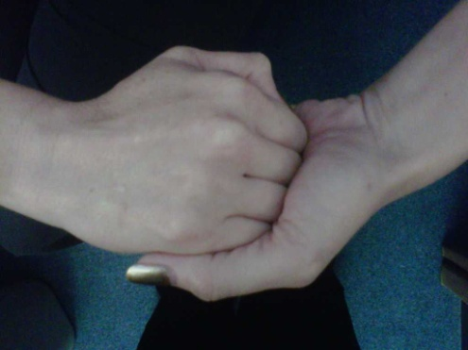
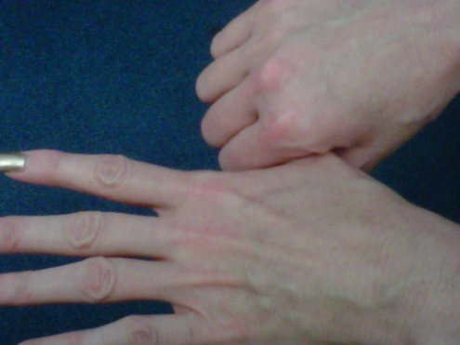
RUB HANDS FOR HAND HYGIENE!
Backs of fingers to opposing palms with fingers interlocked
Rotational rubbing of left thumb clasped in right palm and vice versa

Slide 55
RUB HANDS FOR HAND HYGIENE!
Rotational rubbing, backwards and forwards with clasped finger of right hand if left palm and vice versa
Once dry, your hands are safe

Slide 56
Training Lab Assignment
Engage in the Skill Acquisition Process for:
SKILL 3.01B
Handrub
http://www.who.int/gpsc/5may/How_To_HandRub_Poster.pdf

Slide 57

Aseptic Technique #2
Come to work clean, neat, and well.
Bathe, wash hair and brush your teeth on a regular basis
Wear clean uniform
Stay well!

Slide 58
Adhere to facility policy regarding staying home when sick. If you are contagious, stay home.

Slide 59


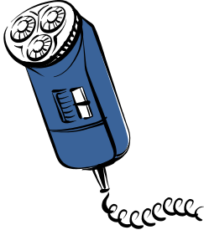
Aseptic Technique #3
Proper handling of all equipment and supplies

Slide 60
MULTIPLE-USE RESIDENT CARE EQUIPMENT
Commonly used equipment or supplies (stethoscope, etc.) must be cleaned and disinfected after use or when soiled
Single-use equipment is preferred and must be discarded properly

Slide 61
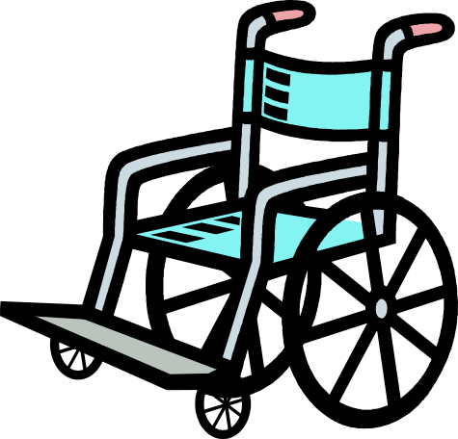
Care of supplies and equipment
Cleaning non-disposable equipment
  Rinse in cold water to remove organic material
  Wash with soap and hot water
  Scrub with a brush if necessary
  Rinse and dry equipment
  Sterilize or disinfect equipment

Slide 62

Care of supplies and equipment
Direct cleaning away from your body and uniform

Slide 63

Care of supplies and equipment
Wash cooking and eating utensils with soap and water after each use.

Slide 64
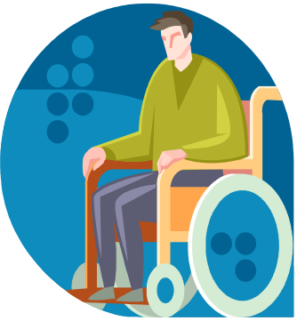



Care of supplies and equipment
Do not transport equipment from one resident’s room to another without cleaning.

Slide 65
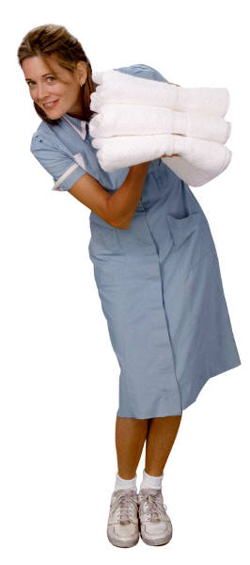

Care of supplies and equipment
Avoid shaking linen
Damp dust furniture

Slide 66
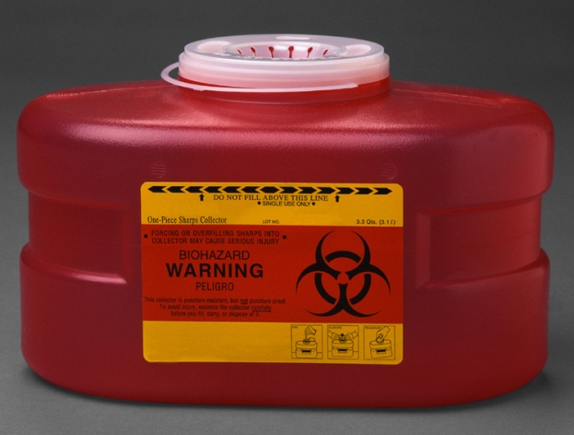
Proper handling of all equipment
DO NOT REUSE DISPOSIBLE ITEMS!

Slide 67
Aseptic Technique #4
Use proper cleaning solutions
When cleaning resident’s unit or
cleaning reusable equipment after use

Slide 68
Aseptic Technique #5
Sterile Procedure
The Nurse Aide I does not perform sterile procedures but should be able to avoid contamination of a sterile field or procedure.

Slide 69
Aseptic Technique #6
Follow Standard and Transmission based Precautions
2007 CDC Guidelines

Slide 70
Standard Precautions PLUS
CDC procedures to control and prevent infections.
Contains two tiers
of precautions:
Transmission Based
Standard

Slide 71
Standard Precautions
Transmission Based
Standard

Slide 72
Standard Precautions
Used on ALL patients
Includes:
  Hand washing
  Personal Protective Equipment (PPE)
    Gloves
    Gowns
    Masks and eye protection
  Needle stick safety
  Sharps
  Spills and splashes
  Resuscitation devices
  Waste and linen disposal
  Injuries

Slide 73
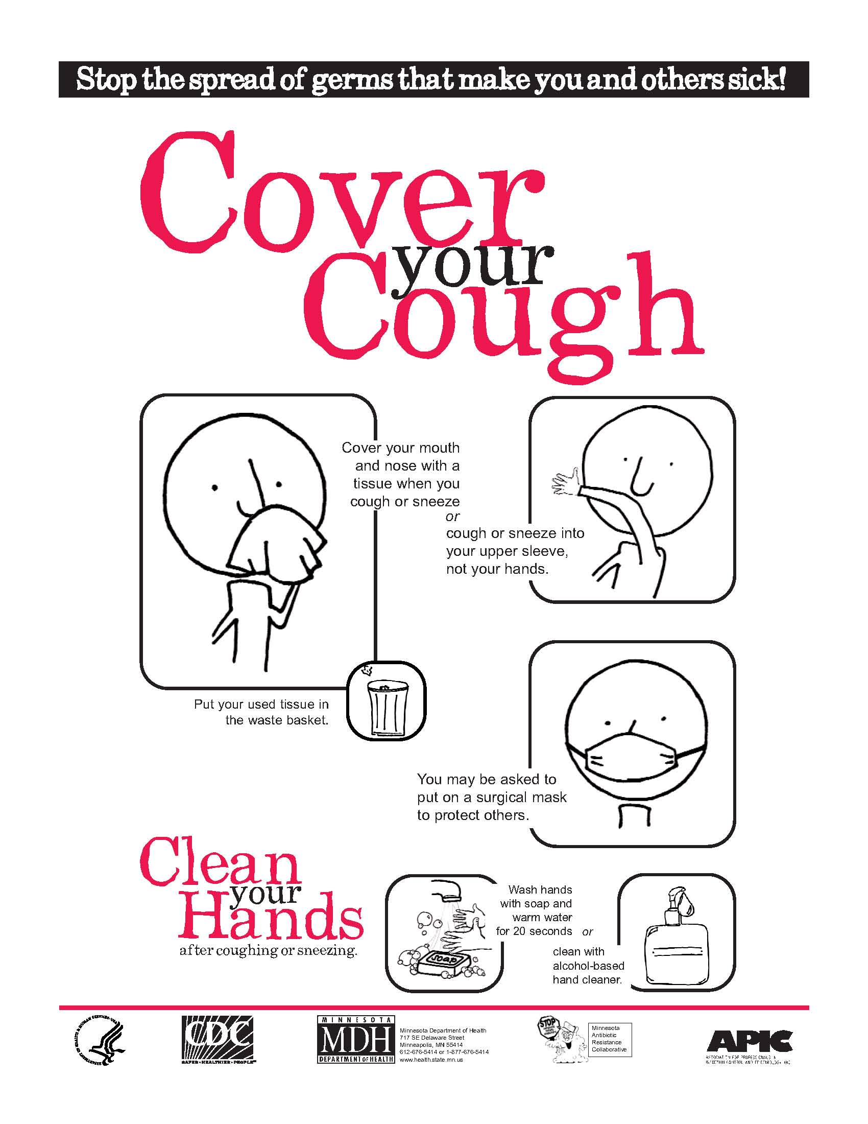
Standard Precaution a newer component

Slide 74
Standard Precaution a newer component
Tuberculosis Standard
OSHA Standard to reduce occupationally transmitted/acquired TB
Requires FIT tested and training in the use of specific respiratory PPE
PPD aka TST skin test annually

Slide 75
Two-step Tuberculin Skin Testing (TST) is useful for the initial skin testing of adults who are going to be retested periodically, such as health care workers or nursing home residents. This two-step method can reduce the likelihood that a boosted reaction to a subsequent TST will be misinterpreted as a recent infection. CDC / TB / Fact Sheets
TST

Slide 76
Standard Precautions
Hand Hygiene
HandWASH
HandRUB

Slide 77
Standard Precautions
Gloves
Gown
Masks and eye protection
Personal Protective Equipment (PPE)

Slide 78
Standard Precautions
GLOVES
Wear gloves (clean, nonsterile gloves) when:
  touching blood, body fluids, secretions, excretions, and contaminated items
  before touching mucous membranes and non-intact skin

Slide 79
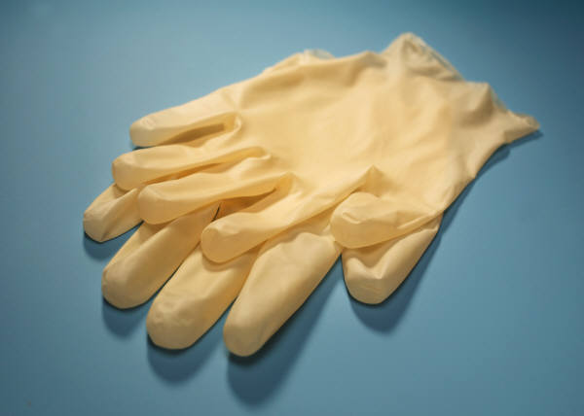
Sterile gloves are more expensive and NOT needed for routine resident care.

Slide 80
Standard Precautions
GOWN
Wear a gown:
  during procedures and resident care activities that are likely to generate splashes of blood, body fluids, secretions or excretions
  remove soiled gown as soon as possible and wash hands

Slide 81
Standard Precautions
MASK, EYE PROTECTION,
FACE SHIELD
Wear a mask and eye protection or a face shield:
  to protect mucous membranes of the eyes, nose, and mouth

Slide 82
Standard Precautions
MASK, EYE PROTECTION,
FACE SHIELD
(continued)
Wear a mask and eye protection or a face shield (continued):
  during procedures and resident care activities that are likely to generate splashes or sprays of blood, body fluids, secretions, and excretions.

Slide 83
Standard Precautions
~PPE Summary~
Gloves
Gown
Masks and eye protection
Personal Protection Equipment (PPE)

Slide 84
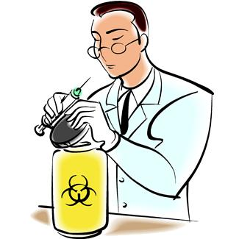
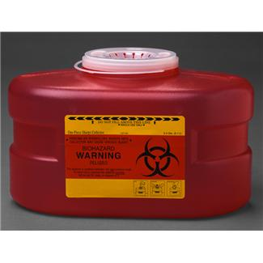
Standard Precautions
Needlestick safety
Sharps

Slide 85
Be very vigilant in watching for needles and other sharps in residents’ beds.
Discard these items a puncture-resistant biohazard container.

Slide 86
Report to your supervisor if sharps are found in the resident's bed.

Slide 87

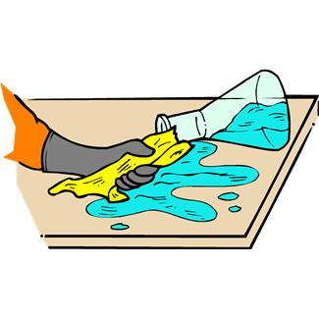

Standard Precautions
Spills and splashes

Slide 88


When pouring contaminated liquids into sinks or toilets; do not splash.

Slide 89
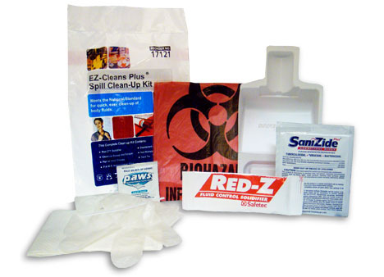
Cleaning Spills
Many facilities use special clean-up kits for spills. Follow manufacture directions when using these kits.

Slide 90

Guidelines: Cleaning Spills involving Blood, Body Fluids, or Glass
Apply gloves before starting. In some cases, industrial-strength gloves are best.

Slide 91

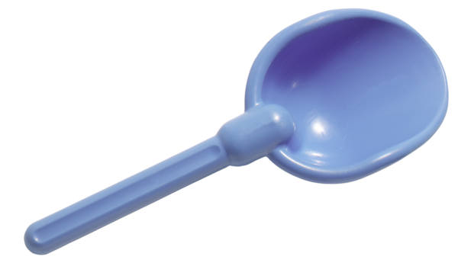
Guidelines: Cleaning Spills involving Blood, Body Fluids, or Glass
First, absorb the spill with whatever product is used by the facility. It may be an absorbing powder.
Scoop up the absorbed spill, and dispose of in a designated container.

Slide 92


Guidelines: Cleaning Spills involving Blood, Body Fluids, or Glass
Apply the proper disinfectant to the spill area and allow it to stand for a minimum of 10 minutes.
minutes

Slide 93


Guidelines: Cleaning Spills involving Blood, Body Fluids, or Glass
Clean up spills immediately with the proper cleaning solution.
Do not pick up any pieces of broken glass no matter how large, with your hands. Use a dustpan and broom or other tools.

Slide 94

Guidelines: Cleaning Spills involving Blood, Body Fluids, or Glass
Waste containing broken glass, blood, or body fluids should be properly bagged. Waste containing blood or body fluids may need to be placed in a special biohazard container.
Follow facility policy.
Agency
Policy

Slide 95
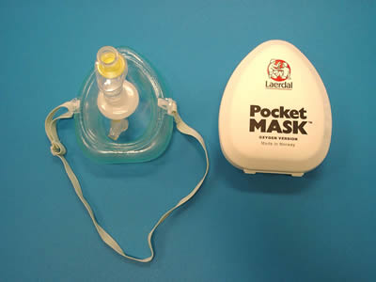
Standard Precautions
Resuscitation devices
MUST BE SINGLE USE

Slide 96
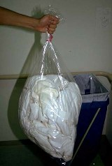
Standard Precautions
Waste and linen disposal
DETERMINE IF CONTAMINATEDWITH BLOOD OR BODY FLUIDS THAT CONTAIN BLOOD. IF SO, HANDLE AS BIOHAZARDOUS MATERIAL.

Slide 97
Standard Precautions
LINEN
Handle, transport, and process used linen soiled with blood, body fluids, secretions, and excretion
  in a manner that prevents skin and mucous membrane exposures and contamination of clothing

Slide 98
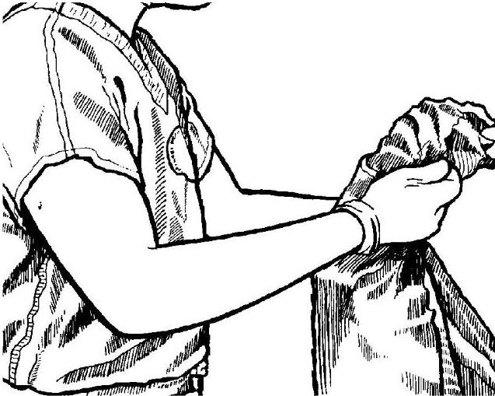
Hold linens away from uniform.

Slide 99
Standard Precautions
LINEN
(continued)
Handle, transport, and process used linen soiled with blood, body fluids, secretions, and excretion (continued):
  in a manner that prevents transfer of microorganisms to other residents and environments

Slide 100
Standard Precautions
RESIDENT PLACEMENT
Place resident who contaminates environment or who does not, or cannot be expected to assist in maintaining appropriate hygiene or environmental control, in private room

Slide 101
Standard Precautions
RESIDENT PLACEMENT
(continued)
If a private room is not available, consult with infection control professionals regarding resident placement or other alternatives

Slide 102
Standard Precautions
TRANSPORT OF INFECTED RESIDENTS
Appropriate barriers (masks, impervious dressings) are worn
Personnel in area to which resident is taken are notified of arrival and precautions to take

Slide 103
Standard Precautions
TRANSPORT OF INFECTED RESIDENTS
(continued)
Inform residents in ways they can assist in prevention of transmission

Slide 104
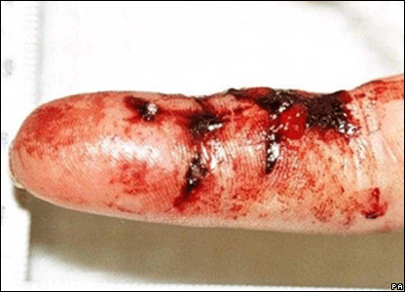

Standard Precautions
Injuries
  Wash the area immediately
  Complete a facility incident report
  Follow procedures for testing and treatment
Exposure
Control
Plan

Slide 105
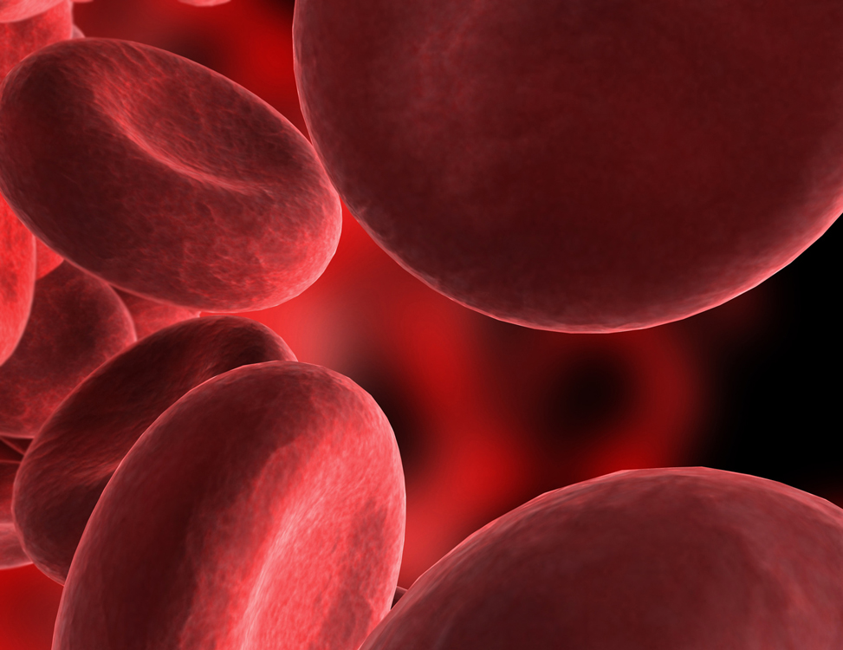
Bloodborne Pathogen Standard
PATHOGENS found in the BLOOD
Notes:
Include basic information about the bloodborne pathogens: Hep B, Hep C, HIV

Slide 106
Bloodborne Pathogen Standard
Applies to all occupational exposure of blood or other potentially infectious material.
Blood = human blood, blood components, blood products
Bloodborne pathogens = disease causing organisms in blood (Hep. B, Hep. C, HIV)
Notes:
Include basic information about the bloodborne pathogens: Hep B, Hep C, HIV

Slide 107

Bloodborne Pathogen Standard
In an emergency when you cannot identify body fluids or tell whether they contain blood, treat all body fluids as potentially infectious.

Slide 108
BLOODBORNEPATHOGENS:
Human Immunodeficiency Virus (HIV)
Hepatitis B Virus (HBV)
Notes:
Include basic information about the bloodborne pathogens: Hep B, Hep C, HIV

Slide 109
Human Immunodeficiency Virus (HIV)
Persons infected with HIV may carry virus without developing symptoms for several years
HIV infected persons will eventually develop AIDS (Acquired Immune Deficiency Syndrome)

Slide 110
Human Immunodeficiency Virus (HIV)
(continued)
Persons infected with HIV may develop AIDS-related illnesses including neurological problems, cancer, and other opportunistic infections
Persons infected with HIV may suffer flu-like symptoms, fever, diarrhea, weight loss and fatigue

Slide 111
Human Immunodeficiency Virus (HIV)
(continued)
Brain of persons infected with HIV may be affected, causing confusion, memory loss, depression or motor dysfunction
Although drugs may delay symptoms, there is no known cure for AIDS

Slide 112
Hepatitis B Virus (HBV)
About one third of persons infected do not show symptoms
Another one third have mild flu-like symptoms which go away
The last one third experience abdominal pain, nausea and fatigue; skin and eyes jaundiced and urine dark

Slide 113
Hepatitis B Virus (HBV)
(continued)
Six to ten percent of HBV infected persons become chronic carriers (may or may not have active infection, few or no symptoms, but can transmit disease)
HBV preventable with use of HBV vaccine

Slide 114
Bloodborne Pathogens
Modes of Transmission
Sexual contact
Sharing contaminated needles
Receiving blood transfusions
Pregnant mother to unborn baby
Nursing mother to baby through breast milk (for HIV, not HBV)

Slide 115
Bloodborne Pathogens
Modes of Transmission
(continued)
Puncture wounds from sharps
Mucous membrane contact
Contact of infectious substances (urine, feces, saliva) with non-intact skin
Contaminated surfaces (for HBV, not HIV)

Slide 116

Nurse Aide has possible exposure to blood or fluids containing BLOOD

Slide 117
Bloodborne Pathogens
Exposure Control Plan
Post-exposure evaluation and follow-up
  Wash the area immediately
  Complete a facility incident report
  Follow procedures for testing and treatment
Exposure
Control
Plan

Slide 118
Bloodborne Pathogens
Exposure Control Plan
Copy must be available at workplace
Mandated by OSHA
Identifies employees at risk of exposure by tasks performed
Exposure
Control
Plan

Slide 119
Bloodborne Pathogens
Exposure Control Plan
Specific measures to decrease risk to exposure
  Administrative controls
  Work practice controls
  Engineering controls
  Housekeeping
  HBV vaccine
Exposure
Control
Plan

Slide 120
Standard Precautions
~Summary~
Used on ALL patients
Includes:
  Hand washing
  Personal Protective Equipment (PPE)
    Gloves
    Gowns
    Masks and eye protection
  Needle stick safety
  Sharps
  Spills and splashes
  Resuscitation devices
  Waste and linen disposal
  Injuries

Slide 121
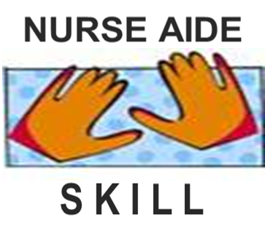
Training Lab Assignment:
Engage in the Skill Acquisition Process for
Skills related to Standard Precautions…

Slide 122
Training Lab Assignment
Engage in the Skill Acquisition Process for:
SKILL 3.01C
Don & Remove
Complete PPE

Slide 123
Transmission based precautions
Transmission Based
Standard

Slide 124


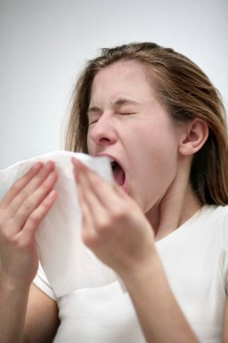
Standard Precautions PLUS
Airborne Precautions
Contact Precautions
Droplet Precautions

Slide 125
Standard Precautions PLUS
aka
Transmission based precautions

Slide 126
Airborne Precautions

Slide 127
Transmission Based Precautions
AIRBORNE PRECAUTIONS
In addition to Standard Precautions, use Airborne Precautions, or the equivalent, for resident known or suspected to be infected with microorganisms transmitted by airborne droplets that remain suspended in the air and can be widely dispersed by air currents.

Slide 128
Transmission Based Precautions
AIRBORNE PRECAUTIONS
(continued)
RESIDENT PLACEMENT: Private room. Negative air pressure in relation to the surrounding areas. Keep doors closed at all times and resident in room.

Slide 129
Transmission Based Precautions
AIRBORNE PRECAUTIONS
(continued)
GLOVES: Same as Standard Precautions
GOWN OR APRON: Same as Standard Precautions

Slide 130
Transmission Based Precautions
AIRBORNE PRECAUTIONS
Mask and Eyewear
For known or suspected pulmonary tuberculosis:
  Mask N-95 (respirator) must be worn by all individuals prior to entering room

Slide 131
Transmission Based Precautions
AIRBORNE PRECAUTIONS
Mask and Eyewear
(continued)
For known or suspected airborne viral disease (e.g., chickenpox, or measles)
  Standard mask should be worn by any person entering the room unless the person is not susceptible to the disease
  When possible, persons who are susceptible should not enter room

Slide 132
Transmission Based Precautions
AIRBORNE PRECAUTIONS
Handwashing
Hands must be washed before gloving and after gloves are removed
Skin surfaces must be washed immediately and thoroughly when contaminated with body fluids or blood

Slide 133
Transmission Based Precautions
AIRBORNE PRECAUTIONS
Resident Transport
Limit transport of the resident for essential purposes only
Place a mask on the resident, if possible

Slide 134
Transmission Based Precautions
AIRBORNE PRECAUTIONS
Resident Care Equipment
When using equipment or items (stethoscope, thermometer), the equipment and items must be adequately cleaned and disinfected before use with another resident

Slide 135

Droplet Precautions

Slide 136
Droplet precautions
  Used when large-particle droplets are expelled during coughing, sneezing, talking or laughing
  Specific PPEs-
    mask if working within
    3 feet of patient

Slide 137
Transmission Based Precautions
DROPLET PRECAUTIONS
In addition to Standard Precautions, use Droplet Precautions, or the equivalent, for a resident known or suspected to be infected with microorganisms transmitted by droplets that can be generated by the resident during coughing, sneezing, talking, or the performance of procedures that induce coughing.

Slide 138
Transmission Based Precautions
DROPLET PRECAUTIONS
(continued)
RESIDENT PLACEMENT: Private room or with resident with same disease.
GLOVES: Must be worn when in contact with blood and body fluids.

Slide 139
Transmission Based Precautions
DROPLET PRECAUTIONS
(continued)
GOWNS: Must be worn during procedures or situations where there will be exposure to body fluids, blood, draining wounds, or mucous membranes.

Slide 140
Transmission Based Precautions
DROPLET PRECAUTIONS
(continued)
MASKS AND EYEWEAR:
In addition to Standard Precautions, wear mask when working within three feet of resident (or when entering resident’s room).

Slide 141
Transmission Based Precautions
DROPLET PRECAUTIONS
(continued)
HANDWASHING: Hands must be washed before gloving and after gloves are removed.

Slide 142
Transmission Based Precautions
DROPLET PRECAUTIONS
(continued)
TRANSPORTING: Limit the movement and transporting of the resident from the room for essential purposes only. If necessary to move the resident, minimize resident dispersal of droplets by masking the resident, if possible.

Slide 143
Transmission Based Precautions
DROPLET PRECAUTIONS
(continued)
RESIDENT-CARE EQUIPMENT: When using common equipment or items, they must be adequately cleaned and disinfected.

Slide 144

Contact Precautions

Slide 145
Transmission Based Precautions
CONTACT PRECAUTIONS
In addition to Standard Precautions, use Contact Precautions, or the equivalent, for specified residents known or suspected to be infected or colonized with important microorganisms.

Slide 146
Transmission Based Precautions
CONTACT PRECAUTIONS
(continued)
These microorganisms can be transmitted by direct contact with the resident (hand or skin-to-skin contact that occurs when performing resident-care activities that require touching the resident’s dry skin) or indirect contact (touching) with environmental surfaces or resident-care items in the resident’s environment.

Slide 147
Transmission Based Precautions
CONTACT PRECAUTIONS
(continued)
RESIDENT PLACEMENT: Private room (if not available, with resident with same disease).
GLOVES: Wear gloves when entering the room and for all contact of resident and resident items, equipment, and body fluids.

Slide 148
Transmission Based Precautions
CONTACT PRECAUTIONS
(continued)
GOWN: Wear a gown when entering the room if it is anticipated that your clothing will have substantial contact with the resident, environmental surfaces, or items in the resident’s room.

Slide 149
Transmission Based Precautions
CONTACT PRECAUTIONS
(continued)
MASKS AND EYEWEAR: Indicated if potential for exposure to infectious body material exists.

Slide 150
Transmission Based Precautions
CONTACT PRECAUTIONS
(continued)
HANDWASHING: After glove removal while ensuring that hands do not touch potentially contaminated environmental surfaces or items in the resident’s room.
TRANSPORTING: Limit the movement and transporting of the resident.

Slide 151
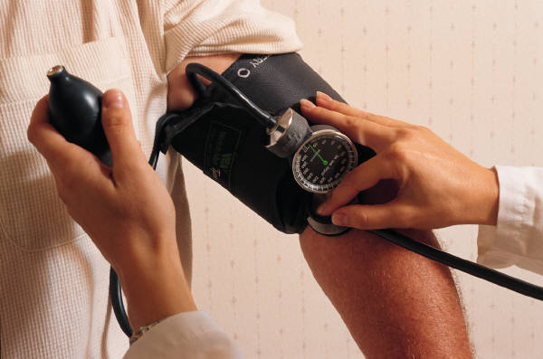
Transmission Based Precautions
CONTACT PRECAUTIONS
(continued)
RESIDENT-CARE EQUIPMENT: When possible, dedicate the use of non-critical resident care equipment to a single resident.

Slide 152
NEVER ISOLATE A RESIDENT
EMOTIONALLY!

Slide 153
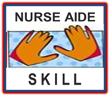
Training Lab Assignment
Engage in the Skill Acquisition Process for:
SKILL 3.01D
Disposition of equipment from resident unit using Transmission based precautions.

Slide 154
Training Lab Assignment
Engage in the Skill Acquisition Process for:
SKILL 3.01E
Collect specimen from resident using Transmission based precautions.

Slide 155

How do nursing facilities control infection

Slide 156
Quality Assurance and
Infection Control
Purpose of Infection Control Programs
  Prevent cross infection
  Prevent re-infection
  Environmental control

Slide 157
Quality Assurance and
Infection Control
(continued)
Role of the Quality Assurance Committee
  Reviews infections
  Recommends policies and procedures to prevent infections
  Made up of members from all disciplines

Slide 158

Quality Assurance and
Infection Control
(continued)
Role of the Quality Assurance Committee
  Monitors infection control program
  All facilities required to have Infection Control Program as part of Quality Assurance Committee
Infection Control
Program

Slide 159
 END 
3.01
Understand nurse aide role in infection control.

