Slide 1
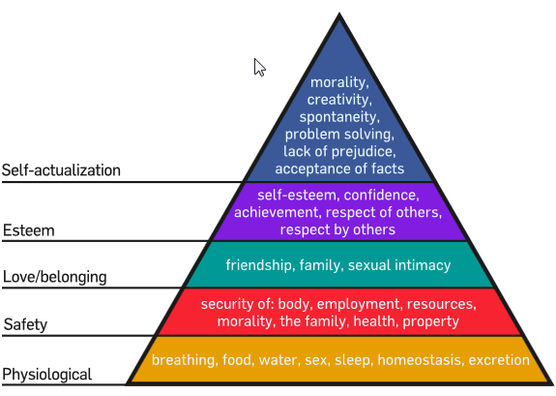
Unit A
Resident Care Skills
Essential Standard NA2.00
Understand nurse aide’s role in providing residents’ hygiene, grooming, and skin care.
Indicator 2.03
Understand basic human needs and nurse aide guidelines in meeting those needs
Understand basic human needs and nurse aide guidelines in meeting those needs.

Slide 2
Basic Physical Needs
Care Needed to Meet Those Needs
Oxygen
  elevate head of bed
  assist to sit up in chair
  report to supervisor if resident is cyanotic or short of breath
  assist with breathing exercises

Slide 3
Basic Physical Needs
Care Needed to Meet Those Needs
Food
  Feed residents unable to feed themselves

Slide 4
Basic Physical Needs
Care Needed to Meet Those Needs
Food
  Serve food
    with proper temperature
    in friendly manner
    in pleasant environment
    in appropriate amounts
  Make sure dentures are in place

Slide 5

Water
  make available within resident’s reach
  provide fresh water at periodic intervals

Slide 6
Shelter
  provide for warmth with extra blankets
  be sure residents are dressed properly
  avoid drafts or drafty areas

Slide 7
Sleep
  Minimize noise and lights during hours of sleep
  Give back rub to relax resident

Slide 8
Sleep (continued)
  Report complaints of pain to supervisor
  Listen to concerns or worries the resident may wish to express
  Leave night light on in the resident’s room, if requested

Slide 9
Elimination
  Assist to bathroom as needed
  Provide bedpan and/or urinal
  Provide for privacy

Slide 10
Elimination (continued)
  Change soiled linen immediately
  Following routine for bowel and bladder retraining as directed

Slide 11
Activity
  ROM exercises as directed
  Turn and reposition at least every two hours

Slide 12
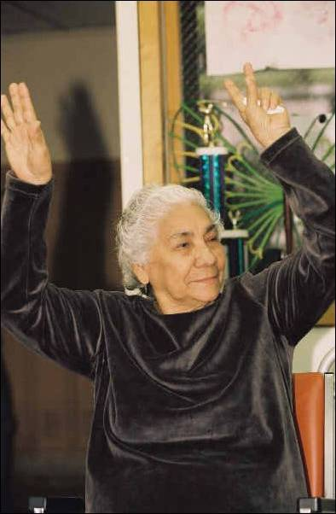
Activity
  Assist with activity as directed
  Encourage movement
  Encourage interesting recreational activities

Slide 13
Safety And Security Needs
Care Needed to Meet Those Needs
Provide for warmth
Establish familiar surroundings
  explain procedures
  talk about “their” room
  keep your promises
  provide a safe environment
  promote use of personal belongings

Slide 14

Maintain order and follow routines, assisting resident to participate in establishing routine as often as possible

Slide 15

Assist to reduce fear and anxiety
  listen to resident’s worries and report to supervisor
  ease concerns when possible
  check on residents frequently
Avoid rushing and assist resident in gentle manner

Slide 16
Love and Affection Needs
Care Needed to Meet Those Needs
Friendship
Social Acceptance
Closeness
Meaningful relationships with others
Love
Sexuality

Slide 17
Belonging
  Need met by family/support system
  Friends may meet this need

Slide 18
The nursing staff as family:
take time to greet residents when you see them
sit and visit for a few minutes when time allows
show interest in residents

Slide 19
The nursing staff as family (continued):
display human warmth with a gentle touch
show acceptance of an individual for his or her unique qualities
provide care in a kind, friendly, considerate manner

Slide 20
Self-Esteem Needs
Care Needed to Met Those Needs
Value, worth or opinion of oneself
Seeing oneself as useful
Being well thought of by others

Slide 21
Self-Esteem Needs
Care Needed to Met Those Needs
Nurse aide’s responsibilities
  call resident by proper name
  praise accomplishments
  discuss current issues
  request resident’s opinion
  show respect and approval

Slide 22
Need for Self-Actualization
(experiencing one’s potential)
Cannot occur until all other needs are met
A feeling that a person is what one wants to be
Rarely is this need totally met

Slide 23
Need for Self-Actualization
(experiencing one’s potential)
Ways to help residents to meet this need:
  assist to participate in meaningful activities
  assist to dress and help with grooming
  encourage independence
  encourage socialization

Slide 24
Need for Self-Actualization
(experiencing one’s potential)
Ways to help residents to meet this need (continued):
  share goals with residents and praise their success or accomplishments
  know what resident has accomplished in his/her lifetime and talk about these things

Slide 25
Spiritual Needs
Residents have the right to worship and express their faith freely.

Slide 26
Spiritual Needs
Guidelines for the nurse aide:
  respect resident’s beliefs
  respect resident’s religious objects
  inform residents of the time and place for religious services

Slide 27
Spiritual Needs
Guidelines for the nurse aide (continued):
  assist resident to attend religious services
  provide privacy for members of the clergy and residents
  welcome members of the clergy

Slide 28
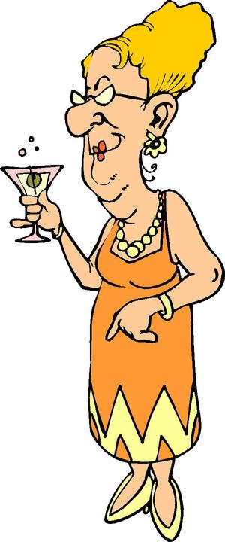
Sexuality
Expressed by individuals of all ages
A way to show feminine or masculine qualities
  Clothing styles and colors
  Hairstyles
  Hobbies and interests
  Sexual habits (continue into
  old age)
  Gestures

Slide 29
Sexuality
May be expressed by:
  Sexual intercourse
  Caressing, touching, holding hands
  Masturbation
Is a right of all residents to experience

Slide 30
Guidelines For The Nurse Aide In Dealing With Resident Sexuality
Assist to maintain sexual identity by dressing residents in clothing appropriate for men or women
Assist with personal hygiene

Slide 31
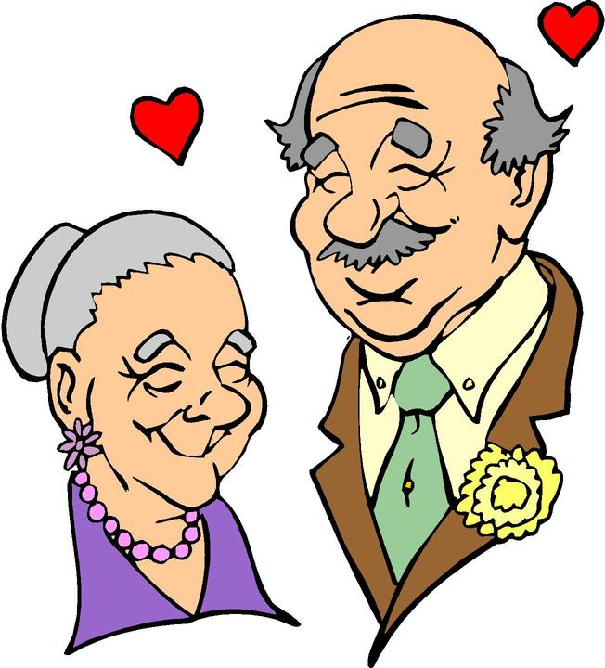
Guidelines For The Nurse Aide In Dealing With Resident Sexuality
Assist to prepare for special activities by “dressing up”
  selecting attractive clothing
  fixing hair in a special way
  applying cosmetics
  wearing a special perfume or aftershave

Slide 32
Guidelines For The Nurse Aide In Dealing With Resident Sexuality
Help to develop a positive self-image
Show acceptance and understanding for resident’s expression of love or sexuality
  provide privacy
  always knock prior to entering a room at any time
  assure privacy when requested

Slide 33
Guidelines For The Nurse Aide In Dealing With Resident Sexuality
Never expose the resident
Accept the resident’s sexual relationships

Slide 34
Guidelines For The Nurse Aide In Dealing With Resident Sexuality
Provide protection for the non-consenting resident
Be firm but gentle in your rejection of a resident’s sexual advances

Slide 35
Possible Effects Of Injury Or Illness On Sexuality
Disfiguring surgery may cause a person to feel:
  unattractive and ugly to others
  mutilated and deformed
  unworthy of love or affection

Slide 36
Possible Effects Of Injury Or Illness On Sexuality
Chronic illness and certain medications can affect sexual functioning

Slide 37
Possible Effects Of Injury Or Illness On Sexuality
Disorders that cause impotence
  diabetes mellitus
  spinal cord injuries
  multiple sclerosis
  alcoholism

Slide 38
Possible Effects Of Injury Or Illness On Sexuality
Surgery can have both physical and/or psychological effects
  removal of prostate or testes
  amputation of a limb
  removal of uterus
  removal of ovaries
  removal of a breast
  colostomy
  ileostomy

Slide 39
Possible Effects Of Injury Or Illness On Sexuality
(continued)
Disorders affecting the ability to have sex:
  stroke
  nervous system disorders
  heart disease

Slide 40
Possible Effects Of Injury Or Illness On Sexuality
(continued)
Disorders affecting the ability to have sex:
  chronic obstructive pulmonary disease
  circulatory disorders
  arthritis or conditions affecting mobility/ flexibility

Slide 41
Reproductive System
Organs have dual functions
  Produce reproductive cells
  Produce hormones responsible for sex characteristics
    females - estrogen and progesterone
    males - testosterone

Slide 42
Common Disorders of the Reproductive System
Rectocele and cystocele – hernias
  rectocele - weakening of wall between vagina and rectum
    constipation results
    hemorrhoids form
  cystocele - weakening of wall between urethra and vagina
    causes urinary incontinence

Slide 43
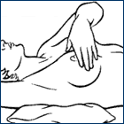
Common Disorders of the Reproductive System
(continued)
Tumors - benign and malignant tumors of uterus, ovaries and breasts
  pap smear
  self breast exams
  biopsy

Slide 44
Common Disorders of the Reproductive System
(continued)
Sexually transmitted diseases
  gonorrhea
  syphilis
  herpes
  AIDS
Prostatic hypertrophy - enlargement of prostate gland
Vaginitis

Slide 45
Changes In Reproductive System Due To Aging
Decreased size of testes
Decreased production of sperm
Delayed or less forceful ejaculation
Slower sexual response
Enlargement of prostate
Decreased sexual desire

Slide 46
Changes In Reproductive System Due To Aging
(continued)
Sagging breasts
Stopping of ovulation
Decreased vaginal secretions
Thinning of tissue of vaginal lining
Decreased sex hormone production
Loss of hair in vulva area

Slide 47


Observations of Reproductive System
Bleeding
Complaint of pain
Vaginal discharge
Complaint of itching
Lumps

Slide 48
 END 
5.01
Understand basic human needs and nurse aide guidelines in meeting those needs.

