Slide 1

Unit A
Nurse Aide Workplace Fundamentals
Essential Standard NA2.00
Apply communication and interpersonal skills and physical care that promote mental health and meet the social and special needs of
residents in long-term care.
Indicator 2.01
Understand communication and interpersonal skills needed to provide resident care and relate to team members.
Communication modifications for individualized
resident care

Slide 2
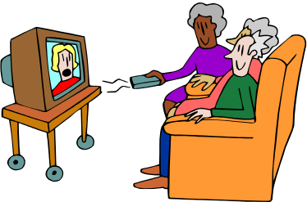




Unit A / Essential Standard NA2.00 / Indicator 2.01
General Modifications to Assist Hearing:
Reduce or Remove Noise
  Turn off or lower TV volume
  Turn off or lower radio volume
  Close resident’s door

Slide 3
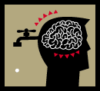

BRAIN STORM
Unit A / Essential Standard NA2.00 / Indicator 2.01
Think
What are other ways to modify the resident’s environment that will improve the resident’s ability to hear?
Act
Raise your hand and share your thoughts.

Slide 4
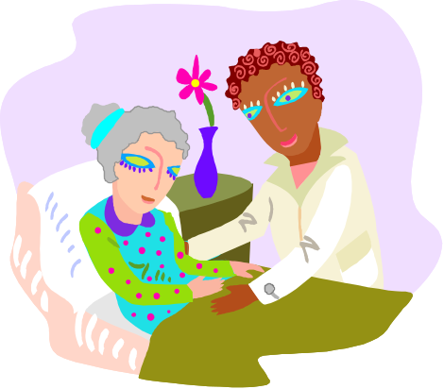
Unit A / Essential Standard NA2.00 / Indicator 2.01
General Modifications to Assist
Hearing:
Get resident’s attention before speaking to them
    Approach from the front
    Lightly touch the arm

Slide 5
BRAIN STORM
Unit A / Essential Standard NA2.00 / Indicator 2.01
Think
Why do you think approaching the patient from the front is better? Why touch them lightly on the arm?
Act
Raise your hand and share your thoughts.

Slide 6
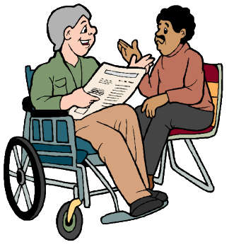

Unit A / Essential Standard NA2.00 / Indicator 2.01
General Modifications to Assist
Hearing:
Face resident at eye level when speaking
    Care giver should adjust to resident’s eye level
    Stoop down if resident in wheelchair

Slide 7

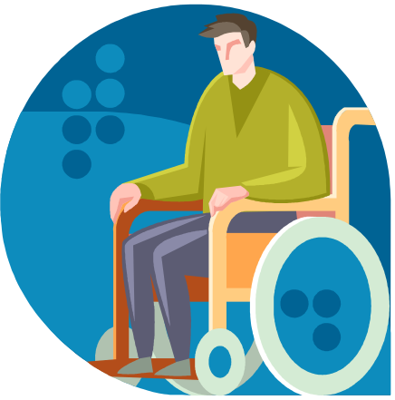

Unit A / Essential Standard NA2.00 / Indicator 2.01
General Modifications to Assist
Hearing:
Light should be on care provider’s face, not the resident's face

Slide 8
BRAIN STORM
Unit A / Essential Standard NA2.00 / Indicator 2.01
Think
Why is it important for light to shine on the care providers face, not the resident’s face?
Act
Raise your hand and share your thoughts.

Slide 9



Unit A / Essential Standard NA2.00 / Indicator 2.01
General Modifications to Assist
Hearing:
Speak clearly, slowly, with a lower pitch of voice using simple sentences

Slide 10
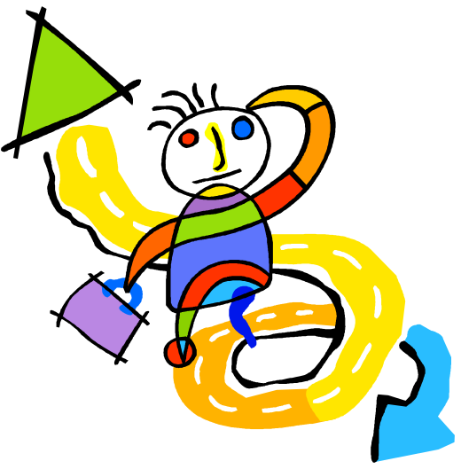
Unit A / Essential Standard NA2.00 / Indicator 2.01 / Letter B
General Modifications to Assist
Hearing:
Avoid sudden topic change

Slide 11


Unit A / Essential Standard NA2.00 / Indicator 2.01
General Modifications to Assist
Hearing:
Do not mouth words in an exaggerated way

Slide 12

Unit A / Essential Standard NA2.00 / Indicator 2.01
General Modifications to Assist
Hearing:
Direct speech to stronger ear but do not shout.

Slide 13



Unit A / Essential Standard NA2.00 / Indicator 2.01 / Letter B
General Modifications to Assist
Hearing:
Use gestures to clarify statements

Slide 14


Unit A / Essential Standard NA2.00 / Indicator 2.01
General Modifications to Assist
Hearing:
Use pictures or notepad

Slide 15



Unit A / Essential Standard NA2.00 / Indicator 2.01
General Modifications to Assist
Hearing:
11. Use basic signing

Slide 16


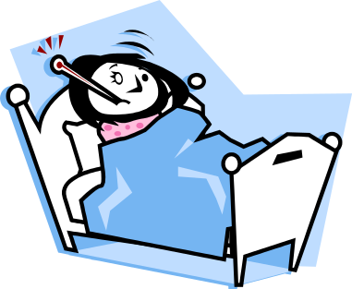
Unit A / Essential Standard NA2.00 / Indicator 2.01 / Letter B
General Modifications to Assist
Hearing:
12. Expect residents to hear less when tired or sick

Slide 17
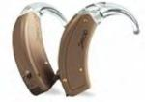
Unit A / Essential Standard NA2.00 / Indicator 2.01
Hearing Aids
Assist the resident in the use and care of hearing aids
http://www.hearingaidinfo.co.uk/
http://www.livestrong.com/article/5324-need-hearing-aid-maintenance

Slide 18
Unit A / Essential Standard NA2.00 / Indicator 2.01
Hearing Aid Insertion
Hearing aid with a red dot goes in the right ear, “red-right”

Slide 19
Unit A / Essential Standard NA2.00 / Indicator 2.01
Hearing Aid Insertion
Follow the natural shape of the ear
Needs to fit snugly without forcing

Slide 20

Unit A / Essential Standard NA2.00 / Indicator 2.01
Hearing Aid Insertion
  Whistling sound could mean: hearing aid is not far enough to create a good seal
  OR
  the volume is up too loud

Slide 21
Unit A / Essential Standard NA2.00 / Indicator 2.01
Hearing Aid Insertion
  Problem:
  hearing aid is not in far enough to create a good seal
  Solution:
  Try to reposition FIRST

Slide 22

Unit A / Essential Standard NA2.00 / Indicator 2.01
Hearing Aid Insertion
  Problem:
  After repositioning the hearing aide, it continues to whistle
  Solution:
  Turn the volume down

Slide 23

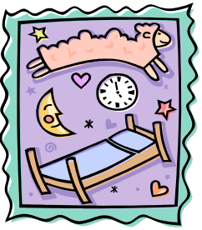
Unit A / Essential Standard NA2.00 / Indicator 2.01
Hearing Aid – Handling & Care
Never allow hearing aid to get WET
  Remove before showers or bathing
  Remove at bedtime (H.S.) hour of sleep

Slide 24

Unit A / Essential Standard NA2.00 / Indicator 2.01
Hearing Aid – Handling & Care
Hearing Aid Gets WET!!!
Remove batteries immediately (stat)
Wipe exterior case with a dry absorbent cloth
Low setting hair dryer can be used for drying
Notify Supervisor

Slide 25


Unit A / Essential Standard NA2.00 / Indicator 2.01
Hearing Aid – Handling & Care
Protect hearing aid from exposure to extreme HEAT
and COLD.
Hearing aids work best at room temperature

Slide 26

Unit A / Essential Standard NA2.00 / Indicator 2.01
Hearing Aid – Handling & Care
Never take a hearing aid apart to examine the inside; this will void warranties.

Slide 27

Unit A / Essential Standard NA2.00 / Indicator 2.01
Hearing Aid – Handling & Care
Follow the manufacturer’s directions
for cleaning

Slide 28
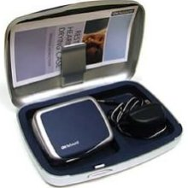

Unit A / Essential Standard NA2.00 / Indicator 2.01
Hearing Aid – Handling & Care
Store hearing aid in it’s case when not worn
If storing for extended time, remove battery

Slide 29

Unit A / Essential Standard NA2.00 / Indicator 2.01
Hearing Aid – Handling & Care
Turn it OFF when not in use

Slide 30

Unit A / Essential Standard NA2.00 / Indicator 2.01
Hearing Aid – Trouble shooting
Be sure aid is turned ON
Try a fresh battery
Make sure tubing is not twisted or bent
Make sure switch is on “M” (microphone), not “T” telephone
Try a spare cord is resident using conventional body type aid
Make sure ear mold if not plugged with wax

Slide 31

Have we got it?
Let’s check and see
Student Name A
Student Name B
Stick diagnostics

Slide 32

Unit A / Essential Standard NA2.00 / Indicator 2.01
Actions to facilitate communications with residents who have DECREASED VISION

Slide 33

Unit A / Essential Standard NA2.00 / Indicator 2.01
Actions to facilitate communications with residents who have DECREASED VISION
Encourage and assist residents in putting on glasses (or sun glasses)

Slide 34
Unit A / Essential Standard NA2.00 / Indicator 2.01
Actions to facilitate communications with residents who have DECREASED VISION
Make sure glasses are CLEAN:
  GLASS lens are cleaned with gentle soap and water and a soft tissue or cloth
  PLASTIC lens are cleaned with cleaning fluid and cleaning cloth

Slide 35

Unit A / Essential Standard NA2.00 / Indicator 2.01
Actions to facilitate communications with residents who have DECREASED VISION
Cleaning glasses that have Anti-Reflective Coating (ARC) with Windex or any chemical will destroy the ARC on the glasses! Use soap, water, and a clean cloth.

Slide 36


Unit A / Essential Standard NA2.00 / Indicator 2.01
Actions to facilitate communications with residents who have DECREASED VISION
Glasses in good condition?
Glasses fit well?
IF NOT… INFORM SUPERVISOR

Slide 37


Unit A / Essential Standard NA2.00 / Indicator 2.01
Actions to facilitate communications with residents who have DECREASED VISION
Use both hands to put glasses on resident
Avoid poking resident’s eye or ear with the side pieces of the glasses

Slide 38
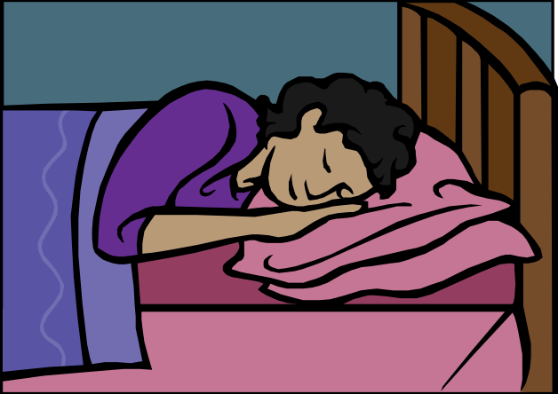
Unit A / Essential Standard NA2.00 / Indicator 2.01
Actions to facilitate communications with residents who have DECREASED VISION
Remove eye glasses when resident is napping or at bedtime

Slide 39

Unit A / Essential Standard NA2.00 / Indicator 2.01
Actions to facilitate communications with residents who have DECREASED VISION
Store glasses in their case, place case in the bedside drawer

Slide 40



Unit A / Essential Standard NA2.00 / Indicator 2.01
Actions to facilitate communications with residents who have DECREASED VISION
Lay glasses down with the side pieces and frame touching the furniture surface
Do NOT lay glasses down on the lens

Slide 41
BRAIN STORM
Unit A / Essential Standard NA2.00 / Indicator 2.01
Think
What are other ways to handle eye glasses that would protect them from damage?
Act
Raise your hand and share your thoughts.

Slide 42
Unit A / Essential Standard NA2.00 / Indicator 2.01
Actions to facilitate communications with residents who have DECREASED VISION
General guidelines to facilitate communications with residents with DECREASED VISION

Slide 43
Unit A / Essential Standard NA2.00 / Indicator 2.01
Actions to facilitate communications with residents who have DECREASED VISION
Knock on door and identify yourself BEFORE touching resident

Slide 44

Unit A / Essential Standard NA2.00 / Indicator 2.01
Actions to facilitate communications with residents who have DECREASED VISION
Let the resident know when you are leaving the room

Slide 45
Unit A / Essential Standard NA2.00 / Indicator 2.01
Actions to facilitate communications with residents who have DECREASED VISION
Tell the resident what you are doing while caring for them

Slide 46
Unit A / Essential Standard NA2.00 / Indicator 2.01
Actions to facilitate communications with residents who have DECREASED VISION
Give specific instructions: “on your right”, “in front of you”

Slide 47

Unit A / Essential Standard NA2.00 / Indicator 2.01
Actions to facilitate communications with residents who have DECREASED VISION
DO NOT TALK TO OTHER RESIDENTS OR STAFF without telling the resident to whom you are talking

Slide 48

Unit A / Essential Standard NA2.00 / Indicator 2.01
Actions to facilitate communications with residents who have DECREASED VISION
CHECK LIGHTING:
Not glaring in eyes of resident
Light shining on care provider’s mouth
Tell resident when light is OFF or ON

Slide 49


Unit A / Essential Standard NA2.00 / Indicator 2.01
Actions to facilitate communications with residents who have DECREASED VISION
When entering a new room with resident, describe locations of objects in relationship to the face of a clock:
“The recliner chair is at 4:00 o’clock”
“The couch is at 7:00 to 8:00 o’clock

Slide 50

Unit A / Essential Standard NA2.00 / Indicator 2.01
Actions to facilitate communications with residents who have DECREASED VISION
Do not move furniture or personal items without the resident’s permission!

Slide 51

Unit A / Essential Standard NA2.00 / Indicator 2.01
Actions to facilitate communications with residents who have DECREASED VISION
Put everything back where it was found

Slide 52


Unit A / Essential Standard NA2.00 / Indicator 2.01
Actions to facilitate communications with residents who have DECREASED VISION
Leave Door completely OPEN or CLOSED
Room 203

Slide 53

Unit A / Essential Standard NA2.00 / Indicator 2.01
Actions to facilitate communications with residents who have DECREASED VISION
Offer LARGE print reading materials

Slide 54

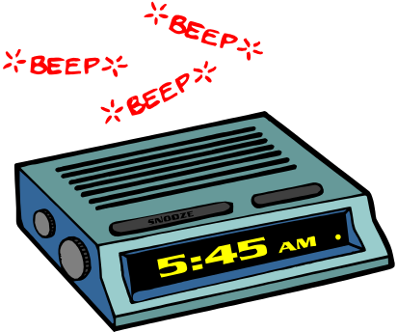
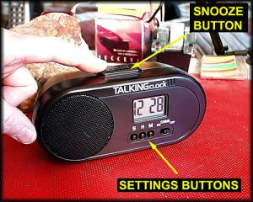
Unit A / Essential Standard NA2.00 / Indicator 2.01
Actions to facilitate communications with residents who have DECREASED VISION
Use large clocks, clocks that chime, and radios to keep track of time

Slide 55


Unit A / Essential Standard NA2.00 / Indicator 2.01
Actions to facilitate communications with residents who have DECREASED VISION
Offer books on CDs or tapes.

Slide 56
Unit A / Essential Standard NA2.00 / Indicator 2.01
Actions to facilitate communications with residents who have DECREASED VISION
Use descriptive words
It is OK to say “see,” “watch,” “look,” in everyday conversation unless the resident says, “I am blind”…then ask what words the resident prefers

Slide 57

Unit A / Essential Standard NA2.00 / Indicator 2.01
Actions to facilitate communications with residents who have DECREASED VISION
Do NOT feed, play, or distract a GUIDE DOG.

Slide 58
Have we got it?
Let’s check and see
Student Name A
Student Name B
Stick diagnostics

Slide 59
Unit A
Nurse Aide Workplace Fundamentals
Essential Standard NA2.00
Apply communication and interpersonal skills and physical care that promote mental health and meet the social and special needs of residents in long-term care. (B2)
Indicator 2.01
Understand communication and interpersonal skills needed to provide resident care and relate to team members.
Letter B:
Communication modifications for individualized
resident care

Slide 60

Unit A / Essential Standard NA2.00 / Indicator 2.01
Actions to facilitate communications with residents who have DIFFICULTY SPEAKING

Slide 61

RAMP IT UP!
APHASIA
medical word that means
defective language function

Slide 62

Unit A / Essential Standard NA2.00 / Indicator 2.01
Actions to facilitate communications with residents who have DIFFICULTY SPEAKING
Encourage to use hand to point out objects

Slide 63

Unit A / Essential Standard NA2.00 / Indicator 2.01
Actions to facilitate communications with residents who have DIFFICULTY SPEAKING
Use communication boards or cards.
WATER
HUNGRY
CHAIR
BATHROOM
COLD
HOT

Slide 64
Unit A / Essential Standard NA2.00 / Indicator 2.01
Actions to facilitate communications with residents who have DIFFICULTY SPEAKING
Ask YES and NO questions
Repeat what you heard to be sure you understood the resident
Let other staff know the meaning of a sound or movement

Slide 65
BRAIN STORM
Unit A / Essential Standard NA2.00 / Indicator 2.01 / Letter B
Think
What are other ways to communicate with residents who have difficulty speaking?
Act
Raise your hand and share your thoughts.

Slide 66
Have we got it?
Let’s check and see
Student Name A
Student Name B
Stick diagnostics

Slide 67



Unit A / Essential Standard NA2.00 / Indicator 2.01
Actions to facilitate communications with residents who are DEPRESSED

Slide 68
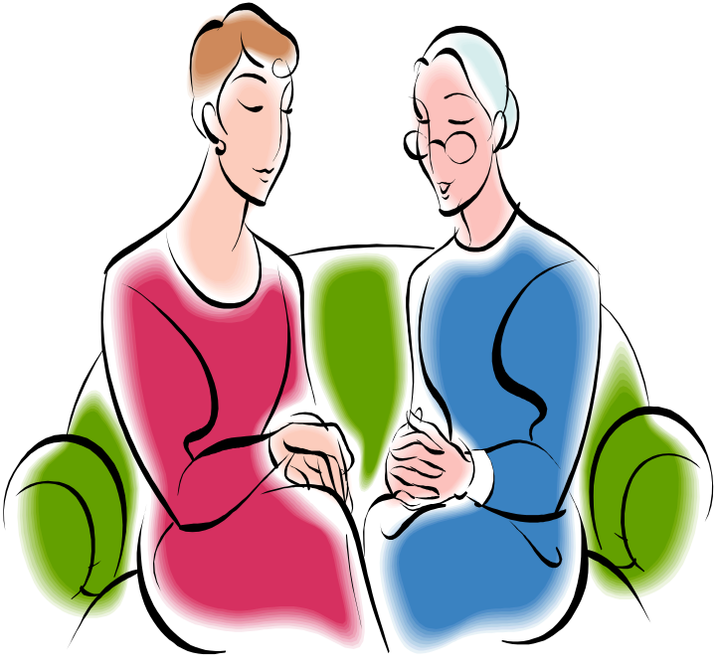
Unit A / Essential Standard NA2.00 / Indicator 2.01
Actions to facilitate communications with residents who are DEPRESSED
SIT QUIETLY WITH THE RESIDENT

Slide 69

Unit A / Essential Standard NA2.00 / Indicator 2.01
Actions to facilitate communications with residents who are DEPRESSED
Return to resident’s room repeatedly until resident responds
BE PATIENT

Slide 70

Unit A / Essential Standard NA2.00 / Indicator 2.01 / Letter B
Actions to facilitate communications with residents who are DEPRESSED
Allow time for resident to say things…

Slide 71
BRAIN STORM
Unit A / Essential Standard NA2.00 / Indicator 2.01
Think
What are other ways to communicate with residents who are depressed?
Act
Raise your hand and share your thoughts.

Slide 72
Have we got it?
Let’s check and see
Student Name A
Student Name B
Stick diagnostics

Slide 73

Unit A / Essential Standard NA2.00 / Indicator 2.01
Actions to facilitate communications with residents who have ALZHEIMER’S

Slide 74

ALZHEIMER’S
DISEASE
CAUSES DEATH OF BRAIN CELLS
BRAIN PARTS BECOME DISCONNECTED
IMPAIRS MEMORY, THINKING, AND DAILY FUNCTION

Slide 75

Unit A / Essential Standard NA2.00 / Indicator 2.01
Actions to facilitate communications with residents who have ALZHEIMER’S
NURSE AIDE must manage their own behavior, actions, words, and reactions.
Residents with Alzheimer’s CANNOT CHANGE!!!

Slide 76

Unit A / Essential Standard NA2.00 / Indicator 2.01
Actions to facilitate communications with residents who have ALZHEIMER’S
Don’t argue with the resident, they are doing the best they can. They have dead brain cells.

Slide 77
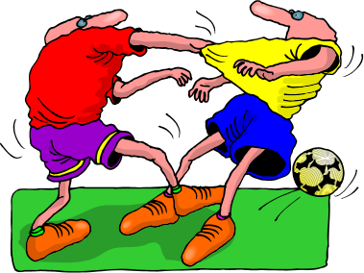


Unit A / Essential Standard NA2.00 / Indicator 2.01 / Letter B
Actions to facilitate communications with residents who have ALZHEIMER’S
DO NOT REACT ON IMPULSE…
RESPOND IN A DELIBERATE PURPOSEFUL MANNER

Slide 78

Unit A / Essential Standard NA2.00 / Indicator 2.01 / Letter B
Actions to facilitate communications with residents who have ALZHEIMER’S
Being “RIGHT” does not necessarily translate into a good interaction outcome

Slide 79

Unit A / Essential Standard NA2.00 / Indicator 2.01
Actions to facilitate communications with residents who have ALZHEIMER’S
Relationship with the resident is MOST critical, not the outcome of the encounter

Slide 80



Unit A / Essential Standard NA2.00 / Indicator 2.01
Actions to facilitate communications with residents who have ALZHEIMER’S
PHYSICAL APPROACH TO THE RESIDENT
⬇
Knock on door or table
⬇
Approach the resident from the front
⬇
Wave and smile
(keeping the hand close to your face),
and look friendly. This gives the resident
a visual cue of your approach.

Slide 81

Unit A / Essential Standard NA2.00 / Indicator 2.01
Actions to facilitate communications with residents who have ALZHEIMER’S
Call the resident by the name they prefer or at least say “HI”; PAUSE. Then start approaching or let the person come to you if he or she likes to be in control
⬇
Move your hand from a wave
(beside your face) to a
greeting handshake position
⬇
Move slowly toward the resident, take slow steps, stand tall, don’t crouch down or lean in toward the resident as you approach
⬇

Slide 82
Unit A / Essential Standard NA2.00 / Indicator 2.01
Actions to facilitate communications with residents who have ALZHEIMER’S
Move toward the right side of the resident and offer your hand, give the person time to look at your hand and reach for it; if he or she is doing something else, offer but do not force
⬇
Stand to the SIDE of the resident at arm’s length, respect person space and be supportive, not confrontational
⬇
Shake hands with the resident
⬇

Slide 83
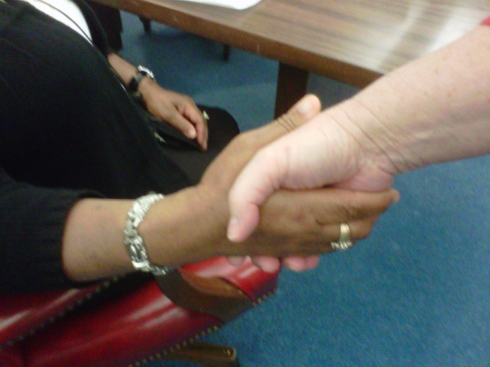
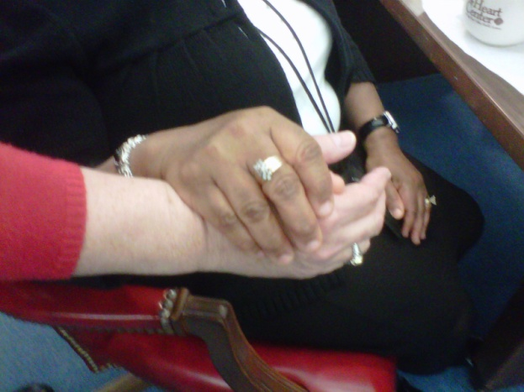
Unit A / Essential Standard NA2.00 / Indicator 2.01
Actions to facilitate communications with residents who have ALZHEIMER’S
⬇
Slide your hand from a “shake” position to a “hand under hand” position for safety, connection, and function
⬇
Give your name and greet the resident – “I am (name)…It is good to see you!”
⬇

Slide 84
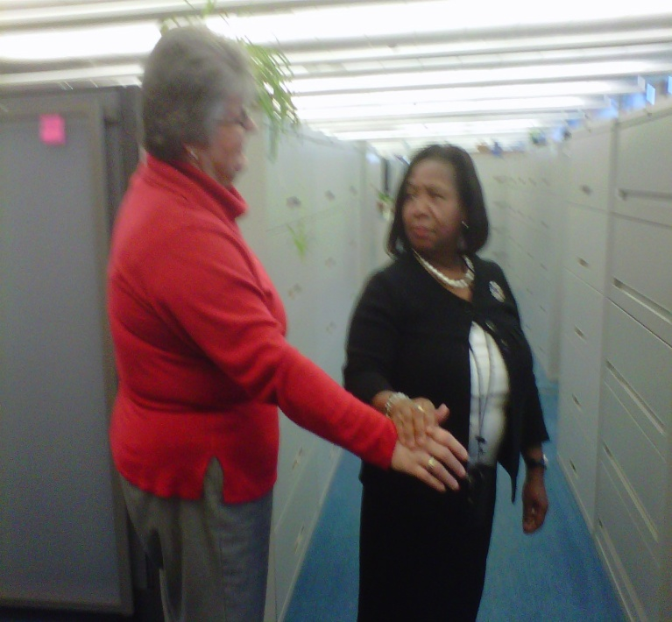
Unit A / Essential Standard NA2.00 / Indicator 2.01
Actions to facilitate communications with residents who have ALZHEIMER’S
⬇
Now, get to the resident’s level to talk; sit, squat, or kneel if the resident is seated and stand beside the resident if he or she is standing
(end of approaching the resident)

Slide 85
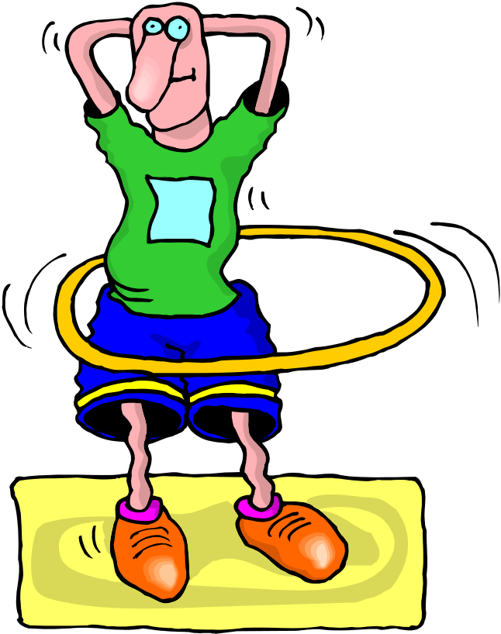
Unit A / Essential Standard NA2.00 / Indicator 2.01
STAND UP & PAIR UP
PRACTICE THIS
APPROACHING THE RESIDENT WITH ALZHEIMERS

Slide 86
Unit A / Essential Standard NA2.00 / Indicator 2.01
Actions to facilitate communications with residents who have ALZHEIMER’S
DELIVERING YOUR MESSAGE
TO THE RESIDENT
⬇
SPEAK DELIBERATELY WITH THESE POINTS IN MIND
  Use a friendly tone of voice; not bossy or critical
  Use simple, short phrases; avoid verbal diarrhea
  Use a normal to deep pitch of voice; avoid high shrill voice pitches
  Speak in a slow and easy speed; not pressured or fast
  Use age appropriate speech; do not address residents as children
  Never assume that you aren’t heard or understood

Slide 87
Unit A / Essential Standard NA2.00 / Indicator 2.01
Actions to facilitate communications with residents who have ALZHEIMER’S
DELIVERING YOUR MESSAGE
TO THE RESIDENT
⬇
GIVE BASIC INFORMATION, “IT IS TIME TO….”
⬇
GIVE SIMPLE CHOICES, IF CHOICES CAN BE UNDERSTOOD.
⬇
GIVE SIMPLE INSTRUCTIONS ONE AT THE TIME, BREAK DOWN THE TASK, “go to eat…lean forward…pull your feet in”
⬇

Slide 88
Unit A / Essential Standard NA2.00 / Indicator 2.01
Actions to facilitate communications with residents who have ALZHEIMER’S
DELIVERING YOUR MESSAGE
TO THE RESIDENT
⬇
ASK THE PERSON TO HELP YOU, IT FEELS BETTER TO GIVE THAN TO RECEIVE
⬇
ASK THE RESIDENT IF THEY WILL AT LEAST TRY…SOMETIMES YOU’LL TRY EVEN IF YOU DON’T THINK YOU CAN
⬇
DO NOT ASK, “ARE YOU READY” OR “DO YOU WANT TO”

Slide 89
BRAIN STORM
Unit A / Essential Standard NA2.00 / Indicator 2.01
Think
How is “delivering the message” different for residents with Alzheimer’s? Why?
Act
Raise your hand and share your thoughts.

Slide 90
Have we got it?
Let’s check and see
Student Name A
Student Name B
Stick diagnostics

Slide 91
Unit A / Essential Standard NA2.00 / Indicator 2.01
Actions to facilitate communications with residents who have ALZHEIMER’S
THREE INTERACTIONS
WITH RESIDENTS WITH ALZHEIMER’S
Attempting to get the resident to DO SOMETHING
Attempting FRIENDLY INTERACTION
Attempting to deal with resident’s frustration, distress, agitation, or anger

Slide 92
Unit A / Essential Standard NA2.00 / Indicator 2.01
Actions to facilitate communications with residents who have ALZHEIMER’S
Attempting to get the resident to DO SOMETHING
  Give a short direct message about what is happening
  Give simple choices about what the resident can do
  Ask the person to help you do something
  Break down the task, give it one step at a time
  Encourage resident to do for themselves all they can
  DO NOT ask “are you ready to”…unless you are willing to come back later if resident says no

Slide 93
Unit A / Essential Standard NA2.00 / Indicator 2.01
Actions to facilitate communications with residents who have ALZHEIMER’S
Attempting FRIENDLY INTERACTION
  Go slow and go with the flow
    Validating accepts a resident’s fantasies without attempting to reorient him/her to reality
    Reminiscence therapy
      is encouraging residents to remember and talk about the past

Slide 94




Unit A / Essential Standard NA2.00 / Indicator 2.01
Actions to facilitate communications with residents who have ALZHEIMER’S
Attempting FRIENDLY INTERACTION
  Acknowledge EMOTIONS, “sounds like…seems like…, I can see you are…”

Slide 95
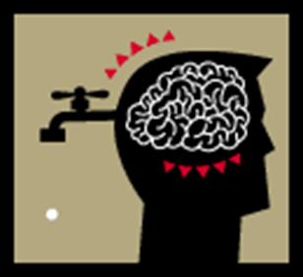
BRAIN STORM
Unit A / Essential Standard NA2.00 / Indicator 2.01 / Letter B
Think
How do residents act when they are happy, sad, frustrated, or angry? How can we learn to identify emotions?
Act
Raise your hand and share your thoughts.

Slide 96

Unit A / Essential Standard NA2.00 / Indicator 2.01 / Letter B
Actions to facilitate communications with residents who have ALZHEIMER’S
Attempting FRIENDLY INTERACTION
  Use words the resident would use
“pass water”
“pee”
“Bathe”
“Wash off”
“take a nap”
“rest for a while”

Slide 97

Unit A / Essential Standard NA2.00 / Indicator 2.01
Actions to facilitate communications with residents who have ALZHEIMER’S
Attempting FRIENDLY INTERACTION
  Know who the person has been, values, likes, interest, etc
VALUES
INTERESTS
LIKES

Slide 98

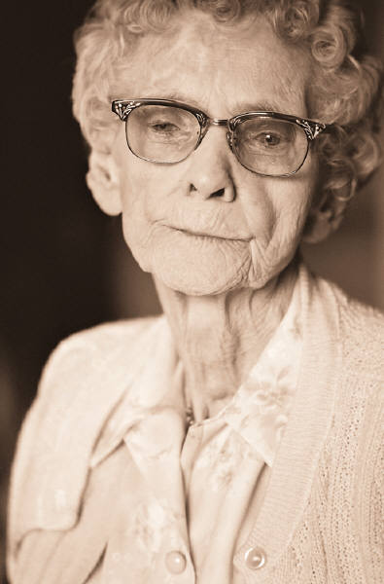



Unit A / Essential Standard NA2.00 / Indicator 2.01
Actions to facilitate communications with residents who have ALZHEIMER’S
Attempting FRIENDLY INTERACTION
  Use familiar objects, pictures, actions to help and direct

Slide 99



Unit A / Essential Standard NA2.00 / Indicator 2.01
Actions to facilitate communications with residents who have ALZHEIMER’S
Attempting FRIENDLY INTERACTION
  Be prepared to have the same conversation over and over, be patient
  Look interested
  Be prepared for some emotional outburst

Slide 100
Unit A / Essential Standard NA2.00 / Indicator 2.01
Actions to facilitate communications with residents who have ALZHEIMER’S
Attempting to deal with resident’s frustration, distress, agitation, or anger
  Change the basic physical approach to the resident
    Look concerned, not happy
    Let the resident move toward you, keeping your body turned to the side (supportive, not confrontational)

Slide 101
Unit A / Essential Standard NA2.00 / Indicator 2.01
Actions to facilitate communications with residents who have ALZHEIMER’S
Attempting to deal with resident’s frustration, distress, agitation, or anger
  After the greeting, try one of these two options
    “Sounds like you are (give an emotion for the feeling that seems to be true)?
    Repeat the person’s words to you…If he or she said, “Where’s my Mom?”…you would say “You are looking for your Mom (pause)…tell me about your Mom”

Slide 102
Unit A / Essential Standard NA2.00 / Indicator 2.01
Actions to facilitate communications with residents who have ALZHEIMER’S
Attempting to deal with resident’s frustration, distress, agitation, or anger
  Always be careful about personal space and touch with the distressed resident
    Block physical blows or step out of the way, NEVER HIT BACK AND NEVER THREATEN A RESIDENT!
    Do not use gestures that could frighten or startle the resident

Slide 103
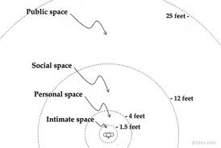
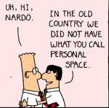
Unit A / Essential Standard NA2.00 / Indicator 2.01
Actions to facilitate communications with residents who have ALZHEIMER’S
Attempting to deal with resident’s frustration, distress, agitation, or anger

Slide 104
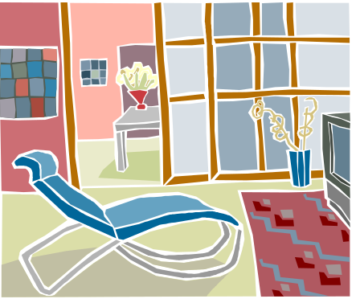


Unit A / Essential Standard NA2.00 / Indicator 2.01
Actions to facilitate communications with residents who have ALZHEIMER’S
Attempting to deal with resident’s frustration, distress, agitation, or anger
  Use EMPATHY, not forced reality or lying
  Allow residents to express feelings, ideas, and frustrations
  Get the resident to a QUIETER PLACE if appropriate

Slide 105
Unit A / Essential Standard NA2.00 / Indicator 2.01
Actions to facilitate communications with residents who have ALZHEIMER’S
Attempting to deal with resident’s frustration, distress, agitation, or anger
  Consider WHAT PROVOKED THE RESIDENT…what does the resident need or want?
    Hungry or thirsty?
    Tired or too much unspent energy?
    Elimination issues?
    Temperature regulation?
    Pain?
    Change in caregiver?

Slide 106

Unit A / Essential Standard NA2.00 / Indicator 2.01
Actions to facilitate communications with residents who have ALZHEIMER’S
Attempting to deal with resident’s frustration, distress, agitation, or anger
LOOK FOR AND MEET THE RESIDENTS NEEDS!

Slide 107






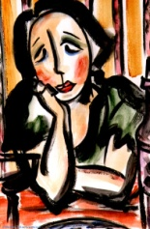
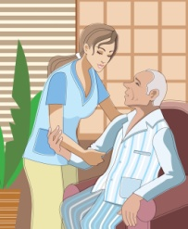
Unit A / Essential Standard NA2.00 / Indicator 2.01
Actions to facilitate communications with residents who have ALZHEIMER’S
Attempting to deal with resident’s frustration, distress, agitation, or anger

Slide 108
MAKE the CONNECTION
Unit A / Essential Standard NA2.00 / Indicator 2.01
Think
What are other needs a resident may have that would cause them to act out? How could you
Act
Raise your hand and share your thoughts.

Slide 109
 END 
2.01
Communication modifications for individualized resident care.

