Slide 1

Unit A
Nurse Aide Workplace Fundamentals
Essential Standard 1.00
Understand the range of function, legal and ethical responsibilities of the nurse aide within the healthcare system.
Indicator 1.03
Understand residents’ rights, advocacy, and grievance procedures.
Understand residents’ rights, advocacy, and grievance procedures.

Slide 2

Residents’ Rights

Slide 3

Basic Human Rights
  Protected by Constitution
  Laws clarify these rights:
    Right to be treated with respect
    Right to live in dignity
    Right to pursue a meaningful life
    Right to be free of fear

Slide 4



Basic Human Rights
  Behaviors that infringe on human rights:
    addressing residents as children
    using demeaning nicknames for residents
    leaving door open during bath
    threatening a resident with harm

Slide 5

OBRA 1987
Residents’ Bill of Rights
  Ethical and legal basis
  States have adopted or codified these rights into law
  Posted in facility
  Distributed on admission in many facilities

Slide 6
OBRA 1987
Residents’ Bill of Rights
Residents have the right to:
Be treated with consideration, respect, and full recognition of personal dignity.

Slide 7
OBRA 1987
Residents’ Bill of Rights
Residents have the right to:
receive care, treatment, and services which are adequate and in compliance with rules

Slide 8
OBRA 1987
Residents’ Bill of Rights
Residents have the right to:
receive a statement of services and charges

Slide 9
OBRA 1987
Residents’ Bill of Rights
Residents have the right to:
have on file the attending physician’s proposed schedule of medical treatment.

Slide 10
OBRA 1987
Residents’ Bill of Rights
Residents have the right to:
privacy

Slide 11
OBRA 1987
Residents’ Bill of Rights
Residents have the right to:
Be free from mental and physical abuse, and free from restraint (except in an emergency)

Slide 12
OBRA 1987
Residents’ Bill of Rights
Residents have the right to:
receive reasonable response to all requests

Slide 13
OBRA 1987
Residents’ Bill of Rights
Residents have the right to:
associate and communicate privately

Slide 14
OBRA 1987
Residents’ Bill of Rights
Residents have the right to:
manage financial affairs

Slide 15
OBRA 1987
Residents’ Bill of Rights
Residents have the right to:
private visits from spouse

Slide 16
OBRA 1987
Residents’ Bill of Rights
Residents have the right to:
privacy in the resident room. Personal items should not be searched.

Slide 17
OBRA 1987
Residents’ Bill of Rights
Residents have the right to:
present grievances and recommend changes

Slide 18
OBRA 1987
Residents’ Bill of Rights
Residents have the right NOT to:
perform services for the facility

Slide 19
OBRA 1987
Residents’ Bill of Rights
Residents have the right to:
retain, store, and use personal clothing and possessions

Slide 20
OBRA 1987
Residents’ Bill of Rights
Residents have the right NOT to:
be randomly discharged or transferred from the facility

Slide 21
OBRA 1987
Residents’ Bill of Rights
Residents have the right to:
be notified if the facility is given a provisional license

Slide 22
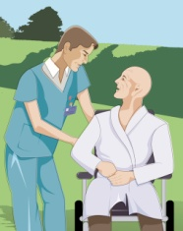

Behaviors That Uphold
Residents’ Rights
Address as Mr., Mrs., or Miss unless asked to use a specific name
Never withhold social responsiveness
Never ignore residents
Make eye contact

Slide 23


Behaviors That Uphold
Residents’ Rights
  Make eye contact
  Allow to complete sentences prior to leaving room
  Don’t shut or slam door to quiet resident
  Never threaten or intentionally hurt

Slide 24
Behaviors That Uphold
Residents’ Rights
Encourage socialization (meal-time)
Assist to activities/meetings/church
Participate in planned activities
Help with phone calls, cards, mail

Slide 25
Behaviors That Uphold Residents’ Rights
Explain care you plan to give
Observe safety precautions
Obtain proper consent after identifying resident

Slide 26
Behaviors That Uphold Residents’ Rights
Treat all residents equally
Promote positive attitudes
Report errors to supervisor immediately

Slide 27

Behaviors That Uphold Residents’ Rights
Handle personal items carefully
Add new items to list of resident’s belongings
Mark all items with resident’s name

Slide 28
Behaviors That Uphold Residents’ Rights
Sit when feeding a resident
Offer a clothing protector; do NOT automatically place clothing protector on the resident prior to eating
Give resident centered, not task centered care

Slide 29
Behaviors That Uphold Residents’ Rights
Address resident in a dignified way
Listen to what resident has to say
Converse with resident in an adult manner
Respect resident’s privacy

Slide 30
Behaviors That Uphold Residents’ Rights
Adult residents must be treated as adults. Give age appropriate care.
Age-appropriate considerations:
  Style of dress
  Hair style and grooming
  Recreational activities
  Social activities

Slide 31
Age Appropriate Care
Guidelines
Don’t ignore or humor resident
Explain what care you are going to give
Promote resident independence
Treat resident as you would want to be treated

Slide 32
Age Appropriate Care
Guidelines
Encourage resident to make choices:
select clothing to wear
select books to read
select television programs to watch

Slide 33
Age Appropriate Care
Guidelines
Encourage resident to make choices:
select food and nourishments
select activities of interest
select friends

Slide 34
Age Appropriate Care
Guidelines
Recognize value of past experience (validate the resident)
Praise age appropriate accomplishments
Encourage adult behavior

Slide 35
Right to be Free from Restraint
Under Omnibus Budget Reconciliation Act 1987 (OBRA),
residents have a right to be free from restraints.

Slide 36

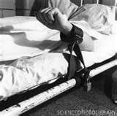
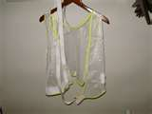
Resident Restraints

Slide 37
Facts Regarding Restraints
RESTRAINTS
restrict
voluntary movement
or behavior
CHEMICAL
PHYSICAL

Slide 38
Facts Regarding Restraints
Physical Restraints
also known as
postural supports
protective devices

Slide 39
Facts Regarding Restraints
Restraint:
Any manual method, physical or mechanical device, material, or equipment attached or next to the resident’s body that the individual cannot remove easily, which restricts freedom of movement or normal access to one’s body

Slide 40

Facts Regarding Restraints
IN THE PAST!
Restraints commonly used to safeguard residents who wander, prone to falls, are violet, at risk of hurting themselves, or pulling tubes out
Abuse of restraints led to new restrictions and laws on use of restraints

Slide 41

Facts Regarding Restraints
Tucking in top sheet so tightly that resident cannot move
NEVER

Slide 42

Facts Regarding Restraints
Placing wheelchair so close to a wall that the wall prevents resident from getting out of chair

Slide 43
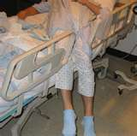
Facts Regarding Restraints
Pulling up full side rails to prevent patient from voluntarily getting out of bed

Slide 44

Facts Regarding Restraints
Restraints MUST not be used
for convenience
or discipline

Slide 45


Facts Regarding Restraints
Unnecessary use of restraint is
FALSE
IMPRISONMENT

Slide 46
Facts Regarding Restraints
Acceptable Reasons for Use of Restraints:
  Temporarily for life threatening medical conditions
  Brief periods to allow medical treatment to proceed if there is documented evidence of resident or legal approval of treatment

Slide 47
Facts Regarding Restraints
Acceptable Reasons for Use of Restraints
When alternatives to restraints are not effective, however, and the physician orders restraints, it becomes essential for the nurse aide to know the risks involved in caring for these residents.

Slide 48
Facts Regarding Restraints
Types of acceptable physical restraints if ordered appropriately
Side rails on a bed
Special chairs such as geriatric chairs
Lap cushions or lap tray
Vests and jacket restraints
Safety belt restraints
Soft ties for wrist and ankles

Slide 49

Facts Regarding Restraints
Restraint-free facility:
Restraints are not used for any reason and not kept in the facility

Slide 50
Restraint Alternatives

Slide 51

Restraint Alternatives
Restraint alternative:
Interventions used instead of using restraints

Slide 52



Restraint Alternatives
  Using friends, family, volunteers or resident directed care provider

Slide 53



Restraint Alternatives
  Interesting activities and diversions such as games, movies or music distract residents

Slide 54


Restraint Alternatives
  Answering call signal promptly

Slide 55
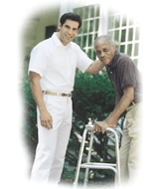
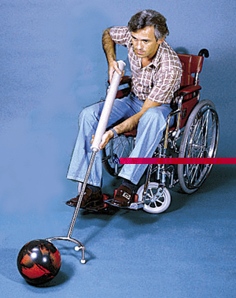

Restraint Alternatives
  Exercise and outdoor activities

Slide 56


Restraint Alternatives
  Consistent reality orientation or validation and staff assignments

Slide 57


Restraint Alternatives
  Having resident’s room close to nurses’ station

Slide 58

Restraint Alternatives
  Barriers such as STOP SIGNS posted on doors discourages confused residents from wandering into the area

Slide 59
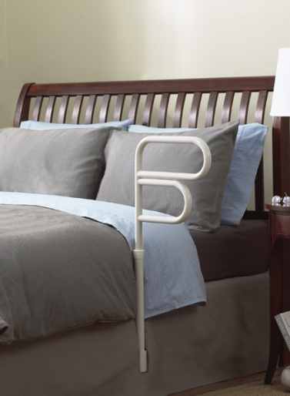
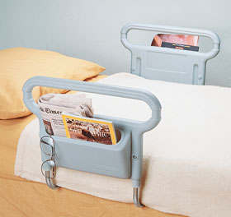
Restraint Alternatives
  Partial bed rails prevent residents from rolling out of bed while allowing them freedom to get up if they wish to

Slide 60
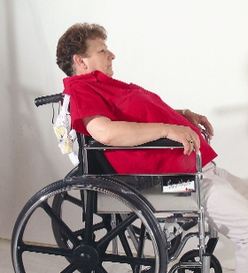
Restraint Alternatives
  Positioning devices and wedges such as wedge cushions placed in wheelchairs to prevent forward sliding

Slide 61
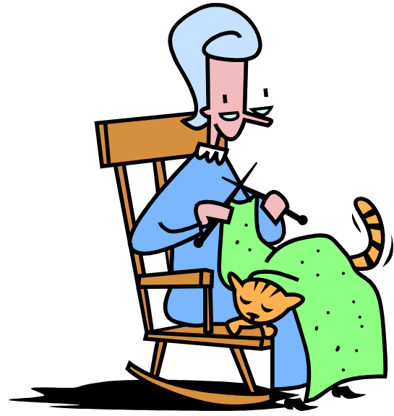
Restraint Alternatives
  Furniture such as low beds, rocking chairs, or recliners

Slide 62
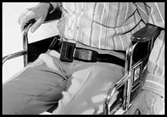
Restraint Alternatives
  Easy –release belts reminds resident of safety but the resident can release if desired

Slide 63
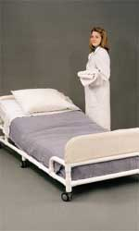
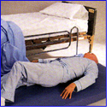
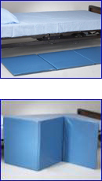
Restraint Alternatives
  Floor cushion or pads next to the bed – decreases injuries if a resident does fall when getting out of bed

Slide 64
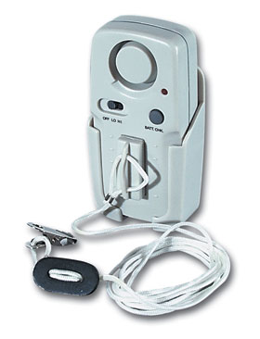
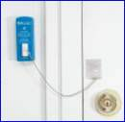
Restraint Alternatives
  Electronic warning devices on beds, wheelchairs, and doors alert staff if patient gets up without help*

Slide 65

Training Lab Assignment
Engage in the Skill Acquisition Process for:
SKILL 1.03A
Apply Personal Electronic Warning Device

Slide 66
The Last Resort!
Occasionally, alternatives do not work and restraints are ordered.

Slide 67
Using Restraints
Ordered by the physician…
when necessary to treat a medical symptom or provide emergency medical treatment
choice of restraint based on multidisciplinary evaluation for the least restrictive measure

Slide 68
Using Restraints
Safety Measures and Considerations When APPLYING Restraints

Slide 69
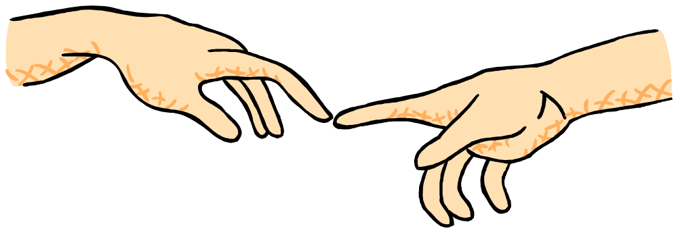
Using Restraints
Safety measures and Considerations APPLYING Restraints:
Use reassurance in an attempt to calm agitated residents

Slide 70

Using Restraints
Safety measures and Considerations APPLYING Restraints:
Be sure there is a physician’s order for restraint use and that it is in the care plan before applying restraint

Slide 71

Using Restraints
Safety measures and Considerations APPLYING Restraints:
Use the correct type of restraint and apply according to manufacturer’s directions and only after you have received instructions in its use

Slide 72

Using Restraints
Safety measures and Considerations APPLYING Restraints:
Secure enough assistance to apply restraints quickly to avoid injury

Slide 73

Using Restraints
Safety measures and Considerations APPLYING Restraints:
Attach restraints to bed frame (immovable part of bed), not to side rails or other parts of the bed
Leave an 8 inch tail

Slide 74

Using Restraints
Safety measures and Considerations APPLYING Restraints:
Use slip knot to tie restraint for quick release

Slide 75

Using Restraints
Safety measures and Considerations APPLYING Restraints:
Protect bony areas and skin by padding them prior to applying restraint

Slide 76
Using Restraints
Safety measures and Considerations APPLYING Restraints:
Adjust restraint so that it allows some movement, but is secure and comfortable – place open flat hand between the resident and the restraint for restraints around the torso.

Slide 77

Using Restraints
Safety measures and Considerations APPLYING Restraints:
Make sure breasts or skin are not caught in the restraint.

Slide 78
Using Restraints
Safety Measures and Considerations AFTER Restraints are applied

Slide 79
Using Restraints
Safety measures and Considerations AFTER Applying Restraints:
Be sure resident NEEDS are MET

Slide 80


Using Restraints
Safety measures and Considerations AFTER Applying Restraints:
Special attention must be paid to basic needs
  Elimination- assist in toileting
  Hydration – offer fluids

Slide 81
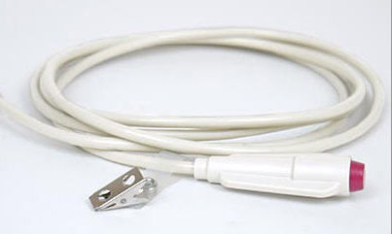
Using Restraints
Safety measures and Considerations AFTER Applying Restraints:
Call signal must be in reach and the resident’s signal for help must be answered immediately (STAT)

Slide 82

Using Restraints
Safety measures and Considerations AFTER Applying Restraints:
Check on resident
every 15 minutes

Slide 83
Using Restraints
Safety measures and Considerations AFTER Applying Restraints:
Every 15 minutes:
Pulse, color, and temperature of any restrained extremity

Slide 84
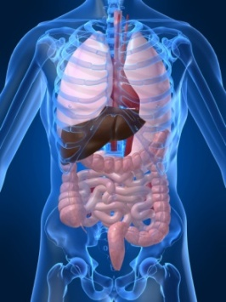
Using Restraints
Safety measures and Considerations AFTER Applying Restraints:
Every 15 minutes:
Breathing of resident with vest (torso) restraint

Slide 85
Using Restraints
Safety measures and Considerations AFTER Applying Restraints:
Every 2 hours:
Remove restraint for 10 minutes and reposition resident

Slide 86
Using Restraints
Safety measures and Considerations AFTER Applying Restraints:
In an emergency, notify supervisor immediately via call bell, stay with the resident, and loosen restraint.

Slide 87
Using Restraints
EMERGENCY EXAMPLES:
Unable to detect a pulse in extremity
Extremity cold, pale, blue-tinged, gray, red, purple in color
Resident complains of pain, discomfort, numbness, or tingling in restrained part
Breathing is impaired with vest or safety belt restraint
URGENT!!! TAKE ACTION

Slide 88

Using Restraints
Observations and reporting should include:
  Color and condition of skin under restraint
  Pulse rate, color and temperature of skin in restrained extremity

Slide 89
Using Restraints
Observations and reporting should include (continued):
  Any complaints about restrained part
  Red or injured skin areas under restraint
  Respiratory rate and color of skin with vest and safety belt restraints

Slide 90
Training Lab Assignment
Engage in the Skill Acquisition Process for:
SKILL 1.03B
Apply Restraints

Slide 91
Resident Advocates

Slide 92
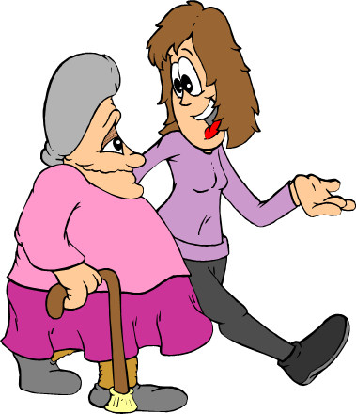
Resident Advocates
What does an advocate do?
Plead cause of another
Resolve grievances
Protect resident’s rights

Slide 93
Resident Advocates
Advocates can be:
  You and your co-workers
  Member of resident’s family/support system
  Resident’s guardian
  Ombudsman

Slide 94
Resident Advocates
Ombudsman Program - History
The national network of long term care ombudsman programs was established in response to the many problems found in nursing homes. The program was first introduced in 1971 as part of President Nixon’s eight-point plan to improve nursing home conditions. This plan established several demonstration ombudsman projects, funded and supervised in the beginning through the U.S. Public Health Service.
In 1973, administration responsibility for these projects was transferred within the Department of Health, Education and Welfare to the Administration on Aging, within the Office of Human Development Services. By 1975, all state agencies on aging were invited to submit proposals to promote effective statewide ombudsman programs. Money was then made available for this voluntary state program.
The Long Term Care Ombudsman Program has been in existence in North Carolina since 1976.

Slide 95
A favorable response to the ombudsman program led to its formal adoption in the 1978 Amendments to the Older Americans Act. The Older Americans Act (federal law) requires that each state establish and maintain a Long Term Care Ombudsman Program to advocate on behalf of residents in nursing and adult care homes (rest homes, assisted living). In 1989, the North Carolina General Assembly enacted legislation for the Long Term Care Ombudsman Program (G.S. 143B-181.15-25) which incorporated federal mandates in the Older Americans Act for the Program and clearly define the roles and responsibilities of the state and regional long term care ombudsmen. In North Carolina, the State Long Term Care Ombudsman Program is located in the Department of Health and Human Services, Division of Aging and Adult Services. The Regional Long Term Care Ombudsman Programs are housed in the 17 Area Agencies on Aging.
Last updated June 2, 2010
LTC Ombudsman Program

Slide 96
Resident Right to
Voice Grievances
Regarding services furnished
Regarding services not furnished
With respect to behavior of others
Nurse aide must report grievances to supervisor

Slide 97

Facility policy components for resident grievance
Acknowledgment
Prompt attempt to resolve
Resident kept apprised

Slide 98


Resident Council:
Advisory Group

Slide 99
Resident Council:
Advisory Group
Provides opportunity for discussion
Recommendations may be made for:
  Facility policies
  Decisions regarding activities
  Exploration of concerns
  Resolving grievances

Slide 100
Resident Council:
Advisory Group
Gives residents a voice in facility operations
Members
  residents
  facility staff members to include Nurse Aides
  representatives from community

Slide 101
The
Bottom
Line
Resident has a right to voice grievances without fear of retaliation or discrimination!

Slide 102
 END 
1.03
Understand resident’s rights, advocacy, and grievance procedures.

