Slide 1
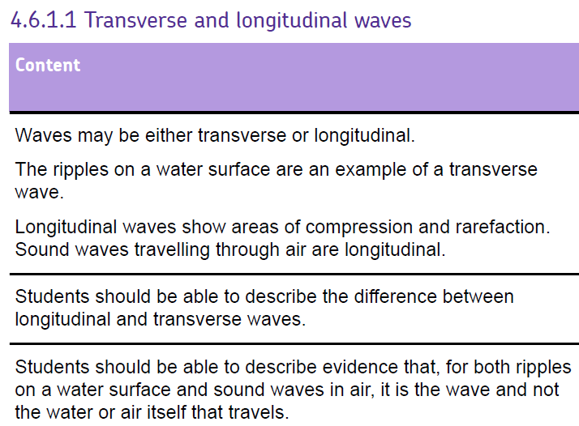

Slide 2


Slide 3
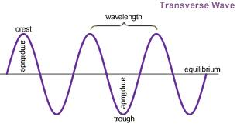
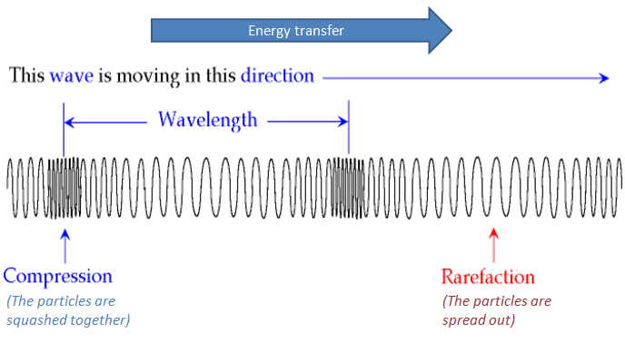
The nature of waves
Transverse waves
The vibrations of a transverse wave are perpendicular to the direction in which the waves transfer energy
Longitudinal waves
The vibrations of a longitudinal wave are parallel to the direction in which the waves are travelling

Slide 4
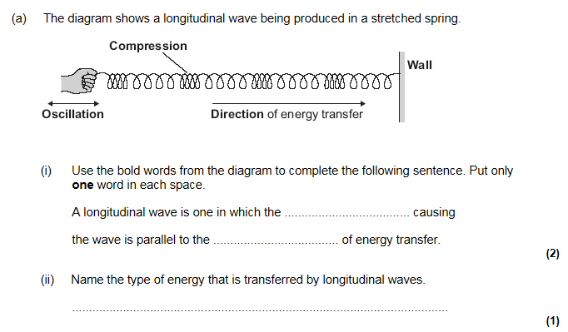
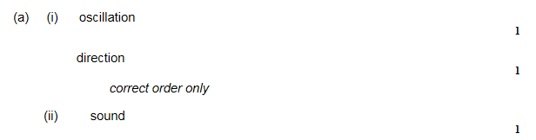

Slide 5
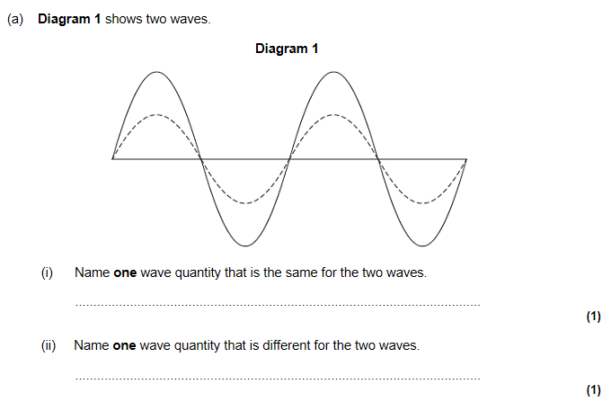
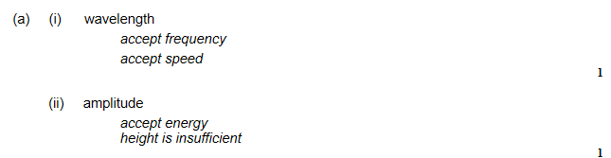

Slide 6
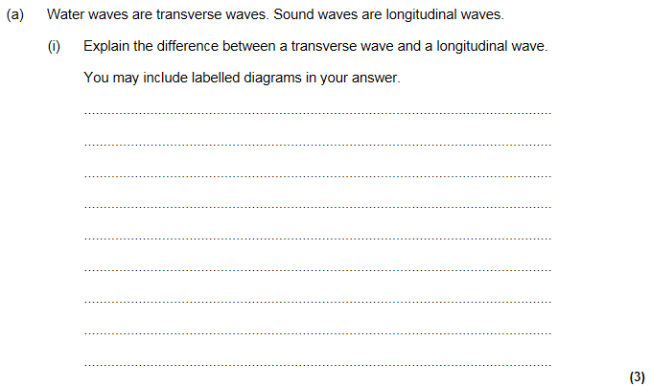
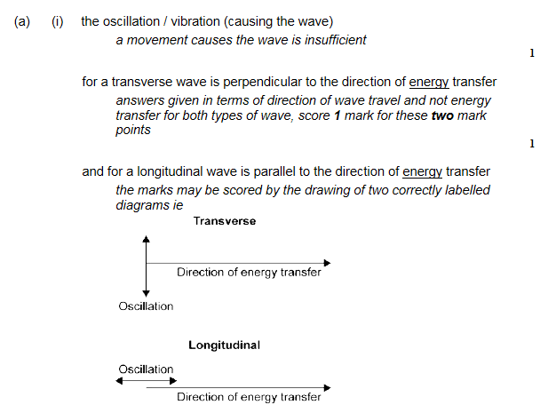

Slide 7
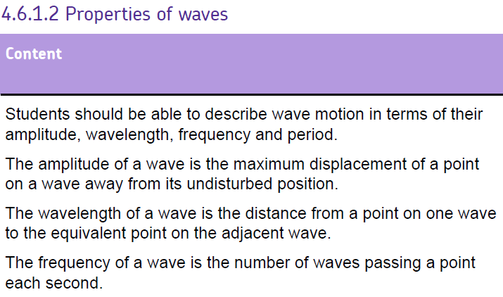
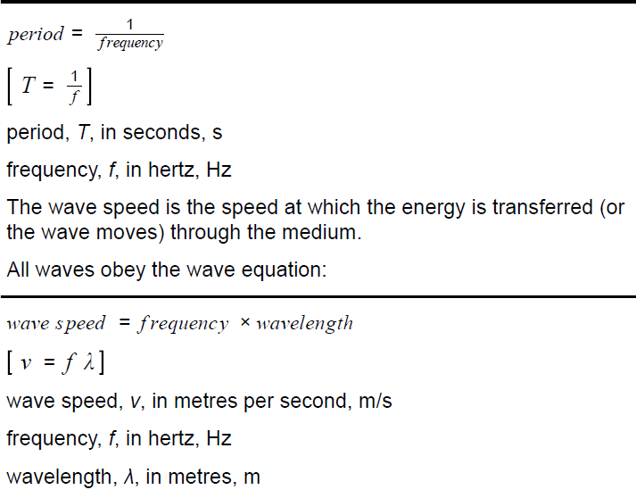

Slide 10
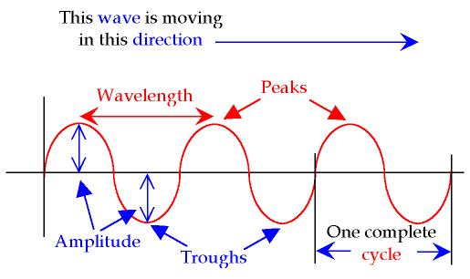
Measuring waves
Wavelength: distance from one wave crest to the next
Frequency: the number of complete waves produced by a source in one second, Hz
Amplitude: the maximum displacement of a wave from its undisturbed position
Waves travel at:
300 000 000 m/s in a vacuum
Wave speed = frequency x wavelength
m/s
Hz
m

Slide 11
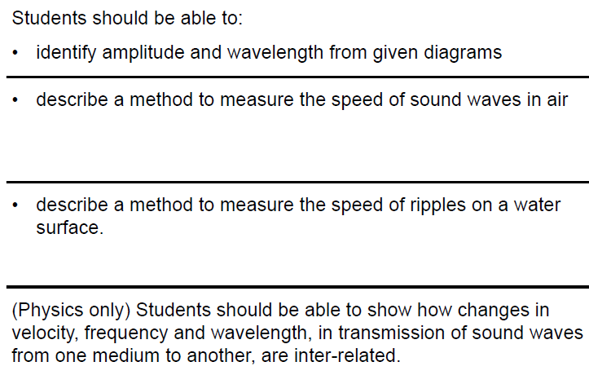
Waves – required practical x2

Slide 12
Using a ripple tank – required practical

Slide 13
Measuring speed of sound in air – required practical

Slide 14
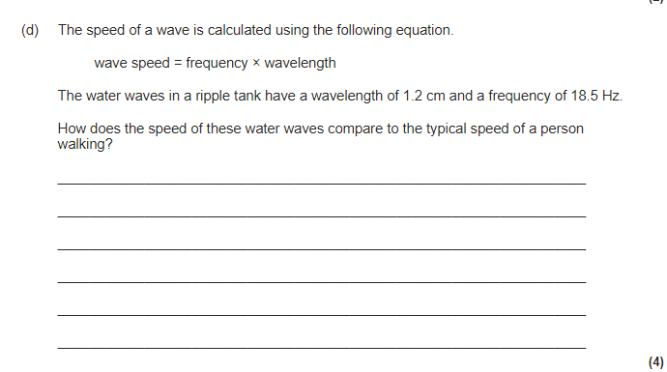
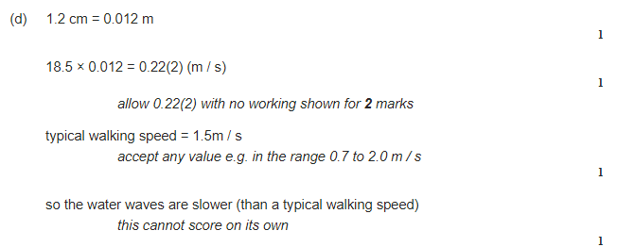

Slide 15
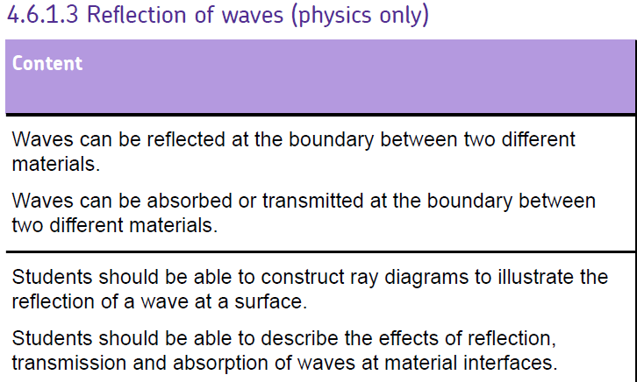

Slide 17
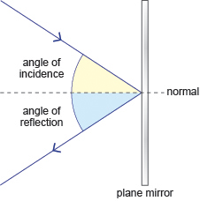
Wave properties: reflection
Incidence ray from ray box
Virtual image is one from which the light rays appear to come but don’t actually come from that image like in a mirror.
Real image is the image formed where the light rays are focussed
Reflected ray
angle of incidence = angle of reflection

Slide 18
Investigation of reflection and refraction

Slide 19
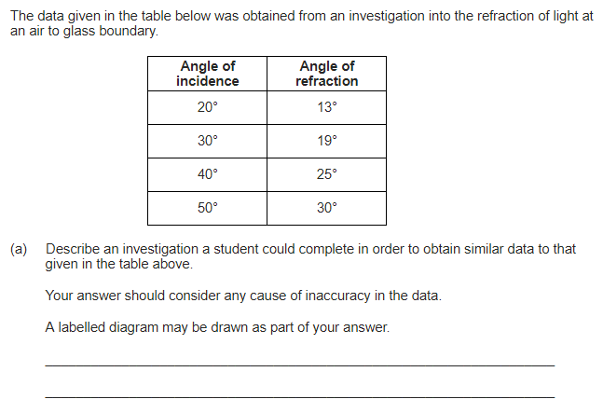
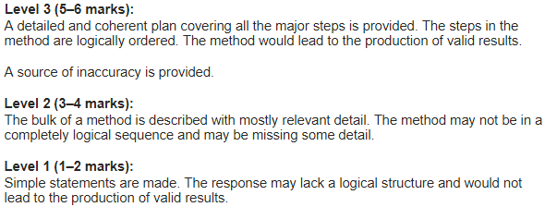
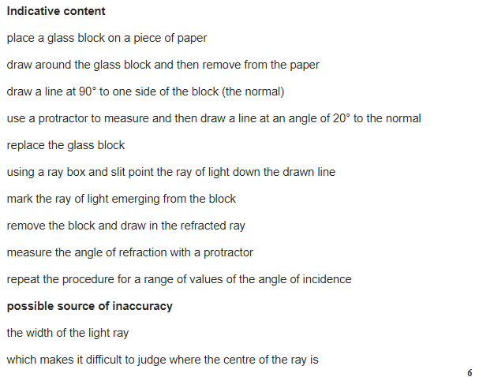

Slide 20
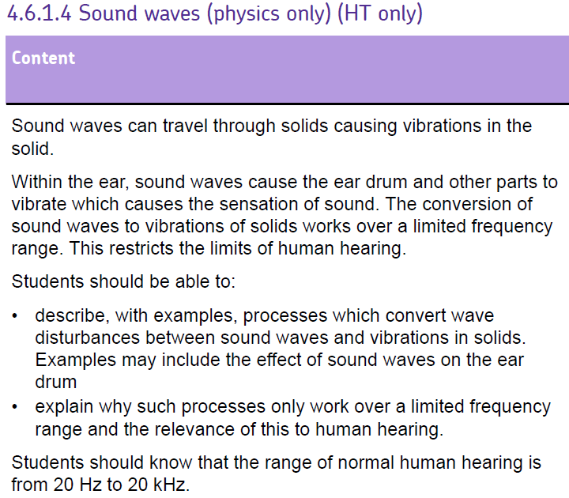

Slide 22
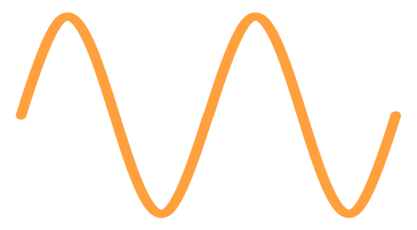

Sound
Frequency: the number of complete waves produced by a source in one second, Hz
Amplitude: the height of a wave from its undisturbed position
lower frequency
higher frequency
frequency (pitch) = the number of vibrations per second and is measured in hertz (Hz)

Slide 23
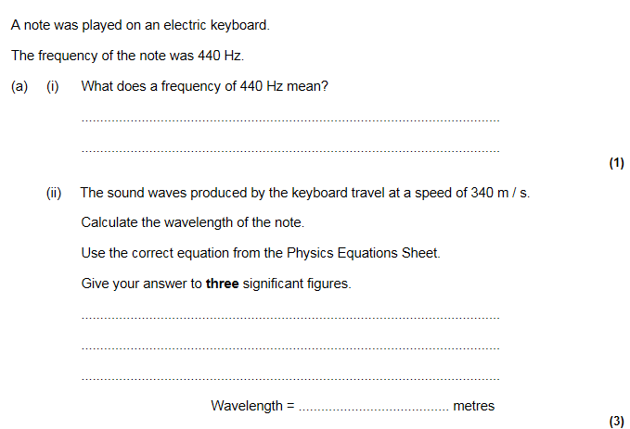
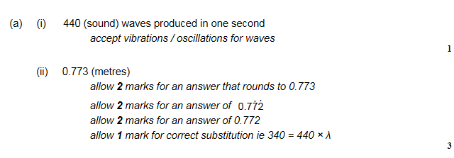

Slide 24
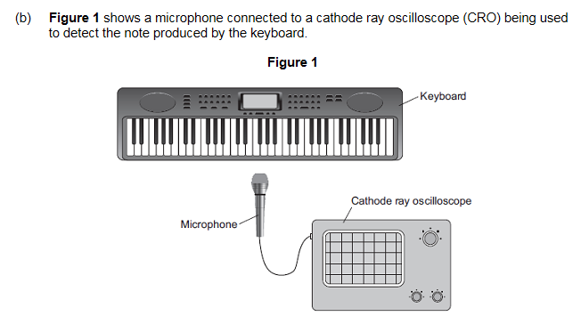
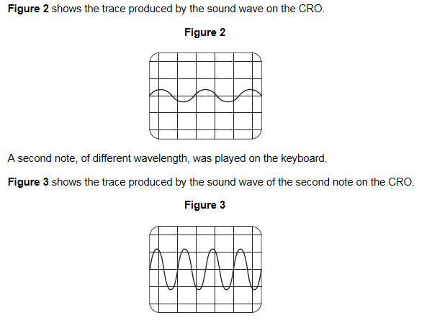
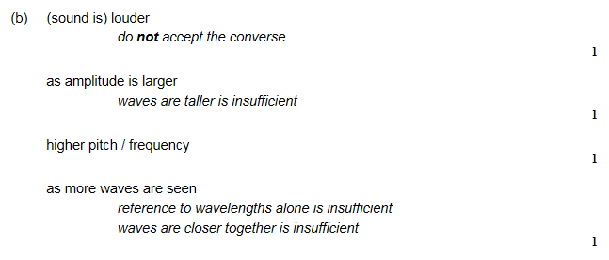
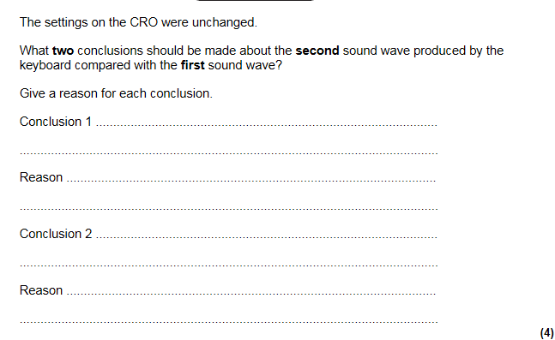

Slide 25
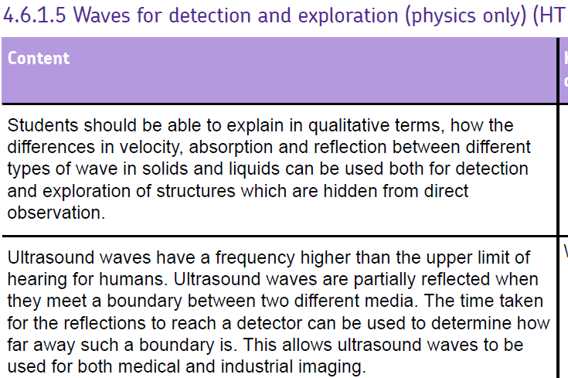

Slide 27
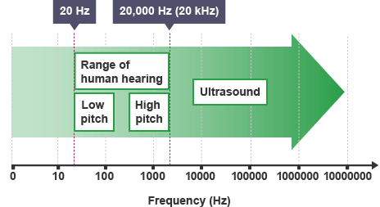
What are Ultrasounds?
An ultrasound is a high frequency sound above the Human hearing range. Some animals (bats) can produce ultrasounds. (anything above 20 kHz)

Slide 28
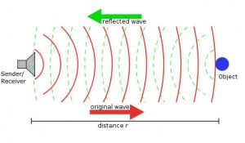
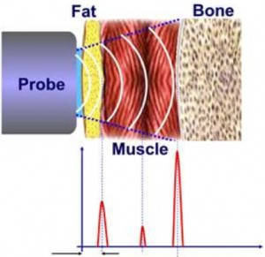
How does an Ultrasound work?
Reflections - When ultrasound waves reach a boundary between two media (substances) with different densities, they are partly reflected back. The remainder of the ultrasound waves continue to pass through.
A detector placed near the source of the ultrasound waves is able to detect the reflected waves. It can measure the time between an ultrasound wave leaving the source and it reaching the detector. The further away the boundary, the longer the time taken.

Slide 29
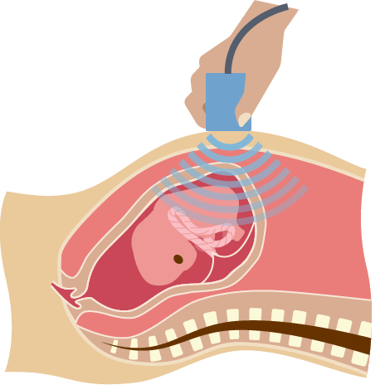
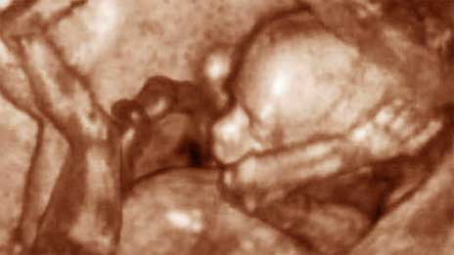
Uses of Ultrasounds
Medical imaging
The human body is composed of different tissues such as muscle and skin. Ultrasound directed at the body will be partly reflected at the boundary between these different tissues.
This principle is used in ultrasound scans. These are widely used in pre-natal scanning to check that a foetus is developing normally and to take measurements of its growth. Computers can combine many ultrasound reflection readings to produce a detailed image from them.

Slide 30
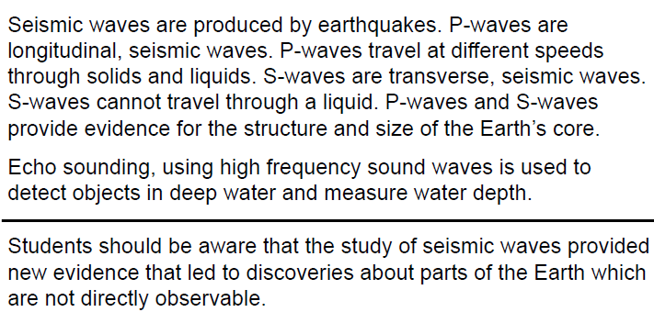

Slide 32
Primary Waves (P-Waves) - Longitudinal
P-waves bend as they travel from the focus through the mantle, this is because their speed is increasing with depth.
They refract when they meet the outer core. This is because the mantle is solid and the outer core is liquid.
The speed of the wave decreases dramatically at the outer core.

Slide 33
Secondary Waves (S-Waves) - Transverse
S-waves bend as they travel from the focus through the mantle, this is because their speed is increasing with depth.
They cannot travel through the liquid outer core because they are transverse waves.
They travel slower than P-waves.

Slide 34
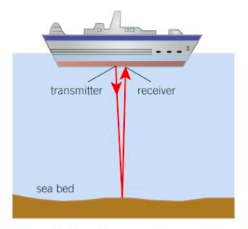
Echo Sounding/Location
This technique is used to measure how deep the ocean is. This is important so ships do not head into shallow waters.
The ship transmits a high frequency sound wave. This is then reflected from the bottom of the ocean and is detected by the ship.

Slide 35
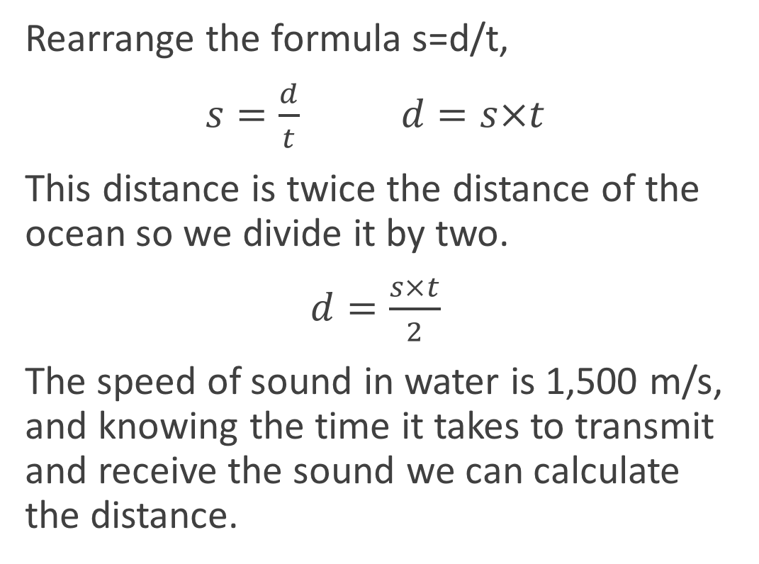
Calculating the distance
Rearrange the formula s=d/t,
$s=\frac{d}{t}$ $d=s×t$
This distance is twice the distance of the ocean so we divide it by two.
$d=\frac{s×t}{2}$
The speed of sound in water is 1,500 m/s, and knowing the time it takes to transmit and receive the sound we can calculate the distance.

Slide 36
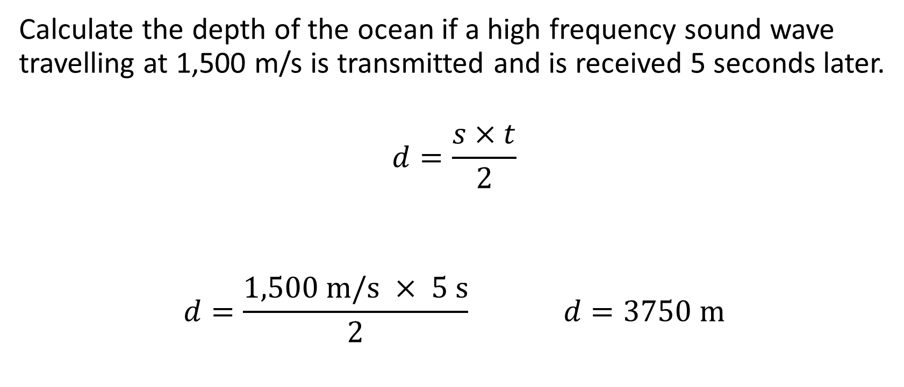
Calculate the depth of the ocean
Calculate the depth of the ocean if a high frequency sound wave travelling at 1,500 m/s is transmitted and is received 5 seconds later.
$$d=\frac{s×t}{2}$$
$$d=\frac{1,500 \text{m}\text{/}\text{s} × 5 \text{s}}{2} d=3750 \text{m}$$

Slide 37
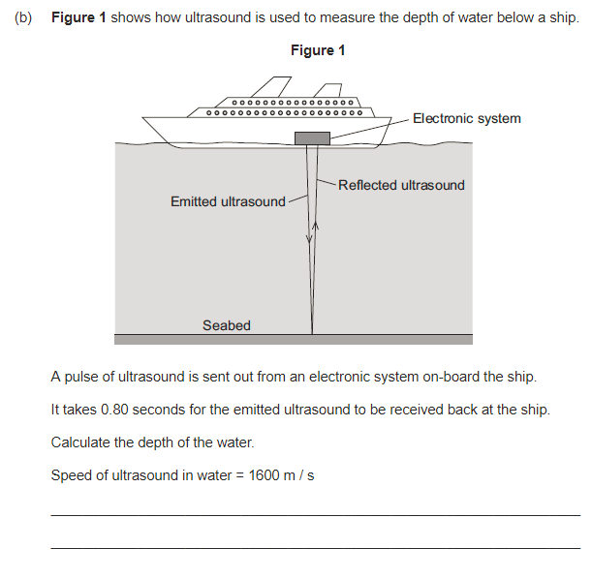
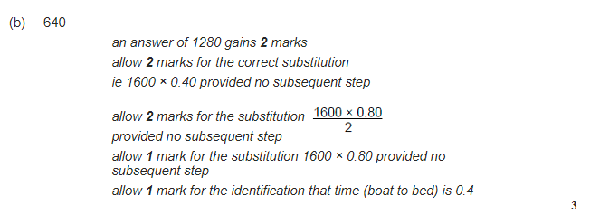

Slide 38
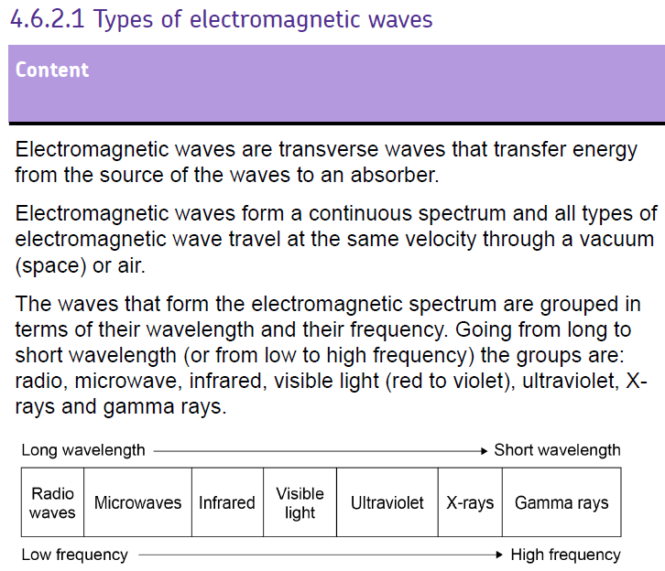
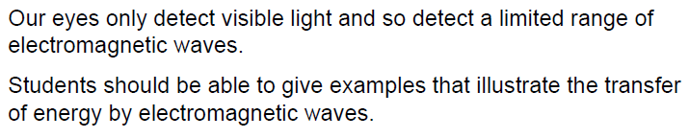

Slide 40
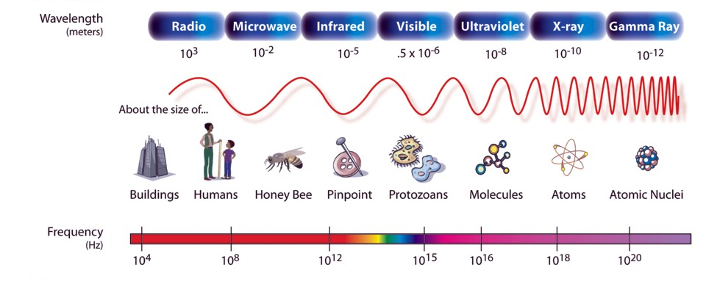
The electromagnetic spectrum
Decreasing
Increasing

Slide 41
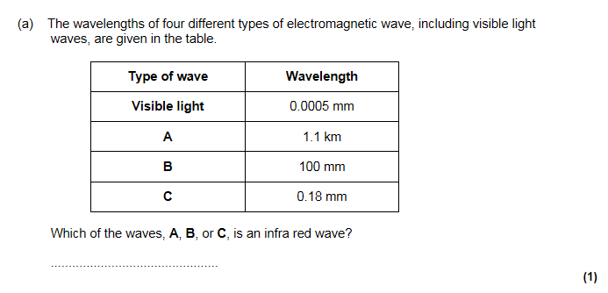
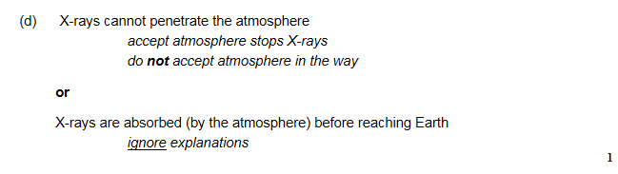
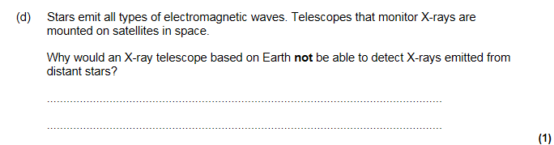

Slide 42
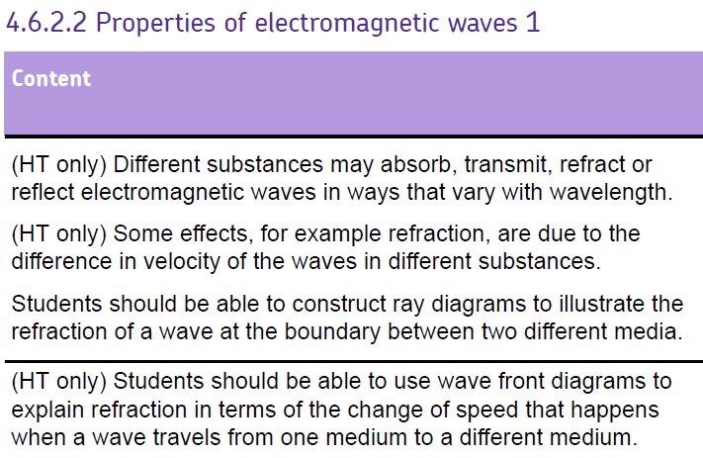

Slide 44
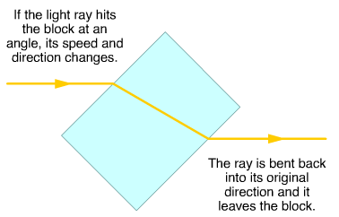
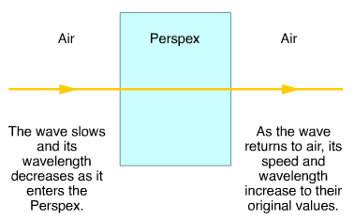
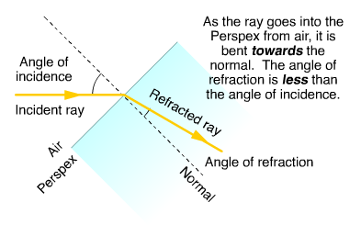
Wave properties: refraction
Sound waves and light waves change speed when they pass between the boundary of two substances with different densities (e.g. air and glass).
This causes them to change direction and this effect is called refraction
Refraction doesn't happen if they cross the boundary at an angle of 90° - in that case they carry straight on.

Slide 45
Infrared investigation

Slide 46



Slide 48



Slide 50

Light, infrared, microwaves and radio waves
Light and colour
Light from ordinary lamps and the sun is called white light
It has all colours of the visible spectrum in it
You can use a glass prism to split a beam of white light
Infrared radiation
All objects emit infrared radiation
The hotter the object, the more infrared radiation
Optical fibres use infrared radiation instead of light
Also used in remotes, scanners and cameras
Microwaves
Shorter wavelength than radio waves used :
Communications – e.g. satellite TV because they can pass through the atmosphere, to beam signals as they spread out less than radio waves, Mobile phones
Radio Waves
Carry radio, TV and mobile phone signals , bluetooth

Slide 51

Communications
Radio wavelengths
Microwaves and radio waves of different wavelengths are used for different purposes:
Shorter wavelengths: carry more information, diffract less, have a shorter range
Microwaves: satellite and TV as they diffract less and can travel between space and the ground
Radio waves of wavelength less than 1m: TV broadcasting as they carry more information than longer wavelengths
Radio waves of wavelength from 1-100m: local radio stations, emergency services as their range is limited
Radio waves of wavelength greater than 100m: national and international radio stations
Are mobile phones dangerous?
Radiation is quite weak but it is close to your brain
Children have thinner skulls than adults so could affect them more. Overall... We’re not sure
Key Points:
Ethics of experiments on children
Bias of researchers working for mobile phone company
Sample size of research (the higher the more reliable)
Control group for COMPARISON

Slide 52



Slide 53




Slide 54



Slide 56



Ray Diagrams for Lenses
Image Distance
Object Height
F
F
Object Distance
Image Height
The magnification can be calculated if we know some of the following values.
Image height
Object height
Image distance
Object distance
$$\text{Magnification}\text{ = }\frac{\text{image} \text{height}}{\text{object} \text{height}}$$
$$\text{Magnification}\text{ = }\frac{\text{image} \text{distance} }{\text{object} \text{distance} }$$

Slide 57

Lenses
Principal focus
Converging lens – Convex
Diverging lens – Concave

Slide 59

Drawing ray diagrams for lenses
Converging (convex) Lens:
Ray #1: Parallel to the axis Refracts through F
Ray #2: Through F
Refracts parallel to axis
Ray #3: Through Centre of lens un-deflected

Slide 60



Drawing ray diagrams for lenses
Draw a ray diagram for a convex lens with a focal length of 5cm and an object that is 15cm away.
$$\text{Magnification}\text{ = }\frac{\text{image} \text{height}}{\text{object} \text{height}}$$
$$\text{Magnification}\text{ = }\frac{\text{image} \text{distance} }{\text{object} \text{distance} }$$
Object distance > 2f: Image is real, smaller, and inverted

Slide 61

Drawing ray diagrams for lenses
Draw a ray diagram for a convex lens with a focal length of 5cm and an object that is 8cm away.
$$\text{Magnification}\text{ = }\frac{\text{image} \text{height}}{\text{object} \text{height}}$$
$$\text{Magnification}\text{ = }\frac{\text{image} \text{distance} }{\text{object} \text{distance} }$$
Object between f and 2f: Image is real, larger, inverted (diminished)

Slide 62

Drawing ray diagrams for lenses
Draw a ray diagram for a convex lens with a focal length of 5cm and an object that is 2cm away.
$$\text{Magnification}\text{ = }\frac{\text{image} \text{height}}{\text{object} \text{height}}$$
$$\text{Magnification}\text{ = }\frac{\text{image} \text{distance} }{\text{object} \text{distance} }$$
Object between f and mirror: Image virtual, larger, upright
v has a negative value

Slide 64
Now, for Diverging lenses……
For a Diverging Lens:
Ray #1: Parallel to the axis on the left
Refracts as if it came from F on the left
2
Ray #2: Through the centre of the lens undeflected

Slide 65

Ray Diagrams for Lenses
Draw a ray diagram for a concave lens with a focal length of 5cm and an object that is 8cm away.
u
2
v
No matter where the object is:
Image is always virtual, smaller and upright.
f has a negative value and v has a negative value

Slide 66
1. OBJECT OUTSIDE 2F
2F
F
F
2F
IMAGE: REAL, INVERTED, DIMINSHED
IMAGE POSITION: between F and 2F

Slide 67
2. OBJECT AT 2F
2F
F
F
2F
IMAGE: REAL, INVERTED, SAME SIZE
IMAGE POSITION: at 2F

Slide 68
3. OBJECT BETWEEN F AND 2F
2F
F
F
2F
IMAGE: REAL, INVERTED, MAGNIFIED
IMAGE POSITION: outside 2F

Slide 69
4. OBJECT AT F
2F
F
F
2F
IMAGE: NO IMAGE FORMED (rays don’t meet)
IMAGE POSITION: none (or at infinity)

Slide 70
5. OBJECT INSIDE F
*VIRTUAL Image: Light does NOT actually pass through it – cannot be projected onto a screen
2F
F
F
2F
IMAGE: VIRTUAL*, UPRIGHT, MAGNIFIED
IMAGE POSITION: inside 2F & SAME SIDE AS OBJECT

Slide 71
6. CONCAVE (DIVERGING) LENS
Same type of image for all object positions
2F
F
F
2F
IMAGE: VIRTUAL, UPRIGHT, DIMINSHED
IMAGE POSITION: INSIDE F SAME SIDE AS OBJECT
Arrow key to animate slide

Slide 72



Slide 73



Slide 74




Slide 75




Slide 76



Slide 78
Visible light – key words
Absorb
  light is taken in by the object it hits
Diffuse reflection
  reflection from a rough surface – the light rays are scattered in different directions
Opaque
  an object that light cannot pass through
Specular reflection
  reflection from a smooth surface. Each light ray is reflected
Translucent
  an object that allows light to pass through, but the light is scattered or refracted
Transmission
  a wave passing through a substance
Transparent
  object that transmits all the incident light that enters the object

Slide 79

Visible light
Each colour in the electromagnetic spectrum as it’s own narrow band. These bands merge into each other.
Also written in standard form
Violet 400-450 nm or 4 x10⁻⁷ to 4.5 x 10⁻⁷ m

Slide 80

Visible light
Work by absorbing certain wavelengths and transmitting other wavelengths.
A red filter will absorb all wavelengths contained in white light and transmit only red light

Slide 81

Visible light
If all wavelengths of light are absorbed the object appears BLACK
If all wavelengths of light are reflected the object appears WHITE
The colour of the surface of any opaque object depends on chemicals called pigments. Pigments absorb certain wavelengths and reflect others.

Slide 82

Visible light
The colour of the surface of any opaque object depends on chemicals called pigments. Pigments absorb certain wavelengths and reflect others.
The colour you see objects as depends on the objects colour and the light you view it in.

Slide 83


Slide 84



Slide 86

Infrared Radiation
All objects give off infrared radiation.
The higher the temperature of an object the more infrared radiation it will emit.

Slide 87
Infrared Radiation
Not only do objects give off (emit) infrared radiation, they also absorb it.
When an object is at constant temperature it is absorbing and emitting infrared radiation at the same rate.
Objects that are good at absorbing are also very good at emitting.
Perfect black body will absorb ALL OF THE RADIATION THAT HITS IT. This means that it is very good at emitting radiation too.
Black body radiation is the radiation emitted by a perfect black body.

Slide 88

As the temperature increases (in Kelvin), the glow of the object becomes more intense.
As the temperature increases so too does the peak wavelength.

Slide 89





Slide 90



