Slide 1
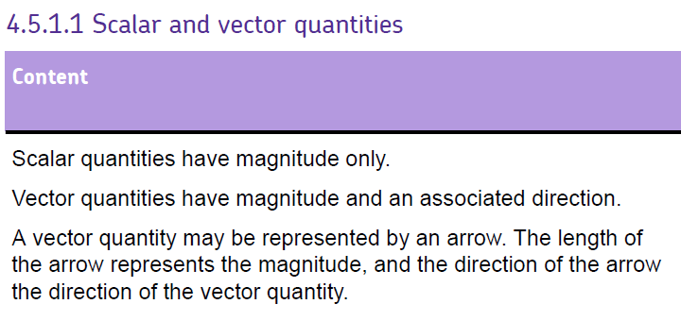

Slide 2


Slide 3
Other scalar quantities:
Mass
Temperature
Speed
Energy
Time
Other vector quantities:
Weight
Force
Velocity
Acceleration
Momentum

Slide 4
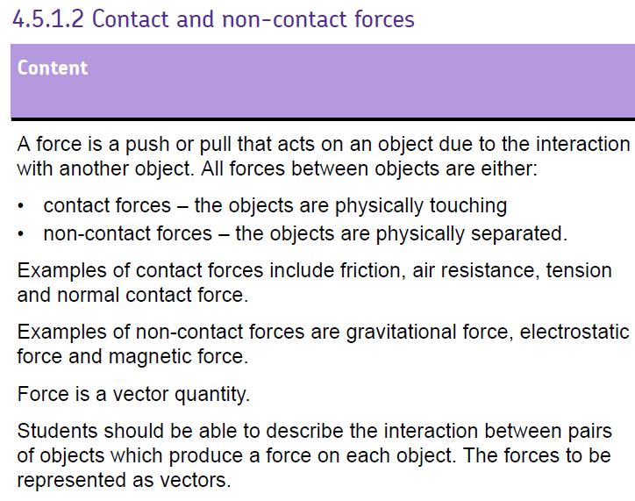
LEARN

Slide 6
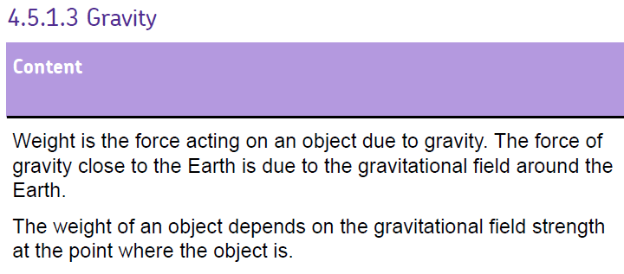
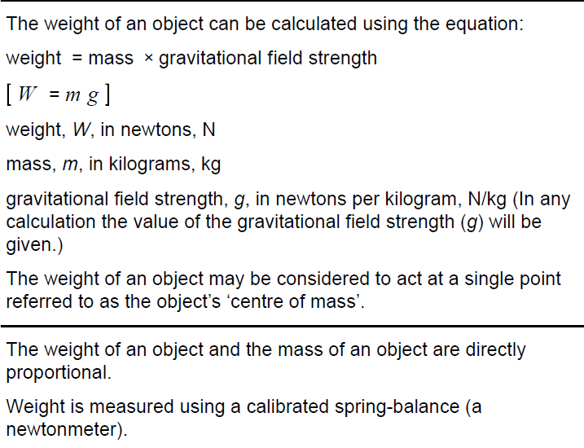

Slide 8
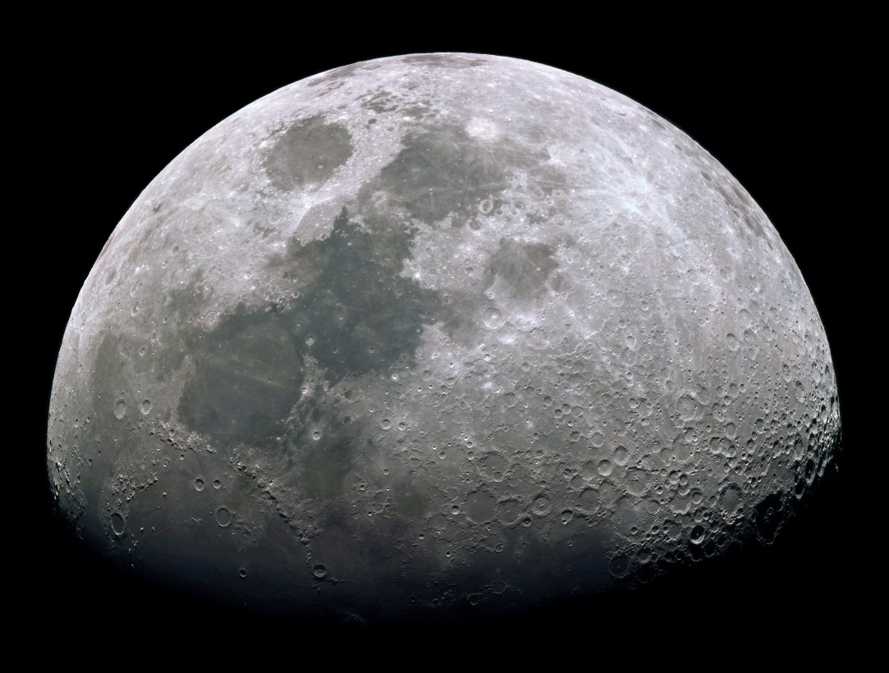
Weight and Mass
Mass = the quantity of matter in an object
Weight = the force of gravity on an object
The gravitational field strength
of Earth is about
10N/kg
(but you will be given the value of g in the question)

Slide 9
Calculating forces
Weight = mass x gravitational field strength
W = m x g
W = weight (N)
m = mass (kg)
g = gravitational field strength (N/kg)
W
m x g

Slide 10
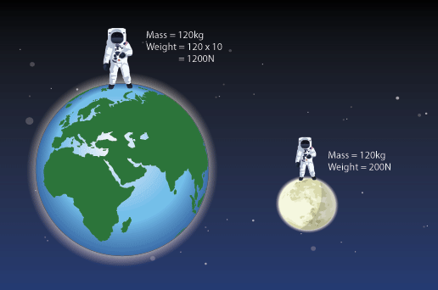
Weight and Mass

Slide 11
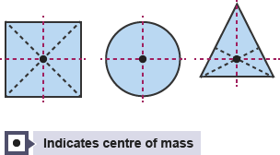
Centre of Mass – Symmetrical Object
For a symmetrical 2D object, its centre of mass is along the line of symmetry.
If the object has more than one line of symmetry then its centre of mass is where the lines meet.
Notes:
Image - http://www.bbc.co.uk/schools/gcsebitesize/science/triple_aqa/using_physics_make_things_work/centre_of_mass/revision/1/

Slide 12
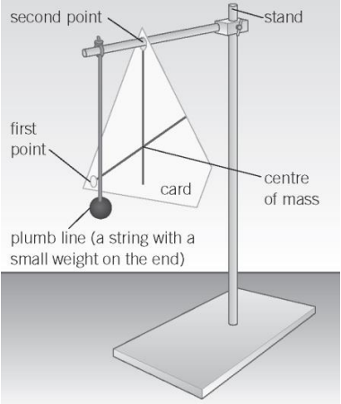
Irregular Object
To find the centre of mass for an irregular object you must hang it twice.
Place a hole through the object and allow it to swing freely.
Hang a plumb line and mark that line on the irregular shape.
Rotate the object and hang it through another hole, mark the plumb line.
The point at which the two plumb lines meet is the centre of mass.
Notes:
Image - https://www.kerboodle.com/app/courses/20465/modules/Resources/node/16070/page/1/content/117693

Slide 13
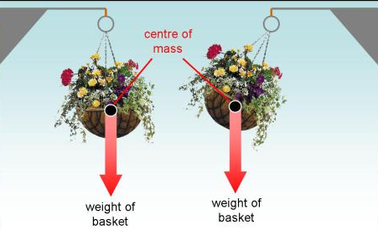
Suspended Equilibrium
If the object is removed from this position and released it will swing back to its equilibrium position. The weight no longer acts directly below where it is suspended and therefore creates a turning effect.
The object is suspended and is in equilibrium. This is because the centre of mass is directly below the point where it is suspended.
Notes:
Image - https://getrevising.co.uk/revision-notes/further_physics_turning_forces

Slide 14
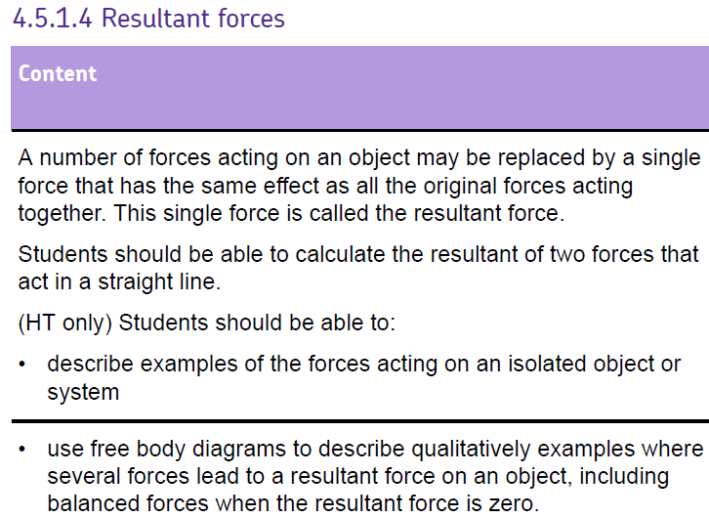

Slide 16
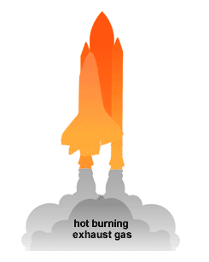
Resultant Force
Resultant force = the ‘overall force’ acting an object
When forces are in the same direction, we add them together to get the total force.
When forces are in the opposite direction, we subtract them.

Slide 17
Resultant Force
40N
60N
20N
60N – 20N = 40N UP

Slide 18
Resultant Force
80N
60N
20N
60N + 20N = 80N UP

Slide 19
Resultant Force
60N
60N
20N
20N
60N + 20N – 20N = 60N UP

Slide 20
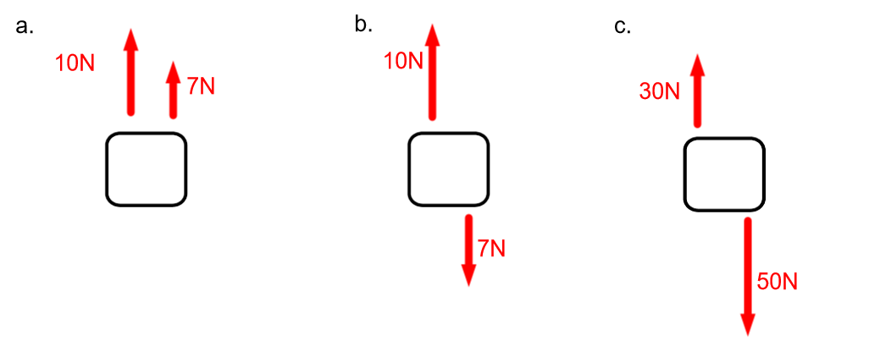
Practice questions (remember force has a direction)
17N UP
3N UP
20N DOWN

Slide 21
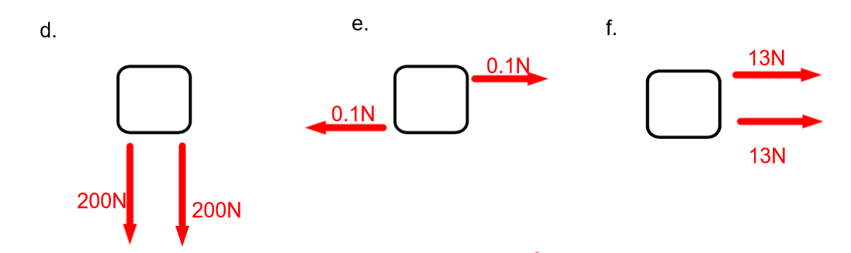
Practice questions
0N
26N RIGHT
400N DOWN

Slide 22
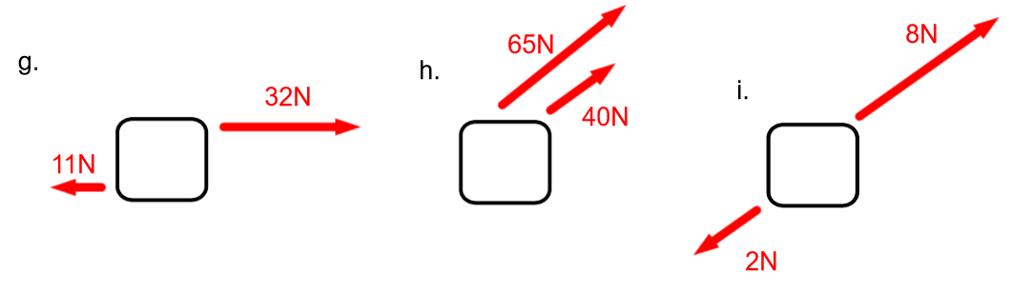
Practice questions
6N DIAGONAL RIGHT
105N DIAGONAL RIGHT
21N RIGHT

Slide 23
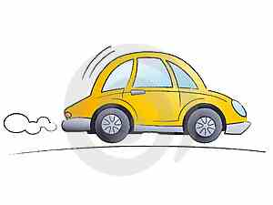
Calculating the resultant force
A car of weight 5000N produces a driving force of 2000N. It experiences friction force from the ground of 500N and air resistance of 300N. What are the horizontal and vertical resultant forces acting on the car?
5000N
Horizontal = 2000N – (300N + 500N) =
1200N to the right
300N
2000N
500N
Vertical = 5000N – 5000N = 0N
5000N

Slide 24
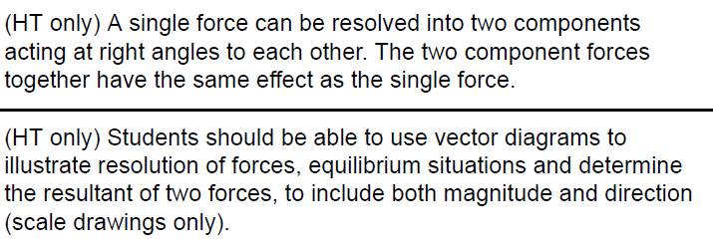

Slide 27
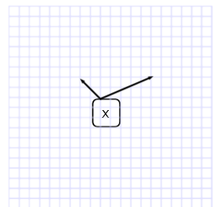
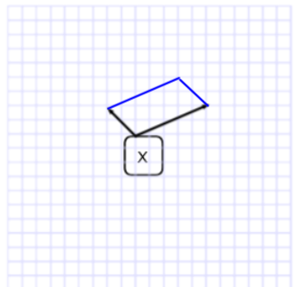
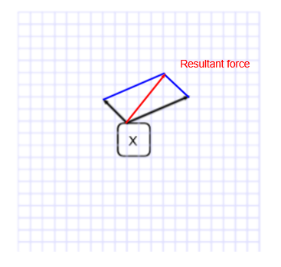
Resultant force when the forces are not parallel (HT)
If we draw it to scale we can work out the magnitude of the resultant force and its direction.

Slide 28
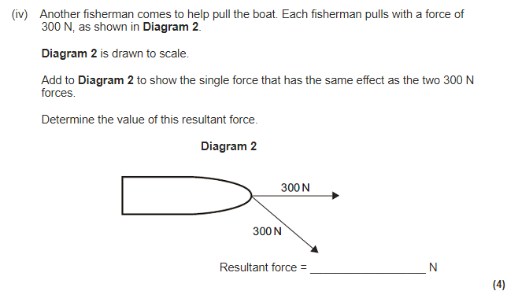
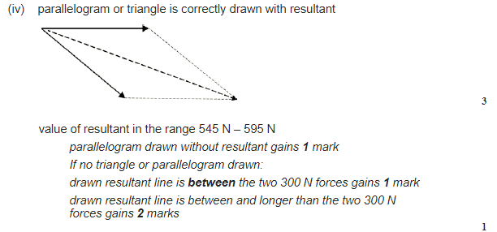

Slide 29
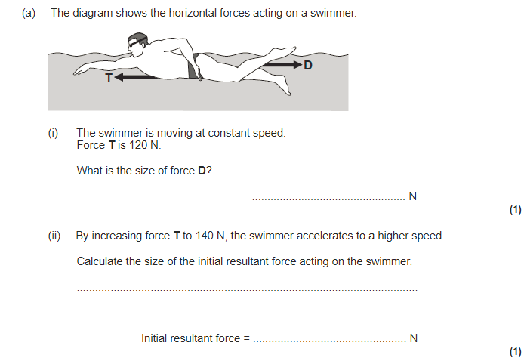
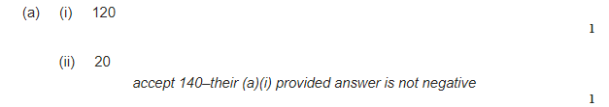

Slide 30
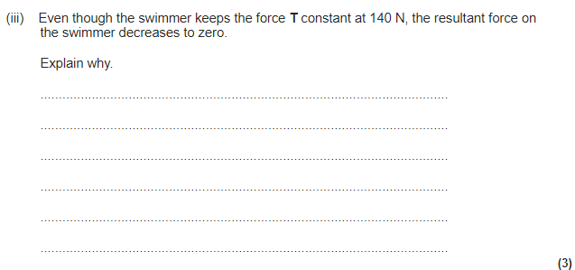
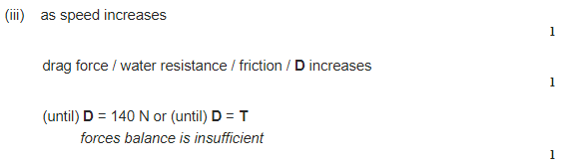

Slide 31
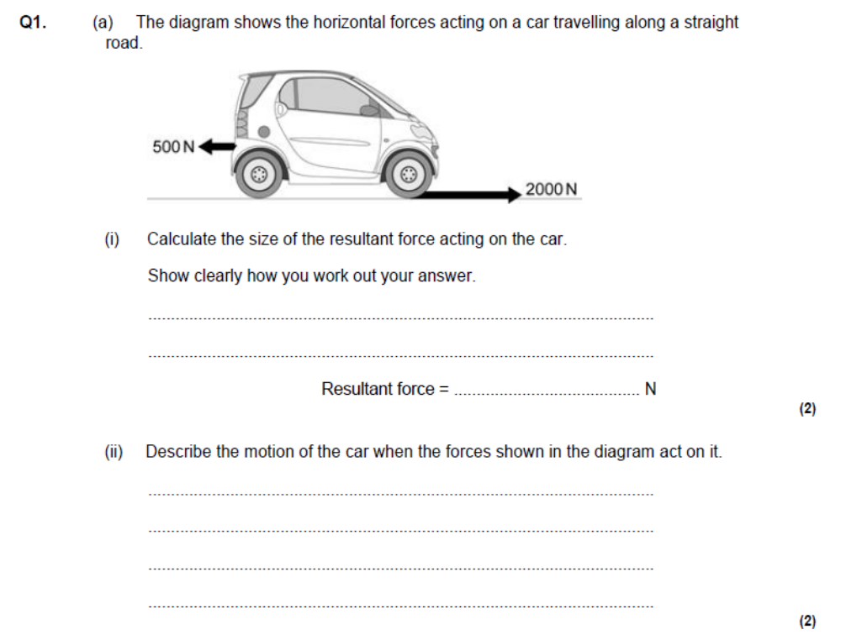
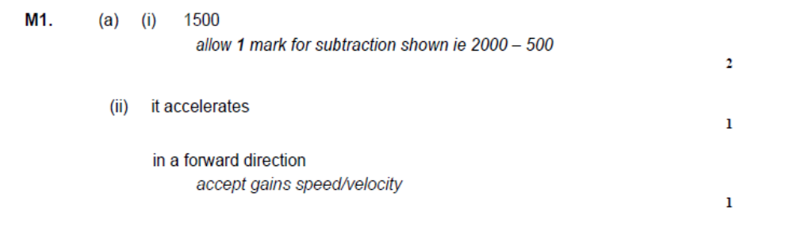

Slide 32
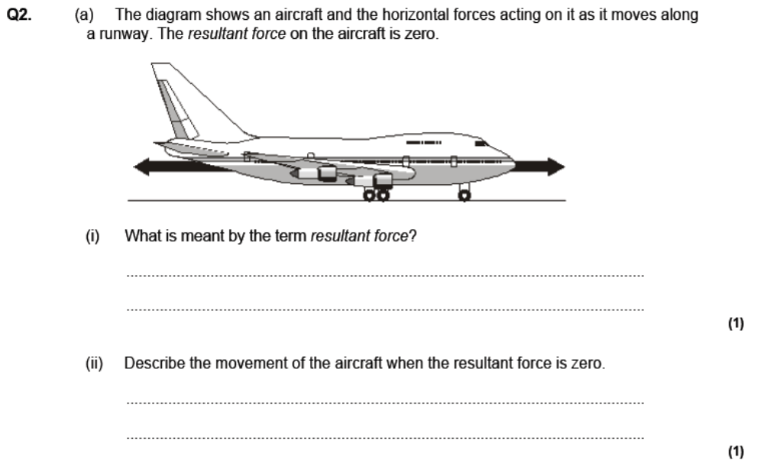
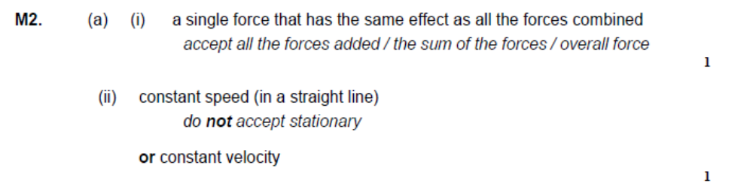

Slide 33
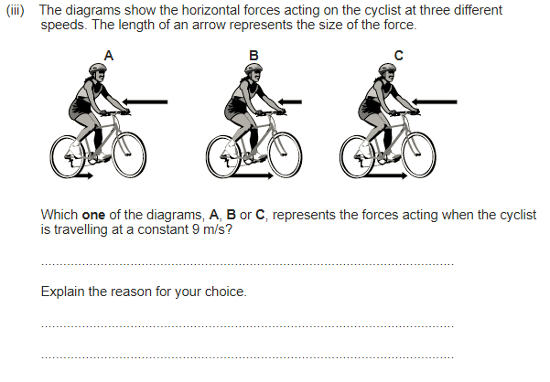
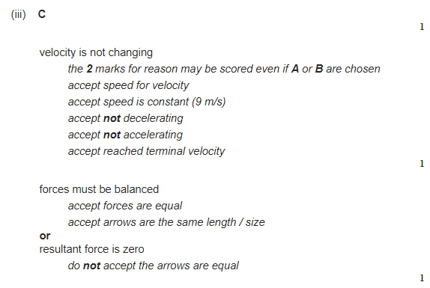

Slide 34

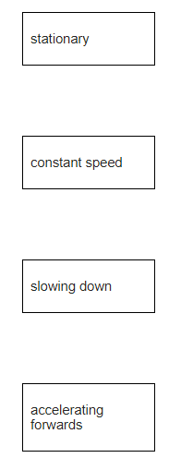
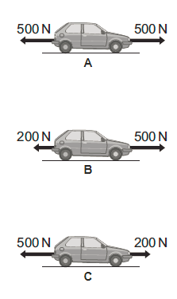

Slide 35
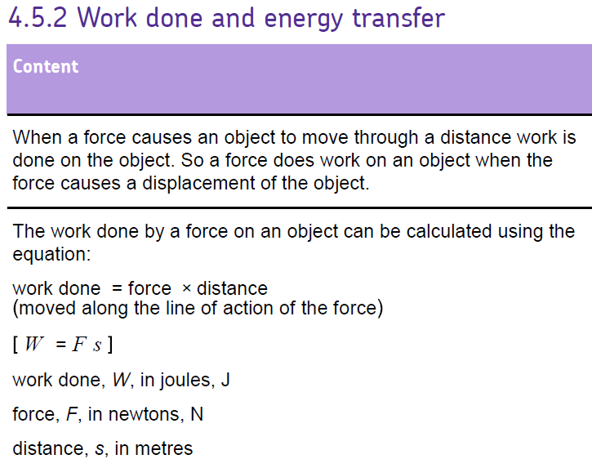
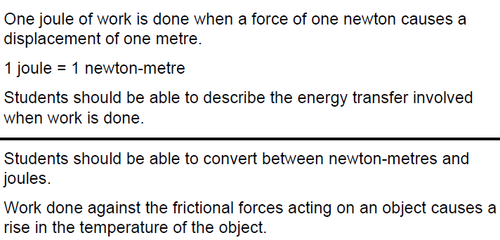

Slide 37
Calculating work
Remember work done is the same as energy transferred
The work done by an object is equal to the amount of energy that it transfers
Work done = force x distance
W = F x d
W
W = work done (J or Nm)
F = force (N)
d = distance (m)
f x d

Slide 38
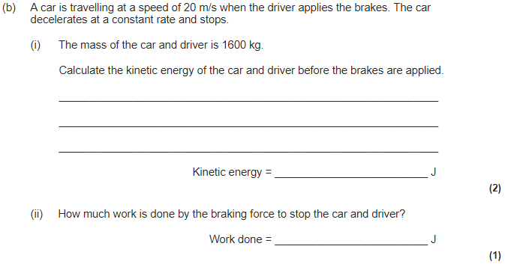
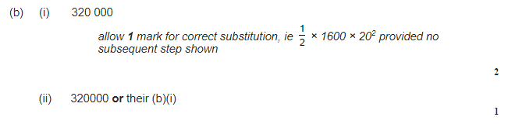

Slide 39
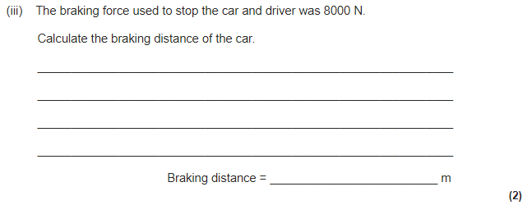
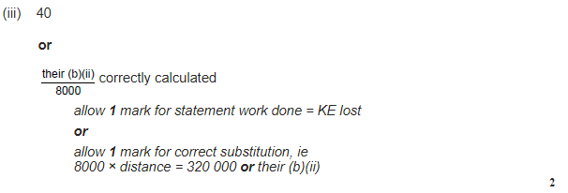

Slide 40
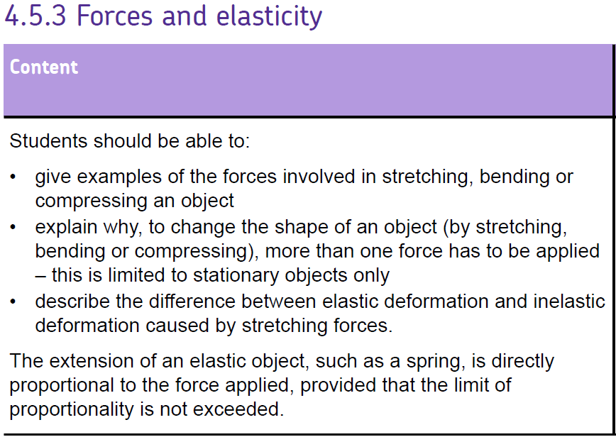
One force just causes an object to move!
An object is elastic if it returns to it’s original shape when forces deforming it are removed

Slide 42
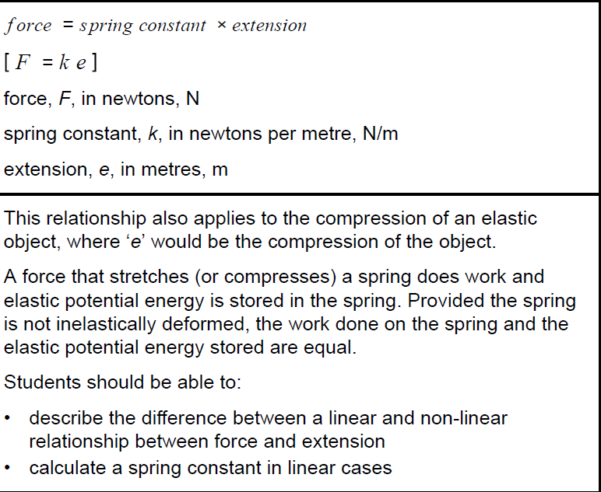
This needs to be MEMORISED

Slide 43
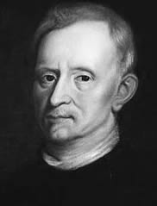
Hooke’s Law
Hooke’s law can be written as:
F = k x e
F
k x e
F = Force (N)
k = spring constant (N/m)
e = extension (m)

Slide 44
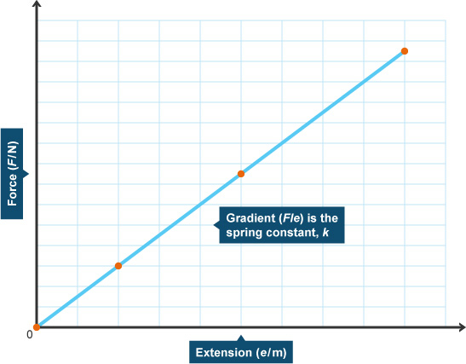
Hooke’s Law
“The extension of an elastic object is directly proportional to the force applied to it”
Gradient =
vertical ÷ horizontal
Force ÷ Extension
Therefore:
Gradient = Spring constant
F
k x e
Increase in length

Slide 45
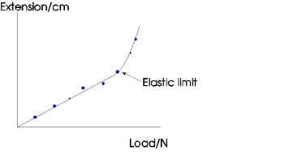
Hooke’s Law – proportional limit
Beyond a point, the material will start to show plastic behaviour.
A small increase in force will give a large increase in extension. The deformation will be irreversible (the material will not go back to the original shape when the force is taken away)
Proportional Limit
Beyond the proportional limit, the material shows plastic behaviour. The extension is now much harder to predict

Slide 46
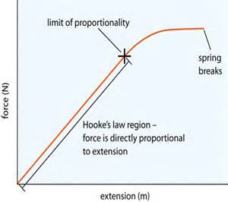
Hooke’s Law
Hooke’s law states that:
The extension of an object is directly proportional to the force that is applied to it provided that the limit of proportionality is not exceeded

Slide 47
Spring required practical

Slide 48
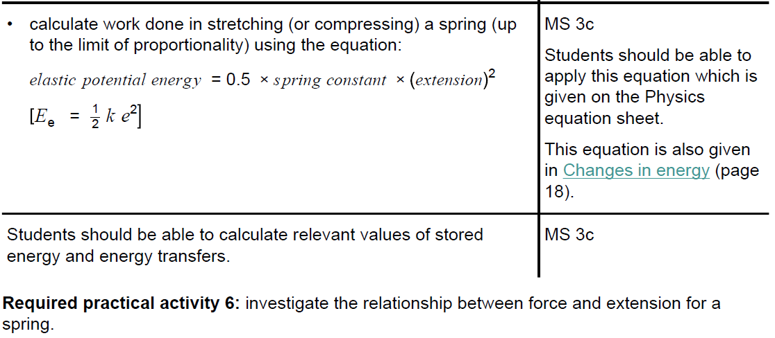

Slide 49
Elastic potential energy
Elastic potential energy = 0.5 x spring constant x (extension)²
E_{e} = ½ x k x e²
E_{e} = Elastic potential energy (J)
k = spring constant (N/m)
e = extension (m)

Slide 50
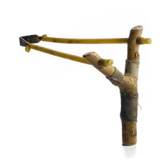
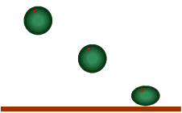
Elastic Potential Energy
An elastic object such as a spring stores elastic potential energy when stretched or squashed.
Work is done on an elastic object when its shape changes and it stores elastic potential energy.
Energy transferred by a force

Slide 51
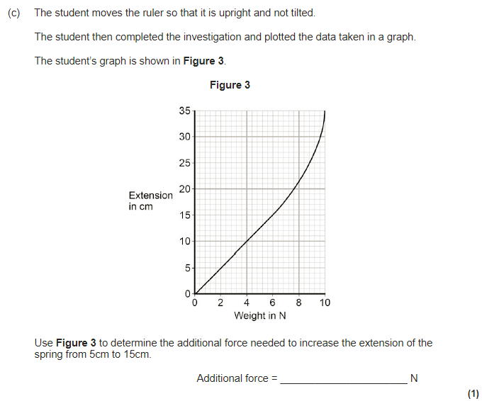


Slide 52
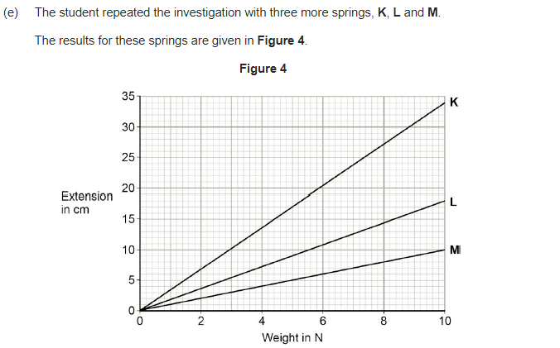

✓

Slide 53


Slide 54




Slide 55




Slide 56


Required practical

Slide 57





Slide 58



Slide 59




Slide 60



Slide 61



Slide 62



Slide 63



Slide 66
Moment’s
The moment of a force can be calculated using:
Moment of a force = force x distance
M = F x d
M
F x d
M = Moment (Nm)
F = Force (N)
d = Perpendicular distance (m)

Slide 67




Moment = Force x Distance
(Nm) (N) (m)
Moment = 500 N x 10 m
Moment = 550 N x 6 m
= 5000 Nm
= 3300 Nm
5000 Nm – 3300 Nm = 1700 Nm
Anti-clockwise
YODA WINS
500 N
10 m
6 m
550 N

Slide 68

Moment = Force x Distance
(Nm) (N) (m)
Moment = 500 N x 10 m
Moment = 1200 N x 7 m
= 5000 Nm
= 8400 Nm
8400 Nm – 5000 Nm = 3400 Nm
Clockwise
DARTH VADER
WINS
500 N
10 m
7 m
1200 N

Slide 69



Slide 70



Slide 72

Real world applications of moments
A spanner is a lever that can be used to unscrew a nut.
The spanner exerts a moment or turning effect on the nut.
pivot
distance from force to pivot
force
It is important to be able to identify where the pivot is, where the force is being applied as a distance from the pivot, and the size of that force

Slide 73

Real world applications of moments
Where is the pivot and in which direction is the force applied in these examples?

Slide 74
Real world applications of moments
Answers
Force
Force
Pivot
Pivot

Slide 75

Real world applications of moments
Force
Force
Force
Pivot
Pivot
Pivot

Slide 76
Real world applications of moments
What’s the difference between the position of the forces acting on a wheelbarrow compared to a seesaw?
Lift Force
Pivot
Load Force

Slide 77

Real world applications of moments
A mechanic pushes on a spanner with a force of 50N. He pushes on the spanner 40cm from the end of
the spanner.
Write the force and the distance on your diagram
Calculate the moment of the force using this information.
40
50
Moment of the force (Nm) = Force (N) x Distance from pivot (m)
Moment of the force (Nm) = 50 N x 0.4 m
Moment of the force (Nm) = 20 Nm
c) (i) Would the moment be bigger or smaller if he used a longer spanner? ________________________
(ii) Explain your answer to part (i).
____________________________________________________________________________________________________________________
bigger
Multiple answers acceptable as long as distance from the
pivot is central to the explanation.

Slide 78



Slide 79



Slide 80



Slide 82
Pressure
Pressure = force
area
p = F
a
F
p x a
p = pressure (Pascals, Pa)
F = force (Newtons, N)
a = area (m²)

Slide 83



Slide 85


Why is water pressure higher at greater depths?
Pressure = $\frac{Force}{Area}$
What provides the force that produces water pressure?
The water particles

Slide 86

Why is water pressure higher at greater depths?
As depth increases the number of particles of water above you increases.
This extra weight of water provides an increased force and hence an increased water pressure.

Slide 87
What about pressure in a horizontal line?
The pressure along a horizontal line is constant.
Why do you think the oil level is higher than the water level?
oil
h_{oil}
h_{water}
water
More oil is needed to exert the same pressure as water therefore oil is less dense than water.
Here the water and the oil exert the same pressure

Slide 88
The Maths
This equation will be given to you
The pressure in a column of liquid can be measured using the following equation:
Pressure = height of the column x density of the liquid x gravitational field strength
P = h p g
Pressure = pascals, Pa
Height = metres, m
Density = kilograms per metres cubed, kg/m3
g = Newtons per kilogram N/kg
Notes:
URL for this optional proof is: https://youtu.be/xfNI8vqyO9M

Slide 89
The Maths
g = 9.8 N/kg, sea water density = 1020 kg/m³
What is the pressure due to sea water at a depth of 500 m?
Pressure = hρg
= 500 m x 1020 kg/m³ x 9.8 N/kg
= 5.00 x 10⁶ Pa

Slide 90

The Maths
g = 9.8 N/kg, sea water density = 1020 kg/m³
How far would you have to go below the surface of the sea to experience double the pressure at the surface on a day when the atmospheric pressure was 102 kPa?
To double atmospheric pressure (102 kPa), the water must produce an additional 102 kPa. First, rearrange equation for height:
$h=\frac{P}{ρg}=\frac{102 × 10^{3}}{1020 × 9.8}=10m$

Slide 91


Slide 92

Atmospheric Pressure
Air pressure is caused by the weight of the air particles pressing down.
As you go higher there are less particles (lower density) and so there is less pressure.

Slide 93

Atmospheric Pressure

Slide 94

Atmospheric Pressure
Gas pressure is also caused by the particles of gas hitting the wall of their container (this provides the force)

Slide 95

Atmospheric Pressure
At sea level on Earth there is an air pressure of 100,000 N/m² pushing down on our bodies!
Why are we not crushed?

Slide 96

Atmospheric Pressure
The pressure inside our bodies is in equilibrium with the pressure outside our bodies.
The forces are equal and opposite so we don’t get squished!

Slide 97

Using Atmospheric Pressure
Pressing on a suction cup forces the air out.
The atmospheric pressure on the outside holds it in place.

Slide 98


Slide 99



Slide 100




Slide 101


LEARN THESE

Slide 103

✓

Slide 104


Slide 105
Speed
Speed = Distance
Time
D
s = distance (m)
v = speed (m/s)
t = time (s)
s x t

Slide 106



Slide 107

Because it is constantly changing direction

Slide 109


Slide 111

Distance – time graphs
Gradient =
vertical ÷ horizontal
Distance ÷ Time
Therefore:
Gradient = Speed

Slide 112



Slide 113



Slide 115
Acceleration
Acceleration can be calculated using the following equation:
Change in velocity
IMPORTANT UNIT
Acceleration =
Time taken
Final velocity – initial velocity
Acceleration =
Time taken
v - u
a = acceleration (m/s²)
v = final velocity (m/s)
u = initial velocity (m/s)
t = time (s)
a =
t

Slide 116



Slide 117


Slide 118
Velocity-time graphs
80
60
40
20
0
constant speed/velocity
Velocity
m/s
decelerating
accelerating
accelerating
10 20 30 40 50
Time (s)

Slide 119
Velocity-time graphs
What does this tell us about an object‘s motion?
∆y
Velocity
(m/s)
Gradient =
∆x
Change in velocity (m/s)
Gradient =
Time taken (t)
Time (s)
The object’s speed is getting faster and faster every second.
When speed is increasing we say it is accelerating.
We measure acceleration in m/s^{2.}
The steeper the gradient, the bigger the acceleration.
As the line is straight, it is a constant acceleration.
Change in velocity (m/s)
Acceleration =
Time taken (t)
Gradient = Acceleration

Slide 120

Velocity-time graphs
What else can we get from a speed-time graph?
Speed
(m/s)
Distance
Travelled !
Height
Base
Time (s)
We can calculate how far an object has travelled by working out the area under the graph. Distance is measured in metres (m).
In the above example, the area under the graph is a triangle.
Area = ½ x Base x Height

Slide 121
Velocity-time graphs
How would you find the distance travelled in this case?
Speed
(m/s)
width
length
Time (s)
The object is moving with a constant speed.
The area under this graph would be a rectangle.
Area = length x width

Slide 122

Velocity-time graphs
Speed (m/s)
Area = 2.7 m
Area = 5.4 m
Area = 10.8 m
Time (s)
Total distance travelled = Total area under the graph
Total distance travelled = 5.4 + 10.8 + 2.7
Total distance travelled = 18.9 m

Slide 123
Velocity-time graphs
A
Speed (m/s)
B
C
Time (s)
Describe the motion between 12 and 16 seconds.
Between A-B : Constant deceleration from 12 to 15 seconds.
Between B-C : Object (car) is stationary from 15 to 16 seconds.

Slide 124

Motion graphs

Slide 125

This equation is on the equation sheet

Slide 127






Slide 128





Slide 129




Slide 130





Slide 131



Slide 133

Man jumps out of plane (mass 70kg)
Terminal Velocity
What forces are acting on him?

Slide 134
Terminal Velocity
Mass = 70 kg
Force of gravity = 10 N/kg
Therefore the weight due to gravity = 700 N
F=ma
Resultant force = 700N
Acceleration = Force/mass
= 700/70
Acceleration = 10 m/s²
(Force due to gravity) WEIGHT

Slide 135
Terminal Velocity
Air resistance DRAG
(Force due to gravity) WEIGHT

Slide 136
Terminal Velocity
Resultant force =
600N
Acceleration = Force/mass
= 600/70
Acceleration = 8.5 m/s²
100 N
What will happen to him?

Slide 137
400 N
Resultant force =
300N
Acceleration = Force/mass
= 300/70
Acceleration = 4.28m/s²
He will accelerate downwards

Slide 138

Terminal Velocity
Some time later
Resultant force = 0N
Acceleration = Force/mass
= 0/70
Acceleration = 0 m/s²
What will happen to him now?

Slide 139
Terminal Velocity
Some time later
He will fall at a constant speed

Slide 140
Terminal Velocity
Highest recorded terminal velocity was 321 mph!! How?
Some time later
Terminal velocity in humans is about 120 mph (55 m/s)
He will fall at a constant speed
His TERMINAL VELOCITY

Slide 141

Terminal Velocity
Man opens parachute
Resultant force =
-400N
Acceleration = Force/mass
= -400/70
Acceleration = -5.71 m/s²
What will happen to him now?

Slide 142
Terminal Velocity
Man opens parachute
He will DECELERATE

Slide 143

Terminal Velocity
His weight downwards equals the ground's push upwards, so there he stays.

Slide 144

Terminal velocity
You must be able to describe terminal velocity in terms of resultant forces and type of motion (accelerating, decelerating, constant speed)

Slide 145





Slide 146




Slide 147



Slide 148


Slide 150



Having EQUAL AND OPPOSITE forces acting on an
object is effectively the same as having NO force acting.
drag
drive
The car moves at constant speed.
No net force = No Acceleration.
= No change in speed.

Slide 151

What happens when there are unbalanced forces acting on an object?
For example when a driver who is travelling at constant speed accelerates or puts on the brakes.
Accelerate:
Brake:
drive
drag
Speed decreases until drag
matches drive again.
Speed increases until drag
grows to match drive.
Back arrow twice
to see again…

Slide 152
How do resultant forces effect the motion of an object?
Resultant Force | Effect on stationary object | Effect on moving object
Equals Zero
Does Not Equal Zero
Remains Still
Constant Speed (same speed)
Acceleration (get faster)
Acceleration (get faster)
De-acceleration (get slower)
Change Direction
Change Direction
NEWTONS FIRST LAW: an object either remains at rest or continues to move at a constant velocity, unless acted upon by an external force

Slide 153
Definition of inertia
Inertia is a measure of how difficult it is to change the velocity of an object

Slide 154

✓

Slide 155
4
Marks

Slide 156



Slide 157



Slide 158



Slide 159


✓

Slide 160



Slide 162
Calculating forces – Newton’s Second Law
Force = mass x acceleration
F = m x a
F
F = (resultant) force (N)
m = mass (kg)
a = acceleration (m/s²)
m x a

Slide 163
Acceleration
The acceleration of an object depends on the size of the resultant force.
If the resultant force is zero the object will remain motionless or continue at a constant speed.
Force (N) = Mass (kg) x Acceleration (m/s²)
Resultant Force 3000N
F
Calculate the acceleration of the bus:
F = ma
a = F/m
a = 3000/2000
a = 1.5 m/s²
Wind 2000N
Air resistance 3000N
2000kg
Engine 4000N
m x a

Slide 164



Slide 165


Weight = mass x gravity

Slide 166



Slide 167



Slide 168



Slide 169
Acceleration required practical

Slide 170





Slide 171


Slide 173


Slide 175

Braking Force
The braking force needed to stop a vehicle is dependant on:
The velocity of the vehicle when the brakes are first applied.
The mass of the vehicle.

Slide 176

Stopping Distance
Stopping distance
Thinking distance
Braking distance

Slide 177

Stopping Distance

Slide 178



Slide 179


Slide 180


Slide 181












Factors affecting Thinking and Braking Distance
Being tired, under the influence of drugs or alcohol, or being distracted INCREASE the THINKING DISTANCE.
Drinking stimulants (caffeine – coffee or energy drinks), being fully rested and wide awake, and distraction free REDUCE the THINKING DISTANCE.
Difficult Concept:
If the driver is driving really fast their thinking TIME will be the SAME. However, their THINKING DISTANCE could change due to any of the conditions mentioned above.
Driving on icy or wet roads, having bald tyres or poor brakes, or driving too fast INCREASE the BRAKING DISTANCE.
Driving on good dry roads, having new brakes and tyres and driving slower REDUCE the BRAKING DISTANCE.
As before Thinking Distance, Braking Distance and Stopping Distance are all DISTANCES.
Remember to discuss DISTANCE in your answer!

Slide 182



Slide 183








Slide 184

Decelerations of greater than 6m/s² on a dry straight road are likely to cause skidding.

Slide 186
Breaking force
What does the braking force needed to stop a car depend on?
Which equation links those things together?
FORCE = MASS x ACCELERATION
The greater the speed, the greater the deceleration needed to stop the vehicle in a certain distance. Therefore the breaking force must be greater than at low speed
The greater the mass, the greater the braking force needed for a given deceleration
a = v – u
t

Slide 187

Braking force
F = (mass x initial velocity)
time
Mass = 700 kg
Car
F = 700 x 100
2
F = 35, 000 N
What is the breaking force of a Formula 1 car? It can decelerate from 360 km/h (100m/s) to 0 km/h in 2 seconds!
a = v – u
t
a = 0 – 100
2
= - 50 m/s²
F = (mv-mu)
t
F = ma
=

Slide 188


Braking force
v² – u² = 2as
BREAKING FORCE needed to stop in 3 seconds from 30m/s (70 mph)
Car
F = 1000 x 30
3
F = 10, 000 N
Lorry
F = 30,000 x 30
3
F = 300, 000 N
1000 kg
30,000 kg
What would the distance be if both these vehicles stopped with a breaking force of 10,000 N if initial velocity was 30 m/s?
Calculate the KE of the Car
K.E = ½ mv²
KE of Car = ½ x 1000 x 30²
450,000 J
Work Done = 450,000J
Calculate the distance if the breaking force was 10,000N… (remember:
Work done = force x distance)
Now work it out for the lorry

Slide 189
Questions
A car with velocity 20m/s stops in 30m. Calculate the deceleration. Is it likely to skid? (2 sig fig)
A car of mass 1100kg uses a breaking force of 10,000N to stop from a velocity of 40m/s. Calculate the distance it takes to stop.
A lorry of mass 10,000 kg, takes 5 seconds to stop from a velocity of 25m/s. What breaking force is used?
Answers
6.7m/s²
88m
50 000N

Slide 190





Slide 191



Slide 192



Slide 193


Slide 195
Momentum
Momentum = mass x velocity
p = m x v
p = momentum (kg m/s)
m = mass (kg)
v = velocity (m/s)
p
m x v

Slide 196




Slide 197




Slide 198


Slide 200

Conservation of momentum
In a closed system, the total momentum before an event and the total momentum after an event are the same. This is called conservation of momentum.
Events you may be asked about in your exams are:
Collisions
Explosions

Slide 201




Slide 202
Example
A 0.5kg trolley A is pushed at a velocity of 1.2m/s into a stationary trolley B of mass 1.5kg. The two trolleys stick together after the collision.
Calculate:
The momentum of the 0.5kg trolley before the collision.
The velocity of the two trolleys straight after the impact.
Remember – momentum BEFORE collision = momentum AFTER collision

Slide 203
Example 1
A 0.5kg trolley A is pushed at a velocity of 1.2m/s into a stationary trolley B of mass 1.5kg. The two trolleys stick to each other after the impact. Calculate:
The momentum of the 0.5kg trolley before the collision
The velocity of the two trolleys straight after the impact
Momentum of trolley A before impact = 0.6kg m/s
Momentum of trolley B before impact = 0kg m/s
Momentum of trolley A after impact = 0.5kg x V
Momentum of trolley B after impact = 1.5kg x V
0.5V + 1.5V = 0.6
2V = 0.6
V = 0.3m/s
Total momentum = 0.6 kg m/s
Total momentum = 0.5v + 1.5v
= 2v

Slide 204
Example 2
A 110kg man runs at a velocity of 8m/s into a stationary man B of mass 80kg. The two men stick to each other after the impact and fall to the floor. Calculate:
The momentum of the 110 kg man before the collision
The velocity of the two men immediately after the impact
Momentum of man A before impact = 880 kg m/s
Momentum of man B before impact = 0kg m/s
Momentum of man A after impact = 110kg x V
Momentum of man B after impact = 80kg x V
110V + 80V = 880
190V = 880
V = 4 m/s
Total momentum = 880 kg m/s
Total momentum = 110v + 80v
= 190v

Slide 205
Example 3
A railway engine of mass 800kg travelling at 5m/s collides with and becomes attached to a truck of mass 200kg travelling at 2m/s. Calculate the speed of the truck and engine after the collision
Represent ‘v’ as the velocity
Momentum of railway engine before impact = 4000kg m/s
Momentum of truck before impact = 400kg m/s
Momentum of railway engine after impact = 800kg x V
Momentum of truck after impact = 200kg x V
800V + 200V = 4000 + 400
1000V = 4400
V = 4.4m/s
Total momentum = 4400kg m/s
Total momentum = 800v + 200v
= 1000v

Slide 206



Slide 207

Clue:
mv + mv = mv + mv
12000 + 0 = 2400 + mv
12000 = 2400 + 3200v
Read the question CAREFULLY!

Slide 208


Clue: remember velocity has a ‘direction’

Slide 209
Conservation of momentum
In a closed system, the total momentum before an event and the total momentum after an event are the same. This is called conservation of momentum.
Events you may be asked about in your exams are:
Collisions
Explosions

Slide 210
Explosions
Momentum of A after the explosion = (mass of A x velocity of A)
Momentum of B after the explosion = (mass of B x velocity of B)
Total momentum before the explosion = 0 (because both things were at rest)
Using conservation of momentum give:
(mass of A x velocity of A) + (mass of B x velocity of B) = 0
Therefore:
(mass of A x velocity of A) = - (mass of B x velocity of B)

Slide 211
Example 4
An artillery gun of mass 2000kg fires a shell of mass 20kg at a velocity of 120 m/s. Calculate the recoil velocity of the gun.
Represent ‘v’ as the velocity
Mass of gun x recoil velocity of gun = -(mass of shell x velocity of shell)
2000 x V = -(20 x 120)
2000V = 2400
2400
= V
V = 1.2 m/s

Slide 212



Slide 213



Slide 214



Slide 215




Slide 216




Slide 217



Slide 219

Changing Momentum
Cars have crumple zones to increase impact time on collision.
If you increase the impact time, it will decrease the impact force.
You are GIVEN this equation
Force (N) = change in momentum (kg m/s)
time taken (s)

Slide 220




