Slide 1
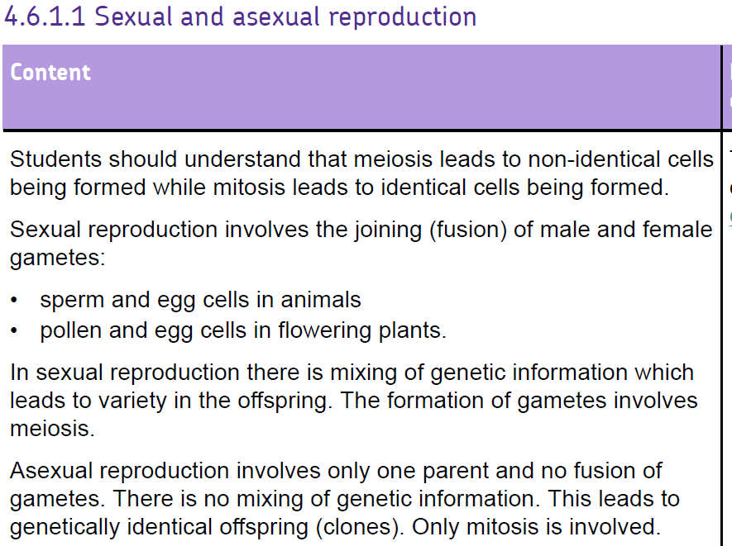

Slide 2


Slide 3
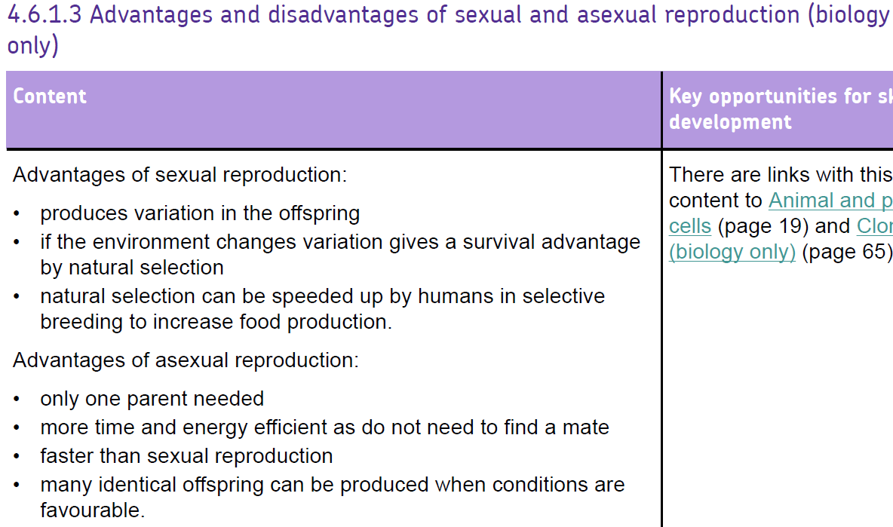

Slide 5
Types of reproduction
Sexual reproduction
Asexual reproduction
Gametes (egg and sperm)
From two parents
Male sex cell and female sex cell - fuse
provides genetic variation important for survival
E.g. Mammals, birds
One individual
No mixing of genetic information
No genetic variation – clones
Cells of body reproduce asexually – divide in two for growth and repair
E.g. Bacteria, strawberries

Slide 6
Which statements are about sexual reproduction and which statements are about asexual reproduction?
Variation gives survival advantage if the environment changes, through survival of the fittest. | The offspring are clones of the parent as they are genetically identical
Only one parent needed | How animal and plants produce replacement cells for repair and growth
Contains genetic information from 2 organisms. | More time and energy efficient as do not need to find a mate.
There is no fusion of gametes or mixing of chromosomes. | Offspring inherit characteristics from both parents.
Many identical offspring can be produced when conditions are favourable (research and agricultural purposes)

Slide 7
Which statements are about sexual reproduction and which statements are about asexual reproduction?
Variation gives survival advantage if the environment changes, through survival of the fittest. | The offspring are clones of the parent as they are genetically identical
Only one parent needed | How animal and plants produce replacement cells for repair and growth
Contains genetic information from 2 organisms. | More time and energy efficient as do not need to find a mate.
There is no fusion of gametes or mixing of chromosomes. | Offspring inherit characteristics from both parents.
Many identical offspring can be produced when conditions are favourable (research and agricultural purposes) | Helps increase the diversity in species.

Slide 8
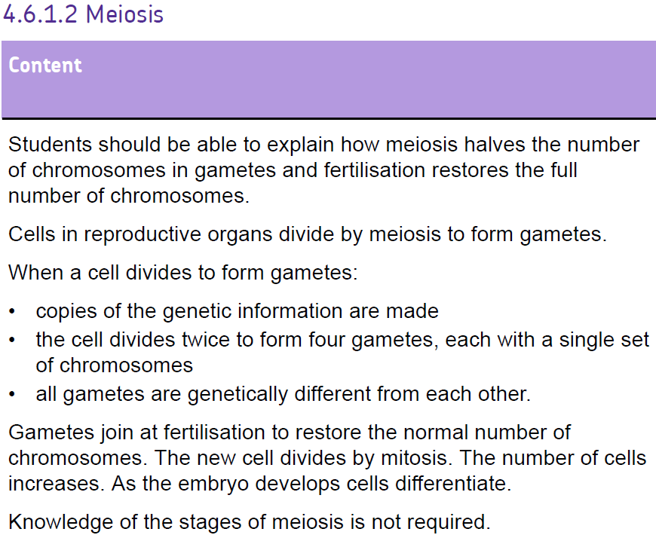

Slide 10
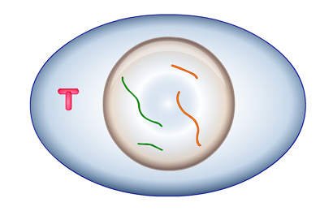

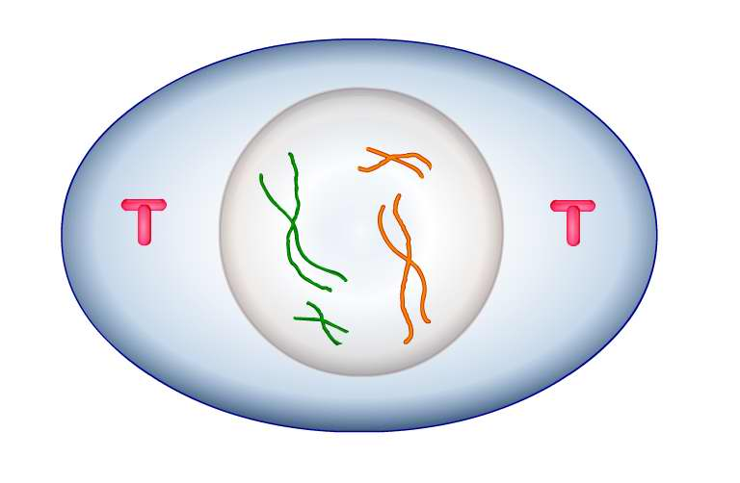


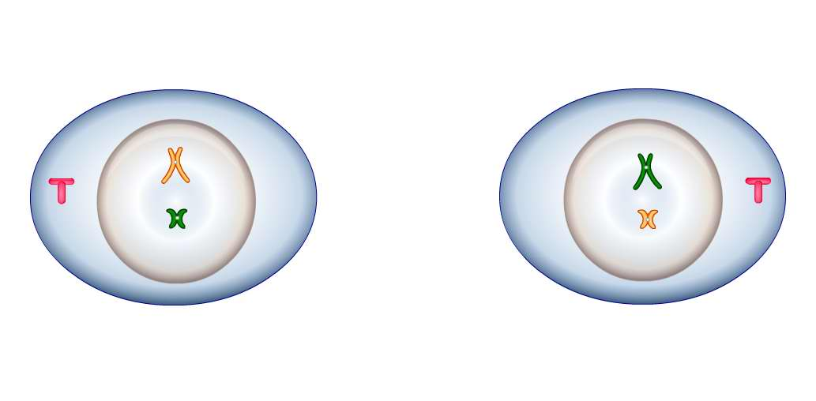
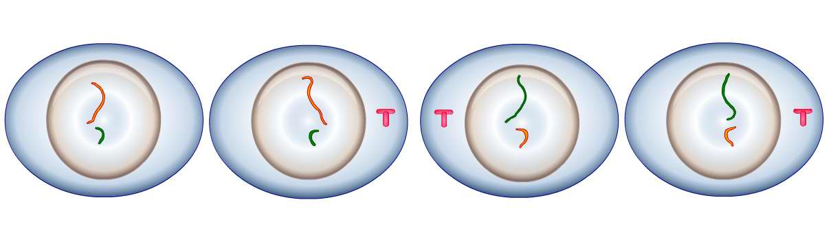
What is meiosis?
Meiosis begins with a single cell.
original cell
First the cell makes a copy
of each chromosome.
first
division
Now, there are two stages of cell division…
second
division
All the gametes are genetically different from each other
4 new cells

Slide 11
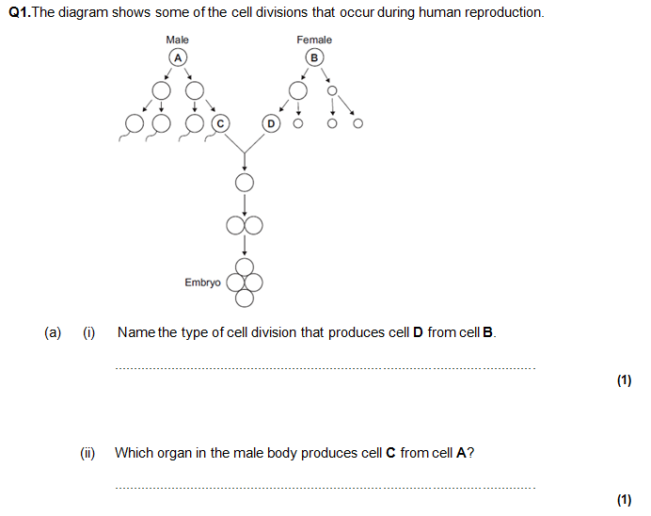
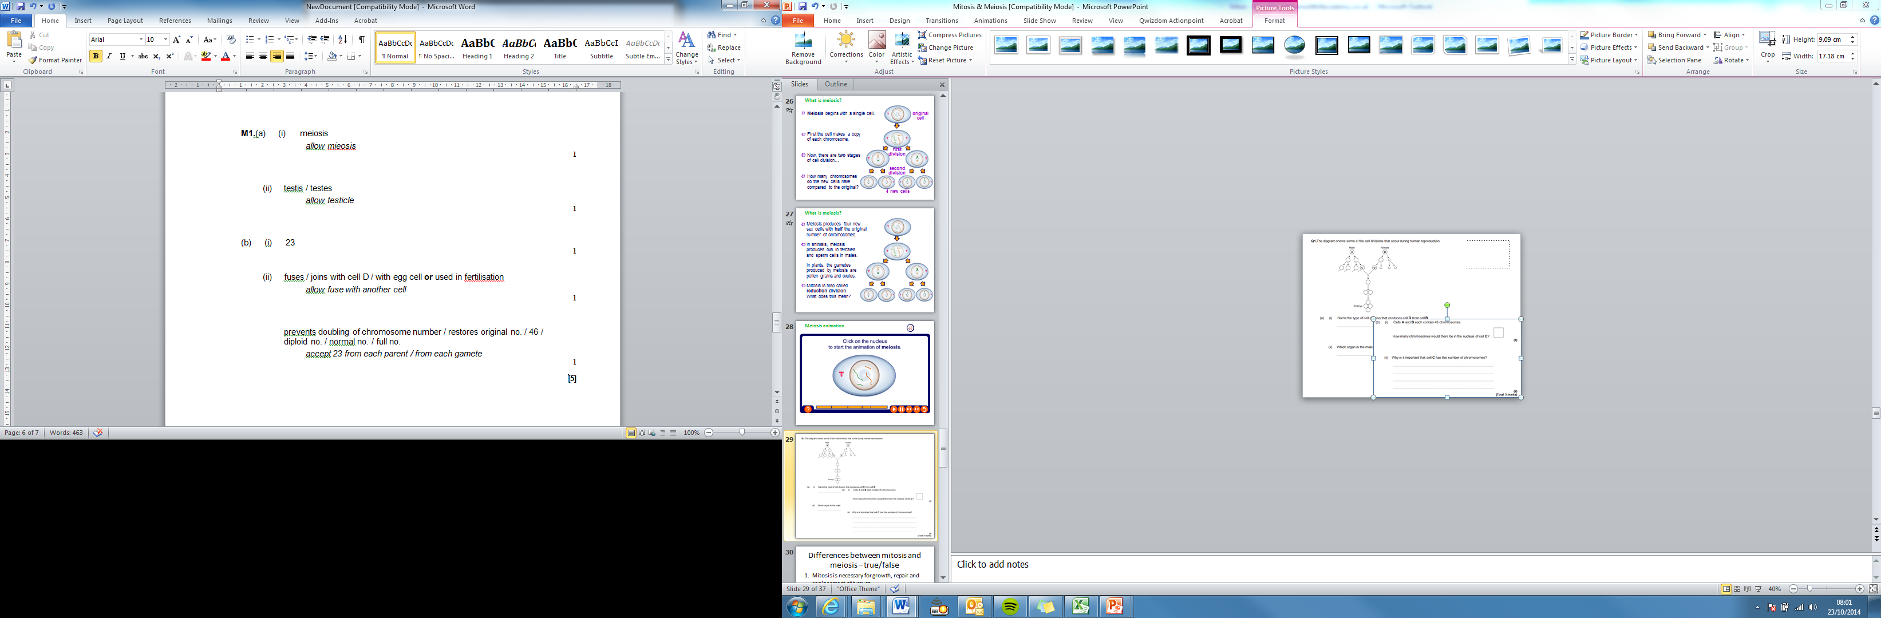
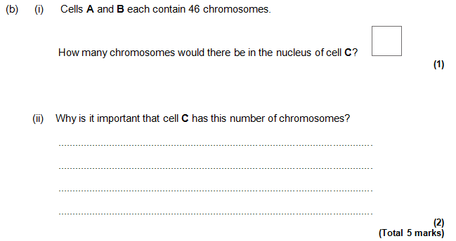

Slide 12
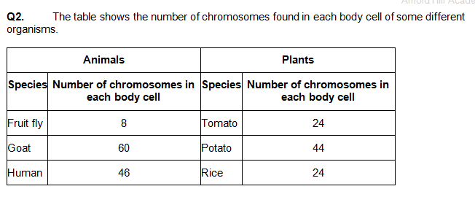
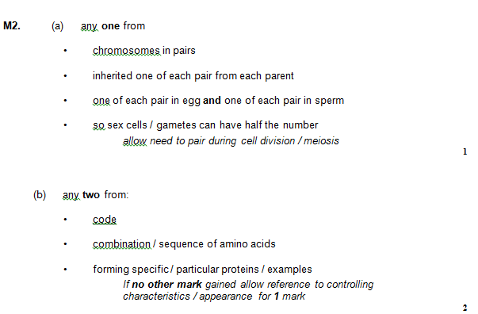
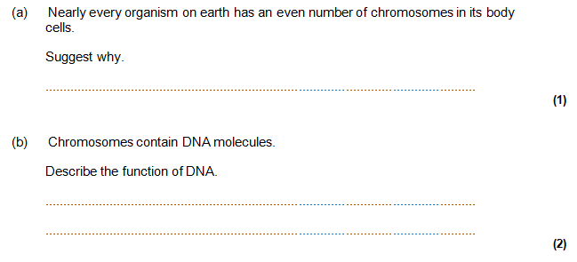

Slide 13
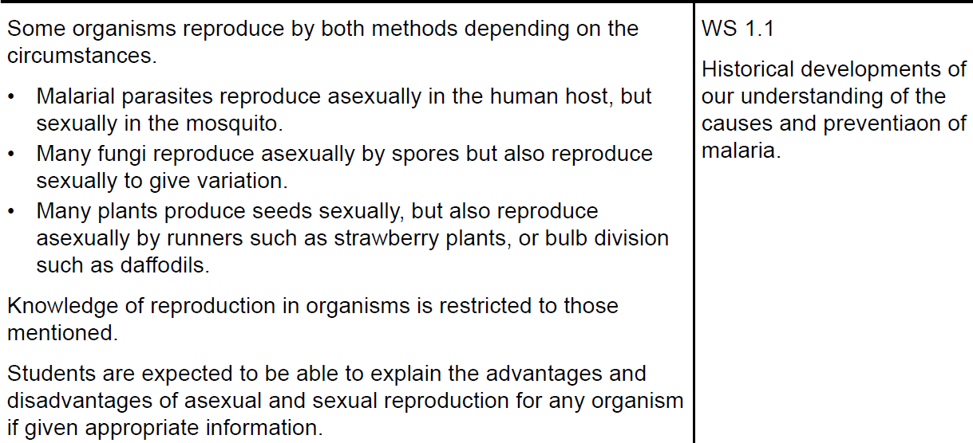

Slide 14
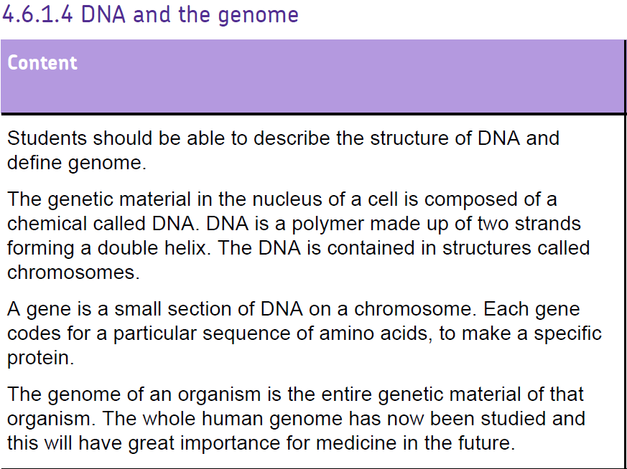
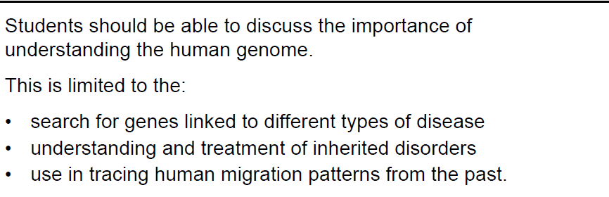

Slide 16
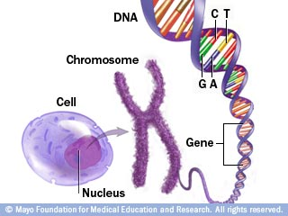

Slide 17
The human genome
The genome of an organism is the entire genetic material of the organism.
The human genome contains over 3 billion base pairs and almost 21,000 genes that code for proteins.

Slide 18
The human genome – why is it important
Search for genes linked to different types of disease
Understanding and treatment of inherited disorders
Use in tracing human migration patterns from the past

Slide 19
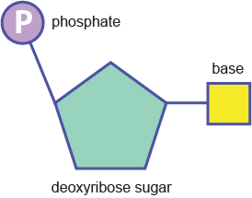
DNA structure - Nucleotide
Nucleotide is a single unit of DNA. Lots of Nucleotides join together to make the DNA molecule.

Slide 20

DNA Structure
Repeating nucleotides make up a long chain called a ‘polymer’.
We say DNA has a ‘sugar-phosphate’ backbone
A key structural feature of a DNA molecule.

Slide 21
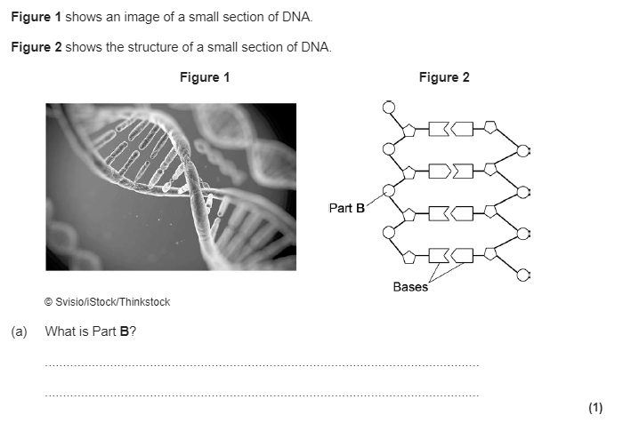
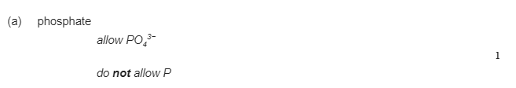

Slide 22
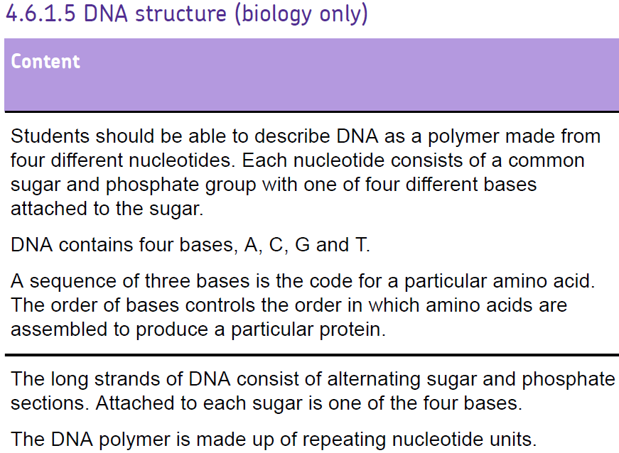

Slide 23




DNA Bases
The double helix ‘ladder’ of a DNA molecule is held together by ‘rungs’ made from pairs of chemicals called bases.
There are four types of bases, and they are usually identified by their initials.
A
C
G
T

Slide 24

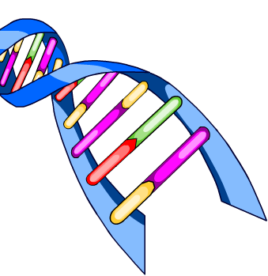

DNA Bases
Base pairs hold the two strands of the DNA helix together.
C
G
A
T
C
G
A
T
It is the sequence of these bases along a DNA molecule that forms the genetic code – it’s that simple!

Slide 25
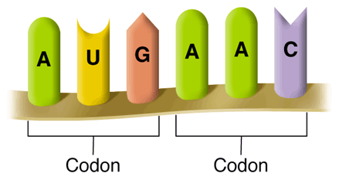
Bases and amino acids
Within a gene, every 3 bases makes up a CODON.
A codon is a 3 base combination that decides which amino acid is assembled in a protein.

Slide 26
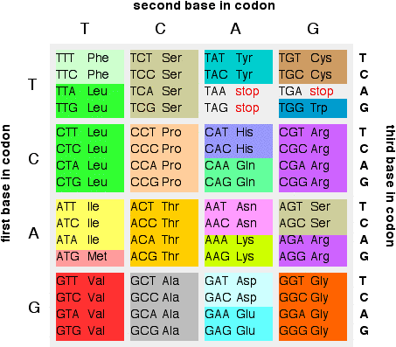
How do we make proteins?
Each 3 bases codes for an amino acid.
When amino acids are assembled in the correct sequence, a protein is made.
Our DNA codes for 20 amino acids in total.
Possible codon combinations that make up amino acids:

Slide 27
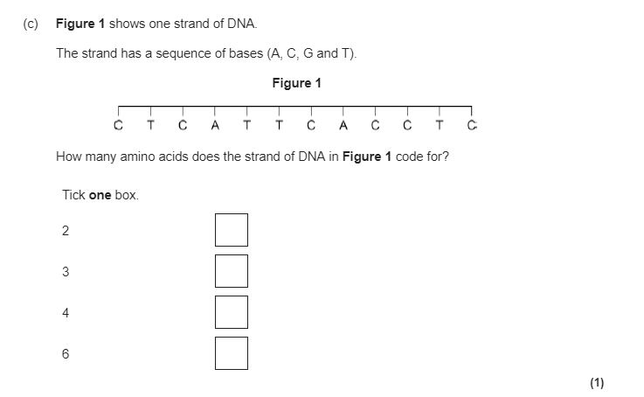


Slide 28
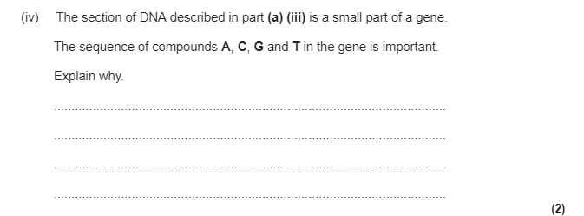
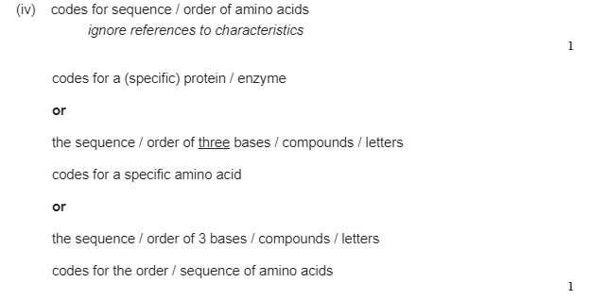

Slide 29
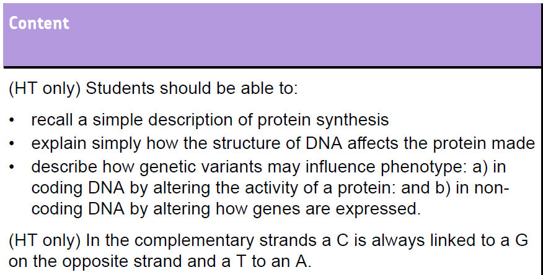
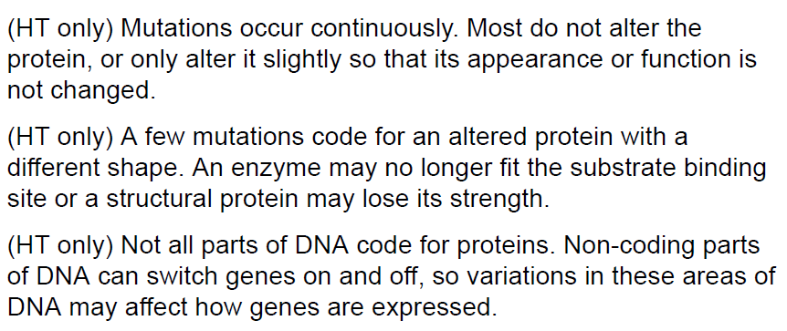
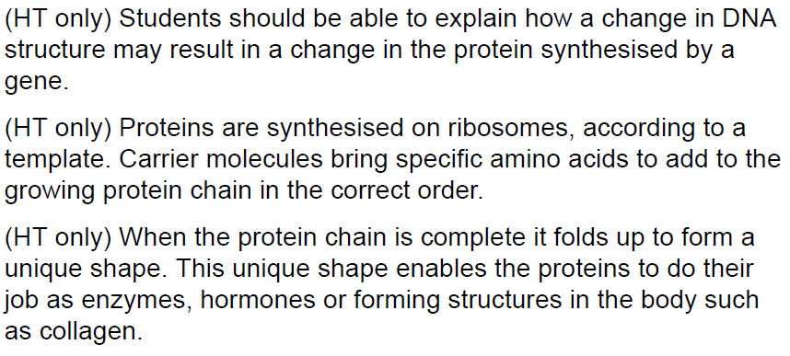

Slide 31
Protein synthesis
In the nucleus
DNA is copied into a single strand that can exit the nucleus.
In the ribosome
Proteins are synthesized according to the DNA template.
Carrier molecules bring specific amino acids to match the 3 base combinations on the template.

Slide 32
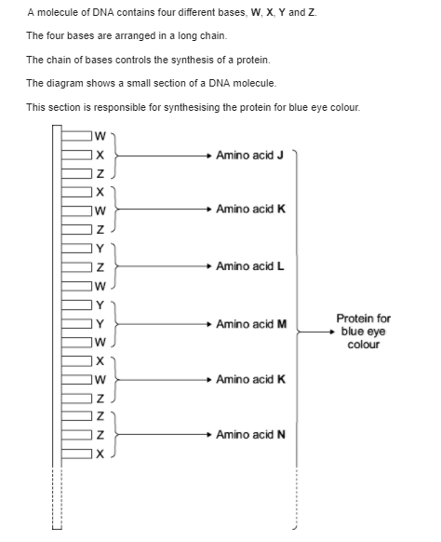
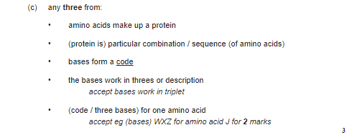
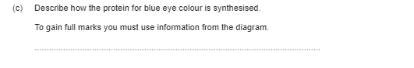

Slide 34
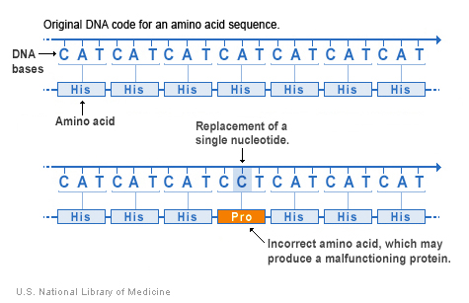
Mutation

Slide 35
Mutations
A mutation is a change to the genetic material.
They are continuously occurring with every cell division.
Most mutations have no effect. E.g. TTC > TTT still codes for the same amino acid.
Some have a slight effect but not so much so that the appearance or function of the protein is affected.

Slide 36
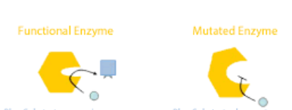
Damaging mutations
Sometimes, a mutation can cause a change to the amino acid sequence. Altering the structure or shape of the protein. This can have a damaging effect on the body.
E.g. Enzymes are important biological catalysts that speed up reactions in the body, e.g. respiration.
If there is a change in the amino acids that make the enzyme, it will no longer work. E.g. a change to binding site.

Slide 37
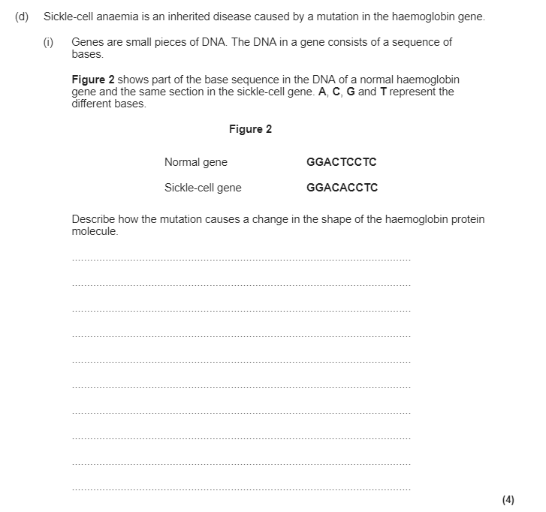
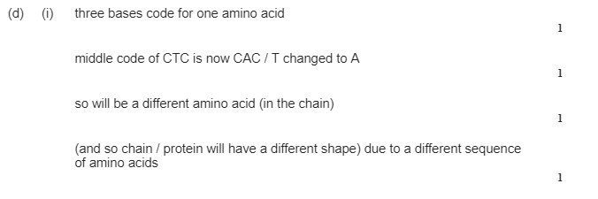

Slide 38
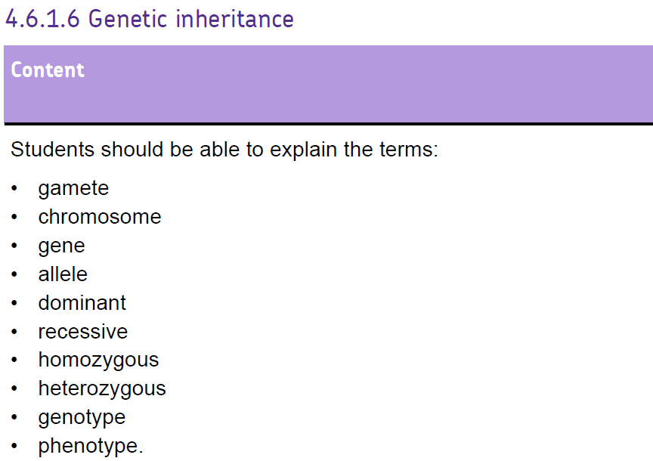

Slide 39
What is the definition of the following words:
Gamete
  Egg or sperm cell
Allele
  Different form of the same gene
Dominant allele
  An allele that controls the development of a characteristic when only one is present
Recessive allele
  An allele must be present of BOTH chromosomes to develop a characteristic
Homozygous
  An individual with two identical alleles for a characteristic e.g DD, dd
Heterozygous
  An individual with different alleles for a characteristic e.g Dd
Genotype
  The genetic makeup of an individual regarding a particular characteristic e.g Dd
Phenotype
  The physical appearance of an individual regarding a particular characteristic e.g dimples

Slide 40
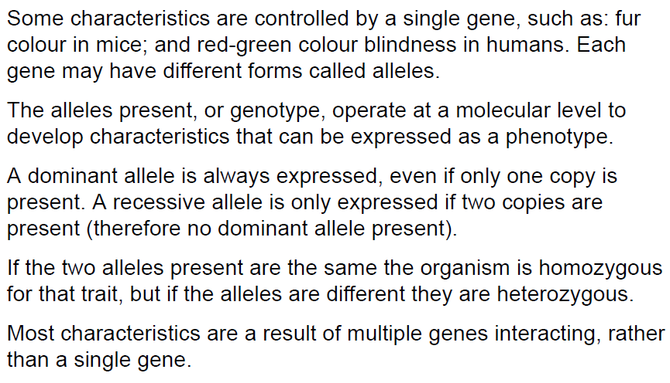
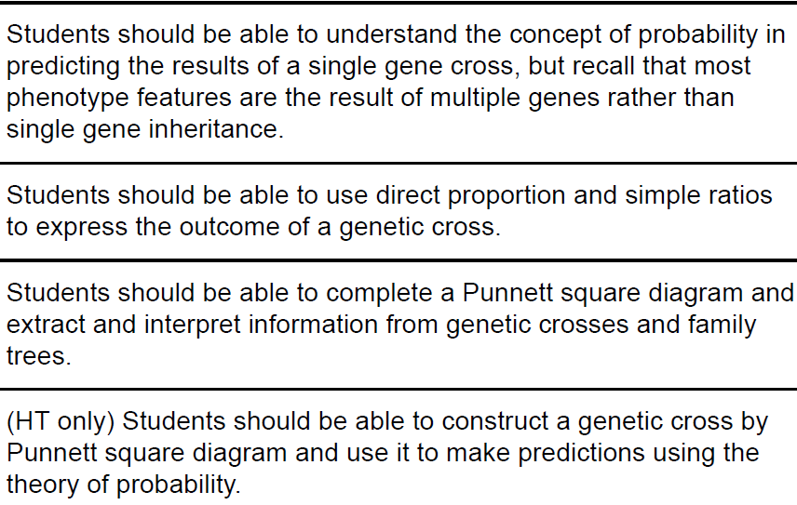

Slide 42
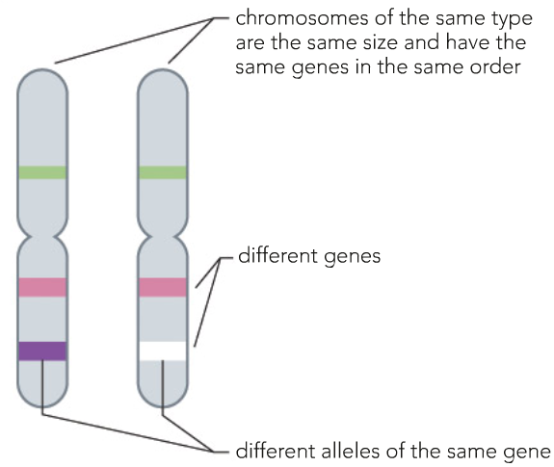
Alleles
Different forms of the same gene
For example, eye colour

Slide 43
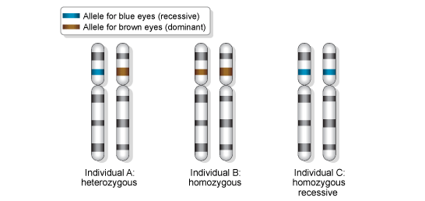
Dominant or Recessive?
Alleles are dominant or recessive.

Slide 44
Representing alleles
Letters are used to represent different alleles.
A dominant allele is always a capital letter.
allele for brown eyes
=
B
A recessive allele is always the corresponding small letter.
allele for blue eyes
=
b
The allele pair for each characteristic is called the genotype.
What colour are eyes with the genotype Bb?

Slide 46
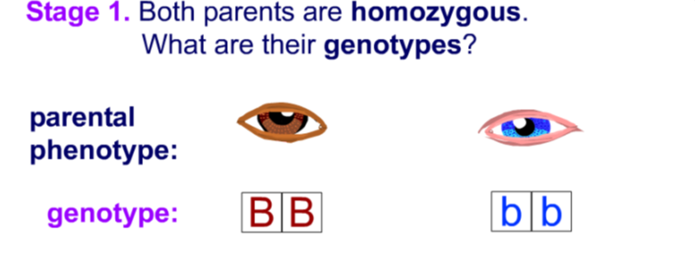
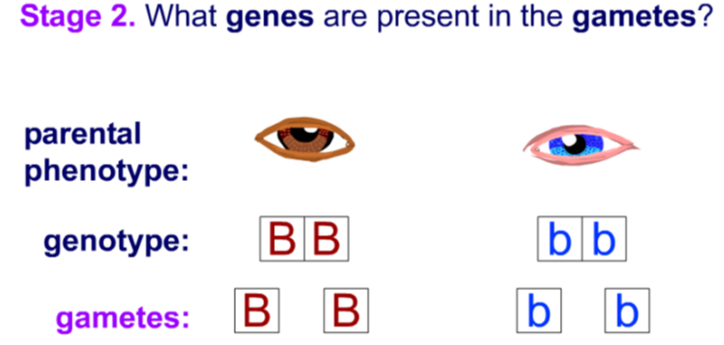
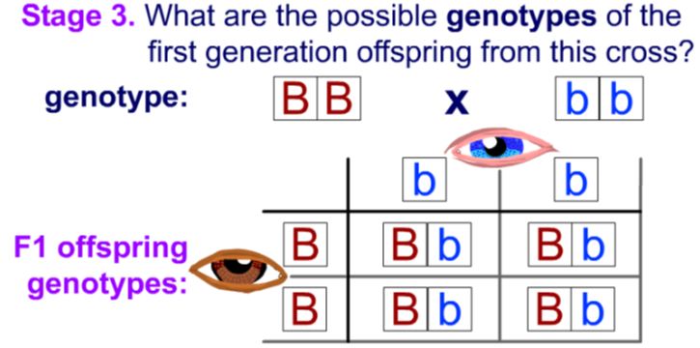
Phenotype = 100% Brown eyes

Slide 47
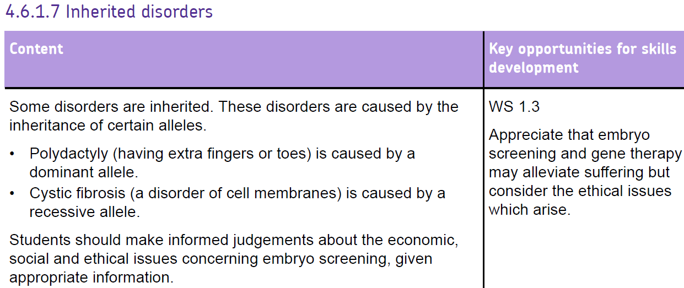

Slide 49
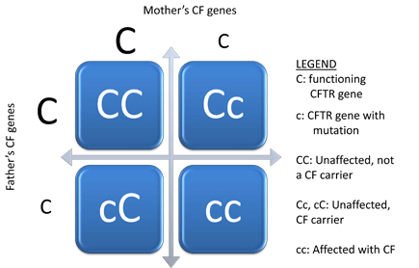
Genetic disorders -Cystic fibrosis

Slide 51
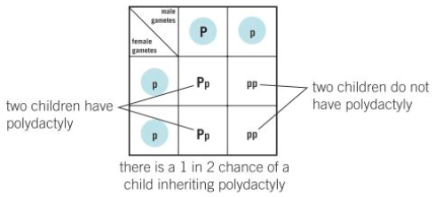
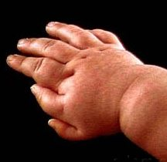
Genetic disorders - Polydactyly
The dominant gene is the allele that causes the disorder, so in this case, there is a 50% chance of having the condition

Slide 52
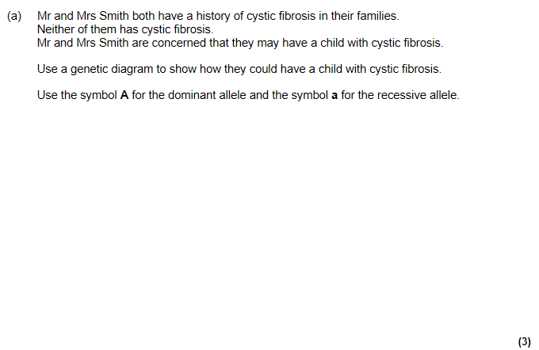


Slide 53







Slide 54


Should Embryos be screened?
FOR | AGAINST
It will help to stop people suffering | May be used to produce designer babies
There are laws to stop it going too far | Dangers from screening process, embryos could be damaged
Embryos that would be destroyed during IVF can be used for research | Ethical or religious issues associated with killing embryos
Treating disorders costs the Government money (saves money) | Screening is expensive

Slide 55



Slide 56






Slide 57


Slide 59

Determining sex
Human body cells have 23 pairs of chromosomes in the nucleus.
One of these pairs controls the inheritance of gender - whether offspring are male or female.

Slide 60

Why is gender a 50/50 chance?

Slide 61


Slide 62


Slide 64



Slide 66






What is the correct order?
A
B
C
D
E
F

Slide 67
A
B
C
D
E
F

Slide 68



Slide 70


SELECTIVE BREEDING
Selective breeding is done intentionally (on purpose)
Done to pass on selected genetic traits
Done to produce desirable traits in both plants and animals
Examples: breeders select dogs with certain personalities, horses that are fast, cows that produce lots of milk
Bengal cat - hybrid breed of a cat mixed with an Asian leopard cat

Slide 71
What steps are involved?
Decide which characteristics are important
Choose parents that show these characteristics
Select the best offspring from parents to breed the next generation
Repeat the process continuously

Slide 72



Slide 73



Slide 74


Slide 75



Slide 77



Genetic engineering
Changing the genetic material of an organism
A gene is taken from chromosomes of one organism and transferred into the chromosomes of a different organism
Using enzymes and a plasmid
Genetic engineering – insulin

Slide 78


Slide 79


Slide 81



Plant cloning
Cuttings
Remove a small section of the plant
New roots and shoot will form to give you a new plant
Rooting powders and moisture will help the process (auxin)
Quick and cheap
Genetically identical plants
Used commercially for orchids and fruit trees
Tissue culture
Expensive and lots of specialist equipment needed
Allows thousands of new pants from tiny piece of plant
Use plant hormones to make a small group of cells produce a big mass of identical plant cells
Using hormones these can then form a new plant
This guarantees all plants will have the desired characteristics
Advantages – quicker, cheaper, no specialist equipment
Disadvantages – doesn’t produce as many plants

Slide 82




Slide 83



Slide 85


Animal cloning
Embryo cloning
Best cow given fertility hormones to produce lots of eggs and fertilise from best bull
Divide each embryo into individual cells - Each cell grows into an identical embryo in the lab
Transfer embryos into surrogate mothers - Identical cloned calves born
Advantages: high quality embryos taken to poor places and produce lots of milk / meat.
Can make lots of identical copies of genetically modified embryos that produce genetically useful compounds
Adult cell cloning
Advantages: Save animals from extinction, Bring back prized animals, Clone genetically engineered, medically useful animals (e.g. Those with useful proteins in their milk)
Disadvantages: Could lead to cloning humans – ethics? Abuse of science – cloning for organs, Reduces variety –species less able to adapt if there is a change (usually some of the species will survive and reproduce but not if we are all clones)

Slide 86



Slide 87




Slide 88



Slide 89



Slide 91

Darwin & natural selection
Darwin travelled the Galapagos Islands and noticed animals were adapted to their surroundings – his theory is that all living organisms have evolved from simpler life forms. This process has come about by natural selection
Follow this pattern but BE SPECIFIC TO THE QUESTION
Variation (possibly caused by mutation)
Competition (for what)
Survival of the fittest
Reproduction (genes passed on)

Slide 92
Accepting Darwin’s Ideas
People initially objected to Darwin’s findings due to the following reasons:
The theory challenged the idea that God made all the animals and plants that live on Earth
There was insufficient evidence at the time the theory was published in order to convince many scientists
The mechanism of inheritance and variation was not known until 50 years after the theory was published

Slide 93




Slide 94



Slide 95





Slide 96

Other theories of Evolution
Jean-Baptiste Lamarck was a French biologist
His idea was that every animal evolved from primitive worms - The change was caused by the inheritance of acquired characteristics. This means that changes that occur during an organisms life time can be inherited
We now know that in the vast majority of cases this inheritance can’t happen

Slide 97






Slide 98



Slide 100
6 Steps to Exam SUCCESS - Speciation
ISOLATION - A species becomes isolated e.g. due to volcanic activity.
GEOGRAPHICAL BARRIER - A barrier is formed between the two populations so they cannot meet to breed.
GENETIC VARIATION - There is genetic variation between the species.
DIFFERENT CONDITIONS – Both populations will live in different conditions
NATURAL SELECTION ACTS DIFFERENTLY- Over time in each population natural selection will cause the most adapted individuals to survive (alleles that give an advantage).
SPECIATION - Eventually the differences between the species will become so great that when they meet again they cannot successfully reproduce = speciation.

Slide 101




Slide 102




Slide 103




Slide 104



Slide 106

Gregor Mendel
Experimented with peas to discover how characteristics were passed on. He saw that the ratios of characteristics were similar depending on what he crossed
Conclusions
Characteristics are determined by hereditary units
Hereditary units are passed on one from each parent
Hereditary units are either dominant or recessive
People did not believe him because he was not a recognised Scientist and people had no understanding of DNA genetics

Slide 107



Slide 108






Slide 109


Slide 110



Slide 112



Fossils form in different ways
Hard parts of an organism get replaced by other minerals.. …most common.
Conditions for decay absent. e.g a whole organism preserved in ice.
Traces of plants or animals are left behind.

Slide 113



Slide 114



Slide 115
The fossil record is incomplete.
Early forms of life were soft bodied.
Fossilisation requires very specific conditions.
Many fossils are destroyed through geological activity.
Many fossils have not been found yet.

Slide 116


Slide 117


Extinction
What causes organisms to become extinct?
  Competition
  New predators
  New diseases
  Environmental changes
  Extreme event (mass extinction)
    Asteroid collision
    Volcanic eruption

Slide 118




Slide 119



Slide 121




Slide 123

The Classification Ladder
We can further classify an organism into these subgroups.
Largest number of organisms
The number of organisms decreases
Smallest number of organisms – the animal is named.

Slide 124
Create your own Pneumonic to remember the order.
Kuwait
Produces
Crude
Oil
For
General
Sale

Slide 125

Classifying a Lion – Kingdom Animalia
What is classification?
To which class does the African lion belong?
Name one other class in the animal kingdom.
At which level of classification is the African lion grouped with the polar bear?

Slide 126

The Five Kingdoms of Living Organisms

Slide 127



Slide 128



Slide 129

We can show evolutionary relationships in evolutionary trees.

Slide 130

We can show evolutionary relationships in evolutionary trees.

