Slide 1
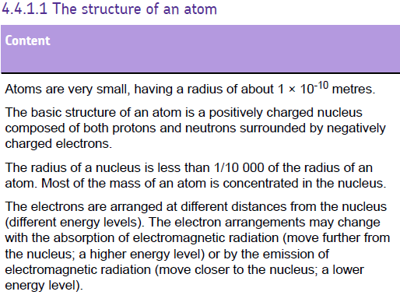

Slide 2
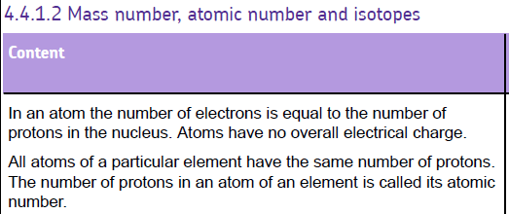
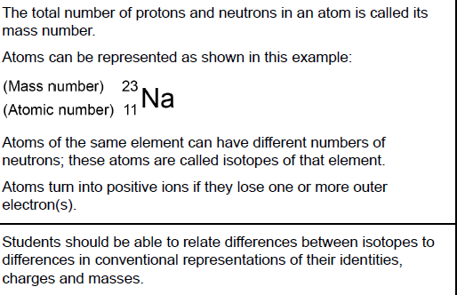

Slide 3
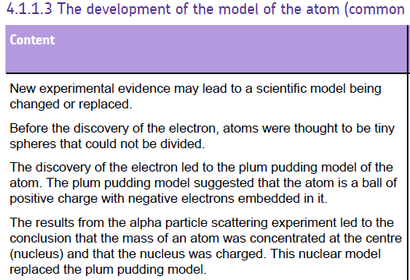
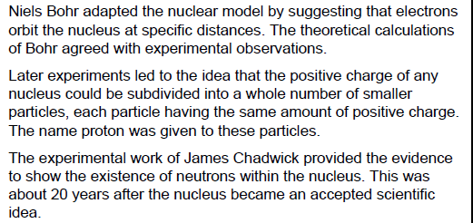

Slide 4
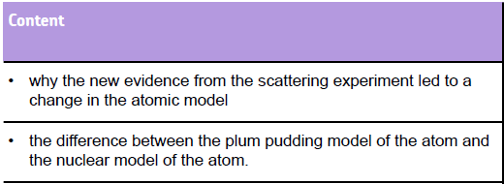

Slide 5
Order of discovery of sub atomic particles
Particle | Date | Scientist
Electron | 1897 | JJ Thomson
Proton | 1919 | Ernest Rutherford
Neutron | 1932 | James Chadwick

Slide 6

Rutherford Experiment: the set up
Geiger and Marsden counted the tiny green flashes in the microscope produced when alpha particles hit the screen.
Both Geiger and Marsden described this as one of the most difficult and boring experiments they’d ever had to do.
Moveable Microscope
Zinc sulphide screen
(glows when hit by alpha particles)
Shield
Source of alpha particles
Vacuum
(air pumped out)
Very thin gold foil

Slide 7
Geiger and Marsden placed the microscope as shown.
As expected, most of the alpha particles went straight through
A few alpha particles were scattered by angles less than 90º, also as expected.

Slide 8
Under protest, Geiger and Marsden placed the microscope behind the gold leaf.
Much to their surprise, a very small number of alpha particles (about 1 in 8000) bounced off the gold atoms!
They handed the results to Professor Rutherford who now had to explain what was going on.

Slide 9
Observations
Rutherford’s experiment finished with 3 observations. You need to explain what each observation tells us about the atom as we know it today
Most of the fast, highly charged alpha particles went whizzing straight through un-deflected.
Some of the alpha particles were deflected through a small angles
A very small number of alpha particles were deflected backwards!

Slide 10
Conclusions
Most of the fast, highly charged alpha particles went whizzing straight through undeflected.
SUGGESTS THAT MOST OF THE ATOM IS EMPTY SPACE!!

Slide 11
Conclusions
Some of the alpha particles were deflected through a small angles!
SUGGESTS THAT THERE IS A CONCENTRATED POSITIVE MASS SOMEWHERE IN THE ATOM.

Slide 12
Conclusions
A very small number of alpha particles were deflected backwards!
SUGGESTS THAT THE CONCENTRATED MASS IS MINISCULE COMPARED TO THE SIZE OF THE REST OF THE ATOM, BUT CONTAINS MOST OF THE MASS

Slide 13
What did Bohr do? (1913)
Realised that electrons should be attracted in to the nucleus
Used mathematical models to show that electrons occupy fixed energy levels (or shells) around the nucleus

Slide 14
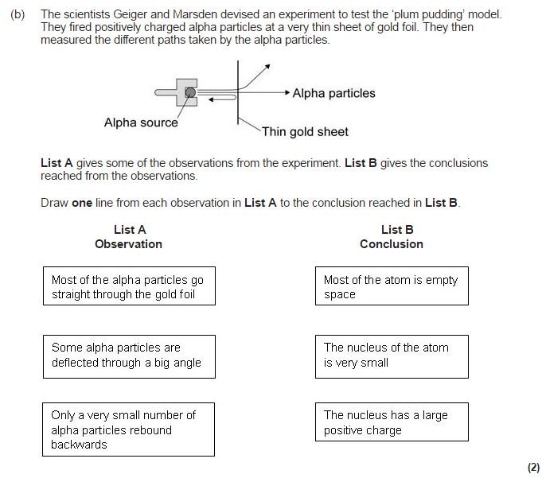
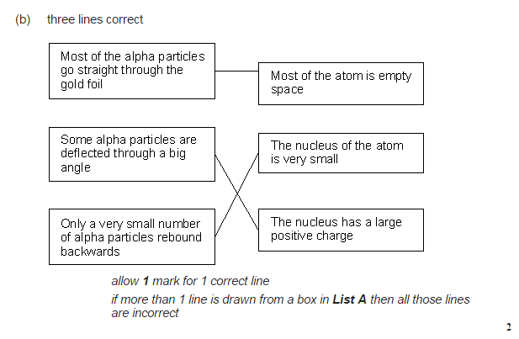

Slide 15
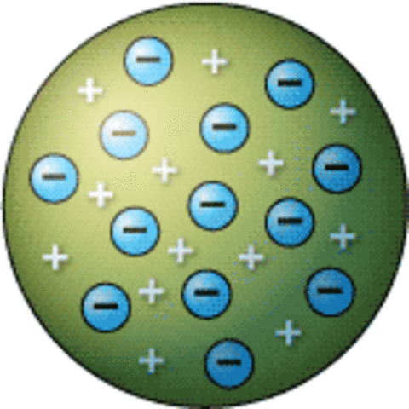
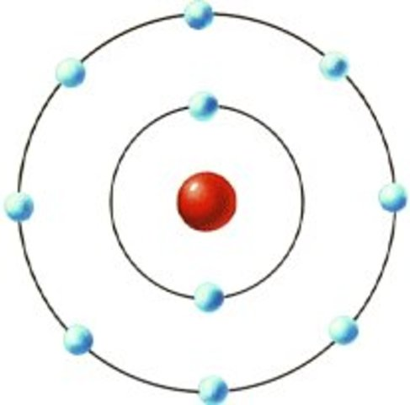
Plum Pudding Model
Nuclear Model
Compare the differences between the plum pudding model and the nuclear model.
Think about the location of:
The mass
The negative charge
The positive charge
The density

Slide 16
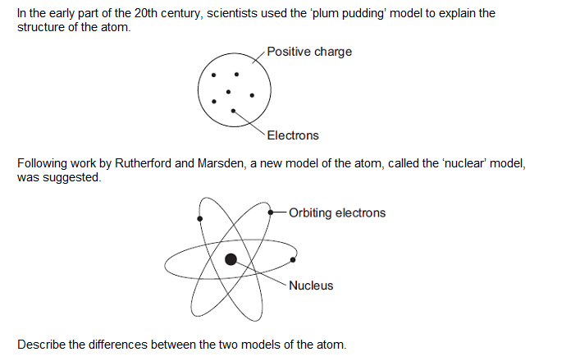
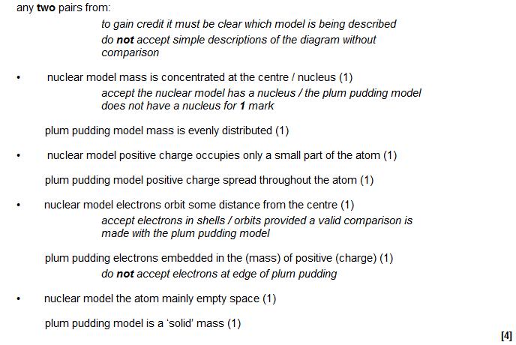

Slide 17
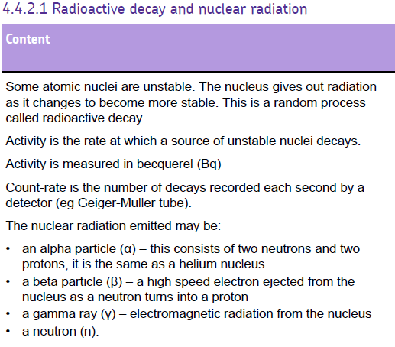
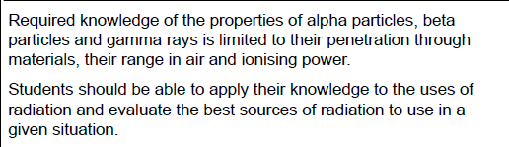

Slide 18

Radioactivity
Some substances give out
radiation from the nuclei of
Their atoms. They are radioactive.
This is because their nuclei are unstable, and they become stable by emitting radiation.
This decay is random and cannot be predicted. It goes on all of the time.

Slide 19
Ionisation
Radiation can knock electrons out of atoms.
This causes the atoms to become charged.
This is called ionisation.
Why?
+
+
Alpha
particle
+
+

Slide 20

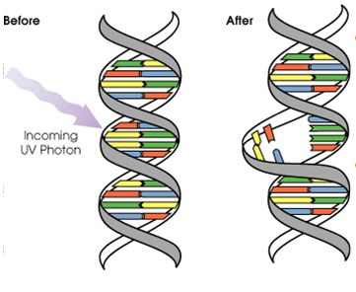
Ionisation
This can damage or kill a living cell.
If the DNA in a cell is damaged, this can also be passed on when the cell generates more cells.
Alpha radiation is
actually more
dangerous than
gamma and beta
radiation. Why?
Incoming radiation

Slide 21
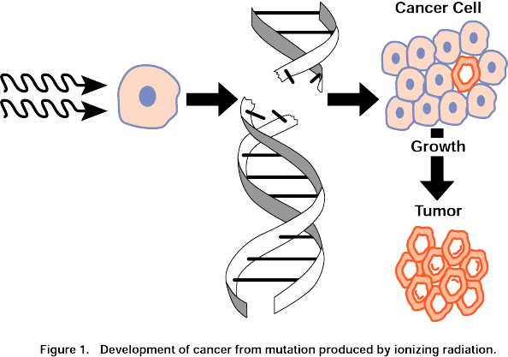

Slide 22
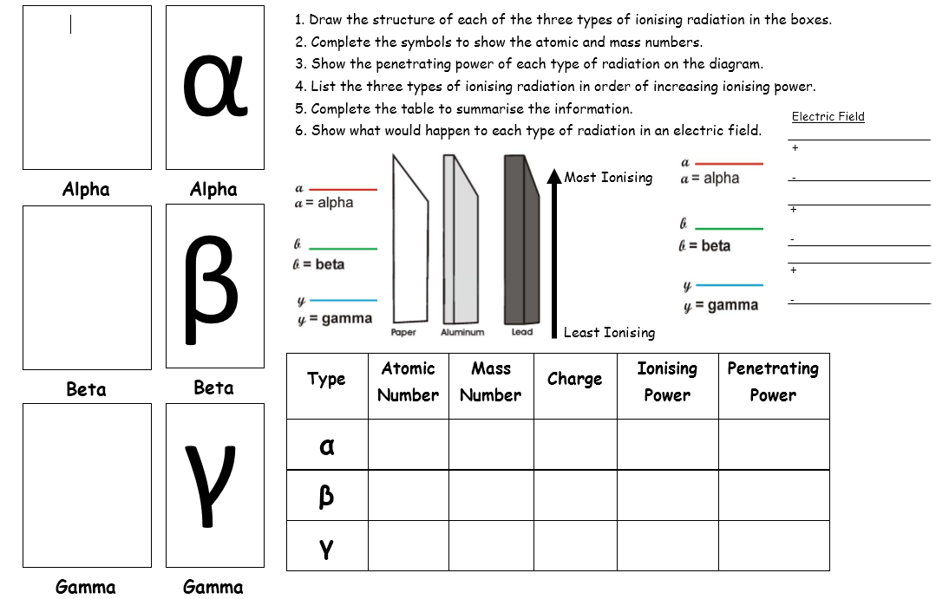


Slide 23
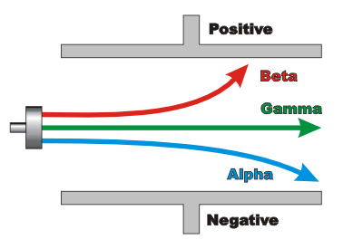
Deflecting Radiation
Using a magnetic field

Slide 24
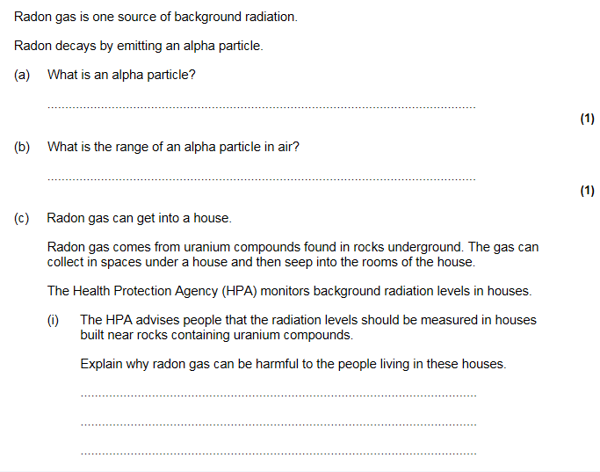
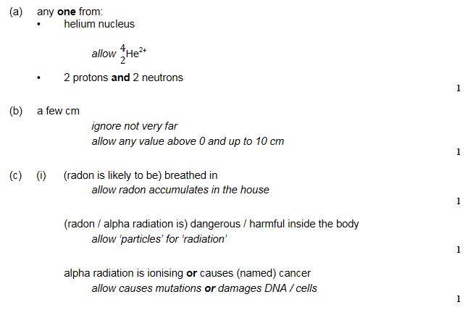

Slide 25
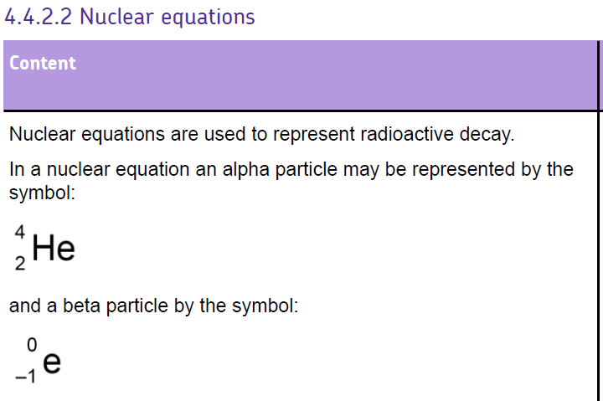

Slide 26
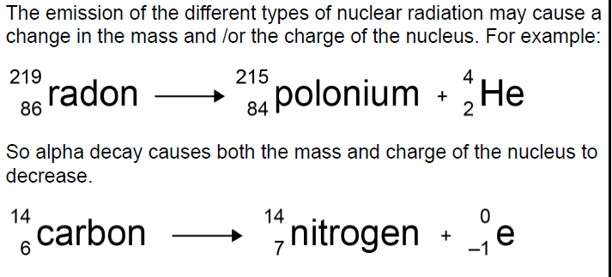

Slide 27
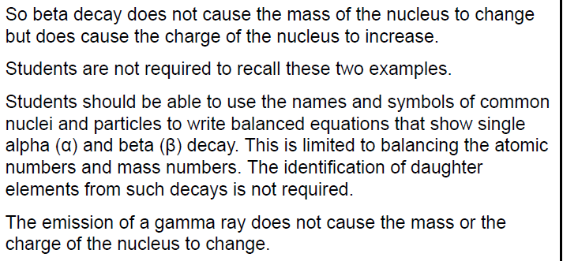

Slide 28
α Alpha decay
The nucleus loses
2 protons and
2 neutrons as an
alpha particle
Americium
Neptunium
α particle
241
237
+
4
Am
Np
He
95
93
2
When an unstable nucleus emits an α particle its atomic number goes down by 2 and its mass number by 4.

Slide 29
β Beta Decay
A neutron changes into a proton.
An electron is created and is emitted.
Carbon
Nitrogen
β particle
14
14
+
0
e
C
N
6
7
-1
When an unstable nucleus emits a β particle its atomic number goes up by 1 but its mass number stays the same.

Slide 30
γ Gamma Radiation
Is not a particle
It is a form of electromagnetic radiation emitted when an atom goes through α or β decay.
It has no charge or mass (unlike α and β radiation)

Slide 31
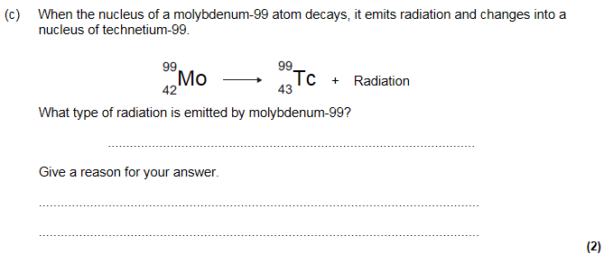
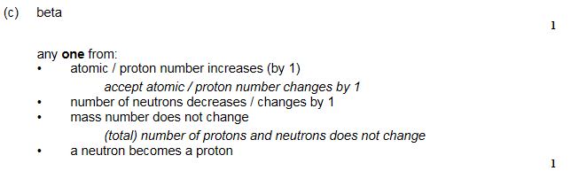

Slide 32
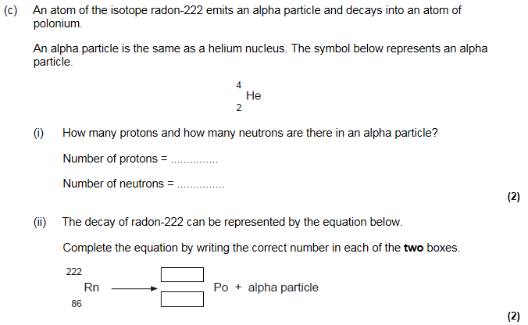
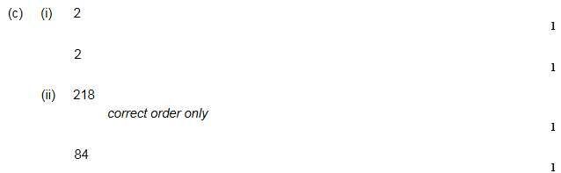

Slide 33
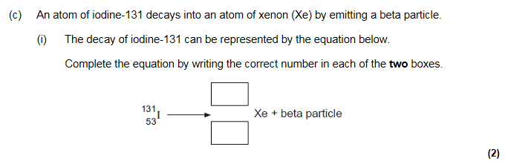
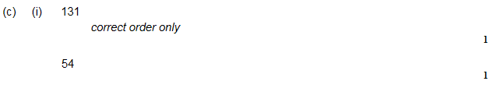

Slide 34
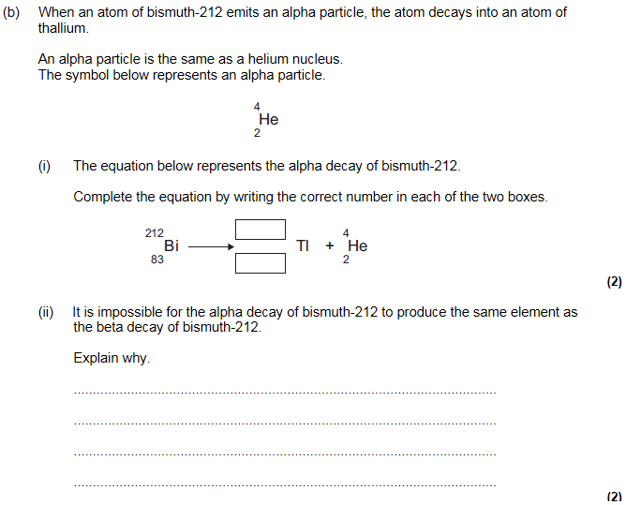
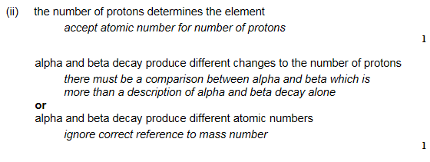

Slide 35
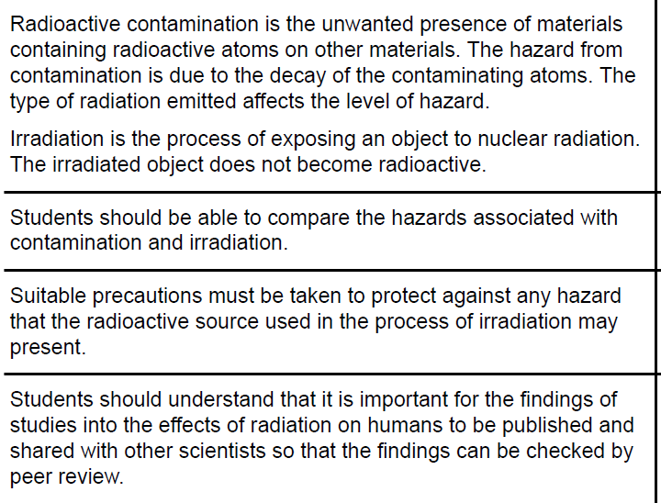
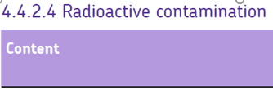

Slide 36
Contamination or irradiation
Contamination - the unwanted presence of materials containing radioactive atoms on other materials
Irradiation - the process of exposing an object to nuclear radiation. The irradiated object does not become radioactive

Slide 37
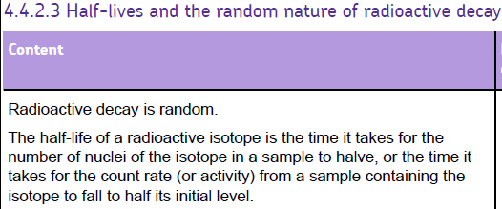
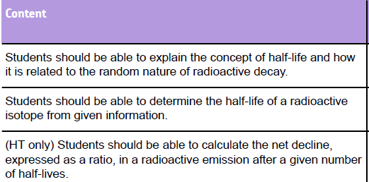

Slide 38
Half life
The decay of radioactive isotopes can be used to measure a material’s age. The HALF-LIFE of an atom is the time taken for HALF of the radioactive isotopes in a sample to decay…
= radioactive atom
= new atom formed
At start there are 16 radioactive atoms
After 1 half life half have decayed (that’s 8)
After 2 half lives another half have decayed (12 altogether)
After 3 half lives another 2 have decayed (14 altogether)

Slide 39
Notes:
Teacher notes
This four-stage animation explains about half-life and how to calculate it from a decay curve graph.

Slide 40
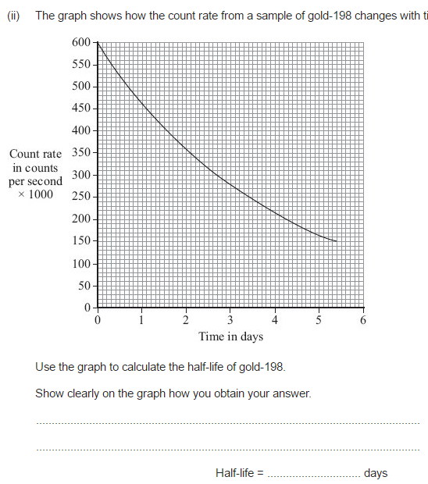

Slide 41
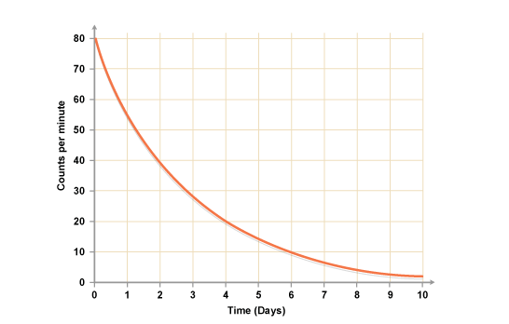

Slide 43
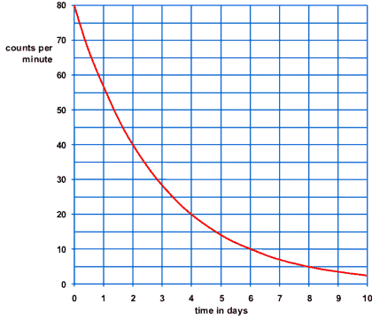

Slide 44
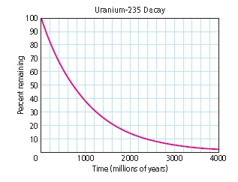

Slide 45
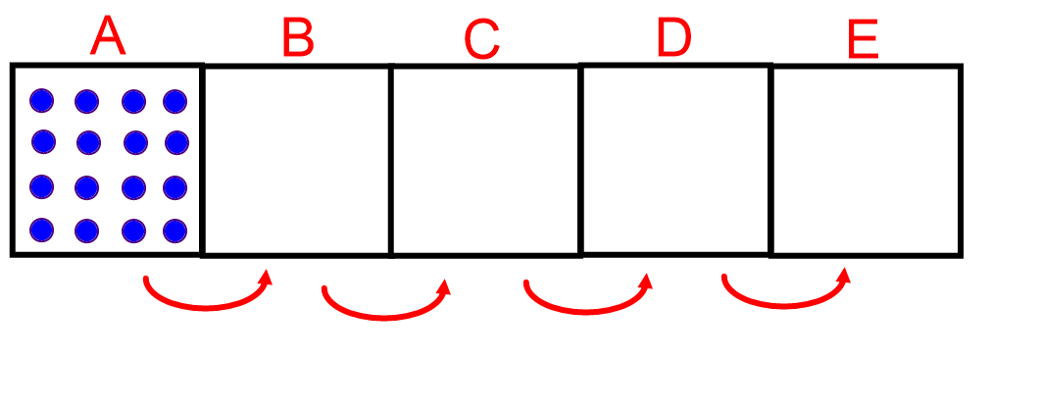
Practice questions
Copy and complete the diagram for an isotope with a half-life of 36 seconds:
Mendelevium-257 has a half-life of 5.5 hours. If a source contains 36,000 mendelevium-257 nuclei, how many would remain after 5.5 hours?
Fermium-253 has a half-life of 3 days. If a source contains 56,742 fermium-253 nuclei, how many would remain after 3 days?

Slide 46
Practice questions
Mendelevium-257 has a half-life of 5.5 hours. If a source contains 36,000 mendelevium-257 nuclei, how many would remain after 11 hours?
Fermium-253 has a half-life of 3 days. If a source contains 5,672 fermium-253 nuclei, how many would remain after 6 days?
Hydrogen-3 has a half-life of 5.3 years. If a source contains 786,044 hydrogen-3 nuclei, how many would remain after 10.6 years?
Hydrogen-3 has a half-life of 5.3 years. If a source has an activity of 2,000Bq, what will its activity be after 21.2 years?
Carbon-15 has a half-life of 2.5 seconds. If we have 19,200 carbon-15 nuclei, how long will we have to wait until we have 1,200 carbon-15 nuclei?

Slide 47
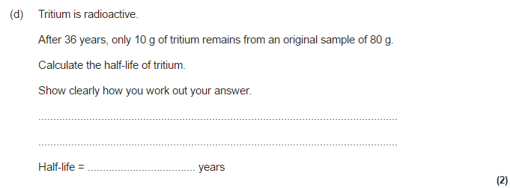


Slide 48
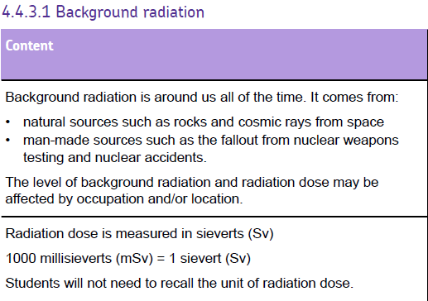

Slide 49
Background Radiation
13% are man-made
Radon gas
Food
Cosmic rays
Gamma rays
Medical
Nuclear power
radiation (received by the body) due to our environment

Slide 50
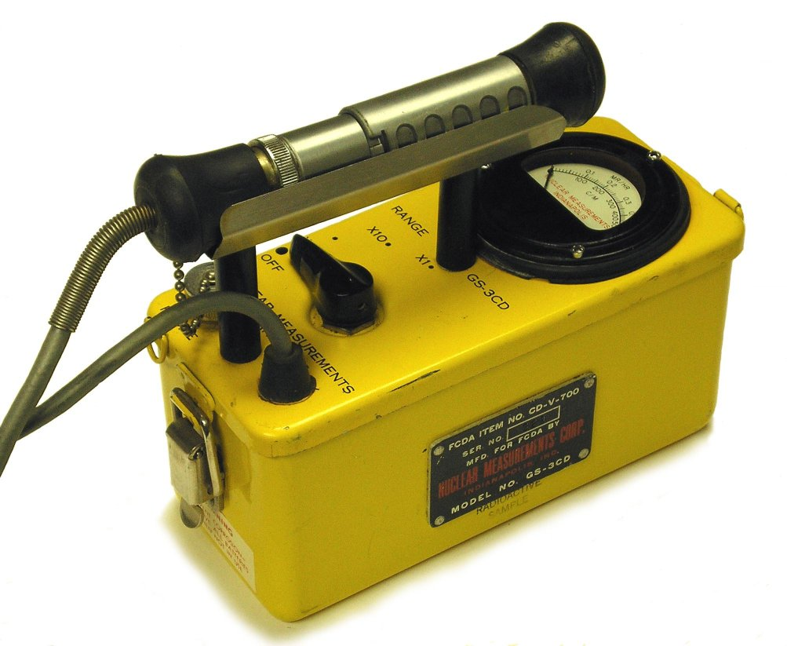
What stops radiation?
We can use a Geiger counter to find out which materials stop, or absorb, radiation.
What could affect our results?
Background radiation!
So we measure the background count rate first, then we measure the radioactive material and take away the background count rate.

Slide 51
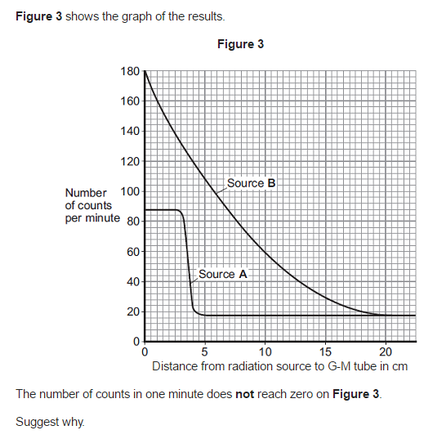

Slide 52
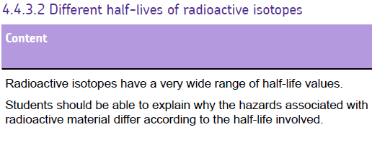
Example
Using a radioactive isotope with a short half life for medical tracers

Slide 53
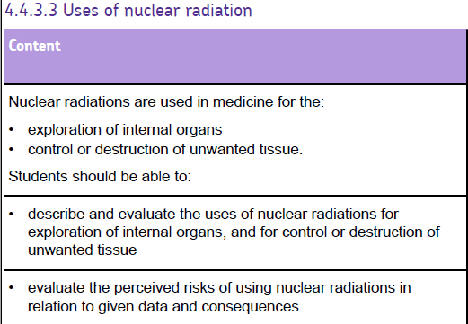

Slide 54
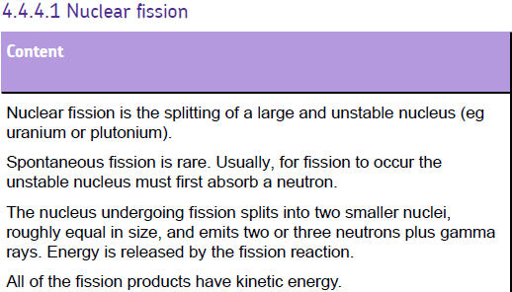
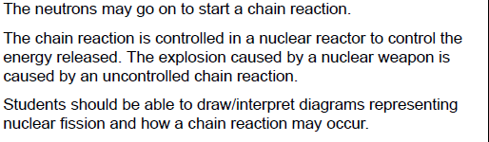

Slide 55
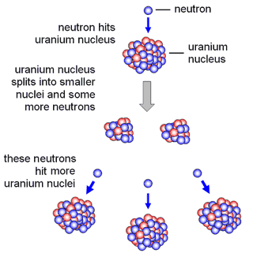
Nuclear Fission
There are TWO fissionable substances in common use: uranium-235 & plutonium-239

Slide 56
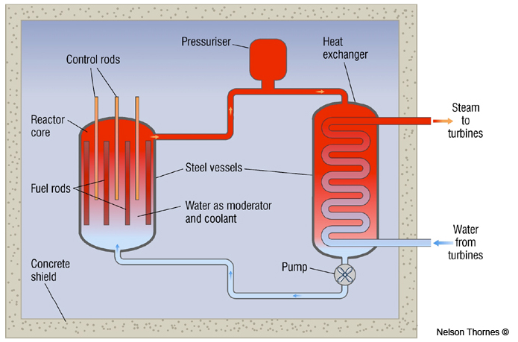
A Nuclear Reactor
Control rods absorb surplus neutrons to keep the reaction under control. Cadmium and boron are commonly used.
The reactor core is made form thick steel and enclosed by concrete, which absorb escaped radiation.
Fission neutrons are slowed down by atoms in the water molecules.
Moderator
Water acts as a coolant. Its molecules gain kinetic energy from the neutrons and the fuel rods.

Slide 57



Slide 58



Slide 59



Slide 60


Slide 61

Nuclear Fusion

Slide 62

Nuclear Fusion
What you need to know:
Nuclear fusion is the joining of
two small nuclei and this process
releases energy.
The Sun releases energy due to
the fusion of hydrogen isotopes.
Nuclear fusion reactors are difficult to build because they need to work at very high temperatures and high pressures.

Slide 63



