Slide 1
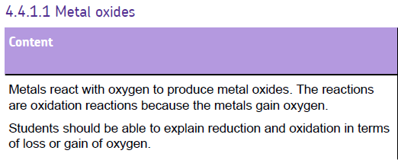

Slide 2
Oxidation
Magnesium + oxygen → Magnesium oxide
Magnesium is OXIDISED, because it has gained oxygen

Slide 3
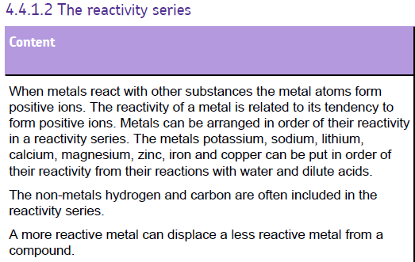
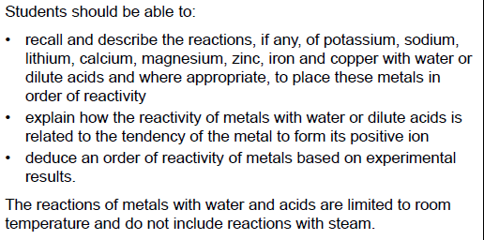

Slide 4
Reactivity series
Potassium
Sodium
Lithium
Calcium
Magnesium
Carbon
Zinc
Iron
Hydrogen
Copper
Silver
Gold
ELECTROLYSIS
REDUCTION
NATIVE METALS

Slide 5
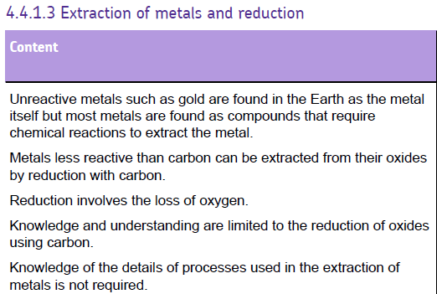
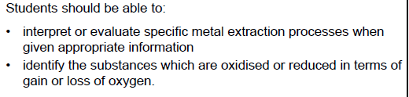

Slide 6
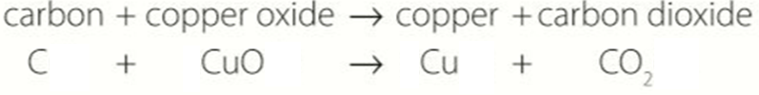
Displacement reactions
Carbon is OXIDISED, because it has gained oxygen
Oxygen is displaced from the metal oxide to join with carbon; leaving the metal
Copper is REDUCED, because it has lost oxygen
Oxygen is a ‘spectator’ ion

Slide 7
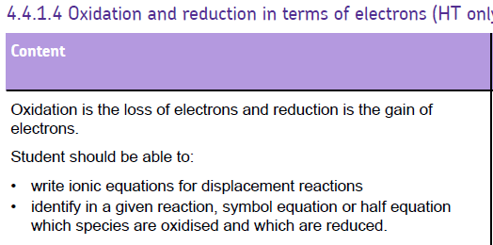

Slide 8
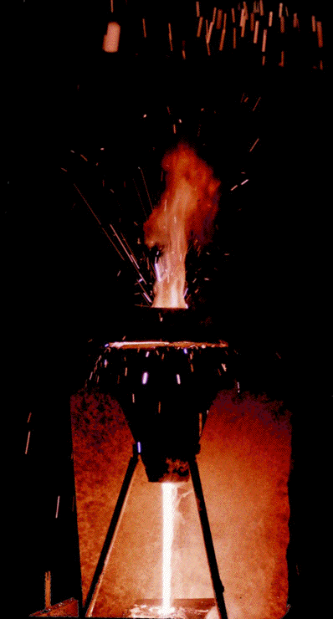
Reduction and oxidation reactions
Fe₂O₃ + Al → Fe + Al₂O₃
Fe³⁺ Al⁰ Fe⁰ Al³⁺
Fe³⁺ + 3e⁻ → Fe Reduction
Al → Al₂O₃ + 3e⁻ Oxidation
Oxygen is a ‘spectator’ ion
Ionic half-equations

Slide 9
OIL RIG
OXIDATION is LOSS (of electrons)
REDUCTION is GAIN (of electrons)

Slide 10
Complete the half-equation Na → Na⁺ | Na → Na⁺+ e⁻
Complete the half-equation Pb⁴⁺ → Pb²⁺ | Pb⁴⁺ + 2e⁻ → Pb²⁺
Complete the half-equation H₂ → H⁺ | H₂ → 2H⁺ + 2e⁻
Complete the half-equation Cr₂O₇²⁻ → Cr³⁺ | Cr₂O₇²⁻ + 6e⁻ → 2Cr³⁺
What’s wrong with this equation? Ce³⁺ + e⁻ → Ce⁴⁺ | Electron is on the wrong side!
What’s wrong with this equation? Mg + 2H⁺ + e⁻ → Mg⁺ + H₂ + e⁻ | Should be Mg²⁺ Electrons should be cancelled out

Slide 11
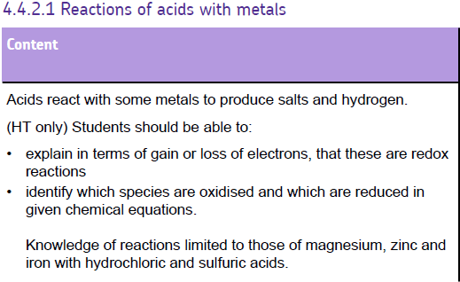

Slide 12

Reaction of Metals with Acids
Metal_{(s)} + Acid_{(aq)}
Salt_{(aq)} + Hydrogen_{(g)}
For example
Hydrochloric + Magnesium
Acid
Magnesium + Hydrogen
Chloride
2HCl_{(aq)} + Mg_{(s)}
MgCl_{2(aq)} + H_{2(g)}
Why is this an example of a displacement reaction? (Key words: reactive, magnesium, hydrogen)

Slide 13
Reaction of Metals with Acids
Hydrochloric + Magnesium
Acid
Magnesium + Hydrogen
Chloride
2HCl_{(aq)} + Mg_{(s)}
MgCl_{2(aq)} + H_{2(g)}
Ionic Equations
2H⁺ + Mg
Mg²⁺ + H₂
Ionic half Equations
Mg – 2e⁻
Mg²⁺
2H⁺ + 2e⁻
H₂

Slide 14
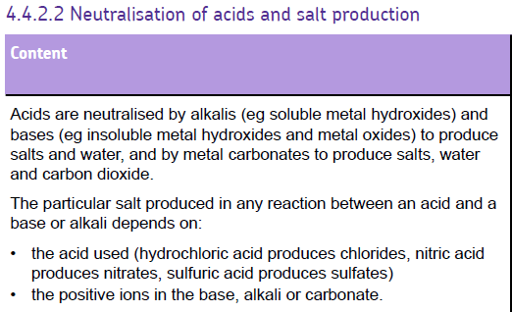
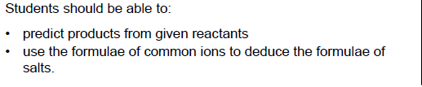

Slide 15
Making Salts
Can dissolve
Soluble salts
Neutralisation
Neutralisation
acid + alkali → salt + water
acid + insoluble → salt + water
base
Neutralisation
acids + metal → salt + hydrogen
acids + carbonate → salt + water + carbon dioxide

Slide 16
What salt is produce
metal
nitric acid
sulfuric
acid
hydrochloric acid
acid
metal
nitrate
metal sulfate
metal
chloride
salt
hydrogen
The salt produced depends on the metal (or metal compound) and type of acid involved in the reaction:
When a metal reacts with hydrochloric acid, the salt produced is a metal chloride.
When a metal reacts with sulfuric acid, the salt produced is a metal sulfate.
When a metal reacts with nitric acid, the salt produced is a metal nitrate.

Slide 17
Complete the word equations
What element do the acids have in common?
Complete the word & symbol equations for metals reacting with acid:
magnesium
nitric acid
?
Acids
Nitric acid = HNO₃
Sulfuric acid = H₂SO₄
Hydrocholric acid = HCl
Salts
Nitrate = NO₃
Sulfate = SO₄
Chloride = Cl
magnesium nitrate
hydrogen
Symbol:
iron
sulfuric acid
?
hydrogen
iron sulfate
Symbol:
zinc
hydrochloric acid
zinc chloride
?
hydrogen
Symbol:
lead
?
sulfuric acid
?
lead sulfate
hydrogen
Symbol:

Slide 18
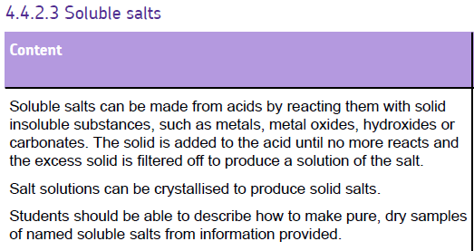

Slide 19
Reaction of Bases with Acids
Neutralisation
Acid_{(aq)} + Base_{(s)}
Salt_{(aq)} + Water_{(l)}
For example
6HCl_{(aq)} + Fe₂O_{3(s)}
2FeCl_{3(aq)} + 3H₂O_{(l)}
Hydrochloric + Iron (III)
Acid Oxide
Iron (III) + Water
Chloride

Slide 20
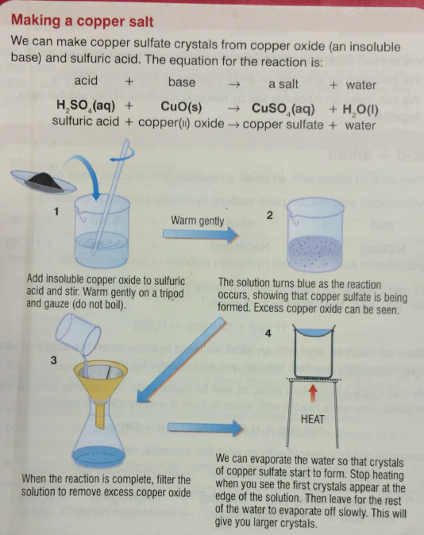
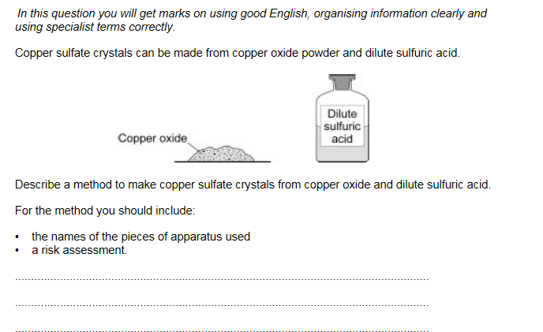
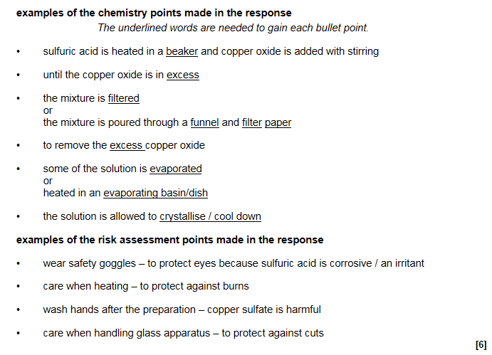

Slide 21
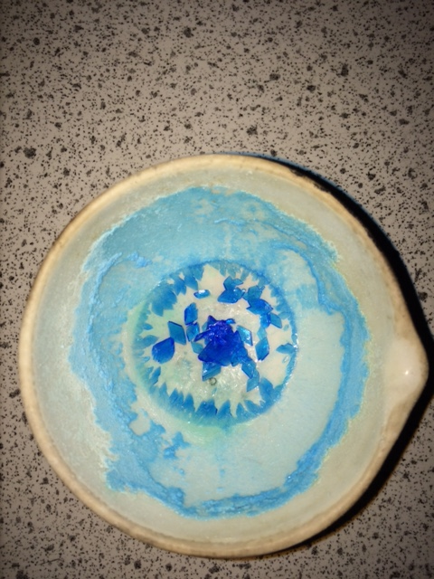
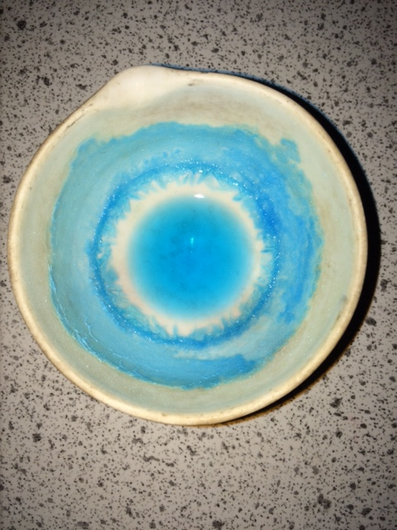

Slide 22
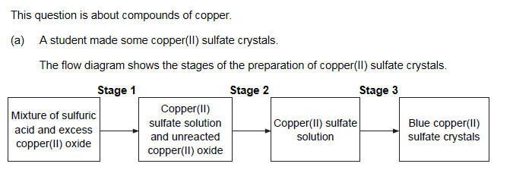
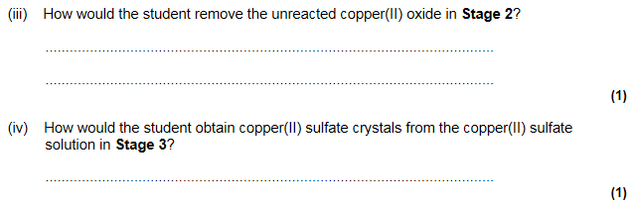
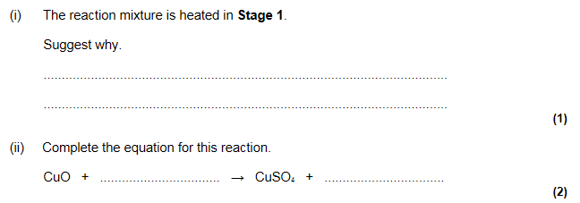
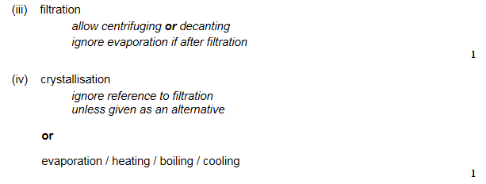
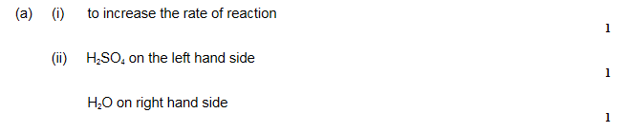

Slide 23
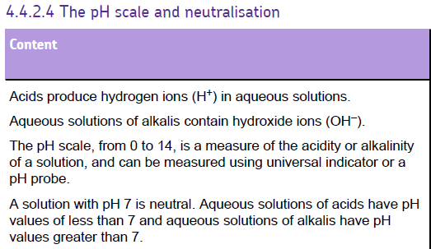
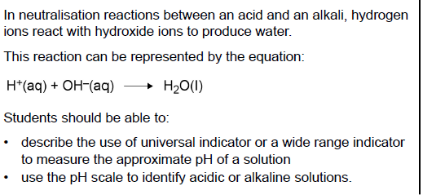

Slide 24
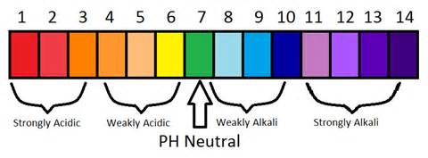
pH Scale
Runs from 1 – 14
1 is a strong acid
An increase in pH means the acid is getting slowly weaker until;
7 is neutral
14 is a strong alkali
Reducing the pH is a
weaker alkali

Slide 25
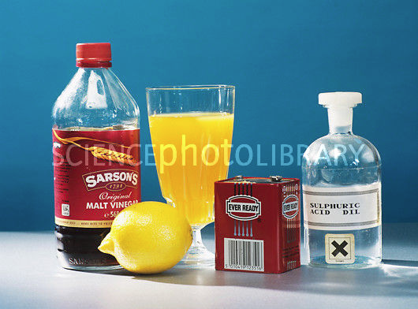
Acids
These are substances that contain hydrogen ions (H⁺)
The pH scale is a measure of the amount of H⁺ a solution contains.
Low pH means high H⁺ and high acidity

Slide 26
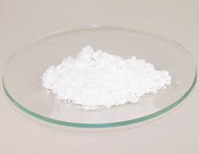
Bases
Substance with a pH GREATER than 7
These are substances which can neutralise acids. Metal oxides and hydroxides (eg magnesium oxide and magnesium hydroxide) are bases.
Bases that dissolve in water are called alkalis and produce OH- (hydroxide ions) in solution.
Bases and alkalis have a high pH over 7 on the pH scale.
BASE
Dissolves in water
ALKALI_{(aq)}

Slide 27
Reaction of Alkalis with Acids
Neutralisation
Acid_{(aq)} + Alkali_{(aq)}
Salt_{(aq)} + Water_{(l)}
For example
Hydrochloric + Sodium
Acid Hydroxide
Sodium + Water
Chloride
HCl_{(aq)} + NaOH_{(aq)}
NaCl_{(aq)} + H₂O_{(l)}

Slide 28
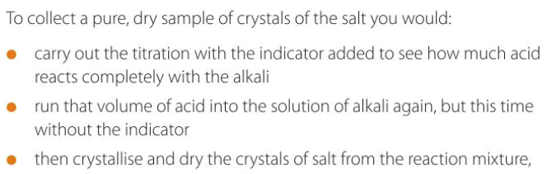
Creating a salt from an acid and alkali

Slide 29
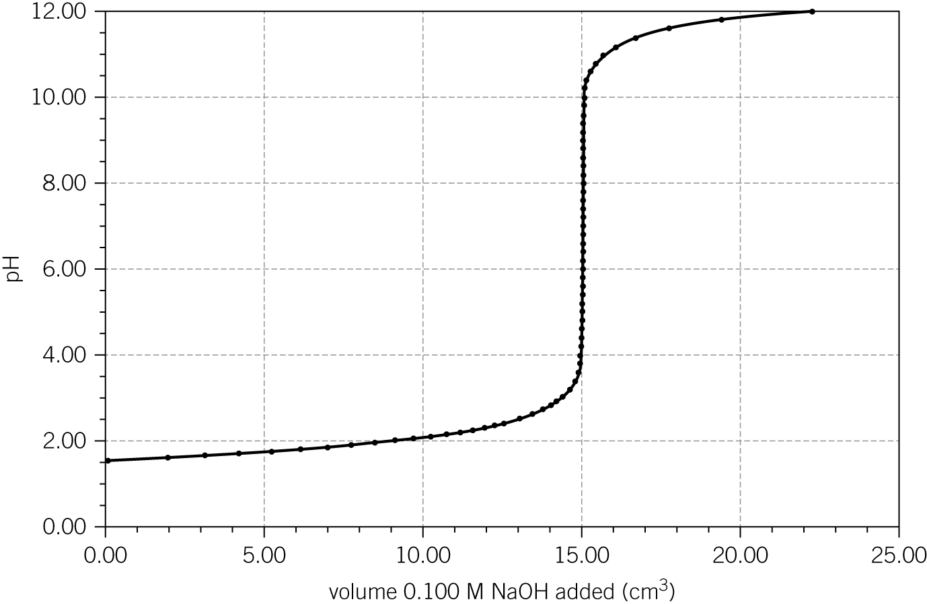
pH Curve
Video

Slide 30
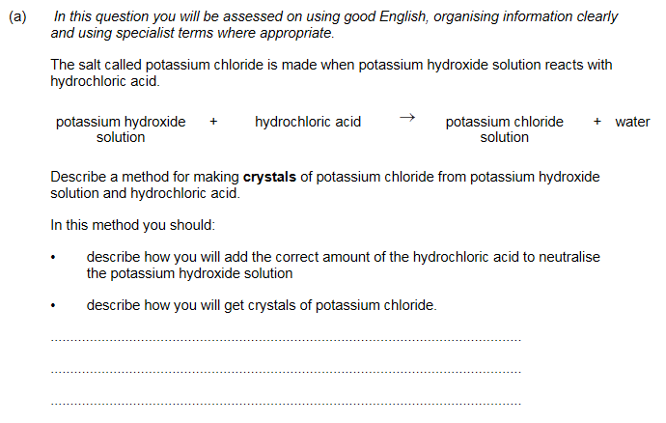
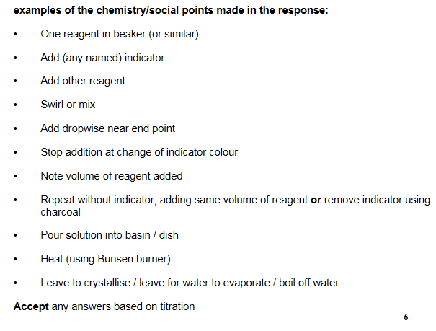

Slide 31
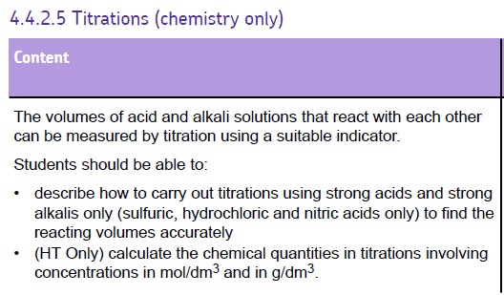

Slide 32

Use the pipette and pipette filler to put exactly 25 cm³ sodium hydroxide solution into the conical flask.
Put the flask on a white tile.
Use the small funnel to carefully fill the burette with dilute sulfuric acid. Before it completely fills put a small beaker underneath the tap, gently open it to allow acid to fill the tap, before closing again and filling the burette to the 0.00 cm³ line. Remove the funnel.
Put 5–10 drops of phenolphthalein indicator into the conical flask. Swirl the flask to mix and put under the burette on top of the tile. The contents of the flask will go pink.
Carefully open the burette tap so that 10 cm³ sulfuric acid slowly flows into the flask. Constantly swirl the flask when adding the acid. Then add the acid drop by drop until you see a permanent colour change from pink to colourless in the flask.
You need to be able to shut the tap immediately after a single drop of acid causes the colour to become permanently colourless.

Slide 33
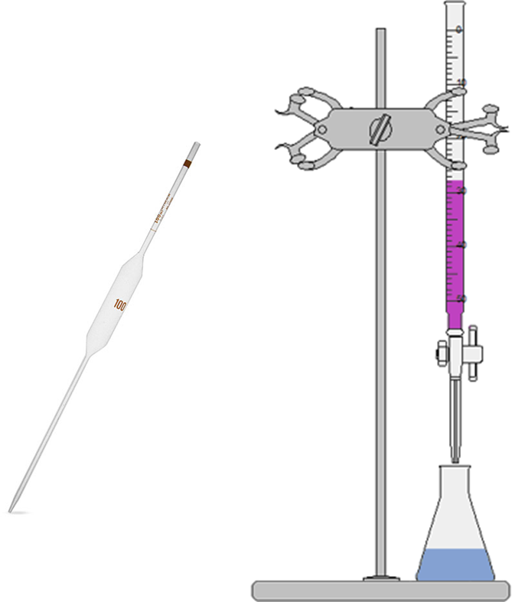
In a diagram…
HCl
Concentration ?
Volume = your average titre
NaOH
Concentration = 0.1 mol dm⁻³
Volume = 25 cm³

Slide 34
Concentration = no. of moles volume
Learn this formula triangle!
number of moles
n
concentration (in mol/dm³)
volume (in dm³)
c
v

Slide 35
Concentration
1 litre
= 1000 cm³
= 1 dm³
Concentration is a measure of how crowded things are.
The concentration can be measured in moles per dm³ (ie. moles per litre).
So 1 mole of ‘stuff’ in 1 dm³ of solution has a concentration of 1 mole per dm³ (1mol/dm³).
The more solute you dissolve in a given volume, the more crowded the solute molecules are and the more concentrated the solution.

Slide 36
Using the triangle
Example 1:
What is the concentration of a solution with 2 moles of salt in 500cm³?
The question already tells us the number of moles and the volume, so use the formula:
c = n = 2 = 4 mol/dm³
v 0.5
convert the volume to dm³ first by dividing by 1000.

Slide 37
Using the triangle
Example 2:
How many moles of sodium chloride are in 250cm³ of a 3 mol/dm³ solution of sodium chloride?
The question tells us the volume and concentration, so use the formula:
n = c x v = 3 x 0.25 = 0.75 moles
convert the volume to dm³ first by dividing by 1000.

Slide 38
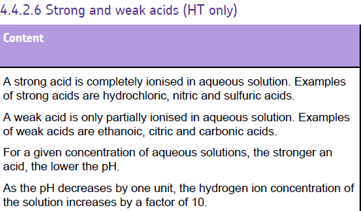
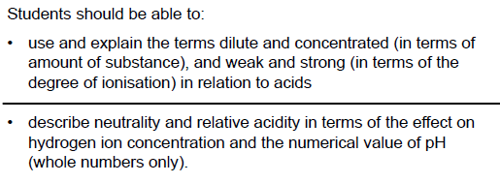

Slide 39
Strong & Weak Acids
Classification of ‘strong’ or ‘weak’ depends on the extent to which they ionise in water.
Strong = 100% ionised in water.
  E.g. HCl, H₂SO₄, HNO₃; NaOH, KOH
Weak = only partly ionised in water.
  E.g. Ethanoic acid (CH₃COOH), citric acid (C₆H₈O₇), carbonic acid (H₂CO₃); Ammonia solution (NH₄OH)
Video 2
Video 1

Slide 40

Strong or Weak?
2 main ways to measure:
  pH scale = measure of concentration of hydrogen ions in a solution.
  E.g. samples of strong and weak acids with the same concentration, strong acid = lower pH.
    It is fully ionised.
HCl→ Cl⁻ + H⁺
Pure hydrogen chloride
Completely ionised, so concentration of H⁺ ions = 1mol/dm³
(Strong acid)
Dissolve each acid in water to make
a 1mol/dm³ solution
Pure citric acid
Only partly ionised, so concentration of H⁺ ions = much less than1mol/dm³
(Weak acid)
CH₃COOH CH₃COO⁻ + H⁺

Slide 41
Concentrated, but weak? Why
A
H
A
H
H⁺
A
A
H
H
A
H
A
A⁻
A⁻
H
A⁻
A⁻
A
A
H
A
H
H
A
H
A
A
H⁺
H
A⁻
A
H
H
A
H⁺
A⁻
H
A
H
A
A
H
H⁺
H
A
A
H
H
A
H
A
H
A
H⁺
A
H
H
H⁺
A
H
A
H
A
H
A
H

Slide 42
Concentrated, and strong? Why
H⁺
A⁻
H⁺
H⁺
A
A⁻
H⁺
A⁻
H
A⁻
A⁻
How could you make it more dilute?
H⁺
H⁺
A⁻
A
A
H
H
A
H
H⁺
A⁻
A⁻
H⁺
H⁺
A
A⁻
H
A⁻
H⁺
A⁻
H⁺
A
A
H
H⁺
H
H⁺
A⁻
H⁺
A⁻
A⁻
A⁻
H⁺
A⁻
H⁺
A
H⁺
A⁻
H
H⁺
A⁻

Slide 43
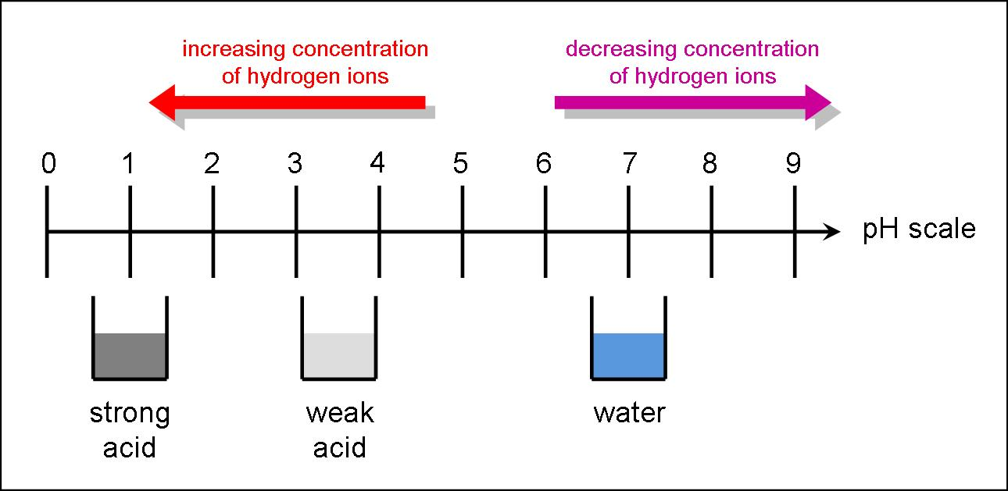
Strong or Weak?
Or – by observing the rate of reaction, when a reactive metal is added.

Slide 44
Strong, weak; concentrated, dilute??
H⁺
A⁻
A⁻
A
H
A
H
H⁺
A
A⁻
A⁻
H⁺
H
A
H⁺
A⁻
H⁺
H
A
H
A
H
A⁻
A
A⁻
A⁻
H
H⁺
H⁺
H⁺
A⁻
A⁻
A
A
A⁻
H⁺
H
A⁻
H⁺
A⁻
H
A
A
H⁺
H
A⁻
A
A⁻
H⁺
H
A
H
H⁺
H
H⁺
H⁺
Weak, concentrated
Weak, dilute
Strong, concentrated
Strong, dilute

Slide 45
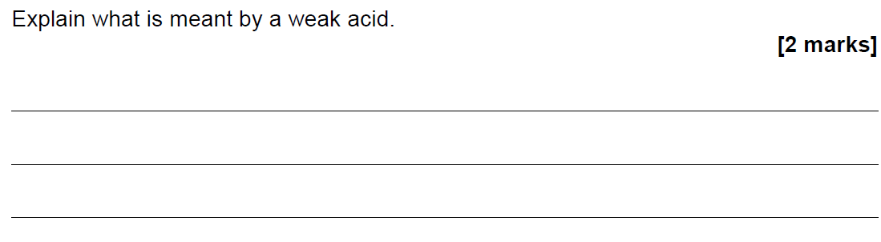
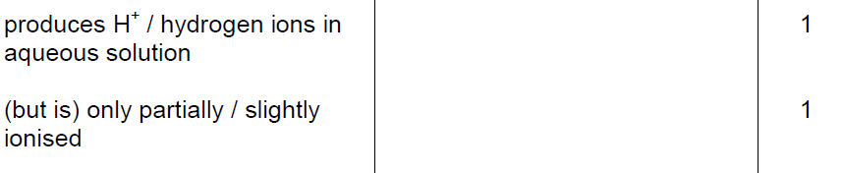

Slide 46
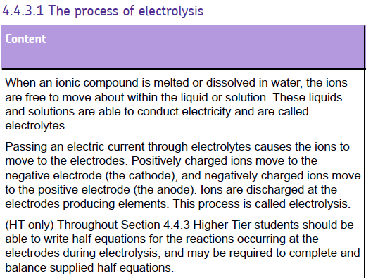

Slide 47
SPLITTING UP IONIC COMPOUNDS 2
2 ways to split up the ions:
-
+
-
MELT
+
-
+
DISSOLVE
-
+
-
+
-
+
+
-
-
+
-
-
+
+
+
+
-
+
-
-
+
+
-
+
-
+
-
+
-
+
-
800°C
20°C
H₂O

Slide 48
SEPARATING THE IONS 2
+
MOLTEN IONIC COMPOUND
+
-
-
-
+
+
-
-
+
-
+
-
+
+
+ ANODE
- CATHODE
When the battery is switched on,
the + IONS move to the – CATHODE
the – IONS move to the + ANODE
This gives a way to SPLIT UP IONIC COMPOUNDS: “ELECTROLYSIS”

Slide 49
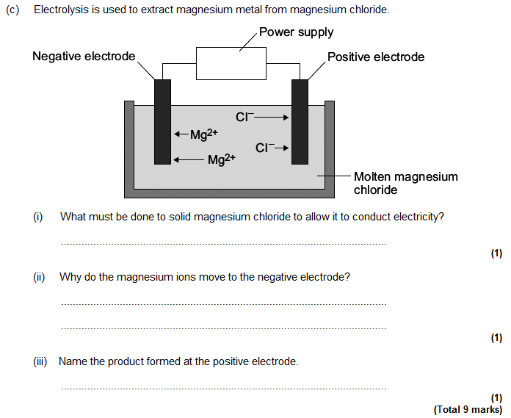
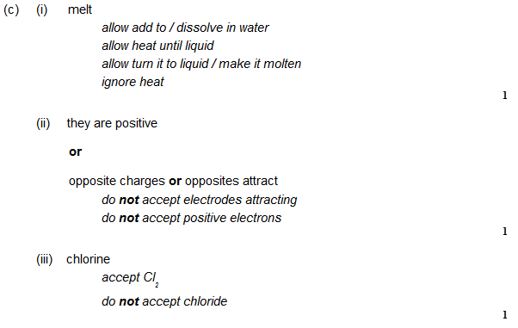

Slide 50
Example 1: Splitting up MOLTEN SODIUM CHLORIDE (salt)
-
=
chloride ION, extra 1 electron
chlorine ATOM,
NEUTRAL
Cl
Cl
Cl₂ molecule
Cl⁻
Cl
+
- chloride IONS lose their extra electrons and turn into neutral chlorine ATOMS
Cl⁻
Cl⁻
Cl
Cl
Cl⁻
Cl
Cl
Cl⁻
At ANODE: Cl⁻ e⁻ + Cl
Both together:
2Cl⁻ → 2e⁻ + Cl₂
then: Cl + Cl Cl₂ (gas)

Slide 51
Example 1: Splitting up MOLTEN SODIUM CHLORIDE (salt)
+
=
sodium ION, missing1 electron
Na
sodium ATOM,
NEUTRAL
Na⁺
+
+ sodium IONS gain an extra electron and turn into neutral sodium ATOMS
Na
Na
Na⁺
Na⁺
Na
Na
Na⁺
Na⁺
At CATHODE:
Na⁺ + e⁻ Na
molten sodium metal sinks to bottom

Slide 52
Example 1: Splitting up MOLTEN SODIUM CHLORIDE (salt)
+ ANODE
- CATHODE
ELECTRONS
CHLORINE gas Cl₂
SODIUM metal Na
MOLTEN SODIUM CHLORIDE
Cl⁻
Na⁺
At ANODE:
Cl⁻ e⁻ + Cl
At CATHODE:
Na⁺ + e⁻ Na
Cl + Cl Cl₂ (gas)

Slide 53
OILRIG
Oxidation is loss, reduction is gain
‘OILRIG’
Cl⁻
Cl⁻
Na⁺
Na⁺
Cl⁻
Cl⁻
Na⁺
Na⁺
ions LOSING electrons to become atoms is called ‘OXIDATION’
(even though oxygen may not be involved)
+ ions GAINING electrons to become atoms is called ‘REDUCTION’

Slide 54
Example 2: Splitting up MOLTEN LEAD BROMIDE PbBr₂
+ ANODE
- CATHODE
ELECTRONS
BROMINE gas Br₂
LEAD Metal Pb
MOLTEN LEAD BROMIDE
Br⁻
Pb²⁺
At ANODE:
Br⁻ e⁻ + Br
At CATHODE:
Pb²⁺ + 2e⁻ Pb
Br + Br Br₂ (gas)
Both together:
2Br⁻ → 2e⁻ + Br₂

Slide 55
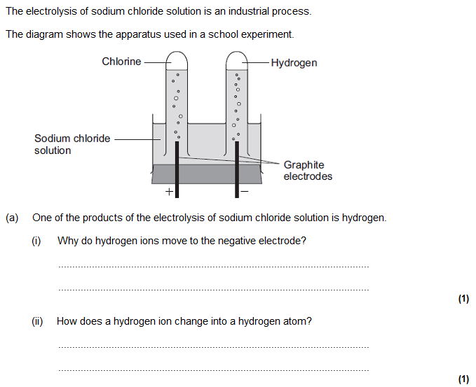
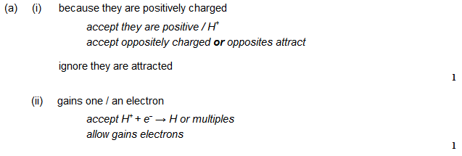

Slide 56
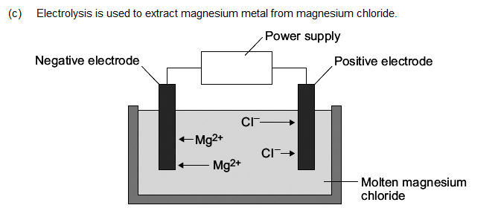
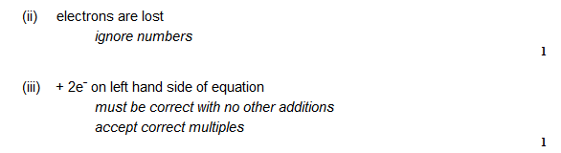
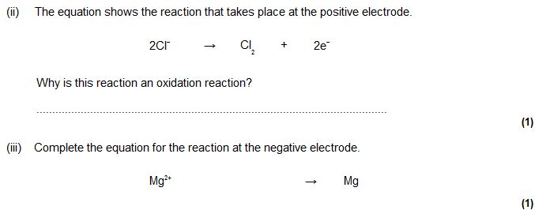

Slide 57
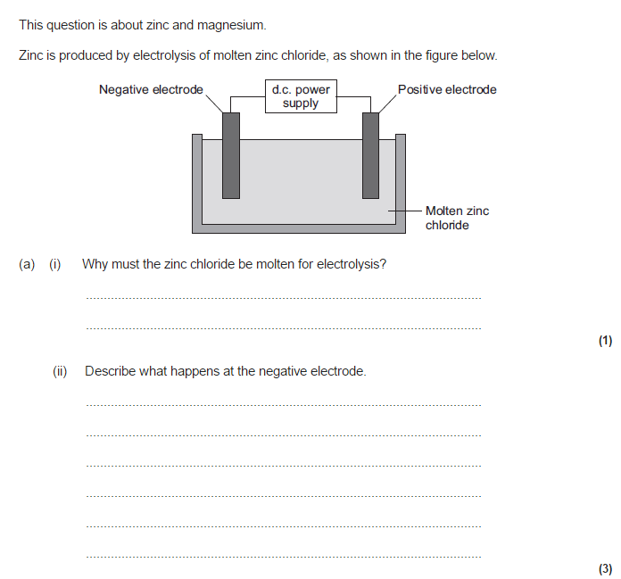
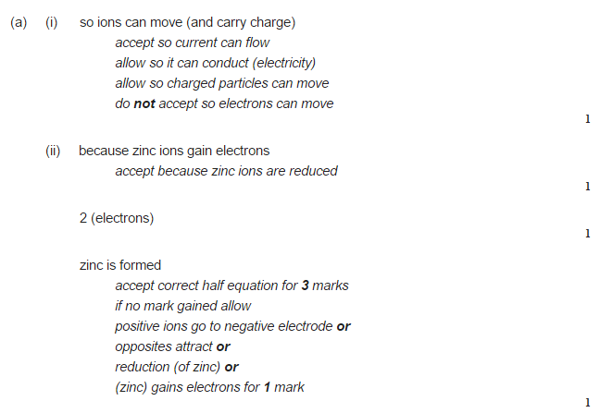

Slide 58
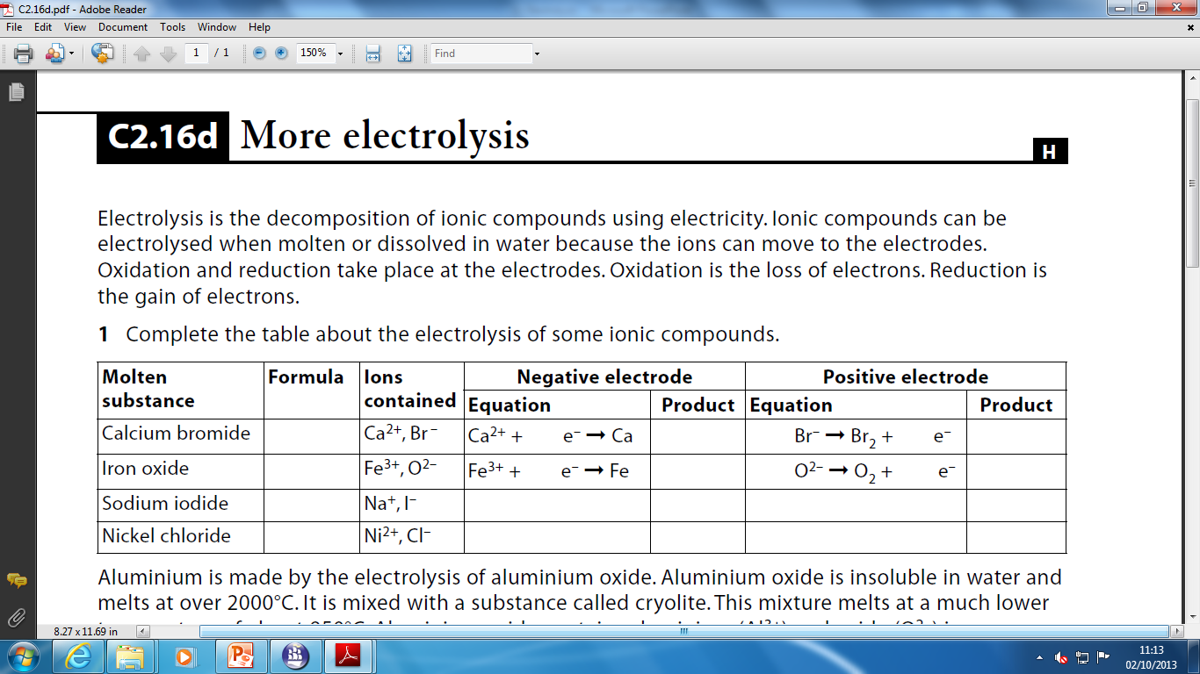
Complete the table, you may choose where to begin:
HIGHER

Slide 59
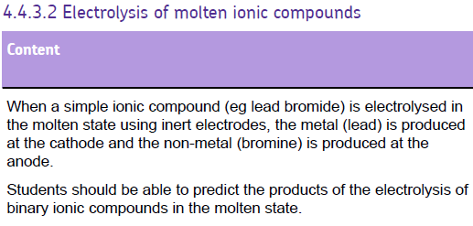

Slide 60

To reduce melting point

Slide 61

Oxygen reacts with the carbon in the electrode to make carbon dioxide
Positive Electrode (Anode)
C
O
O
Al³⁺
Al³⁺
Al³⁺
O²⁻
Al
O²⁻
Al
Al
Negative Electrode (Cathode)

Slide 62


Slide 63
What happens when the ionic compounds are dissolved in water?
Here, water molecules break up into HYDROGEN IONS, H⁺ and HYDROXIDE IONS OH⁻
H₂O ➔ H⁺ + OH⁻
So, in an ionic solution (eg sodium chloride solution), there will be FOUR types of ion present:
TWO from the ionic compound and TWO from the water (H⁺ + OH⁻)
SODIUM CHLORIDE SOLUTION NaCl (aq)
H⁺
Cl⁻
OH⁻
Na⁺
H⁺
Na⁺
OH⁻
Na⁺
H⁺
Cl⁻
OH⁻
Cl⁻

Slide 64
RULES FOR IONIC SOLUTIONS
+ ANODE
Attracts – ions (‘Anions’)
- CATHODE
Attracts + ions (‘Cations’)
If – ions are HALOGENS ie
chloride Cl⁻
bromide Br⁻
iodide I⁻
the HALOGEN is produced.
If + ions (metals) are MORE REACTIVE than hydrogen
K, Na, Ca, Mg, Zn, Fe
Then HYDROGEN is produced
If – ions are NOT HALOGENS
Eg sulphate SO₄²⁻,
nitrate NO³⁻
carbonate CO₃²⁻
OXYGEN is produced.
If + ions (metals) are LESS REACTIVE than hydrogen
Cu, Ag, Au
Then the METAL is produced

Slide 65
(REACTIVITY: K⁺ Na⁺ Ca²⁺ Mg²⁺ Al³⁺ Zn²⁺ Fe³⁺ H⁺ Cu²⁺ Ag⁺ Au³⁺ )
Compound
State
Ions
Cathode (-)
Anode (+)
potassium chloride
molten
K⁺ Cl⁻
potassium
chlorine
aluminium oxide
molten
copper chloride
solution
sodium bromide
solution
silver nitrate
solution
potassium chloride
solution
zinc sulphate
solution
(REACTIVITY: K⁺ Na⁺ Ca²⁺ Mg²⁺ Al³⁺ Zn²⁺ Fe³⁺ H⁺ Cu²⁺ Ag⁺ Au³⁺ )

Slide 67


Slide 68



Slide 69




Slide 70




Slide 71



Slide 72



