Slide 1
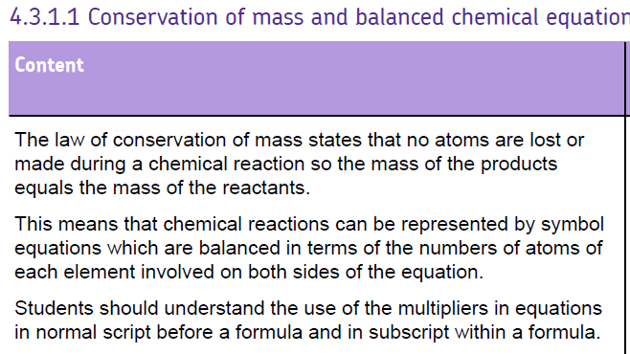

Slide 2
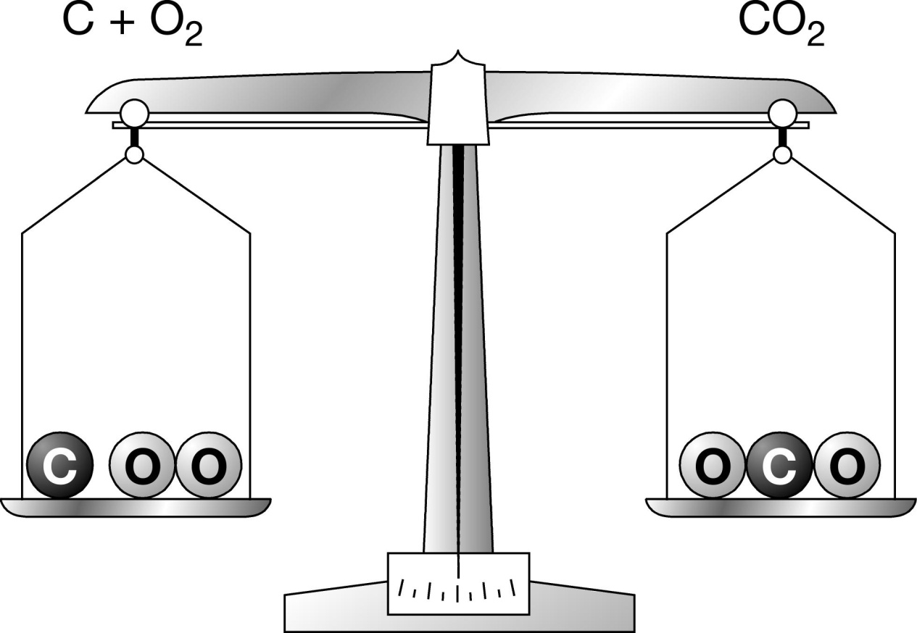
Word equations
Reactants
Products
Notes:
Often the topic of Balancing Equations gives rise to many misconceptions. These may include:
Students frequently find it difficult to realise that they can only add stoichiometric co-efficients in front of formulae, not within a formula, e.g. Na + Cl₂ → Na2Cl
Despite having learned how to form ionic/molecular formula, students will often change the small number in a formula to balance an equation, e.g. H₂O could become H₂O₂ as in H₂ + O₂ → H₂O₂
The objective of this presentation is to:
Explain how to balance a symbol equation.
When using this PowerPoint presentation it is possible to modify the slides and their order so that you can tailor the lesson for your students. This presentation is supported by material from the Chemistry for You pupils’ book which tackles this topic in full (page 24), and questions are included in the text and at the end of the chapter (page 27). Further examination questions are on page 38.

Slide 3
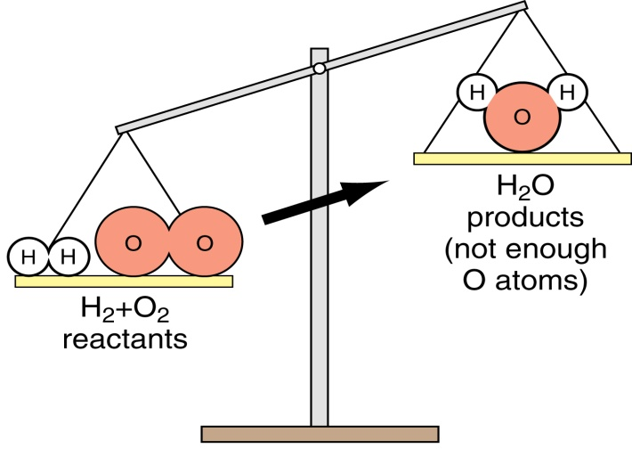
Making water
Word eq^{n}: hydrogen + oxygen → water
Symbol eq^{n}: H₂ + O₂ → H₂O
Atom count: 2xH, 2xO 2xH, 1xO
Notes:
This is an animated slide: when you click the left-hand mouse button once, the first piece of information will appear; click the button again and the next will appear, etc. This animation can be removed to have all text displayed by going into Slide Show, Custom Animation, then by highlighting each piece of text in turn and clicking (left-hand mouse key) Remove.

Slide 4
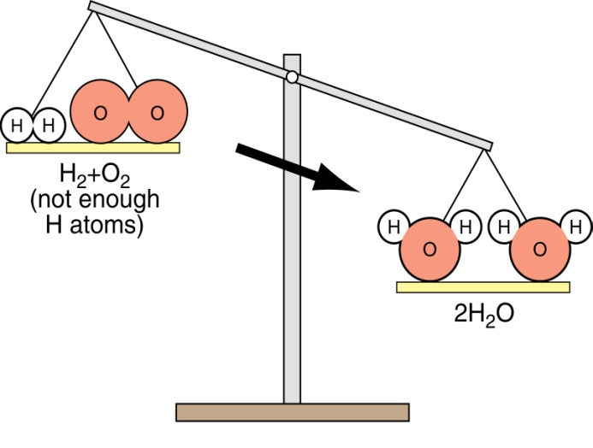
Making water
Symbol eq^{n}: H₂ + O₂ → H₂O
Balance O’s: H₂ + O₂ → 2H₂O
Atom count: 2xH 2xO 4xH, 2xO
Notes:
This is an animated slide: when you click the left-hand mouse button once, the first piece of information will appear; click the button again and the next will appear, etc. This animation can be removed to have all text displayed by going into Slide Show, Custom Animation, then by highlighting each piece of text in turn and clicking (left-hand mouse key) Remove.

Slide 5
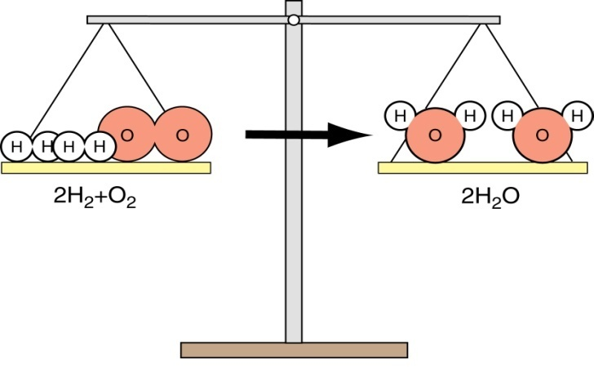
Making water
Symbol eq^{n}: H₂ + O₂ → 2H₂O
Balance H’s: 2H₂ + O₂ → 2H₂O
Atom count: 4xH 2xO 4xH, 2xO
Notes:
This is an animated slide: when you click the left-hand mouse button once, the first piece of information will appear; click the button again and the next will appear, etc. This animation can be removed to have all text displayed by going into Slide Show, Custom Animation, then by highlighting each piece of text in turn and clicking (left-hand mouse key) Remove.

Slide 6
Balance the equations below:
H₂ + Br₂ → HBr
Ca + O₂ → CaO
MgCO₃ + HCl → MgCl₂ + H₂O + CO₂
Fe + O₂ → Fe₂O₃
Fe + Cl₂ → FeCl₃

Slide 7
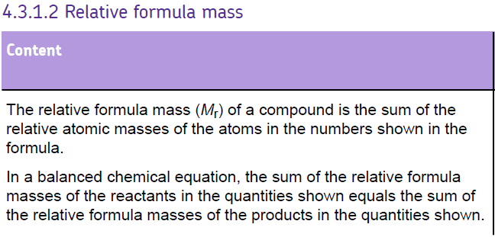

Slide 8
Relative formula mass
Relative atomic masses (A_{r})
e.g. Na = 23, Cl = 35.5
Relative formula masses (M_{r})
Mass of a compound found by adding A_{r} of each element
e.g. NaCl = 23 + 35.5 = 58.5
12
C
6

Slide 9
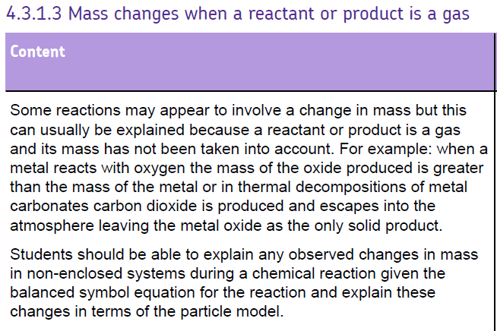

Slide 10
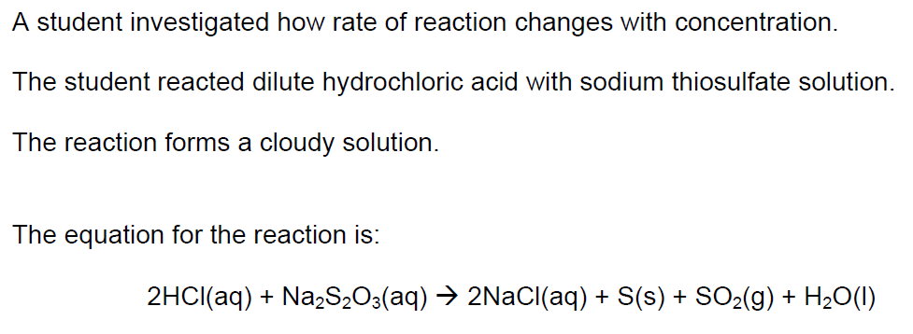
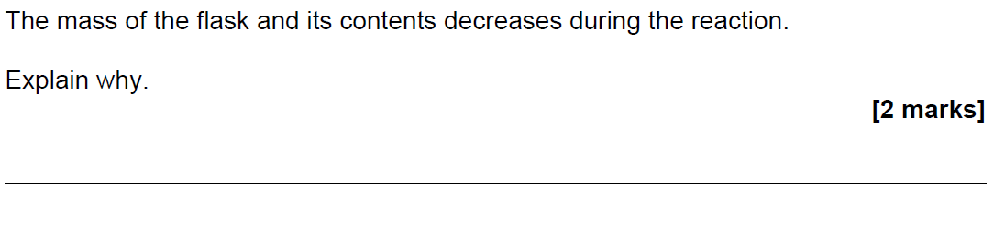
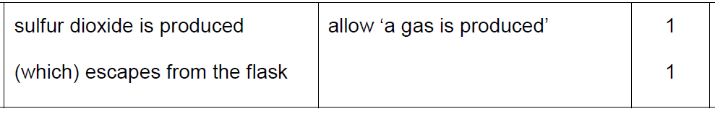

Slide 11
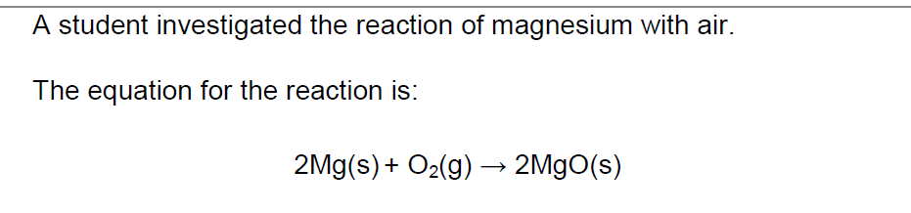
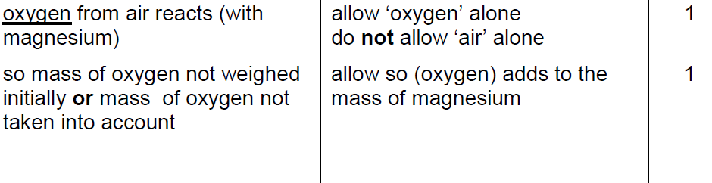
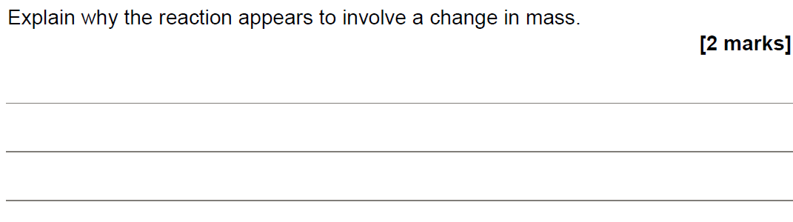

Slide 12
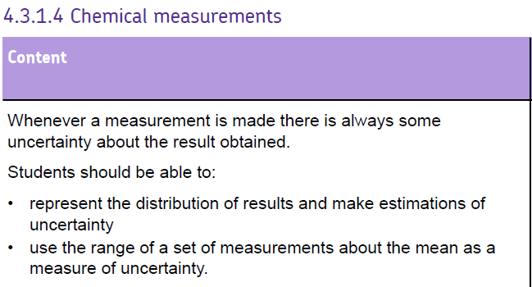

Slide 13
Error / Uncertainty
The interval within which the true value can be expected to lie, with a given level of confidence or probability, e.g 'the temperature decrease is 5.6°C ± 0.2 °C.
 | Trial 1 | Trial 2 | Trial 3 | Trial 4 | Mean
Initial temperature in °C | 21.2 | 21.0 | 21.0 | 21.1
Final temperature in °C | 15.6 | 15.2 | 15.6 | 15.6
Temperature decrease in °C | 5.6 | 5.8 | 5.4 | 5.6 | 5.6
Uncertainty = 5.8 – 5.4 (range)
= 0.4
Uncertainty
0.4 ÷ 2 = ± 0.2 °C

Slide 14
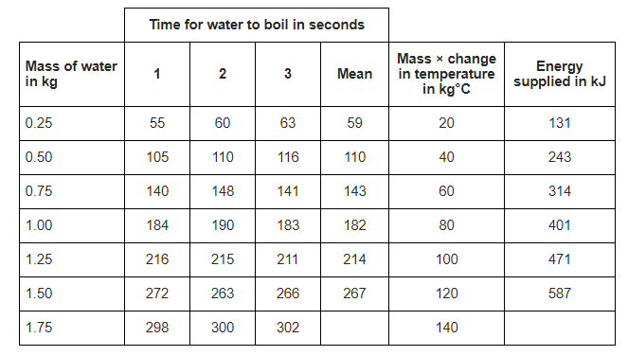
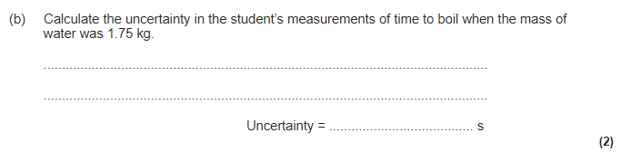
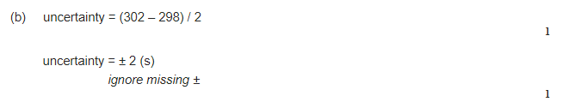

Slide 15
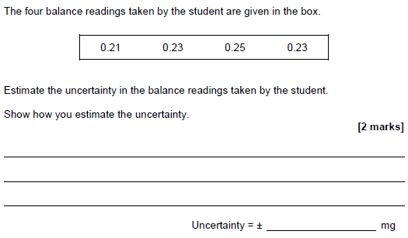

Spread about the mean is 0.04. Therefore, 0.04 / 2 = 0.02

Slide 16
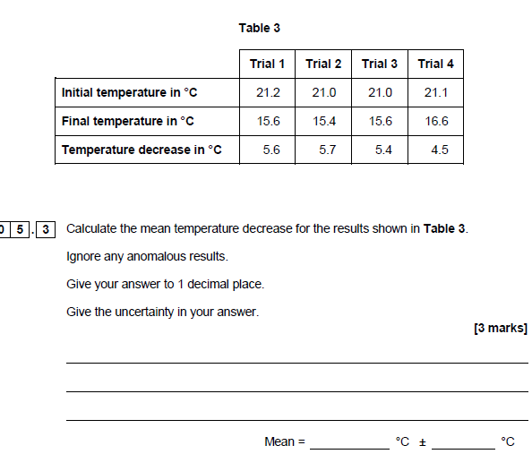
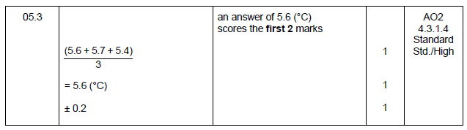
Spread about the mean is 0.3.
Therefore, 0.3 / 2 = 0.15
So to 1 d.p = 0.2

Slide 17
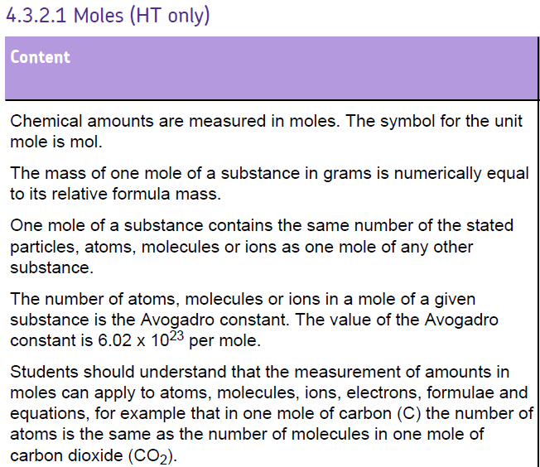
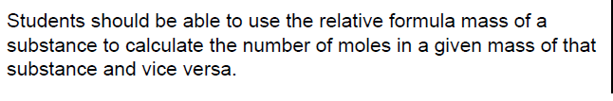

Slide 18



Masses of atoms and moles
Moles
A mole of any substance always contains same number of particles (Avagadro’s number = 6.02 x 10²³)
It is either:
the relative atomic mass in grams
the relative formula mass in grams
Mass = Moles x RFM (M_{r})

Slide 19
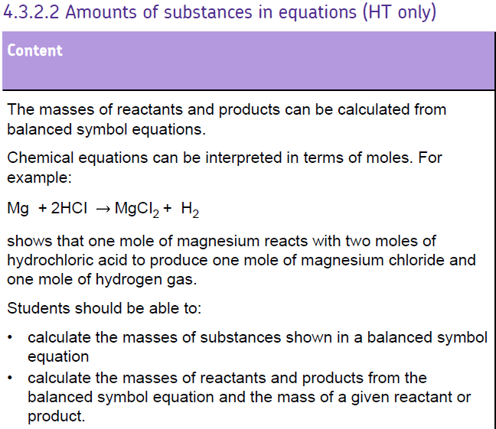

Slide 20
2H₂ + O₂ → 2H₂O
If I react 4g of hydrogen with 32g of oxygen I should expect to get 36g of water
Hydrogen = 2x 2g = 4g
Oxygen = 2 x 16g = 32g
Water = 2 x 18g = 36g

Slide 21
Worked Example 1
If we have a solution containing 100g of sodium hydroxide, how much chlorine gas should we pass through the solution to make bleach?
2NaOH + Cl₂ → NaOCl + NaCl + H₂O
2NaOH = 80g Cl₂ = 71g
80/80 = 1g 71/80 = 0.8875g
1g x 100 = 100g 0.8875g x 100 = 88.75g of Cl₂
So we’ll need 88.75g of chlorine to react with
100g of sodium hydroxide
STEP 1 : Balance the equation
STEP 2 : Work out the mass for the relevant part of the question
STEP 3 : Divide to get 1g
STEP 4 : Multiply to get figure asked for
STEP 5 : Answer

Slide 22
Worked Example 2
You start with a solution containing 0.95g of magnesium chloride. You add silver nitrate. If all the magnesium chloride reacts, how much silver chloride could be made?
2AgNO₃ + MgCl₂ → 2AgCl + Mg(NO₃)₂
MgCl₂ = 95g 2AgCl = 287g
Divide to get 1g of MgCl₂
95/95 = 1g 287/95 = 3.021…g
Multiply to get 0.95g of MgCl₂
1 x 0.95 = 0.95g 3.021… x 0.95g = 2.87g
Therefore if all 0.95g of Magnesium chloride reacts, you would make 2.87g of silver chloride

Slide 23
Reacting masses
2NaOH + Cl₂  NaOCl + NaCl + H₂O
If we have a solution containing 100 g of sodium hydroxide, how much chlorine gas should we pass through the solution to make bleach? Too much, and some chlorine will be wasted, too little and not all of the sodium hydroxide will react.

Slide 24
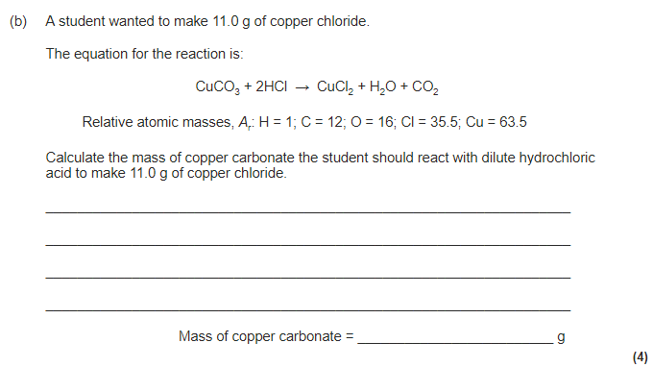
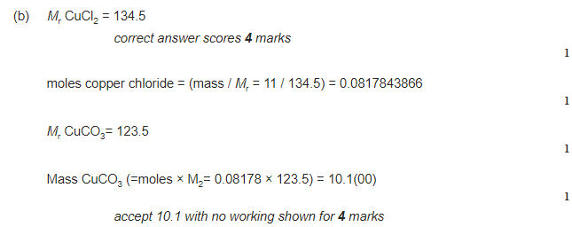

Slide 25
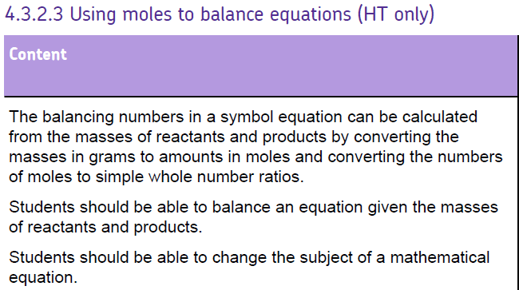

Slide 26
Reacting masses
2NaOH + Cl₂  NaOCl + NaCl + H₂O
80g 71g 74.5g 58.5g 18g
 | 2NaOH | Cl₂
A_{r} / M_{r} | 40 | 71
Ratio method | (80/80) = 1 1 x 100 = 100 | (71/80) = 0.8875 0.8875 x 100 = 88.75
Mass | 100 g | 88.75 g
Moles method | Mass/Mr 100/40 2.5 moles | Mass /Mr 88.75/71 1.25 moles
Notice the ratio 2:1 given by the balanced equation
2:1

Slide 27
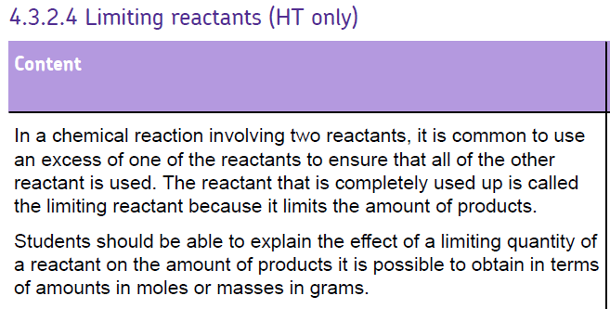

Slide 28
Limiting reactants
Take the reaction….
2H₂ + O₂ → 2H₂O
2moles + 1mole → 2moles
4g + 32g → 36g
This means that even if we provide 10g of Hydrogen to 32g of Oxygen, we still only make 36g of water. The Oxygen is then a LIMITING REACTANT in this case.

Slide 29
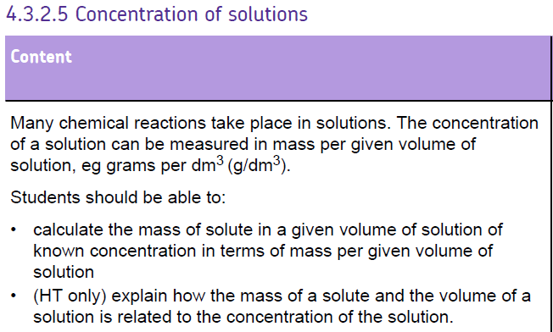

Slide 30
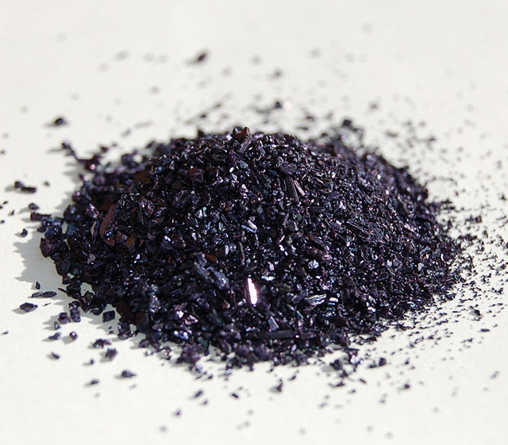
Calculate the mass in grams of 1 mole of solid potassium permanganate (KMnO₄)
K = 39
Mn = 55
O = 16 x 4 = 64
= 158 g / mol
K = 39; Mn = 55; O = 16

Slide 31
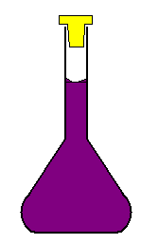
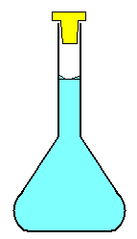
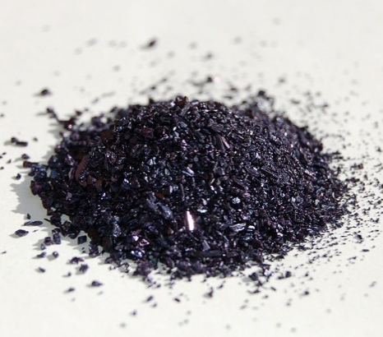
If we dissolve 158g of KMnO₄ in 1 litre of water we would make a solution of concentration 1mol/dm³
1 litre

Slide 32
Concentrate!
We can calculate the concentration of a solution using the following formula:
conc = moles / volume
1000
volume in cm³ must be changed to dm³ by dividing by 1000
We can use this in titration calculations to calculate concentration of an unknown solution vs a solution of known concentration.

Slide 33
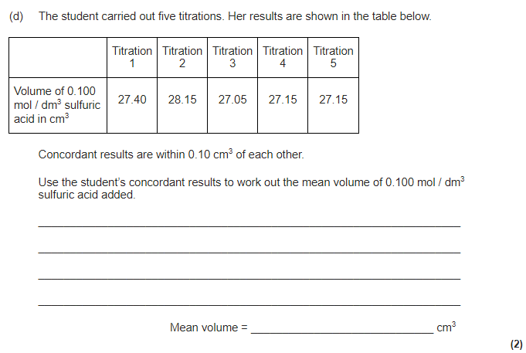
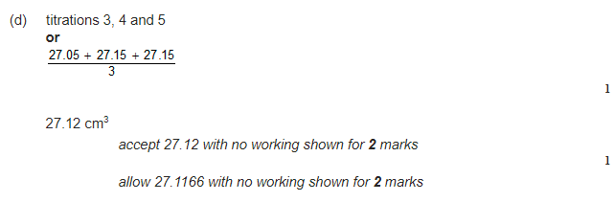

Slide 34
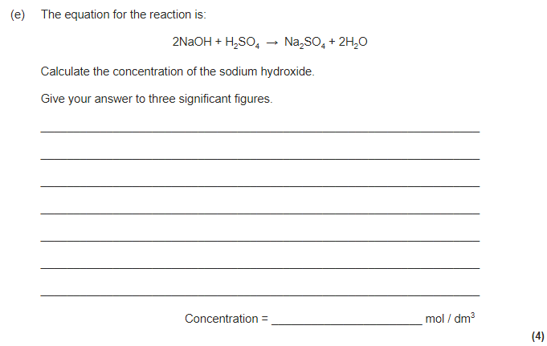
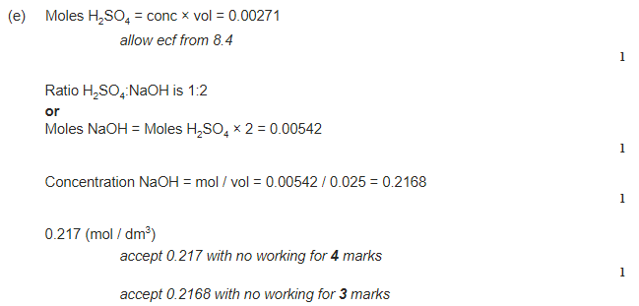

Slide 35
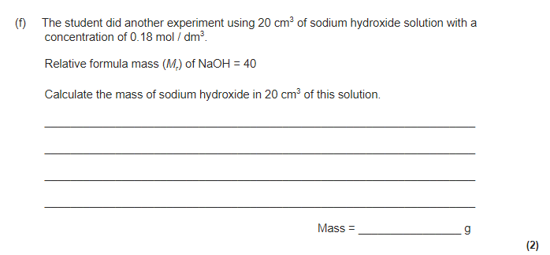
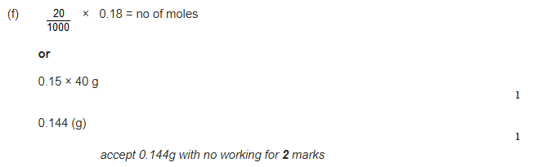

Slide 36
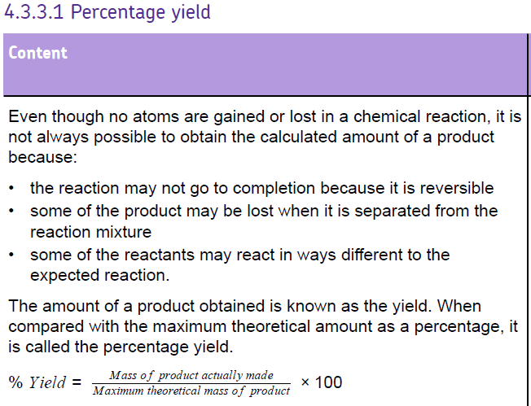
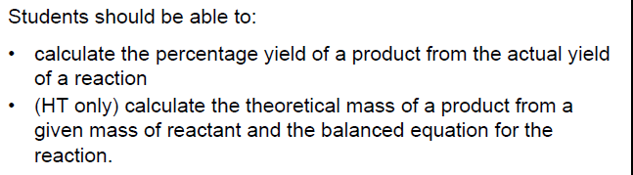

Slide 37
% YIELD is the amount of product you actually make as a % of the amount you should theoretically make
REACTANTS
PRODUCT
% YIELD ABOUT 75%
+
SHOULD make this much
ACTUALLY make this much

Slide 38
Percentage Yield
The amount of product made in a reaction is called its yield.
The percentage yield tells us the amount of product made compared to the maximum amount that could be made.
e.g. Using known masses if A and B it was calculated that the chemical reaction could produce 200g of product, C. When the reaction was carried out only 140g of C is produced.
What is the percentage yield?
Percentage = amount of product actually produced (g) yield (%) Maximum amount of product that could be produced (g)
140 x 100% = 70%
200
X100

Slide 39
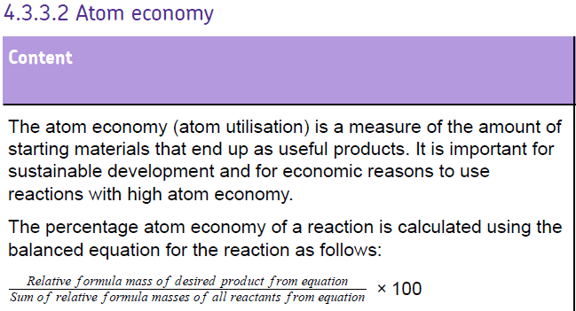
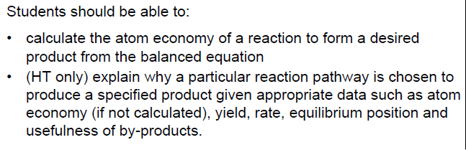

Slide 40
Atom Economy
Compare these two industrial reactions
2Mg + O₂ → 2MgO
USEFUL PRODUCT
What do you notice about each one?
Think raw materials, useful products, waste products
In which reaction are atoms ‘wasted?’
CaCO₃ → CaO + CO₂
USEFUL PRODUCT

Slide 41
ATOM ECONOMY is the mass of the product you want as a % of the mass of all the products you make
REACTANTS
PRODUCTS
+
Stuff you also get but don’t want
Stuff you want
ATOM ECONOMY about 50%

Slide 42
CALCULATING ATOM ECONOMY
Often, chemical reactions produce unwanted products along with the product you want.
ATOM ECONOMY is the mass of product you want as a % of the mass of all the products you make
Useful product
Waste product
CaCO₃ = CaO + CO₂
RFM: 100 56 44
mass useful product
mass of all products
ATOM ECONOMY
=
X 100%
Atom Economy = 56 / (56 + 44) = 56 / 100 = 56 %

Slide 43
ATOM ECONOMY is the mass of product you want as a % of the mass of all the products you make
2Mg + O₂ → 2MgO
RAM
Mg 24
Fe 56
C 12
O 16
RFM: 48 32 80
Atom Economy = 80 / 80 x 100% = 100 % (obviously)
Fe₂O₃ + 3CO → 2Fe + 3CO₂
160 84 112 132
Atom Economy = 112 / 244 x 100% = 45.9 %

Slide 44
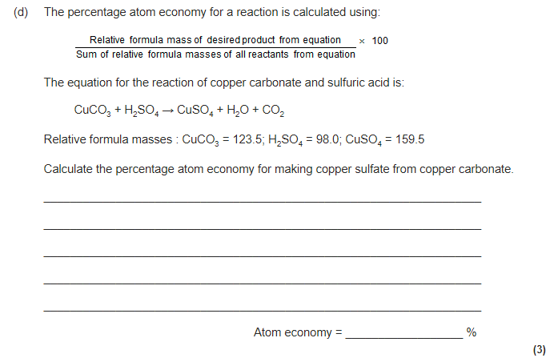
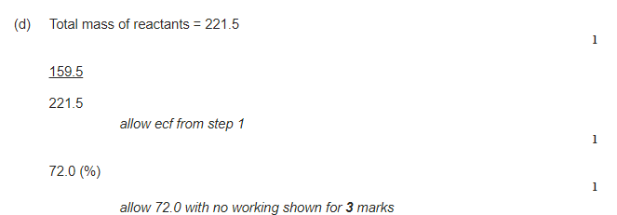

Slide 45
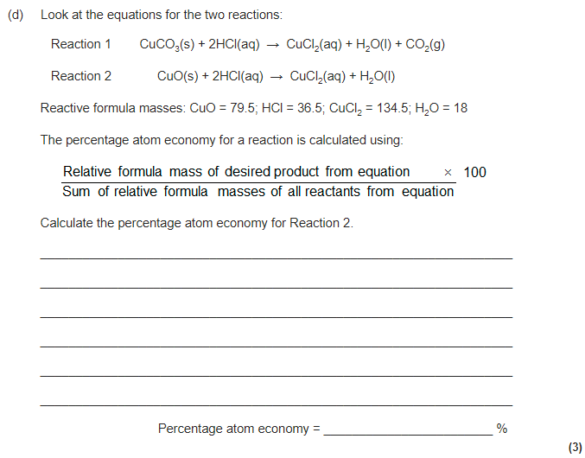
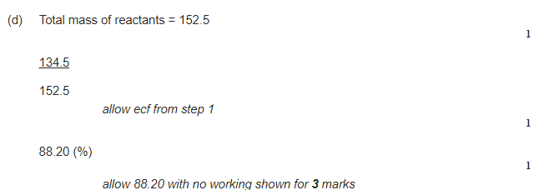

Slide 46
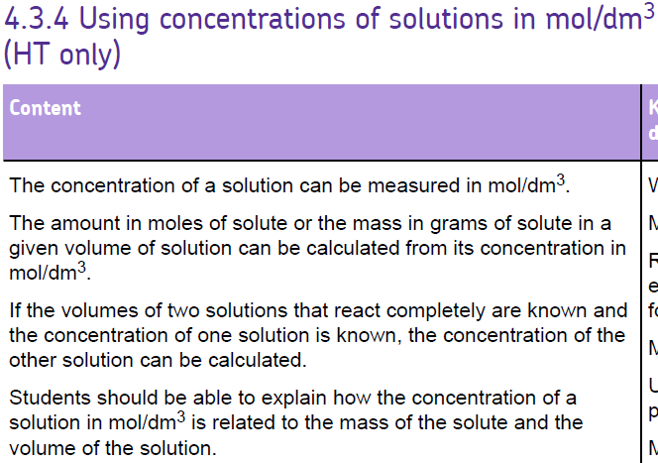

Slide 47
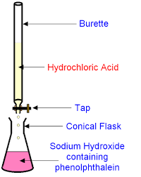
Titrations can be used to make a soluble salt from an acid and an alkali (soluble base).
eg. sodium chloride can be made from hydrochloric acid and sodium hydroxide, according to the equation:
HCl(aq) + NaOH(aq) → NaCl(aq) + H₂O(l)

Slide 48
moles = mass
Mr
Converting concentrations in mol/dm³ to g/dm³:
Worked eg. A sulfuric acid (H₂SO₄) solution has a concentration of 0.25 mol/dm³. What is its concentration in grams per dm³?
mass = moles x Mr
= 0.25 x (2x1+32+4x16)
= 24.5 g
Therefore concentration =24.5 g/dm³
Rearrange the equation to make mass the subject.
Substitute the values in, including Ar values from the periodic table to calculate the relative formula mass.
Answer, with units.

Slide 49
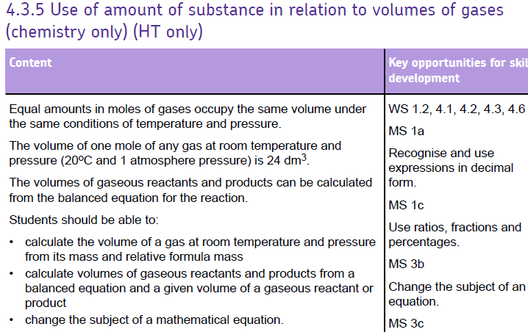

Slide 50
Moles of gases
1 mole H₂ weighs 2g.
This means 2g of Hydrogen gas will have a volume of 24dm³
This is the same volume as 4g of He gas.
To find volume of the gas multiply Number of moles by 24.
E.g 0.25 moles Hydrogen gas. 0.25 x 24 = 6 dm³

