Slide 1
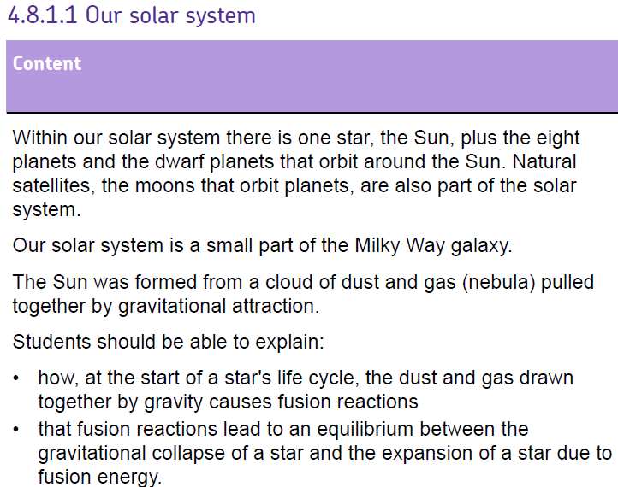
Learn these facts

Slide 2


Slide 3
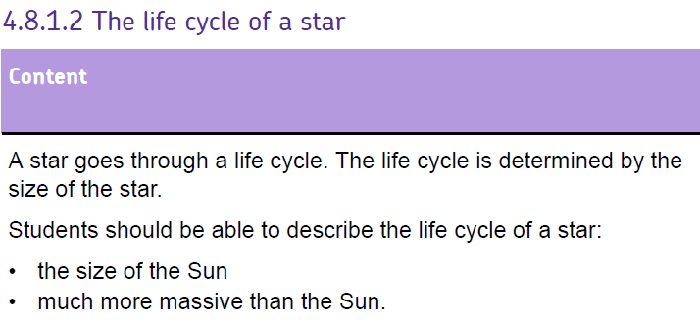

Slide 5
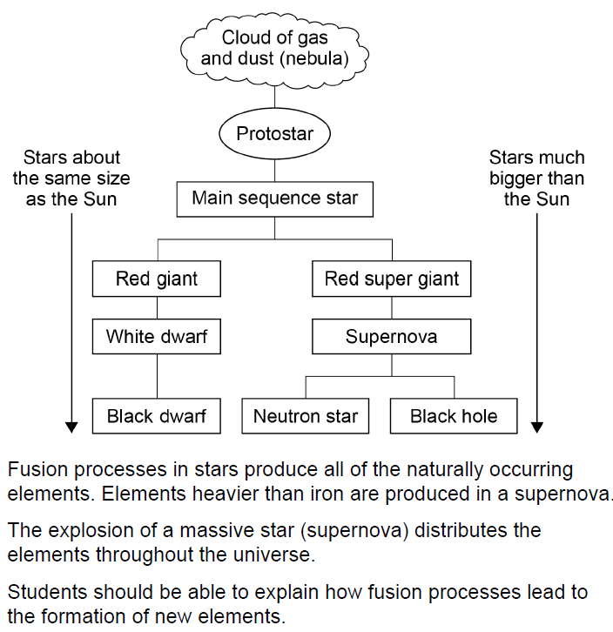

Slide 6
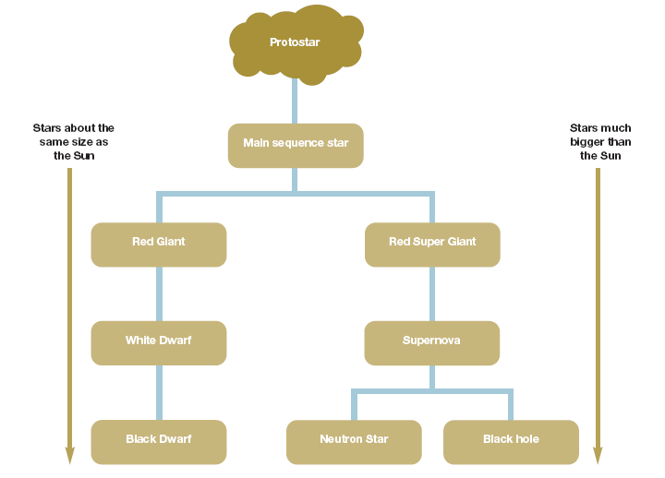
Fusion – turning Hydrogen into Helium. Main Stable because forces within it are balanced.

Slide 7
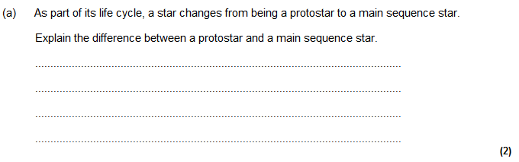
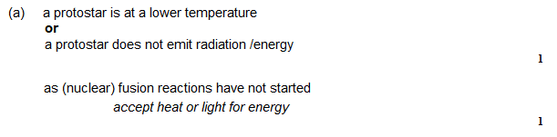

Slide 8
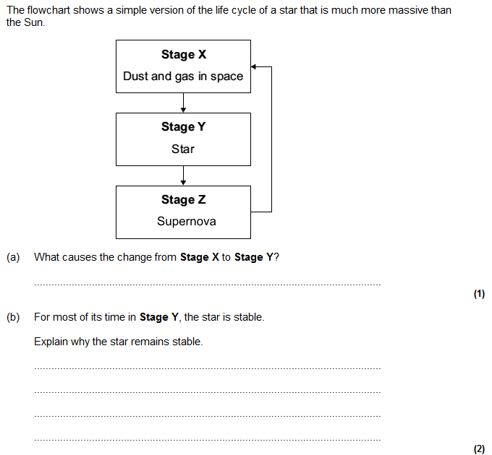
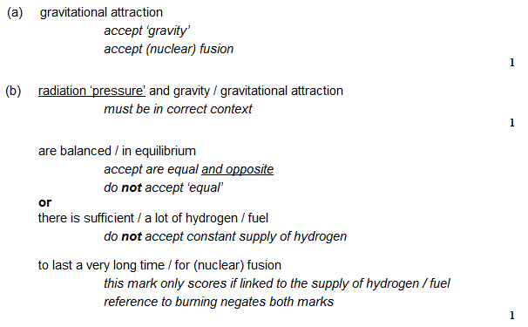

Slide 9
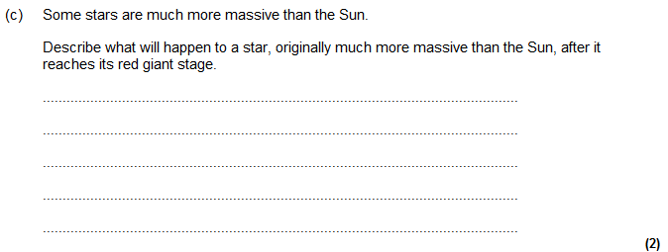
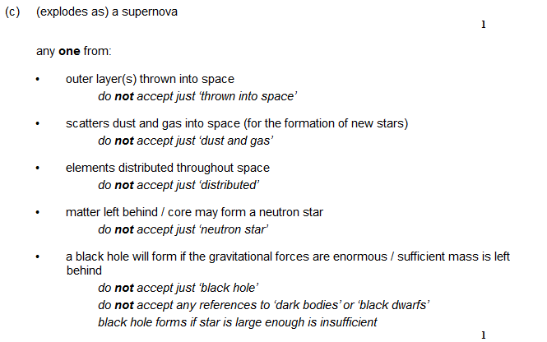

Slide 10
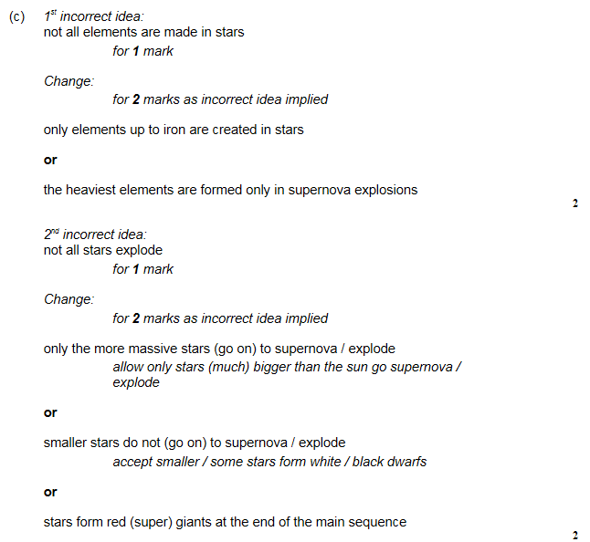
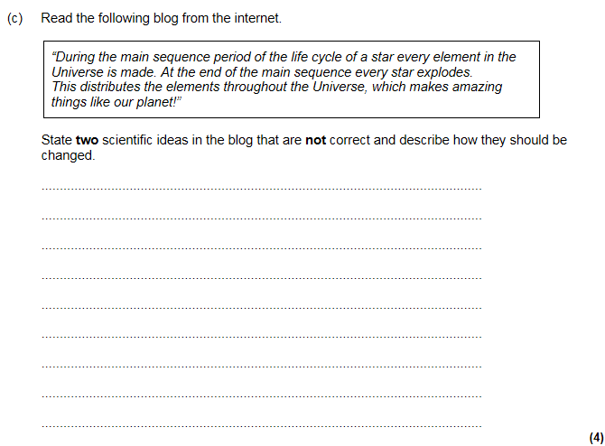

Slide 11
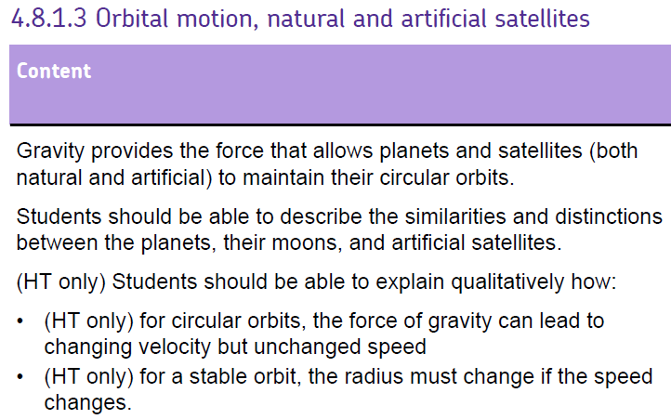

Slide 13


Which direction would the ball go if the string was cut?
Circular Motion
C
B
A
Notes:
B is correct. Velocity is at a tangent to the circular path. Demo with golf ball on string – let go instead of cutting. Could also use a sparkler in a drill

Slide 14
Circular Motion
Velocity
Force
Force acting towards centre is a resultant force called the centripetal force.
The ball is travelling at a constant speed but the velocity is changing constantly.
This means that the ball is accelerating towards the centre of the circle.
Notes:
Remind pupils that velocity is a vector so it changes with direction hence there is an acceleration.

Slide 15

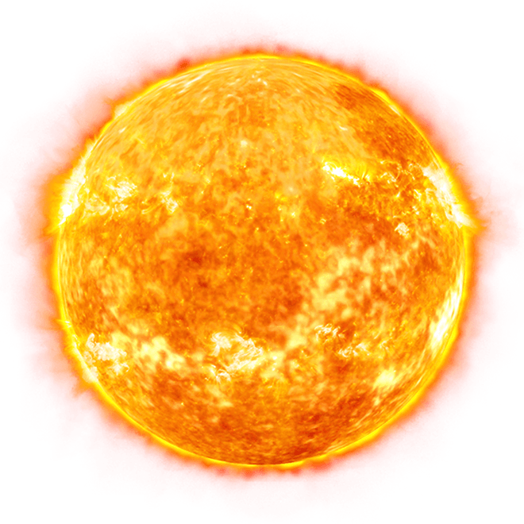
Circular Motion
Velocity
Force
of gravity
In the same way the Earth is constantly falling (accelerating) towards the sun.
It is moving at a constant speed. If this speed were to change then the orbit radius would change. How might speed and radius be linked?
Notes:
Example of Earth and sun – starting to link in speed and orbital radius.

Slide 16
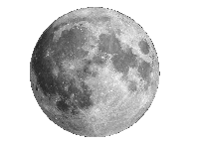
Circular Motion
Velocity
Force
of gravity
The moon is constantly accelerating towards the Earth in a near stable orbit.
Interesting fact: The moon is moving away from us at a rate of around 4 cm per year. Why?
Notes:
Should link in increasing radius to tidal forces. This is complicated so if short on time – delete the why question or leave it in for students to wonder ☺

Slide 17
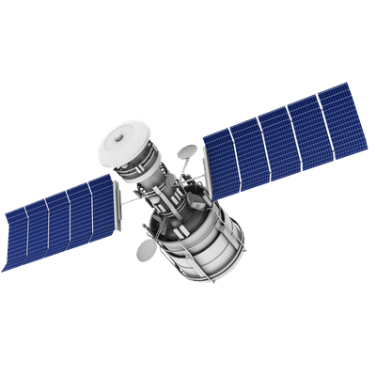
Circular Motion
Velocity
Force of gravity
Artificial satellites orbit close to the Earth but with enough speed to prevent them hitting the Earth.
Notes:
Should link in increasing radius to slow moving moon. As an extension you could ask why this rate is increasing over time (HINT: Tides)

Slide 18
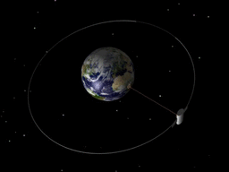
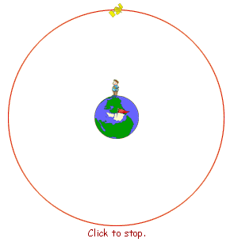
Geostationary orbits
A special orbit that is very useful is one that orbits above the equation on planet Earth and has a rotational period of exactly 24 hours.
This is useful because fixed receivers on Earth do not need to move to track these satellites because they appear to be stationary in the sky.
All geostationary satellite orbit at 36,000 km above sea level.
Notes:
Use keplers… r³/T² ⁼ GM/4pi²

Slide 19
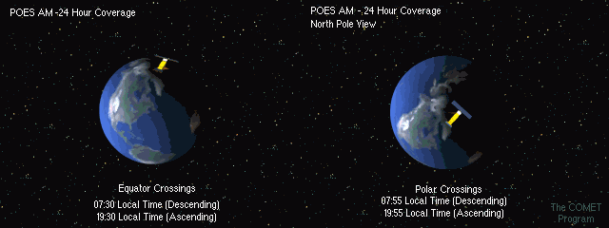
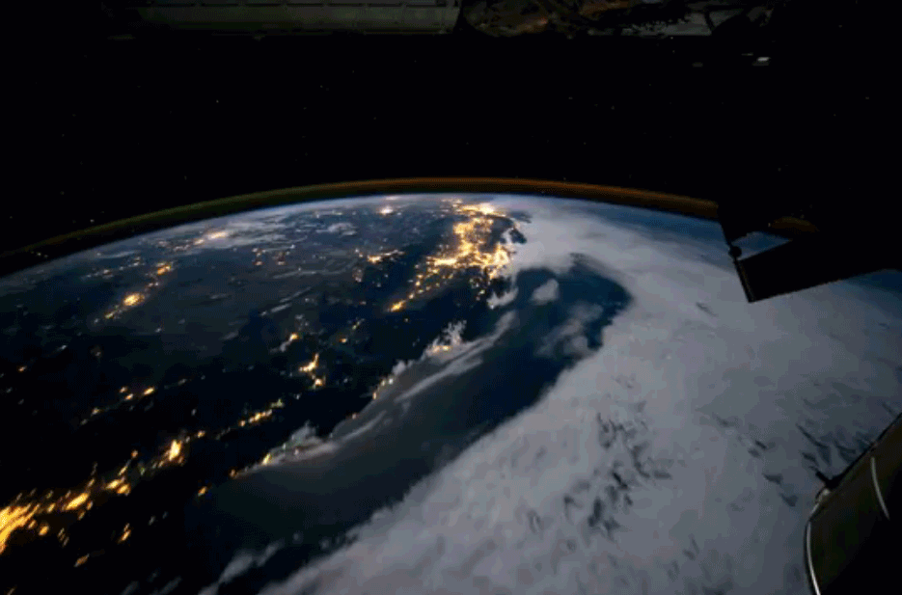
Monitoring orbits
Some satellites have monitoring orbits which are usually:
  much lower
  have higher speeds
  and an orbital period of much less than 24 hours, perhaps only 1.5 hours!
These can be used to monitor climate, weather, and environment.
Notes:
Top right – POES - Polar Operational Environmental Satellites 14.1 orbits per day – orbital period just under 1h45min
Bottom right – ISS – 1.5 hour orbital period
For advanced classes – mention keplers… r³/T² ⁼ GM/4pi²

Slide 20
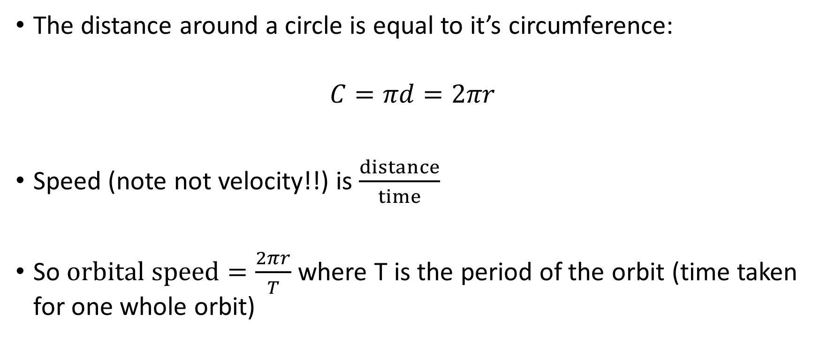
How Fast?
The distance around a circle is equal to it’s circumference:
$$C=πd=2πr$$
Speed (note not velocity!!) is $\frac{distance}{time}$
So $orbital speed=\frac{2πr}{T}$ where T is the period of the orbit (time taken for one whole orbit)

Slide 21
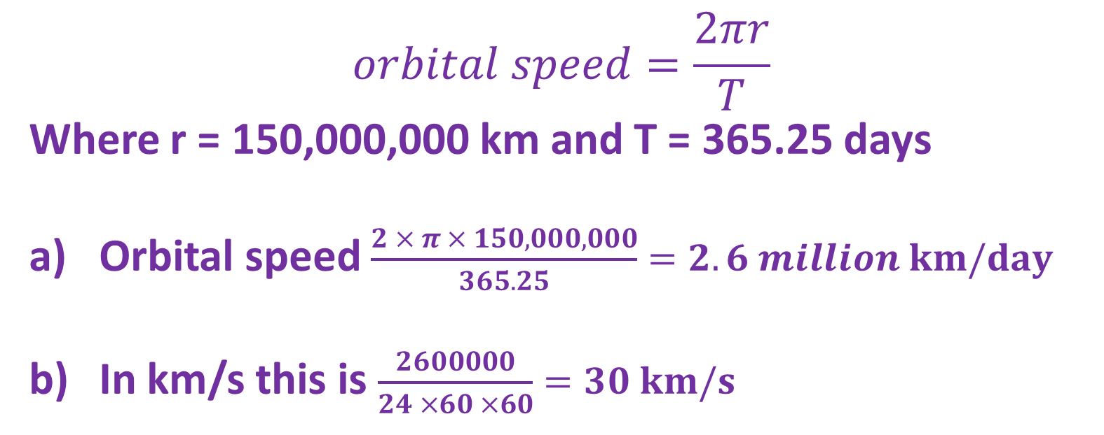
How Fast?
The Earth is 150 million km from the Sun and takes 365.25 days to orbit it. What is the orbital speed of the Earth in:
  km / day
  km / s
$$orbital speed=\frac{2πr}{T}$$
Where r = 150,000,000 km and T = 365.25 days
Orbital speed $\frac{2 × π × 150,000,000}{365.25}=2.6 million km/day$
In km/s this is $\frac{2600000}{24 ×60 ×60}=30 km/s$
Notes:
At this speed it would take about 22.22 minutes to go around the Earth or about 6 seconds from Wilsthorpe to London

Slide 22
What effects the size of the centripetal force?
The centripetal force needed to maintain circular motion will increase if:
The mass of the object increases.
  F = ma so to maintain circular motion a higher force is needed.
The speed of the object increases.
  Faster objects cover more distance so a larger deflection is required which means larger acceleration and thus larger force.
The radius of the orbit decreases.
  Smaller circles require higher acceleration towards the centre of the circle to maintain the rapidly changing angle

Slide 23
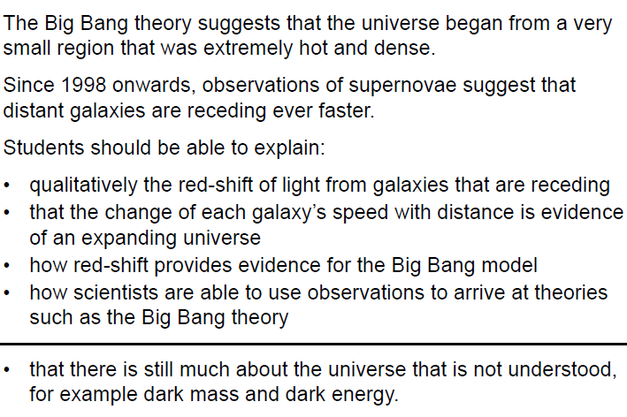
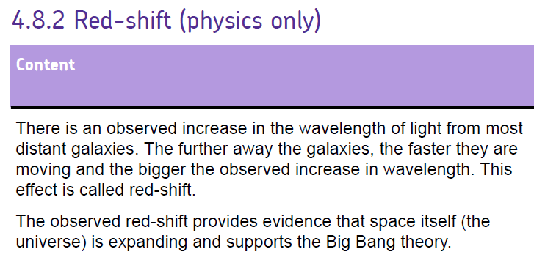

Slide 25
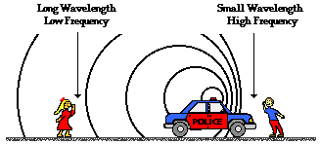
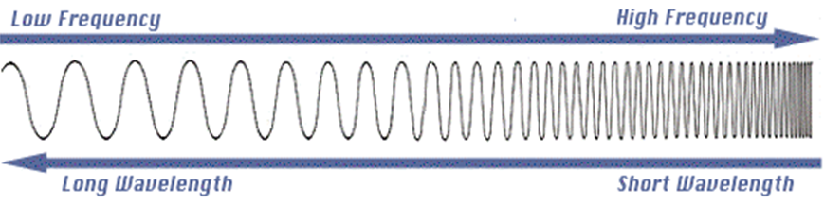
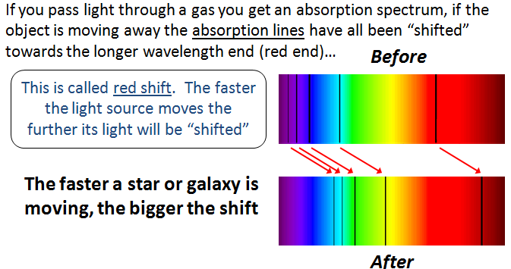
The expanding universe
The Doppler effect: Change in observed wavelength of waves due to the motion and source of the waves
Edwin Hubble
Discovered that:
The light from distance galaxies was red-shifted, The further away, the bigger the red shift
Concluded that:
Distant galaxies are moving away from us, Greater the distance the greater the speed its moving away
This must mean that the whole universe is expanding

Slide 26


The expanding universe

Slide 27
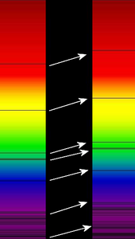
Cosmological Redshift II
Why do we think the Universe is expanding?
Red shift
Atomic spectra from the sun
Atomic spectra from the far off star
Low frequency visible light is red
High frequency visible light is blue
Don’t get confused! Radiation does not become redder but the wavelength increases / frequency decreases. Infra red radiation does not become shifted into the red part of the visible spectrum!

Slide 28
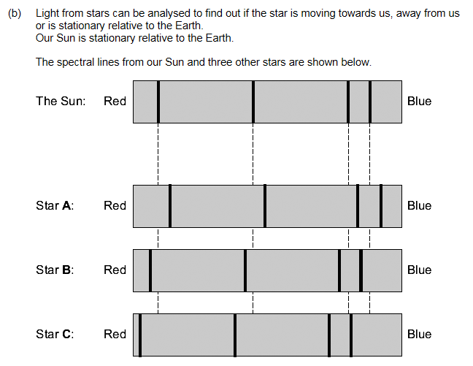
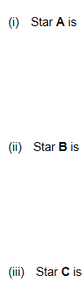
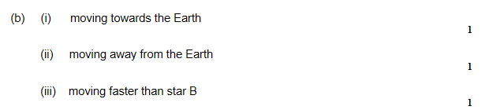
…. the Earth
… the Earth
… than Star B

Slide 29
The Big Bang
The Big Bang theory states that:
The universe is expanding after exploding suddenly in a Big Bang from a very small initial point
Space, time and matter were created in the Big Bang
Evidence for the Big Bang:
Cosmic microwave background radiation (CMBR)
It was created as high-energy gamma radiation after the big bang and has been travelling through space since then
As the universe has expanded it has stretched out to longer and longer wavelengths and is now microwave radiation
It has been mapped out using microwave detectors
Future of the universe:
If the density of the universe is less than a certain amount then it will expand forever.. If not, it will stop expanding and reverse ending in a crunch

Slide 30
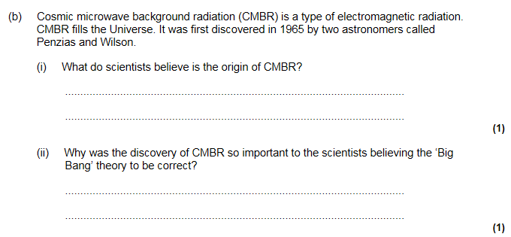
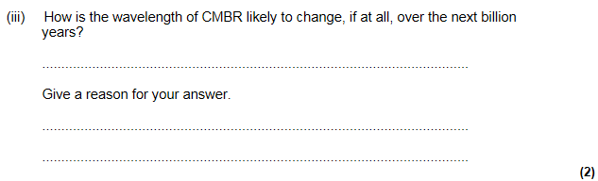
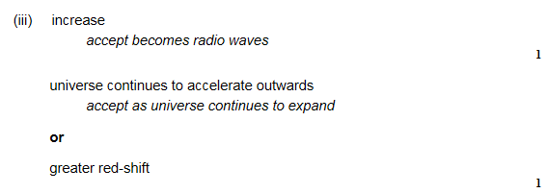
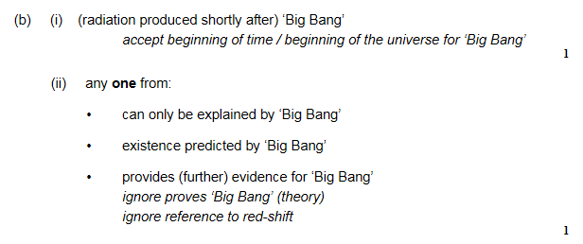

Slide 31
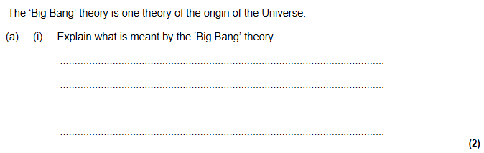
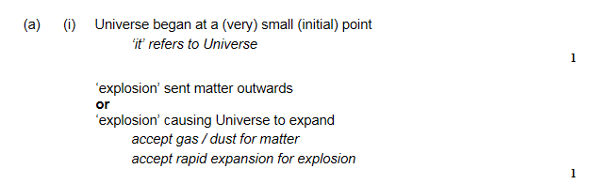
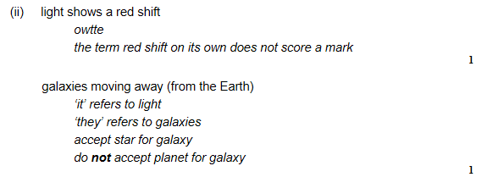
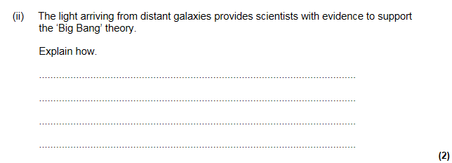

Slide 32
