Slide 1
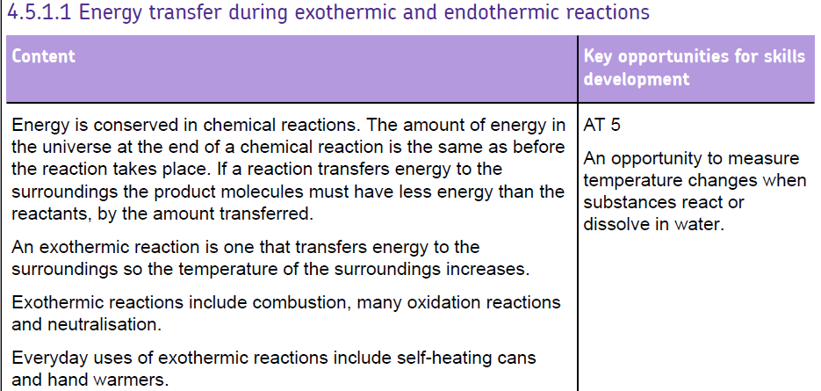

Slide 2
Energy changes
Exothermic reactions
Examples: respiration, combustion, oxidation, neutralisation
Energy ‘exits’ reaction – heats surroundings
Thermometer readings rises
Uses: self heating can and hand warmers

Slide 3
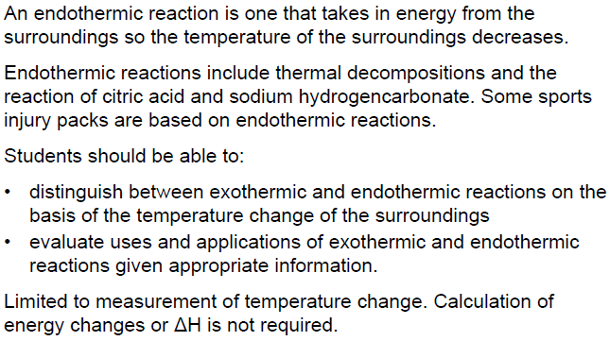

Slide 4
Energy changes
Endothermic reaction
Examples: photosynthesis, thermal decomposition, reaction of citric acid and sodium hydrogencarbonate
Energy ‘enters’ reaction (takes in energy) – cools surroundings
Thermometer readings fall
Uses: sports injury packs

Slide 5

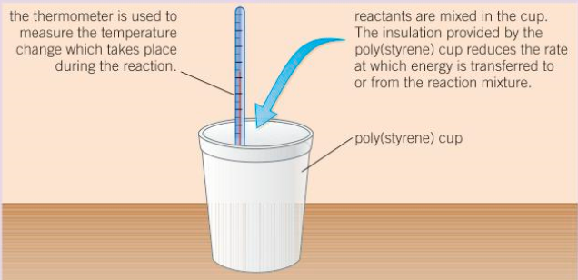
measure volume of hydrochloric acid in a measuring cylinder
pour hydrochloric acid into suitable container
measure temperature of hydrochloric acid using a thermometer
measure mass of magnesium using a balance
add magnesium to hydrochloric acid and stir
measure maximum temperature reached
calculate the change / rise in temperature
repeat procedure for same mass of magnesium
find mean temperature rise
repeat with different masses of magnesium

Slide 6
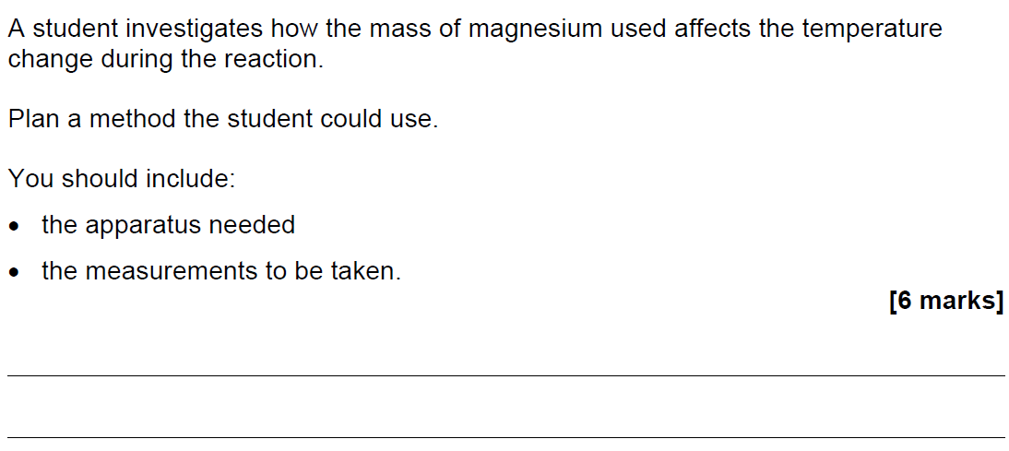
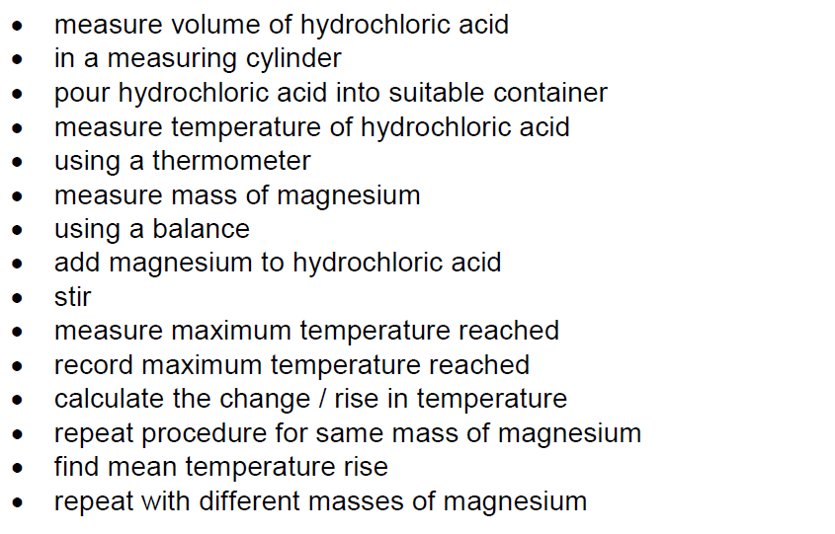

Slide 7
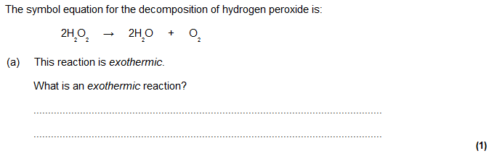

Slide 8
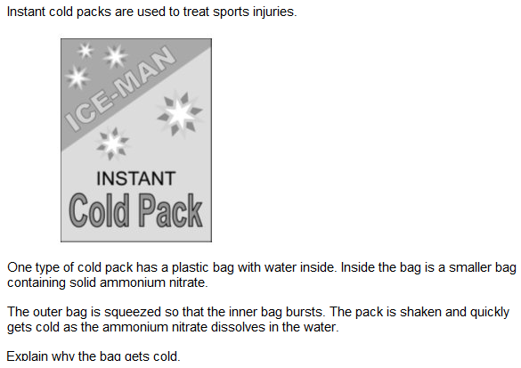
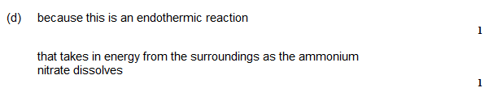

Slide 9
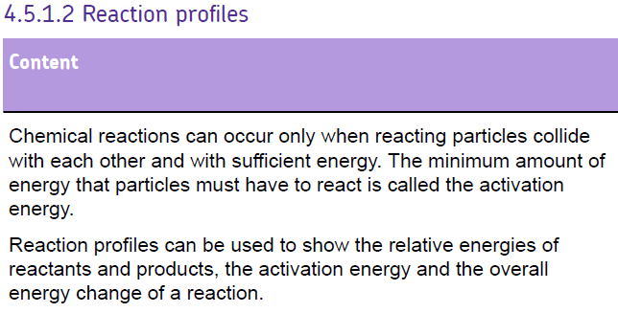
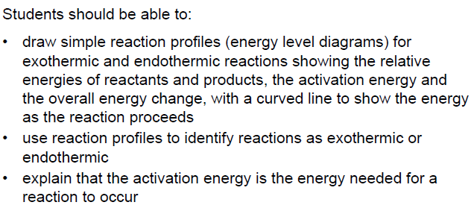

Slide 10
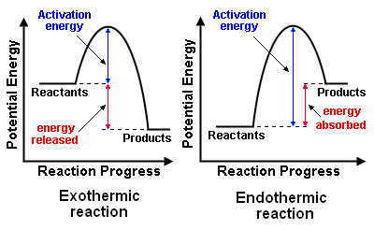
Reaction profiles

Slide 11
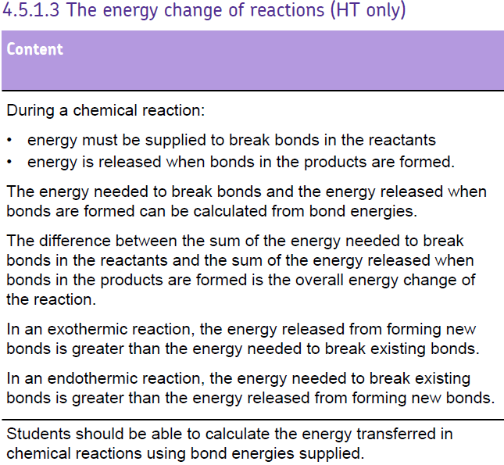

Slide 12
Bond Breaking and Bond making
For a reaction to happen bonds have to be broken to then form new ones
C
H
H
H
H
Bond
Breaking
O
O
O
O
Bond
Forming
H
O
Energy in chemicals
O
C
O
O
H
ΔH
O
H
H
H
H
O
O
C
O
H
H
Progress of reaction

Slide 13

BENDOMEX
Bendo = Breaking is endo
Mex = Making is exo

Slide 14
BENDOMEX
Where the energy from bond forming exceeds that needed for bond breaking the reaction is exothermic.
Where the energy for bond breaking exceeds that from bond forming the reaction is endothermic.
Exo
Endo
Bonds break
Bond forming
Bonds form
Energy in chemicals
Energy in chemicals
Bonds break
products
ΔH
ΔH
reactants
products
reactants

Slide 15
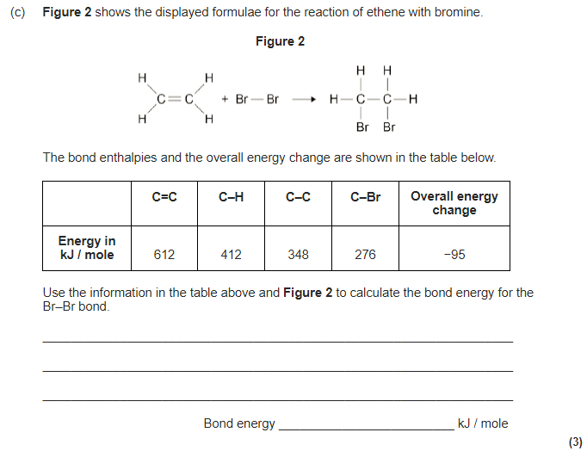
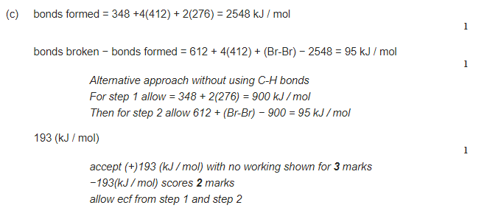

Slide 16
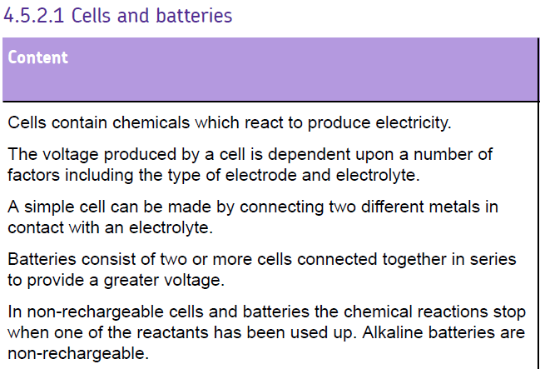
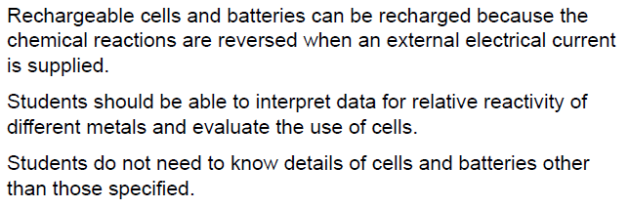

Slide 17
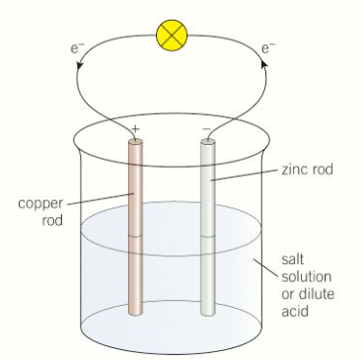
How does a battery operate?
If magnesium is losing electrons and copper is gaining electrons, which metal is being ‘reduced’ and which metal is being ‘oxidised’
Two metals of different reactivity
An electrolyte (salt solution)
Wires
The most reactive metal always forms the negative electrode.
The electrons flow from the most reactive metal to the least reactive metal
Remember OILRIG (oxidation is loss, reduction is gain)
The bigger the difference in reactivity between the metals, the higher the voltage of the battery

Slide 18
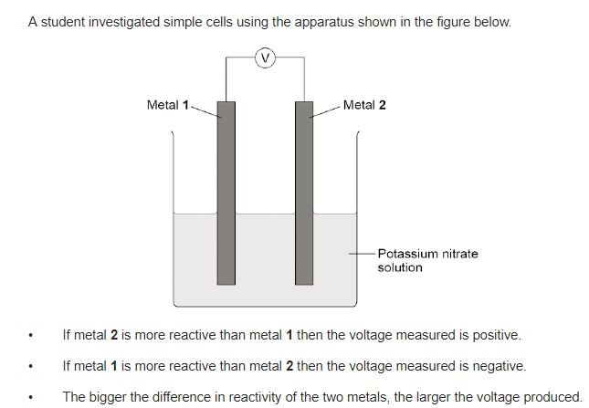

Slide 19
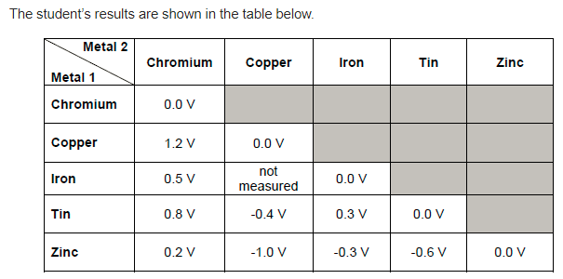

Slide 20
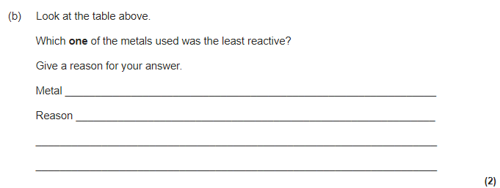
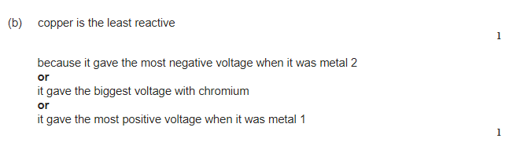

Slide 21
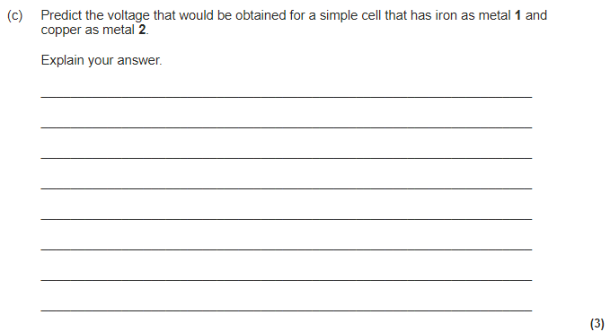
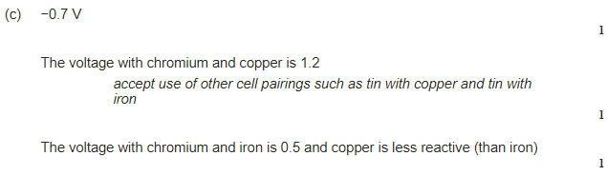

Slide 22
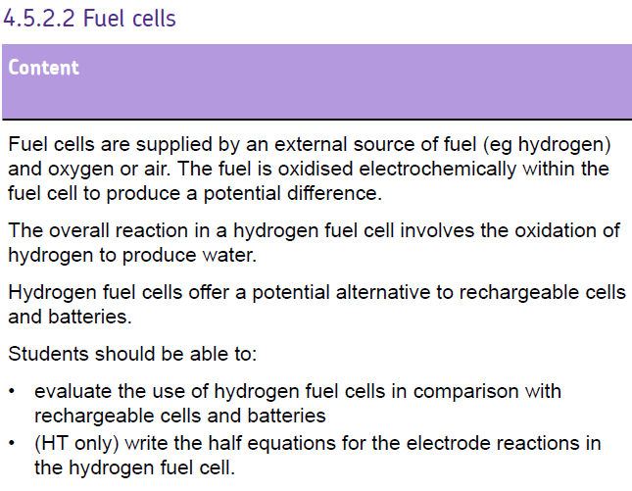

Slide 23
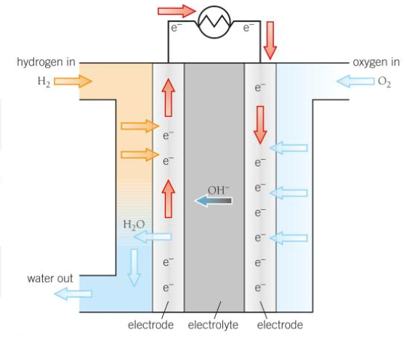
Hydrogen goes through a catalyst and splits in protons and electrons. The protons (H+) move through the electrolyte and the electrode move round the electrode and meet up on the other side
Oxygen gas reacts with (is reduced) by the hydrogen and the electrons to produce water.
2H₂ → 4H⁺ + 4e⁻
O₂ + 4H⁺ + 4e⁻ → 2H₂O
Overall reaction =
H₂ + O₂ → H₂O

Slide 24
