Slide 1
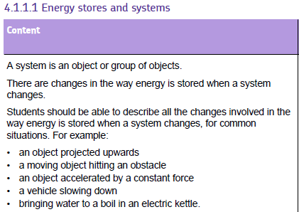
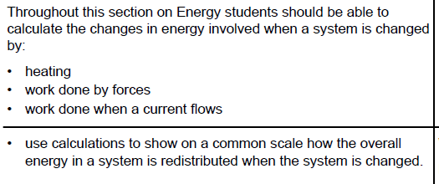

Slide 2
A system
A system is any object or group of objects that we wish to consider for the purpose of a physics problem. Examples of a system for a physics problem include: a car; a car and its surroundings, the Universe.

Slide 3
Energy
There is a quantity in Physics known as energy. This quantity has the property of remaining constant in a closed system. That is to say, if we have a system which does not allow energy in or out, the amount of energy in the system will stay the same.

Slide 4
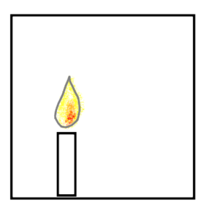
Energy stores
Energy cannot be created or destroyed
Let us consider an example: Imagine a completely sealed and insulated box. Inside the box is some air and a burning candle. The box is a closed system as no energy can get in or out. The candle burns and eventually goes out. The total amount of energy in the box has not changed. Energy has transferred from one store to another.
Never use the word MAKE/PRODUCE and ENERGY in the same sentence!!

Slide 5
Energy stores
We can think of energy as being present sometimes as stores and sometimes as pathways.
We consider energy as a store when it is a property of an object.
Examples of energy stores:
Kinetic energy store – a property an object has because it is moving
Potential energy store – a property an object has because it has been lifted
Chemical energy store – a property an object has because of its chemical composition. (e.g. fuels, batteries, food)
Elastic potential energy store – a property an object has because it has been stretched or squashed.
Thermal energy store – a property an object has because of the kinetic energy of its particles.

Slide 6
Energy pathways
We can think of energy as a pathway when it is moving between objects.
Examples of energy pathways:
Light energy pathway
Electrical energy pathway
Heating energy pathway

Slide 7
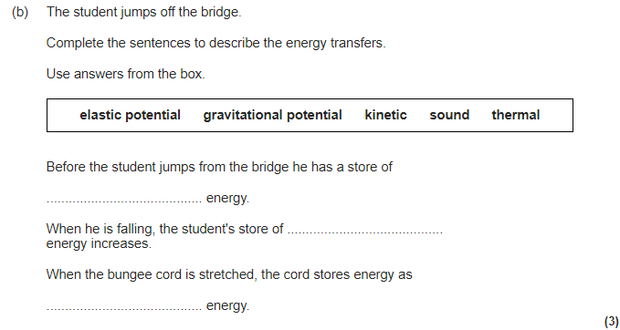
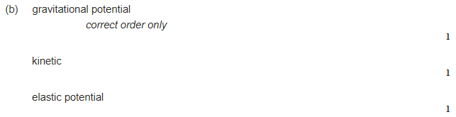

Slide 8
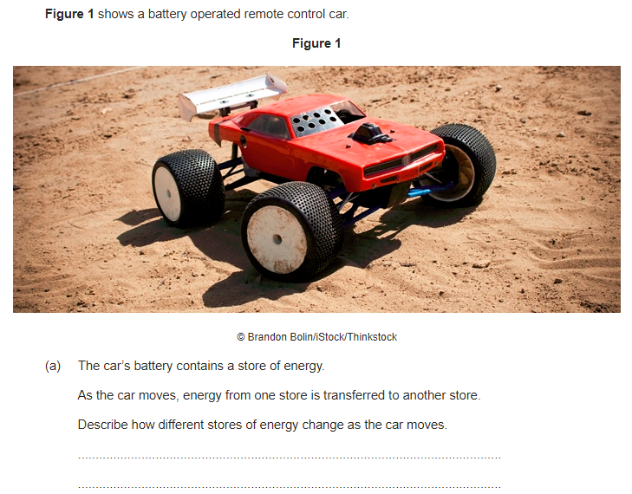
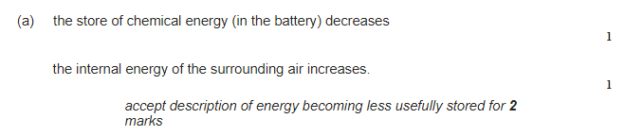

Slide 9
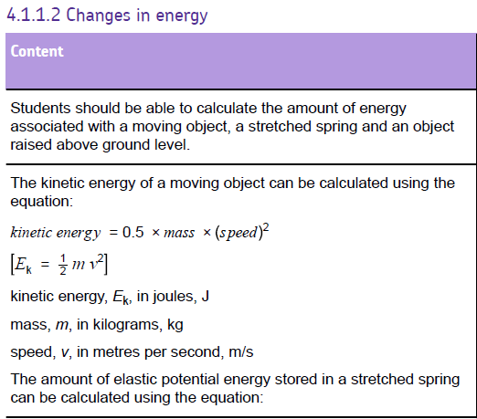

Slide 10
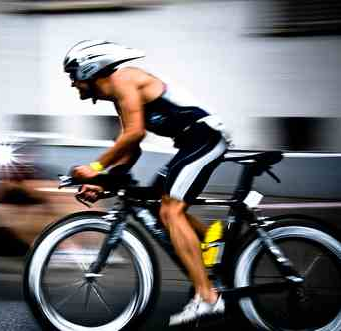
Kinetic energy
Kinetic energy = ½ x mass x velocity²
Now rearrange the equation to have mass and velocity as the subject of the equation (you can’t use a formula triangle for this!)
E_{k} = ½ x m x v²
E_{k} = kinetic energy (J)
m = mass (kg)
v = velocity (m/s)

Slide 11
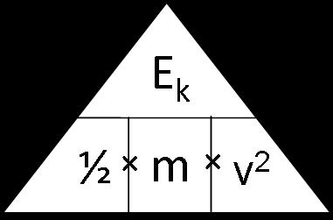
Formula triangle
Kinetic energy
V = √(2x KE)÷m
M = (2xKE) ÷ v²

Slide 12
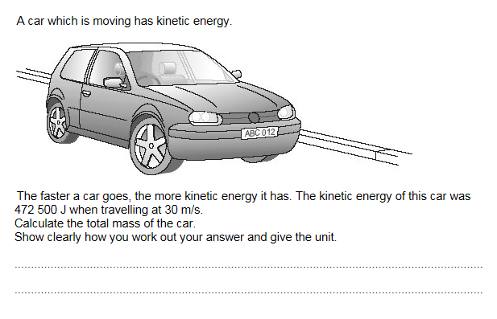
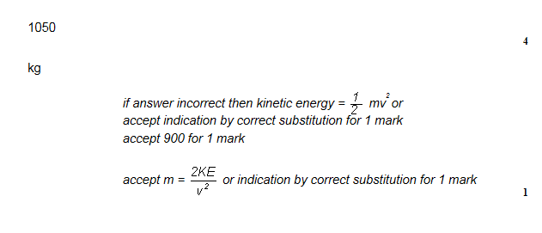

Slide 13
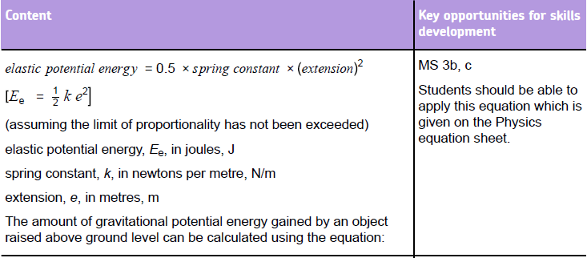
You only need to be able to USE this equation. You don’t need to remember it

Slide 14
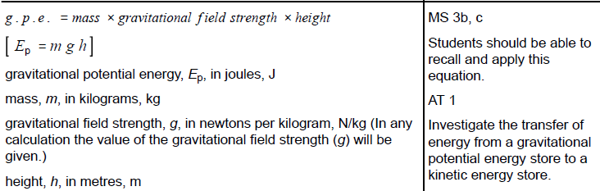

Slide 15
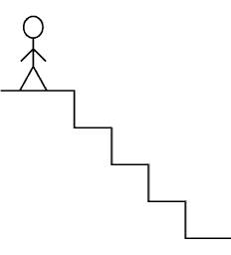
Gravitational Potential Energy
Any object that is raised above the ground will have gravitational potential energy
Now rearrange the equation to have mass, g and then height as the subject of the equation (you can’t use a formula triangle for this!)
gravitational
field strength
E_{p} = mass x
x Δheight
E_{p} = m x g x Δh
GPE = gravitational potential energy (J)
m = mass (kg)
g = gravitational field strength (N/kg)
h = height (m)

Slide 16
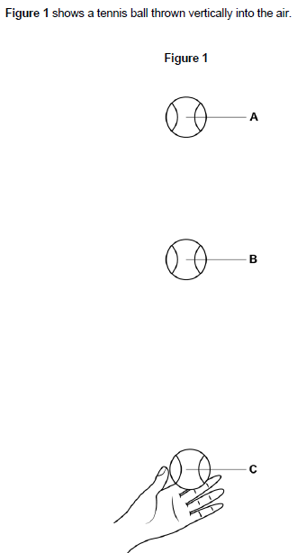
E_{k} and E_{p}
Gravitational potential energy here
Loss in E_{p} = Gain in K_{e}
mgh = ½ mv²
Kinetic energy here

Slide 17
mgh = 0.5mv²
A shot putt has a mass of 10kg. A shot putter needs to throw this a minimum of 5 meters in the air against a gravitational field strength of 10 kg/N. What is the minimum velocity it should leave his hand at?
Answer
mgh = ½ mv²
10 x 10 x 5 = 0.5 x 10 x v²
√ 500/5 = v
v = 10m/s

Slide 18
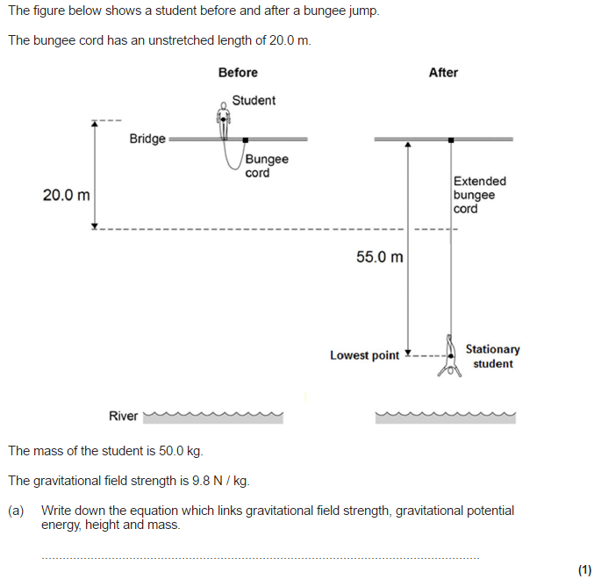
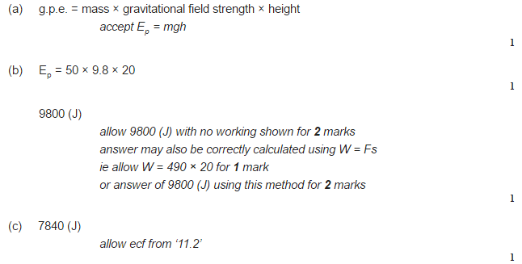
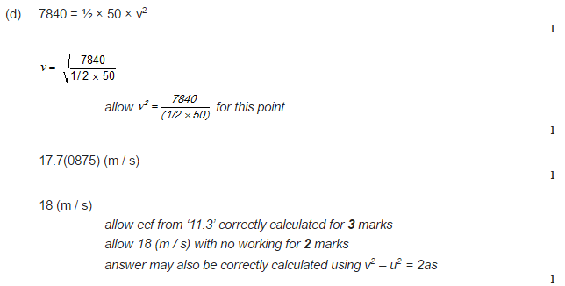
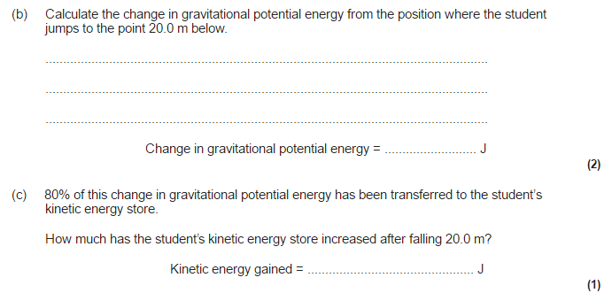
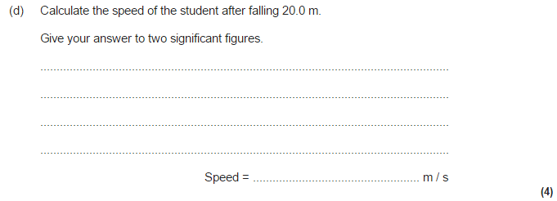

Slide 19
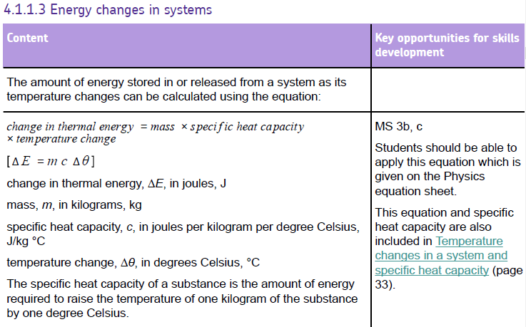

Slide 20
Things that affect the temperature rise of a substance...
The amount of energy supplied to it
The mass of the substance
What the substance is

Slide 21
Specific Heat Capacity
The SHC is the amount of energy needed to increase the temperature of 1kg of a material by 1ºC
Energy transferred (E) = mass × specific heat capacity × ∆temperature
E = energy (J)
m= mass (kg)
c = specific heat capacity (J/kg˚C)
∆t = change in temperature (˚C)
Can you rearrange the equation to get c (specific heat capacity) on its own?
E
m x c x ∆t

Slide 22
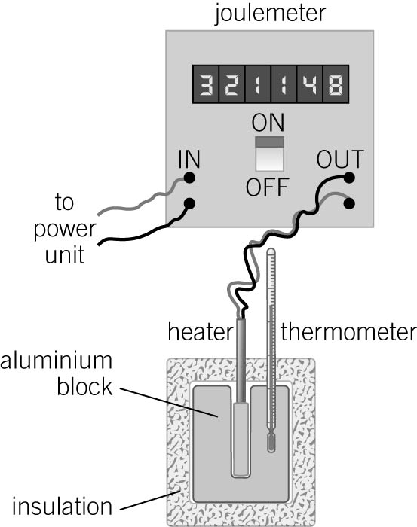
Specific heat capacity required practical
Required practical video
Check the mass of the aluminium block (It is 1 kg).
With the power supply switched off, set up the apparatus as shown in the diagram
Place the thermometer in the aluminium block and measure the temperature of the block. Record this as the ‘starting temperature’ of the block.
Switch the joulemeter on and record the ‘starting’ reading of the joulemeter.
Switch the power supply on.
Watch the reading on the thermometer, and when it reaches about 15°C above the starting temperature, switch off the power supply.
Record how many flashes of light there were (each flash represents 100J).
The thermometer reading might continue to increase for up to a few minutes after the heater has been switched off. Measure and record the highest reading of the thermometer after the heater was switched off.
Create a table that will enable you to record all the bits of information you need to calculate SHC

Slide 23
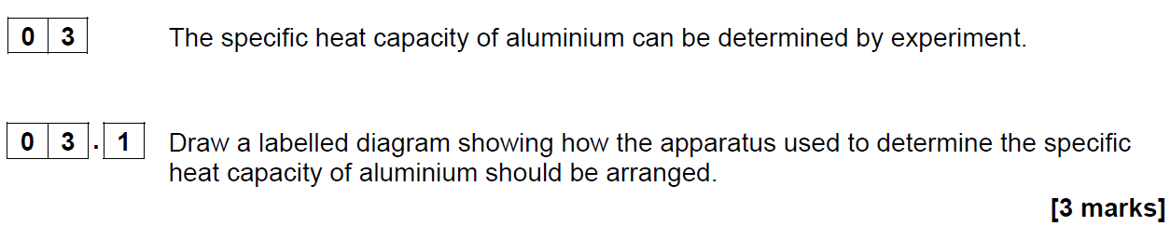
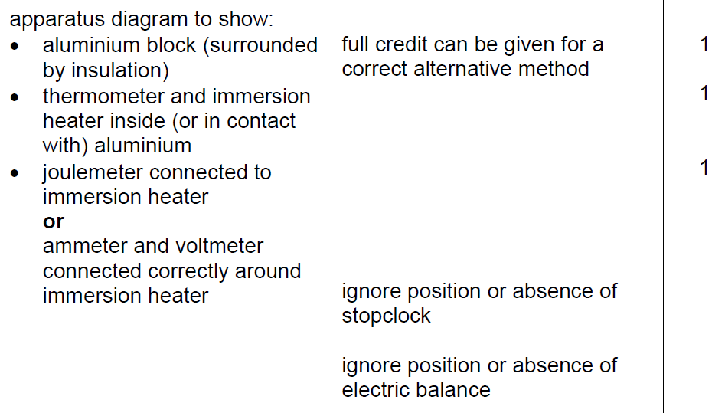

Slide 24
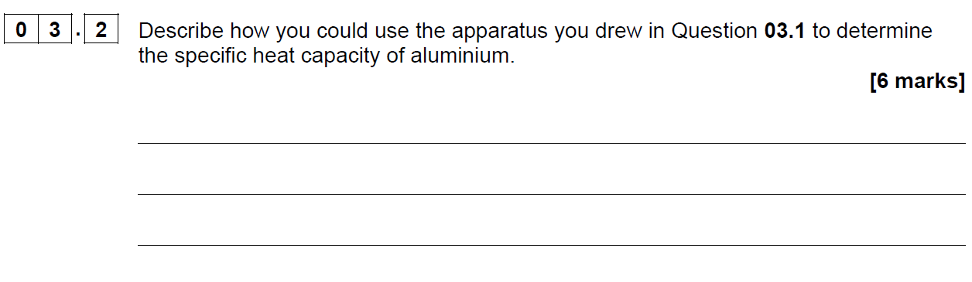
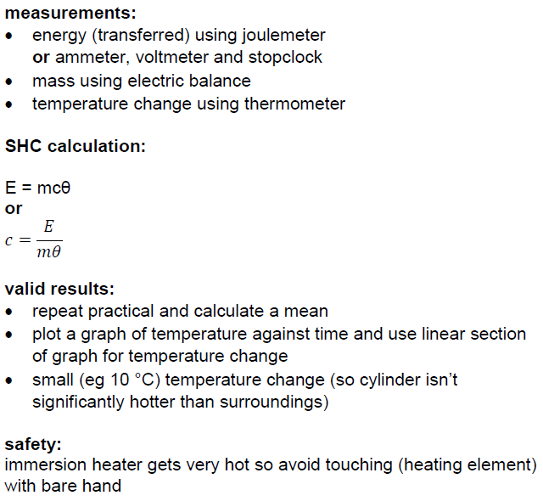

Slide 25
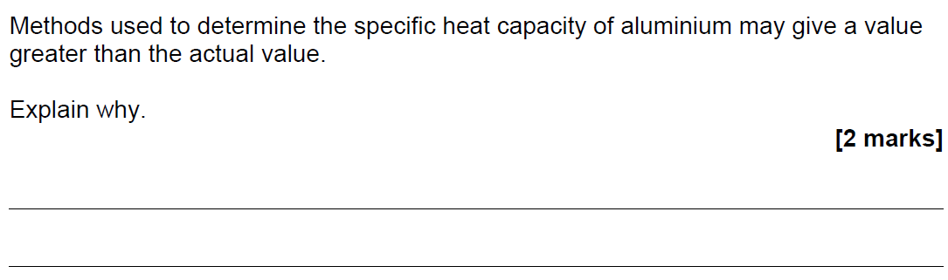
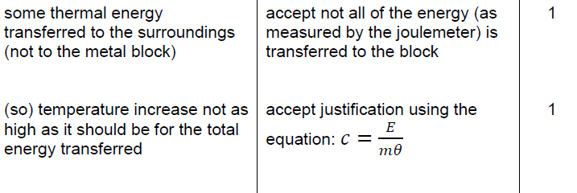

Slide 26
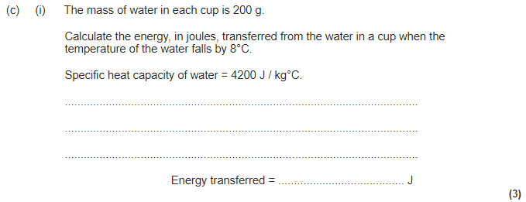
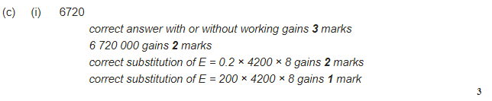

Slide 27
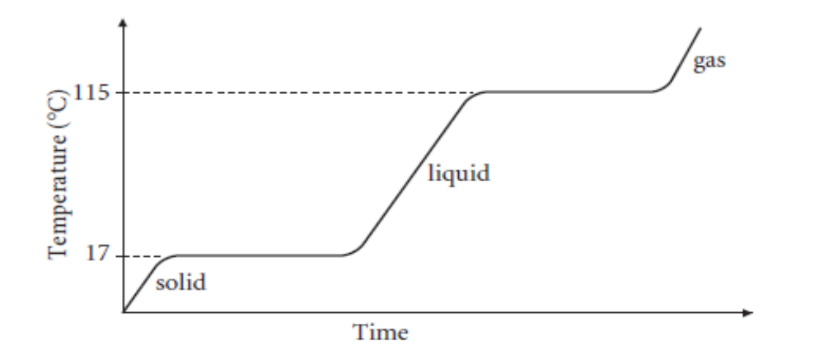
Heating curve – what is happening at each stage?
Used to measure specific heat capacity (how much energy it takes to raise the temperature of a substance)

Slide 28
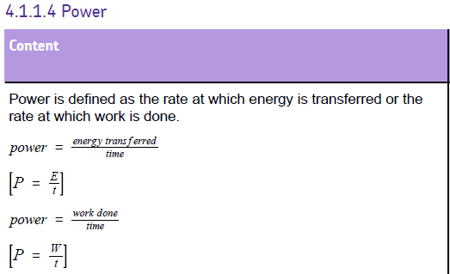
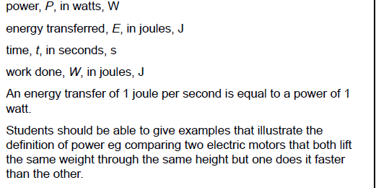

Slide 29
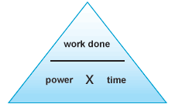
Calculating power
Power is the amount of work done/energy transferred in a given time
Power = work done / time
P = W / t
P = power (Watts (W)) or (Joules per second) (J/s)
W = work done (Joules) (J)
t = time (Seconds) (s)

Slide 30
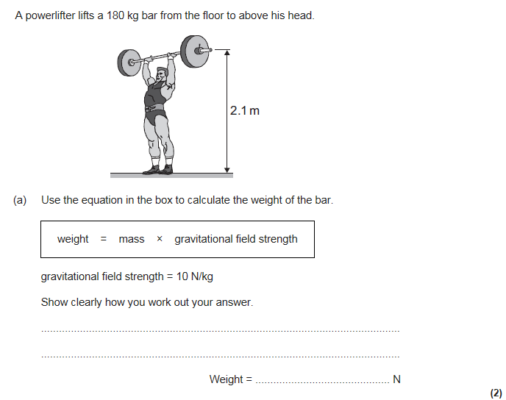
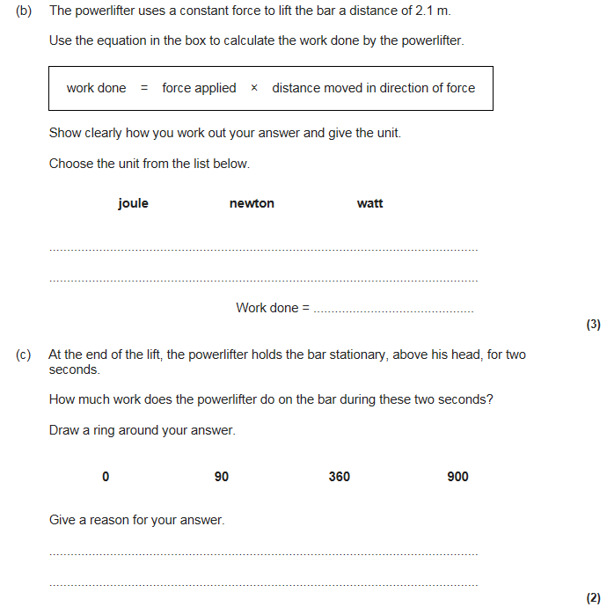
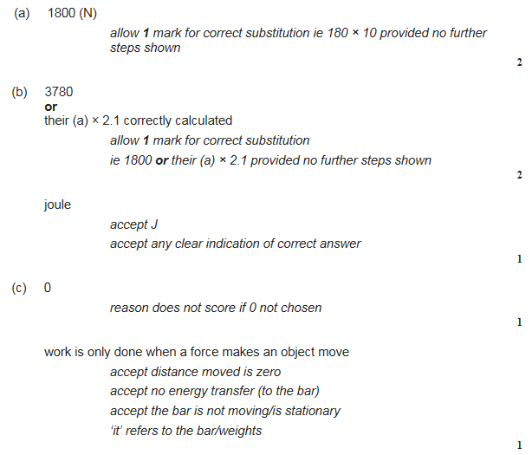

Slide 31
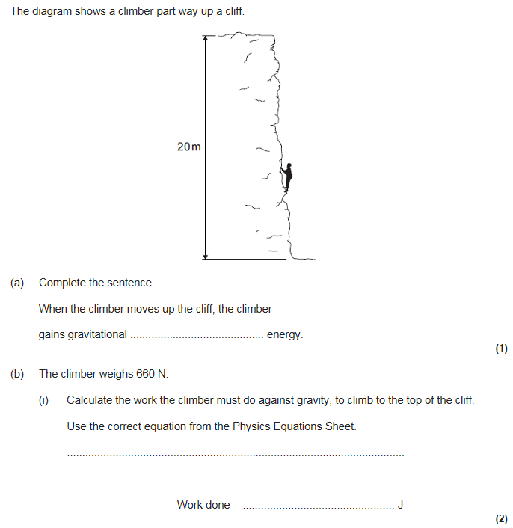
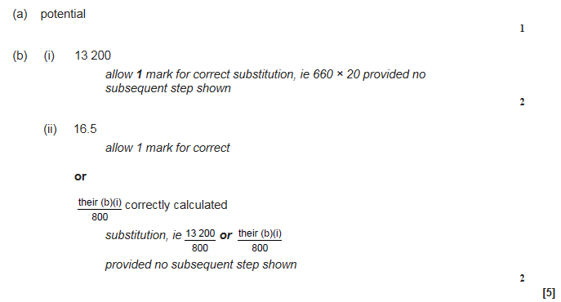
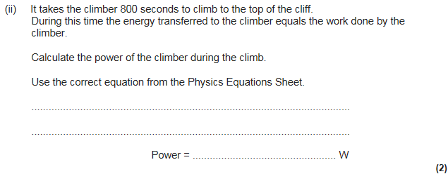

Slide 32
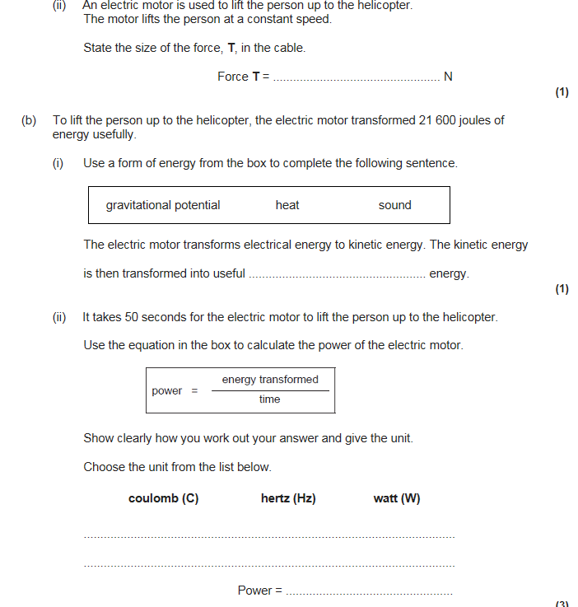

Slide 33
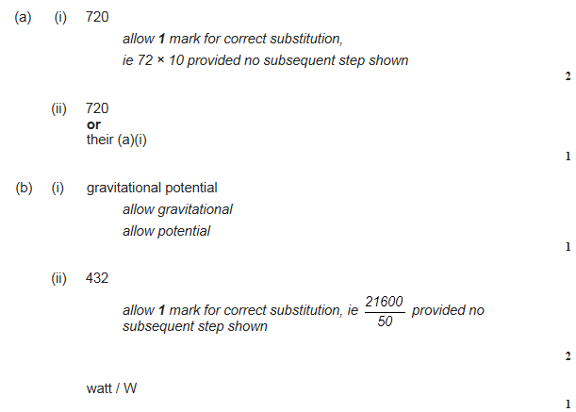

Slide 34
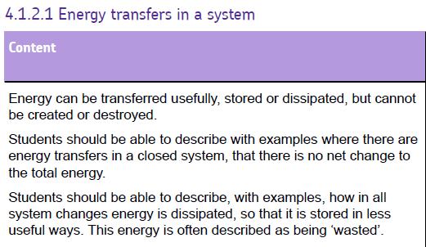
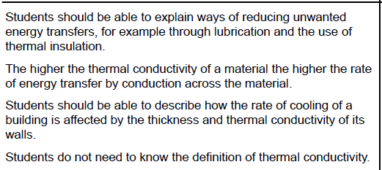

Slide 35
Energy and efficiency
Efficiency limits
No machine can be more than 100% efficient because we can never get more energy from a machine than we put into it
Improving efficiency
Why machines waste energy | How to reduce the problem
Friction between moving parts causes heating | Lubricate the moving parts to reduce friction
The resistance of a wire causes the wire to get hot when a current passes through it | In circuits, use wires with as little electrical resistance as possible
Air resistance causes energy transfer to the surroundings | Streamline the shapes of moving objects to reduce air resistance
Sound created by machinery causes energy transfer to the surroundings | Cut out noise (e.g. Tighten loose parts to reduce vibration)

Slide 36
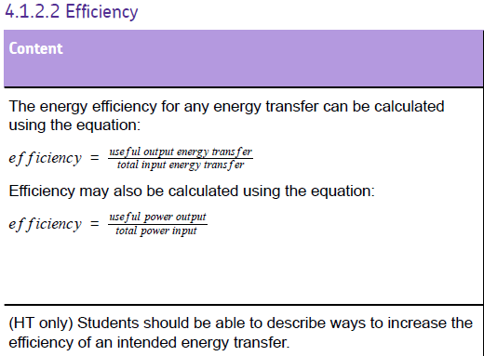

Slide 37
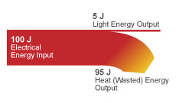
Energy and efficiency
Weight is measured in Newtons (N)
Energy is measured in Joules (J)
Sankey diagrams
Shows how we can represent any energy transfer where energy is wasted
Input energy = useful energy delivered + energy wasted
Efficiency = useful energy transferred by the device
Total energy supplied to the device
X 100

Slide 38
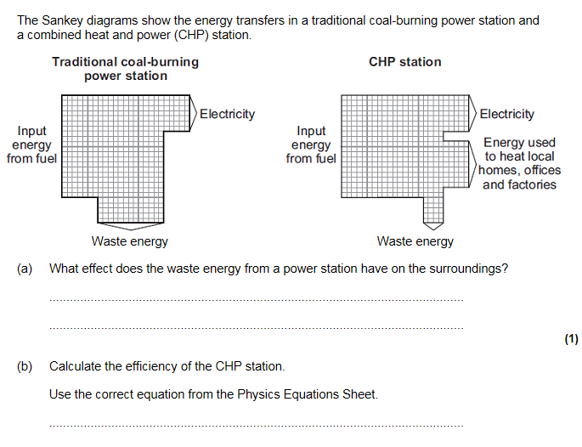
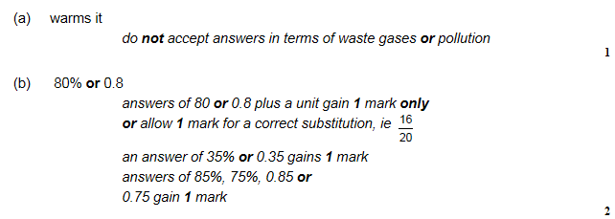

Slide 39
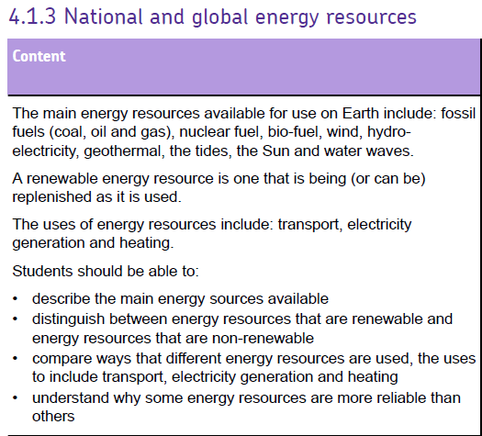



Slide 40

Fuel for electricity
Biofuels: methane gas from cows, manure, sewage works can be used in power stations. Biofuels are renewable and carbon neutral because the carbon dioxide taken in can balance the amount released when it burns
Fossil fuels, nuclear fuels and biofuels are operated in the same way. The fuel releases heat energy, which heats water that turns into steam. This then turns a turbine which is connected to a generator to generate electricity.
Almost all of the electricity you use is generated in power stations
Advantages
Can be used for base load of electricity
Reliable
Disadvantages
Non-renewable (except bio-fuel)
Causes pollution

Slide 41



Slide 42



Slide 43




Energy from wind and water
Wave
A wave generator uses the waves to make a floating generator move up and down, turning the generator. A cable links this with the shore and grid system. They need to withstand storms and lots of cables might be needed
Wind
A wind turbine is an electricity generator at the top of a narrow tower, the wind drives the turbines blades around and power increases with wind speed
Hydroelectric
Rainwater collected in a reservoir flows downhill, the floating water drives turbines that turn the generators at the foot of the hill
Tidal
Traps water from each high tide behind a barrage which is then released into the sea through turbines which drive the generators in the barrage

Slide 44



Slide 45



Slide 46



Slide 47


Power from the sun and the Earth
Solar radiation
Transfers energy to generate electricity using solar cells
We can also use the suns energy to heat water directly in solar heating panels
They are useful in remote places or where only small amounts of energy
They are expensive to buy but cost nothing to run
Lots of them and sunshine are needed
Geothermal energy
Comes from the energy released by radioactive substances deep within the Earth
The energy released heats the surrounding rocks and energy is transferred by heating towards the Earth’s surface
Water is pumped down to produce steam which drives the turbines

Slide 48



Slide 49



Slide 50




Slide 51
How do we use the main energy sources
Heating | Transportation | Generating electricity
Fossil fuels
Biofuels
The sun
Water pumped into hot rocks
Fossil fuels
Biofuels
Fossil fuels
Biofuels
Nuclear fuel
Solar power
Tidal power
Wind power
Wave power
Geothermal power
Hydroelectric power

Slide 52

Energy and the environment
Fossil fuel problems
Greenhouse gases (carbon dioxide) are released which may cause global warming
Sulphur dioxide which causes acid rain – we can remove sulphur from a fuel to reduce this
Non-renewable – they will run out
Nuclear vs renewable
Advantages: no greenhouse gases, more energy per gram of fuel
Disadvantages: used fuel rods contain radioactive waste, an explosion could release radioactive material
Renewable
Advantages: never run out, no greenhouse gases or acid rain, no radioactive waste, can be used in remote areas
Disadvantages: wind turbines make a whirring noise, unattractive, tidal barrages affect estuaries and habitats, hydroelectric may flood habitats to create dams, solar cells need to cover large areas

Slide 53




