Slide 1
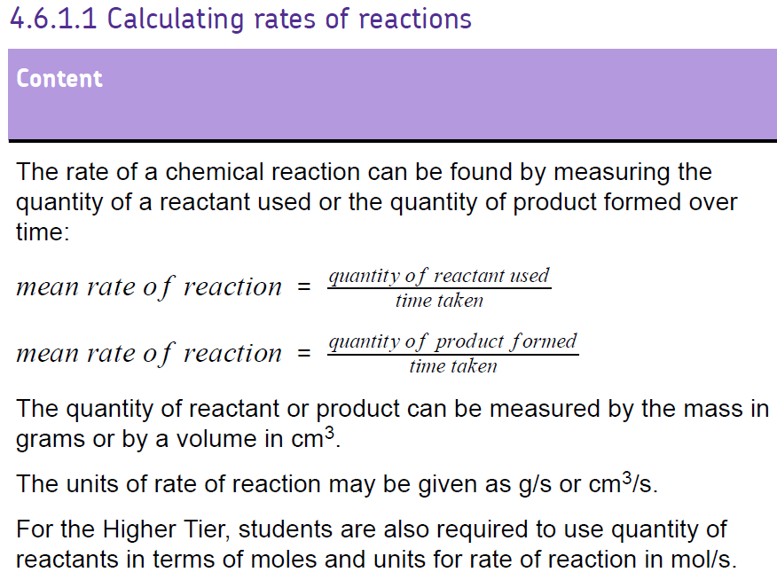
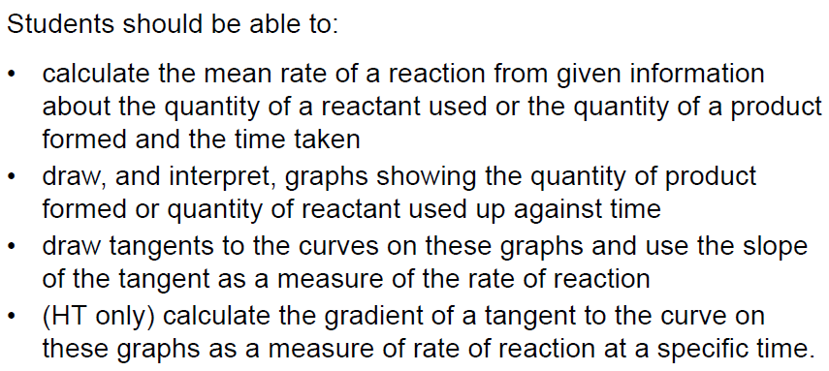

Slide 2


Slide 3
What do we mean by ‘rate’?
The rate of a reaction is ‘the time taken for a product to form, or reactants to be used up’
Reactants
Products
Mg + 2HCl MgCl₂ + H₂

Slide 4
The equation for rate of reaction
Rate of reaction = Amount of product formed
time
OR
Rate of reaction = Amount of reactant used
time

Slide 5
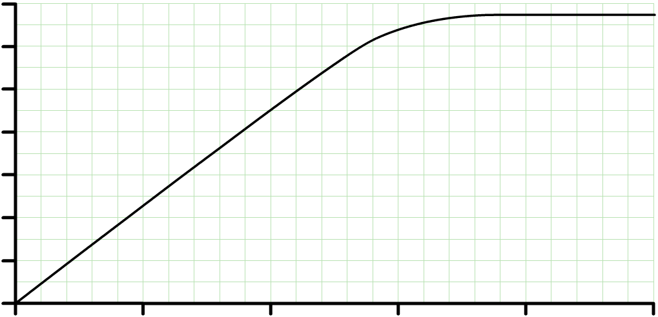
Calculating rate of reaction from graphs
70
60
50
x
rate of reaction =
y
40
hydrogen produced (cm³)
x
30
20
y
10
0
0
10
20
30
40
50
time (seconds)
The gradient of the graph is equal to the initial rate of reaction at that time
rate of reaction =
45 cm³
=
2.25 cm³/s
20 s

Slide 7
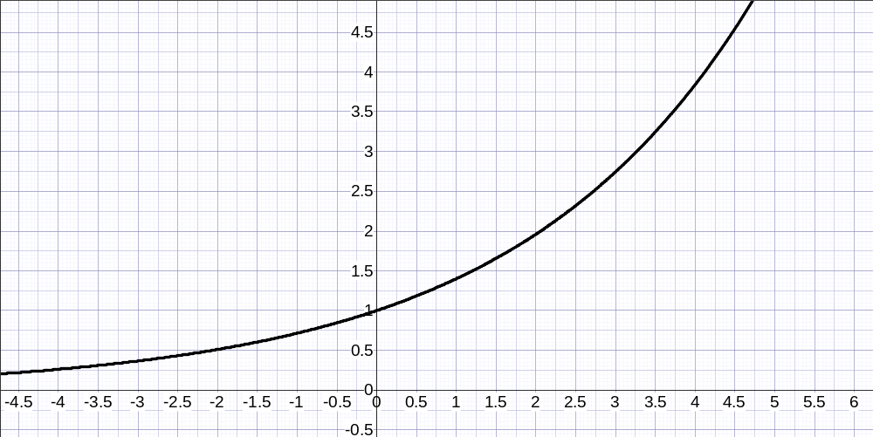
How to find a gradient using a tangent
Gradient = y
x
Gradient = 4 – 1
4.5 – 1
Gradient = 3cm³
3.5s
Gradient =
0.86 cm³/s
hydrogen produced (cm³)
time (seconds)

Slide 8
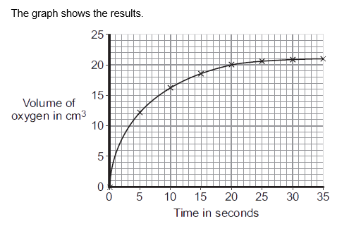
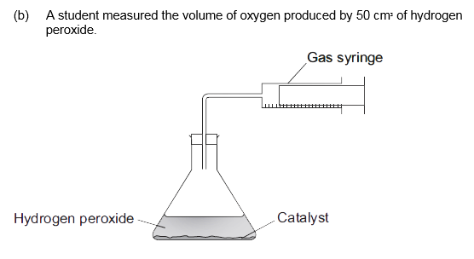
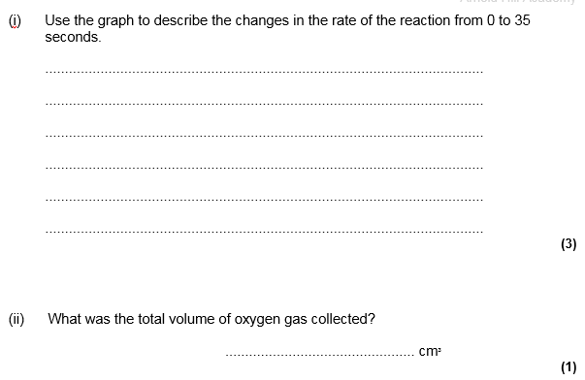
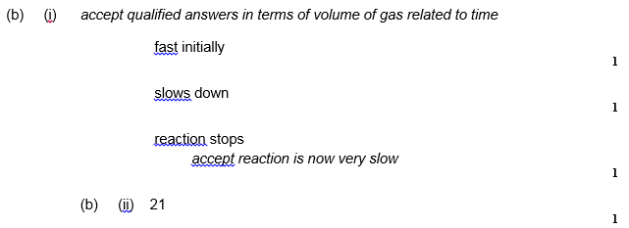

Slide 9
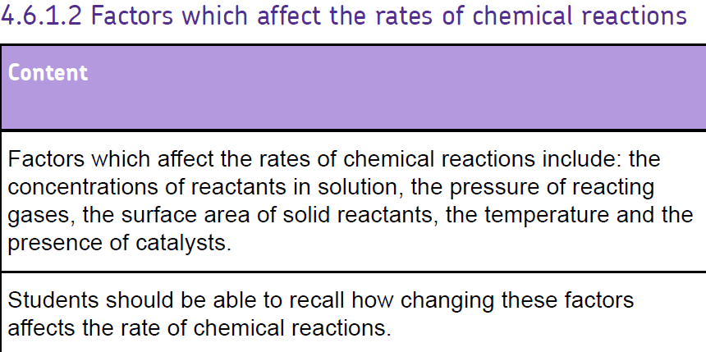

Slide 10
Factors affecting rate
Pressure/Concentration
Temperature
Surface Area
Catalysts

Slide 11
How can we measure the rate?
Volume of gas produced
Change in mass
Colour change
Precipitate

Slide 13
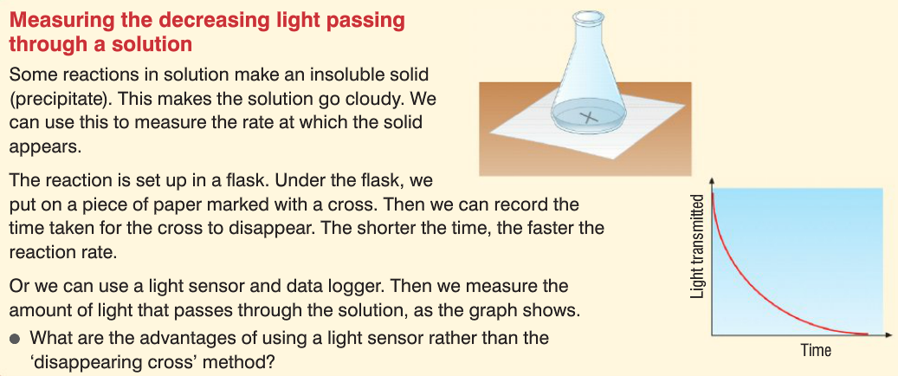
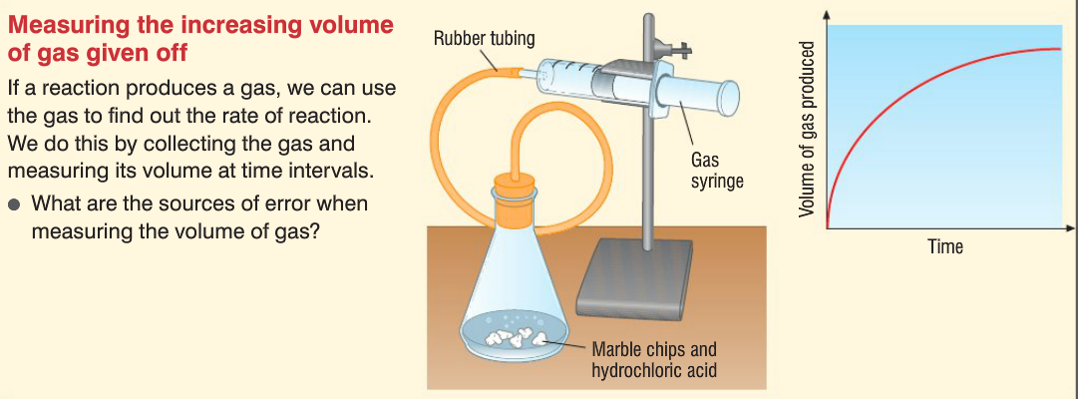
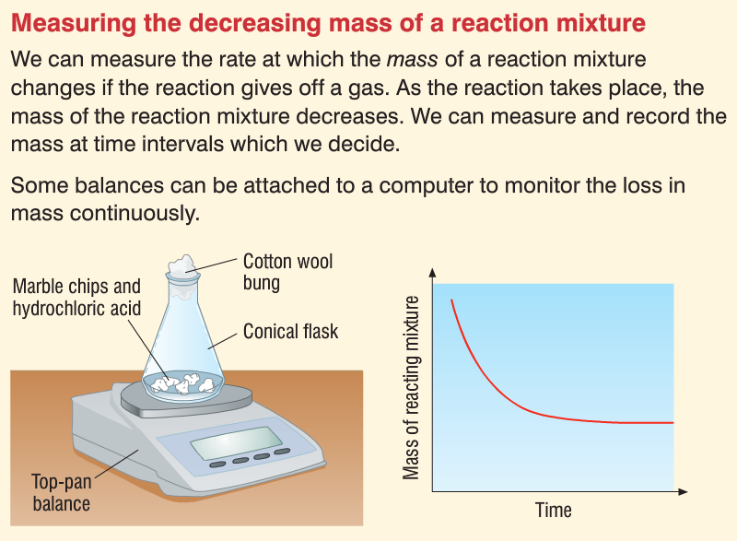
How do we do them?
Think about how often you will need to make measurements (time interval)
You need a suitable table to record your results. We will be drawing graphs to calculate rates
Warm sodium thiosulfate
Cold sodium thiosulfate
1M HCl
Magnesium powder
1M HCl
0.5M HCl
Magnesium strips
Magnesium powder
1M HCl
What are the independent, dependent and control variables in each experiment?

Slide 14
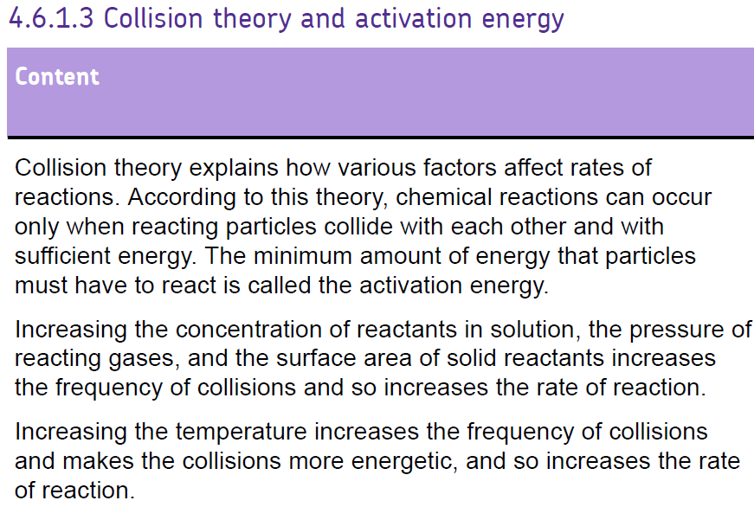
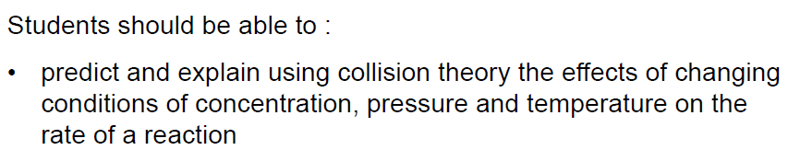
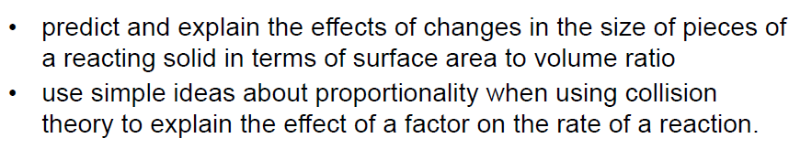

Slide 15
The Collision Theory
Particles are constantly moving
For a chemical reaction to take place the reactant particles must collide first
For the collision to be effective the particles must have the right amount of energy
The minimum amount of energy required for an effective collision is called the activation energy

Slide 17
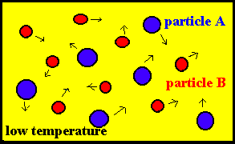
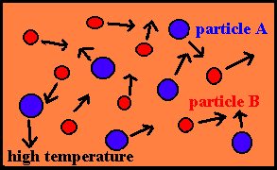
Temperature
Particles turn heat energy into kinetic energy
When they get hotter they move faster because they have more energy
When they move faster they collide more frequently and with more energy
The collisions are more successful

Slide 18
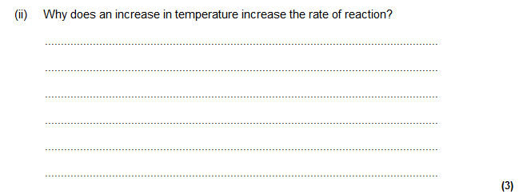
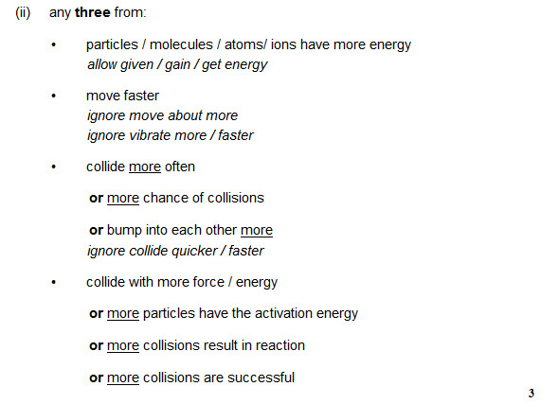

Slide 20
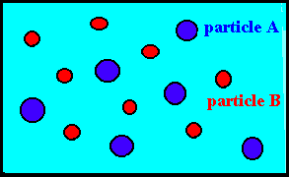
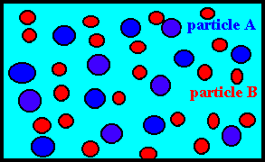
Pressure/Concentration
More particles in the same space means more frequent collisions.
If we double the concentration we double the number of collisions

Slide 21
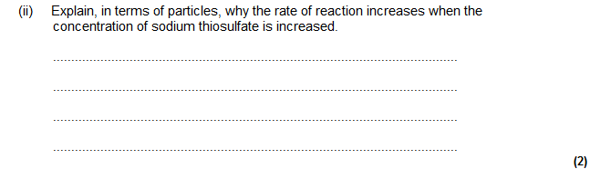
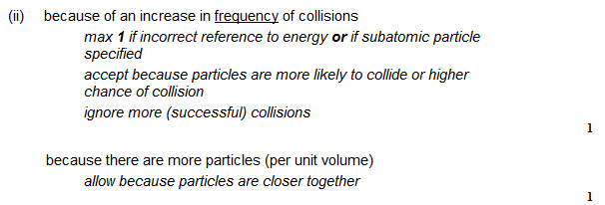

Slide 23
Surface Area/Particle Size
Using smaller particles increases rate
Increase in surface area allows more frequent collisions at surface
Cutting something into smaller pieces gives it a larger surface area : volume

Slide 24
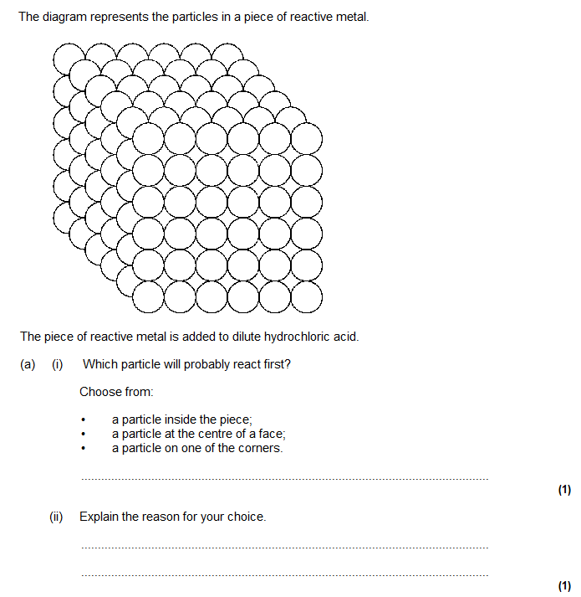
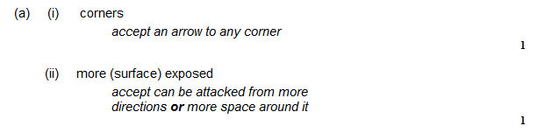

Slide 25
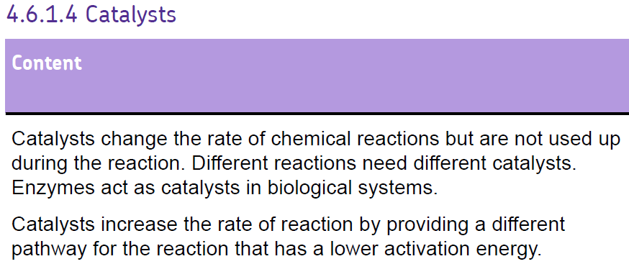
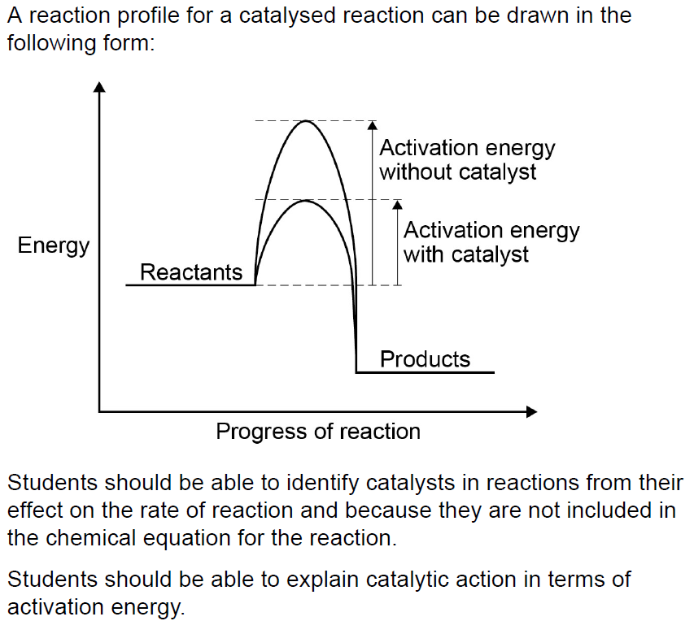

Slide 27
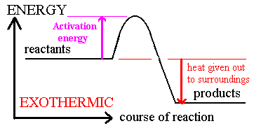
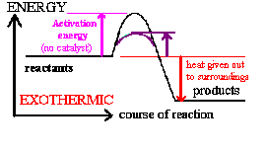
Catalysts
Activation energy
with a catalyst
Catalysts reduce the activation energy needed for a reaction
They do this by offering an alternate route for the reaction to take
Less activation energy means more effective collisions
More effective collisions means faster rate

Slide 28
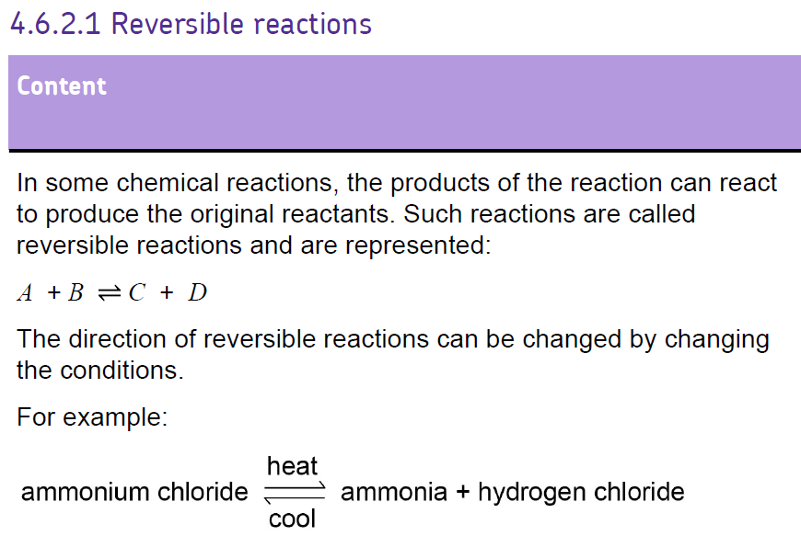

Slide 29
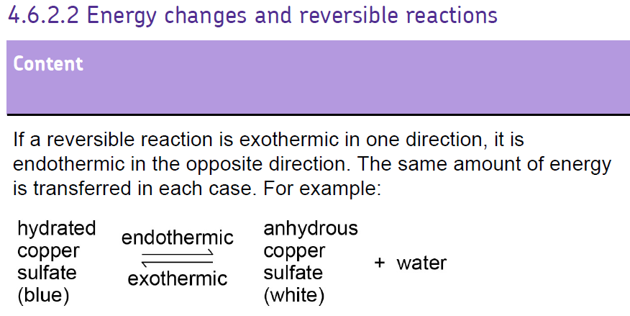

Slide 31

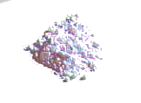
Reversible Reactions
Heat in
Heat out
hydrated copper sulphate
anhydrous copper sulphate
steam
CuSO₄.5H20 CuSO₄ + 5H₂O
The forward reaction requires heat –it is endothermic
The backwards reaction gives out heat – it is exothermic

Slide 32
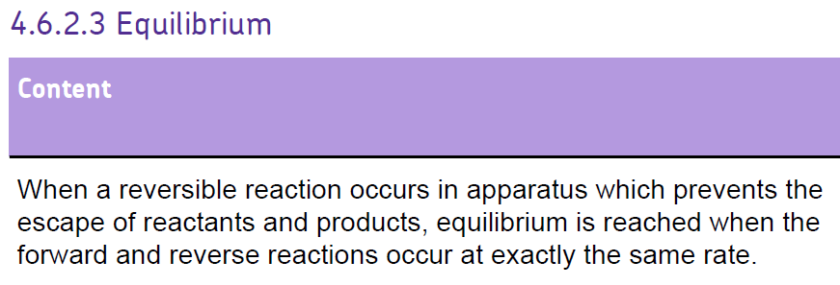

Slide 33
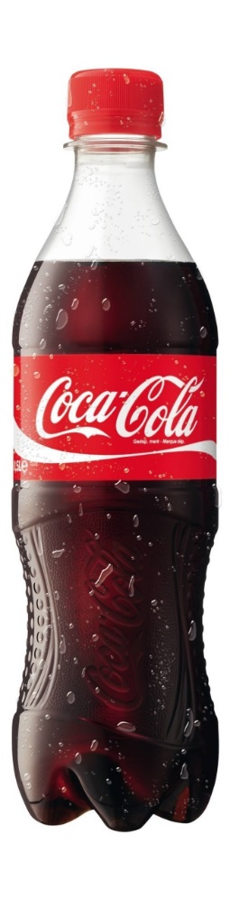
Dynamic equilibria
Where do the bubbles come from when you open a bottle of coke?
Inside the bottle a reaction is happening constantly in a closed system:
CO_{2 (g)} + H₂O _{(l)} H₂CO_{3 (aq)}
This is the stage in reversible reaction where the rate of the forward reaction is equal to the rate of the backward reaction.
The amount of product and reactant stays the same.

Slide 34
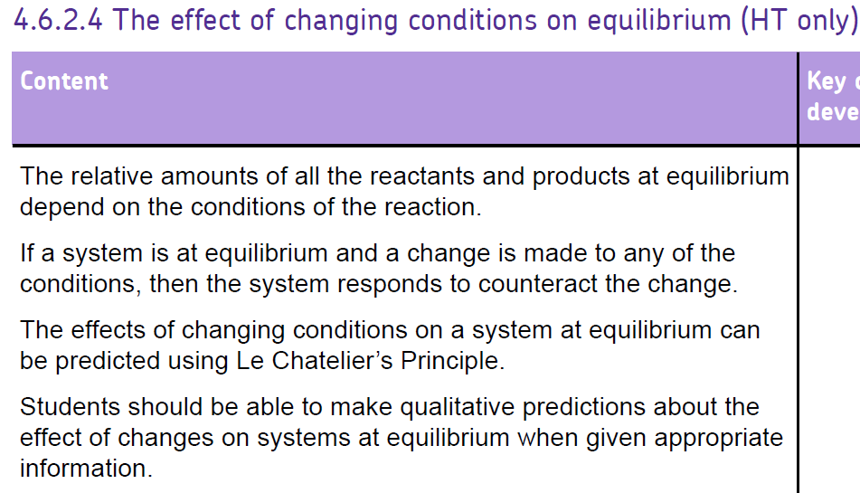

Slide 35
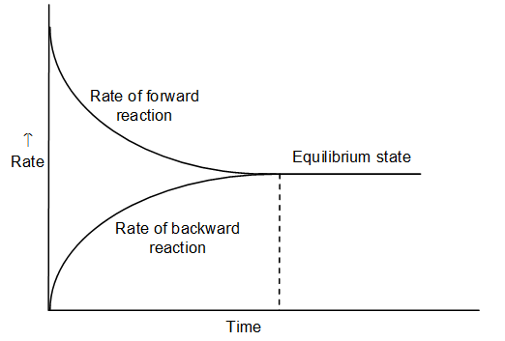
Reversible reaction

Slide 36
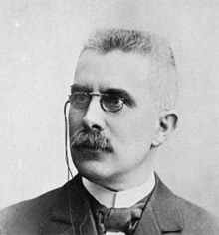
Le Chatelier’s Principle
The principle describes how the position of equilibria changes to favour the forward or backward reaction
Equilibrium shifts to reduce change. NO ONE LIKES CHANGE!
When conditions are changed the reaction will do everything it can to counteract the change

Slide 37
Le Chatelier’s Principle
Therefore if the temperature changes the reaction will shift to favour the side that will reduce the temp (e.g. endothermic)
If the concentration increases on one side they are more likely to react together shifting the equilibrium so the concentration decreases
Increasing the pressure shifts the reaction to favour the reaction that produces a smaller number of products

Slide 38
This is called shifting equilibrium
Reactants ⇌ Products
If equilibrium shifts so the “forward” reaction is favoured (Reactants→Products) we say equilibrium shifts to the right. (More products are made)
If equilibrium shifts to favour the “backward” reaction (Products→Reactants) we say equilibrium shifts to the Left (We make more reactants)

Slide 39
Effects on Equilibria
If you increase the temperature it will try and reduce it
If you increase the concentration of the reactants it will try and get rid of some
If you increase the pressure it will try and reduce it

Slide 40
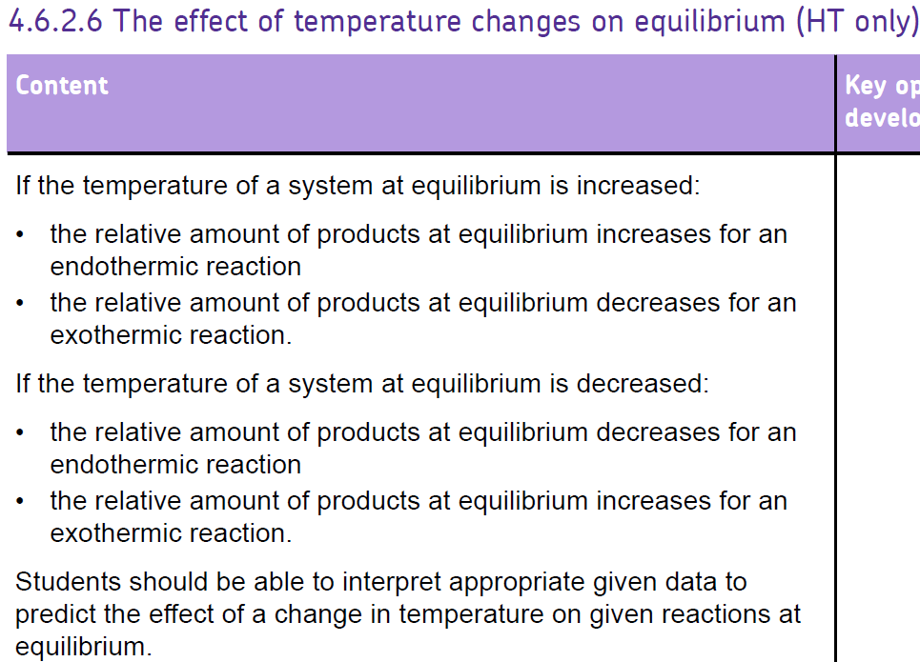

Slide 42
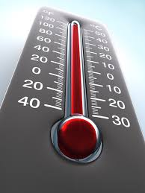
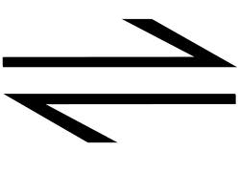
Changing temperature
Increasing temperature makes the reaction go in the endothermic direction
Decreasing temperature makes the
reaction go in the exothermic direction
A + B C ΔH = -100kJmol⁻¹
If I heat up the reaction will it go to the left or to the right?

Slide 43
In a reversible reaction. One direction will be exothermic. The other direction will be endothermic
All reversible reactions are exothermic (give out heat) in one direction and endothermic (take in heat) in the other. E.g. nitrogen dioxide (NO₂) joins to form dinitrogen tetroxide (N₂O₄) exothermically.
Gets cold going backward (endothermic)
2NO₂  N₂O₄
Gets hot going forward (exothermic)
The hotter a reaction is, the more likely it is to go in the endothermic direction.
If we increase the temperature what will happen to the yield? Which way has equilibrium shifted?
If we decrease the temperature what will happen to the yield? Which way has equilibrium shifted?

Slide 44
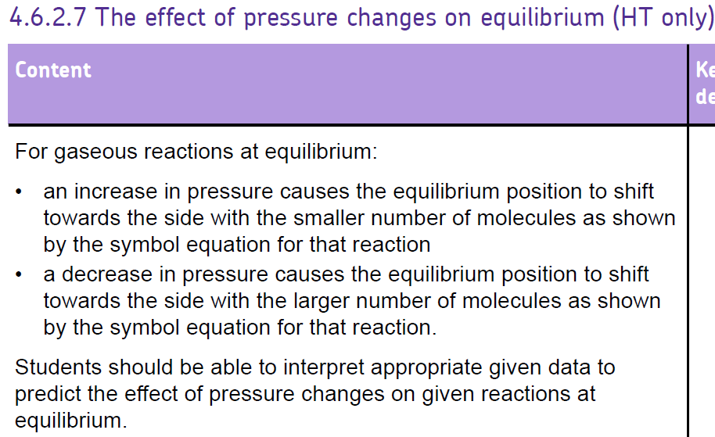

Slide 46
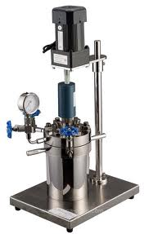
Changing pressure
Changing pressure only has an effect if the molecules are in the gaseous state AND only if there are different molecules on each side of the equation e.g:
A(g) + B(g) C(g)
How many molecules are on each
side of this equation?

Slide 47
Changing pressure
Increasing pressure sends the equilibrium towards the side with less molecules
Decreasing pressure sends the equilibrium towards the side with more molecules
If I increase pressure, which way will this reaction go?
2A+B C + D

Slide 48
Pressure
This applies to gas reactions.
Here the rule depends upon the number of gas molecules on each side of the equation
Get more gas molecules in backward direction
2NO₂(g)  N₂O₄ (g)
Get fewer gas molecules in forward direction
The higher the pressure, the more the reaction moves in the direction with fewer gas molecules.
If we increase the pressure what will happen to the yield? Which way has the equilibrium shifted and why?
If we decrease the pressure what will happen to the yield? Which way has equilibrium been shifted and why?

Slide 49
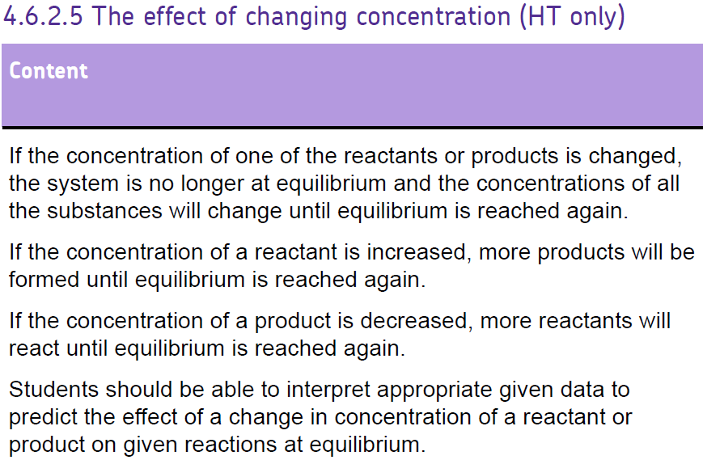

Slide 51
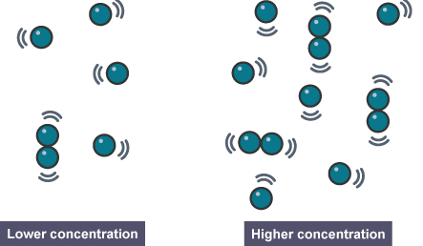
Changing Concentration
Increasing concentration sends the equilibrium towards the opposite side
Decreasing concentration sends the equilibrium towards the same side
If I increase concentration of C, which way will this reaction go?
2A+B C + D

Slide 52
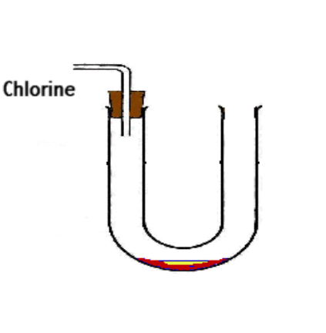
Concentration
Chlorine gas reacts with iodine chloride (a brown liquid) converting it to iodine trichloride (a yellow solid).
ICl (l) + Cl₂ (g)  ICl₃ (s)
brown pale green yellow
What effect will adding more chlorine have on the colour of the mixture in the U-tube?
If the U-tube is turned on its side, chlorine gas pours out of the tube.
In which way will this change the equilibrium?

Slide 53
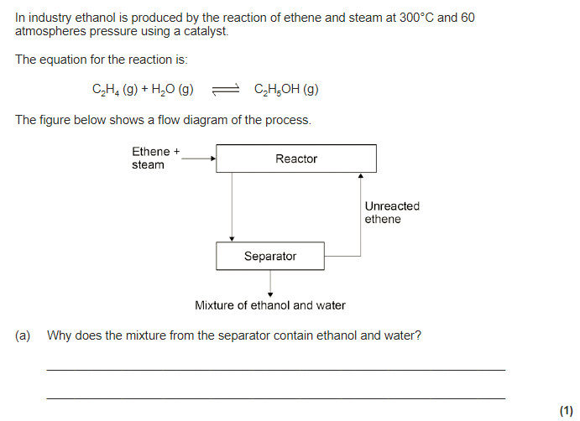
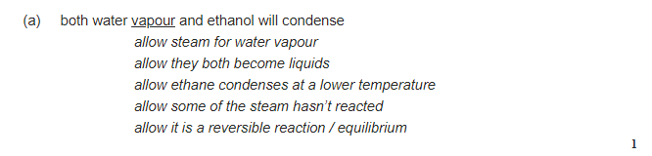

Slide 54
